Slide 1





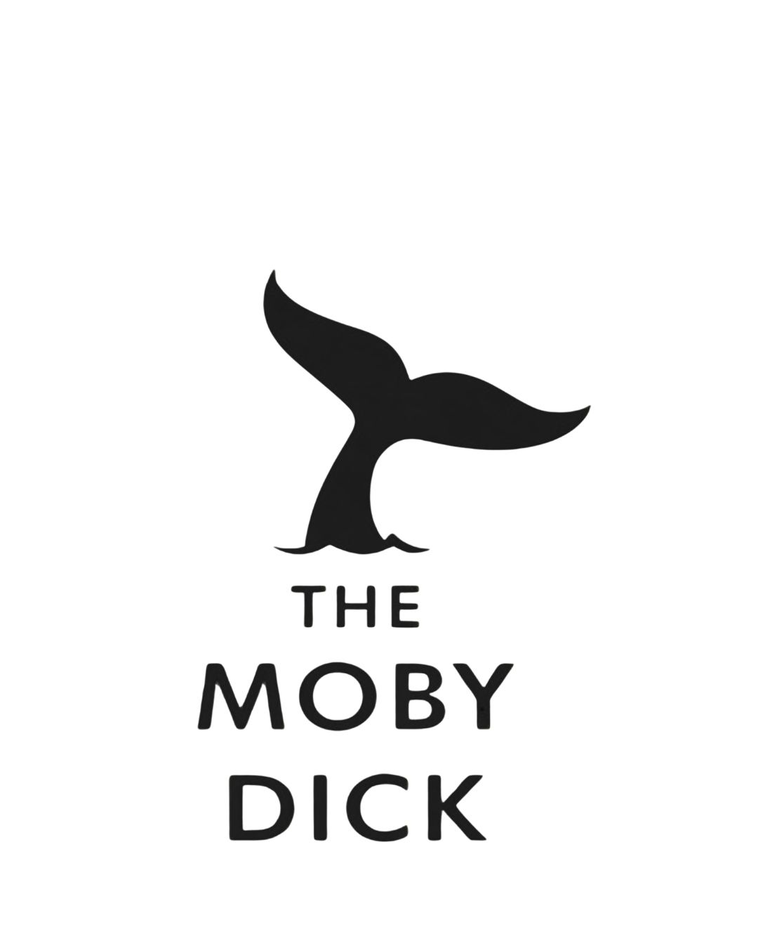







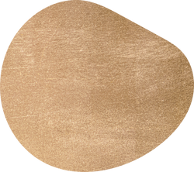











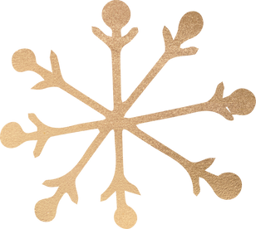


CELEBRATE CHRISTMAS
at
THE MOBY DICK

Slide 2
CHRISTMAS MENU
£35 for Two Courses
£45 For Three Courses
STARTERS
Cured Salmon
Roasted Squash and Chestnut soup (VE)
Chicken Parfait
MAIN
Roast Turkey
Honey and Mustard Roasted Gammon
Roast Topside beef
Nut Wellington (VE)
All Christmas dinners are served with, Roast Potatoes, Honey Roasted Carrots, Seasonal Veg, Parsnips, Pigs in Blankets and Yorkshire pudding
TO FINISH
Rich Chocolate Ganache
Mulled Wine Poached Pear with Vanilla Meringue Stack (VE)

