Slide 1

Welcome Address of the President of DIGM Indonesia
Professor Rasijid Soeparwata MD PhD

Slide 2
Guten Tag, selamat sore, welcome, Ladies and Gentlemen.
Greeting to all of you, distinguished Guests, Professors, and all online attendants, especially to Professor Asmarinah, President of the Indonesian Consortium of Biomedical Sciences and Dr. Siti Khaerunnisa, KIBI Treasurer.
My name is Rasjid Soeparwata, I am President of DIGM Indonesia.
Yogyakarta, where I was born, is a beautiful University city like Münster. My Medical Education began in Indonesia and ended in Germany at Justus Liebig University in Gießen, followed by a Training in General -, Thoracic- and Cardiovascular Surgery at Universities of Frankfurt, Würzburg and Gießen.

Slide 3
I was Research Assistant and Senior Surgeon in the Department of Thoracic and Cardiovascular Surgery at the University Hospital Münster from 1998 to 2008 and in this time I have received the Venia Legendi and became Professor for Thoracic and Cardiovascular Surgery.
Thereafter, I was appointed Visiting Professor at three Universities in Indonesia, Medical School of Muhammadiyah Yoyakarta, Medical School of University Gajah Mada Yogyakarta and Medical School of University of Indonesia in Jakarta.

Slide 4
The purpose of to day´s Meeting is to sign the MoU between DIGM and KIBI in order to advance academic collaboration between Germany and Indonesia in medical research and education.
This goal is supported by the DIGM Indonesia, which also plans to participate in future collaboration.
I would like to express its gratitude to each and everyone of you for your ongoing support and participation to reach this goal.
My deep thank goes to Prof. Antoinette am Zehnhoff-Dinnesen who passionately prepared and organized this event.
Thank you very much.

Slide 5


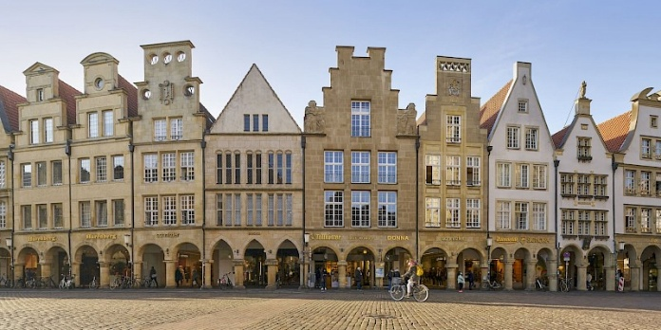
Yogyakarta
Jakarta
Münster

