Slide 1
Indonesian Consortium for Biomedical Science
2025
Exploring Strategic Collaborations in Research and Academia

Slide 2
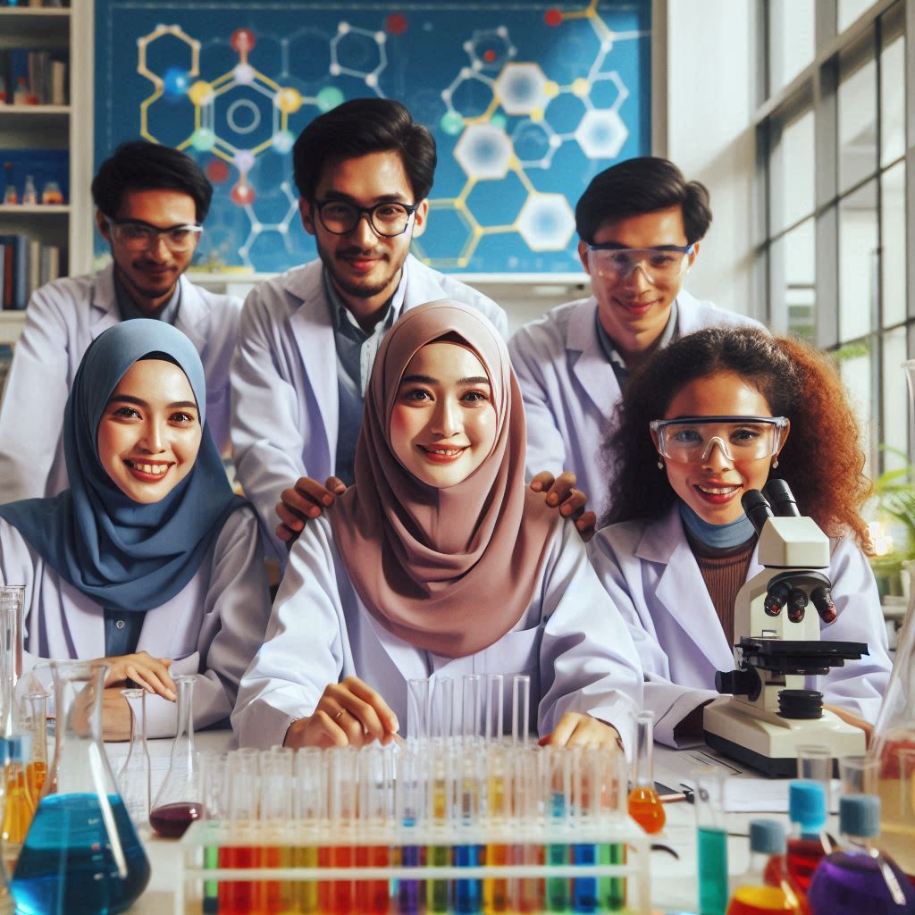
Introduction
This presentation introduces the Indonesian Consortium for Biomedical Science and explores potential collaboration opportunities.
The focus is on enhancing research initiatives, forming academic partnerships, and identifying additional collaborative areas that can benefit the consortium, stakeholders, and the broader biomedical community.

Slide 3
Objectives of the Organization
To unify academic units in the form of Study Programs that provide Biomedical Science education within universities that have Faculties of Medicine.
To promote the development of Biomedical Science Study Programs in Indonesia, particularly in terms of human resources, facilities, and infrastructure.
To establish minimum requirements and provide recommendations for the implementation of Biomedical Science Study Programs in higher education institutions in Indonesia.
To determine the student admission requirements for Biomedical Science Study Programs at the Master's and Doctoral levels in higher education institutions in Indonesia.
To define the graduate profile of Biomedical Science Study Programs
To determine the learning outcomes and core competencies of students enrolled in Biomedical Science Study Programs, as stipulated in the Bylaws (ART).
To facilitate collaboration among KIBI members and between KIBI members and similar institutions in other countries.

Slide 4

Potential Collaboration
Academic partnership
- Joint degree program
- Student and lecture exchange
- Online Modules
Joint Research
- Collaborative Research Grant

Slide 5

Collaboration Areas

Slide 6

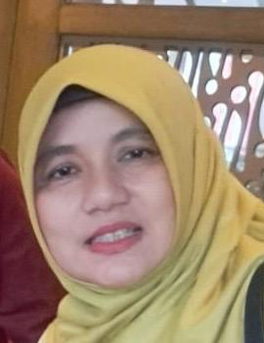
Prof.Dr.rer.nat. Asmarinah, MS. asmarinah.si@gmail.com
+62 81381472194
Faculty of Medicine Universitas Indonesia
Doctoral Program in Biomedical Science
Expertise
Genetic, Epigenetic, Reproduction, Cancer, CVD
Research Area
Genetics and Epigenetics in Cardiovascular Disease
Collaboration Interest
Research collaboration, joint supervision for PhD students, lecturer exchange (in and out).
07

Slide 7

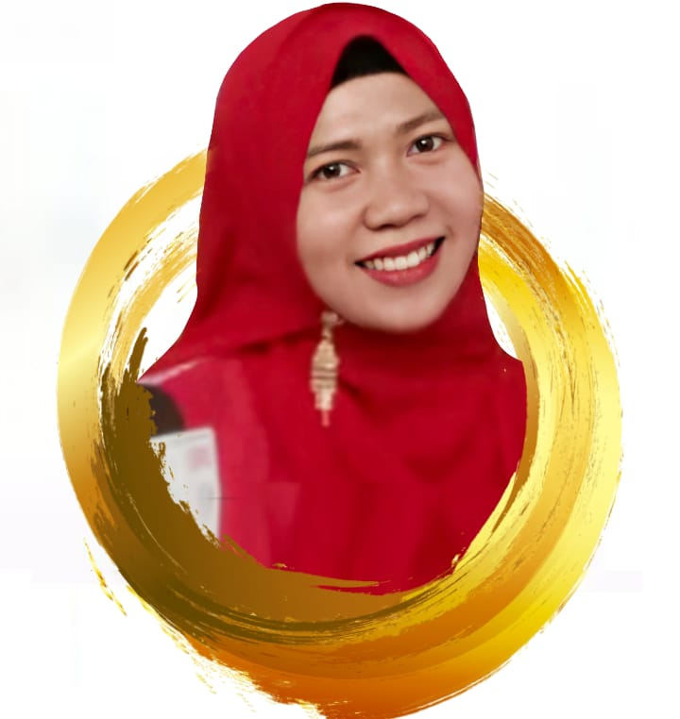
Faculty of Medicine Universitas Airlangga
Master Program of Basic Medical Science
Expertise
Medical Biochemistry and Bioinformatics
Research Area
Herbal and Nutritional Medicine in Metabolic Diseases and Neuroscience, Bioinformatics
Collaboration Interest
Research Collaboration, Student/Lecturer Exchange, Guest Lecture etc
Dr. Siti Khaerunnisa, M.Si
st.khaerunnisa@fk.unair.ac.id
+62 81233118194
27

Slide 8

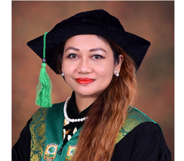
Prof. dr. Ilmiawati, Ph.D ilmiawati@med.unand.ac.id
+62-82169474770
Faculty of Medicine Universitas Andalas
Master Program in Biomedical Sciences
Expertise
Environmental toxicology, environmental epidemiology, environmental health, biomonitoring, molecular endocrinology
Research Area
Persistent organic pollutants (pesticides, fluorinated compounds) exposure and toxicity, heavy metals biomonitoring and toxicity, lifestyle medicine
Collaboration Interest
Student and faculty exchange, guest lectures, research collaboration, joint publication, joint community outreach
04

Slide 9

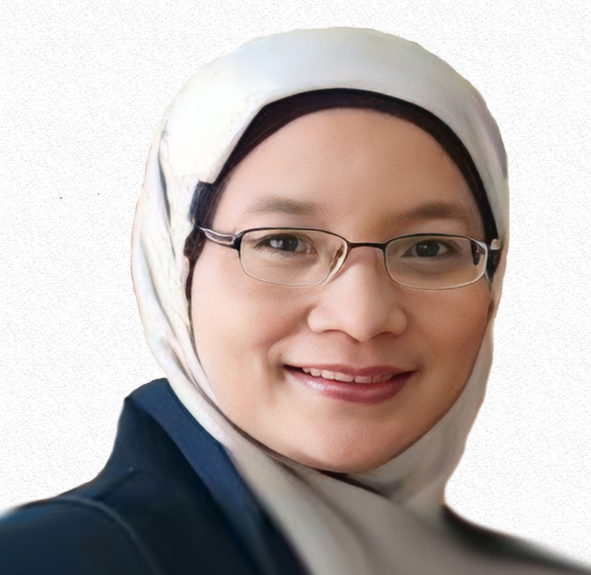
Prof. Dr. dr. Loeki Enggar Fitri, M.Kes., Sp.ParK lukief@ub.ac.id
+6285649561303
Faculty of Medicine Universitas Brawijaya
Doctoral Study Program in Medical Science
Expertise
Malaria, Toxoplasmosis, Oppurtunistic Disease, Tropical Disease
Research Area
Infectious Disease
Collaboration Interest
Diagnostic and drug development in Tropical Diseases
Research Executive Summary/Roadmap
https://drive.google.com/open?id=1dOf4oJwa_LHNC6TuP0SPM8v-eL41WH_x
26

Slide 10


Mas Rizky A.A Syamsunarno, MD, Ph.D rizky@unpad.ac.id
+62 81321644359
Faculty of Medicine Universitas Padjadjaran
Master Program in Basic Medical Sciences
Expertise
Adipose tissue; Adipokine; Cardiovascular Disease; Lipid Metabolism; Obesity
Research Area
Metabolic Medicine.
Collaboration Interest
Joint proposal for international grant; Capacity development for student and staff
Research Collaboration interest : Investigating Obesity, Lipid Profiles, and Adipokine Dynamics in Acute Myocardial Infarction Patients
https://drive.google.com/open?id=1tDRhhMSNOoWOzHa6SIT3JppHhhbwkHEi
20

Slide 11
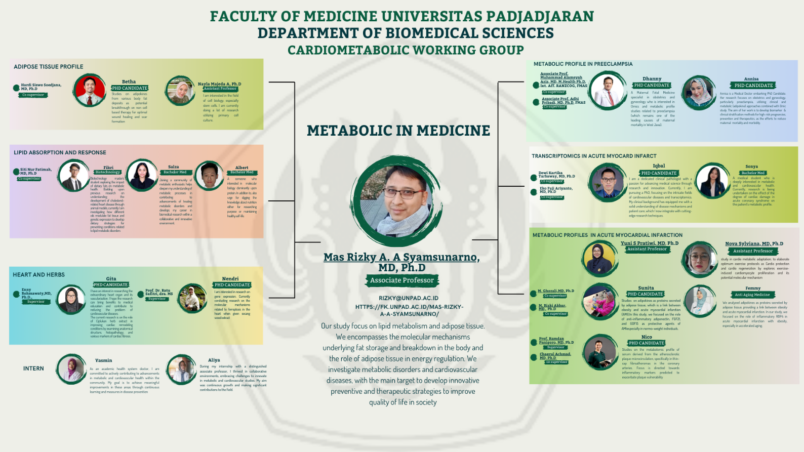
Mas Rizky A.A Syamsunarno, MD, Ph.D
rizky@unpad.ac.id
+62 81321644359
Faculty of Medicine Universitas Padjadjaran
Master Program in Basic Medical Sciences
Research Interest

Slide 12


Dr.dr. Zulkarnain, M.Sc., AIFO-K zulkarnain_md@usk.ac.id
+6285277728024
zulkarnain_md@usk.ac.id
Faculty of Medicine Universitas Syiah Kuala
Master Program in Biomedical Sciences
Expertise
Endocrine phsiology, proteomic, metabolomic, herbal medicine, cancer
Research Area
Genetics and Epigenetics in Cardiovascular Disease, Leprosy
Collaboration Interest
Herbal medicine and Cancer
01

Slide 13

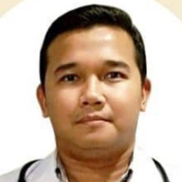
Faculty of Medicine Universitas Muhammadiyah Sumatera Utara
Master Program in Biomedical Sciences
Expertise
Arrhythmia, Electrophysiology, Heart Failure, Risk Factors, Quality of Life
Research Area
Arrhhythmia
Collaboration Interest
First Aid Training for Families
dr. Ahmad Handayani, M.Ked(Cardio), Sp.JP
ahmadhandayani@umsu.ac.id
+6285275989147
02

Slide 14
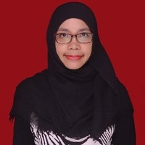
Faculty of Medicine Universitas Muhammadiyah Sumatera Utara
Expertise
Medical Education
Research Area
Interprofessional education, information and digital literacy
Research Executive Summary/Roadmap
https://drive.google.com/open?id=1jbtpP_OcVmAB8eHpZEvMugQCUM2egMYx
dr. Ratih Yulistika Utami, M.Med.Ed
ratihyulistika@umsu.ac.id
+628116023347
03

Slide 15
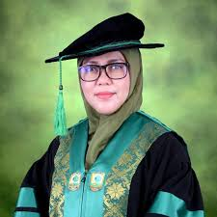
Prof.Dr.Aisyah Elliyanti MD aelliyanti@med.unand.ac.id
+62 8126636987
Faculty of Medicine Universitas Andalas
Doctoral Study Program in Biomedical Science
Expertise
Thyroid cancer, Thyroid disease, Radioiodine, iodine, sodium iodide symporter
Research Area
Oncology
Collaboration Interest
Lecturer exchange/visiting professor (in and out), especially in biomedical sciences
exchange speaker in seminars/conferences
04

Slide 16
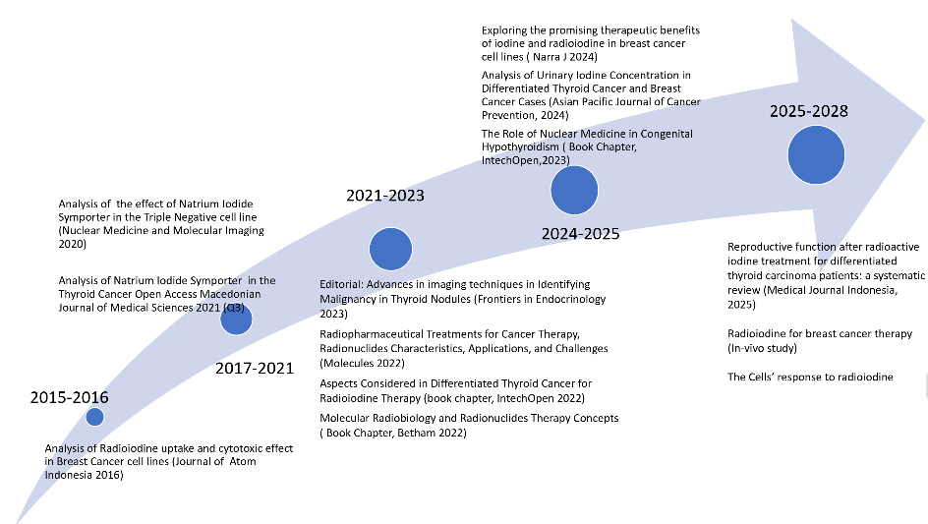
Prof.Dr.Aisyah Elliyanti MD aelliyanti@med.unand.ac.id
+62 8126636987
Faculty of Medicine Universitas Andalas
Doctoral Study Program in Biomedical Science
Research Interest
Our study to relate to thyroid, breast and prostate cancer. We seek the opportunity to use radioiodine or iodine as potential adjuvant therapy for breast or prostate cancer, and also find out solution of some thyroid cancer (well differentiated) which shown non-response to radioiodine. Furthermore, we also study the toxic effect of radioiodine to the normal cell on molecular prospective,

Slide 17

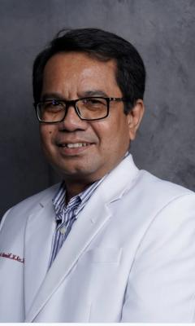
Dr. dr. M. Yulis Hamidy, M.Kes, M.Pd.Ked, Sp.KKLP yulis.hamidy@gmail.com
+’6281933695060
Faculty of Medicine Universitas Riau
Master Program in Biomedical Sciences
Expertise
Pharmacology
Research Area
Genetics and Epigenetics in Cardiovascular Disease
05

Slide 18
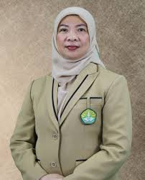
Prof. dr. Arfianti, M. Biomed, M. Sc, PhD
Arfianti@lecturer.unri.ac.id
+628117600672
Faculty of Medicine Universitas Riau
Master Program in Biomedical Sciences
Expertise
liver cancer, liver fibrosis, MASLD, obesity, mesenchymal stem cell
Research Area
Molecular biology, stem cells, genetics in liver diseases
Collaboration Interest
Joint conferences, staf exchange, joint master or PhD supervision
Research Executive Summary/Roadmap
https://drive.google.com/open?id=16wKjYLj0RelhNcACkCbslIeb_60IKSd9
06

Slide 19
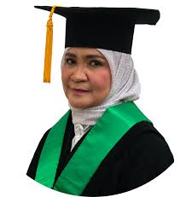
Prof. Wawaimuli Arozal, MD, PhD wawaimuli@gmail.com
081808408680
Faculty of Medicine Universitas Indonesia
Doctoral Program in Biomedical Science
Expertise
Pharmacology, Toxicology, cardiovascular pharmacology, neuroscience
Research Area
Genetics and Epigenetics in Cardiovascular Disease, Neuropharmacology
Collaboration Interest
Research collaboration, joint supervision for PhD students, lecturer exchange (in and out).
08

Slide 20
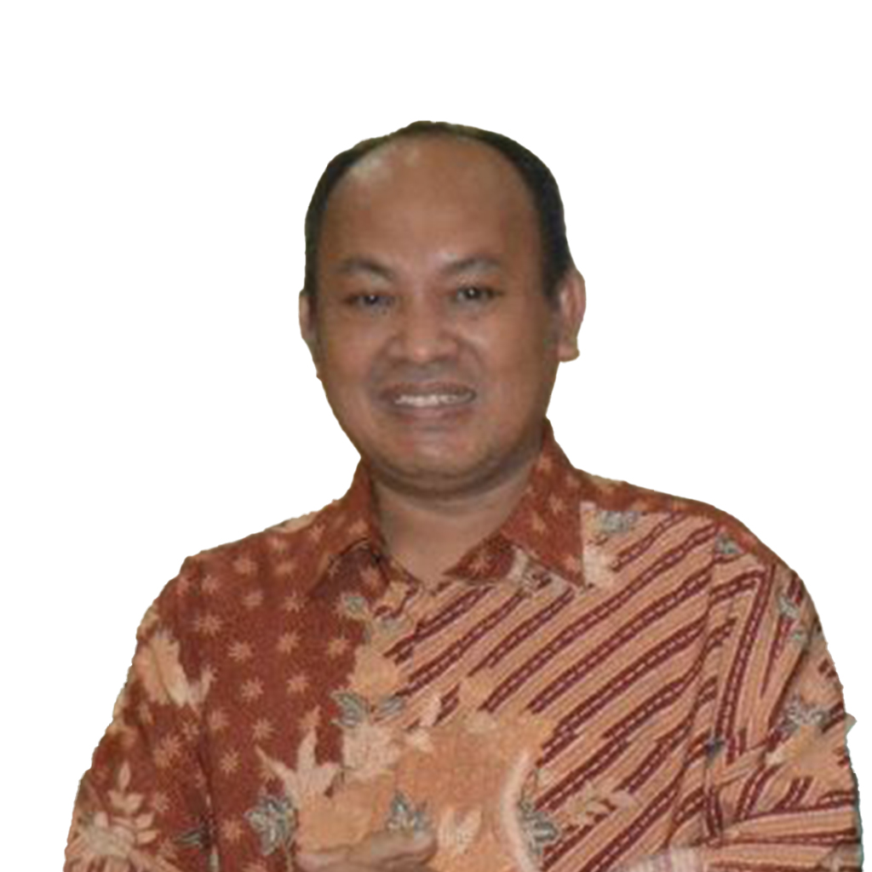
Faculty of Medicine Universitas Indonesia
Doctoral Program in Biomedical Science
Expertise
Entomology and Helminthology
Research Area
Mosquito resistance to insecticides
Collaboration Interest
Research collaboration in Epidemiology and Control of intestinal helminths in rural Indonesia
Dr.Drs. Rizal Subahar, Mbiomed
subaharizal@yahoo.com
09561167964
09

Slide 21
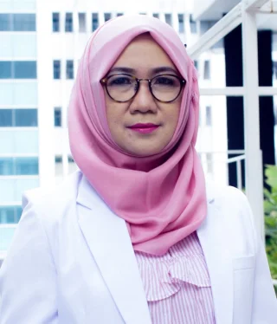
Faculty of Medicine Universitas Indonesia
Department of Medical Biology
Expertise
Birth defect, rare disease, genetic, genomic, pediatric
Research Area
Pediatric genetic and genomic
Collaboration Interest
Research collaboration in gene therapy for genetic disease (MPS type 2)
Research Executive Summary/Roadmap
https://drive.google.com/open?id=1efF3jDj81IH9h970gylpZWVVIG_D1zr_
Dr. dr. Yulia Ariani, Sp.A(K)
yulia.ariani@ui.ac.id
+6281280885100
10

Slide 22

Faculty of Medicine Universitas Muhammadiyah Metro
Expertise
Molecular Biology, Tropical Environment, Oncology
Research Area
Molecular Biology, Tropical Environment, Parasitology, Microbiology, Pharmacy
Research Executive Summary/Roadmap
https://drive.google.com/open?id=1-mAwrsOXDAsr0-vooimJJDTn6w_J9xP5
Miftahuz Zakiyah, M.Biomed
miftahuzzakiyah@gmail.com
+6281319702875
11

Slide 23
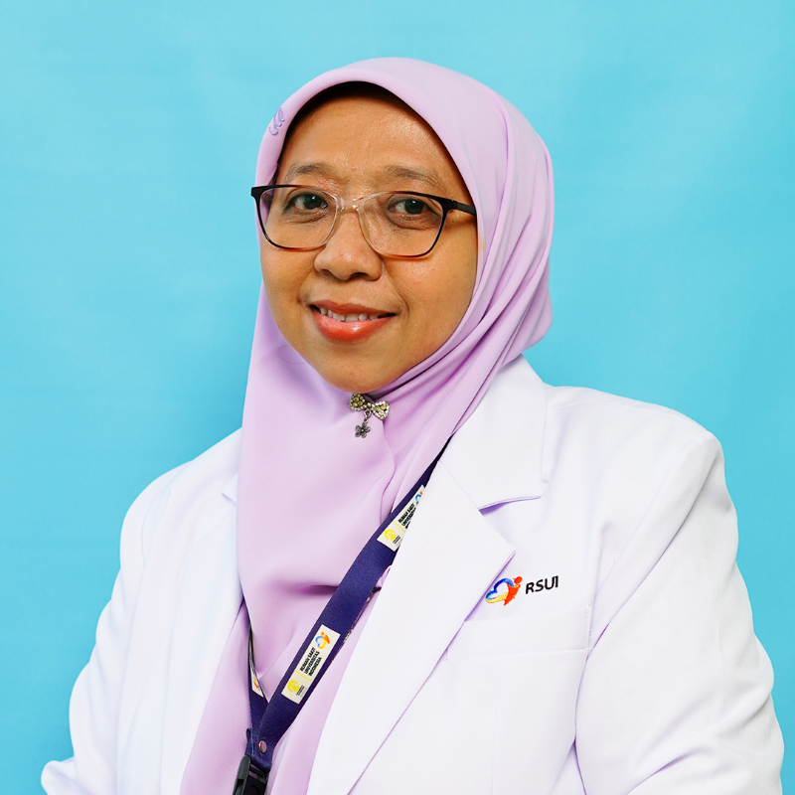
Faculty of Medicine Universitas Indonesia
Parasitology Department
Expertise
Diagnostic; medical mycology; molecular fungal identification; fungal epidemiology
Research Area
Diagnostic medical mycology
Collaboration Interest
Lecturer exchange/visiting professor (in and out) and short course especially in biomedical
exchange speaker in seminars/conferences
Research Executive Summary/Roadmap
https://drive.google.com/open?id=1EFRKXpJ5roOeuPmivcGCnDHRfcYt8vt2
Robiatul Adawiyah, MD., M.Biomed, PhD, Sp.Par.K(K)
robiatul.adawiyah01@ui.ac.id
+628159710834
12

Slide 24
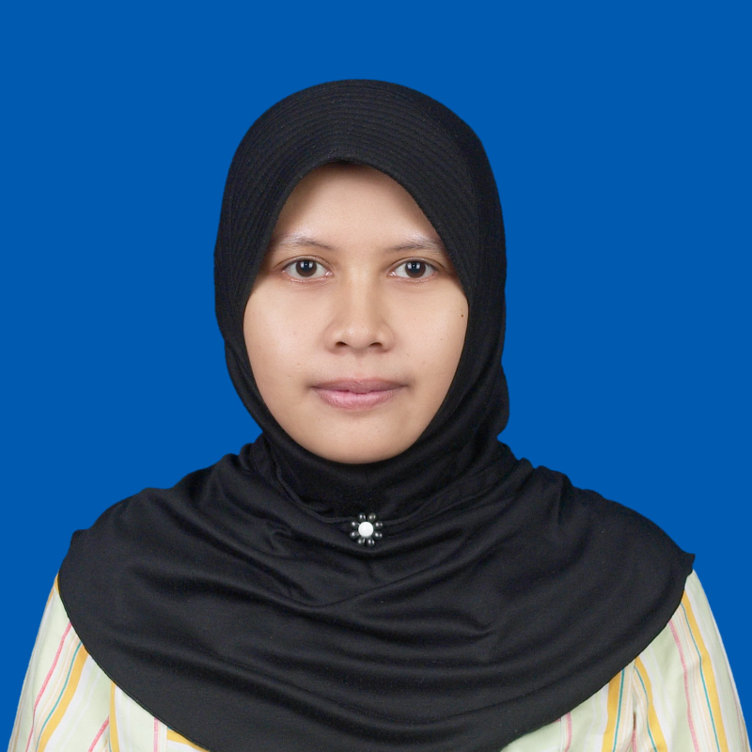
Faculty of Medicine Universitas Indonesia
Department of Parasitology
Expertise
Parasite; Protozoa; Entomology; Imunoparasitology
Research Area
Protozoology
Collaboration Interest
Molecular diagnosis of protozoa and molecular epidemiology
Research Executive Summary/Roadmap
https://drive.google.com/open?id=1ydPsyCEm9IR07ufbEtMFPTB9z4MqY9E_
Ika Puspa Sari, MD, PhD
ika.puspa@ui.ac.id
6281218268614
13

Slide 25

Faculty of Medicine Univesitas Methodist Indonesia
Master Program of Biomedical Sciences
Research Area
Herbal Medicine for infectious disease
Research Executive Summary/Roadmap
https://drive.google.com/open?id=1aTTicnju_3BPaRk-8e08jsw3rpsfcd1G
Dr.dr.Hanjaya,M.Biomed.,MKM.,MH.,AIFO-K.,CFBH.In.,CMDC.,CHDTPC.
drjaya2017@gmail.com
+6282272798309
14

Slide 26
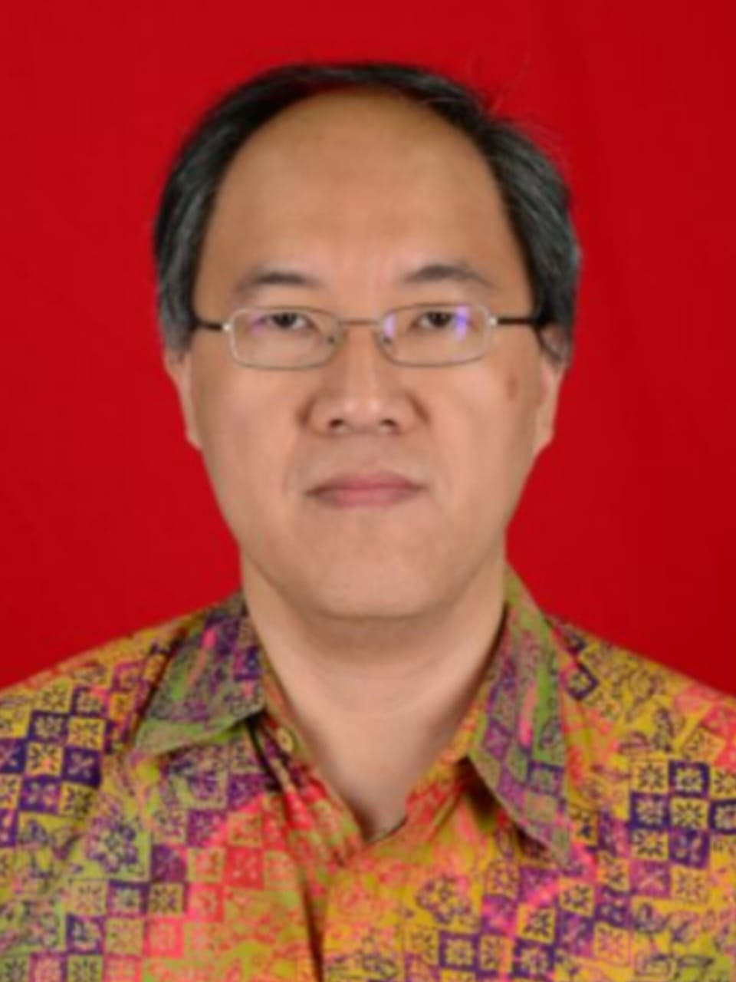
Faculty of Medicine Atma Jaya Catholic University of Indonesia
Master Program of Biomedical Sciences
Expertise
Immunology; infection; virology; gastroenterology infection;
Research Area
infection
Collaboration Interest
Student Exchange
Soegianto Ali, MD, M.Med.Sc. PhD
soegianto.ali@atmajaya.ac.id
+62-81290482014
15

Slide 27
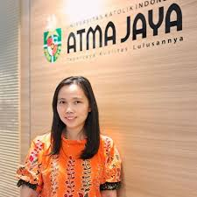
Faculty of Medicine Atma Jaya Catholic University of Indonesia
Master Program of Biomedical Sciences
Expertise
Infectious Diseases; Helminth; Immunoparasitology; Vaccine response
Research Area
Intestinal parasitic infections and immune response
Collaboration Interest
Infectious disease related to gut health and vaccine response
Research Executive Summary
https://drive.google.com/open?id=1tbhZBRN4FuBGd2ZH9yRvG6KqkALtsCP1
Maria M M Kaisar., PhD
maria.kaisar@atmajaya.ac.id
+6281382256574
16

Slide 28
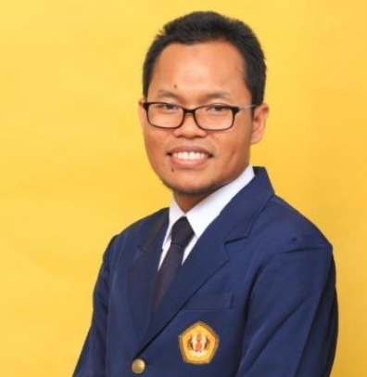
Eko Fuji Ariyanto, dr., M.KM., Ph.D. fuji@unpad.ac.id
+6281316099791
Faculty of Medicine Universitas Padjadjaran
Master Program in Basic Medical Sciences
Expertise
Epigenetics; nutrigenomics; metabolism; adipocyte biology
Research Area
Genetics and Epigenetics in Cardiovascular Disease
Research Executive Summary/Roadmap
https://drive.google.com/open?id=1ERPsfv-H2UXPL0nyKyN9y7ByJnh306bI’
17

Slide 29
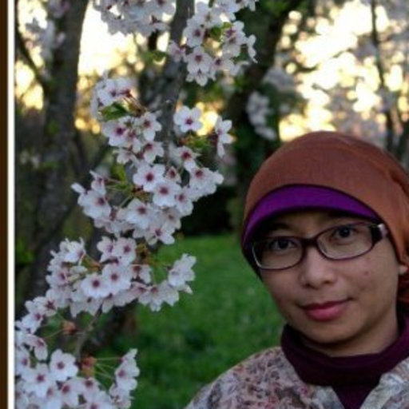
Dr.rer.nat Savira Ekawardhani,M.Si savira@unpad.ac.id
+6281287910120
Faculty of Medicine Universitas Padjadjaran
Master Program in Basic Medical Sciences
Expertise
DARPin; protein binder;3D cell culturing;genetic engineering
Research Area
Oral or topical therapeutic protein
Collaboration Interest
Oral or topical therapeutic protein
Research Executive Summary/Roadmap
https://drive.google.com/open?id=1ERPsfv-H2UXPL0nyKyN9y7ByJnh306bI’
18

Slide 30
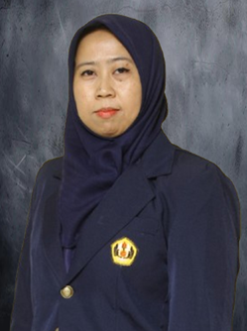
Yunia Sribudiani y.sribudiani@unpad.ac.id
+6281324729211
Faculty of Medicine Universitas Padjadjaran
Master Program in Basic Medical Sciences
Expertise
Molecular genetics; Clinical Genetics
Research Area
Gastrointestinal genetics (Colon Cancer, Hirschsprung disease), Thalassemia
19

Slide 31
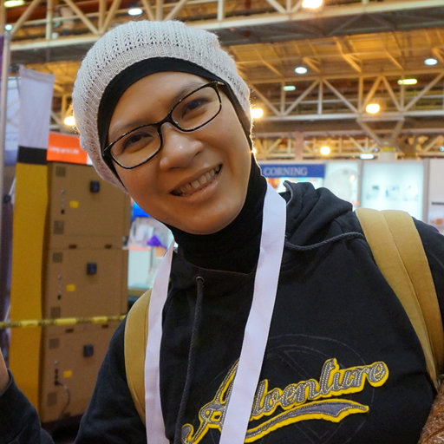
Astrid Feinisa Khairani, MD., Ph.D astrid.khairani@unpad.ac.id
+628112112612
Faculty of Medicine Universitas Padjadjaran
Department of Biomedical Sciences
Expertise
Structural Biology, Cytoskeleton Structure and Function, bioimaging, ultrastructural imaging, breast cancer
Research Area
Cell Biology
Collaboration Interest
Research collaboration interest: Cytoskeleton Proteins in Breast Cancer: Changes in their structures and roles
21

Slide 32

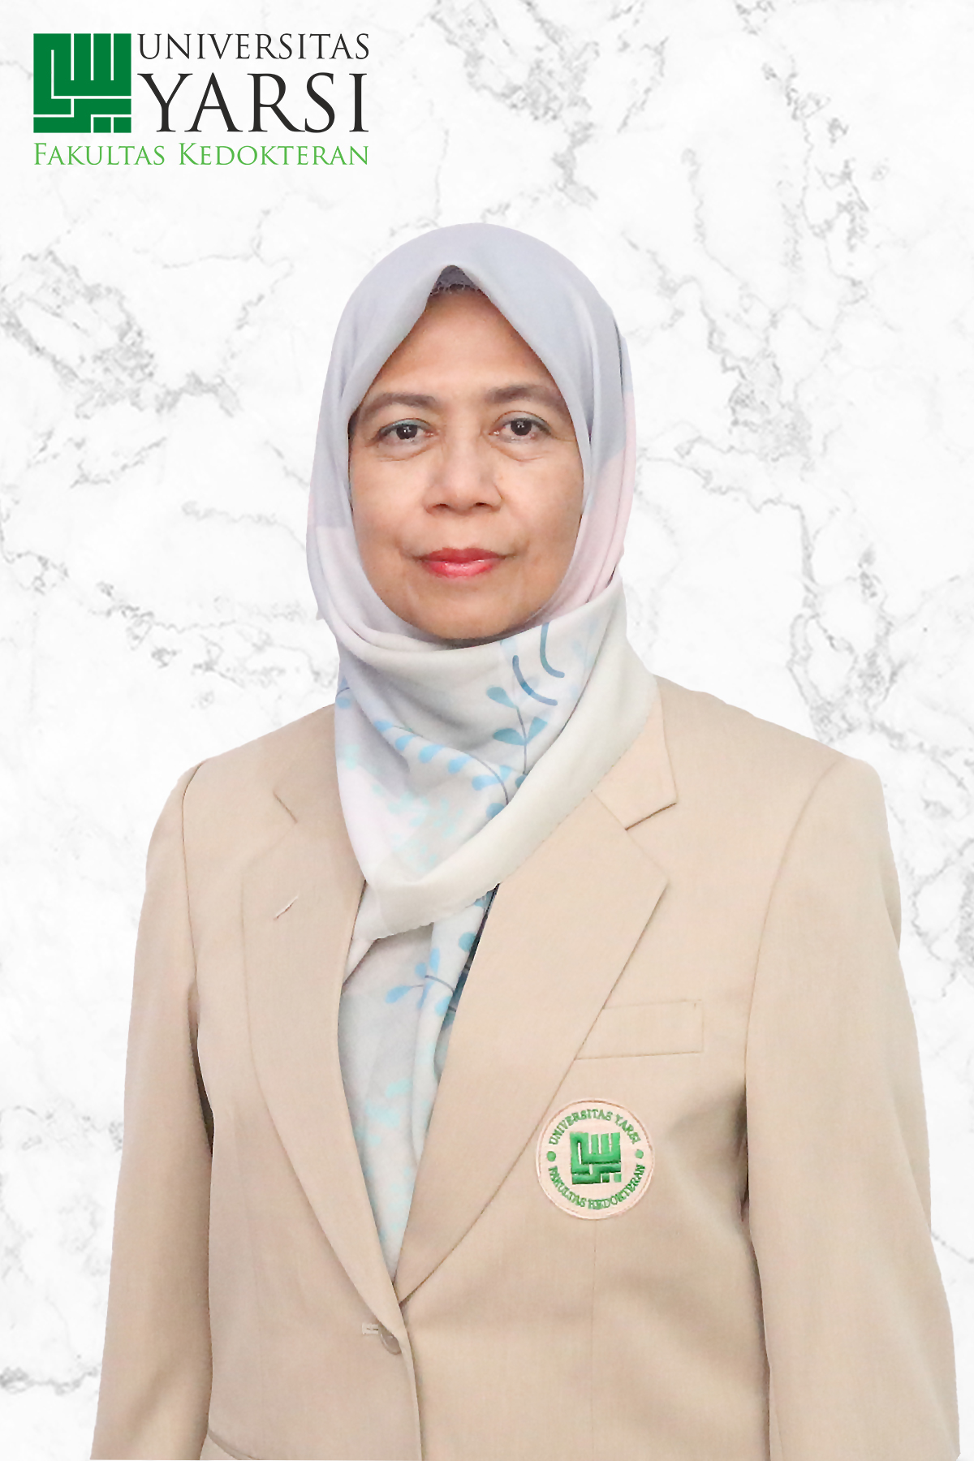
Faculty of Medicine Universitas Yarsi
Expertise
"Exercise physiology" ; "physical activity"; "aging and longevity";
Research Area
Genetics and Epigenetics in Cardiovascular Disease
Research Executive Summary/Roadmap
https://drive.google.com/open?id=19ePHC6jvCC8LvKtz6uYHmgLHOTqmSg7d, https://drive.google.com/open?id=1gY8S7wIevNHBLTwtItPmMMQa7AJ7Z8tE, https://drive.google.com/open?id=1m_XeUBe0haAJfWRG2SkFZR-8_-X66l5K, https://drive.google.com/open?id=1x3MwS38EXnsCUQYZYV_et4hkWLxAvO8d, https://drive.google.com/open?id=1HDSLBzwItg6VSbBblCP6hrIhFpcLNNeA
Dr.dr.Diniwati Mukhtar MKes AIFM diniwati.mukhtar@yarsi.ac.id
+628158153746
22

Slide 33
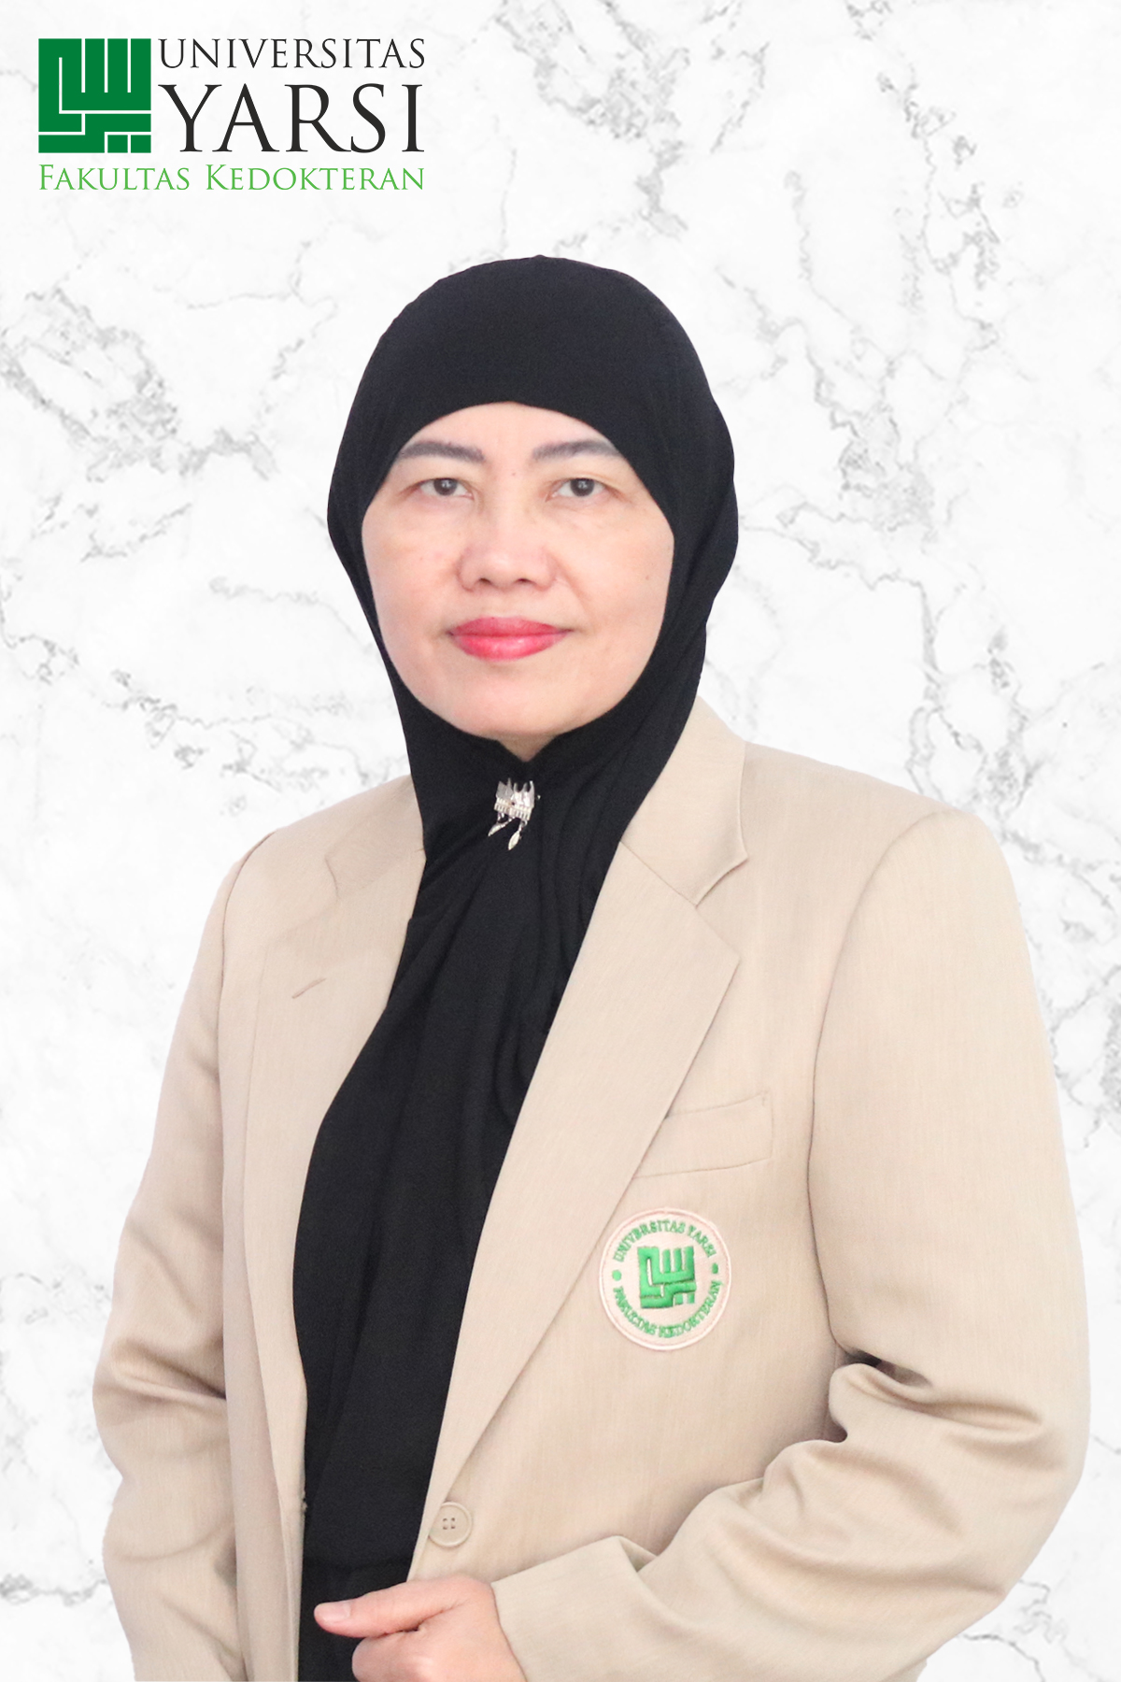
Faculty of Medicine Universitas Yarsi
Expertise
"Thyroid", "Diabetes Mellitus", "Metabolic Syndrome", "Genetic", "Nutrition""
Research Area
"Thyroid", "Diabetes Mellitus", "Metabolic Syndrome", "Genetic", "Nutrition""
Collaboration Interest
Genetic and Metabolic Syndrome
Research Executive Summary/Roadmap
https://drive.google.com/open?id=1Diw8xc4zzfoY-OLIlbDmgxZ5Yk9i8f3l
Fatimah Eliana
fatelianasppd13@gmail.com
+628161326220
23

Slide 34
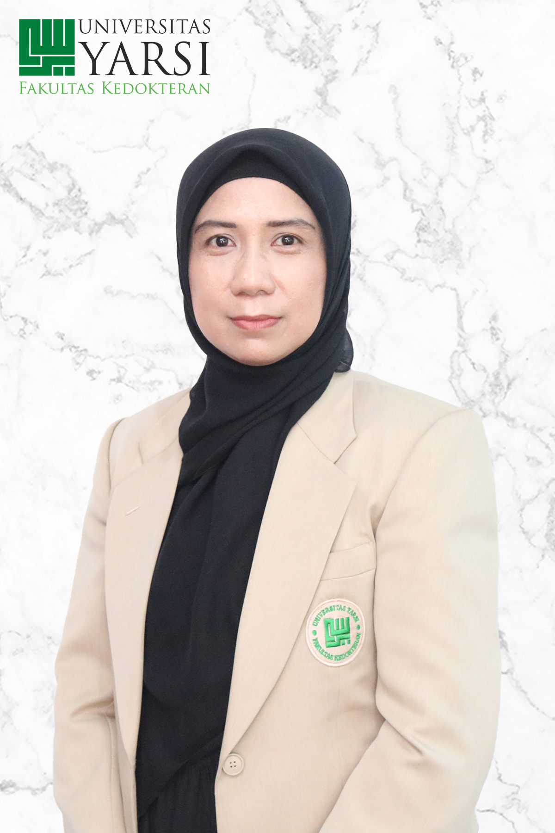
Faculty of Medicine Universitas Yarsi
Expertise
Pharmacogenomic, diabetes, cv disease
Research Area
Genetics and Epigenetics in Cardiovascular Disease, effect of genetic variation of PRKAA2 gene in metformin response and risk of CV disease in type 2 Diabetes
Collaboration Interest
Prevalence of CYP2C19*2 and CYP2C19*3 Patients with Cardiovascular Disease in Koja General Hospital, Jakarta (has been conducted)
The effect of genetic variation of PRKAA2 gene in metformin response and risk of CV disease
dr. Sakura Muhammad Tola, Sp.FK
sakurachacha1706@gmail.com +628119767771
24

Slide 35

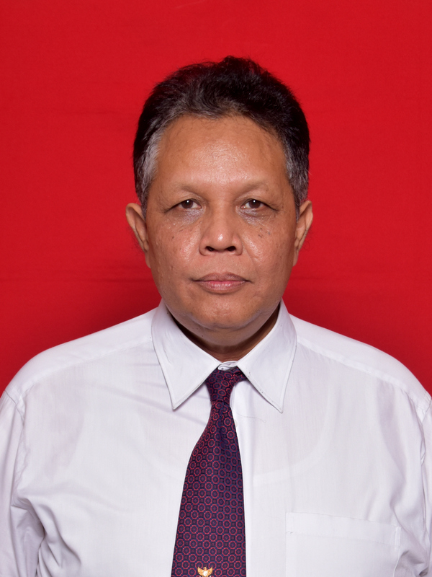
Faculty of Medicine Universitas Jenderal Soedirman
Expertise
virology; bacteriology; pathogen; genomic; survaillance
Research Area
Ototoxicology, Molecular pathogen of otitis media and respiratory virus (severe acute respiratory illness)
Dr. Drs. Daniel Joko Wahyono, M.Biomed.
daniel.wahyono@unsoed.ac.id
+6281804758154
25

Slide 36
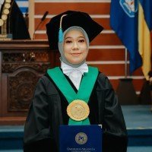
Faculty of Medicine Universitas Airlangga
Master Program of Basic Medical Science
Expertise
Immunopharmacology: Herbal medicine:metabolic sundrome, autoimmune; cancer
Research Area
immunopharmacology for non-communicable deseases
Roadmap
https://drive.google.com/open?id=1Hjh71dTBFGiF0KMkRNt44SyS0FvI7329
Prof. Dr. Arifa Mustika,dr.,M.Si
arifa-m@fk.unair.ac.id
+6287851540939
28

Slide 37
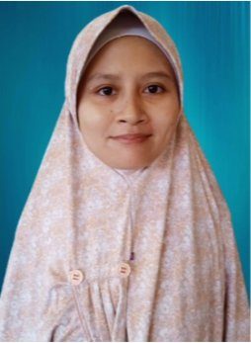
Faculty of Medicine Universitas Airlangga
Master Program of Basic Medical Science
Expertise
Genomic medicine; cardiometabolic; molecular biology; biochemistry
Research Area
Genetics and Epigenetics in Cardiovascular Disease
Dr. Citrawati Dyah Kencono Wungu, MD, Ph.D
citrawati.dyah@fk.unair.ac.id
+6285790220989
29

Slide 38

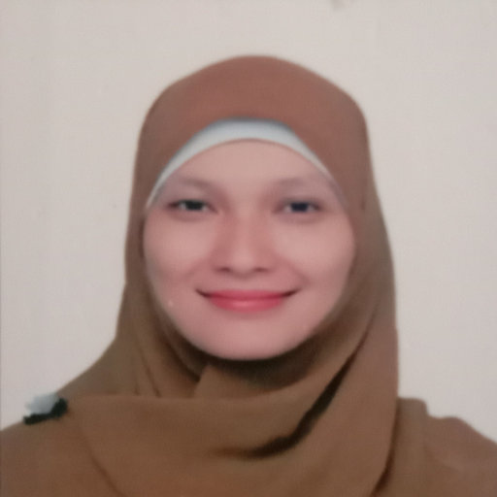
Dr. dr.Yetty Machrina, M.Kes yetty@usu.ac.id
+62 81397382797
Faculty of Medicine Universitas Sumatera Utara
Master Program in Biomedical Sciences
Expertise
Exercise physiology, DM type-2,, Cardiovascular physiology, Endocrine, Reproductive Function
Research Area
Herbal and Nutritional Medicine, Cardiovascular and metabolic health., Exercise and sport medicine
Collaboration Interest
lecturer exchanges, guest lectures
01

Slide 39

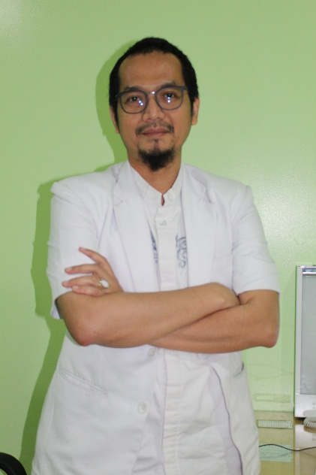
DR dr Eka Airlangga MKed (Ped) SpA ekaairlangga@umsu.ac.id
+62 8116000409
Faculty of Medicine Universitas Muhammadiyah Sumatera Utara
Master Program in Biomedical Sciences
Expertise
pandemic, mobile health, children, clinical decision support system
Research Area
pandemic and mobile health, clinical decision support system
Collaboration Interest
Guest lecture
02

Slide 40

Darmawi, MD, PhD darmawi@lecturer.unri.ac.id
+62 82385253300
Faculty of Medicine Universitas Riau
Master Program in Biomedical Sciences
Expertise
Adenomyosis; Bioinformatics
Research Area
Reproductive health
Collaboration Interest
Guest lecture
05

Slide 41

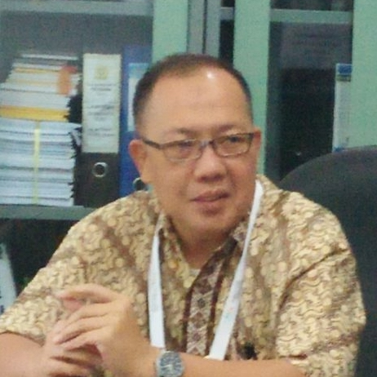
Prof. Dr. dr. Irfannuddin, SpKO(K), irfan.md@unsri.ac.id
+62 81367673749
Faculty of Medicine Universitas Sriwijaya
Doctoral Study Program in Biomedical Science
Expertise
Neurophysiology, Complementary Medicine, Herbal Medicine
Research Area
Herbal and Nutritional Medicine, Cardiovascular and metabolic health., Neurocognitive and mental health, Cancer management and recovery
Collaboration Interest
Propose for educational and PhD candidate research cooperation.
06

Slide 42
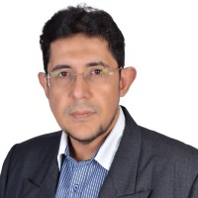
Dr. dr. Zen Hafy, M.Biomed zhafy@yahoo.com
+62 818118608
Faculty of Medicine Universitas Sriwijaya
Master Program in Biomedical Sciences
Expertise
Biomedicine
Research Area
Molecular Biology
Collaboration Interest
We are currently focusing on academic collaborations and knowledge exchange. While our primary focus is academic at the moment, we are open to exploring potential research collaborations in the future.. we are also open to exploring future research collaborations.
We are interested in connecting with potential collaborators working in the fields including Pharmacology, Physiology, Biochemistry, and Microbiology.
07

Slide 43
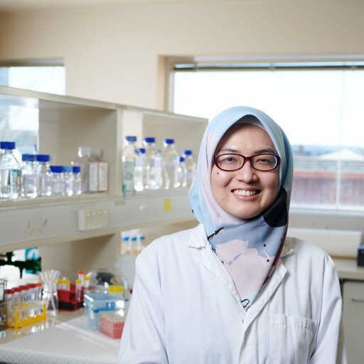
dr. Ayeshah Augusta Rosdah, Ph.D arosdah@unsri.ac.id
+62 85664378425
Faculty of Medicine Universitas Sriwijaya
Master Program in Biomedical Sciences
Expertise
Pharmacology; Drug discovery; Protein-Bioinformatics; Mitochondria; Cardiometabolic disease
Research Area
Herbal and Nutritional Medicine, Cardiovascular and metabolic health., Targeting Mitochondria in Cardiometabolic Diseases;
Collaboration Interest
We are currently focusing on academic collaborations and knowledge exchange. While our primary focus is academic at the moment, we are open to exploring potential research collaborations in the future.. we are also open to exploring future research collaborations.
I am interested in collaborating with researchers who focus on herbal medicine and cardiometabolic diseases.
08

Slide 44

dr. Veny Larasati, M.Biomed dr.venylarasati@gmail.com
+62 81278310008
Faculty of Medicine Universitas Sriwijaya
Master Program in Biomedical Sciences
Expertise
Biomedical sciences; Anti-Aging Medicine
Research Area
Anti-aging medicine
Collaboration Interest
Collaboration with experts specializing in herbal medicine and wound healing. Ideal collaborators would have experience in phytopharmacology, natural product formulation, and preclinical or clinical studies related to tissue regeneration.
Student/lecturer exchange; guest lectures; editor and reviewer in Biomedical Journal.
09

Slide 45
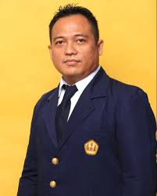
Prof. Dr. Leonardo Lubis, dr. leonardo@unpad.ac.id
+62 85353699557
Faculty of Medicine Universitas Padjadjaran
Master Program in Basic Medical Sciences
Expertise
Metabolic Syndrome; Energy Expenditure; Irisin; Anthropometry; Muscle mass
Research Area
Cardiovascular and metabolic health.
11

Slide 46

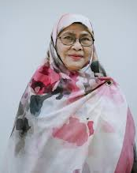
Dr. Arief Budi Yulianti, Dra., MSi ab.yulianti@unisba.ac.id
+62 89675780986
Faculty of Medicine Universitas Islam Bandung
Master Program in Biomedical Sciences
Expertise
alpha synuclein; supplement of semipolar garlic; pesticides
Research Area
Herbal and Nutritional Medicine
Collaboration Interest
Lecturer exchange
It is an honor to be able to collaborate on research
13

Slide 47

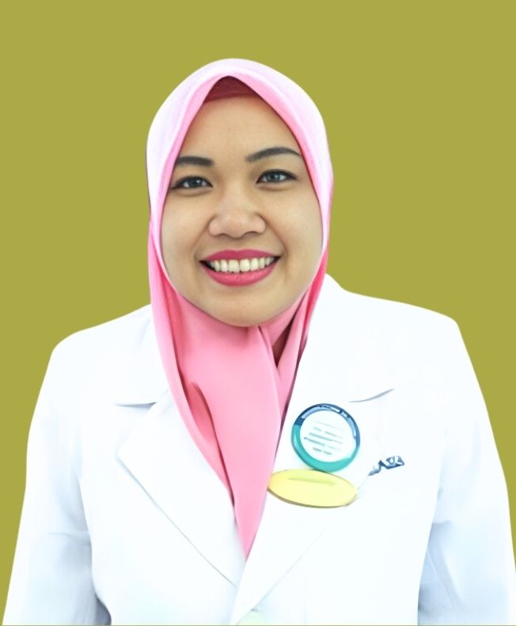
Dr.dr.Julian Dewantiningrum, SpOG jdewantiningrum@fk.undip.ac.id
+62 81225709248
Faculty of Medicine Universitas Diponegoro
Master Program in Biomedical Sciences
Expertise
Maternal health, fetal growth, fetal programming, stunting
Research Area
Reproductive health
Collaboration Interest
Guest lecture
14

Slide 48
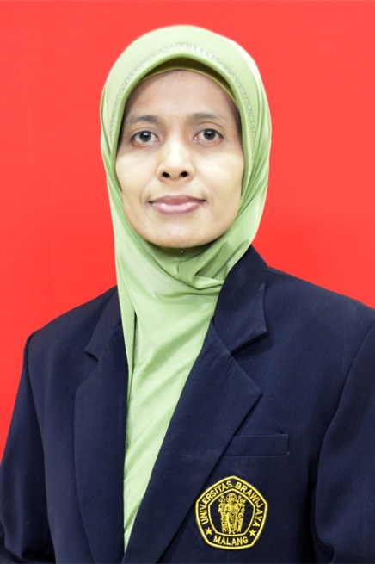
Prof. Agustina Tri Endharti.,Ph.D tinapermana.fk@ub.ac.id
+62 85233140794
Faculty of Medicine Universitas Brawijaya
Doctoral Study Program in Medical Science
Expertise
Cancer therapy; immunology molecular; nanomedicine
Research Area
Herbal and Nutritional Medicine, Cancer management and recovery, Immunity and inflammation
Collaboration Interest
student/lecturer exchange; guest lecture; research collaborations
15

Slide 49
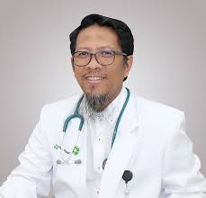
Prof. dr. Mohammad Saifur Rohman, Ph.D. ippoenk@ub.ac.id
Faculty of Medicine Universitas Brawijaya
Doctoral Study Program in Medical Science
Expertise
Molecular Cardiology; Cardiology Intervention; Cardiovascular Medicine, Genetics, Circadian Physiology
Research Area
Herbal and Nutritional Medicine, Cardiovascular and metabolic health.
Collaboration Interest
student/lecturer exchange; guest lecture; research collaborations
16

Slide 50
Thank you!

