Slide 1

Presentation of the German-Indonesian Society for Medicine
Professor Antoinette am Zehnhoff-Dinnesen MD PhD
University Münster, Germany
Vice-President of DIGM

Slide 2
The Roots: Medical Cooperation between Germany and Indonesia since more than 500 years

Slide 3
Founded in 1996, for almost three decades, our society has stood for:
Promoting dialogue and cooperation between medical professionals from both nations
The joint organization of training courses, workshops and research projects
The exchange of best practices and support with professional and cultural challenges
https://www.digm.info/

Slide 4
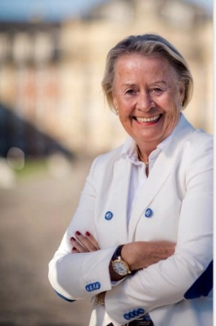
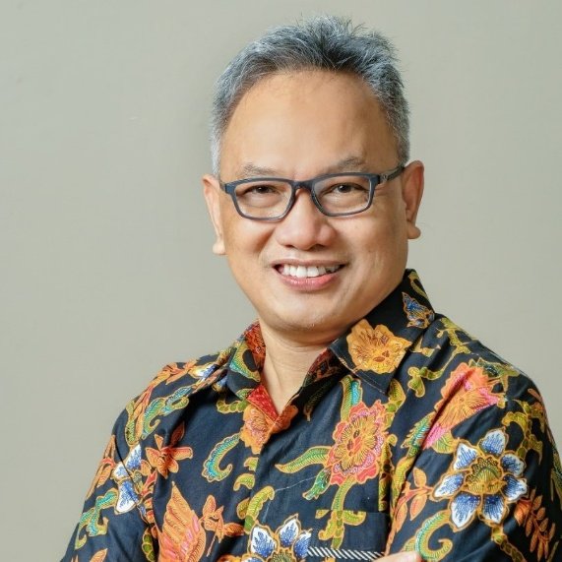
Patrons
Mrs Karla Völlm, Honorary Counsul of the University of Münster and recipient of the Federal Cross of Merit
Professor Ismunandar PhD Chem., former Ambassador of the Republic Indonesia, UNESCO Paris, Member of Indonesian Academy of Sciences, Senior Advisor in the Ministry of Culture, Republic Indonesia, Jakarta

Slide 5
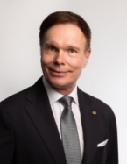
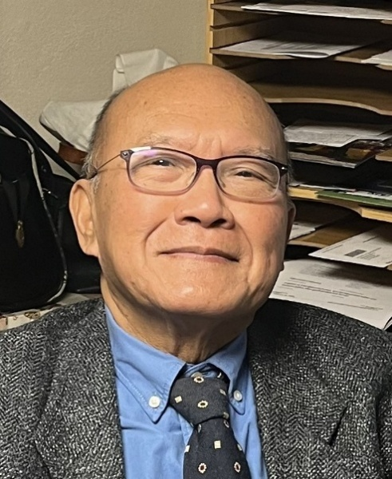
Board
President Docent Professor (PL) Matthias Prinz zu Schwarzburg MD PhD, ENT, Clemens-Hospital Münster
Co-President Professor Rasjid Soeparwata, MD PhD, former Thoracic and Cardiovascular Surgeon, University of Münster and University of Indonesia Jakarta, President of the Indonesian Section of the DIGM

Slide 6
Vice-Presidents
Professor Antoinette am Zehnhoff-Dinnesen, MD PhD, Past Director of the Department of Phoniatrics and Paediatric Audiology at Münster University Hospital (UKM) and Honorary President of the Union of European Phoniatricians
Professor Alexander Hemprich MD DDS PhD, Past Director of the Clinic for Maxillofacial and Plastic Surgery at Leipzig University Hospital, recipient of the Order of Merit of the Federal Republic of Germany and President of DEVIEMED (Interdisciplinary Help for Children in Vietnam)
Sabine Walter, MD, Regional Medical Officer for Southeast Asia at the German Embassy in Jakarta
Board Member Prof. Matthias Sigler, Director of Clinic for Pediatric and Adolescent Medicine – Pediatric Cardiology UKM Münster
Treasurer DMSc Michael Osada, Physicist, IT Specialist, Nottuln
Secretary Joke Tio MD, gynecologist, senologist, Head of Breast Centers at University Hospital and Clemens Hospital Münster
Office Manager Nicole Neptun, President of the Association for the Promotion of the Contemporary Way of Life, NRW e.V.

Slide 7
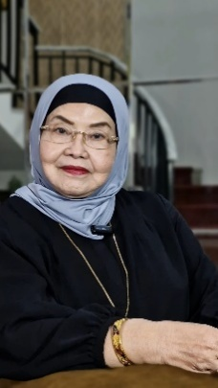
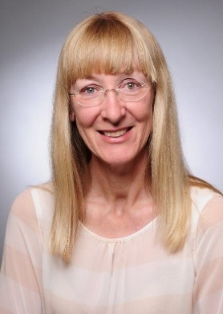
Indonesian Section: Patrons
Ina Lepel, Ambassador of Federal Republic of Germany in Jakarta
Dr Dr Siti Fadilah Supari, Sp. JP(K), former Health Minister in Indonesia, Jakarta

Slide 8
Executive Board Members:
President Professor Rasjid Soeparwata, MD PhD, Yogyakarta, Jakarta
Vice-Presidents
Professor Asmarinah, DMSc, Biomedical Science, Faculty of Medicine University of Indonesia, Jakarta
Dudy Arman Hanafy, MD PhD, MARS, Thoracic, Cardiac and Vascular Surgeon, National Cardiovascular Center Harapan, Jakarta
Treasurer Dr. Widyorini Lestari Hutami Hanafi, Sp.OG (K), Oncological Gynecologist, National Cancer Center, Jakarta
Secretaries dr. Ayla Putri Zahari, M.Biomed, Dr. med. dr. Nyityasmono Tri Nugroho, SpB.Subsp.BVE(K), dr. Radietya Alvarabie, M.Biomed
LEGAL ADVISOR: DR. Drs. Ishak Nawawi,SH,MH,MM,QIA,CFrA, assisted by Anang Kamal Should, S.H., M.Kn.

Slide 9
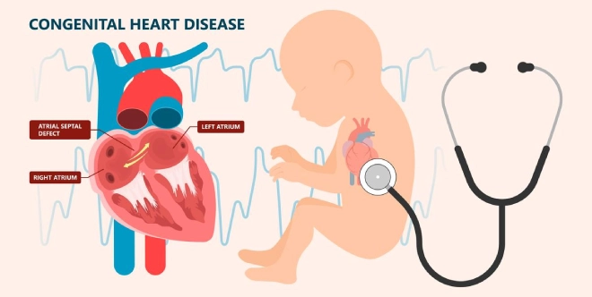
Webinars 2024/2025 with up to more than 800 participants
Webinar on Congenital Heart Failure 4th June 2024
Many thanks to Prof. Gerhard-Paul Diller, Director of EMAH Centre and Prof. Matthias Sigler, Director of Pediatric Cardiology, UKM

Slide 10

Webinars 2024/2025 with up to more than 800 participants
Webinar on Newborn Hearing Screening 25th June 2024
Webinar on Ototoxicity 14th July 2024
Webinar on Ototoxicity – Management and Update 4th November 2024
Webinar on the Essential Role and Value of Otoprotection 22nd June 2025
Many thanks to members of OWG, experts from Indonesia, Germany, Great Britain, Turkey, the USA and the Netherlands

Slide 11
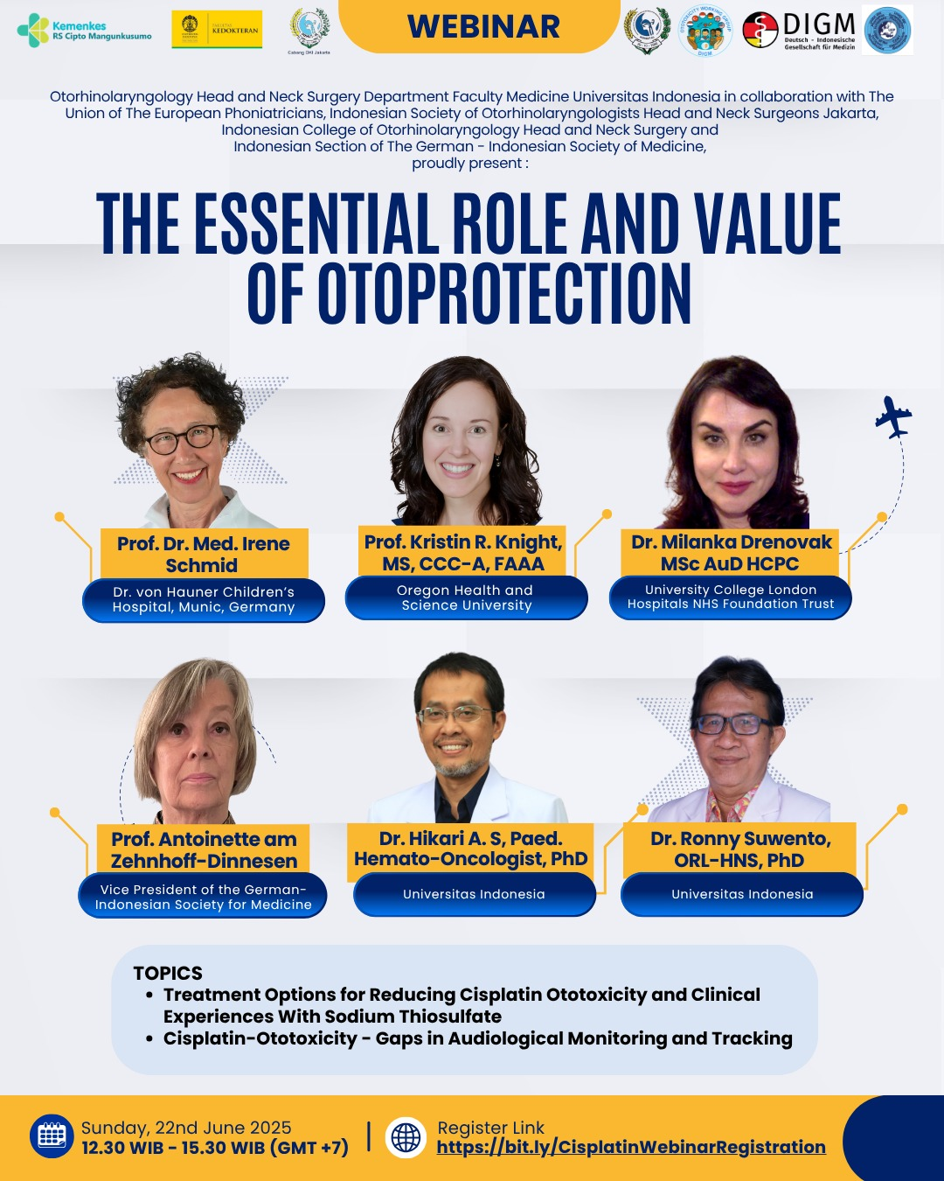

Slide 12
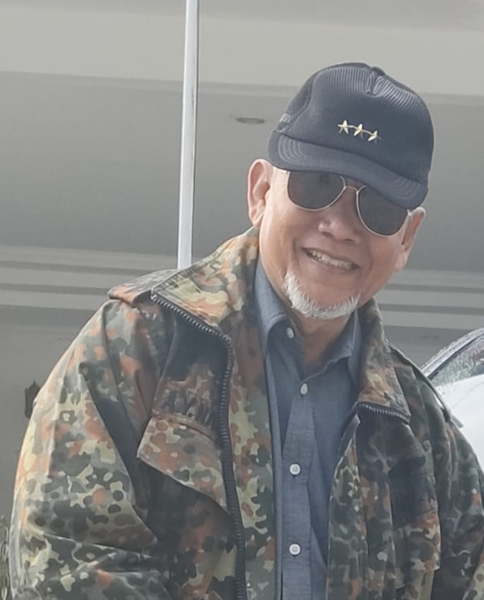
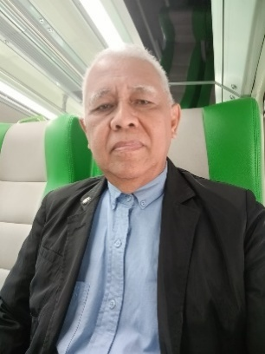
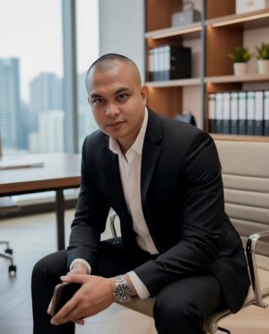
Room for Preventive Health Care in Jakarta
On initiative of Prof. Rasjid Soeparwata, the Ruang Kesehatan Tower C at apartment Mitra Oasis, Jakarta, was established, a dedicated space for hosting community health seminars. These seminars aim to educate the public with practical and reliable health information, empowering them to take charge of their well-being. Often, they are given by colleagues with a medical education in Germany, similar to that from Prof. Soeparwata.
With heartfelt gratitude, we extend our deepest thanks to the three esteemed Patrons of Ruang Kesehatan, Tower C, Mitra Oasis, Jakarta.
Lt Gen A. Y. Nasution
Dr. Drs. H. Ishak Nawawi, SH, MH, MM, QIA, CFr
Mr. Rifki Pangandaheng
S1 Economy Management

Slide 13
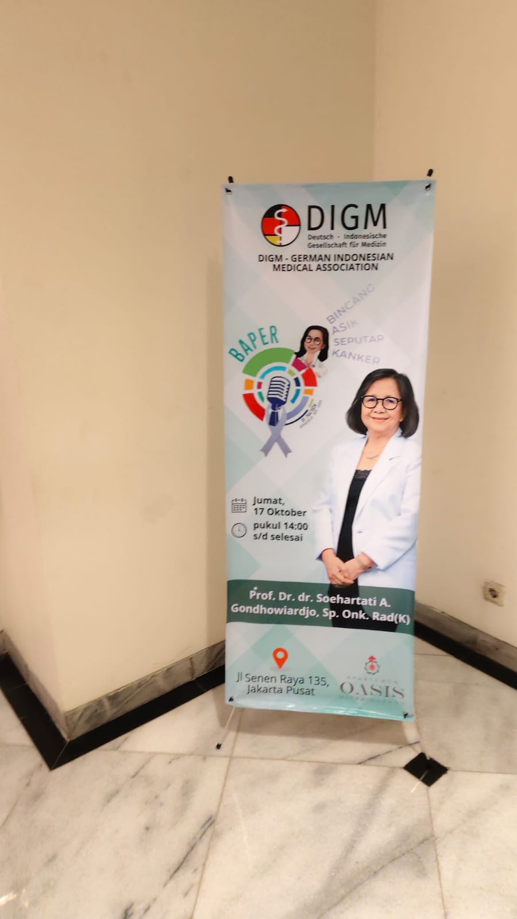

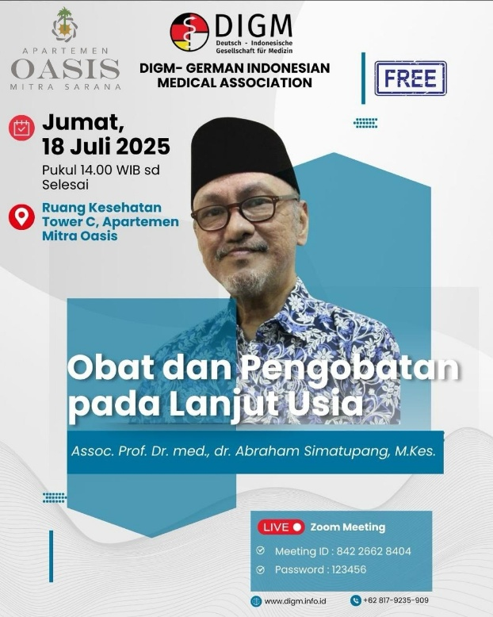
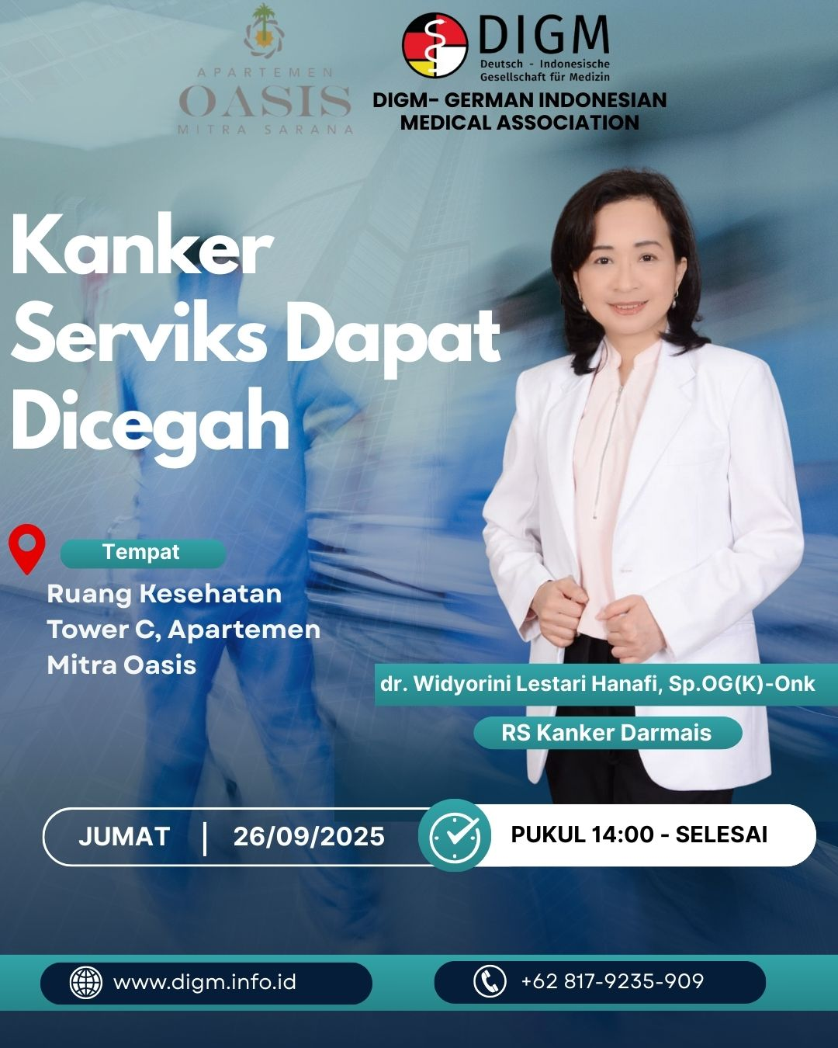
Assoc. Prof. Dr. Med. dr. Abraham Simatupang, M.Kes: Insights into safe and effective medication management for older adults
Dr. Widyorini Lestari Hanafi, SpOG(K): Cervical Cancer Prevention
Prof. Dr. dr. Soehartati A. Gondhowiardjo, Sp.Onk. Rad (K): Talking about Cancer
Dr. dr. Dudy Arman Hanafy, Sp.BTKV Subsp. JD(K), MARS, FIHA, FISA: Coronary Artery Disease

Slide 14
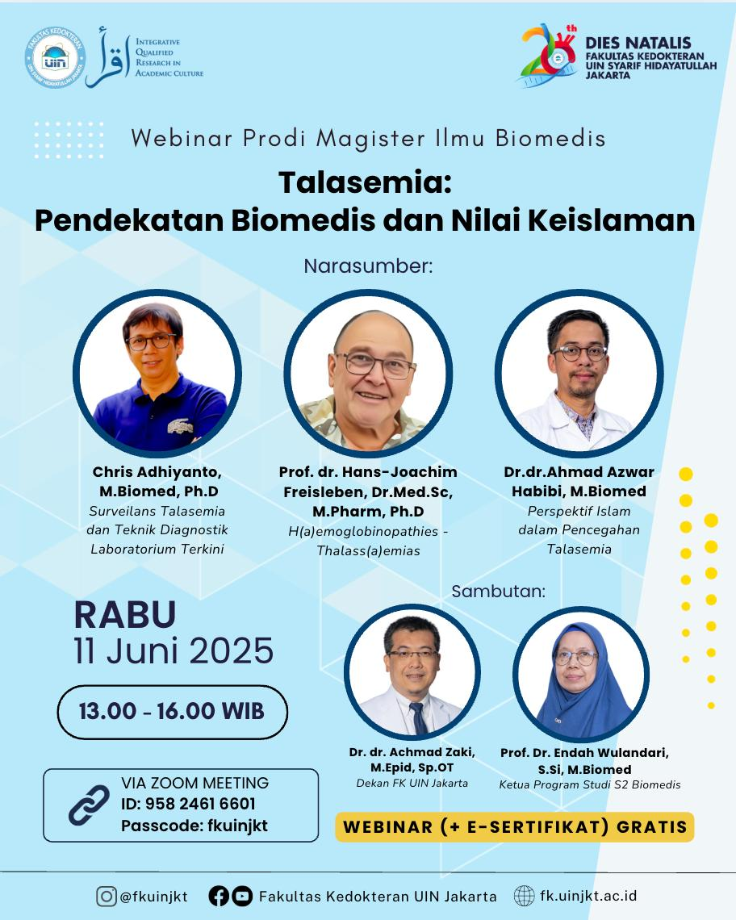
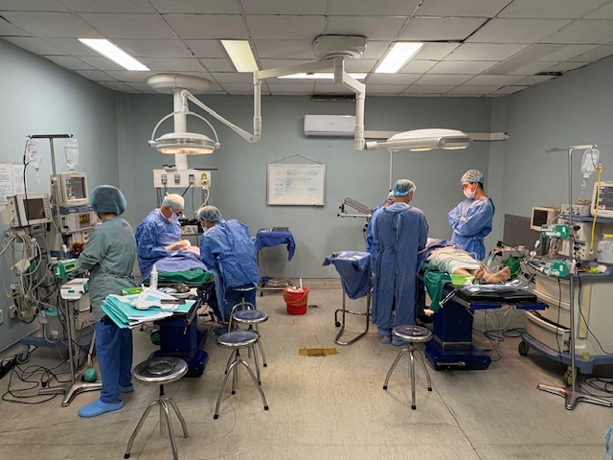
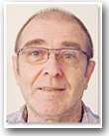
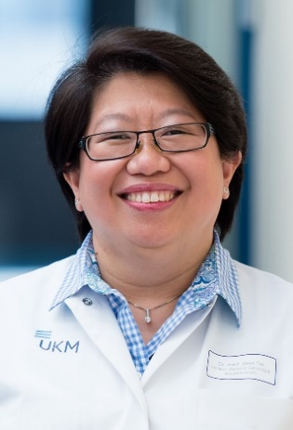
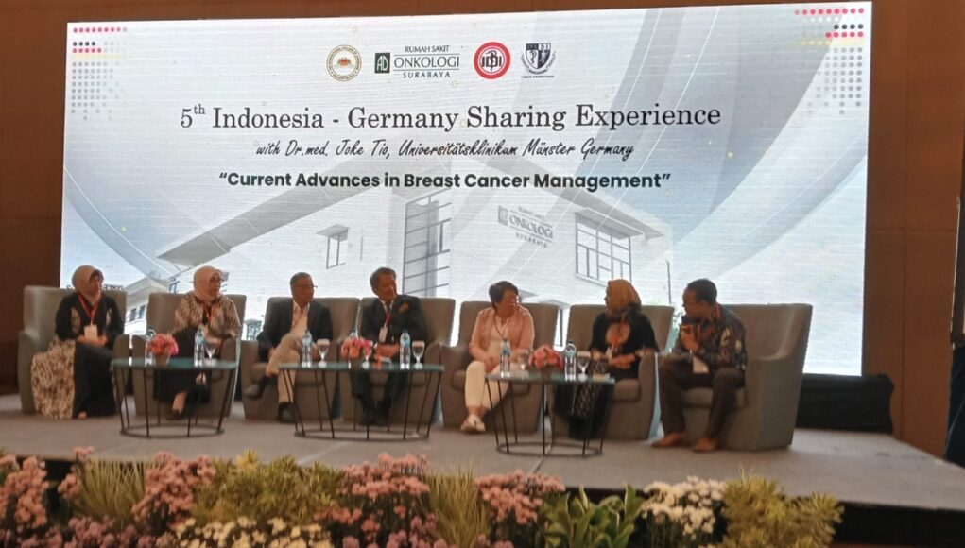
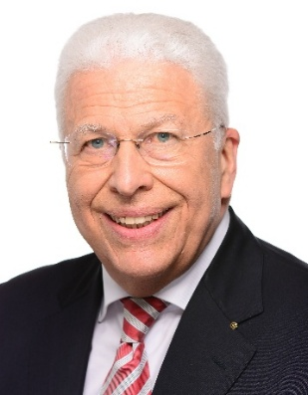
Current Projects
Studies to find iron-chelating agents from domestic sources, if possible, with concomitant antioxidant capacity as alternative or adjuvant therapeutics for iron loaded thalassemic patients by Professor Hans Joachim Freisleben DMSc
Within Indonesian German Sharing, build-up of a Breast Cancer Center in Surabaya, several advanced training courses concerning breast cancer, also for nurses and build-up of a so called second-opinion-clinic in Jakarta with international experts for virtual tumour conferences by Joke Tio MD
Surgery of Indonesian children with cleft palate by Professor Alexander Hemprich MD DDS PhD, in preparation

Slide 15
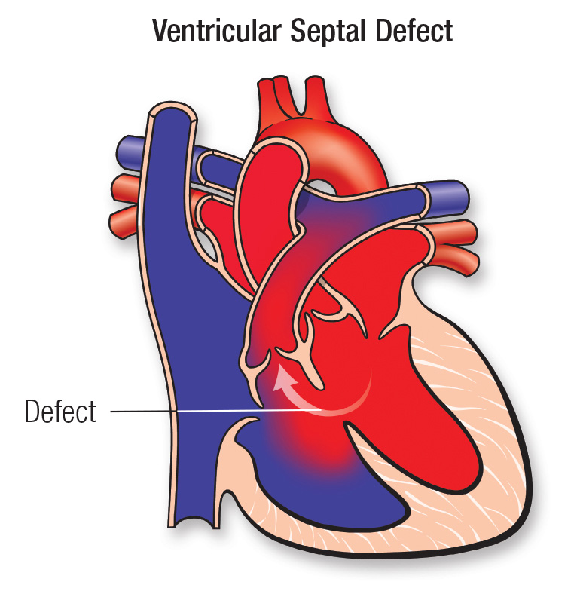
Indonesian Consortium for Biomedical Sciences (KIBI): Advancing Biomedical Education and Research Across Indonesia – Current Cooperation Plans with DIGM
DNA Methylation Profile in Children with Ventricular Septal Defect: A Study to Explore Epigenetic Link with Environmental Exposure in Indonesia (Food, Lead and BPA exposure)
Anisa Rahmadhany, Pediatric Cardiology Division, Department of Pediatrics, Dr. Cipto Mangunkusumo Hospital, University of Indonesia, Jakarta, Indonesia and Asmarinah, Department of Medical Biology, University of Indonesia, Jakarta, Indonesia in Cooperation with Prof. Diller, EMAH Centre and Prof. Sigler, Pediatric Cardiology UKM

Slide 16
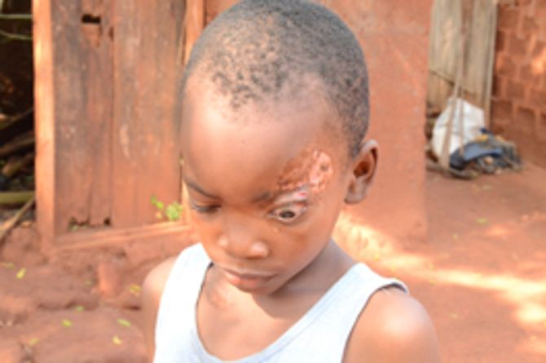
Assessing case detection delay and associated factors in paediatric leprosy in endemic areas in Indonesia Tristia Rinanda, Microbiology Department, Faculty of Medicine - Universitas Syiah Kuala in Cooperation with Prof. Bing Thio, Dermatology, Erasmus University Medical Centre, Rotterdam Further Leprosy Projects with Prof. Alexander Mischnik, National and WHO Supranational Reference Center for Mycobacteria in Borstel and Anil Fastenau, Global Health Advisor of the German Leprosy and Tuberculosis Relief Association DAHW, Würzburg
Elie does not cry. Child with Buruli Ulcer “little sister of lepra” dahw.de

Slide 17

Untuk kerjasama yang baik
Indonesian Consortium of Biomedical Sciences
Terima kasih atas perhatian Anda

