Slide 1

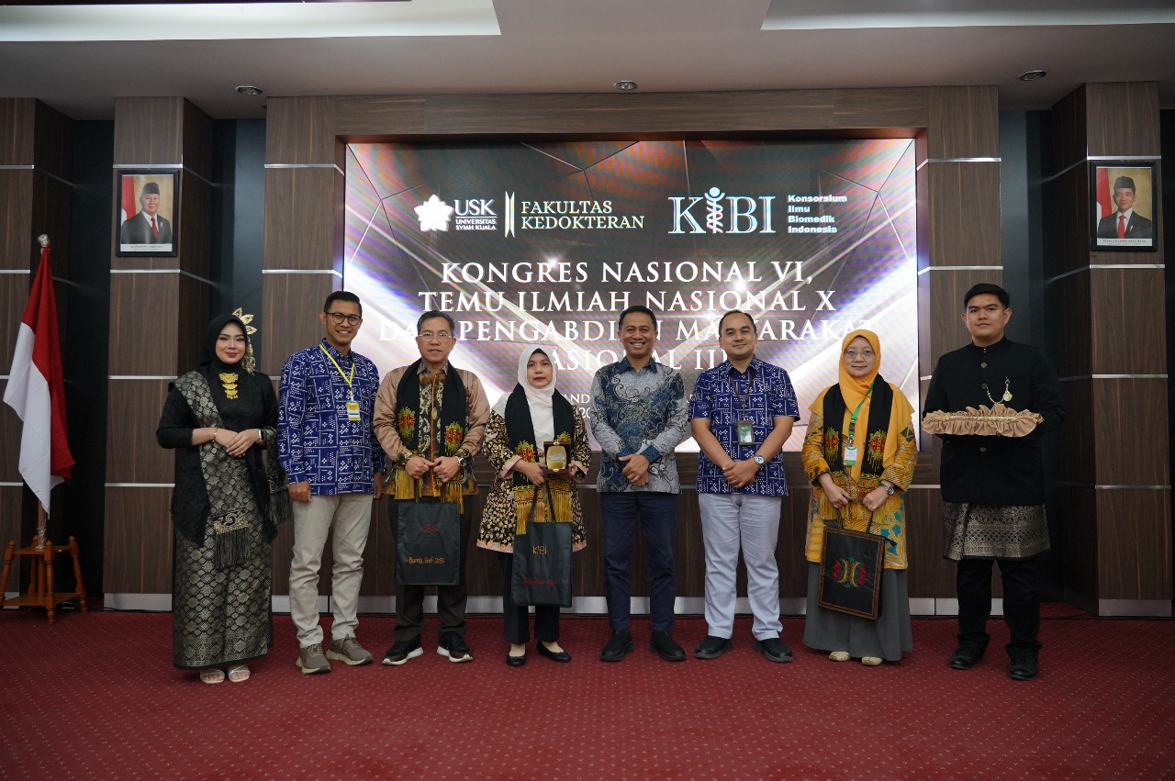
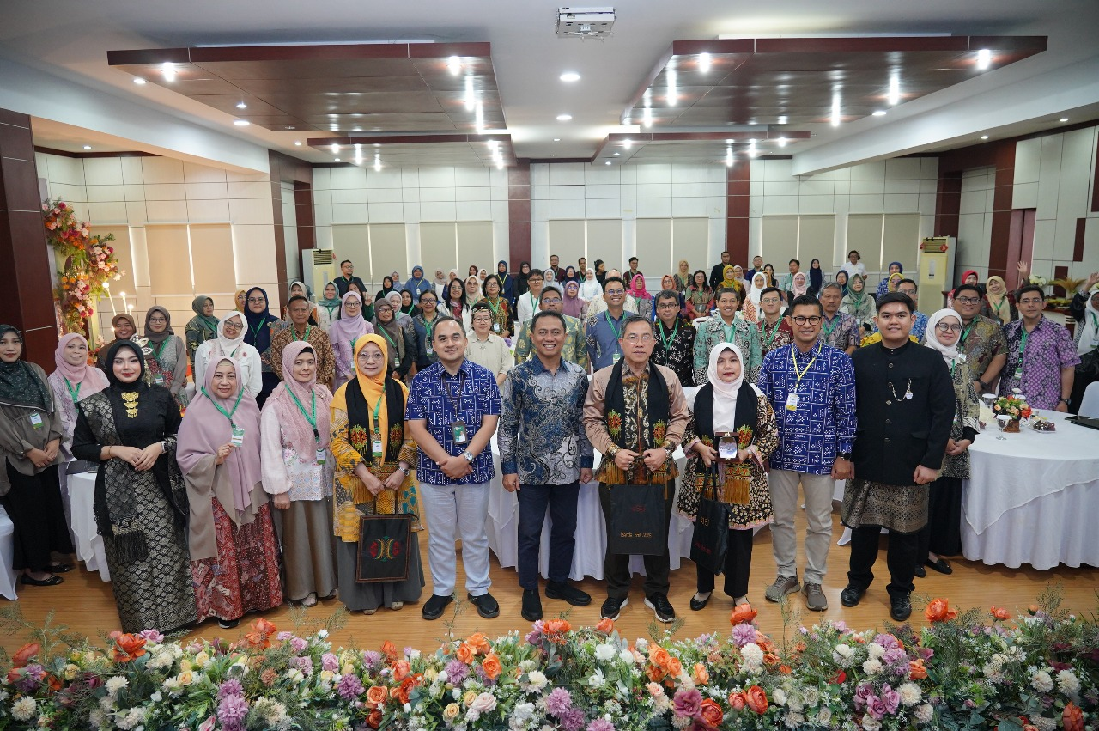

Indonesian Consortium of Biomedical Sciences
Konsorsium Ilmu Biomedik Indonesia
(KIBI)
https://biomedicalsciences.or.id

Slide 2

About KIBI
Founded on June 2015 at the Faculty of Medicine Universitas Brawijaya, Malang.
Declared at Faculty of Medicine Universitas Indonesia, Jakarta, on 26-27 August 2015
Becoming a non-profit legal entity August 2016.
An organizational platform for higher education in the field of biomedical sciences affiliated with a faculty of medicine in Indonesia.
MEMBERS
38 study programs from 26 universities in Indonesia
4
23
11
Bachelor
Masters
Doctoral

Slide 3





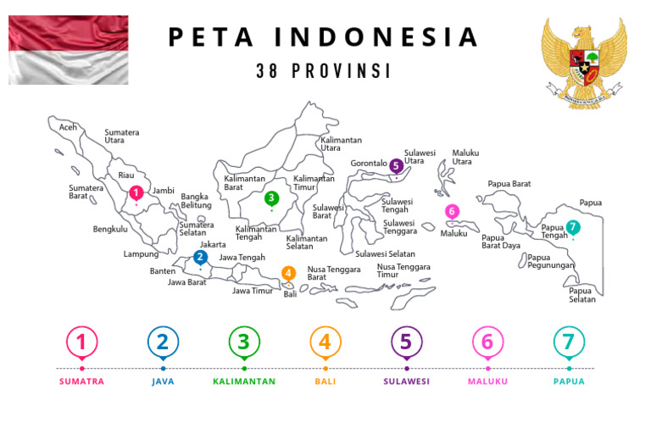



















INDONESIAN CONSORTIUM OF BIOMEDICAL SCIENCE
Affiliated Member’s distribution
38 Study Programs from
26 Universities

Slide 4
Members of Indonesian Consortium of Biomedical Sciences
No | University and City | Study program | No. of study program
1 | Universitas Indonesia, Jakarta | a. Master Program in Biomedical Sciences | 1
 |  | b. Doctoral Program in Biomedical Sciences | 2
2. | University of Brawijaya, Malang | a. Master Program in Biomedical Sciences | 3
 |  | b. Doctoral Program in Medical Sciences | 4
3. | University of Airlangga, Surabaya | a. Master Program in Basic Medical Sciences | 5
 |  | b. Doctoral Program in Medical Sciences | 6
4. | University of Gadjah Mada, Yogyakarta | a. Master Program in Biomedical Sciences | 7
5 | University of Andalas, Padang | a. Bachelor Program in Biomedical Sciences | 8
 |  | b. Master Program in Biomedical Sciences | 9
 |  | c. Doctoral Program in Biomedical Scienes | 10
6. | University of North Sumatra, Medan | a. Master Program in Biomedical Sciences | 11
 |  | b. Doctoral Program in Medical Sciences | 12
7. | University of Padjajaran, Bandung | a. Master Program in Basic Medical Sciences | 13
 |  | b. Doctoral Program in Medical Sciences | 14
8. | University of Jenderal Soedirman, Purwokerto | a. Master Program in Biomedical Sciences | 15
9. | University of Sriwijaya, Palembang | a. Master Program in Biomedical Sciences | 16
 |  | b. Doctoral Program in Medical Sciences | 17

Slide 5
Members of Indonesian Consortium of Biomedical Sciences
No | University and City | Study program | No. of study program
10. | University of Yarsi, Jakarta | a. Master Program in Biomedical Sciences | 18
 |  | b. Doctoral Program in Biomedical Sciences | 19
11. | University of Sultan Agung, Semarang | a. Master Program in Biomedical Sciences | 20
 |  | b. Doctoral Program in Biomedical Sciences | 21
12 | University of Diponegoro, Semarang | a. Master Program in Biomedical Sciences | 22
13. | University of Riau, Pekanbaru | a. Master Program in Biomedical Sciences | 23
14. | Catholical University of Atmajaya, Jakarta | b. Master Program in Biomedical Sciences | 24
15 | University of Muhammadiyah North Sumatra | a. Master Program in Biomedical Sciences | 25
16. | University of Pattimura, Ambon | a. Bachelor Program in Biomedical Sciences | 26
17. | University of Sebelas Maret, Solo | b. Doctoral Program in Medical Sciences | 27
18. | University of Syiah Kuala | a. Master Program in Biomedical Sciences | 28
19. | University of Hasanudin, Makasar | a. Master Program in Biomedical Sciences | 29
20. | University of Udayana, Bali | b. Master Program in Biomedical Sciences | 30
 |  | c. Doctoral Program in Medical Scienes | 31
21. | University of Islamic Bandung | a. Master Program in Biomedical Sciences | 32

Slide 6
Members of Indonesian Consortium of Biomedical Sciences
No | University and City | Study program | No.of study program
22 | University of Muhammadiyah Metro, Lampung | a. Bachelor Program in Biomedical Sciences | 33
23 | University of Methodist, Medan | a. Master Program in Biomedical Sciences | 34
24 | IPB University, Bogor | a. Bachelor Program in Biomedical Sciences | 35
25 | University of Veteran, Jakarta | a. Master Program in Biomedical Sciences | 36
26 | State Islamic University, Jakarta | a. Master Program in Biomedical Sciences | 37
 | University of Sebelas Maret, Solo (Univ No..17) | a. Master Program in Biomedical Sciences | 38

Slide 7
Vision & Mission
KIBI Vision
KIBI Mission
  Organizing education, research, and community empowerment activities among members and with non-members to strengthen the consortium's and all members' capacities.
  Organizing activities in collaboration with national and international partners.
  Formulating recommendation and policy advocacy in education and advancement of medicine to the government and other stakeholders.
Becoming a nationally and globally recognized biomedical sciences organization by contributing to the advancement of science and medicine through education, research, and community empowerment activities.

Slide 8





AIMS
Resource development and resource sharing
Determination of Graduate profiles
Standardization of Quality Assurance of Study program
Standardization Graduate learning outcome and basic competencies
Collaboration in research and Community services
Standardization Core curriculum

Slide 9


Indonesian Health Issues for Potential Collaboration
High prevalence of tuberculosis
High
prevalence of stunting
High prevalence of metabolic disease
Hypertension, stroke, diabetes
Strengthening the competitive edge of
Indonesian human resource
Contact us: konsbiomedindo@gmail.com

Slide 10



KIBI’s partner collaboration
Tsukuba University, Japan
Research training (10 students from KIBI member)
Advanced research development for lecturer
Akkon University for Human Sciences, Germany
Research collaboration plan in Leptosprosis
Western Sydney University, Australia
Student & staf exchanges, join supervision, research collaboration
MoU signing on May, 2025

Slide 11
KIBI’s partner collaboration
DIGM (German-Indonesia Society for Medicine)
MoU will be signed on October 13th, 2025
Research collaboration plan on Leprosy
Research collaboration plan on cardiovascular disease
Research collaboration plan on ototoxicology
Research collaboration in on Leptospyrosis
Join supervision
Staff and student mobility
Join webinar

Slide 12

THANK YOU

