Slide 1
What to expect at a Council Meeting

Slide 2
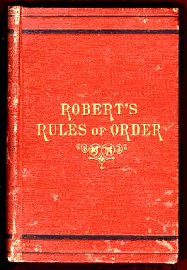
Most boards and commissions follow what is known as “Robert’s Rule of Order”

Slide 3
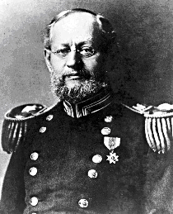
Wait…. Who the heck is Robert?
Written by Brigadier General Henry Robert, Chief Engineer of the Army in 1876
A set of rules for conduct at meetings.
It gives each member a chance to be heard and be part of making informed decisions in an effective, fair and efficient way.

Slide 4
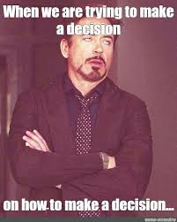
What decisions are made during a meeting?
Also called “Council Action”
Approval of minutes of previous meetings
Approval of annual budgets
Approval of any projects and financial spending
Approval of the five-year state plan
Approval of candidates for the Executive Committee and any other committees.

Slide 5
Let’s go through the motions….
To bring up new business or simply approve an item is to “make a motion” or “ I move to”
For Example: “I move to approve the 2026 Council Budget”
A basic motion by a single person requires a “second”-someone who supports the motion being discussed. One would say I “second”

Slide 6
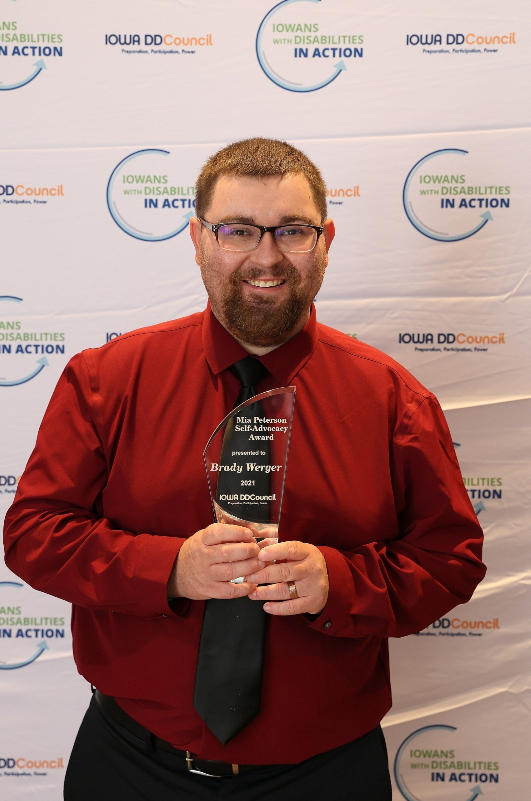

Going through the motions
The Council Chair then restates the motion
Chair opens discussion if the motion is debatable
Chair calls for a vote after discussion closes
A Majority of vote is needed –over half of the members
Chair announces the result

Slide 7
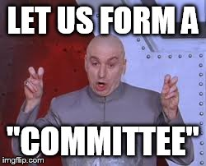
Still Going through the motions….
Sometimes motions are made by a committee Chair (Executive Committee, Nomination committee, legislative committee)
Example: “I move on behalf of the Executive Committee to approve the 2024 Council budget”
Committee motions already have the backing of more than one person and thus do not require a second
The “motion” may then be up for discussion and/or vote.

Slide 8
Going through the motions continued
If there is a motion that you want to make better you can “move to amend” the motion
Tell the Council what you want changed
A Second person must agree to your amendment
You may also want more time to study or investigate a proposal- you can “ move to postpone” or “move to table the motion”
A Second person must agree

Slide 9
Going through the motions….
You may have had enough discussion- you can “move the previous question” or “move to close the debate”
This cuts off discussion and brings the Council to a vote
Another person must “second” the motion to close the discussion.
If the discussion doesn’t pertain to the agenda item, you can “call for the orders of the day”

Slide 10
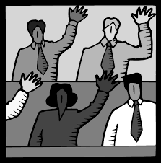
Going through more motions….
Remember any Council member can make a motion or talk during the discussion, but you must be “given the floor” by being called by the Council Chair

Slide 11
You may INTERRUPT a speaker for these reasons only:
To get information about business “point of information” or “request for information”
To get information about Council rules “point of parliamentary inquiry”
If you cannot hear, safety reasons, comfort, etc., “point of personal privilege”
If you see or hear a violation of rules or if we are off the agenda “orders of the day”

Slide 12
Robert’s Rules Fun
https://youtu.be/aSAN-_OKKNk
JEOPARDY

