Slide 1
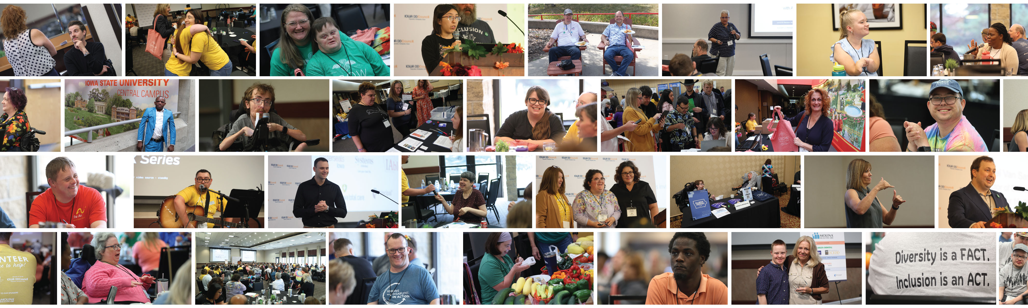

The Iowa Developmental Disabilities Council will work to create change with and for persons with developmental disabilities so they can live, and work, learn and play in the community of their choosing.

Slide 2

what does the council do
What does the Iowa DD Council do?
The Iowa DD Council receives money from the federal government – Administration on Community Living
With that money, we advocate for services and supports so that Iowans with disabilities can have a better life!
We also help people with disabilities be their own ADVOCATE!

Slide 3
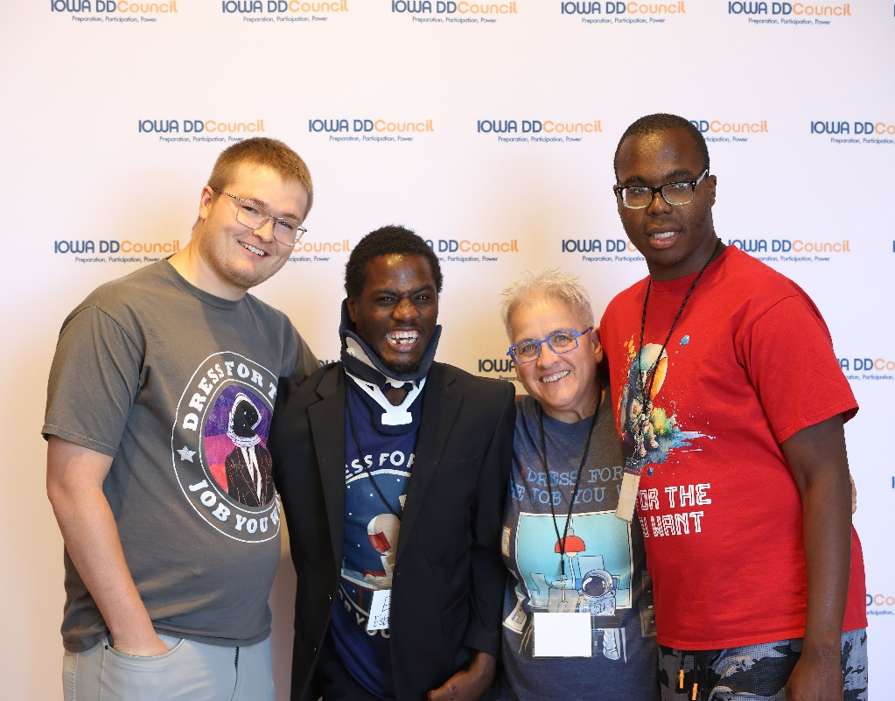
The Developmental disability assistance and bill of rights
The Developmental Disability (DD) Assistance and Bill of Rights Act
The DD Act of 2000 Public Law 106-402 established a set of programs to improve the lives of people with developmental disabilities through capacity building and systems change, advocacy and the enforcement and protection of civil rights
These programs are the state DD Councils, Disability Rights Centers (Disability Rights Iowa), and the University Centers for Excellence in Developmental Disabilities (Center for Disabilities and Development).
These are sometimes called the DD Network.

Slide 4
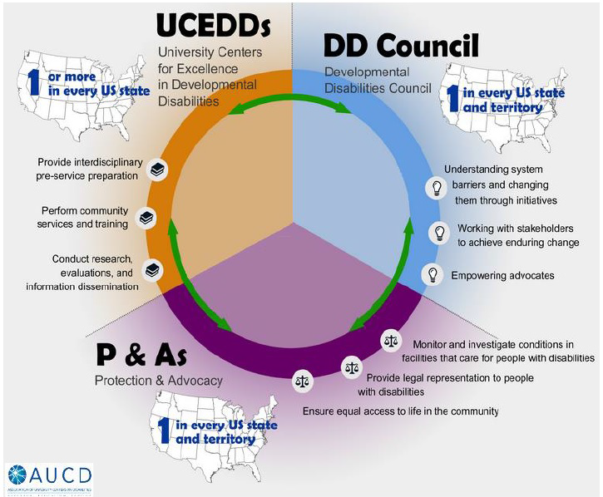
DD network

Slide 5
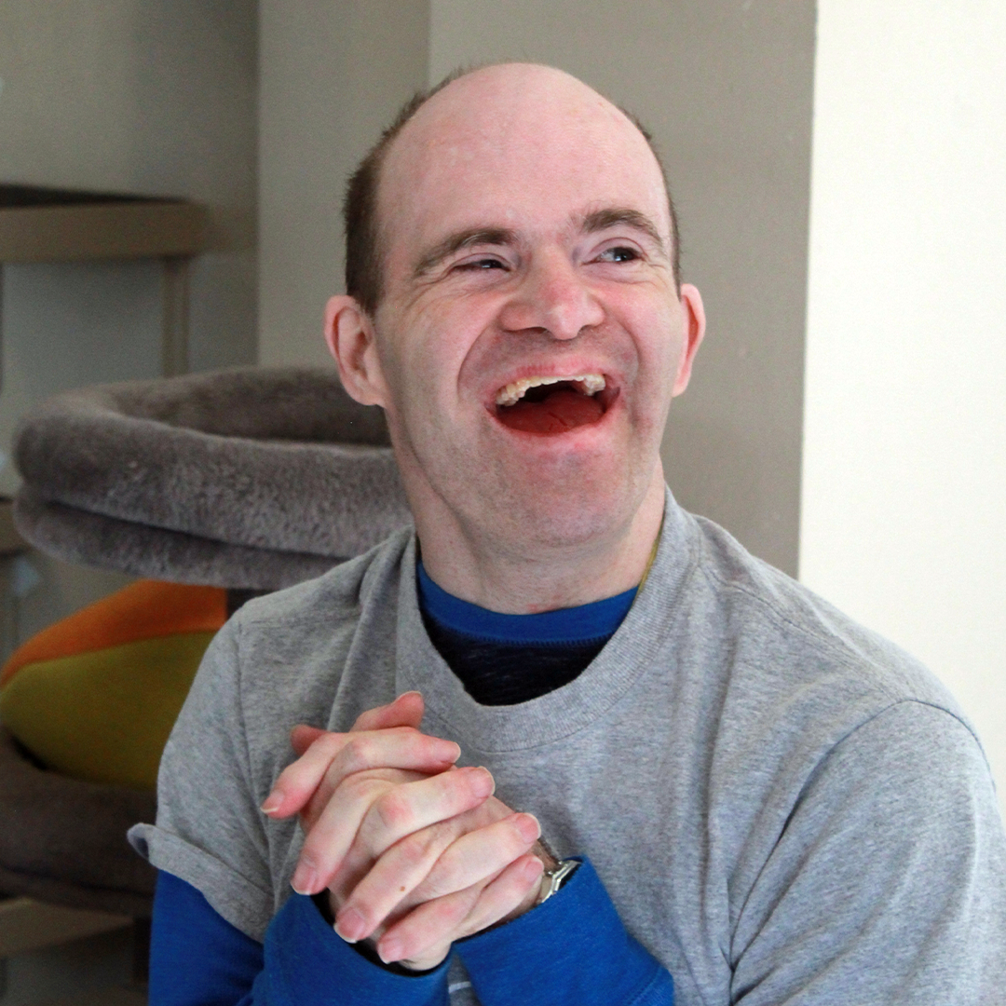
The DD assistance and bill of rights acts
The Developmental Disability (DD) Assistance and Bill of Rights Act
Congress finds that disability is a natural part of the human experience that does not diminish the right of individuals with disabilities to:
  Live independently
  Have control and choice over their own lives
  Fully participate in and contribute to their communities

Slide 6
We want people with disabilities to
We want people with disabilities to:
  have a say in their supports,
  have access to needed community services,
  have services that promote self-determination independence, and inclusion in all parts of community life.
We achieve this through engaging in advocacy, capacity building and system change activities

Slide 7
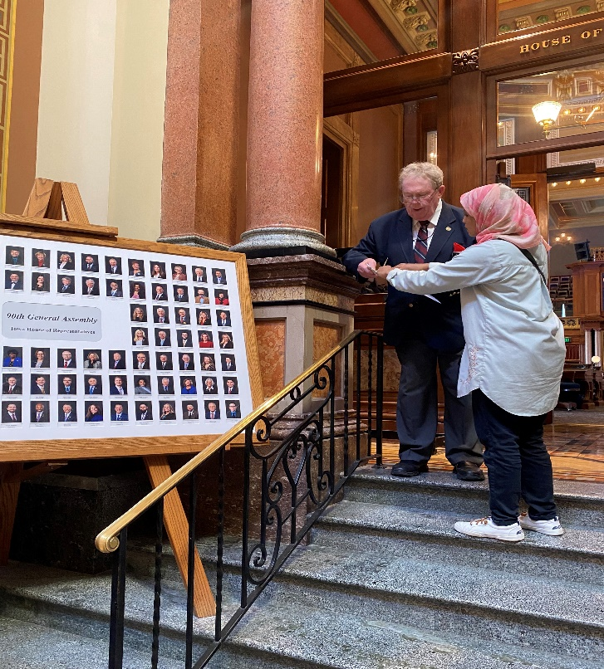
Advocacy
Advocacy
“advocacy” is acting, speaking or writing to promote, protect and defend the rights of people with disabilities and their families
An example- talking to law makers about waiting lists for services

Slide 8

Systems change
Systems Change Activities
“systems change activities” means a positive change in the services and supports for people with disabilities and their families
An example: Making it easier for people to receive waiver services.

Slide 9
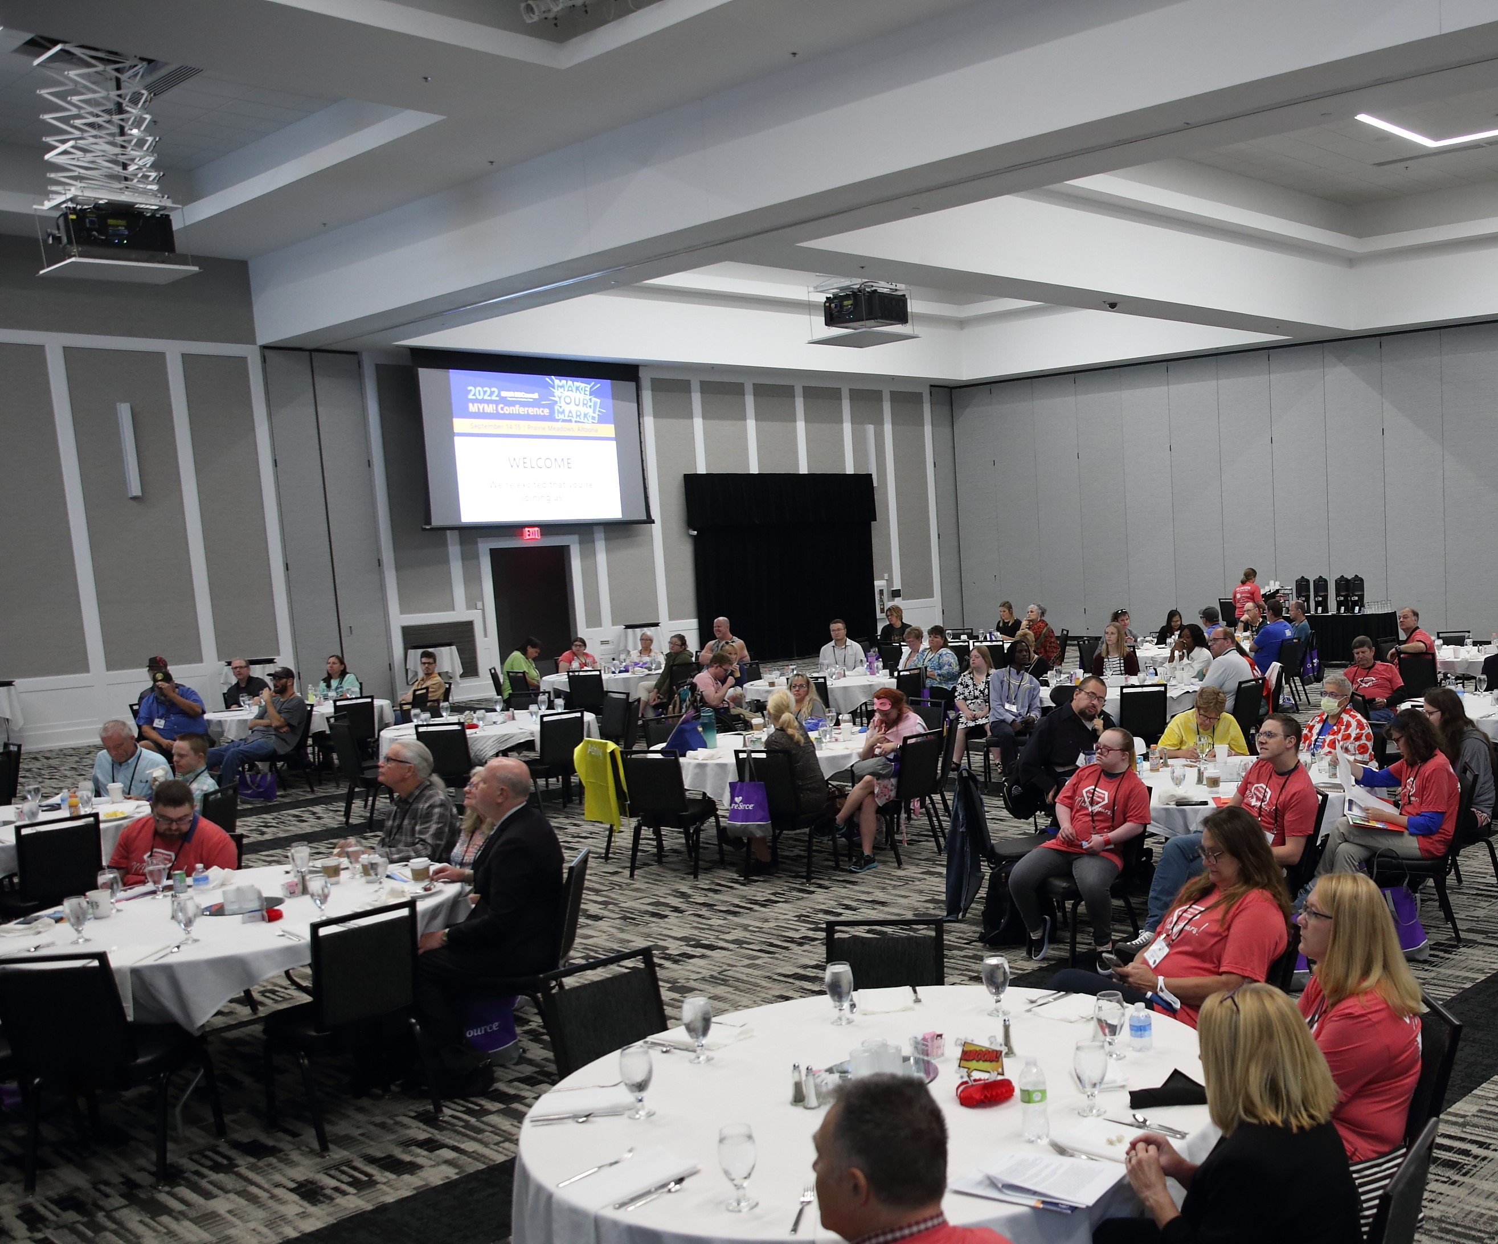
Capacity building
Capacity Building
“capacity building activities” means activities that expand and/or improve the ability of individuals with disabilities to live independent and inclusive lives in the community
An example: Providers trained to support people with disabilities to get employment in the community

Slide 10
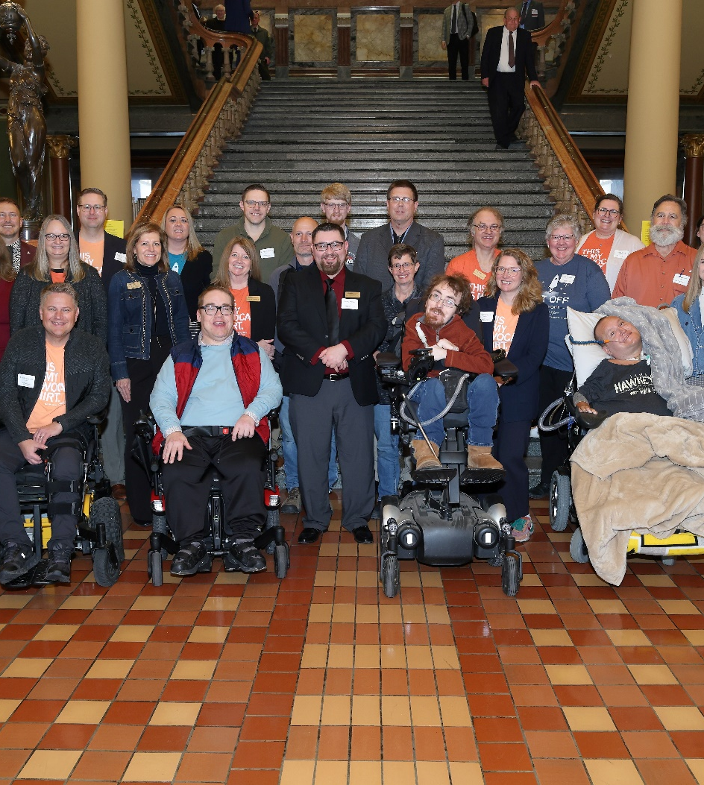
Who are we?
The Iowa DD Council is a group of volunteers dedicated to creating change.
24 members appointed by the governor
60% people with disabilities or family members
People who work for the state government
  Disability Rights Iowa, Center for Disabilities and Development, Dept. Education, Health and Human Services Aging Bureau, Child Health Specialists Clinics, Vocational Rehabilitation, Medicaid County/local reps, Providers

Slide 11
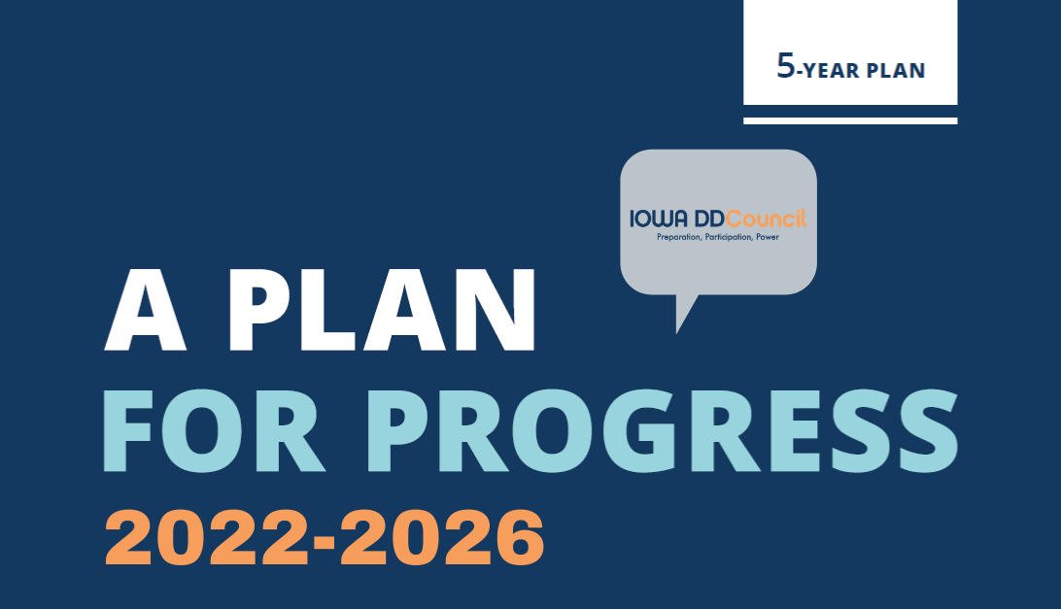
State plan
State Plan
ADVOCACY GOAL: Develop Strong Advocates & Leaders Who Create the Change They Want to See
SYSTEMS CHANGE GOAL: Improve Policy & Practice That Positively Impacts People With Disabilities
CAPACITY BUILDING GOAL: Strengthen Communities to Support People With Disabilities

Slide 12
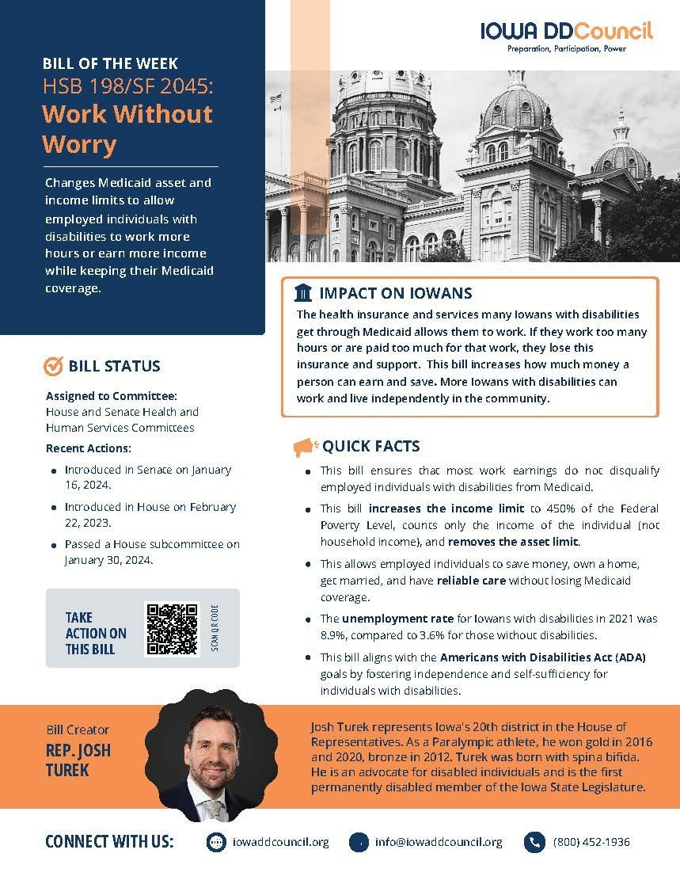

Keeping advocates informed
Keeping Advocates Informed!
Resources for civic and political participation for people with disabilities and their family members

Slide 13

Public policy agenda

Slide 14
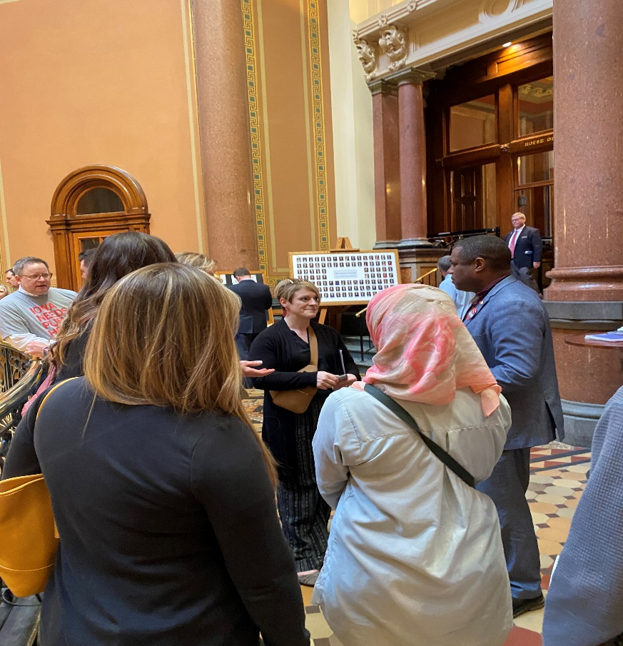
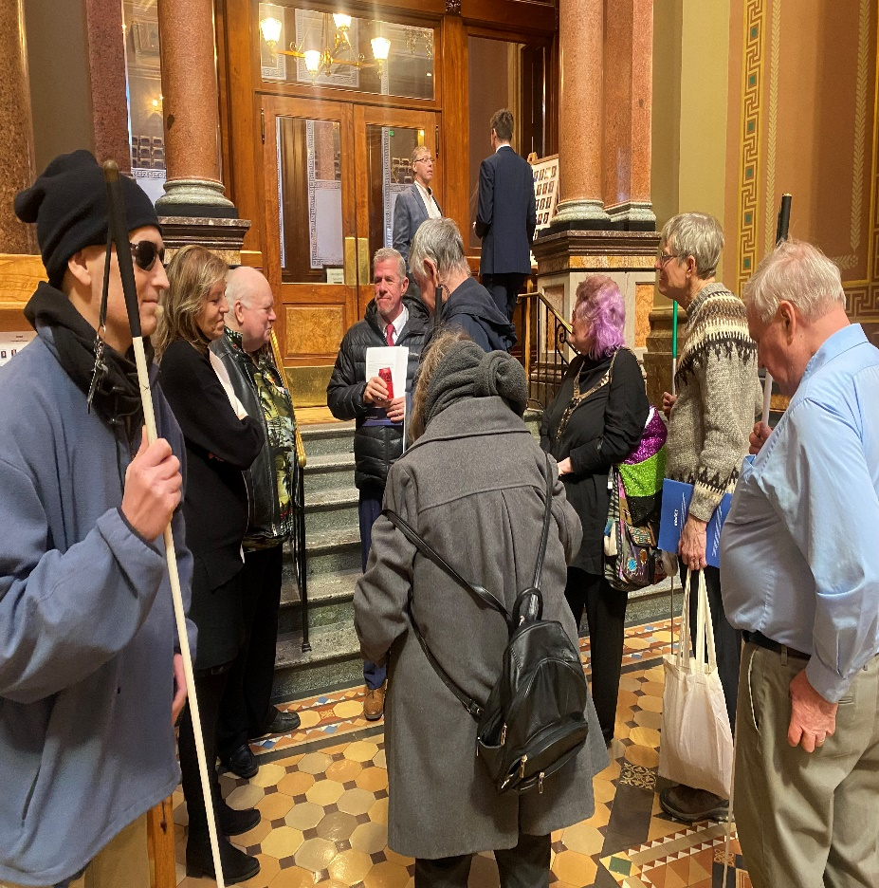
Advocacy at the capitol
ADVOCACY AT THE CAPITOL
Putting Self-Advocacy into Practice

Slide 15
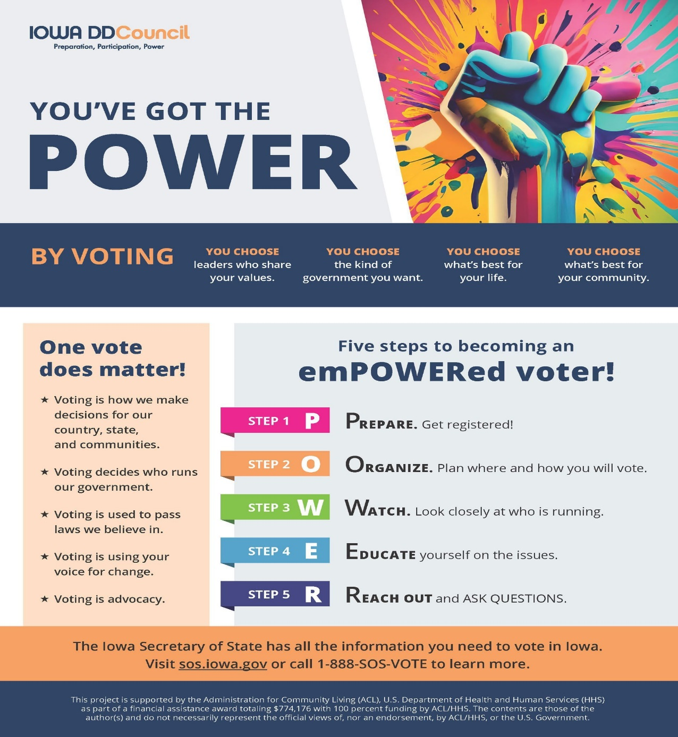
voting

Slide 16
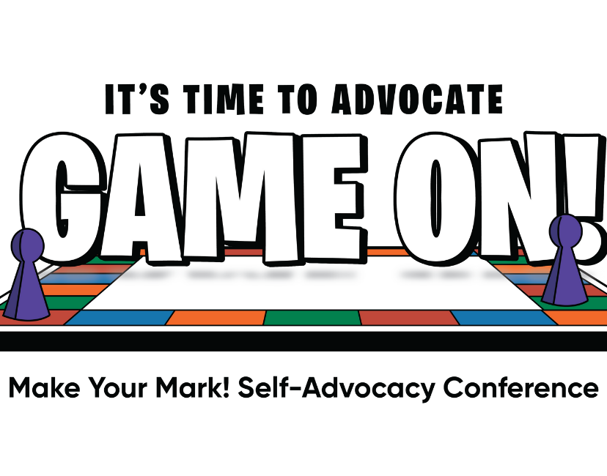

MYM

Slide 17

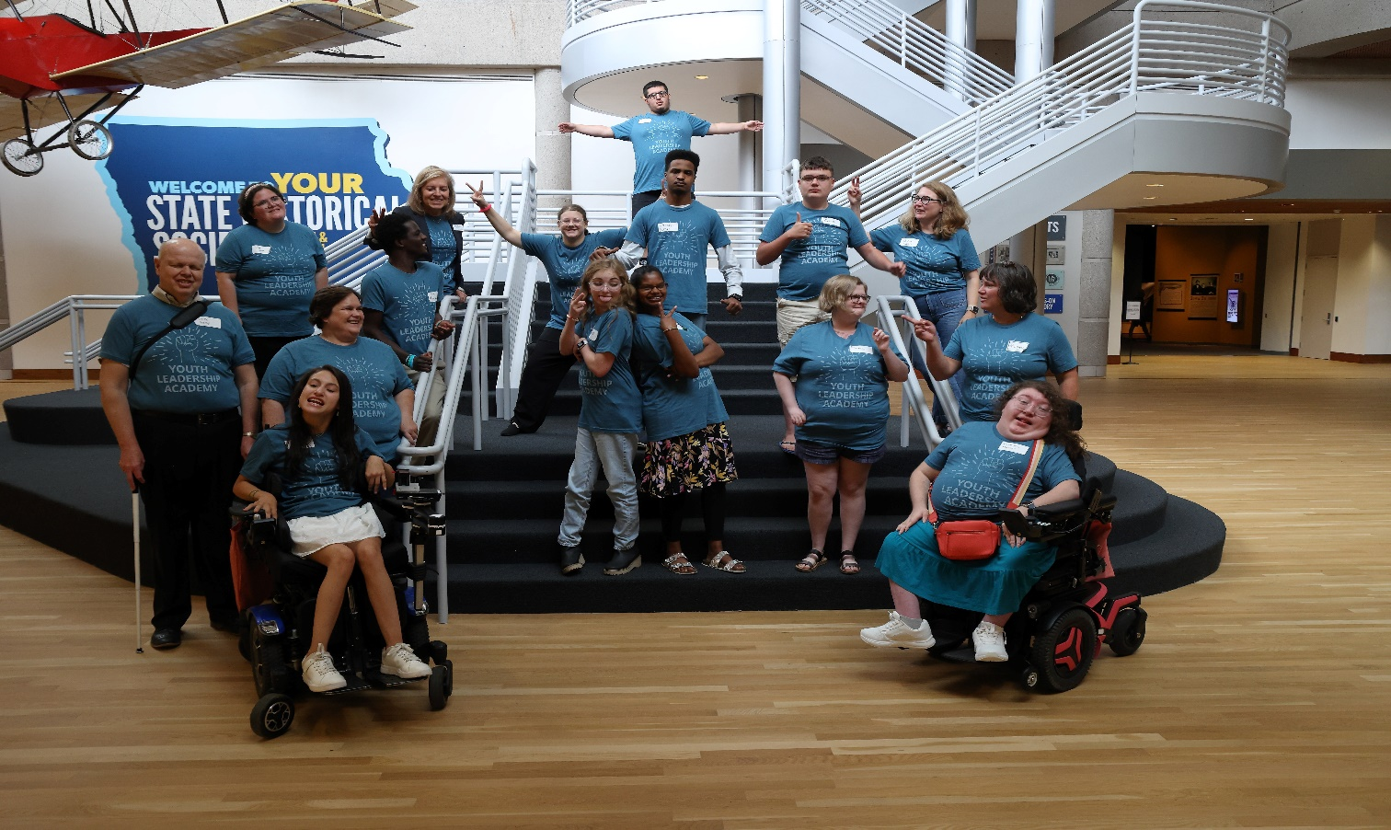
YLA

Slide 18
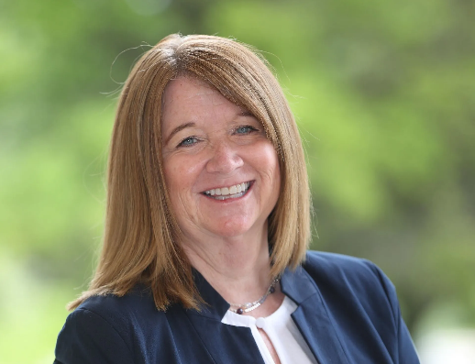
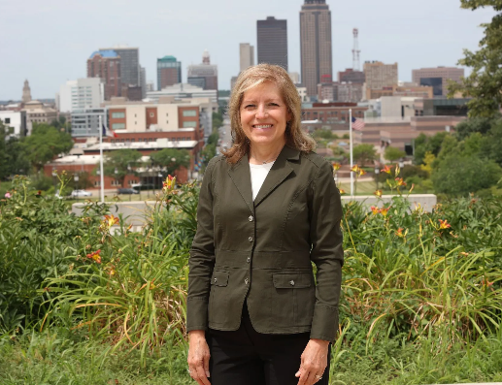
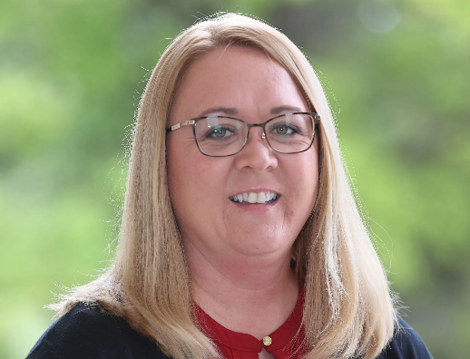
Council staff
Council Staff
Brooke Lovelace
Carlyn Crowe
Lindsay Hommer
Executive Director
Public Policy Manager
Administrative Assistant

