Slide 1

Public Policy Update 09.11.25
Public Policy Committee 2025-2026
Wendy Andersen, Chair
Caitlin Owens, Vice-Chair
Kevin Harris, Past Chair
Dakota Caldwell
Casey Wilkinson
George Thompson, ex-officio
Council members are invited to attend all meetings

Slide 2

Public Policy Update
Public Policy Priorities
The Public Policy Committee recommends:
Adopting the 2025 priorities for 2026
Adding two issues for 2026 for study, education and possible policy recommendations (slide 10)
Starting a two-year cycle of developing priorities (reflects the two-year cycle of the Iowa General Assembly) next year
Producing one-pagers to focus on higher priority bills or issues
Continuing development of stories of lived experience

Slide 3
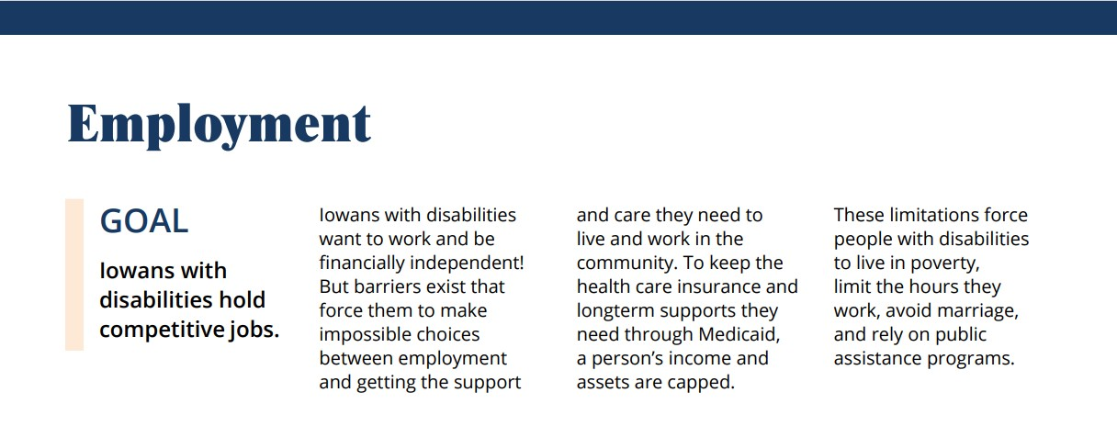

Public Policy Priorities 2026

Slide 4
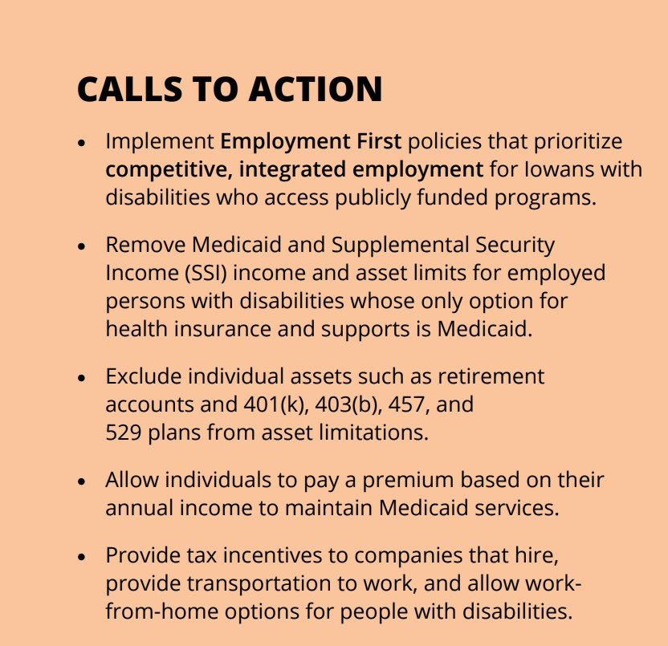
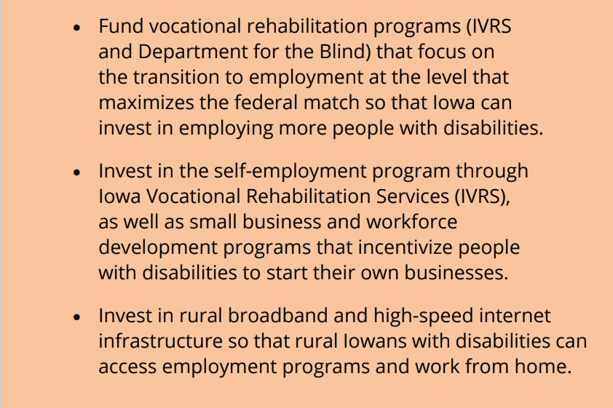

Slide 5
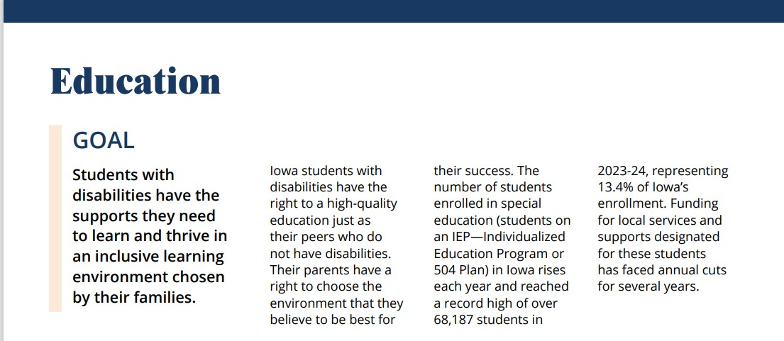

Public Policy Priorities 2026

Slide 6
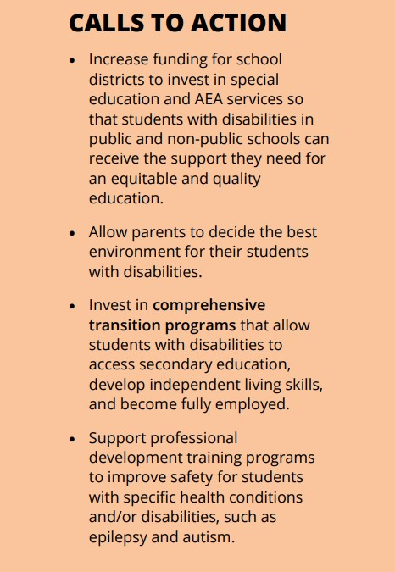
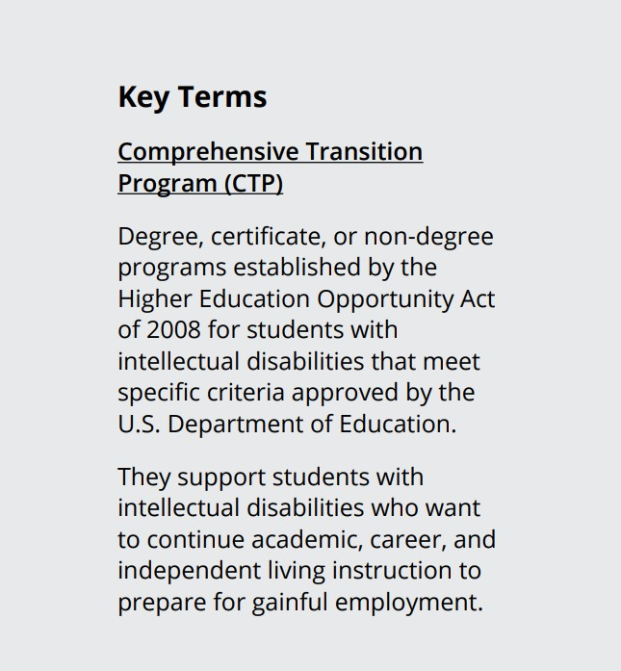

Slide 7
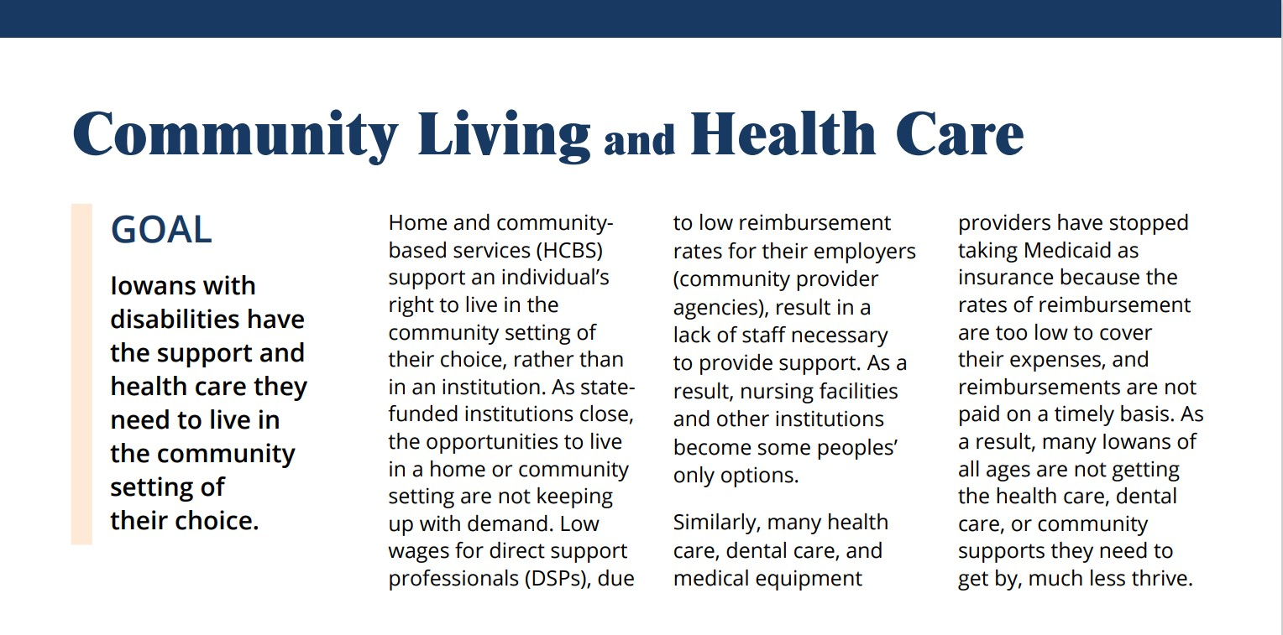

Public Policy Priorities 2026

Slide 8
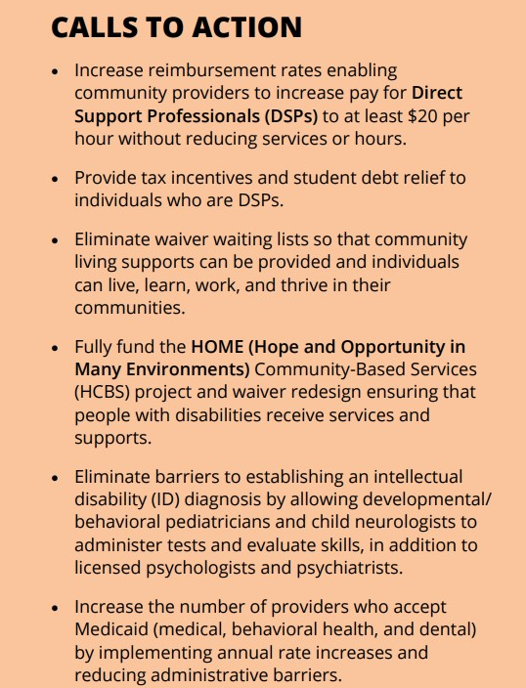
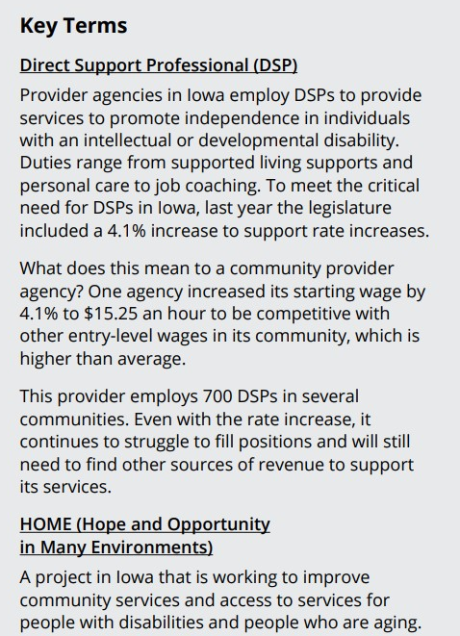

Slide 9
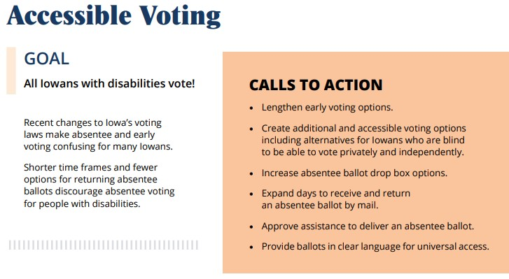
Public Policy Priorities 2026

Slide 10
Public Policy Update
The Public Policy Committee recommends:
Adding two issues for 2026 for study, education and possible policy recommendations
    Requirement for a Medicaid member or insured private insurance enrollee with pervasive developmental disorder and/or autism to receive a rediagnosis to maintain waiver eligibility or coverage for specific treatments
    Abuse and neglect of persons with disabilities in public and private long-term care facilities.

Slide 11
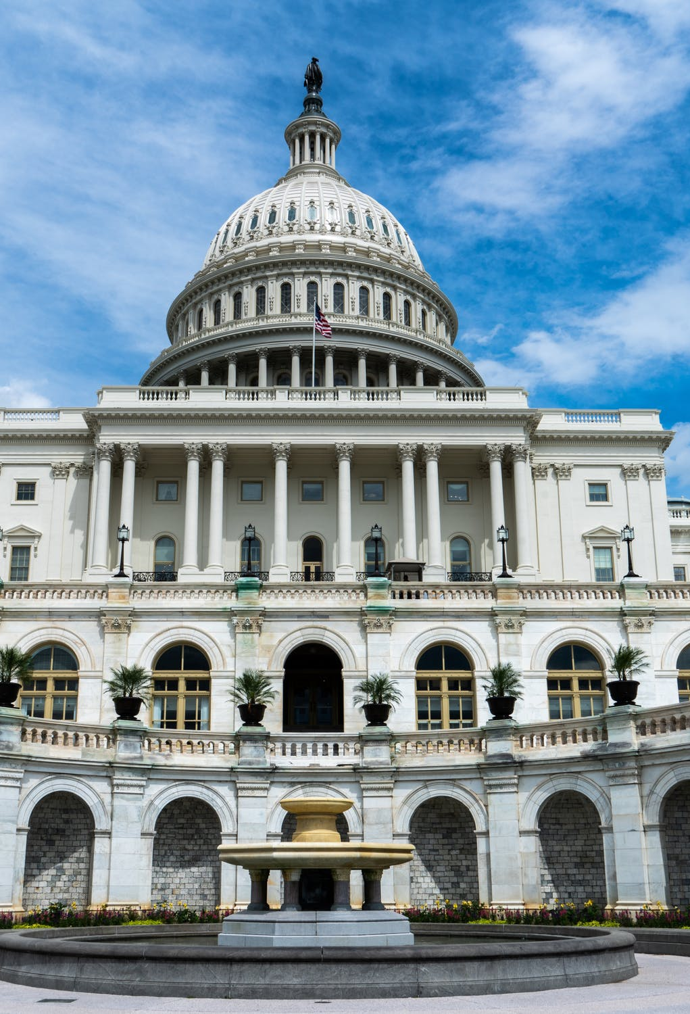
Public Policy Update
Federal Policy
REMINDER this year there are TWO separate major budget bills in play
1. Budget RECONCILIATION
Passed in July
2. Budget APPROPRIATIONS
Must pass by Sept. 30 or pass
continuing resolution to
avoid government shutdown

Slide 12
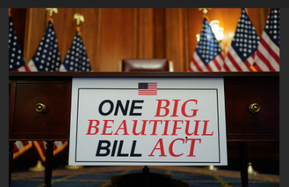
Public Policy Update
Federal Policy
Budget Reconciliation -
OBBB Act passed
How will its
implementation
affect Iowa?

Slide 13
Public Policy Update
Federal Reconciliation and Iowa: Medicaid*
Eligibility
More strict on residency and eligibility review– every 6 months
Work requirements
Iowa will adopt federal rules
Affects non-disabled, low-income
adults 19-64, without dependents
under 13 on Iowa Health and Wellness
Cap on Federal Funding Growth
Limits how much Medicaid funding can grow, even if costs rise
States have to cover more of the costs or reduce services
Projection: 10-12 million Americans will lose Medicaid coverage over 10 years
Source: Iowa HHS

Slide 14
Public Policy Update
Federal Reconciliation and Iowa: SNAP and Medicaid*
SNAP - Error Rate Penalities
States funding will be taken away if there are
errors in who receives SNAP benefits
Current Iowa error rate is 5.9%
States must be below 6%
Medicaid payment Error Rate – measures 3 payment areas
Fee for Service – Direct payments made to doctors, hospitals and other providers
Managed Care Payments – Monthly capitation payments paid to the MCO
Eligibility – Whether the person was truly qualified
If Iowa had a 5% error rate for Medicaid payments and eligibility the financial penalty would be $102 million
Source: Iowa HHS

Slide 15
Public Policy Update
Federal Policy
Budget APPROPRIATIONS
Must pass by Sept. 30 or pass
continuing resolution to
avoid government shutdown
House and Senate Appropriations Committees each have 12 subcommittees, responsible for one regular appropriations budget.
Subcommittee on Labor, Health and Human Services, Education, and Related Agencies

Slide 16

Public Policy Update
Federal Policy: What to Watch→Act
Executive Orders* and Proposals of the
Trump Administration
Cuts to SSI Benefits for the Disabled/Elderly
Eliminating mailed/paper ballots and some
voting machines
Withdrew new minimum staffing standards for Long-Term Care Facilities/Nursing Homes
No guarantee for minimum wage and overtime for caregivers who provide in-home care
Withdrew rule proposal that would not allow people with disabilities to be paid less than minimum wage
Department of Ed to stop collecting certain data from states about students with disabilities
Recommendations on the cause of and cure for Autism
Scrutiny of not-for-profit organizations and lobbying
*Currently 100 under review

Slide 17
Public Policy Update
Federal Policy: What to Watch→Act
Just today….
The U.S. Department of Education is canceling millions of dollars in grants for special education teacher training, parent resource centers and more saying that they don’t align with Trump administration priorities.

Slide 18

Public Policy Update
State Policy: What to Watch→Act
HCBS Waiver Amendments/HOME
Implementation
  Comment period ends Sept. 19
Community Choices Option (CCO) change from unit-based to daily rate for SCL for ID and BI waivers
Work Requirements – Iowa to follow new federal rules (OBBB) to implement Dec. 2026
Iowa Medicaid budget is forecast to have a deficit of $76 million for 2026 and $181 million for 2027

Slide 19

Public Policy Update
What to do →Act

Slide 20
Public Policy Update
Upcoming Events
Fall Listening sessions and listening posts (town halls)
Fall Public Policy Committee - strategize for Legislative Session
Sept. 18-19 Make Your Mark Conference, Des Moines
Sept. 26 Capitol Chat – Panel on “Bills: Moving from idea to law”
October National Disability Employment Awareness Month
Oct. 31 Capitol Chat – Employment Focus
Nov. 13 DD Council Meeting
Dec. 5 Capitol Chat – Getting ready for Session!
January 7 Legislative open house - 12 noon virtual (tentative)
January 12 First day of Legislative Session
January 28 Legislative Reception at Iowa State Capitol 1-4 p.m.

