Slide 1
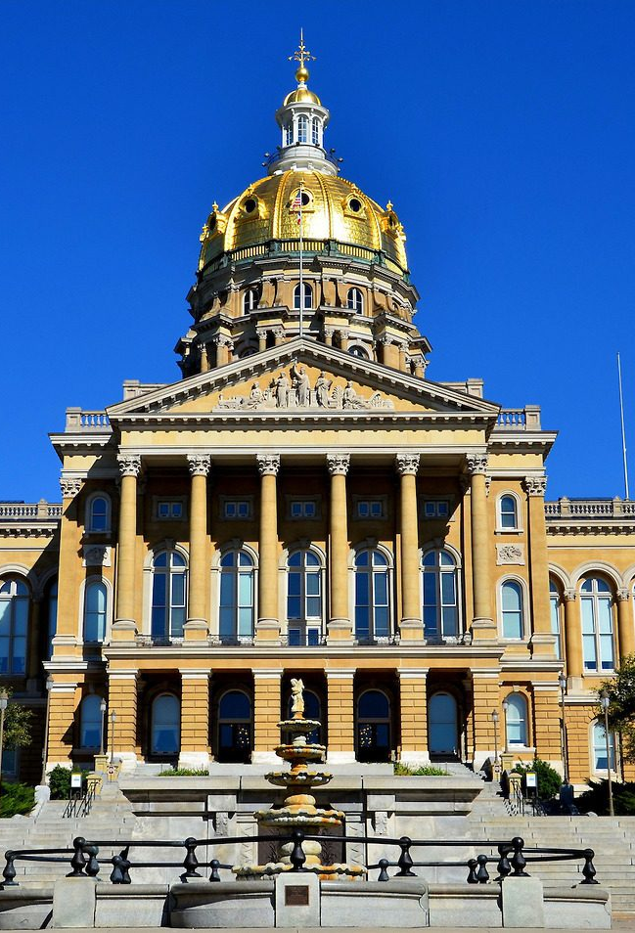

Public Policy Update July 10, 2025
Public Policy Committee
Duties:
With the public policy manager….
Propose an annual public policy agenda and activities corresponding to that agenda.
Assist with reviewing and tracking current and proposed legislation impacting persons with developmental disabilities.
May provide education to the Legislature, and policy makers, in regard to issues impacting people with developmental disabilities and their families.
Must be composed of at least 5 members including the chair. DD Council chair shall serve as ex-officio members and may vote in the event of a tie.

Slide 2
Public Policy Update July 10, 2025
Public Policy Committee
Committee member slate for 2025-2026
Wendy Andersen, Chair
Caitlin Owens, Vice-Chair
Kevin Harris
Dakota Caldwell
Casey Wilkinson
George Thompson, ex-officio

Slide 3
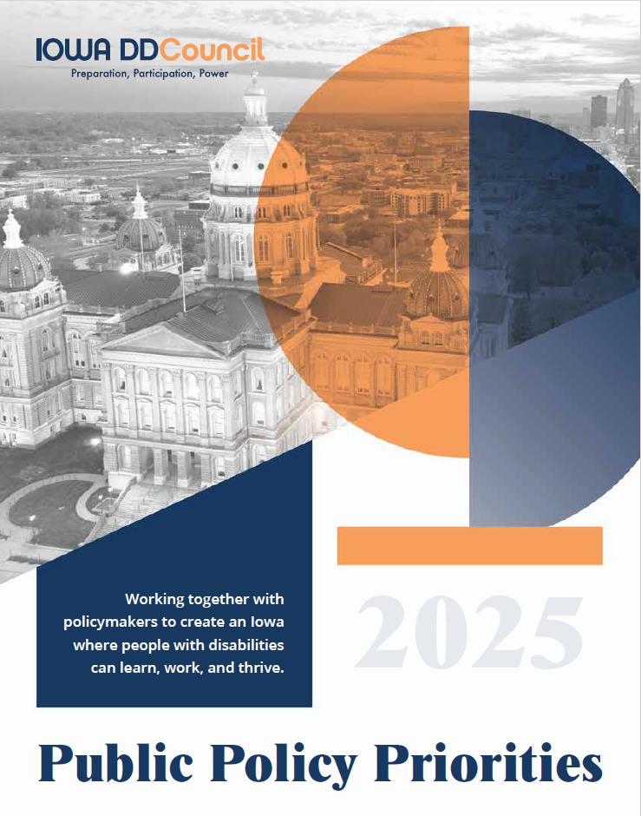
Public Policy Update
Summer /Fall focus is on
  Public Policy Priorities
  Employment Policy Brief
  Strategy work for 2026
  Youth Leadership Academy
  Federal Policy

Slide 4
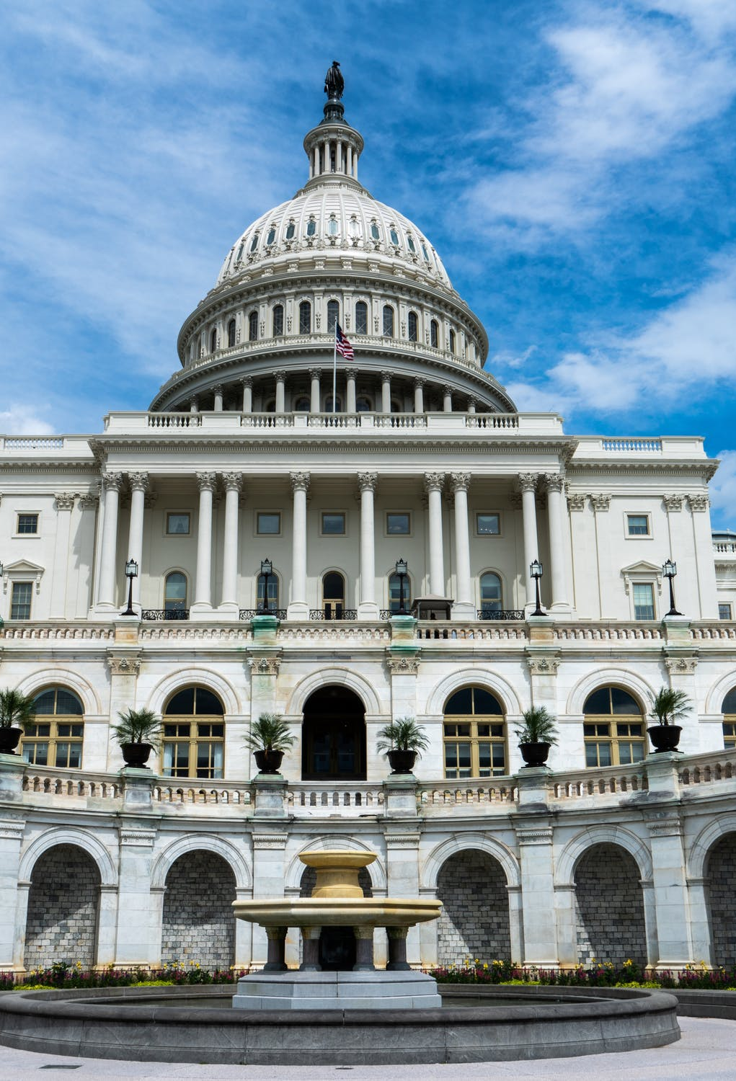
Public Policy Update
Federal Policy
Usually about 10% of our time, not this year!
NACDD works on behalf of DD Councils for appropriations advocacy (our funding in the federal budget)
But this year there are TWO separate budget issues in play
Budget RECONCILIATION
and
Budget APPROPRIATIONS

Slide 5
Public Policy Update
Federal Policy
Budget Reconciliation
Doesn't happen every year—special process and special rules
Only deals with changes to mandatory spending
Mandatory spending = Social Security, Medicare, Medicaid, and SNAP.
Required by laws already passed by Congress
Congress does not have direct control over this spending, but through budget reconciliation, it can make changes that try to balance the budget

Slide 6
Public Policy Update
Federal Policy
Budget Reconciliation
The budget reconciliation bill passed and was signed into law. It is now formally known as the
“One Big, Beautiful Bill Act”
Now that the reconciliation bill has passed, work moves to…
  Implementation of OBBB
  Budget Appropriations

Slide 7
Public Policy Update
Federal Policy
Budget Appropriations
Appropriations = discretionary funding
Congress has direct control over discretionary funding
Discretionary funding is a set of 12 budget bills
Yearly deadline of September 30 (required by law because federal fiscal year starts October 1)
Vote required in Senate: 60 to pass

Slide 8
Public Policy Update
Federal Policy
Budget Appropriations includes funding for:
  Developmental Disabilities Councils
  University Centers of Excellence
  on Developmental Disabilities
  Protection and advocacy programs (disability rights)
  Independent Living Centers
  Programs that serve seniors and children with disabilities
  Civil rights protection work
  Housing (including money for Section 8)
  And much, much more!

Slide 9
Public Policy Update
Federal Policy
Budget Appropriations
This year may look different as we educate and advocate for continued funding for organizations, programs and services that serve Americans with disabilities
More advocacy and collaboration in partnership with other organizations

Slide 10
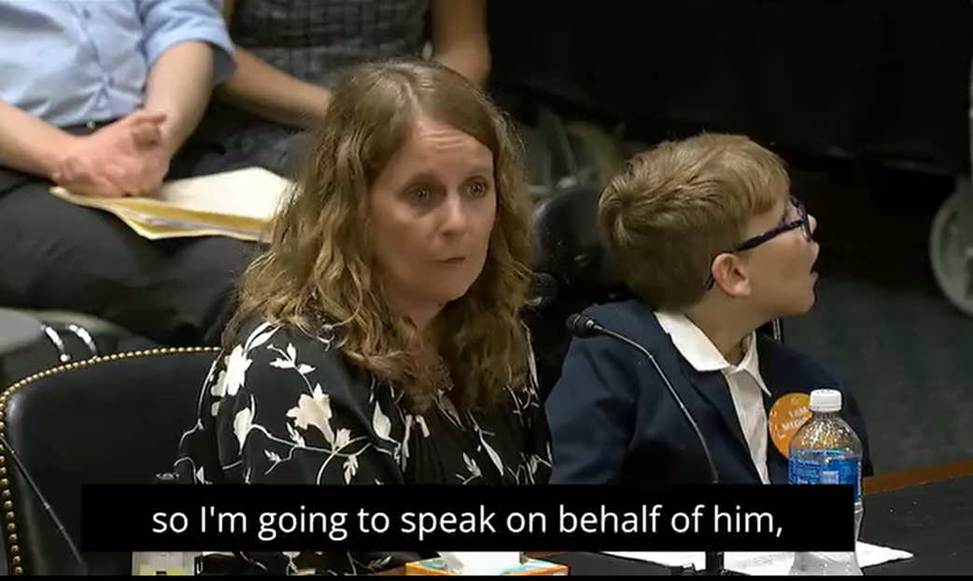
Public Policy Update

Slide 11
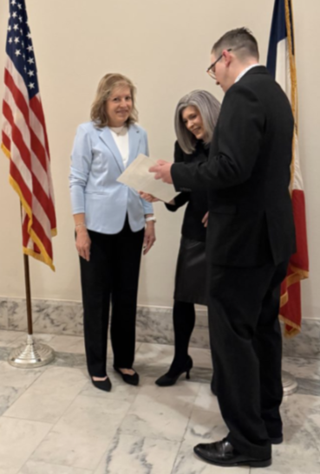
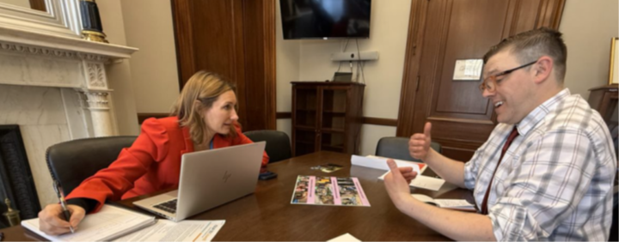
Public Policy Update

Slide 12
Public Policy Update
Upcoming Events
Fall Listening sessions and listening posts (town halls)
August 28 Capitol Chat - voting law and local elections 2025
Sept. 11 DD Council Meeting – approve public policy priorities
Sept. 18-19 Make Your Mark Conference, Des Moines
Sept. 26 Capitol Chat – Panel on “Bills: Moving from idea to law”
October National Disability Employment Awareness Month
Oct. 31 Capitol Chat – Employment Focus
Nov. 13 DD Council Meeting
Dec. 5 Capitol Chat – Getting ready for Session!
January 7 Legislative open house - 12noon virtual (tentative)
January 12 First day of Legislative Session
January 28 Legislative Reception at Iowa State Capitol 1-4 p.m.

