Slide 1

Public Policy Update 11.13.25
Public Policy Committee Report
Wendy Andersen, Chair
Members:
Caitlin Owens, Vice-Chair
Kevin Harris, Past Chair
Dakota Caldwell
Casey Wilkinson
George Thompson, ex-officio

Slide 2
Public Policy Priorities
Priority Areas for 2026
Employment
Education
Community Living and Health Care
Voting
Two “study” issues for 2026
Eliminate requirement for a Medicaid member or insured private insurance enrollee with pervasive developmental disorder and/or autism to receive a rediagnosis to maintain waiver eligibility or coverage for specific treatments
Abuse and neglect of persons with disabilities in public and private long-term care facilities.

Slide 3

Public Policy Priorities

Slide 4
Public Policy Priorities
EMPLOYMENT Priority
GOAL : Iowans with disabilities hold competitive jobs
Iowans with disabilities want to work and be financially independent! But barriers exist that force them to make impossible choices between employment and getting the support and care they need to live and work in the community.
To keep health care insurance and long-term supports they need through Medicaid, a person’s income and assets are capped.
These limitations force people with disabilities to live in poverty, limit the hours they work, avoid marriage and rely on public assistance programs.

Slide 5

Public Policy Priorities

Slide 6
Public Policy Priorities
LET US WORK! Campaign
A campaign to educate lawmakers and change policy to give Iowans with disabilities the freedom to work!
Phase 1: Fall BLITZ (Now – December)
GOAL: Reach out to EVERY Iowa legislator and let them know what this policy change means for Iowans with disabilities.
Phase 2: Capitol BLITZ (January-March)
GOAL: Disability policy advocates have a presence EVERY DAY of the Legislative Session at the Iowa State Capitol

Slide 7


Slide 8

Public Policy Priorities
MCO Stories Request
In response to legislators’ requests, we are collecting stories about the experiences of Medicaid members with denials by MCOs (Managed Care Organizations).
Your story may be shared with legislators but your personal information can be kept confidential by request.

Slide 9
Public Policy Priorities

Slide 10
Public Policy Update
State Update
Revenue Estimates:
$9.3 billion budget for FY 2026, gap between spending & revenue is $1.3 BILLION
9% drop in current fiscal year (FY 2026, which ends June 30, 2026) - $375 million
$198 million of that is due to federal “Big Beautiful Bill Act”
$1.9 billion ending fund balance, $4 billion in Taxpayer Relief Fund
School vouchers – cap off, anyone qualifies at any income level
3.8% state flat tax fully implemented
Governor’s budget will go off December Revenue Estimates
Legislature’s budget will go off the lesser of two – Dec. 2025 or Mar. 2026
Medicaid Shortfall:
Medicaid Shortfall: $76 million FY26, $181 million FY27
Does not include $114 million expected MCO capitation rate increases

Slide 11
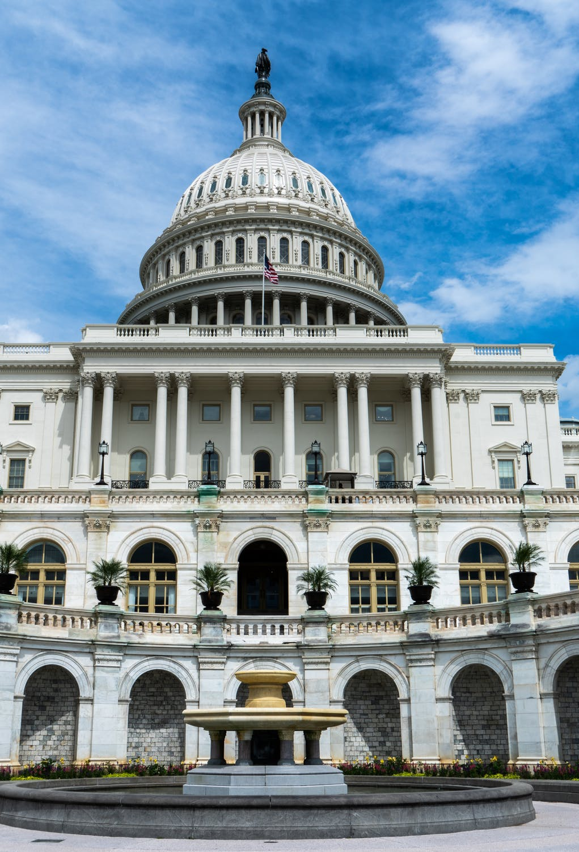
Public Policy Update
Federal Update
There are still TWO separate major budget bills in play
1. Budget RECONCILIATION
Will it ever pass?
2. Budget RECONCILIATION
Will it ever pass?

Slide 12
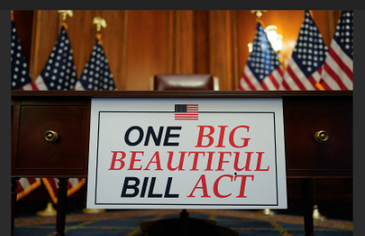
Public Policy Update
Federal Policy
Budget Reconciliation -
OBBB Act passed
How will its
implementation
affect Iowa?

Slide 13
Public Policy Update
Upcoming Events
Nov-Dec. Let Us Work! Fall Blitz
Dec. 5 Capitol Chat – Getting ready for Session!
January 7 Legislative open house - 12 noon virtual (tentative)
January 12 First day of Legislative Session
January 28 Legislative Reception at Iowa State Capitol 1-4 p.m.
Jan-March Let Us Work! Capitol Blitz

