Slide 1


Duties and responsibilities of council members and staff
Duties and Responsibilities of Council Members and Staff

Slide 2

COUNCIL MEMBERS
Oversees the activities of the Council
It is the role that you have assumed accepting the position of a Council member
  Guides our actions

Slide 3

other duties
Other Duties
Decision making
  Members of the Council help decide what we do.
Financial Responsibility
  Ask questions if something on the budget doesn’t make sense

Slide 4
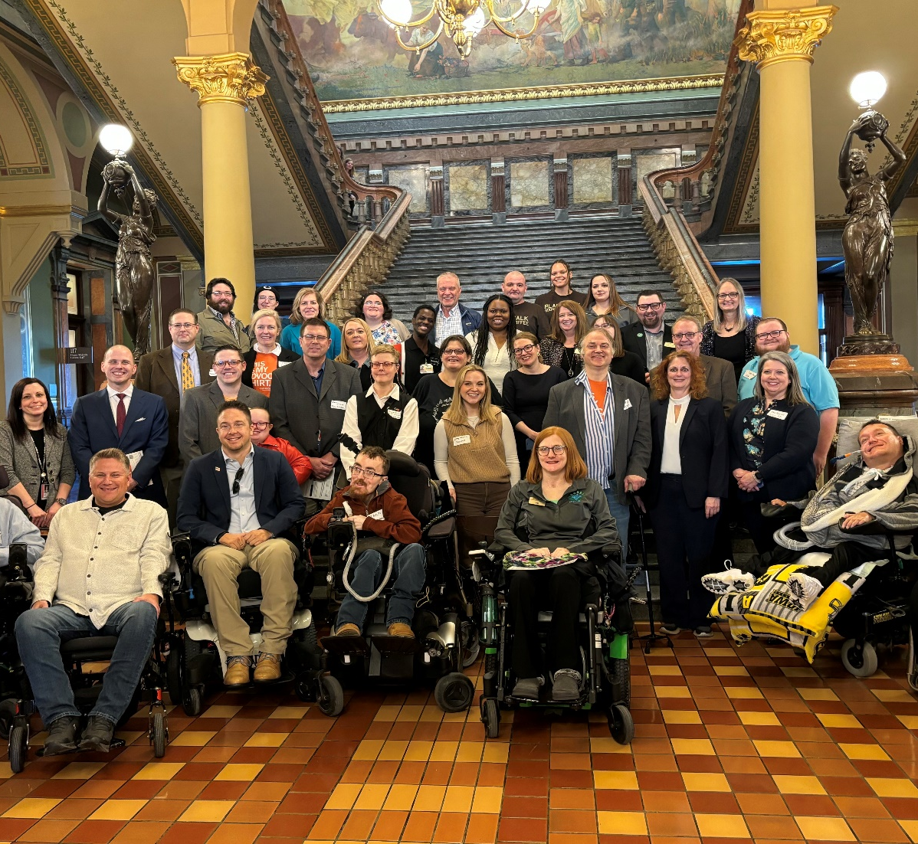
Responsibility of the whole Council
The Council acts only together and once it does so members support the decisions.
  When the Council acts, it must do so as a group
  Individual members have no power; it comes from the Council as a whole

Slide 5

The whole council
The whole Council
Members consider, discuss and can disagree with one another regarding an issue
  Once a vote is taken, members must support the Council’s decision even if a member voted against it.
  If a member keeps refusing to support the Council’s decisions, it might be time for them to step down

Slide 6
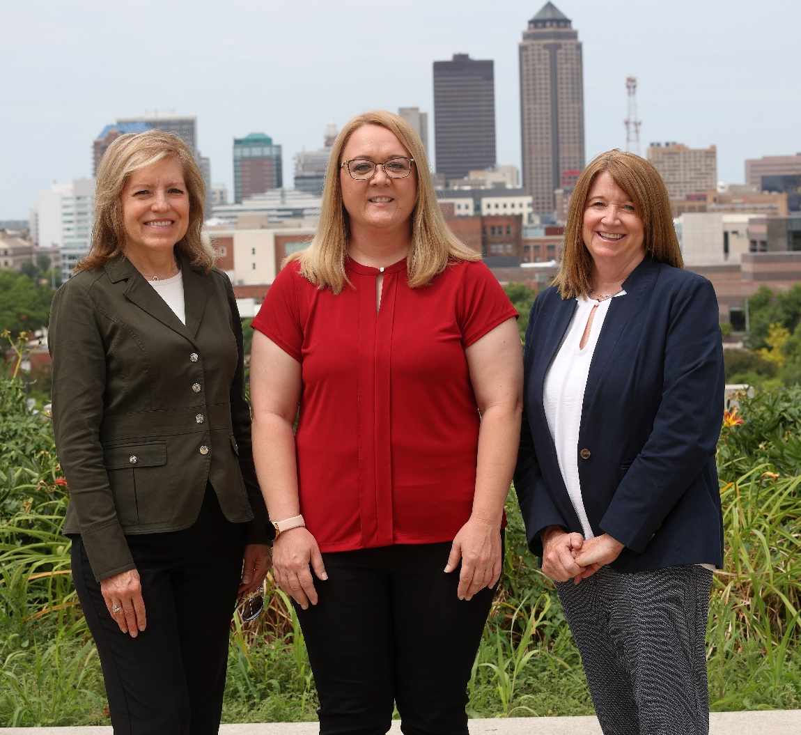
Council staff
Council Staff
Council Staff DO THE WORK!
  Staff carry forward the work of the Council
  Council staff understand the issues facing people with developmental disabilities and their families

Slide 7

Membership staff partnership
The Member- Staff Partnership
Staff members share the vision of the Council
Council members provide leadership and guidance for all Council activities
Staff should provide information and assistance to the Council as it seeks to fulfill its role in our state
Staff and Council members are part of a team

Slide 8

The work
The Work!
Staff
  Develop the 5-year state plan goals and objectives based on Council input
  Reports on status of goals and objectives
Council
  Approve 5-year state plan and any changes.
  Actively participate in the development and the implementation of the 5-year state plan

Slide 9
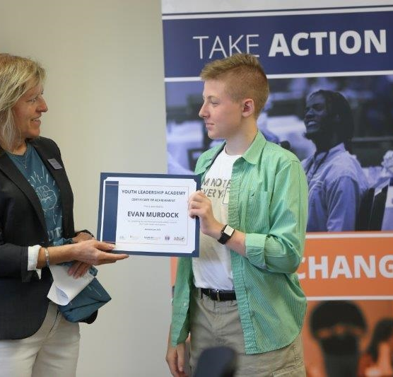
Doing the work
Doing the Work!
Staff
  Assess needs of individuals with DD and family members
  Recommend solutions to those needs
  Prepare budget for Council approval
  Guarantee spending is within budget

Slide 10
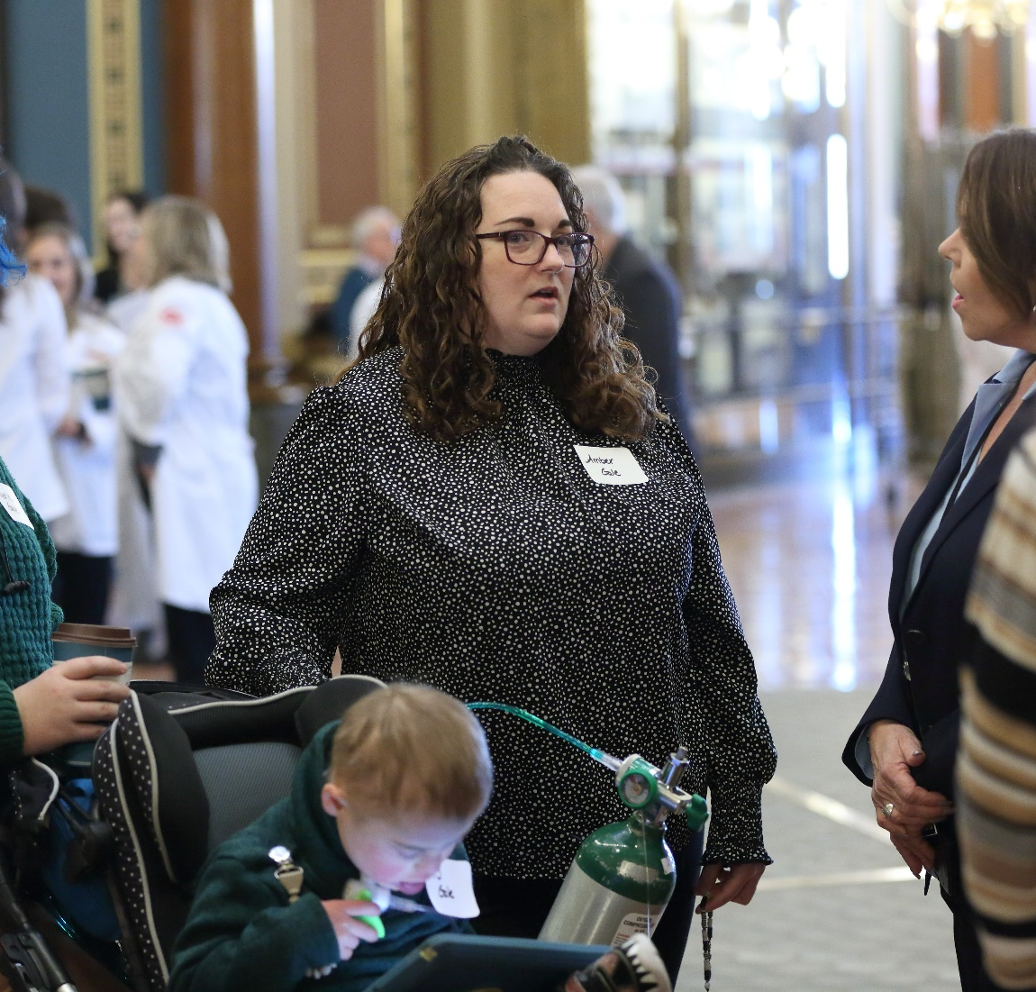
Doing the work
Doing the Work!
Council
  Help keep staff informed of the needs they see
  Finalize and approve budget
  Approve spending outside authorized budget
Both
  Recruit and train new Council members
  Communicate the Councils mission, accomplishments and goals to the public-Share the work!

Slide 11
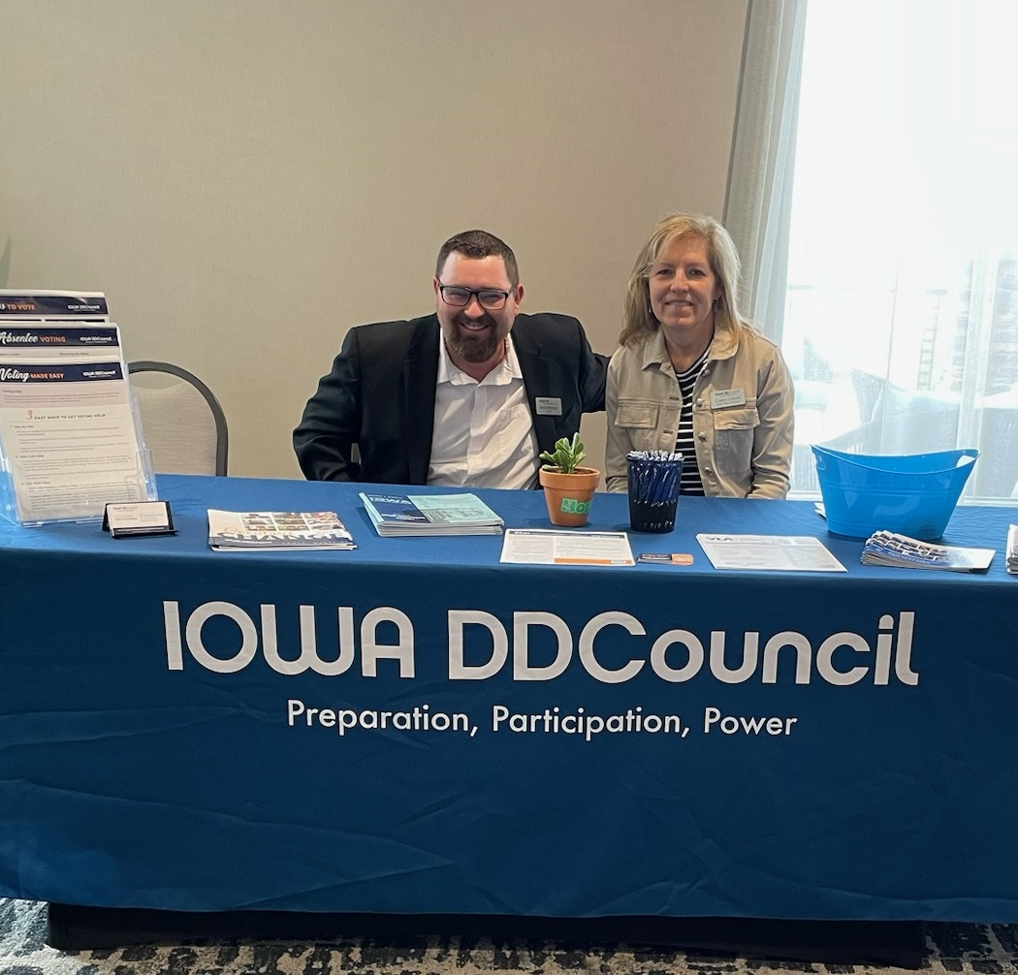
Summary
Summary
The role of the Council member is to provide leadership and direction for the Council
The role of staff is to “do the work”
Staff are hired to implement the Council’s five-year state plan
The Executive Director is the staff member that works for the Council
  The staff works for the Executive Director.

Slide 12
Lobbying
Lobbying
What is it?
When a person or group tries to change the decisions made by lawmakers
What are some activities of lobbying?
Telling a lawmaker how to vote on funding bills (vote Yes, vote No)
Giving money to a campaign or a political party
Telling a policymaker how to vote on federal, state, or local legislation (vote Yes, vote No)

Slide 13


Lobbying vs Education
Lobbying vs Education
Councils are free to advocate a position AS LONG AS:
You are fairly describing the issue to help the policymaker
Do not present unsupported opinions or facts
Do not use offensive terms
Avoid conclusions based on emotions rather than facts

Slide 14
Lobbying continued
Councils can advise legislators and others on proposed laws and policies AS LONG AS:
Approach is unbiased
Discussion includes pros and cons

Slide 15
Advocating a position
A Council does not have to be neutral about outcomes for people with developmental disabilities – BUT…
Must show a fair attitude when looking at options for meeting needs
Advocating a position

Slide 16
Lobbying example
EDUCATION
Six out of 10 Americans with disabilities vote. In Iowa it is 6.5 people with disabilities vote
Advocacy
The DD Council would like to see that number increase. Limiting the days someone can submit an absentee ballot creates another barrier for voting
Lobbying
Please vote No for HF 45 limiting absentee voting time

Slide 17
Conflict of interest definition
Conflict of Interest
Definition
A conflict of interest is real or believed. It exists if the Iowa Developmental Disabilities Council member or a member of their family appears to benefit personally from their position on the Council

Slide 18
Conflict of interest
Conflict of Interest
Councils value the participation of stakeholders, state agencies, DD Act agencies, and other disability advocates
This participation may at times create real or believed conflict of interests
Talking openly is the best for the Council to keep a good view with the public

Slide 19
Example of conflict
Conflict of Interest Example
Situation: a member serves on the Council as well as on the board of directors of a disability organization that applies for a grant from the Council.
Result: Even though the Council member may not receive direct money from the grant, it may appear as a conflict of interest.
Recommendation: The Council member can say they have a conflict and not take part in discussions or voting on the grant

