Slide 1
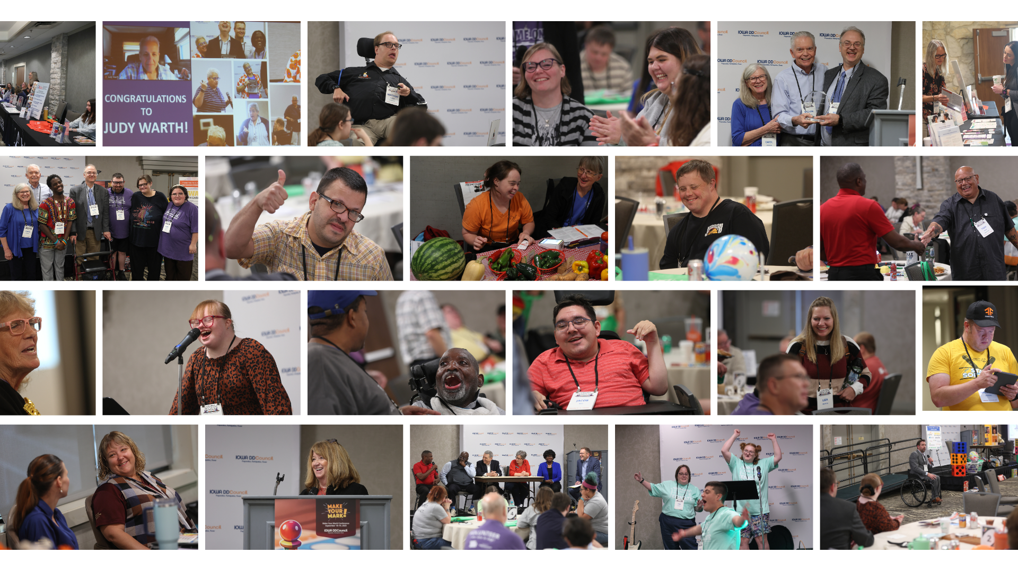


Self-Advocacy Conference
September 18-19, 2025

Slide 2

THEME
This year's theme encouraged us to approach advocacy with strategy, determination, and teamwork.
Just like in a game, every player counts and every move is important.
It’s time to roll the dice, make your move, and play your part in advocating for change!

Slide 3

SPONSORS
JACKPOT SPONSOR
The Arc of Iowa and the Julie and Katie Beckett Advocacy Foundation
GAME MASTER SPONSOR
University Center for Excellence in Developmental Disabilities (UCEDD)
MVP SPONSOR
Molina Healthcare of Iowa
PLAYMAKER SPONSOR
Wellpoint Iowa
STRATEGIZER SPONSOR
IAble
Iowa HHS Division of Aging and Disability Services
Iowa Total Care
CALMING ROOM SPONSOR
Easterseals Iowa
GENERAL SPONSOR
Delta Dental of Iowa Foundation

Slide 4
EXHIBITORS
Allies in Advocacy
ASK Resource Center
Association for Frontotemporal Degeneration
Axis Therapy Centers
Bridges 2 Advocacy/EmpowerEd Consulting
Bubba's Freeze Dried Foods
Camp Albrecht Acres
Caring Hearts of West Central Iowa
Dea ex Machina
Disability Rights Iowa
Easterseals Iowa
Epilepsy Foundation
Iowa Coalition Against Sexual Assault
Iowa Department for the Blind
Iowa Department of Transportation
Iowa Secretary of State
Iowa Statewide Independent Living Council
Iowa Vocational Rehabilitation Services
Life Interpretation Inc
Straw Hat Farms
Talk to Me Technologies
UI REACH
West Des Moines Public Library

Slide 5

VOLUNTEERS
Andrea Maher
Brady Werger*
Caitlin Owens
Casey Wilkinson *
Charlene Wyatt Sauer *
Dakota Caldwell
Daryn Richardson
Edward Esbeck
Eric Evans
George Thompson
Hugh Kelly *
Judy Warth
Julie Bergeson
Kevin Harris
Mike Hoenig *
Rachel Bussan
Stella Thompson
Wendy Andersen *
* Planning Committee Member

Slide 6
ATTENDANCE
 | 2019 (In-Person) | 2020 (Virtual) | 2021 (WDM/Hybrid) | 2022 (Prairie Meadows) | 2023 (Coralville) | 2024 (Ames) | 2025 (Urbandale)
Attendance Total | 171 | 171 | 215 | 148 | 159 | 212 | 249
Person with a Disability / Self-Advocate | 58 | 76 | 86 | 53 | 51 | 82 | 93
Family Member of a Person with a Disability | 95 | 34 | 39 | 29 | 44 (family member or DSP) | 21 | 35
Service Provider or Caregiver | - | - | - | - | - | 31 | 37
Professional | - | - | - | - | 27 | 30 | 7
Sponsor | 4 | 1 | 1 | 4 | 19 | 10 | 17
Exhibitor | 15 | 3 | 22 | 15 | 18 | 25 | 34
Volunteer | - | - | - | - | 10 | 13 | 18
Other | 18 | 61 | 90 | 47 | N/A | N/A | 26

Slide 7
CONFERENCE BUDGET
 | Expense | Revenue
Sponsors | N/A | $26,575
Exhibitors | N/A | $4,035
Shirts Sold | $1,566 | $612
Venue (hotel, A/V, food/beverage) | $41,571 | N/A
Speaker Fees | $5,300 | N/A
Giveaways (Awards, Prizes, Tote Bags) | $633 | N/A
Supplies (Volunteer Shirts, Folders, Nametags, Signage, Programs, Hoyer Lift) | $5,946 | N/A
Event Support (Photography, ASL Interpreting) | $6,000 | N/A
Total DD Council Cost - $29,794 | Total Expense $61,016 | Total Revenue $31,222

Slide 8
CONFERENCE BUDGET – Arc of Iowa Grant
 | Expense
Thursday evening dinner Taco bar Popcorn Cookies | $3,000
Hotel rooms 58 total nights 34 attendees had rooms through the grant | $6,300
Hoyer lifts (3) | $875
 | Total: $10,175

Slide 9
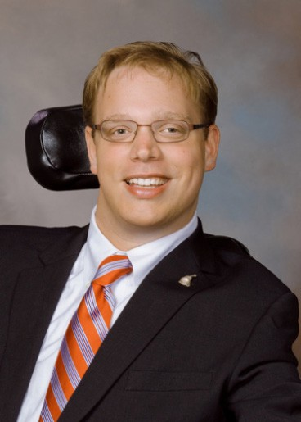
DAY 1 KEYNOTE - Mastering ‘Matthew’s Tool Box’ to Stay the Course and Advocate for Issues You Believe In
Presenter: Matthew Shapiro
Comments / Lessons Learned:
Keep trying to make your point
Don't give up
Very inspiring
He started his own company! Wow
Very well thought out and delivered.

Slide 10
GENERAL AND BREAKOUT SESSIONS – DAY 1
Session Name | Comments / Lessons Learned
Legislative Panel | Learned how to effectively communicate my concerns with my representative
Iowa Blueprint for Change: From Plan to Action | Creating my own blueprint to plan my goals and figure out what to do next We are all working on the same goals, just to a different capacity How to ask for help and self-advocacy Keep advocating and more forward in the future Use a chart to help set goals for employment To check with other organizations on my goals with partnership The speaker was fantastic and I enjoyed the hands on activity to learn. Enjoyed the activity we did.
All comments are directly from submitted evaluations (65 total).

Slide 11
GENERAL AND BREAKOUT SESSIONS – DAY 1
Session Name | Comments / Lessons Learned
Pregame Poetry | Poetry is a creative way to deal with life A good way to express yourself Practicing self care through poetry Very good session
Workplace Accommodation Strategies | I liked that they took turns talked

Slide 12
GENERAL AND BREAKOUT SESSIONS – DAY 1
Session Name | Comments / Lessons Learned
Advocating for Your Disability Can Get Your Game On | Stay strong When things don't go the way I want, keep going
Understanding ABLE Accounts: A Path to Financial Independence | She seemed pretty knowledgeable on the subject and if she didn’t know something- she said so and suggested contacting them in the office My questions were answered. I do plan to look into it some more but it’s something that I wanted to know more about.

Slide 13
GENERAL AND BREAKOUT SESSIONS – DAY 1
Session Name | Comments / Lessons Learned
Introduction to Nonprofit Leadership Roles | Thinking about joining nonprofit board Join a board of directors - be your own representative Inclusive board guide. Ask for a Board mentor to help if you are new to Boards. The ability to get liability coverage for leadership roles Great wealth of Information!
Level Up: The Infinite Spectrum | Learned a lot more of how to navigate my disability and how to be an ally to others I learned a lot about how autism presents differently in different people Ethan did a fantastic job Excellent presentation!

Slide 14
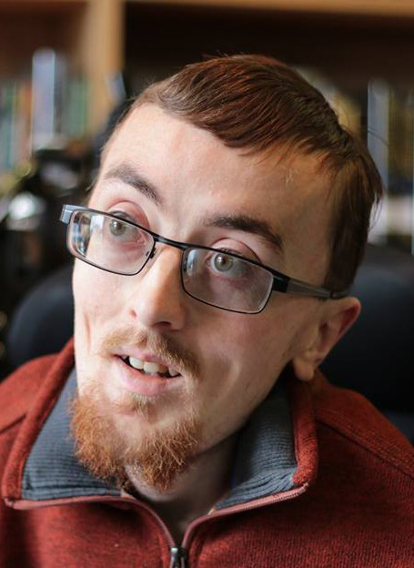
DAY 2 KEYNOTE - Welcome to the Big Leagues
Presenter: Zach Mecham
Comments / Lessons Learned:
Practice your speech and simplify
I will apply the answers from table discussions (answers and questions) to how I can
make changes in my local community and state boards for the better! And my personal
life (if applies)
Self care and taking care of your health is necessary to be a good advocate or a good anything.
Zach is so good, so effective. This was a wonderful session!
How to be a better leader
Zach his fantastic!
PLEASE PLEASE have this person back! Super easy to understand and follow along!
Zach's comedy makes it easy and fun to listen to his message.

Slide 15
GENERAL AND BREAKOUT SESSIONS – DAY 2
Session Name | Comments / Lessons Learned
Iowa Health and Human Services (Breakfast Keynote) | "Redesign" of 7 waivers - base support on need rather than diagnosis. How does a person apply to be considered on a waiver if diagnosis is not cause or reason. Continuing the same base services. I learned the disability services are updating the rights and laws to fit and make life fair for all people with disabilities I wanted to know why IHH case managers were being let go and turning it over to MCOs - that stinks. I had a great IHH case manager!

Slide 16
GENERAL AND BREAKOUT SESSIONS – DAY 2
Session Name | Comments / Lessons Learned
Benefits Bingo: Path to Financial Independence | MEPD - age limit; earned and unearned income definitions Good topics/slides, however before I can write key points down, this person already on next slide/sometimes 2 slides ahead! Have handouts. Great audience participation!
Game On: Advocating for Assistive Technology to Unlock Your Goals | Learning where to go for help and how to ask questions. Learning of the very large library with assistive devices. Thanks for informing of the options and availability of assistive resources.

Slide 17
GENERAL AND BREAKOUT SESSIONS – DAY 2
Session Name | Comments / Lessons Learned
Community Inclusion | Having a daily plan. A good reminder, be intentional about staying connected. I needed this session today! Everyone can be included
Living with Disabilities and Leadership | They did a great job Sunflower pass, card for introductions I am in "AWE" of this family! Thank you for sharing your stories, such an inspiration How you can advocate for self A lot of the activities they participated in seem good for my son who has autism. Didn't know about the sunflower pass! What do you need to change and how can you change it? That you advocate for yourself almost everything you do This was a very interesting topic. I enjoyed the stories. Really great job - very inspiring

Slide 18
What did you like about this conference?
FULL CONFERENCE FEEDBACK
Overall Conference Rating
* | ** | *** | **** | *****
 |  |  | 4.55% | 95.45%
Great speakers, fun comedy/talent show
How inclusive it was
The location, the breakout sessions
How to advocate a little better for myself
How organized it was
I liked the variety of topics and breakouts, lots of opportunities to learn and participate. Enjoyed having the legislators and HHS people there to hear about changes going on.

Slide 19
What did you like about this conference?
FULL CONFERENCE FEEDBACK
I liked the topics covered and different things to hear and learn about. It was a great conference and can't wait to come back.
Making new friends and seeing people that I know every year
Variety of speakers. Venue and meals were excellent.
Keynote speakers and breakout sessions were great
Learning about different types of disability
I liked meeting new friends and had good food and I liked the speakers

Slide 20
What would you change for the next conference?
FULL CONFERENCE FEEDBACK
Talking to more people getting know them a little better
More group discussion time
Change the agenda every year
More zero sugar drink options, breakfast
Consider avoiding people ask to say their names and disability in public. Expressing feelings and delay in diagnosis to a stranger a person just met is/can be uncomfortable. Ask representatives of the vendors to communicate the resources of their company to their group.
The way food is served. People coughing over the food and touching it all with dirty hands
Just entertainment and have hands on to understand for everyone having fun
More days and more talent and talent show

Slide 21
What did you learn at the conference this year?
FULL CONFERENCE FEEDBACK
Great ideas/techniques to use/think about and can apply going forward. Either for myself/board I'm on currently!
Tools to live on my own someday
Tools for standing up for myself
I learned too much to write. The presenters were very knowledgeable.
Self-advocacy
There are many definitions of advocacy depending on what it means to the person advocating.
How to advocate for yourself, come out of my shell a little more

Slide 22
What did you learn at the conference this year?
FULL CONFERENCE FEEDBACK
Skills for advocacy, changes in HCBS services
To listen to people
Learning to talk abut yourself in front of big crowds
Resources available at Easterseals. Contact information to request help from multiple organizations.
More on ABLE accounts
Work without worry
About Medicaid and housing bills and other stuff

Slide 23
How do you plan to use what you learned in your own community?
FULL CONFERENCE FEEDBACK
Educate others
I want to talk to my staff and start a self-advocacy group in my town.
Look out for friends and how to advocate for ourselves
To get people outplaced into the community
Contact Easterseals and schedule an appointment to search for assistive devices
Get signed up for an ABLE account
Get involved
Helping people when they needed for younger and older to be able
To do more advocacy stuff
To tell my family and friends what we talked about

Slide 24
FULL CONFERENCE FEEDBACK
What new topics would you like to learn about
next year?
Tools on independence on my own someday
How to advocate for myself, karaoke, how to get the community involved - fundraisers
More accessibility in my community
Mindfulness, stress management
Disability Iowa activities and duties. Review the legal rights of disabled individuals and options when those rights have been affected.
Updates on HOME project
Learn about behavioral psychology and find ways to cope better
About people asking you personal questions about your disability at your job

Slide 25
How satisfied were you with the exhibitor/sponsor package and everything that came with it?
Very Satisfied: 80%
Satisfied: 20%
EXHIBITOR AND SPONSOR FEEDBACK
Did the event structure give you sufficient time to interact with attendees?
Yes: 90%
No: 10%
  Need more time in between sessions to talk with vendors
Was the location of your booth suitable for generating traffic?
Yes: 90%
No: 10%
  Yes, although it was a bit cramped behind the booth for getting in/out

Slide 26
Please tell us how we can improve the exhibitor/sponsor experience in the future.
I would say continue with the sticker game or something similar to encourage attendees to visit all the booths.
It was another excellent conference and very impressive to get the new IA Medicaid Director in attendance to give remarks! This conference is always a great networking opportunity with participants, speakers and exhibitors/partner organizations. I thought the venue space was very cramped in the exhibitor hallway and for the food line compared to previous venues. The food was blah.
Food was hectic - ran out and no silverware. Many folks using same plates. I would recommend that the hotel help staff the buffet table and assist where needed
Maybe have a couple longer exhibitor breaks rather than multiple 15 minute ones. I noticed a lot of people still talking to exhibitors past the 15 minute break and missing their sessions.
The exhibitor space was a little "snug" but also nice that attendees were very close to everything.
EXHIBITOR AND SPONSOR FEEDBACK

Slide 27
How would you describe your volunteer experience?
Rewarding. Really appreciated all the prep material!
It was great! You all are SO organized and make it extremely clear and easy.
Good. I like the teamwork and meeting the attendees.
My experience has a volunteer was good and rewarding experience. I was room host in my assignment and felt it was a very easy, but helpful assignment. My experience as a volunteer was a very positive experience.
VOLUNTEER FEEDBACK

Slide 28
Please tell us how we can improve the volunteer experience in the future.
Maybe have a few more people identified to assist with serving lines just in case. Council members can easily eat last and assist attendees.
Provide guidance for room moderators on what to do when session time has ended but a robust discussion is continuing. This happened to me once, and I told all in the room that we were "at time" and asked presenters if they could stick around-which they did.
I honestly can't think of anything you didn't think of already! Great job!
My volunteer experience was very positive. I do not have any suggestions to change anything in the future.
VOLUNTEER FEEDBACK

Slide 29
Thank You!

