Slide 1


Creating Tip to Tip Learning Progressions
Part ONE
Cherie Smith
SST6
As a part of the State System of Support, the State Support Team collaborates with schools, families and regional partners through a continuous improvement process to ensure each child in Ohio has access to a high-quality education. We focus on leadership and team development, and inclusive instruction practices to assist districts and schools in improving outcomes for each child.
Notes:
Hello and Welcome to Creating Tip to Tip Learning Progressions. My name is Cherie Smith. I am a consultant for State Support Team 6, one of 16 regions of State Support Teams in Ohio.
As a part of the State System of Support, the State Support Team collaborates with schools, families and regional partners through a continuous improvement process to ensure each child in Ohio has access to a high-quality education. We focus on leadership and team development, and inclusive instruction practices to assist districts and schools in improving outcomes for each child.

Slide 2

5 Part Series Goal
Create an IDEAL Tip to Tip Learning Progression!
Notes:
The goal for this presentation is to create an IDEAL Tip to Tip Learning Progression. During the 5 part series, we will look at a few examples of Learning Progressions and talk a bit about what it takes to write an IDEAL Tip to Tip Progression.

Slide 3
Five Part Series
Part One: Overview of Tip to Tip Learning Progressions
  Explore the concept of tip to tip learning progressions and why they are necessary
  Access and practice using tools that can be helpful when creating splinter skills for each standard
Part Two: Building the Base
Part Three: Deconstructing the Standard
Part Four: Moving Beyond the Standard
Part Five: Critiquing Your Tip to Tip Learning Progression
Notes:
Part one provides an overview to learning progressions, highlights resources from the Ohio Department of Education as well as OCALI, and introduces learners to some other resources that are helpful when creating Tip to Tip Learning Progressions.
Part two focuses on the first part of a Tip to Tip Learning Progression, Building the Base.
Part three focuses on deconstructing the standard.
Part four focuses on moving beyond the standard.
Part five allows viewers to evaluate and critique their own Tip to Tip Learning Progressions using the Practice Profile shared in part one and throughout the first four sessions.

Slide 4
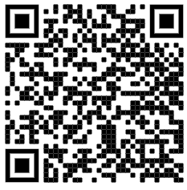
Resource Folder Contents: Part 1
Practice Profile*
Acronyms and Links*
Cognitive Rigor Matrices (Tools 1-8)*
Diamond Graphic
Articles on Learning Progressions
Videos:
  Myth of Average
  7/10 split
QR code to Google Folder
*Recommended to print out
Notes:
All materials for this 5 part series are available using this QR code. Use the camera feature on your smartphone or a QR code reader to get a direct link to the google folder containing each of these handouts.
https://drive.google.com/drive/folders/1JxUoGchh5Z3oMp9UL6LsVkbpCGGxhRBa?usp=sharing
Resources mentioned in part one will be:
Part One:
Practice Profile
Acronyms and Links
Cognitive Rigor Matrices (Tools 1-8)
Diamond Graphic (background)
Articles on Learning Progressions
Videos (Myth of Average and 7/10 split)

Slide 5
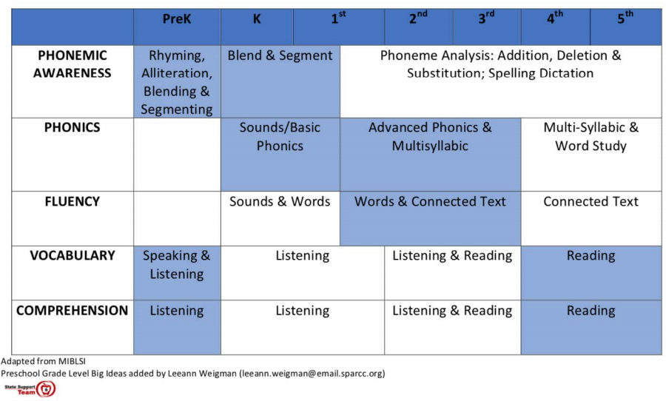
Learning Progressions (From Ohio’s standards-writing
Use pic from our state progressions- literacy example
Notes:
The idea of learning progressions is not a new one. In multiple disciplines, learners begin with more basic skills and as they progress in their learning, they begin to learn more complex versions of the skills or combine skills into more complex skills or concepts.
The graphic on here shows how students learning to read begin in PreK by learning phonemes through phonemic awareness, phonemes are the sounds that make up words. They learn to hear these sounds in through rhyming and alliteration, through blending and segmenting, and then as they move up in grade, students begin to do more complex work with those sounds. There is a progression of being able to hear the sounds, recognize them, isolate them, and then manipulate those sounds.
The same can be said for phonics, fluency, vocabulary, and comprehension. There is a progression over time that students will go through when learning each of these 5 areas of reading.

Slide 6
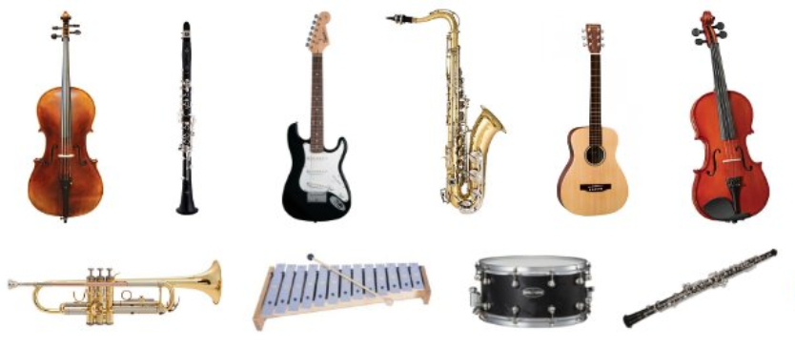

Learning Progressions
Notes:
This is true for other subjects and disciplines as well.
Think about a time you learned to play an instrument, or learned to play a sport. For me, I think about dance class and learning to make the sounds necessary to tap dance.
Like learning to play and instrument or sports, when learning those skills I practiced progressions ranging from basic to more complex.

Slide 7

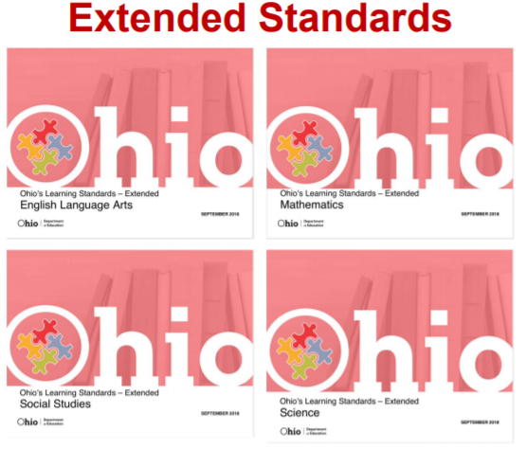
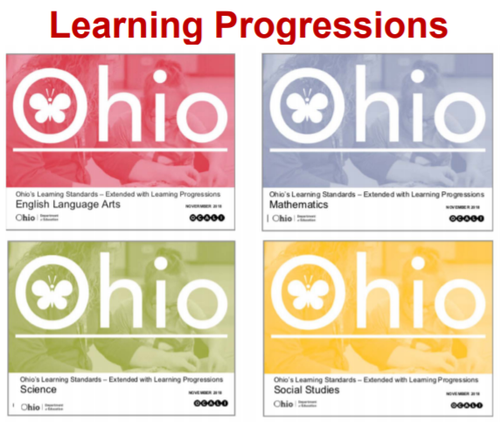
Tip to Tip Learning Progression per STANDARD
For the purpose of today’s presentation, we will look at one way to create a tip-to-tip learning progressions for each of our state’s learning standards.
Notes:
For the purpose of today’s presentation, we will look at one way to create a tip-to-tip learning progressions for each of our state’s learning standards.
This presentation will show the resources need to create a Tip to Tip Learning Progression using Ohio’s Learning Standards, the Extended Standards, and Learning Progressions documents created by the ODE and OCALI.
Pictured below are images that represent three resources used in today’s presentation: 1) Ohio’s Learning Standards, 2) Ohio’s Learning Standards Extended which list the extended standards that align to each general standard and 3) the Learning Progressions document that includes Learning Progressions created for each of Ohio’s Learning Standards along with the extended standards on one document.
There are links provided for each of these on the next slide.

Slide 8
Resources and Acronyms
Acronym | Name and link to resource
OLS | Ohio’s Learning Standards
OLS-E | Ohio Learning Standards-Extended
LP | Ohio Learning Standards-Extended with Learning Progressions
CRM | Cognitive Rigor Matrix
PLD | Performance Level Descriptors
Splinter Skills | Or sub skill
Notes:
The resources I will be sharing in this training video are listed here along with the acronyms I will be using throughout the training for each.
We already discussed the first three listed.
Let’s take a look at the remaining two resources a little bit closer since these many may not be as familiar.

Slide 9
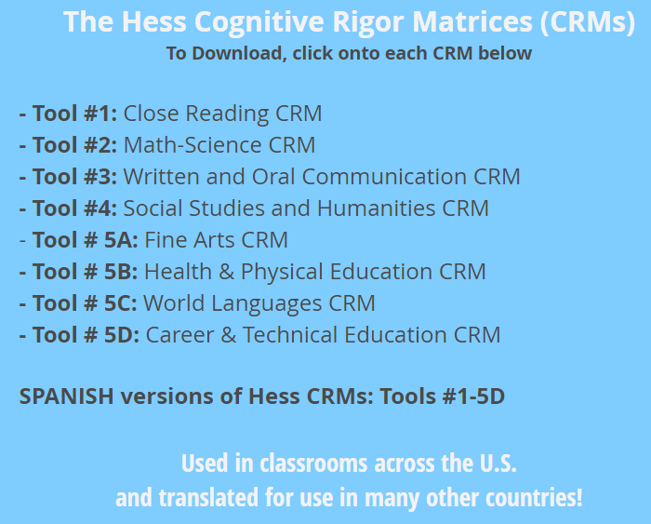
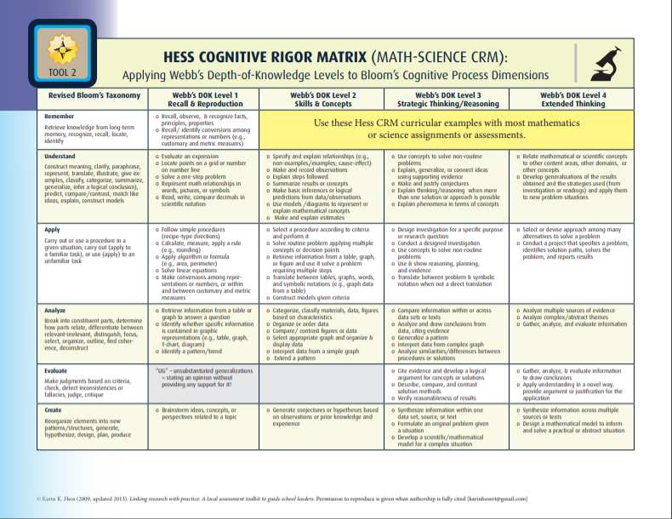
Learning Progressions and Cognitive Rigor Matrices
“A learning progression can visually and verbally articulate a hypothesis about how learning will typically move toward increased understanding for most students.”
— Karin Hess
Notes:
In the resource folder you will find each of the tools listed in the blue box. There are 8 tools available for use (read each one).
These tools are wonderful!
To quickly orient you on the format of the Matrices.
Down the left side you will see the Revised Bloom’s Taxonomy. Across the Top you will see the Webb’s Depth of Knowledge with a title for that level. The matrix allows you to examine how students will progress to a deeper level of knowledge for each level of Blooms.
Again, this information is so very valuable when creating learning progressions.
A general rule of thought is that a student will move from the left to right and then down throughout the matrix. This will vary depending on content which is why I called it a “general” rule. There will be examples of this later in the presentation.

Slide 10
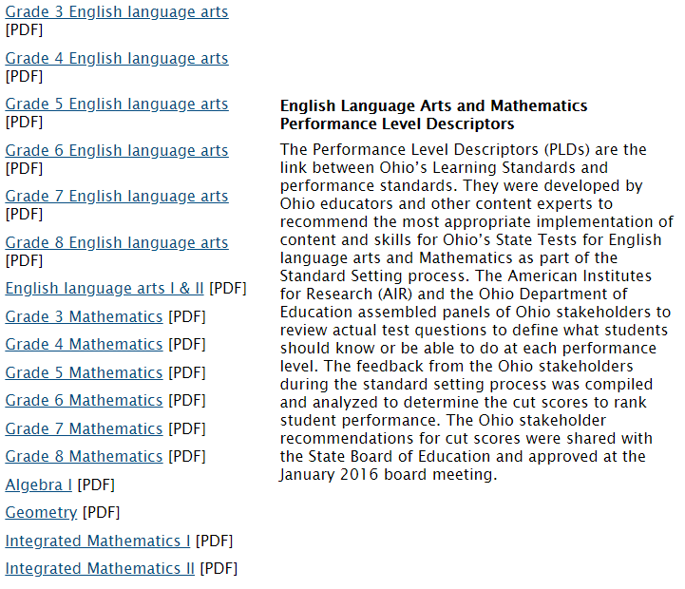
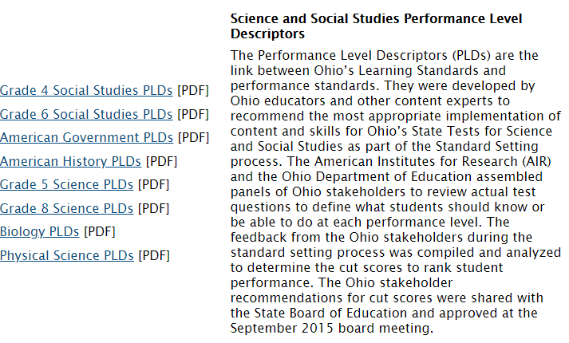
Performance Level Descriptors (PLD)
Notes:
The next link, for Performance Level Descriptors will take you to Ohio’s Testing Portal, into the reporting resources folder.
As you scroll down the page you will see a PDF version for each testing subject, for each grade level. We are going to take a look at American Government and 4th grade math on the next few slides.

Slide 11
Practice on your own: Accessing PLD
Visit the Ohio Department of Education’s Testing Portal
Click on your level of access (ex: Test Coordinator)
Go next into Resources
Click Reporting Resources then find the grade level PLD for your tested subject
*If you are a subject that is not tested, your district may still ask you to support particular standards such as writing or reading. Review those PLDs.
Or you may choose to review with a partner that does have a PLD and decide how the performance levels vary within your own standards.
Notes:
Pause the presentation here.
If you have not been provided your PLD, you will need to access them by going to the ODE’s Testing Portal
Once you find your desired Performance Level Descriptors, you can resume the presentation.

Slide 12
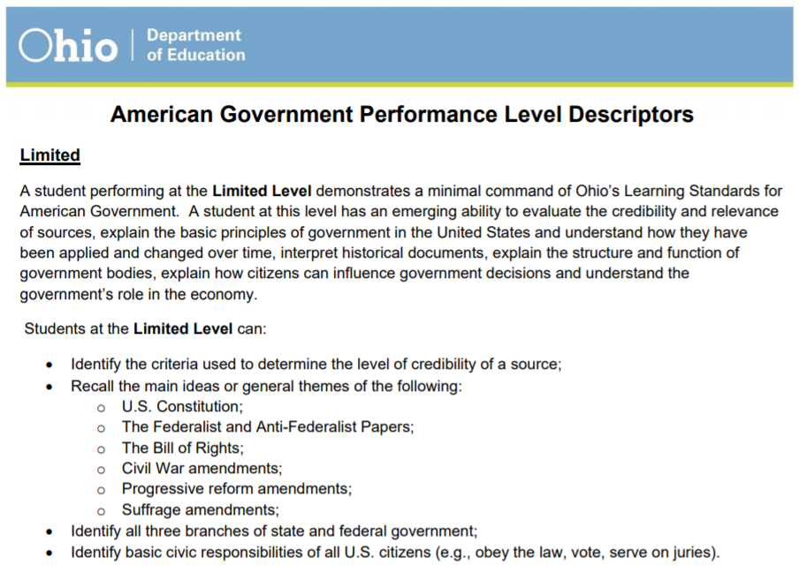
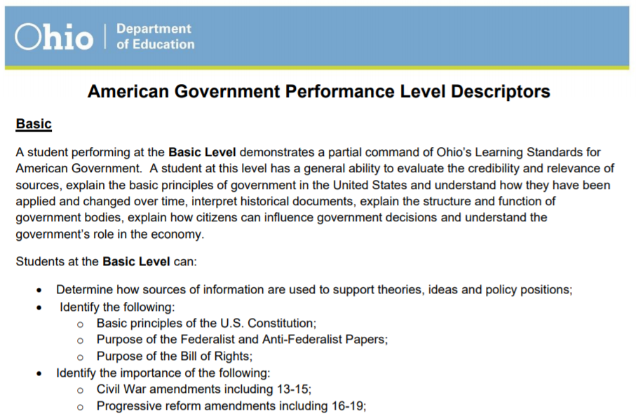
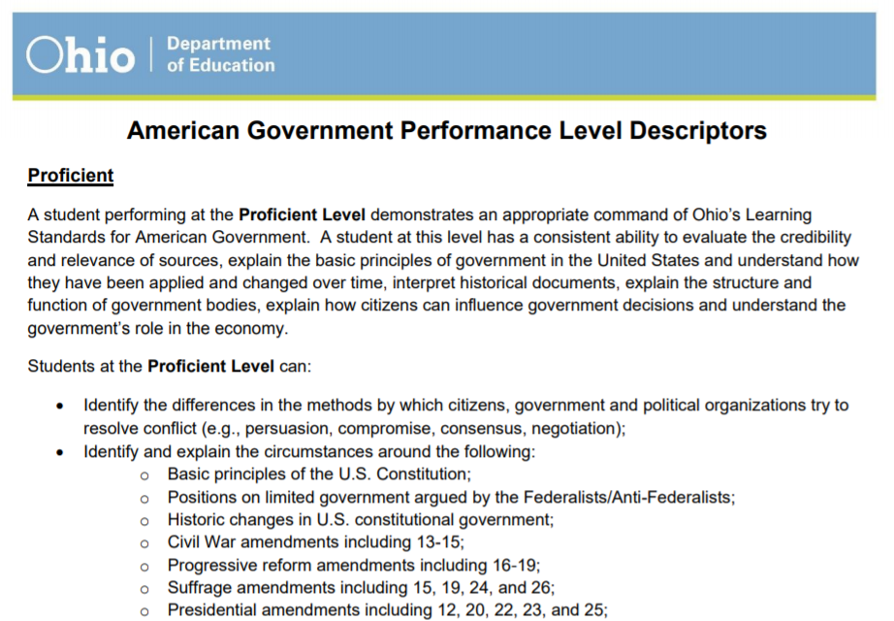
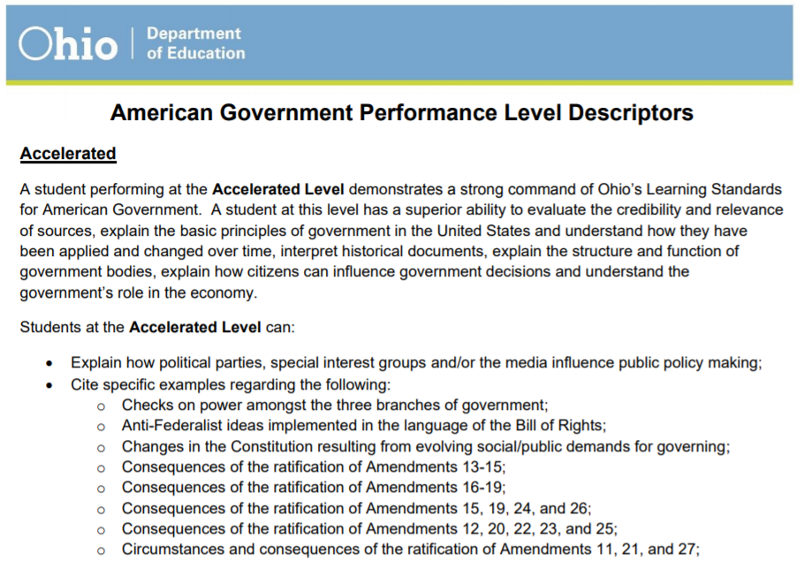
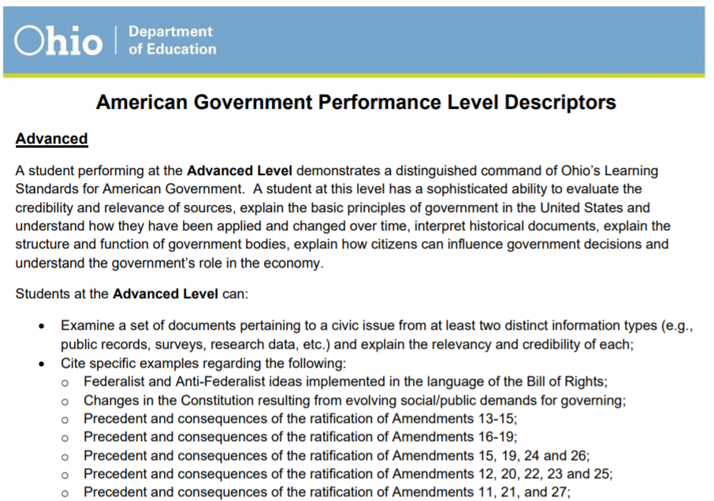
Notes:
Let’s take a look at how the Performance Level Descriptors move to higher levels in Depth of Knowledge (DOK).
The first paragraph states:
Limited:
A student performing at the Limited Level demonstrates a minimal command of Ohio’s Learning Standards for American Government. A student at this level has an emerging ability to evaluate the credibility and relevance of sources, explain the basic principles of government in the United States and understand how they have been applied and changed over time, interpret historical documents, explain the structure and function of government bodies, explain how citizens can influence government decisions and understand the government’s role in the economy.
Now let’s look at the next part, it states:
Students at the Limited Level can: (and then lists the topics aligned to the state standard). Note that the bullet points do not state the standard but I have found that they are general listed in the same order so if you look at the standards for American Government, the first one should correspond to the first bullet point, and the second one should correspond to the second, etc. Sometimes the bullet points stop at proficient for a given standard and sometimes there are multiple bullet points for one standard. Teachers trained in their content area will be able to align them appropriately.
Identify the criteria used to determine the level of credibility of a source;
The verb here is identify.
So this is what a student at the limited performance level can do. If your students are here when they are testing, you can expect them to score in the limited level for questions testings this standard.
ANIMATE NEXT IMAGE:
Now, let’s look at the next Level: Basic.
The paragraphs is similar to the last, only this time, rather than having an emerging ability, the student has a “general ability.”
Let’s look at what the student can do in relation to that first bullet point:
Now, Students at the Basic Level can:
Determine how sources of information are used to support theories, ideas and policy positions;
The verb here is Determine.
Notice that students are now being asked not only to identify criteria to determine credibility of a source, but to determine how sources are used to support positions.
ANIMATE NEXT IMAGE:
Notice the first paragraph describing Proficient is similar but now students have a consistent ability to achieve in the following content.
Looking at the first bullet point again, a student at the proficient level can:
Identify the differences in the methods by which citizens, government and political organizations try to resolve conflict (e.g., persuasion, compromise, consensus, negotiation);
Notice here, students have moved to an even higher depth of knowledge. Students are now being asked to do much more with this information and demonstrate a high level of thinking.
Let’s quickly look at the next two:
ANIMATE NEXT IMAGE:
At the next level, Accelerated: Students have superior ability to achieve or master the content AND are now being asked to:
Explain how political parties, special interest groups and/or the media influence public policy making;
The verb here is explain.
ANIMATE NEXT IMAGE:
If we look at the Advanced level, the first paragraph states that students at this level have a sophistocated ability in regard to the following:
At this level, students can:
Examine a set of documents pertaining to a civic issue from at least two distinct information types (e.g., public records, surveys, research data, etc.) and explain the relevancy and credibility of each;
The verb here is examine.

Slide 13
Practice on your own: Analyzing PLD
Using the Performance Level Descriptors for a tested subject:
Choose one bullet point (or standard) and analyze how this statement changes from limited to accelerated. Make a list of each if you prefer.
Note what changes for each level. Notice the verbs for each bullet point.
Notes:
Choose one bullet point (or standard) and look at the how this statement changes from limited to accelerated
Note what changes for each level. Notice the verbs for each bullet point.
The math example asks students to
sort at the Limited level using right angles
Sort using sides and angles
Classify based on specific properties
Classify based on properties of lines an angles
Write and solve equations using this information…
You may Pause the presentation here.

Slide 14
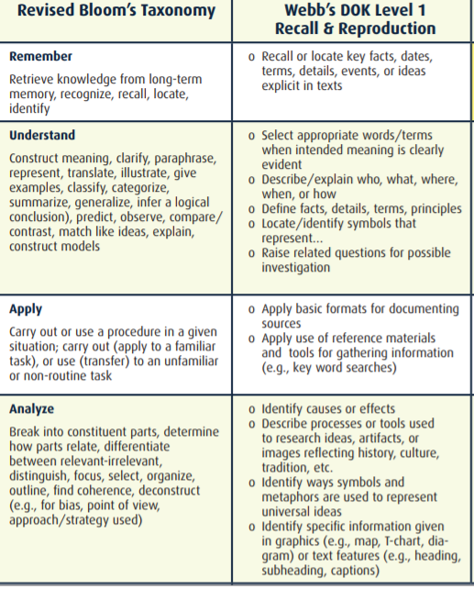
PLD and CRM
If we look at the verb in the example PLD we progressed from:
Identify
Determine
to :
Explain
Examine
Using the Cogntive Rigor Matrix and Performance Level Descriptors, decide how far into the matrix this standard is asking students to go.
Notes:
Now to connect those two resources:
If we look at the verb in the American Government PLD we can see that they progressed through blooms from:
Identify and
Determine
to higher levels of blooms using the verbs:
Explaining and
Examining
However, often times the tests do not simply progress through levels of blooms or what students know. They often include a range in depth of knowledge and test how well the students are able to use what they know to do a variety of cognitive tasks.
Both Blooms and Depth of knowledge levels are captured in the CRM shared with you in the resource folder, as shown on the following slide.
Using the Cogntive Rigor Matrix and Performance Level Descriptors, decide how far into the matrix this standard is asking students to go.

Slide 15
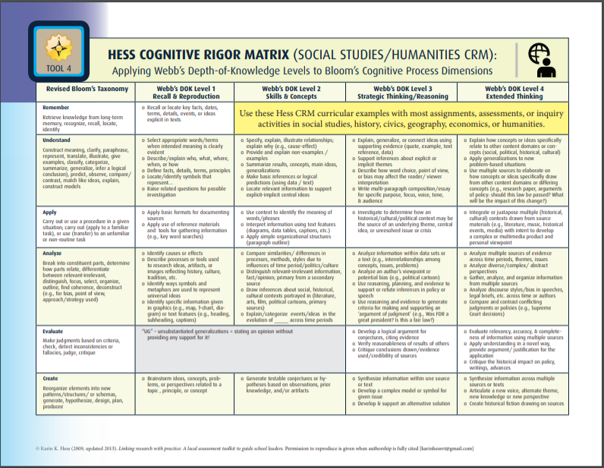
Notes:
Let’s look at the American Government Example:
How far does this standard require students to Cognitive Rigor Matrix?
ANIMATE
Your History department or American Government teacher might decide that the standard is really asking students to get to this level within the matrix because by examining a set of documents and explaining the relevance and credibility of each, students will essentially be working in Webb’s DOK level 3 because they will be strategically thinking or reasoning. For this standard, they will also be in working in the Analyze level of Blooms because they are analyzing information from multiple text and looking for how those concept apply to an issue and thus explaining how that relates to their credibility or relevance.
This step of determining where the standard is asking students to go in very important when using the CRM to help identify splinter skills for the Tip to Tip Learning Progression.

Slide 16
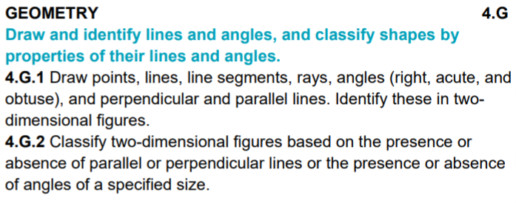
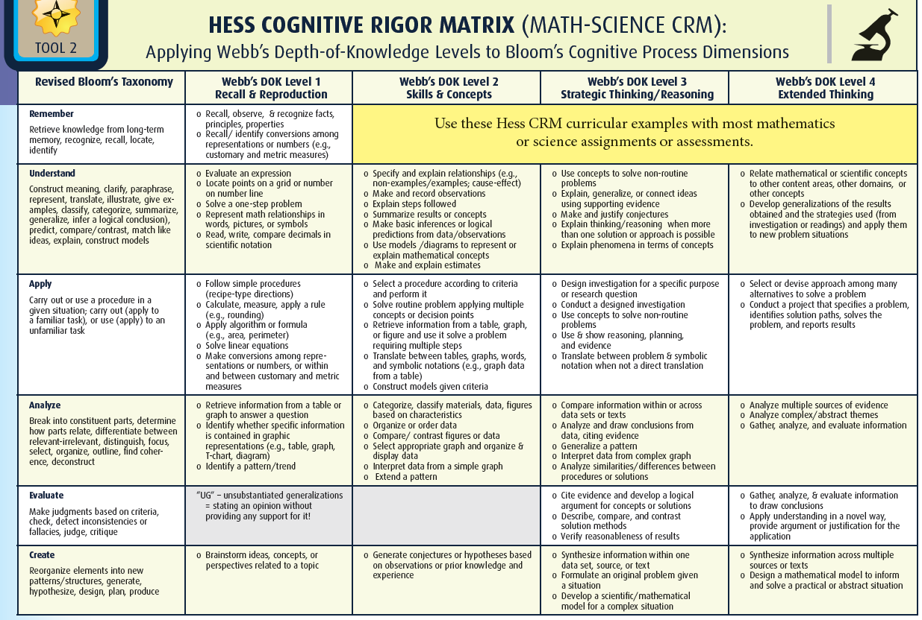
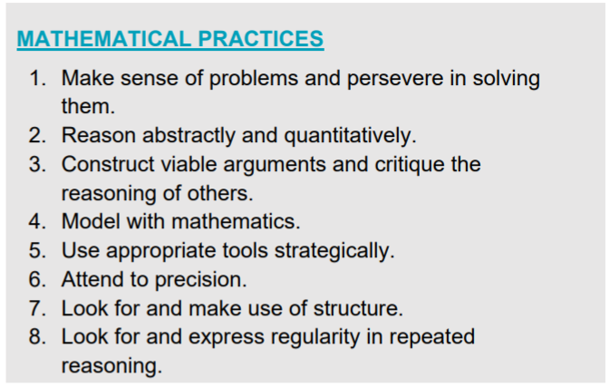
Practice on your own: Using the CRM
Using your standard and appropriate Cognitive Rigor Matrix, take a look at one of your standards. How far into the CRM is this standard requiring students to go for each level?
Notes:
Using your standard and appropriate Cognitive Rigor Matrix (meaning you would use math-science CRM if you are teaching math standards, etc), take a look at one of your standards.
How far into the CRM is this standard requiring students to go for each level?
Using the 4th grade math example 4.G.2. (read 4G.2- classify…..)
This teacher or teacher team has determined that this standard is asking students to get to the Analyze level of Blooms and into the DOK Level 2: or the Skills and Concepts column.
Once you have determined where your standard falls in the CRM you may resume this presentation
You may Pause the presentation

Slide 17
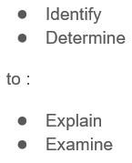
Notes:
When looking at both the Performance Level Descriptors and the Cognitive Rigor Matrix, you can see that the PLD provide a good start to deconstructing what students will be able to know and do, but are missing steps along the way. In a learning progression, those are referred to as splinter skills.
Looking at the American Government example again, there are missing steps along the way. Those steps that take a student from less to more complex parts of the standard are called splinter skills. In the Am Govt example, you can see that there are missing steps that would need to be included and explicitly taught for some students to help them get from the identify and determine part of the CRM ANIMATE to the Example and Explain level ANIMATE of the matrix, which is where this standard is taking each student.
Please note, some students will be able to progress quickly from left to right and down the matrix (or to higher levels of blooms). Those students, sometimes labeled as gifted or just coming to you with an abundance of background knowledge or a high level of interest in this standard, may benefit from a more compacted curriculum in regards to this standard/content.
For example, my friend teaches law, has written books on various topics such as the electoral college, appears on national televised political show, etc. At the dinner table, his family often has discussions around this very topic! His daughters, would have (potentially) more background in this area than perhaps my own children. Similarly, those involved in local political or social groups/organizations may have experience in these areas. Finally, those interested in a career in this field may be able to or motivated to move through the matrix at an accelerated pace.
This applies for any content area.
So that conversation regarding giftedness (whether identified or not) touches upon the need for a Tip to Tip learning progressions. Some students will be highly motivated or skilled in the standard and we need to include their learning needs in our progressions. However, we need to address the other Tip of the progression as well.

Slide 18
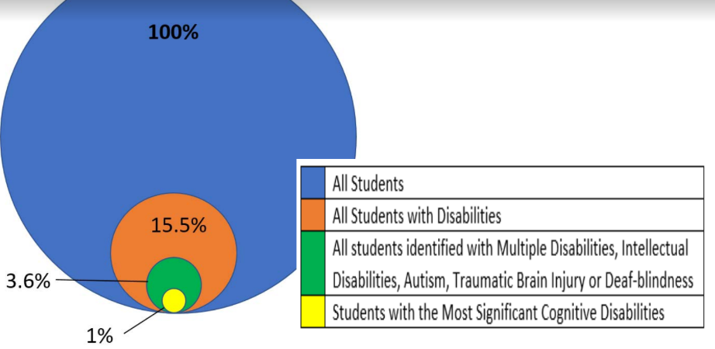
Tip to Tip Learning Progressions should include ALL
Notes:
Tip to Tip Learning Progressions for each standard should give ALL students access to each standard, even those in the 1% or those students with the most significant cognitive disabilities.
This would be the other Tip of the Tip to Tip learning progression.

Slide 19
Disclaimer
To include those students who are at the 1%, we include Ohio’s Learning Standards- Extended and the Learning Progressions that accompany them into our learning progressions for EACH standard.
Because these extended standards align to state standards, all students can benefit from these Learning Progressions.
Please Note: NOT ALL students will have an assessment goal based on the extended standards, those students would only consist of the 1% of the population that are taking an alternative assessment, the AASCD.
Students participating in general state assessments can benefit from the Building the Base Learning Progressions as ENTRY points for instruction. These MAY be formatively assessed TO GUIDE instruction only and are NOT appropriate for the end goal for most students.

Slide 20
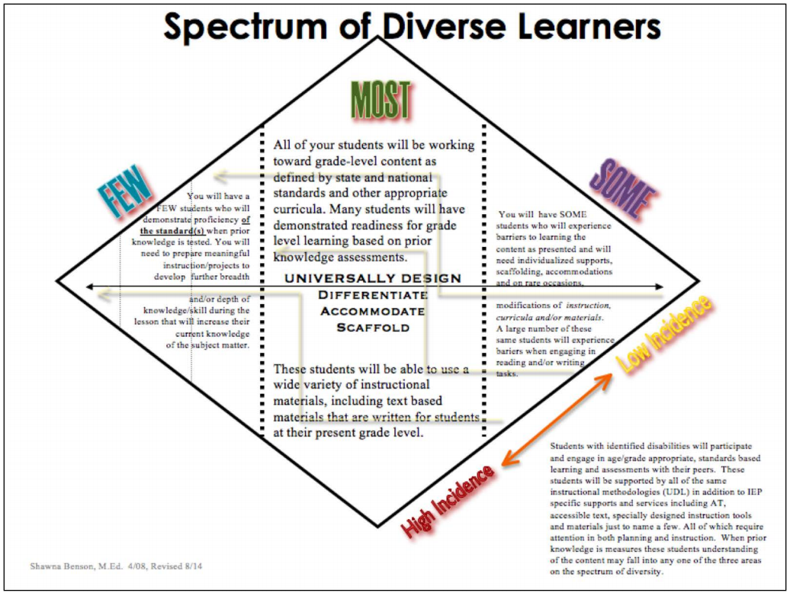
Notes:
Tip to Tip Learning Progression should include students at both ends to reach a spectrum of diverse learners.
This graphic, from the Shawna Benson and the diverse learning center at OCALI, shows the wide range of students that will be learning grade level standards. This graphic was really the basis for the tip to tip learning progressions and shows how it is designed to reach the FEW students who are moving beyond the standard to SOME of the students that are making progress toward grade level standards.
Because we want our students to have access to the high expectations the first and every time they are taught standards, we want to make sure we are really using the Universal Design for Learning framework to design lessons that include all learners.

Slide 21
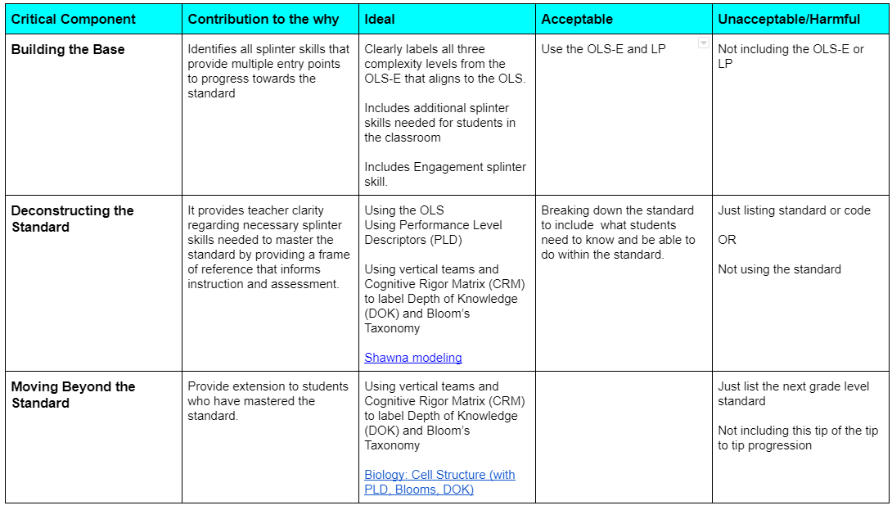
Practice Profile
Notes:
HANDOUTS
This Practice Profile was created as a way to guide you in creating a Tip to Tip Learning Progression for each of your standards.
(a practice profile defines actions that are necessary to create a tip to tip learning progression. This one shows three different levels of quality – ideal, acceptable, and unaccetbable/harmful--- in other words, what it is and what it is NOT)
It also includes the three main areas of a Tip to Tip LP which are: 1) Building the Base, 2) Deconstructing Grade Level Standard, and 3) Moving Beyond the Standard.
It also includes a statement indicating why each area is important and descriptions of what an ideal, acceptable, and unacceptable or harmful learning progression may include.
For example, it would be harmful for students to only have the grade level standard listed. This would be teaching only to the middle and ignoring students at the tips. This practice is harmful because it only sends a message of marginalization to those students.
See Todd Ross’s Myth of Average Video to hear more about the Myth of Average and having a strong belief that teachers should be designing to the edges.
The links can be used as resources.

Slide 22
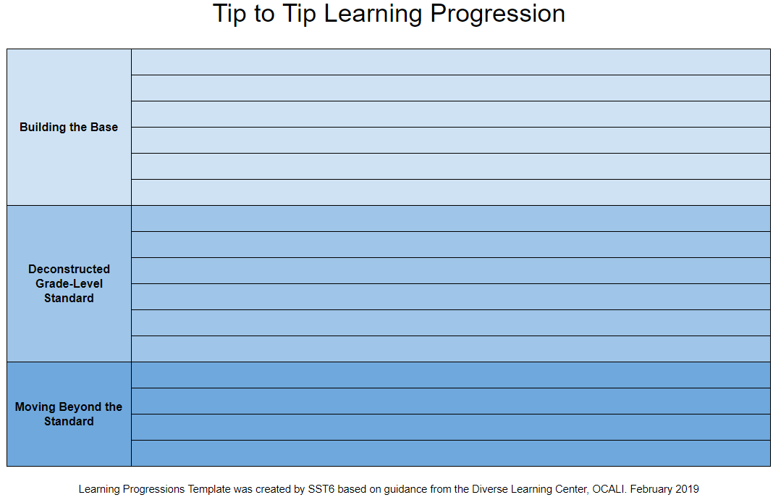
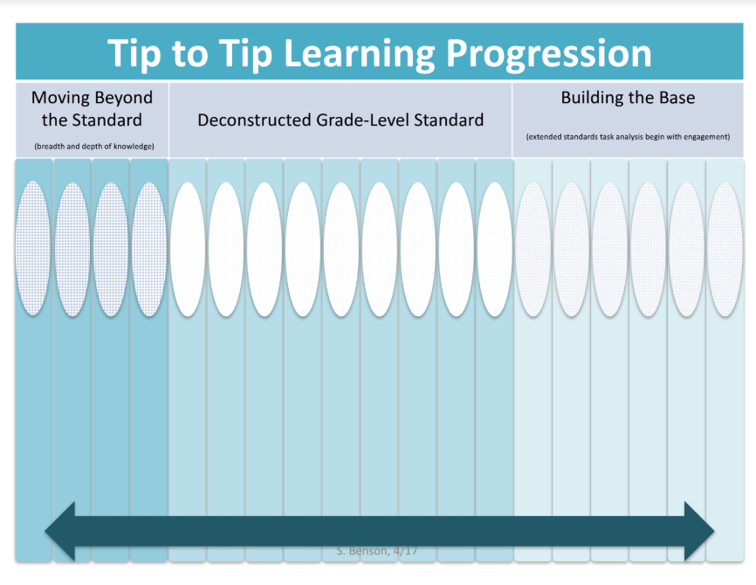
Templates
Notes:
In order to begin creating a Tip to Tip Learning Progression teachers can access many different templates.
Please note that the particular template is not important as long as it has some key components:
Clear Progression from LEAST to MOST complex that aligns with the three areas
Building the Base on the LEAST complex slide
Deconstructing Standards in the Center
Moving Beyond the Standard in the Most complex side
All splinter skills (as best as possible) follow the progress (meaning complexity A is closest to the grade level standard because it is the most complex of the extended standards).
The Engagement level is at the LEAST complex tip
Many of these are included in the Practice Profile.
I will quickly go through the process together. There will be a list at the end of the presentation to use to guide the creation of each level.

Slide 23
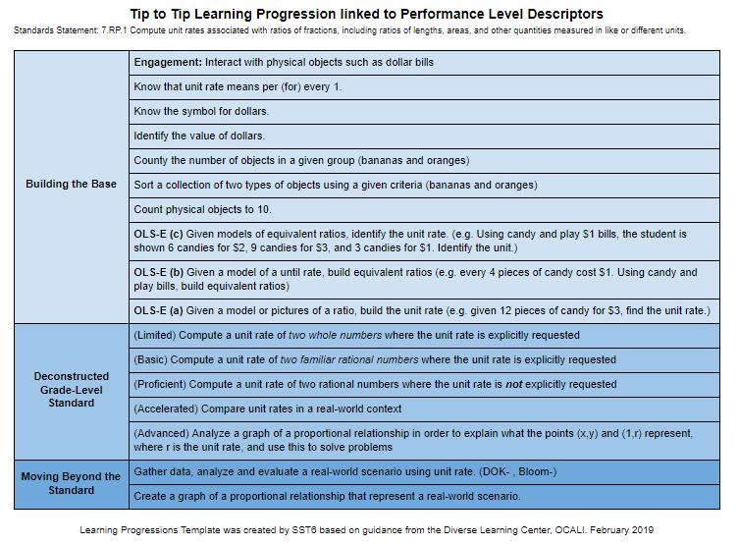
Notes:
Here is a mostly finished example of a 7th grade Tip to Tip Learning Progression one team created. We will look at this later in the presentation to examine whether or not this meets the IDEAL, acceptable, or unacceptable level according to our practice profile.

Slide 24

Five Part Series
Part One: Overview of Tip to Tip Learning Progressions
  Explore the concept tip to tip learning progressions and why they are necessary
  Access and practice using tools that can be helpful when creating splinter skills for each standard
Part Two: Building the Base
Part Three: Deconstructing the Standard
Part Four: Moving Beyond the Standard
Part Five: Critiquing Your Tip to Tip Learning Progression
Notes:
Congratulations! You have completed part one of the series!
You have just completed part one.
During part 2 we will begin to create a tip to tip learning progression, beginning with the building the base section.

Slide 25
Before moving on to part 2:
Bring:
  Standards and Learning Progressions Document
Notes:
Before moving on to session two, please make sure you have the learning progressions document that contains the grade level standard as it aligns to the extended standard AS well as the learning progressions that help to build the bridge from Engagement to Grade Level Standard for EACH STANDARD.
This document will help you to create the first part of your tip to tip learning progression.

Slide 26
Creating Tip to Tip Learning Progressions
Part TWO
Cherie Smith
SST6
As a part of the State System of Support, the State Support Team collaborates with schools, families and regional partners through a continuous improvement process to ensure each child in Ohio has access to a high-quality education. We focus on leadership and team development, and inclusive instruction practices to assist districts and schools in improving outcomes for each child.
Notes:
Hello and Welcome to Part 2 of Creating Tip to Tip Learning Progressions. My name is Cherie Smith and I am consultant for State Support Team 6.
As a part of the State System of Support, the State Support Team collaborates with schools, families and regional partners through a continuous improvement process to ensure each child in Ohio has access to a high-quality education. We focus on leadership and team development, and inclusive instruction practices to assist districts and schools in improving outcomes for each child.

Slide 27
5 Part Series Goal
Create an IDEAL Tip to Tip Learning Progression!
Notes:
The goal for this recording presentation is for audience members to be able to create an IDEAL Tip to Tip Learning Progression.

Slide 28
Five Part Series
Part One: Overview of Tip to Tip Learning Progressions
Part Two: Building the Base
  Access and use the Learning Progressions and Extended Standards to build splinter skills
Part Three: Deconstructing the Standard
Part Four: Moving Beyond the Standard
Part Five: Critiquing Your Tip to Tip Learning Progression
Notes:
So far you have completed part 1, the overview which guided you through the documents and ideas necessary to begin creating your own tip to tip learning progression.
Part two looks that creating the building the base section of a tip to tip learning progression.

Slide 29
Resource Folder Contents: Part 2
Building the Base Handout
Cognitive Rigor Matrices (Tools 1-8)
Template
Practice profile
QR code to Google Folder
Notes:
When you access the recording you should be able to download the handouts that accompany this training. Use the camera feature on your smartphone or a QR code reader to get a direct link to the google folder containing each of these handouts.
https://drive.google.com/drive/folders/1JxUoGchh5Z3oMp9UL6LsVkbpCGGxhRBa?usp=sharing

Slide 30
Resources and Acronyms
Acronym | Name and link to resource
OLS | Ohio’s Learning Standards
OLS-E | Ohio Learning Standards-Extended
LP | Ohio Learning Standards-Extended with Learning Progressions
CRM | Cognitive Rigor Matrix
PLD | Performance Level Descriptors
Splinter Skills | Or sub skill
Notes:
As a reminder, The resources I will be sharing in this series are listed here on the Resources and Acronyms Handout in the resources folder.

Slide 31
Practice Profile
Notes:
Also, as a reminder, this handout was reviewed during part 1 of the series.
It is a Practice Profile for creating a Tip to Tip Learning Progression for each of your standards.

Slide 32
Building the Base
Notes:
Ok. Let’s begin creating a practice profile!
First, we’ll start with building the base.
Regardless of Template, find the Building the Base section.
ANIMATE ARROWs
Read Practice Profile!

Slide 33
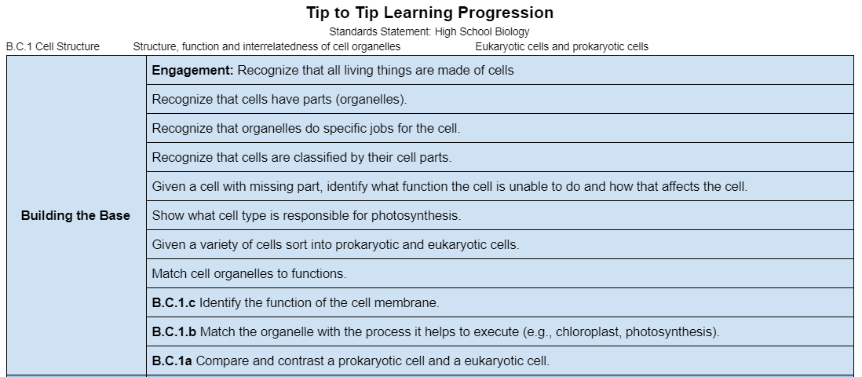
Notes:
Use your resources to include the LP and Extended standards in order from most to least complex, as show here.
Note that this will sometimes include splinter skills that represent mental processes or cognitive skills needed to ensure success in the standard. This would also include necessary background knowledge and may also include content learned in previous grades. Vertical alignment activities within the district would be evident in this area.
ANIMATE each arrow to point out needed components.
In my own experience planning with teachers for instruction and assessment as well as training high school teachers on learning progressions, MANY realize that what they are teaching each year can be found in the a, b, and complexities of the extended standards, and with some classes, students rarely move beyond those levels into grade level proficiencies/high levels of DOK.

Slide 34

Step 1: Build the Base
Using the OLS-E or OLS-E with LP resources, identify the standard (with the OLS-E that align to the OLS).
State the OLS on your Tip to Tip LP
Identify the Engagement Splinter Skill
List the Splinter Skills from Least to Most Complex (this comes from LP and teacher’s own knowledge)
Include the OLS-E complexities a, b, and c in the progression
Consider if you need additional splinter skills for your classroom.
Notes:
In the resources folder there is a handout that matches this slide. It contains the steps to take when creating the build the base section of the tip to tip learning progression.
Now it’s time to create your own!
Read the slide.
After this slide you may pause the video to complete the Building the Base portion of the Tip to Tip Learning Progression using the documents listed and pictured here. Feel free to restart the video when you are ready to proceed to deconstructing the standard.
Tip: Sometimes it can be helpful for vertical teams to have a discussion about what is required at previous grades.
Background knowledge from previous grades, if not learned, would be something to consider adding to your grade level learning progression in building the base or possible early in the deconstruction of grade level standard.
An example of this would be from a change in standards. If the new standards require information to be taught a earlier grades but the current students have not been taught those topics/skills/content you would want to include those concepts/skills as splinter skills in the learning progression, perhaps in the build the base section.
Disclaimer: There may be additional splinter skills your students need to build the base that are not in the LP document created by ODE and OCALI.
At this time you may pause the video to complete the Building the Base portion of the Tip to Tip Learning Progression using the documents listed and pictured here. Feel free to restart the video when you are ready to proceed to Deconstructing the Standard portion.

Slide 35

Self Reflection
Reflect on creating the building the base section your tip to tip learning progression; how did it go?
Did you create an ideal building the base? If not ideal, why?
What additional support do you need?
Remember, there are resources in folder and linked to the practice profile.
Notes:
Reflect on creating the building the base section your tip to tip learning progression; how did it go?
Did you create an ideal building the base? If not ideal, why?
What additional support do you need?
Remember, there are resources in folder and linked to the practice profile.

Slide 36
Five Part Series
Part One: Overview of Tip to Tip Learning Progressions
Part Two: Building the Base
  Access and use the Learning Progressions and Extended Standards to build splinter skills
Part Three: Deconstructing the Standard
Part Four: Moving Beyond the Standard
Part Five: Critiquing Your Tip to Tip Learning Progression
Notes:
Congratulations! You have completed part two of the series!
During part 3 we will continue creating a tip to tip learning progression, and moving onto with the deconstructing the standards section.

Slide 37
Before moving on to part 3:
Bring:
  Standards
  Performance Level Descriptors
    You may choose to use the list you made during part 1 that looked at one standard and how it progressed through performance levels.
  Appropriate Cognitive Rigor Matrix
  Tip to Tip Learning Progression from Part 2 (with the build the base section completed)
Notes:
Before moving on to part three, please make sure you (read the slide)

Slide 38
Creating Tip to Tip Learning Progressions
Part THREE
Cherie Smith
SST6
As a part of the State System of Support, the State Support Team collaborates with schools, families and regional partners through a continuous improvement process to ensure each child in Ohio has access to a high-quality education. We focus on leadership and team development, and inclusive instruction practices to assist districts and schools in improving outcomes for each child.
Notes:
Hello and Welcome to Creating Tip to Tip Learning Progressions. My name is Cherie Smith. I am consultant for State Support Team 6. There are 16 regions of State Support Teams in Ohio.
As a part of the State System of Support, the State Support Team collaborates with schools, families and regional partners through a continuous improvement process to ensure each child in Ohio has access to a high-quality education. We focus on leadership and team development, and inclusive instruction practices to assist districts and schools in improving outcomes for each child.

Slide 39
5 Part Series Goal
Create an IDEAL Tip to Tip Learning Progression!
Notes:
The goal for this series is to be able to create an IDEAL Tip to Tip Learning Progression.

Slide 40
Five Part Series
Part One: Overview of Tip to Tip Learning Progressions
Part Two: Building the Base
Part Three: Deconstructing the Standard
  Access and use Performance Level Descriptors and Cognitive Rigor Matrices to identify what students will be able to know and do
  Create splinter skills that range from least to most complex within each standard
Part Four: Moving Beyond the Standard
Part Five: Critiquing Your Tip to Tip Learning Progression
Notes:
In the first two parts of the series we learned (in part one) about learning progression, along with some tools to help us create them AND in part two we started creating our own tip to tip learning progression at the building the base section. ANIMATE ANIMATE
Part Three will move onto the next section, deconstructing the standard.

Slide 41
Resource Folder Contents: Part 3
Deconstructing the Standard Handout
Cognitive Rigor Matrices (Tools 1-8)
Template
Practice Profile
QR code to Google Folder
Notes:
Remember the resources for this part and the entire series can be found in the resources folder: https://drive.google.com/drive/folders/1JxUoGchh5Z3oMp9UL6LsVkbpCGGxhRBa?usp=sharing

Slide 42
Deconstructing the Standard
Notes:
For the next few slides you will need the Tip to Tip learning progression you began creating in sesion 2. The building the base section should be completed (although feel free to make edits as you move along through the series, when necessary).
Next, locate the deconstructing the standard section.
Unlike the building the base section, there are no state level documents that deconstruct each standard. If your district hasn’t participated in professional development unpacking or deconstructing standards this part may take more time. If your district HAS complete such training activities and produced resources such as curriculum maps and pacing guides aligned to the standards, those would be a good resources to include as well.
ANIMATE ARROWs
Read Practice Profile

Slide 43
Notes:
Here is a mostly finished example of a 7th grade Tip to Tip Learning Progression one team created. In this example, you can see that the deconstructing the standard portion of the tip to tip learning progression is in the middle of the template. It has included and labeled the Performance Level Descriptors for that grade level.

Slide 44
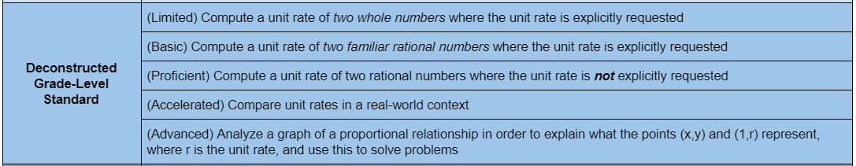
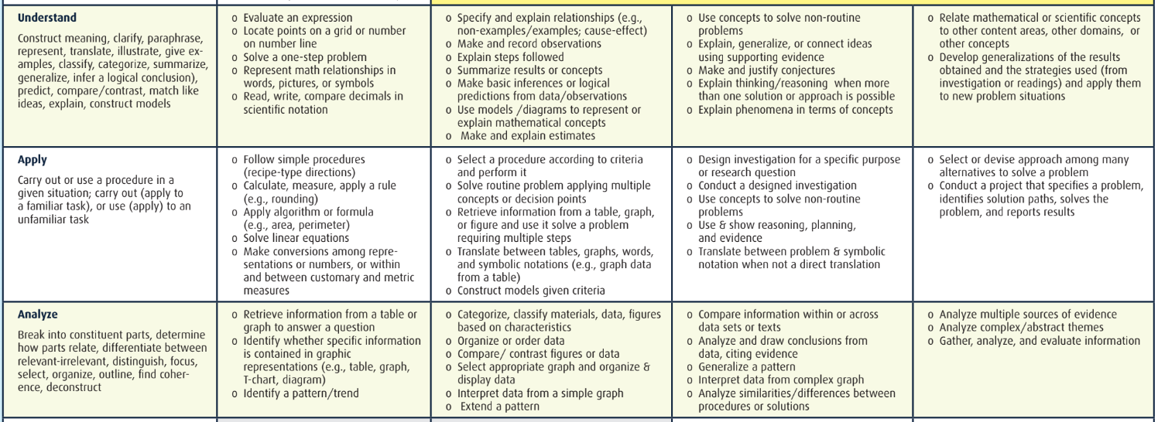
Example with only PLD
Notes:
Note that this example, taken from the previous slide, is missing splinter skills. Since this team ONLY included performance level descriptors, many steps in cognition have be not be considered.
In my experience, this is a common practice among teachers. I have had many teachers realize, after looking at the CRM, that they are beginning instruction at a DOK too high for many of their students and have to plan for ways to build their understanding before teaching and assessing them at high DOK levels.
In this example,
ANIMATE twice: The teacher are PLDs are somewhere in this level of blooms and DOK
ANIMATE again
This level of DOK is asking students to use concepts to solve non-routine problems to be proficient.
Additionally, they are being asked to compare. ANIMATE
And then to score advanced to Analyze ANIMATE
ANIMATE arrow: to get to the next PLD (Accelerated) students will need to be able to apply this learning to other concepts or real-world scenarios.
ANIMATE next arrow.
This is taking them from Blooms understanding DOK 3 to DOK 4 and then to Blooms Analyze level at DOK 2, skipping DOK 1. Again, some students, probably those successful earlier on with this content have probably mastered that splinter skill in previous grades or lessons. Others, those with disabilities or gaps in learning, may not be able to automatically fill in this skill and be ready for the next splinter skill.
ANIMATE final arrow:
Before students can analyze multiple sources, they may need to compare data sets or text and note difference, then have a conversation, practice, and feedback around possible causes/outcomes for the differences.
Finally, many teachers I work with find that they are not even trying to reach Advanced or Accelerated levels with most of their students. Sometimes this is due to unintentional tracking within the school system where teachers are only getting the lowest 20% of students in their tested area. However, research clearly shows the negatively effects of such ability grouping. Students of all levels should be able to interact in heterogeneous groups with students of multiple performance levels.
We must move all students, even those with disabilities, towards higher levels. This is how teachers can have high expectations for ALL students STANDARD by STANDARD.

Slide 45
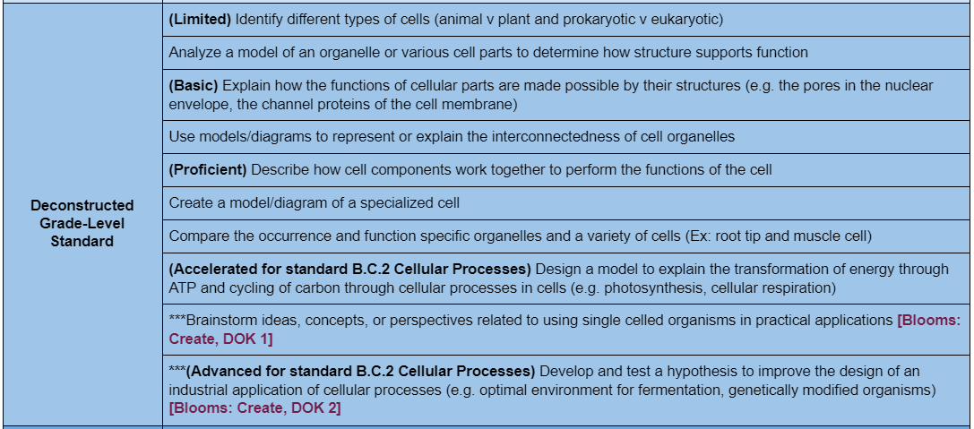
Notes:
This next example shows how one teacher has used the PLD as a starting point for her deconstruction. Her district did NOT have any deconstruction or unpacking resources available as a starting point.
Here you can see, that she looked at what necessary splinter skills might be to move students beyond building the base and through the PLD.
ANIMATE top three arrows.
When she examined the PLD for this standard, she could not find any for the Accelerated or Advanced PLD. Also, since this is a Biology example, many standards build and related together in themes. She considered how the students would use this information and decided that it was best applied along with another standard.
There is no “right or Wrong” necessarily. Districts, Curriculum Directors, and teams can determine what makes sense for their content.

Slide 46
Step 2: Deconstruct Grade Level Standard
Breakdown what the student will need to know and be able to do to master the grade level standard.
Use the Practice Profile to guide your practice
Look at the verb(s)
Multiple ideas within the standard may need to be broken into individual splinter skills
Include cognitive processes as splinter skills
Consider barriers when teaching this standard
Use the Performance Level Descriptors so your progression can align to state assessments.
Use Cognitive Rigor Matrix for your content area to help identify gaps in Blooms and DOK that may need to be filled with splinter skills.
Notes:
Read the slide
At this time you may pause the video to complete the Deconstructing the Standard portion of the Tip to Tip Learning Progression using the documents listed and pictured here. Feel free to restart the video when you are ready to proceed to Moving Beyond the Standard portion.

Slide 47
Self Reflection
Reflect on the deconstructing the standard portion of your learning progression; how did it go?
If you did not get to ideal level, why?
What additional support do you need?
Remember, there are resources in folder and linked to the practice profile like the link pictured here.
Notes:
Reflect on the deconstructing the standard portion of your learning progression; how did it go?
If you did not get to ideal level, why?
What additional support do you need?
Remember, there are resources in folder and linked to the practice profile, like the link pictured here. This particular link includes Shawna Benson from the Diverse Learning Center of OCALI calling out the verb from the standard.

Slide 48
Five Part Series
Part One: Overview of Tip to Tip Learning Progressions
Part Two: Building the Base
Part Three: Deconstructing the Standard
  Access and use Performance Level Descriptors and Cognitive Rigor Matrices to identify what students will be able to know and do
  Create splinter skills that range from least to most complex within each standard
Part Four: Moving Beyond the Standard
Part Five: Critiquing Your Tip to Tip Learning Progression
Notes:
Congratulations! You have completed part three of the series! ANIMATE ANIMATE ANIMATE
During part 4 we will continue creating a tip to tip learning progression by completing the moving beyond the standard portion.

Slide 49
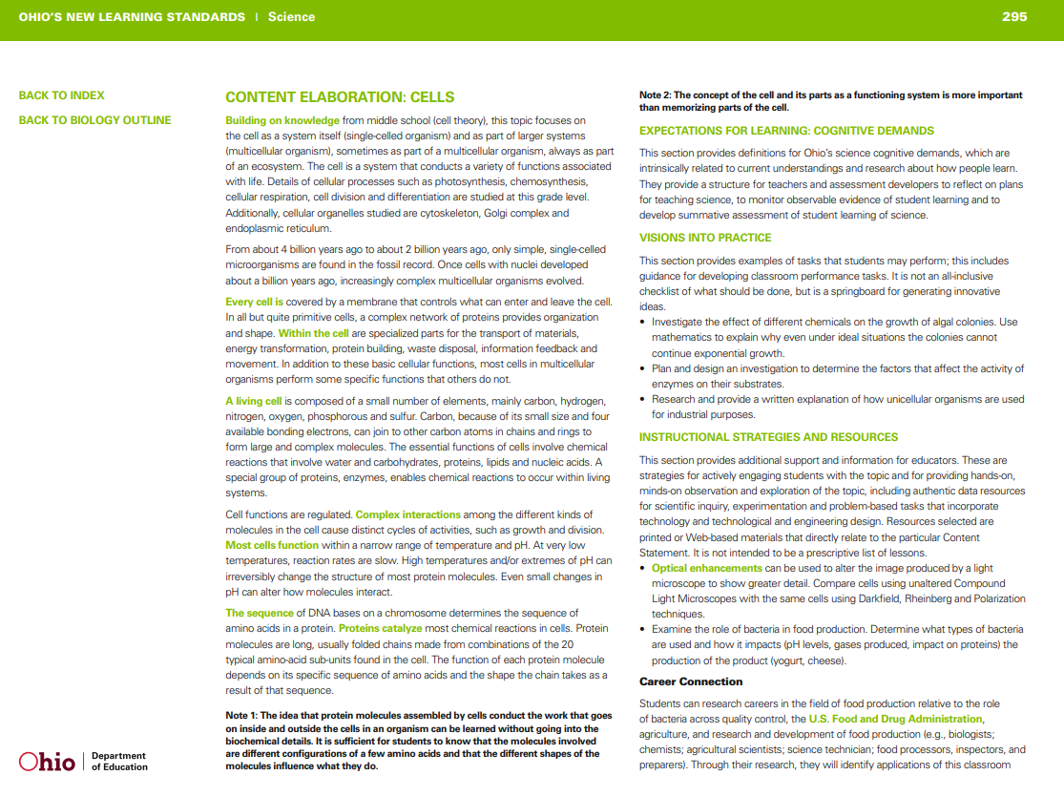
Before moving on to part 4:
Bring:
  Standards Documents (content elaboration or additional info)
  Appropriate Cognitive Rigor Matrix
  Tip to Tip Learning Progression from Part 3 (with the build the base section and deconstructing the standard sections completed)
  Any other resources your district is using to guide lesson design including:
    Model curriculum – college and career connections
    Project or Problem Based Learning Materials
    Real world experience or Opportunities
Notes:
Before moving on to part four, please make sure you have the following….

Slide 50
Creating Tip to Tip Learning Progressions
Part FOUR
Cherie Smith
SST6
As a part of the State System of Support, the State Support Team collaborates with schools, families and regional partners through a continuous improvement process to ensure each child in Ohio has access to a high-quality education. We focus on leadership and team development, and inclusive instruction practices to assist districts and schools in improving outcomes for each child.
Notes:
Hello and Welcome to Creating Tip to Tip Learning Progressions. My name is Cherie Smith. I am consultant for State Support Team 6. There are 16 regions of State Support Teams in Ohio.
As a part of the State System of Support, the State Support Team collaborates with schools, families and regional partners through a continuous improvement process to ensure each child in Ohio has access to a high-quality education. We focus on leadership and team development, and inclusive instruction practices to assist districts and schools in improving outcomes for each child.

Slide 51
5 Part Series Goal
Create an IDEAL Tip to Tip Learning Progression!
Notes:
The goal of this series to be able to create an IDEAL Tip to Tip Learning Progression. We will look at a few examples of Learning Progressions and talk a bit about what it takes to write an IDEAL Tip to Tip Progression.

Slide 52
Five Part Series
Part One: Overview of Tip to Tip Learning Progressions
Part Two: Building the Base
Part Three: Deconstructing the Standard
Part Four: Moving Beyond the Standard
  Use tools such as the Cognitive Rigor Matrix to create splinter skills that go beyond the standard
  Consider how creating splinter skills at both tips of the learning progression can benefit all learners
Part Five: Critiquing Your Tip to Tip Learning Progression

Slide 53
Resource Folder Contents: Part 4
Moving beyond Standard Handout
Cognitive Rigor Matrices (Tools 1-8)
Template
Practice Profile
QR code to Google Folder
Notes:
https://drive.google.com/drive/folders/1JxUoGchh5Z3oMp9UL6LsVkbpCGGxhRBa?usp=sharing

Slide 54
Moving Beyond the Standard
Notes:
Finally, the third section, moving beyond the standard, is one that many teachers may be uncomfortable with completing at first. I would recommend consulting with curiculum leads or gifted interventionists if your district has access to these professionals.
If not, again the cognitive rigor matrix can help teachers move deeper within the standard without simply moving to the next grade level standard.
ANIMATE ARROWs
Read Practice Profile

Slide 55
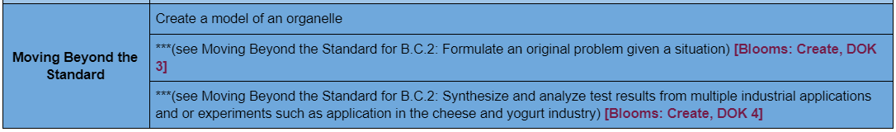
Notes:
Let’s begin by looking at the end of deconstructing the standard. Note, that some districts consider the accelerated and advanced levels as moving beyond the standard. However, since there are students who in many grades and content areas are beginning the year already mastering these levels. Those students need stretch as well. Therefore, we in our region include the accelerated and advanced performance levels within the deconstructing the standard block.
Using the Biology example, beginning with the higher DOK of the Deconstructing the Standard section, you can see how the CRM has informed this teacher’s decisions for Cellular Processes Learning Progressions. You can see that the PLD is at the CREATE level of BLOOMS. ANIMATE CIRCLE
ANIMATE ARROW
The PLD then moves to DOK 2 ANIMATE CIRCLE and ARROW
This teacher wanted to support students by adding a splinter skill that asks them to brainstorm ideas or concepts as a scaffold to their thinking before requiring them to generate or develop a test for a hypothesis. Again, many students may come with this skill and begin to brainstorm on their own while others will need this scaffold in cognition.
NOW TO MOVE BEYOND THE STANDARD you can see this pattern continued:
If you have students that can develop and test a hypothesis already (achieving at the advanced level) HOW would you help them to keep learning and going deeper? Well look at your matrix.
The next level of DOK, is DOK 3 ANIMATE ARROW
This teacher used this box, second bullet point, as a guide to help her think how she can keep growing her high performing students.
Continue with application (and using the Content Elaboration guide provided by the department of education), she was able to keep going with this particular standard into DOK 4. ANIMATE ARROW
ANIMATE CIRCLE: by asking students to synthesize and analyze test results from multiple application and or experiments such as the application in the cheese and yogurt industry. See this handout for more details and links to articles relating to this topic.

Slide 56
Putting it all together
Tip to Tip Learning Progression
Yogurt Example

Slide 57
Step 3: Moving Beyond the Standard
Use the Cognitive Rigor Matrix to determine how to increase DOK in the current level of Blooms
Use Cognitive Rigor Matrix to increase level of Blooms
Continue to move toward higher levels of DOK
Tip:
Connect to Real World and Careers
Real world applications allows students from both “tips” to benefit from real/concrete examples
Considering Social Emotional Learning needs/Emotional Intelligence. These may be included within your progressions.
Notes:
Read the Slide.
At this time you may pause the video to complete the Moving Beyond the Standard portion of the Tip to Tip Learning Progression using the documents listed and pictured here. Feel free to restart the video when you are ready to proceed to Final Slides.
Tip: Also Consider the Content Elaboration information provided by the department of education and found within the standards information.

Slide 58
Self Reflect
Reflect on your moving beyond the standard portion of your tip to tip learning progression; how did it go?
If you did not get to ideal level, why?
What additional support do you need?
Remember, there are resources in folder and linked to the practice profile.

Slide 59
Five Part Series
Part One: Overview of Tip to Tip Learning Progressions
Part Two: Building the Base
Part Three: Deconstructing the Standard
Part Four: Moving Beyond the Standard
  Use tools such as the Cognitive Rigor Matrix to create splinter skills that go beyond the standard
  Consider how creating splinter skills at both tips of the learning progression can benefit all learners
Part Five: Critiquing Your Tip to Tip Learning Progression

Slide 60
Before moving on to part 5:
Bring:
  Tip to Tip Learning Progression from Session 4 (including all three parts completed)
Notes:
Before moving on to session five, please make sure you have your Tip to Tip Learning Progression you worked on in session 2, 3, and 4.

Slide 61
Creating Tip to Tip Learning Progressions
Part FIVE
Cherie Smith
SST6
As a part of the State System of Support, the State Support Team collaborates with schools, families and regional partners through a continuous improvement process to ensure each child in Ohio has access to a high-quality education. We focus on leadership and team development, and inclusive instruction practices to assist districts and schools in improving outcomes for each child.
Notes:
Hello and Welcome to Creating Tip to Tip Learning Progressions. My name is Cherie Smith. I am consultant for State Support Team 6. There are 16 regions of State Support Teams in Ohio.
As a part of the State System of Support, the State Support Team collaborates with schools, families and regional partners through a continuous improvement process to ensure each child in Ohio has access to a high-quality education. We focus on leadership and team development, and inclusive instruction practices to assist districts and schools in improving outcomes for each child.

Slide 62
5 Part Series Goal
Create an IDEAL Tip to Tip Learning Progression!
Notes:
The goal for this recording presentation is for audience members to be able to create an IDEAL Tip to Tip Learning Progression. We will look at a few examples of Learning Progressions and talk a bit about what it takes to write an IDEAL Tip to Tip Progression.

Slide 63
Five Part Series
Part One: Overview of Tip to Tip Learning Progressions
Part Two: Building the Base
Part Three: Deconstructing the Standard
Part Four: Moving Beyond the Standard
Part Five: Critique Your Tip to Tip Learning Progression
  Reflect on the learning progression you have created
  Identify next steps in your learning

Slide 64
Resource Folder Contents: Part 5
Example Learning progression
Practice profile
Tips for Curriculum Teams or Directors
QR code to Google Folder
Notes:
https://drive.google.com/drive/folders/1JxUoGchh5Z3oMp9UL6LsVkbpCGGxhRBa?usp=sharing

Slide 65
Notes:
Here again is the example of a 7th grade Tip to Tip Learning Progression.
At this time, you may want to pause the video with your team and with the use of the Tip to Tip Learning Progression Practice Profile, determine if this would fall within the IDEAL, ACCEPTABLE, or UNACCEPTABLE category for each area of the learning progression (building the base, deconstructing the standard, and moving beyond the standard).
Have a conversation with your team about what you liked and what could be improved.

Slide 66
Practice Profile
Notes:
You may have rated this Tip to Tip Learning Progression in a similar fashion.
Warm feedback to this teacher or teacher team might be that you like the idea of include or labeling blooms and level of DOK.
Cool feedback might be that the teacher or team needs to consider other splinter skills in the deconstruction of the standard section BEYOND just listing the PLD.

Slide 67
Practice Profile
Notes:
HANDOUTS
This Practice Profile was created as a way to guide you in creating a Tip to Tip Learning Progression for each of your standards.
It includes the three main areas of a Tip to Tip LP which are: 1) Building the Base, 2) Deconstructing Grade Level Standard, and 3) Moving Beyond the Standard.
It also includes a statement indicating why each area is important and descriptions of what an ideal, acceptable, and unacceptable or harmful learning progression may include.
For example, it would be harmful for students to only have the grade level standard listed. This would be teaching only to the middle and ignoring students at the tips. This practice is harmful because it only sends a message of marginalization to those students.
See Todd Ross’s Myth of Average Video in the resources folder to hear more about the Myth of Average and having a strong belief that teachers should be designing to the edges.
Now that your team has had time to create a Tip to Tip Learning Progression that includes all students (even those that might not be in your classroom yet) you can begin to critique your own Tip to Tip Progression.
Take a look at each critical component. Analyze the why and determine which level you were able to achieve. If you are not at the Ideal level, why? What additional support, training, or resources might be helpful to achieve that level of implementation.

Slide 68

What’s next in your learning?
Notes:
Finally, identify some next steps in your learning.
Do you need to know how to incorporate Learning Progressions into lesson design? TBT conversations and continuous improvement?
Take a second to jot down your thoughts and remember to share them with your leadership.

Slide 69
Five Part Series
Part One: Overview of Tip to Tip Learning Progressions
Part Two: Building the Base
Part Three: Deconstructing the Standard
Part Four: Moving Beyond the Standard
Part Five: Critiquing Your Tip to Tip Learning Progression
  Reflect on the learning progression you have created
  Identify next steps in your learning

Slide 70
Coming Soon!
After teachers gain teacher clarity (.75 Effect Size) from creating Tip to Tip Learning Progressions, it is important that they begin to integrate them into lesson design AND make them visible to their students.
The next webinar series will address ways to effectively use Tip to Tip Learning Progressions in lesson design, assessment, teacher based teams, and individual education programs.
Notes:
Congratulations on completing your tip to tip learning progression!
Coming soon!
One tip would be to include them in your lesson plans in order to begin to really use them to inform lesson design.

Slide 71
Special Thanks to my PARTNERS
Shawna Benson, Program Director of the Diverse Learning Center at OCALI
Becky Rees, Director SST6
SST6 Consultants on the Special Ed Team: Kim Moritz, Tiffini Flugga, Caryn Timmerman, Michele Bambauer, and my officemate, Michelle Vandemark.
Vaughn Ray, Curriculum Director
Chad Brinkman, High School Principal and Maureen Rentz, Special Education Director.
Pam VanHorn, OLi4 and national speaker: Brandon Doubek, EdSuccess LLC

