Slide 1

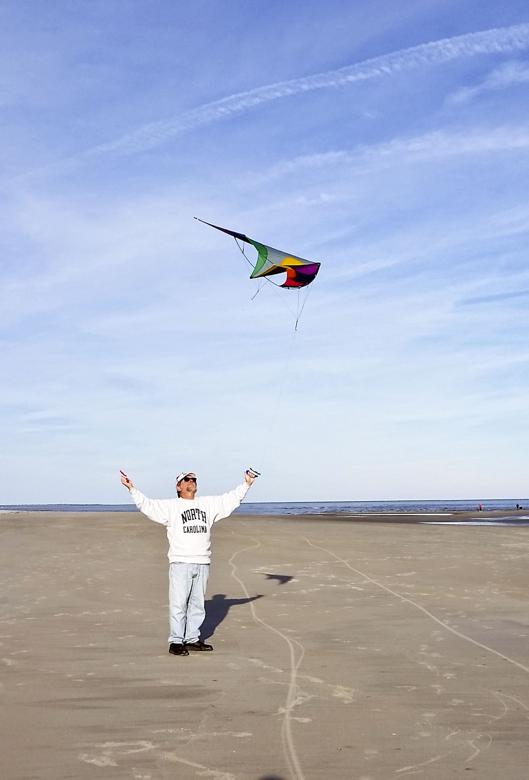

Play, Recreation and leisure: personal and professional perspectives
North west university, Potchefstroom campus, march 2017

Slide 2


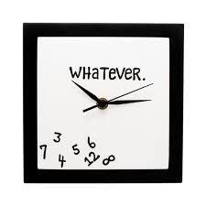
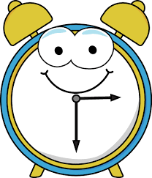
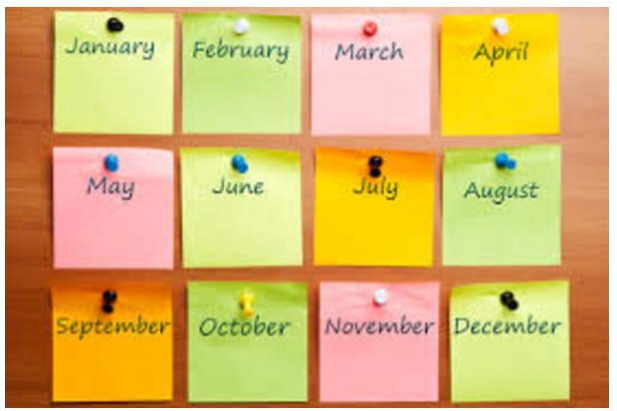

time
8, 760 hours
What are you doing with the other 2/3s?
7.14 hours of sleep on average or 1/3 of your life.

Slide 3
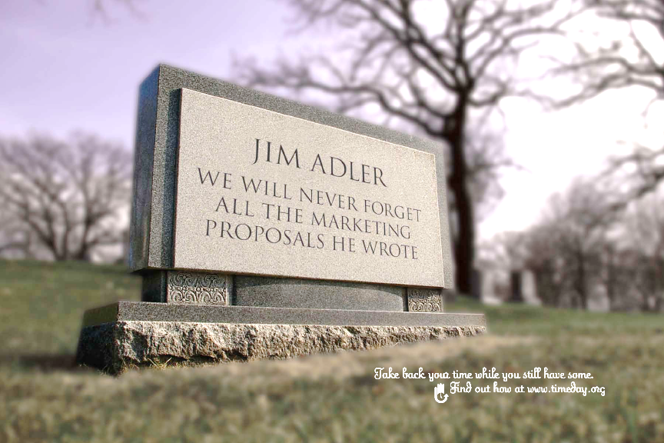

Slide 4
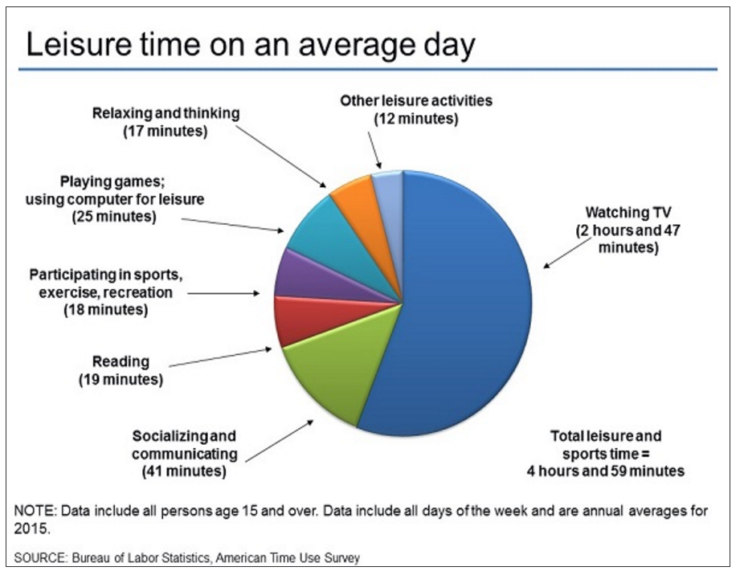
How do nwu students spend their time?
?
?
?
American College Students from 2011-2015

Slide 5
American College Students from 2011-2015
Have you ever done a time diary?
Try it, you’ll be surprised.

Slide 6
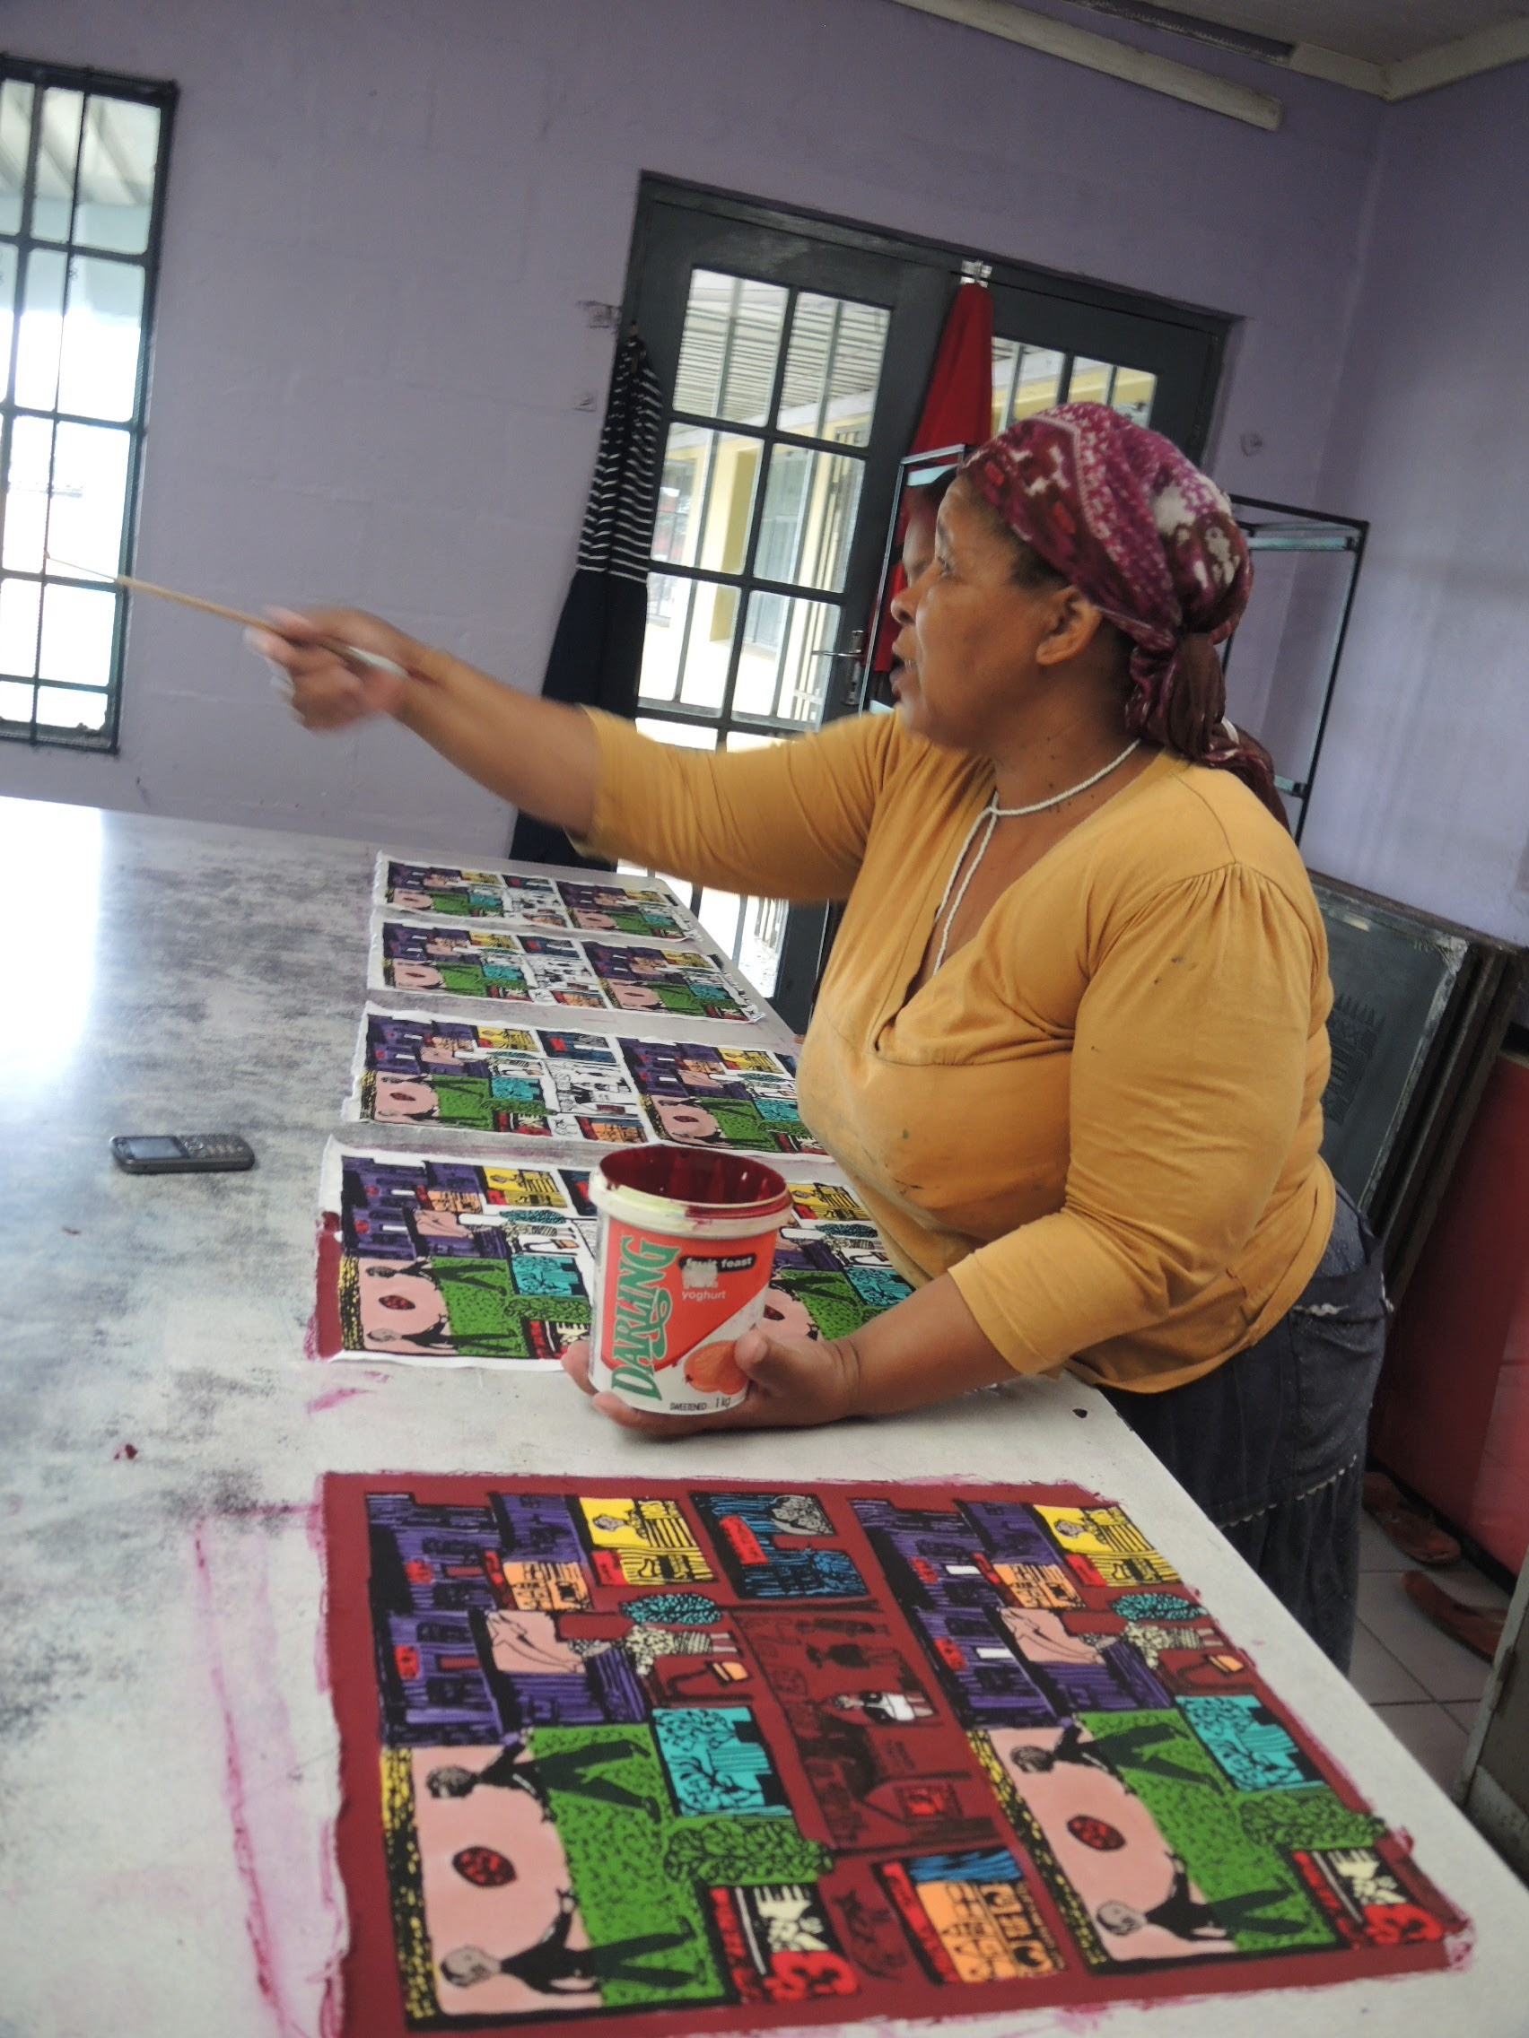
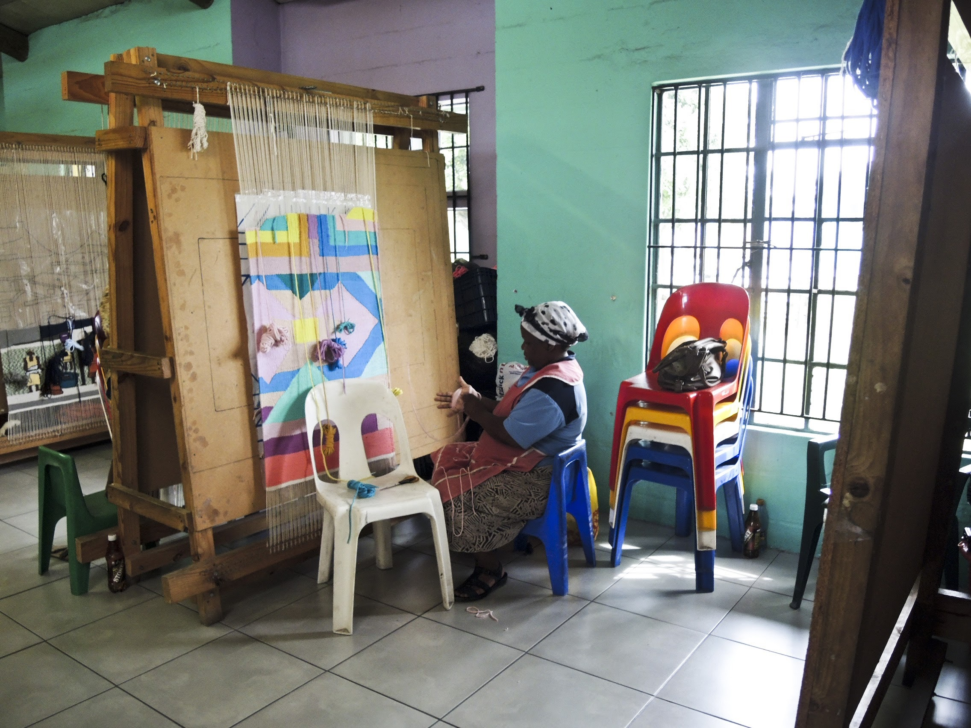
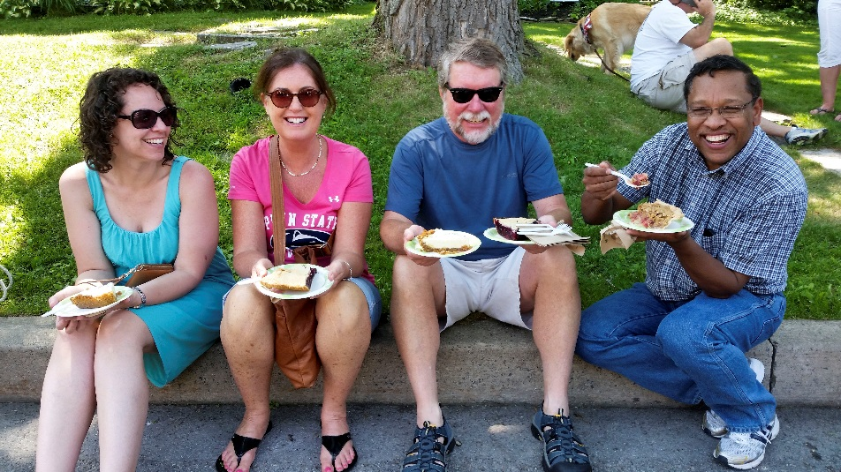
Leisure

Slide 7
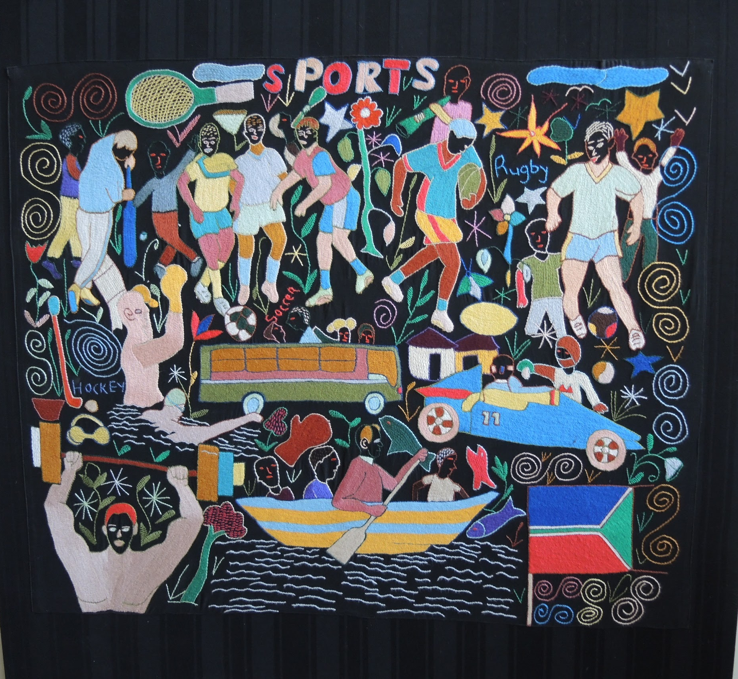
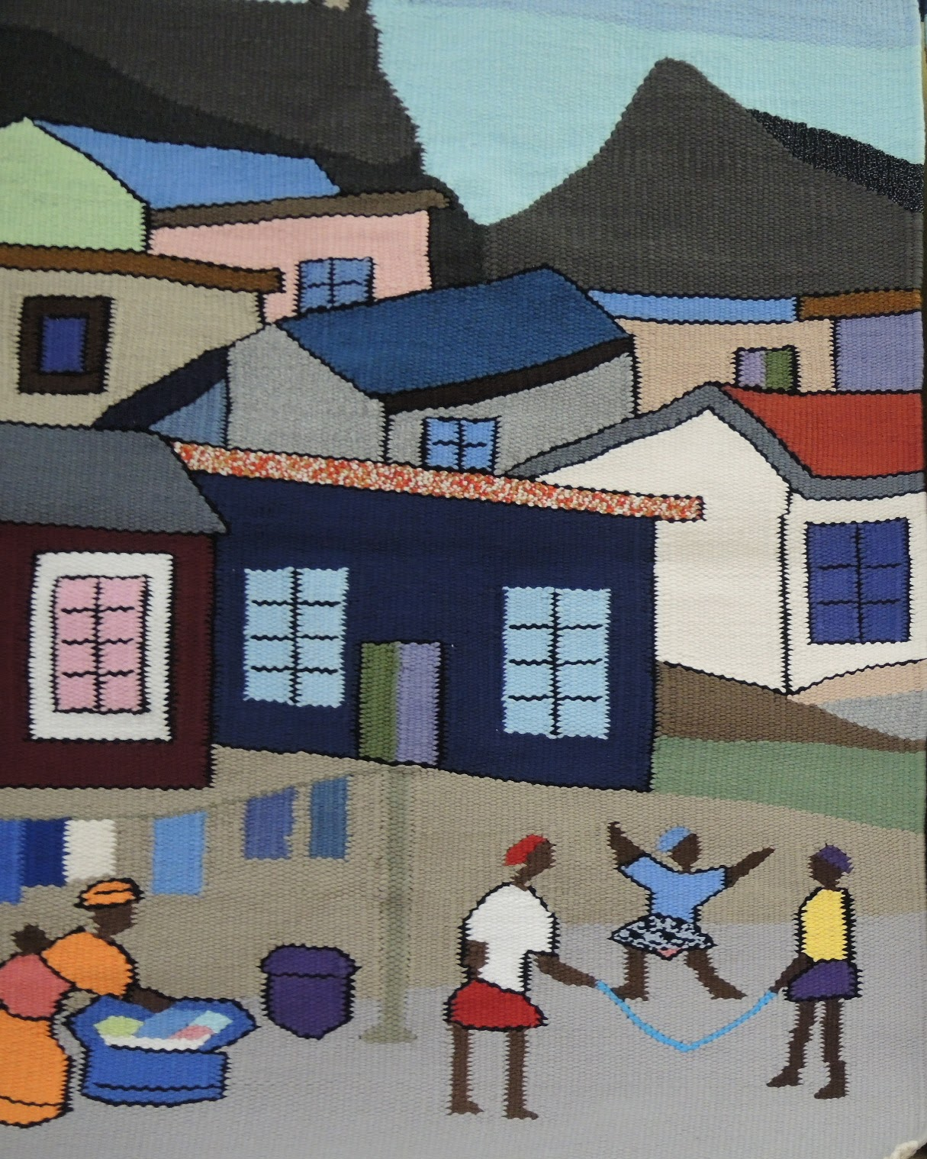
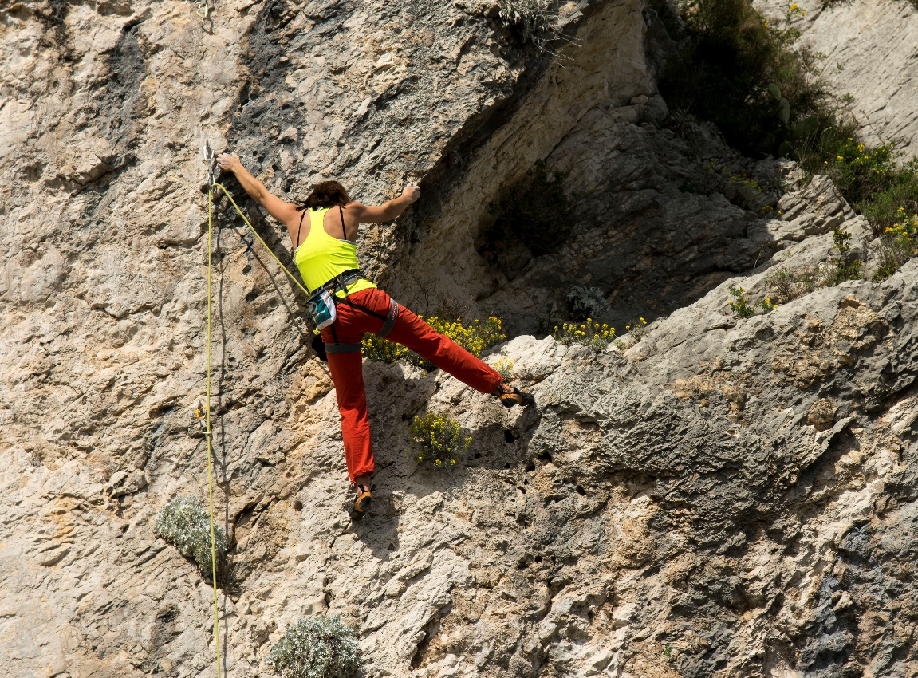
Recreation = re=creation

Slide 8
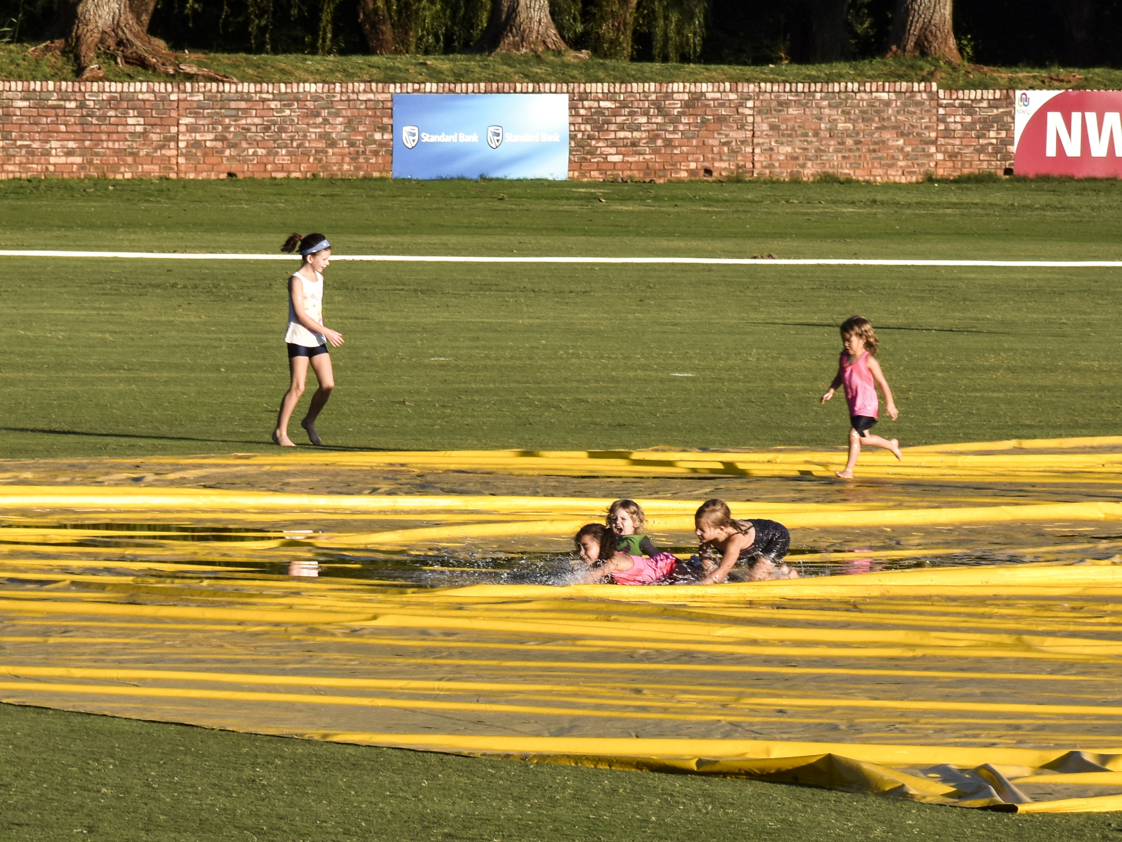

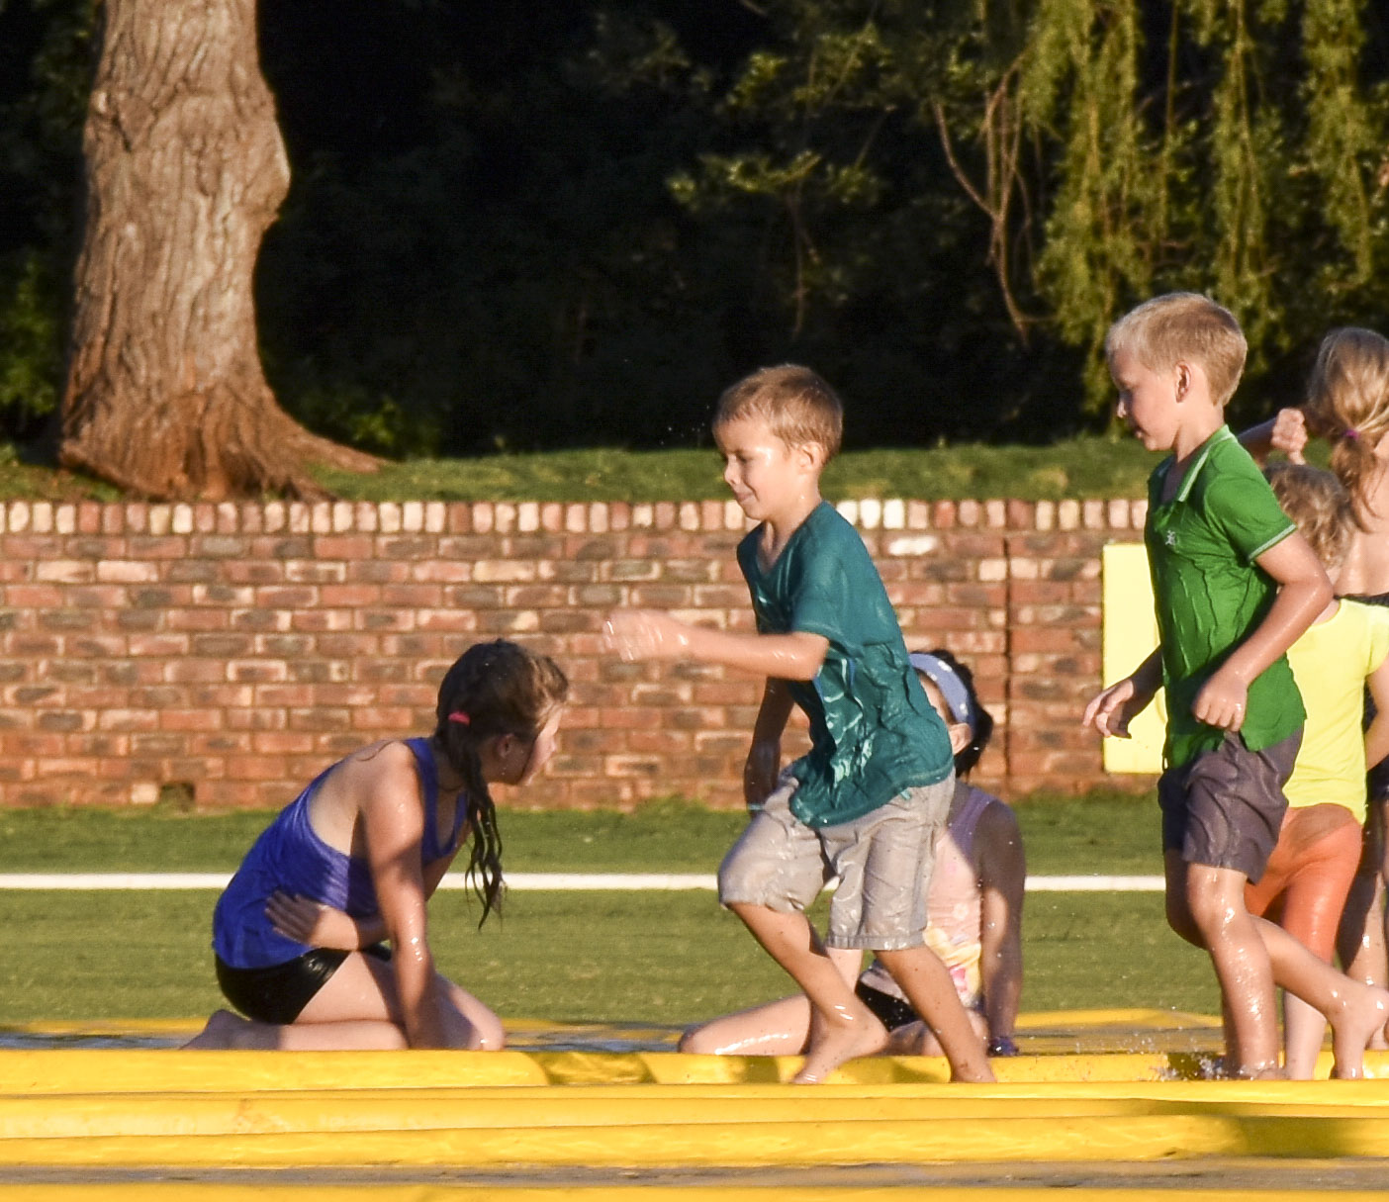
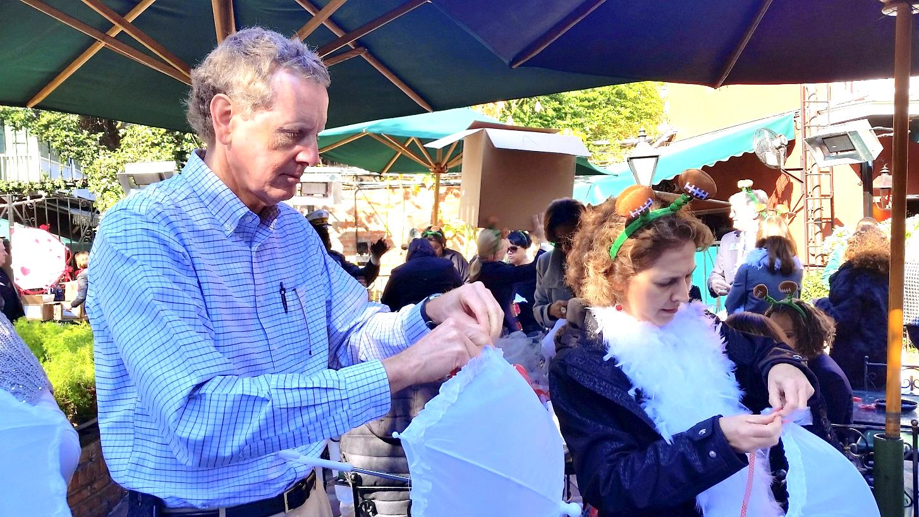
Play

Slide 9
Play

Slide 10



Slide 11
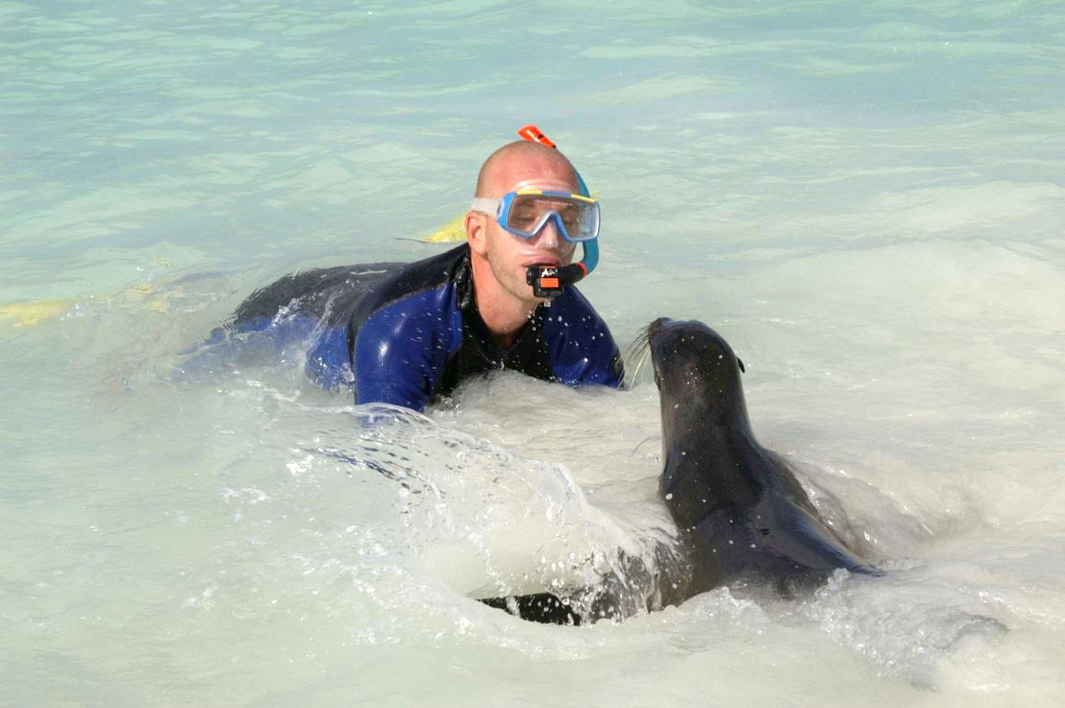
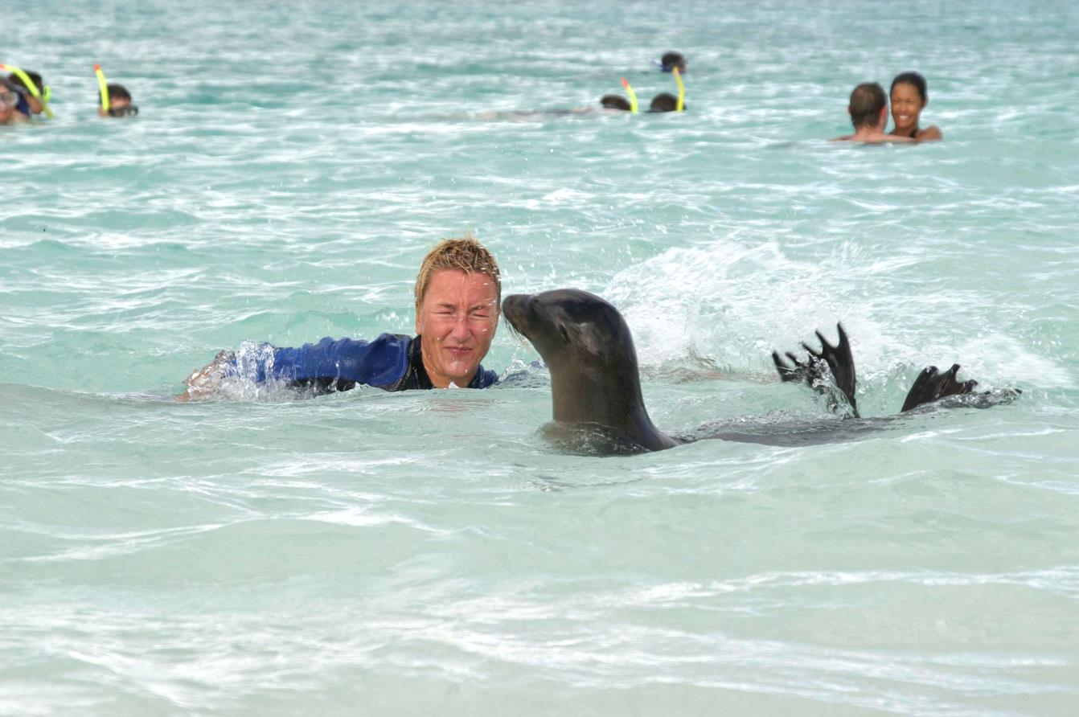
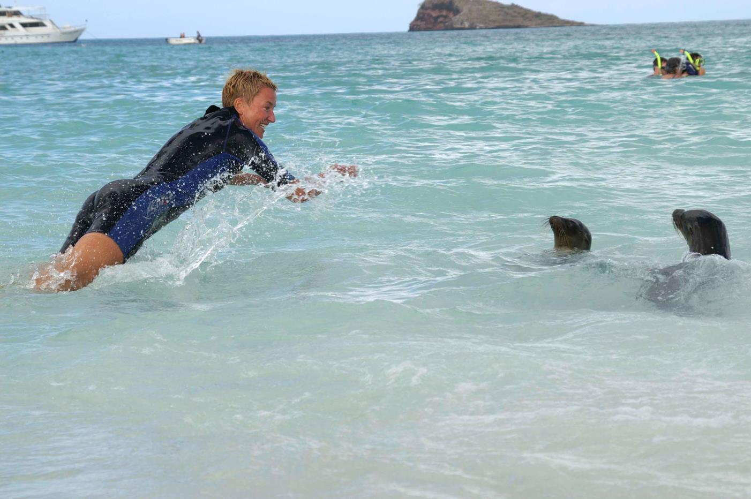

Slide 12
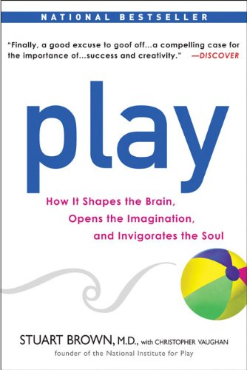
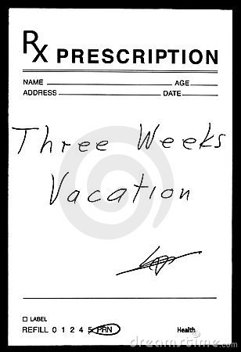


Slide 13

https://usplaycoalition.org/2017panel

Slide 14

Why??? Why is leisure important to human potential?
Brainstorm time: Identify five reasons

Slide 15
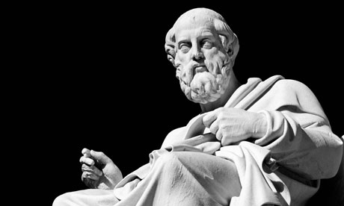
Proper use of leisure = main
focus of life
Balance of body and mind
Plato
424 ⁻ 347 BCE
Notes:
428/427 or 424/423^{[b]} – 348/347 BCE) was a philosopher in Classical Greece and the founder of the Academy in Athens, the first institution of higher learning in the Western world. Along with his teacher, Socrates, and his most famous student, Aristotle, Plato laid the very foundations of Western philosophy and science.

Slide 16
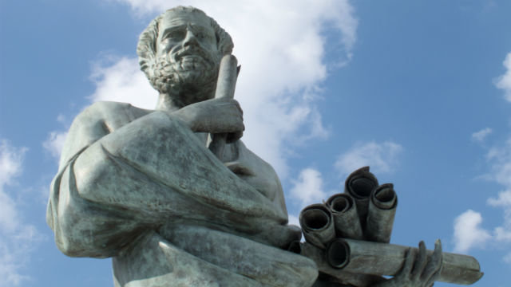
Scholè “employment of leisure time to study and learn.”
Freedom
Natural settings and gymnasia
Important to mental, physical, & cognitive health
Aristotle
It is commonly believed that
happiness depends on leisure
because we occupy ourselves so
that we have leisure, just as we
make war to live in peace.
Ethics
384–322 BCE
Notes:
384–322 BC At seventeen or eighteen years of age, he joined Plato's Academy in Athens

Slide 17
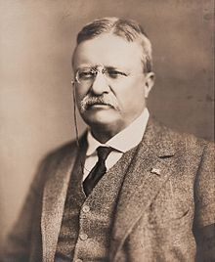
Through the whole of life, from childhood to old age, there should be opportunity for the practice of those forms of recreation, which Renew Life, and which make for the Joy of Living.
Theodore Roosevelt
1858-1919, president of US from 1901-1909
Notes:
Theodore Roosevelt Jr. (/ˈroʊzəvɛlt/ roh-zə-velt;^{[a]}October 27, 1858 – January 6, 1919) was an American statesman, author, explorer, soldier, naturalist, and reformer who served as the 26th President of the United States from 1901 to 1909.

Slide 18
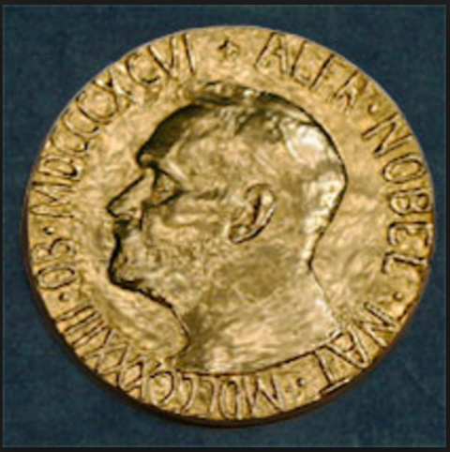
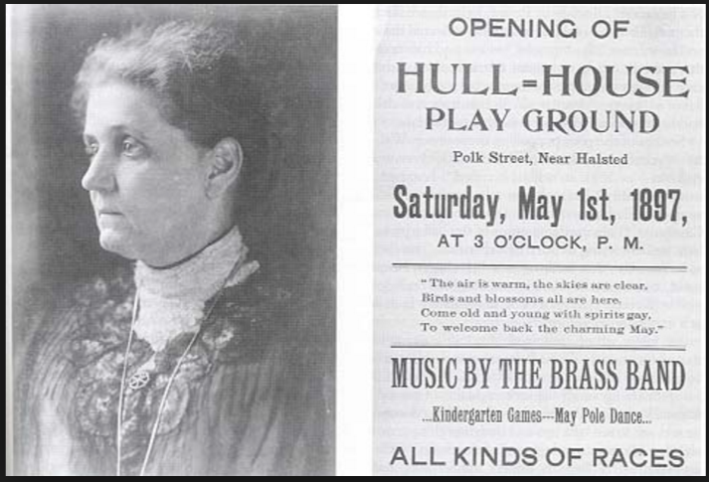
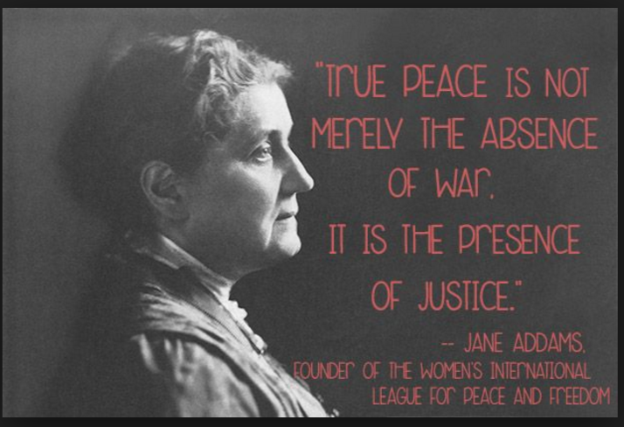
1860-1935, 1889 Hull House, 1920 ACLU, 1931 Nobel Peace Prize
Notes:
Jane Addams known as the "mother" of Social Work (September 6, 1860 – May 21, 1935) was a pioneer American settlement activist/reformer, social worker, public philosopher, sociologist, author, and leader in women's suffrage and world peace. She co-founded, with Ellen Gates Starr, the first settlement house in the United States, Chicago's Hull House. In an era when presidents such as Theodore Roosevelt and Woodrow Wilson identified themselves as reformers and social activists, Addams was one of the most prominent^{[1]} reformers of the Progressive Era. She helped America address and focus on issues that were of concern to mothers, such as the needs of children, local public health, and world peace.
In 1889 she co-founded Hull House, and in 1920 she was a co-founder for the ACLU.^{[4]}In 1931 she became the first American woman to be awarded the Nobel Peace Prize, and is recognized as the founder of the social work profession in the United States.

Slide 19
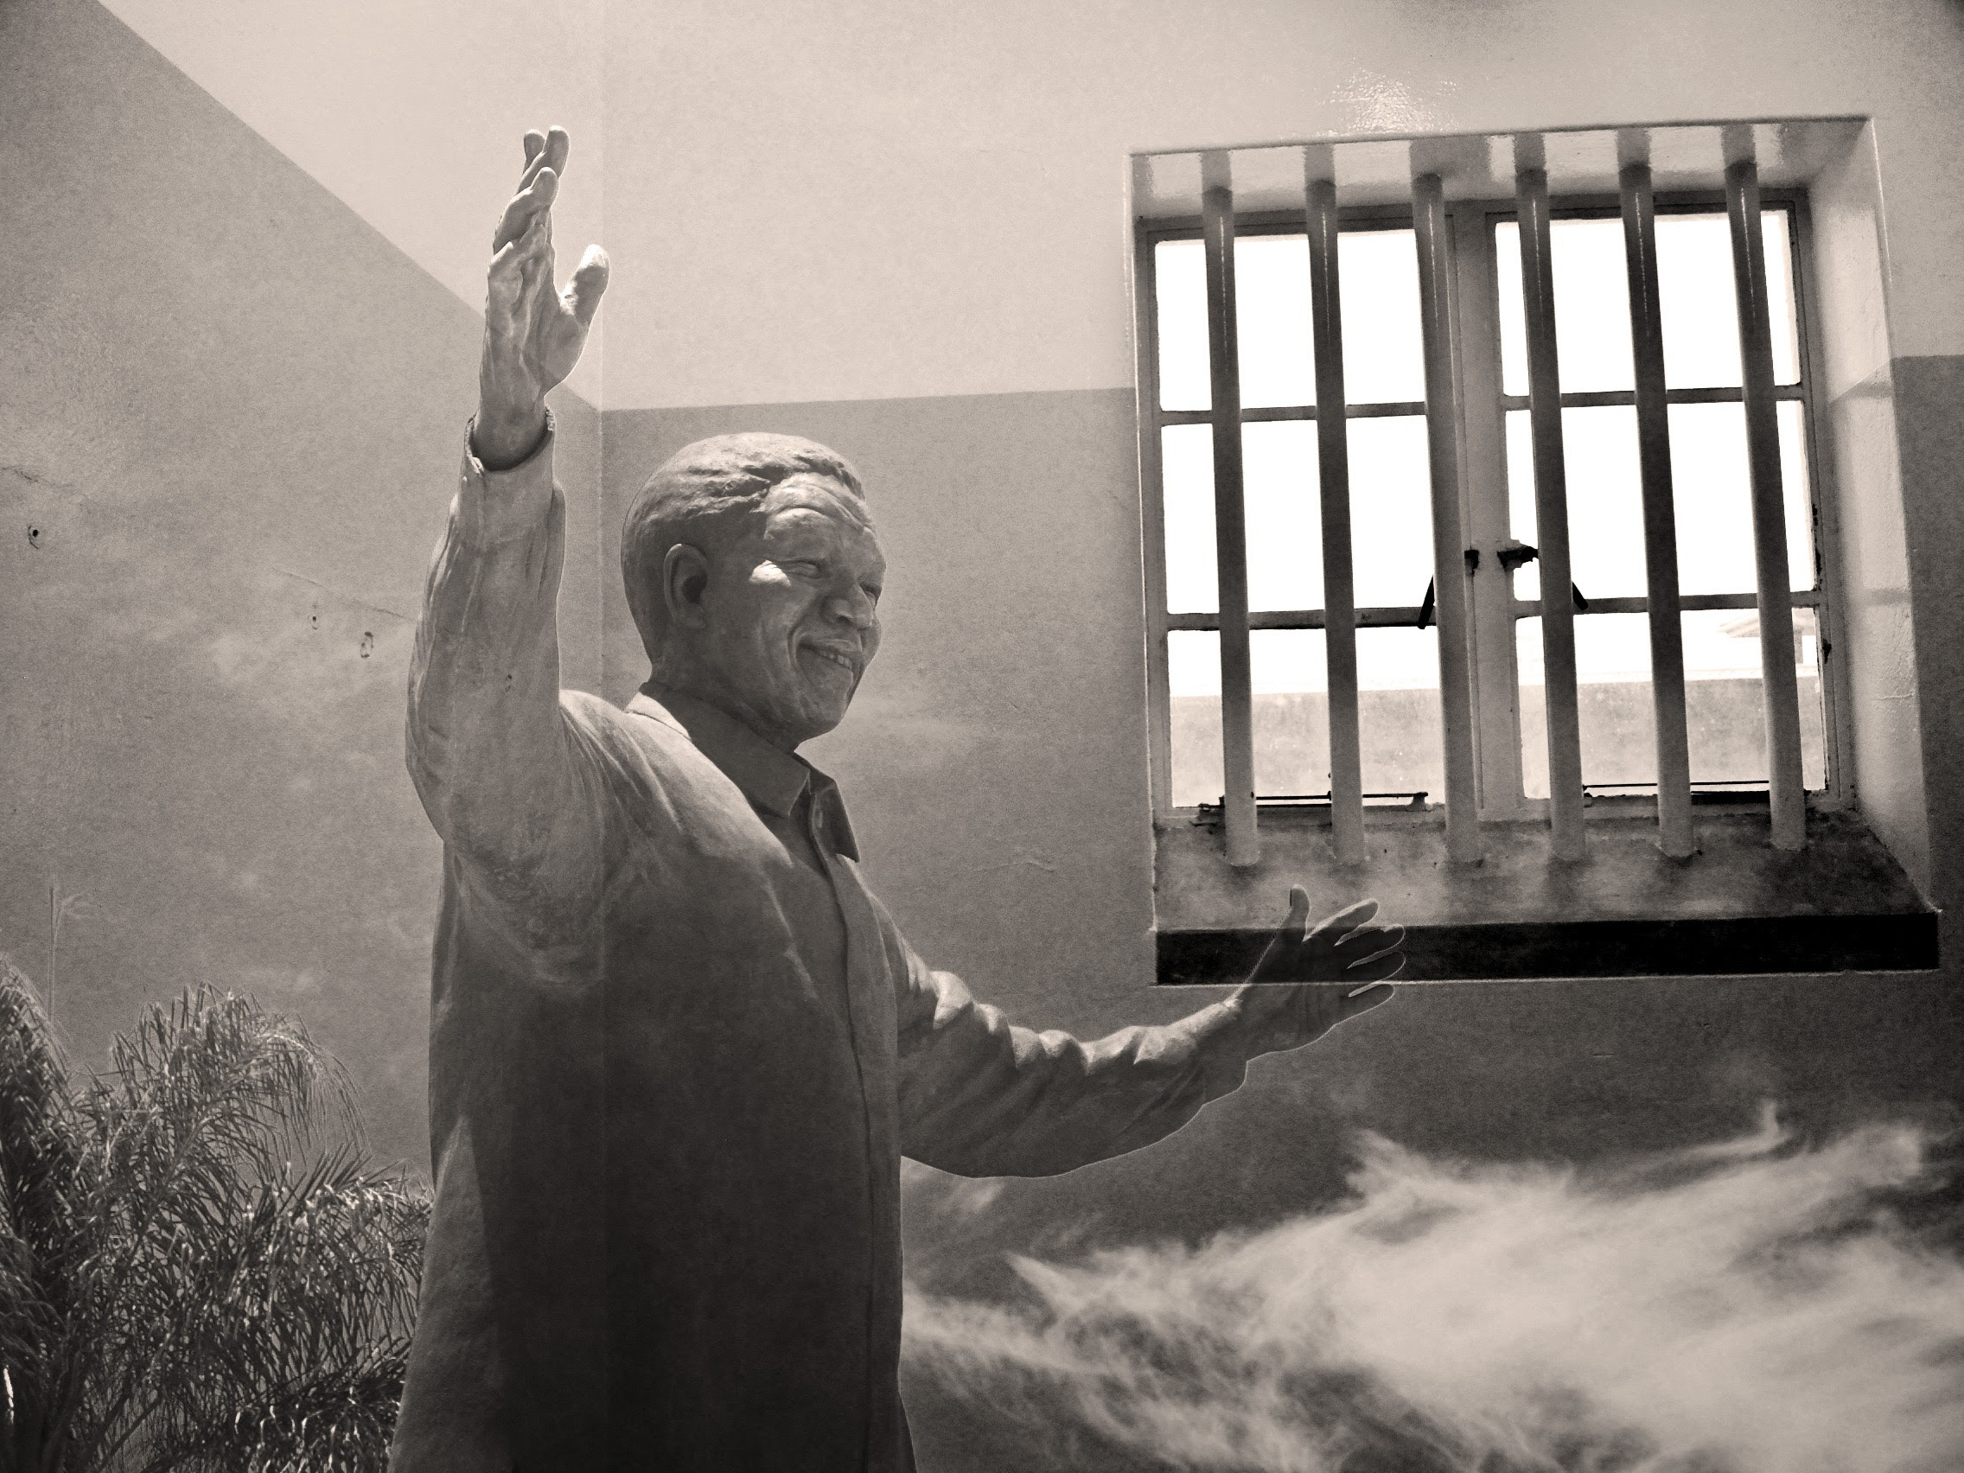
Playing tennis and attending to my gardening became my two favorite hobbies on Robben Island.
Being able to experience one’s mind and body through play was Immensely Freeing.
Nelson Mandela
It was a strange sensation enjoying such civilised hobbies in such an uncivilised place.
1918-2013
Notes:
Goes to serious leisure, experience of freedom, even in very constrained situation. 26 years in prison. Treated inhumanely.

Slide 20
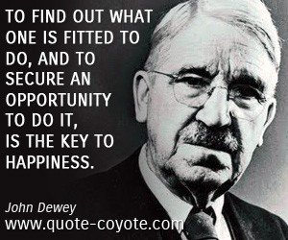
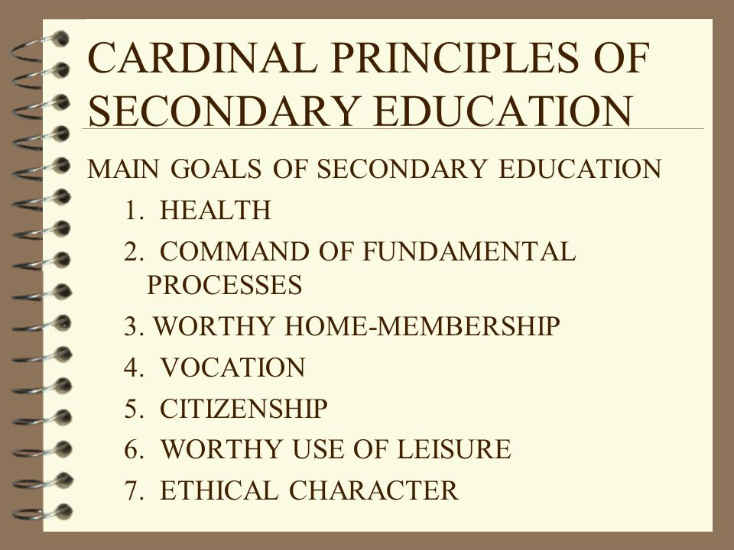
Worthy Use of Leisure
1859-1952
Notes:
The overriding theme of Dewey's works was his profound belief in democracy, be it in politics, education or communication and journalism. As Dewey himself stated in 1888, while still at the University of Michigan, "Democracy and the one, ultimate, ethical ideal of humanity are to my mind synonymous.“John Dewey (/ˈduːi/; October 20, 1859 – June 1, 1952) was an American philosopher, psychologist, and educational reformer whose ideas have been influential in education and social reform.
It is through this reasoning that Dewey became one of the most famous proponents of hands-on learning or experiential education, which is related to, but not synonymous with experiential learning. He argued that "if knowledge comes from the impressions made upon us by natural objects, it is impossible to procure knowledge without the use of objects which impress the mind" (Dewey, 1916/2009, pp. 217–218).

Slide 21
https://www.youtube.com/watch?v=37_uEYeMJSA

Slide 22
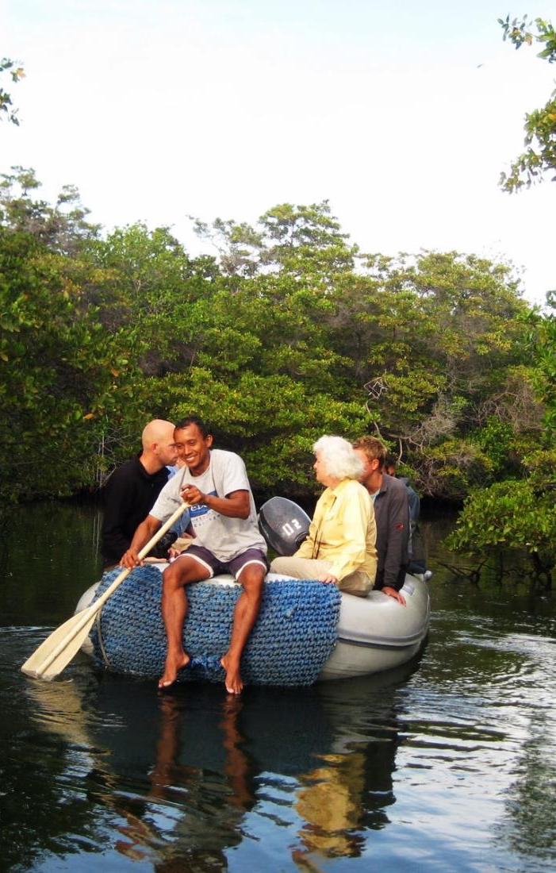
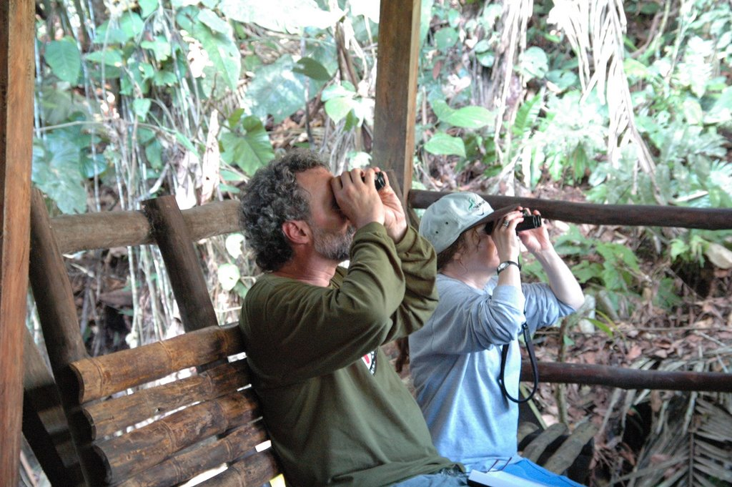
Why is Leisure Important to Human Potential?
Social
Affiliation
Competence
Learning
Identity
Total absorption
Beauty
Nature
Meaning
Creativity
Autonomy
Intrinsic action
Choice
Self-reflection
Disengagement
Excitement
Challenge, risk
Control

Slide 23

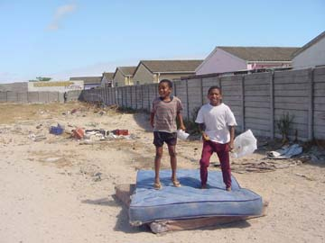
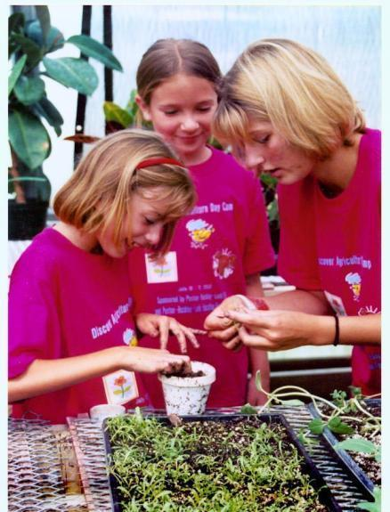
Leisure Activity Experience Context Model (LACE)
Activities
Context
Experience

Slide 25
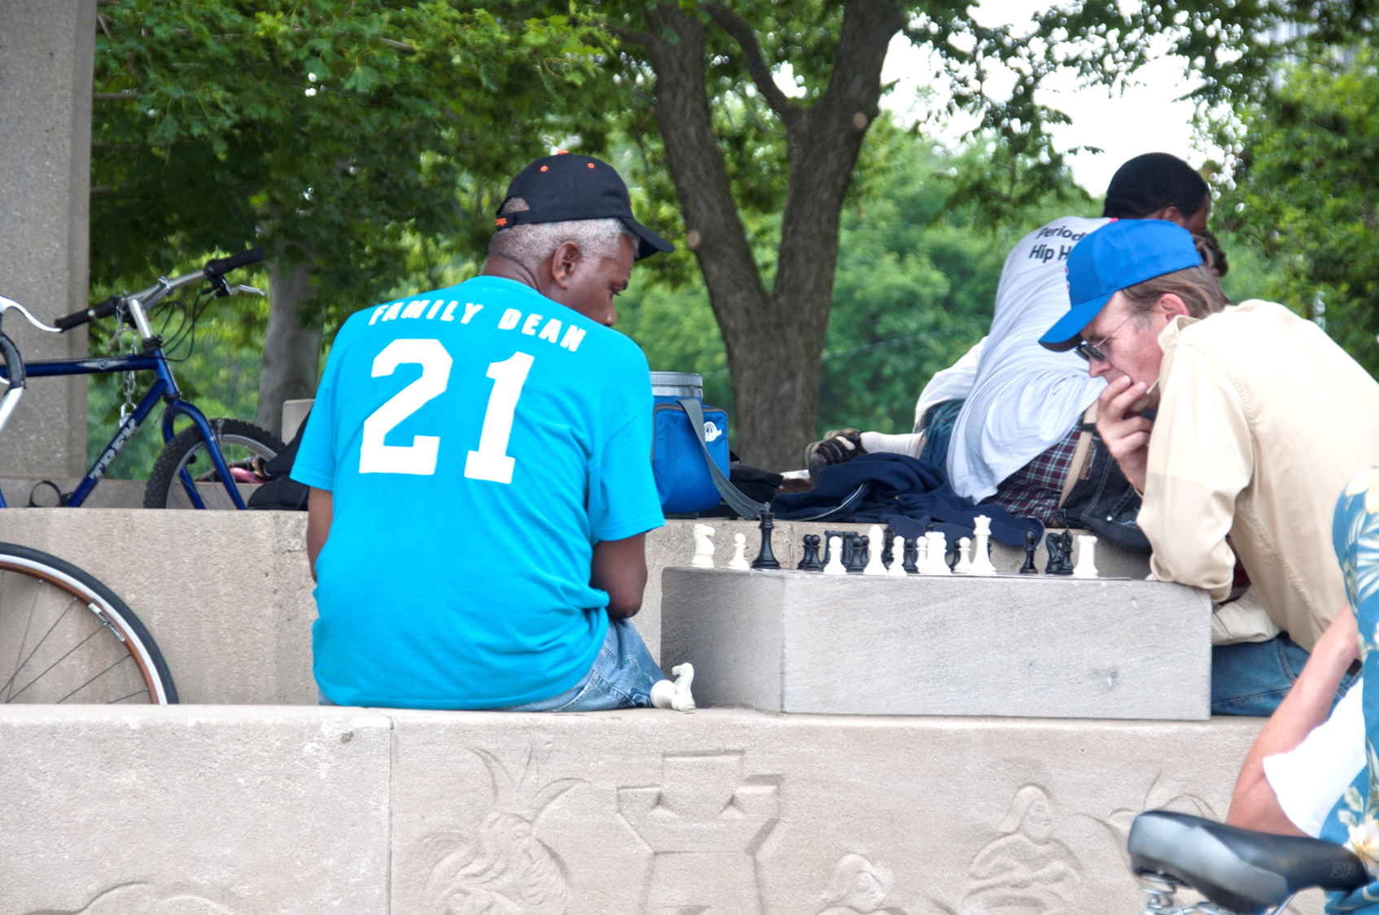
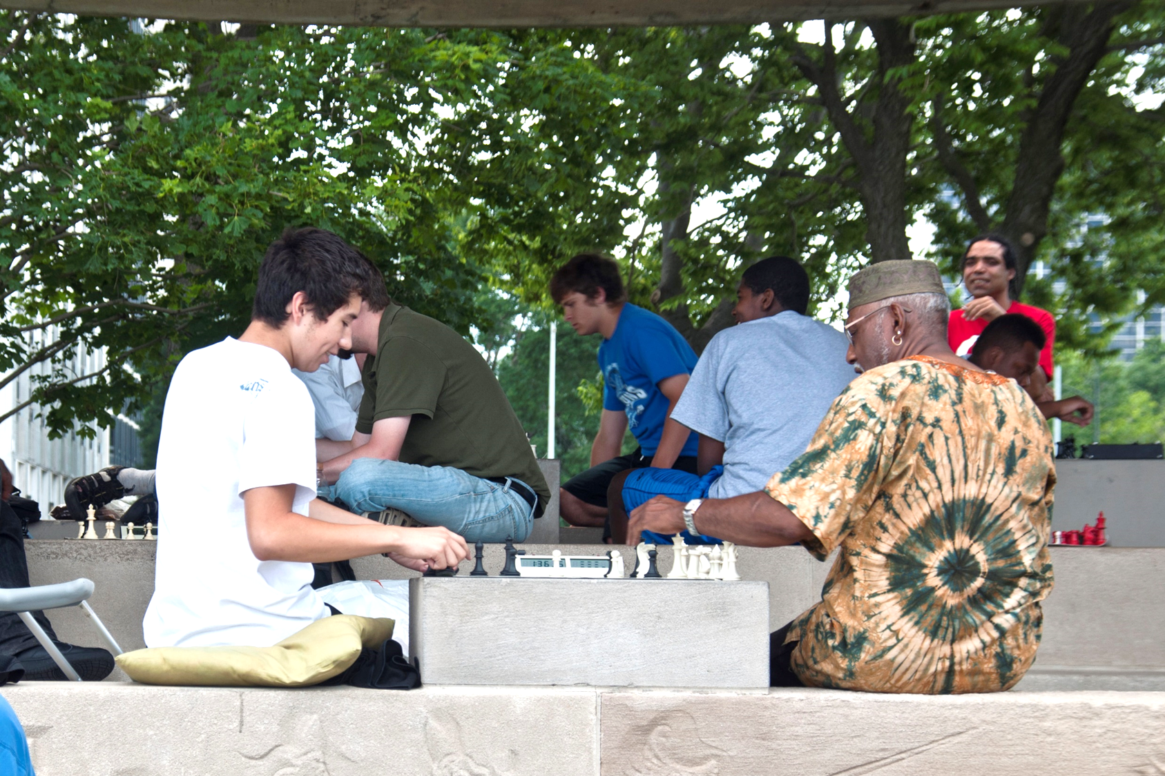
Prevention – Alzheimer’s and Dementia
Greater number of activities = lower risk (Crowe et al., 2003)
Personal development, social engagement, community involvement predict cognitive development (Singh-Manoux et al, 2003; Whitehall II study)

Slide 26
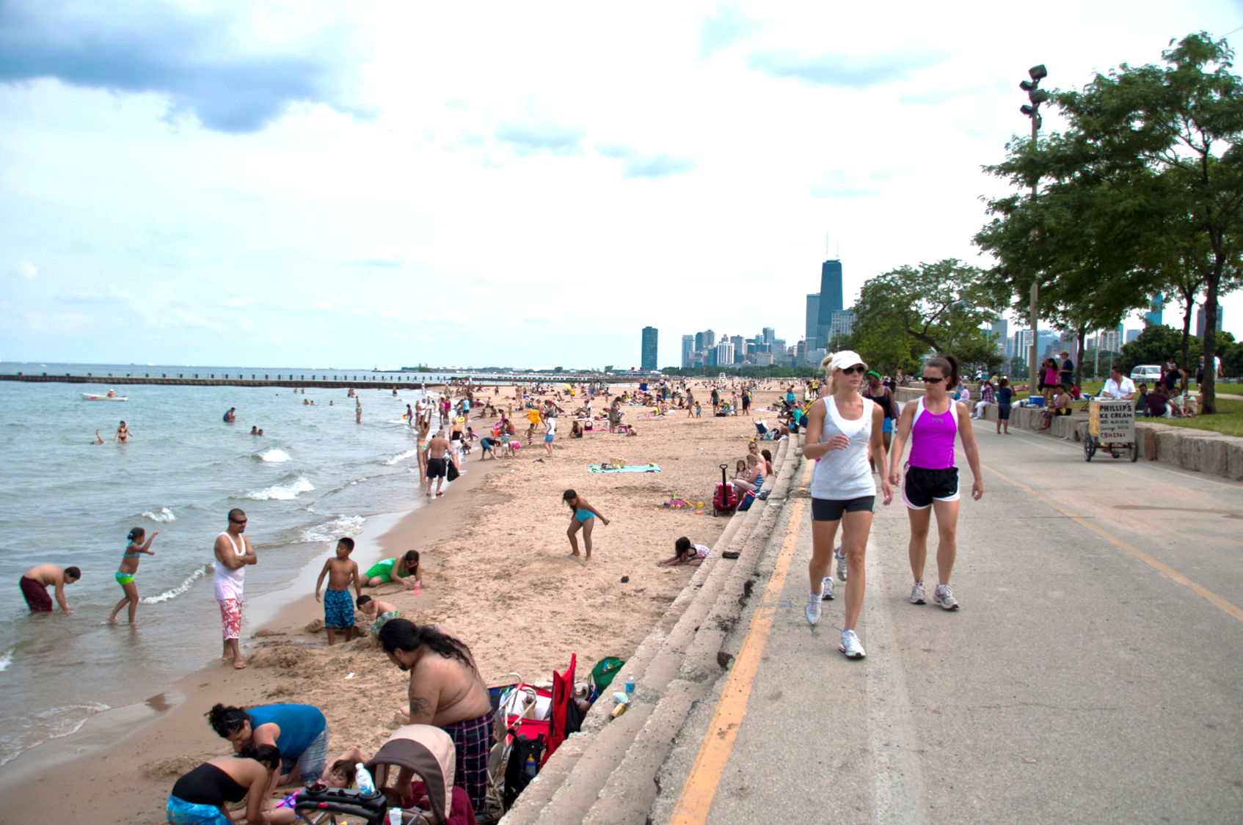
Promotion – Physical Health
Moderate intensity, habitual walking = cardio-respiratory fitness and decreased physical disability (Wong et al., 2003)
Leisure walking lowered risk of hip fracture in postmenopausal women (Feskanich et al., 2002)
Increase of 1 hour a week walking reduced fractures by 6%

Slide 27
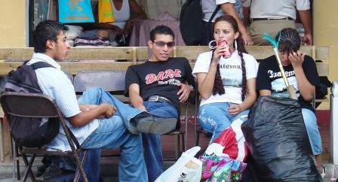
experience
Activities
Context
Experience
The LACE Model

Slide 28
Positive Experiences
Free
Challenged
Social
Happy
Relaxed
Stress release
Coping
Self-determined
Intrinsic motivation

Slide 29
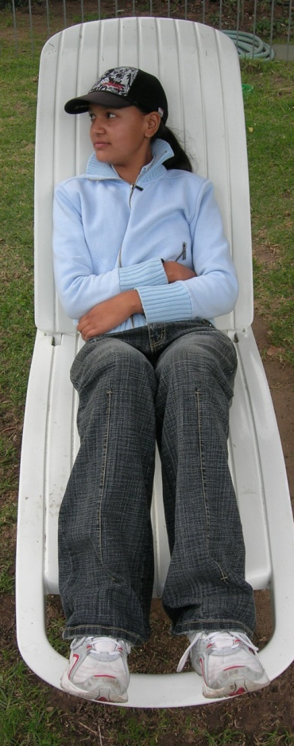

Negative Experiences
Bored
Scared
Alienated
Stressed
Lonely

Slide 30



Slide 31
Stress and south Africans
Bloomberg ranked South Africa as the second "most stressed out" nation in the world, following Nigeria.
High stress linked to mental illnesses such as depression and anxiety, and substance abuse.
In severe cases, these problems can lead to a person becoming suicidal," says Viljoen.
Estimated 21 South Africans commit suicide daily.
http://bhekisisa.org/article/2015-07-01-sa-is-stressed-out-and-suicidal

Slide 32
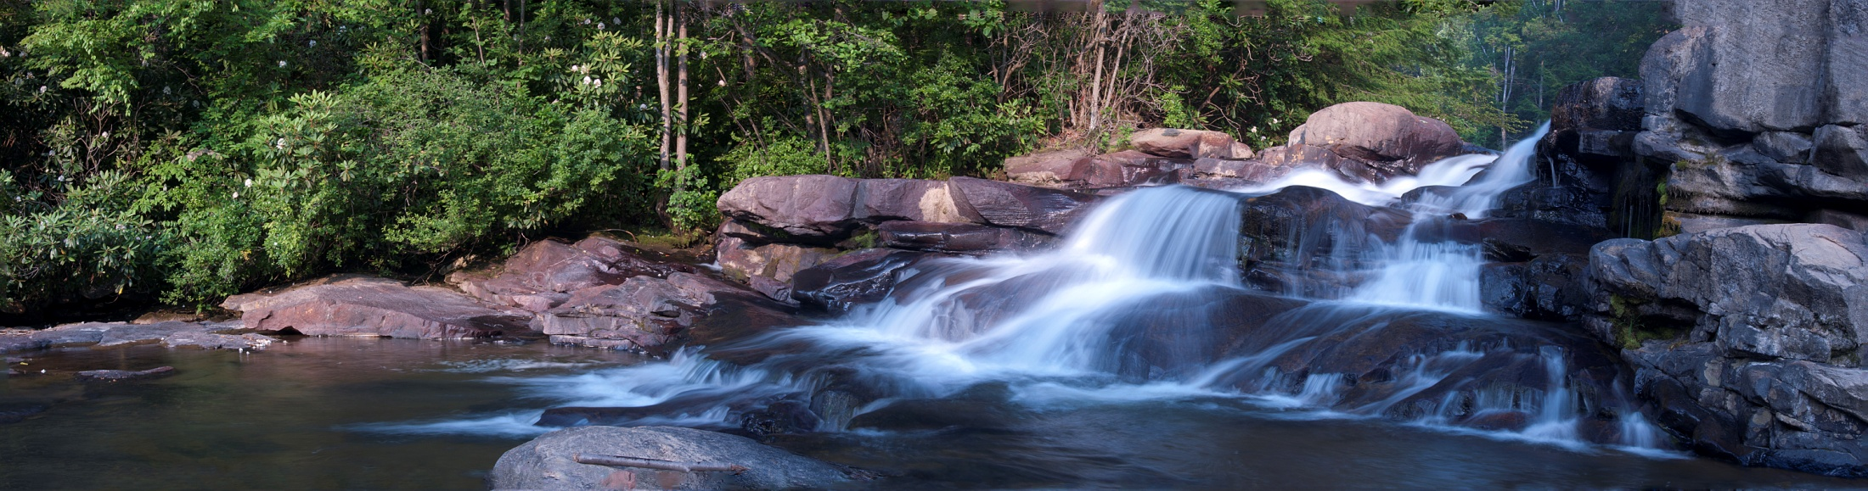
Leisure-based Coping with Stress
In general, leisure-based coping associated with physical and mental health
Palliative coping (e.g., running = temporary relief)
Mood enhancement (e.g., viewing nature, art, comedy act)
Companionship (e.g., spend time with friends over dinner)
Notes:
Daily hassles and negative life events norm, not exception. Sporadic or persistent associated with daily life or severe, negative acute events.
Most leisure literature on stress-coping.

Slide 33
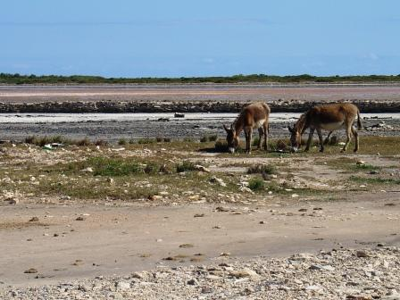
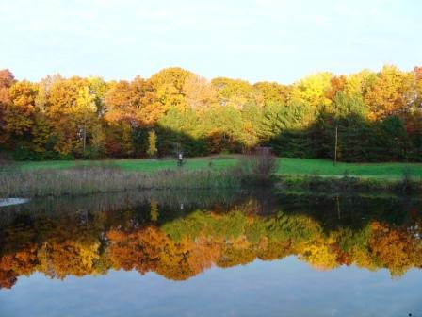
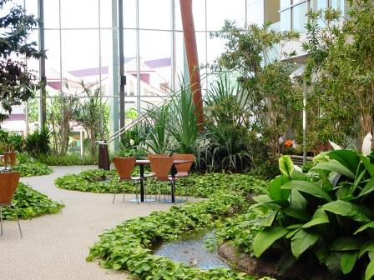
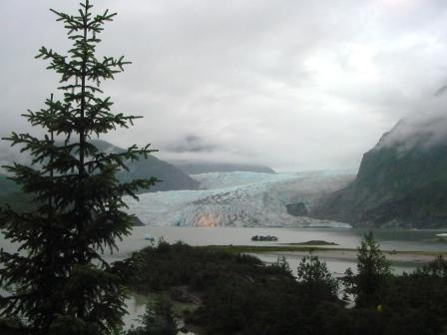

context
Activities
Context
Experience
The LACE Model

Slide 34
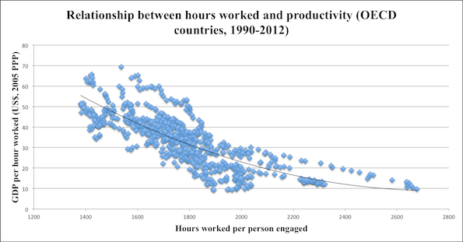
Leisure and productivity
A 2011 International Labor Organization study of OECD countries from 1950 to 2012 found that, as number of hours of work increased, productivity per hour decreased
The Economist
Notes:
Significant increase in worker errors beyond a 40-hour limit

Slide 35
Leisure, family and productivity
1 May 1926: Henry Ford voluntarily instituted a 40-hour work week in his auto plants
Norm at the time was 12 hour days, 6 days a week
1910 – President Taft recommended 2 months vacation a year!
“Every man needs more than one day a week for rest and recreation….The Ford Company always has sought to promote [an] ideal home life for its employees. … in order to live properly every man should have more time to spend with his family.” Edsel Ford
“It is high time to rid ourselves of the notion that leisure for workmen is either ‘lost time’ or a class privilege.” Henry Ford
Notes:
The decision to reduce the workweek from six to five days had originally been made in 1922. According to an article published in The New York Times that March, Edsel Ford, Henry’s son and the company’s president, explained that “Every man needs more than one day a week for rest and recreation….The Ford Company always has sought to promote [an] ideal home life for its employees. We believe that in order to live properly every man should have more time to spend with his family.”
Henry Ford said of the decision: “It is high time to rid ourselves of the notion that leisure for workmen is either ‘lost time’ or a class privilege.” At Ford’s own admission, however, the five-day workweek was also instituted in order to increase productivity: Though workers’ time on the job had decreased, they were expected to expend more effort while they were there. Manufacturers all over the country, and the world, soon followed Ford’s lead, and the Monday-to-Friday workweek became standard practice.

Slide 36
Stress, work and leisure
In SA about R3-billion a year lost to workplace stress.
Employees are crumbling - disempowered by stress.”
The reality is that employees work more today than they did 25 years ago
Ipsos Global and Reuters, showed that up to 53% of South Africa's workforce does not take their allotted annual leave (2014).
(http://bhekisisa.org/article/2015-07-01-sa-is-stressed-out-and-suicida
The People Element
¾ Americans say that they are stressed, with one in four stating that they are either “very” or “extremely” stressed
In 1975 typical family vacation was 7 days
In 2010, it had dropped to just 3.8 days
Oxford Economics/US Travel Association

Slide 37
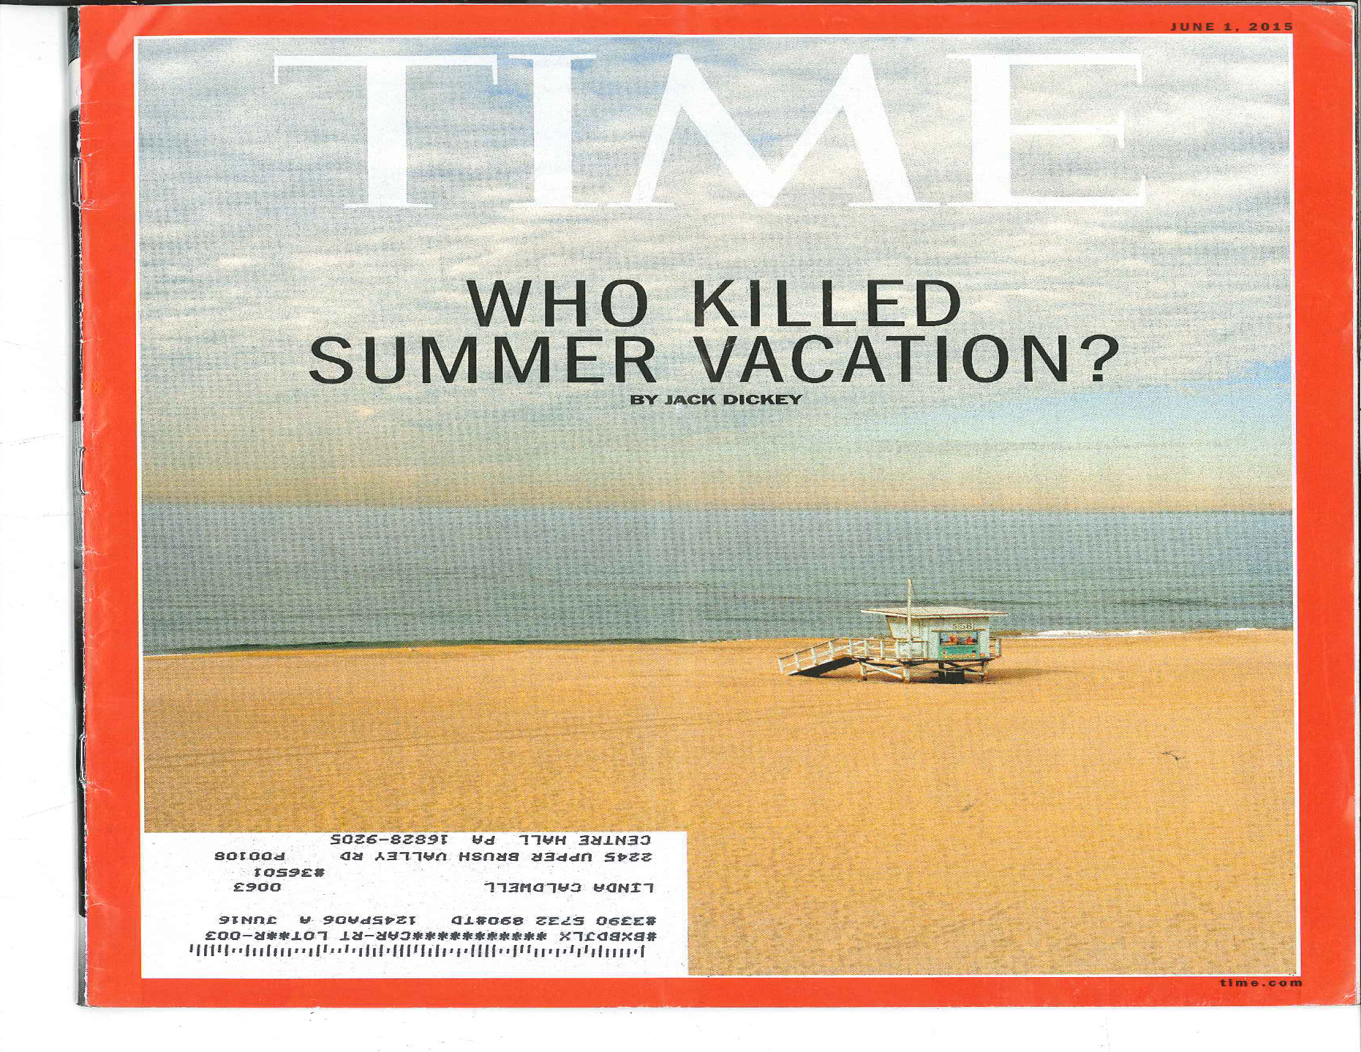
Every now and then go away, have a little relaxation, for when you come back to your work your judgement will be surer.
Go some distance away because then the work appears smaller and more of it can be taken in at a glance and a lack of harmony and proportion is more readily seen.
Leonardo Da Vinci

Slide 38
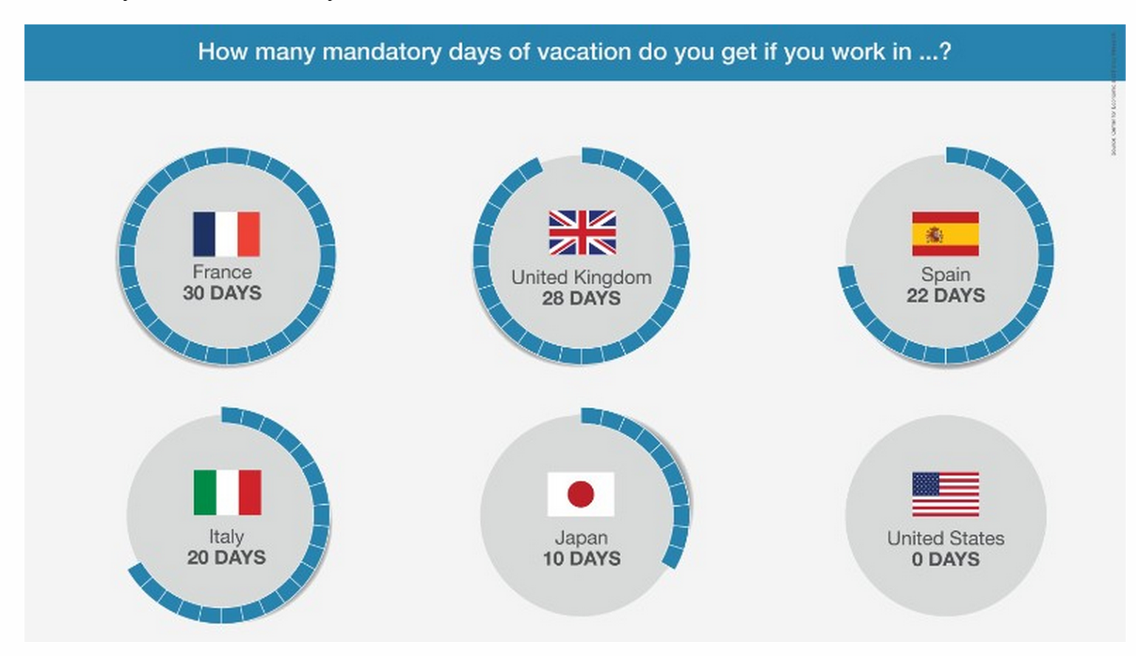

Slide 39

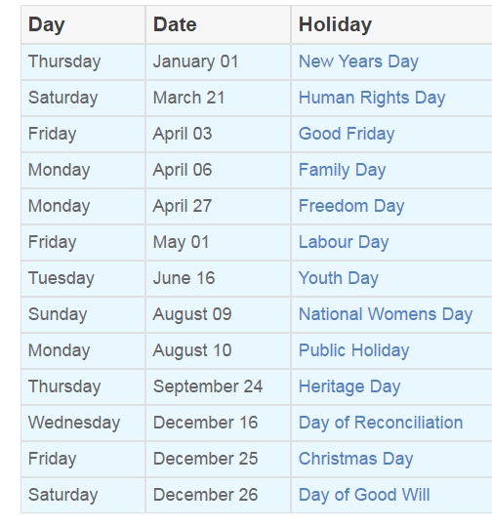
The Basic Conditions of Employment Act
Annual leave on completion of a year of continuous service with an employer.
Workers entitled to 21 consecutive days of paid annual leave.
Or, a worker may be entitled to one day of leave for every 17 days worked or one hour for every 17 hours worked on mutual agreement.

Slide 40
Vacations and health
Males who had skipped vacation for five or more consecutive years --32 percent more likely to have heart attacks than those who took at least one week off a year.
Women who hadn’t taken a vacation in six or more years were eight times more likely to develop heart disease than women who vacationed at least twice a year.
1,500 women from rural Wisconsin showed that participants who took at least two vacations a year were less likely to be tense, depressed, or tired than those who only took vacations every two years.

Slide 41

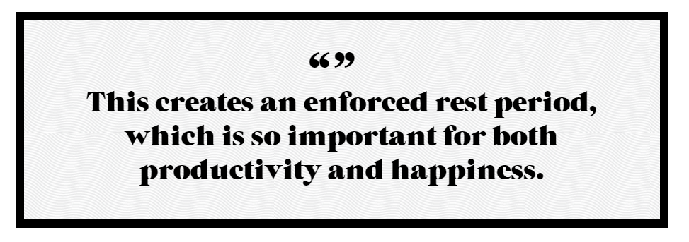

Notes:
The cause for roughly one-third of suicides in Japan in 2011 was attributed to overwork.

Slide 42
Why is Leisure Important to Human Potential?
Social
Affiliation
Competence
Learning
Identity
Total absorption
Beauty
Nature
Meaning
Creativity
Autonomy
Intrinsic action
Choice
Self-reflection
Disengagement
Excitement
Challenge, risk
Control

Slide 44
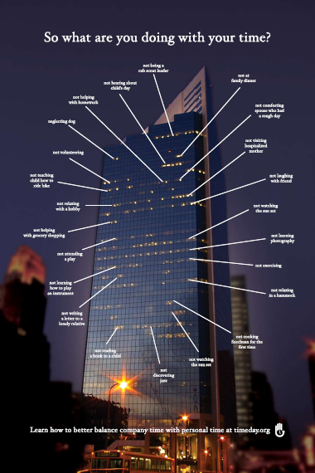








What Aren’t You Doing??

