Slide 1
TimeWise: Taking Charge of Leisure Time and Living Your Why …
How to LiveWise!
TimeWise for Lamoille Valley
Spring 2022
Session 8: Planning and Goal Setting
Notes:
Materials Needed for Session 8: Planning and Goal Setting
ETR manual and student workbook material:
TW teacher manual pages 42, 49, 60
Transparency 6 (Planning Flowchart)
TW workbook pages 23 (My Leisure Action Plan), page 26 (To Do Lists)
TW Messages: Making an Action Plan (TW workbook page 20), Managing Daily Leisure (TW workbook page 25), Putting it All Together (TW workbook page 27), TW Messages (TW workbook page 32)
TW Review (TW workbook page 28)
TW Creative Pages (pages 30-31) for writing down goals and final thoughts, answering questions

Slide 2

Plan for Change: How Can My Leisure Time be Better?
What do you have too much of?
What do you have too little of?
Is something missing?
Notes:
This is our final session. We want to give you more specific tools so that you can plan for your free time and make sure it is enjoyable and satisfying. You’ll have a lot of free time this summer and it is important to think aboaut how you’ll make the most of it.
A lot of leisure time activities are spontaneous. You just do them “because” and don’t really plan them, and often you don’t really have a good reason for doing the activity. Sometimes those spontaneous activities are really fun, but often they leave you feeling not very satisfied, and maybe that you are wasting your time, or you wish you were doing something else. This is when your leisure time is just okay, but not something that you deep down truly enjoy.
Or another way to look at it is if you have one or two activities that you really enjoy but the rest of your leisure activities aren’t that fun or interesting, something is missing there, too. Or maybe you have too much going and you are stressed out about doing everything. Some kids have something scheduled every afternoon, evening and weekend, and it becomes too much. On the other hand, some kids just think there is nothing to do.

Slide 3
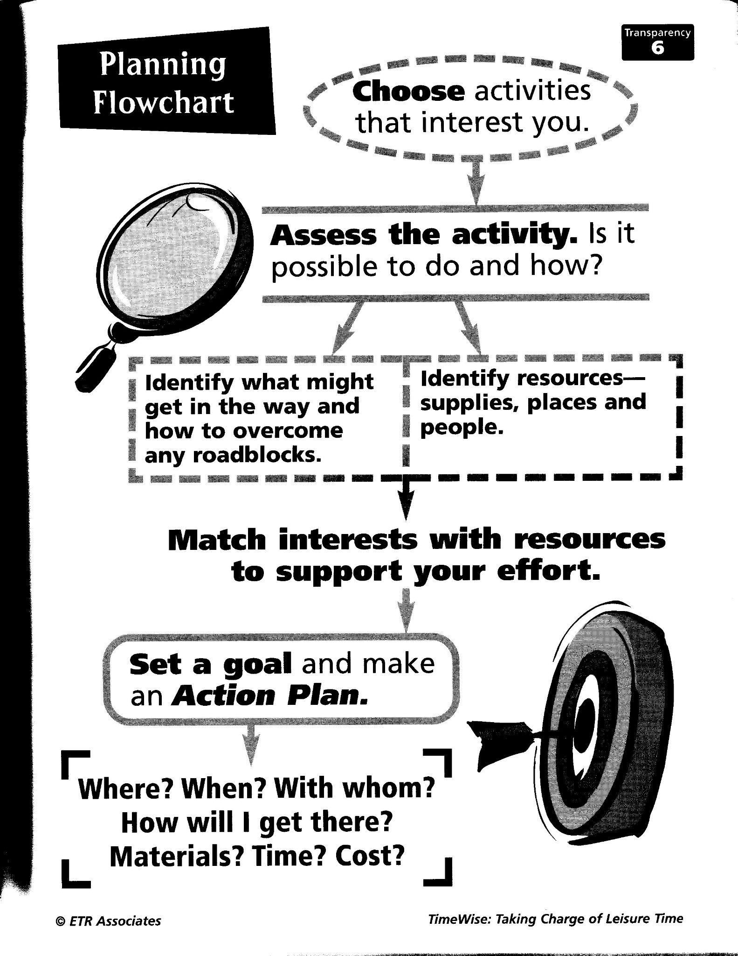

Notes:
When planning your activities, remember to think about why you want to do it, what benefits you might get, and if it gives you enough variety and balance.
Also think about what is available in your community and remember not to let stereotypes or perceived roadblocks to get in your way. Consider that in every season, you will be able to do different things.

Slide 4
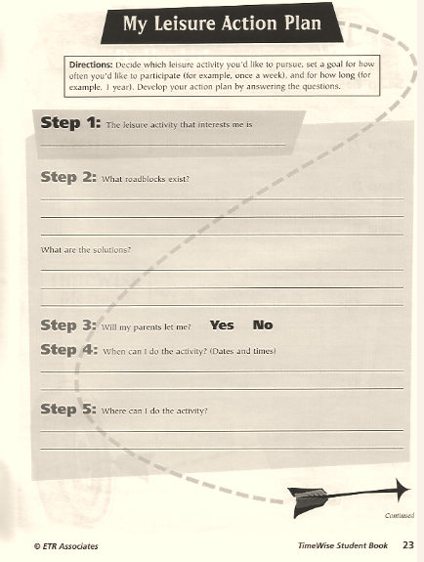

Notes:
Also, it might be helpful for you to complete the “Leisure Action Plan” on pages 23 and 24 (TW workbook). Encourage them to complete it themselves, or with a parent or other adult.
Since summer is coming up, you might want to plan for an activity you’d like to do this summer. Of course your daily pattern will be different during the summer so you will have some different opportunties and some different roadblocks to consider.

Slide 5
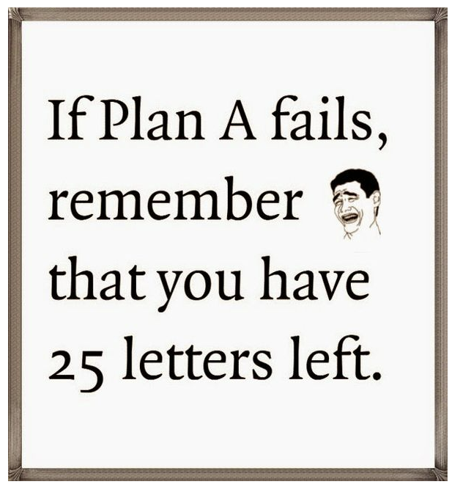

Notes:
Encourage students to not give up if their plans don’t work out as they thought. It is a learning experience and we all learn from failures and mishaps.

Slide 6
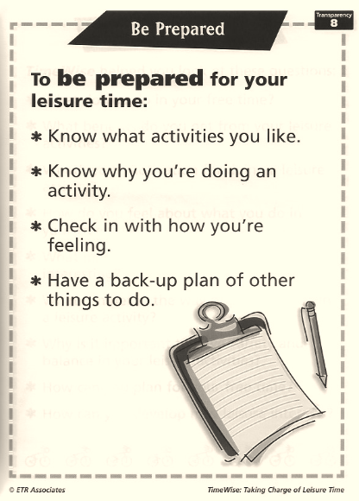

Notes:
We’ve already talked about being prepared for leisure time because you have to plan for it. Here is another tool in your planning toolkit. You might want to make a list of things to do when you have unexpected free time and don’t know what to do. Keep the list handy and refer to it when you need to. Use Transparency 8 (Be Prepared).

Slide 7
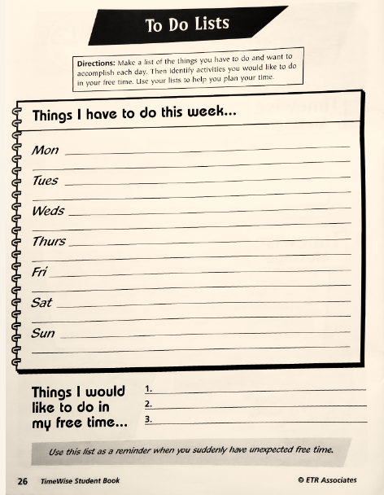
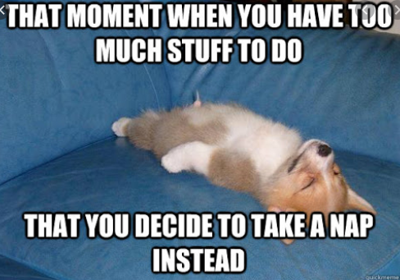
Notes:
Now that you’ve identified a goal or two, we think it might be useful for you to complete the activity on page 26 at home. Doing this type of activity will help you with planning and also will give you some ideas for things you’d like to try when you don’t know what else to do (or sometimes if you have too much to do and need more balance).
Think about where to find the things you would like to do and what’s in the community and ideas from the Live Your Why. If you complete “Where to Find It” on page 22, you will have a list of possibilities when you are looking for seomething to do. Feel free to include the website or an email address as well.

Slide 8
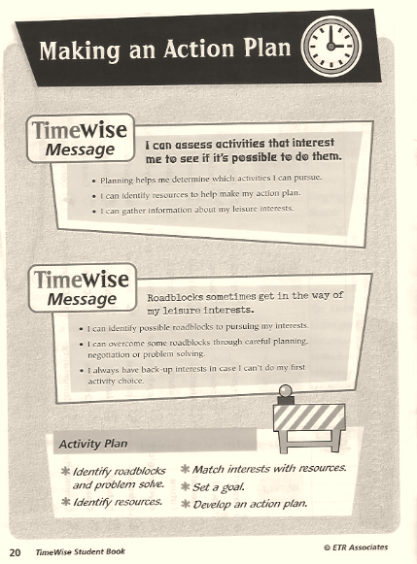
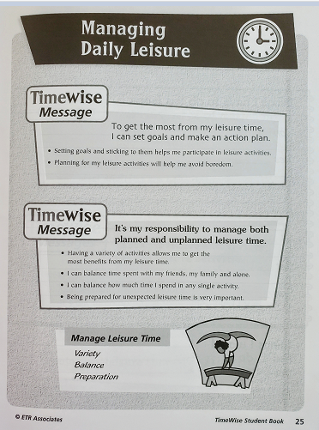
Notes:
Take a look at the TW Messages: Making an Action Plan (TW workbook page 20) and Managing Daily Leisure (TW workbook page 25), Like with the other TW messages pages, these pages can be a good refreshers on what we’ve discussed today.

Slide 9
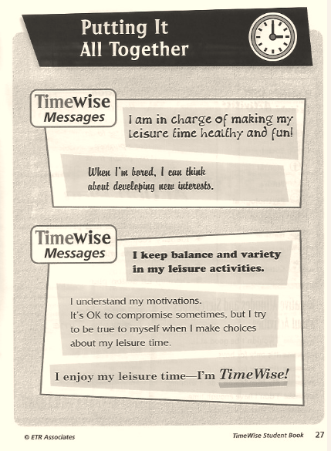
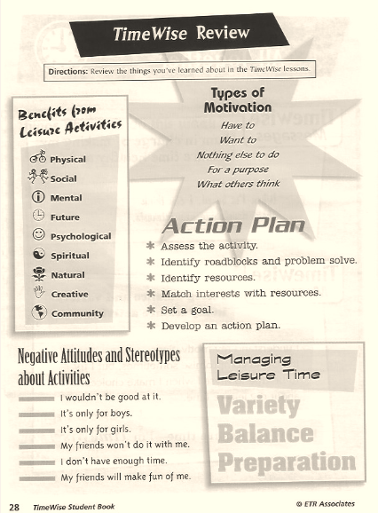
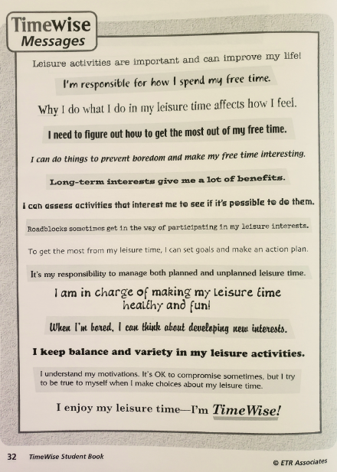
Wrapping it Up!
Notes:
We hope that you’ve learned about how to take charge of your leisure time so that it is more satisfying, interesting, fun, and gives you a lot of benefits. We also hope that you understand that not having satisfying leisure, like usually being bored or doing things for no other reason that “it just happens” and you have no purpose, can lead to unhealthy and risky behaviors like harm to yourself or to others.
Let’s review the things that we’ve gone over. Use the following pages for this wrap-up: Putting it All Together (TW workbook page 27), TW Messages (TW workbook page 32), and TW Review (TW workbook page 28).

Slide 10
Now It’s Your Turn to Plan and Set Goals!
Think of things you’d love to do or for a purpose that will give you benefits, variety, and balance.
Which benefits (social, physical, mental, future, psychological, spiritual, natural, creative, and community) would you like to get more of?
Thinking about variety and balance you have in your leisure, what do you need more or less of?
What things would you like to change about your leisure in order to be really happy, healthy, and fulfilled?
Notes:
Goal setting and planning for satisfying leisure is something you can do for the rest of your life. So let’s start with this summer.
Take out TW Creative Pages (pages 30-31). What benefits would you like to get more of? Write out a goal about a benefit you would like to get more of. For example, you might write something like “I really love to be creative but I haven’t done as many creative activities as I would like to.” Writing a goal like that connects to your motivation for doing things you love.
You might want to write a goal about variety and balance. That is, you might want to get more of something (like sleep!) or less of something (like structured activities).
You might want to write a goal about other things in your leisure time that you might like to change. Do you want to develop a new skill, or do more things with your family?
Getting to know yourself and how you feel about these things will help you better take charge of your leisure time and get the most out of it.
It would be great if you wanted to share what you’ve learned with other people. Think about other friends or family members who might benefit from hearing some of the things you’ve learned!

Slide 11
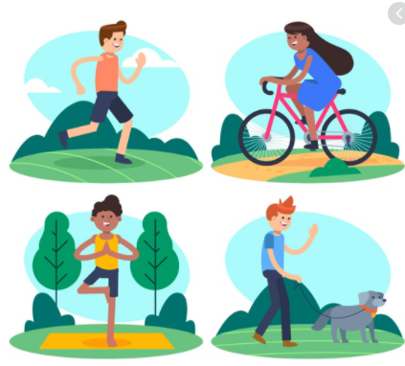

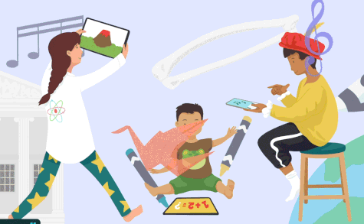

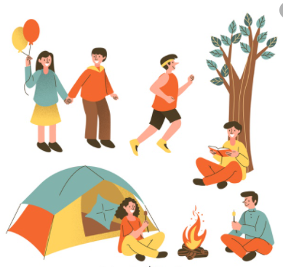
Enjoy your leisure!
Notes:
We’ve really enjoyed getting to know you through these sessions. We hope you’ve learned things that will help you have positive, fun, and healthy leisure activities throughout your life!

