Slide 1
TimeWise: Taking Charge of Leisure Time and Living Your Why …
How to LiveWise!
TimeWise for Lamoille Valley
Spring 2022
Session 7: Community Resources
Notes:
Note: SLIDES 5 AND 6 WILL NEED TO BE ADAPTED IF YOU ARE NOT IN HARDWICK, VT.
FOR SLIDE 9 FIND A MAP OF THE GREATER HARDWICK AREA (OR MULTIPLE MAPS)
ETR manual and student workbook material:
TW teacher manual pages 46-48
Transparencies 7 (Variety & Balance) related material page 52 teacher manual), 8 (Be Prepared)

Slide 2

Were You Successful in Meeting Your Goal for Last Week?
Not at All Just a Little Goal Achieved!
Notes:
🍐 This is a Pear Deck Draggable™ Slide.
🍐 To edit the type of question, go back to the "Ask Students a Question" in the Pear Deck sidebar.
In the last session you wrote down a goal on sticky that you wanted to work on this past week. Take a look at that goal.
Goal setting is an important part of planning for your leisure. That is what we will be talking about next.

Slide 3
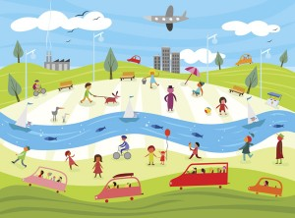
Community Connections
What is a community?
Notes:
We will talk more about planning next week. This week we are going to talk about how much you know about your community, because knowing about community resources is important in terms of planning for your free and leisure time.
Ask students to share what they think “community” means. Is this school a community?
In every community there are resources – places, organizations and people – that could be helpful to you in some way. The important thing is to know what resources are in your community and then to know how to use them. Examples of community resources are the library, the clinic, schools, sports clubs, teachers etc.
It helps to get to know what is available in your community or neighborhood so that you can make the best use of the resources to help you get the most out of your free time.
And sometimes if there are things you would like to have in your community that don’t exist, you might have to take responsibility to organize or advocate for it to become a reality.

Slide 4

Notes:
What do you think this word means?
A duty one has towards doing something”.
Taking responsibility for ourselves means that we have a duty to take control of our lives. We have the power to make the best of whatever situation we may find ourselves in. We are all faced with challenges but with some creative problem-solving, we can usually find a way to overcome these challenges. But no-one can do this for you - it is up to YOU to take responsibility for yourself!
That is why we are teaching you these skills so that you can take responsibility for your own free/leisure time.
In this last lesson, we’ll talk more about planning and how to access community resources.

Slide 5
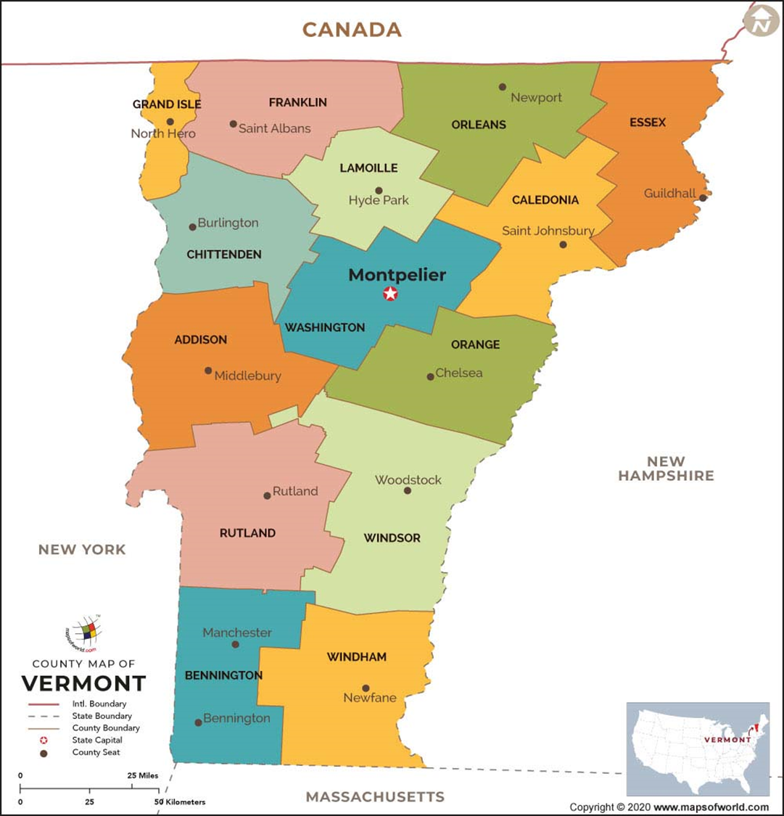

Maps help us find things and understand our communities
They are useful tools to see how we exist in relation to other people and other areas

Slide 6
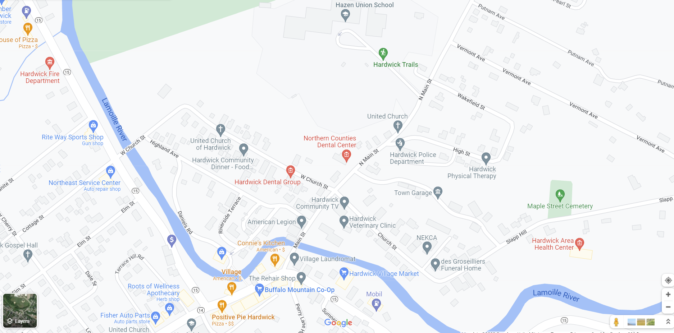

Notes:
Let’s talk about what this map shows us. Or use next map with elementary school.
Update as needed to reflect your community.

Slide 7
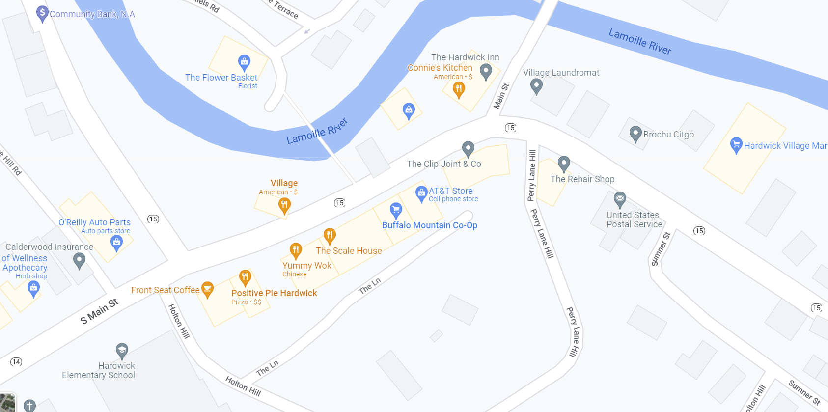

Notes:
Update as needed.

Slide 8
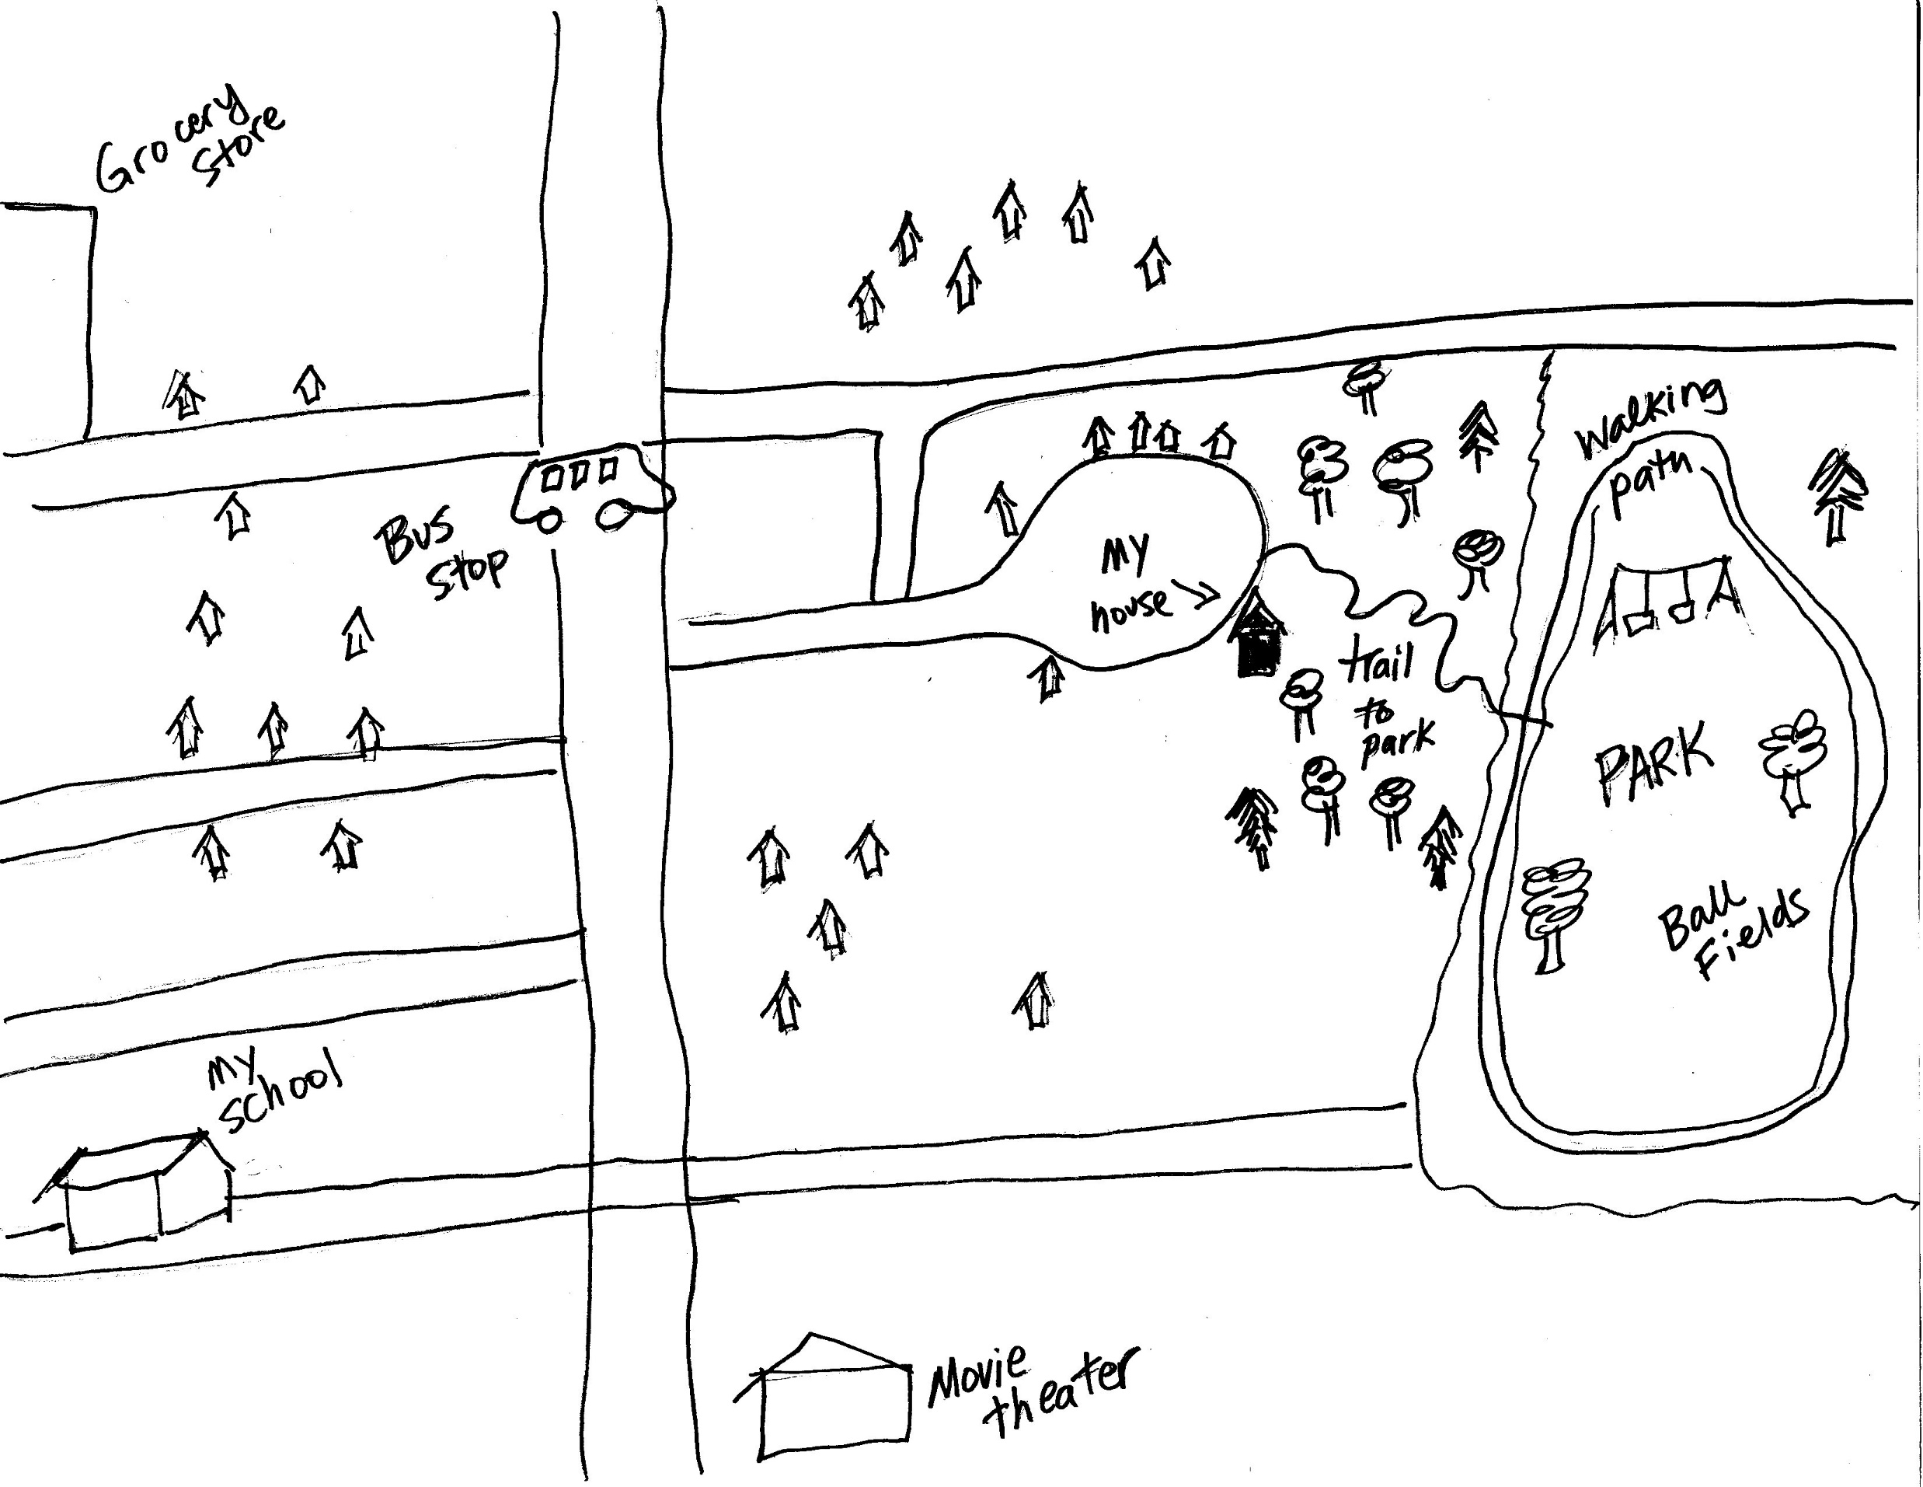

Notes:
Here is a map of my house. My kids and I can walk to the park through a trail in the woods behind my house. There are a lot of things to do in this park, with picnic tables, walking trails, ball fields, playground equipment, and disc golf. We can take a public bus into town, and the grocery store and movie theater are nearby. The kids get the bus to their school, which is also near by.
Could you draw a map of your neighborhood?

Slide 9
Let’s dig a little deeper...A typical day in your community
Identify places where you typically spend your free time
When you are at those places, how do you feel? Happy, tired, anxious, bored, etc. Why do you feel that way?
Who are you typically with?
Is this a place where healthy activities take place?
Are there places where risky behavior often takes place?
If you had a choice, where would you like to spend your time? Why?
Would you like to make any changes about where you spend your time? What would it be and how can you make it happen?
How does the physical or natural environment influence you or influence your experience?
Where are places where you can find adults who can help you or listen to you or provide activities that you would like to do?
Notes:
Provide a map of the community or communities where students live. Get into small groups of students who live near each other. Ask them to discuss the questions on the slide.

Slide 10

Think about our community…
In small groups or pairs, identify the following:
What community resources have you used?
What community resources would you like to see in your community?
What would you like to know more about in your community?
Do you know where to find places and organizations that offer advice and help to young people?

Slide 11
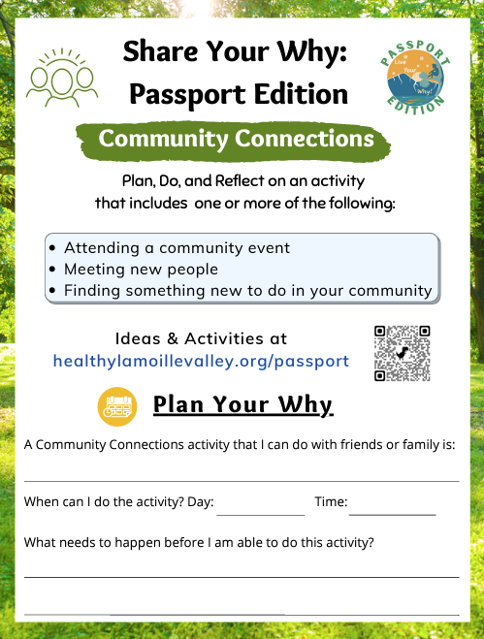
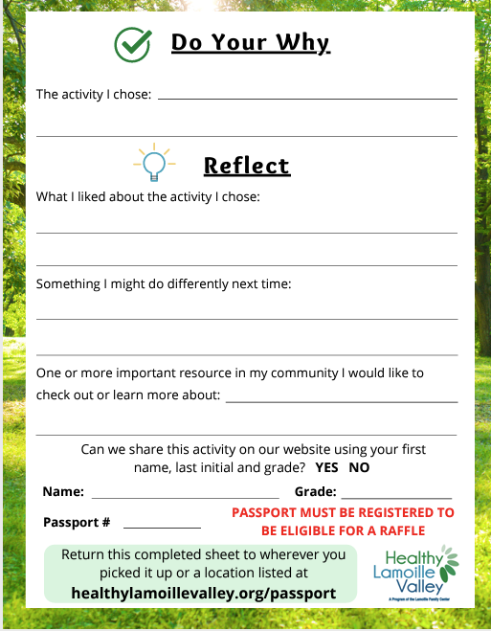
Live Your Why Passport Edition
https://www.healthylamoillevalley.org/passport/
Notes:
Here is a resource to help you understand what’s in your community.
Ask students to identify what they might like to have added to the Live Your Why Passport Edition.
Email Brian at passport@healthylamoillevalley.org with suggestions.
Give out passports and planning sheet.

Slide 12
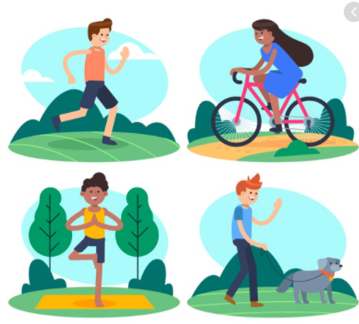
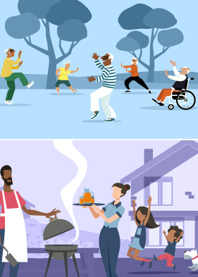
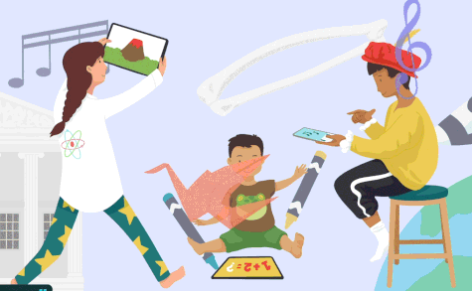
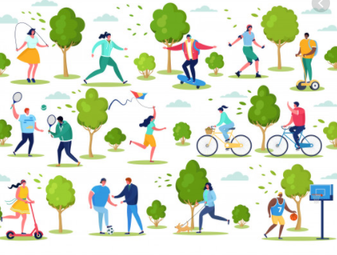
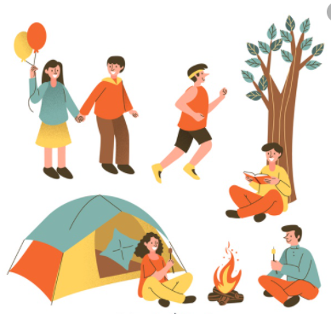
Enjoy your leisure!
Notes:
Next time will be our last session!

