Slide 1
TimeWise: Taking Charge of Leisure Time and Living Your Why …
How to LiveWise!
TimeWise for Lamoille Valley
Spring 2022
Session 4: My Motivation
Notes:
Materials Needed Session 4: Motivation
ETR manual and student workbook material:
TW teacher manual pages 19-30
Transparency 3 (Motivations)
TW workbook page 14 (Exploring my Motivation); 15 (Interview with an Adult),
TW Message: Checking Out My Motivation (TW workbook, page 11)
Master 2 (Motivation Scenarios)

Slide 2
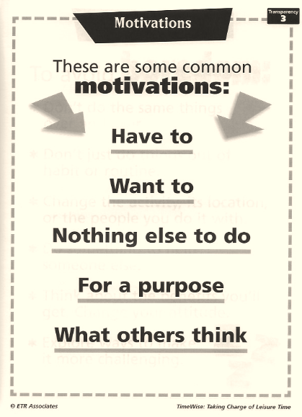

Why Do I Do What I Do???
Live Your Why!
Notes:
Think back to your TimeWise Journal and analysis and why you did different things during the day.
Recall that when you completed your journals, you identified 5 types of reasons you did things. Have to, want to, nothing else to do, for a purpose, and for what others think.
Let’s dig a little deeper in terms of why you do things.
Motivation refers to why you do what you do. Every person has different motivations for doing things and not everyone does the same activity for the same reason. Usually doing something is more complex than doing it for just one reason…usually we have a few reasons for doing things. But for our purposes here, it is helpful to identify the main reason you do things. This is also important because being bored and interested is closely linked with the reasons you do activities.
Next we will talk about what each of these motivations mean in more detail.

Slide 3


I have to...
Notes:
🍐 This is a Pear Deck Text Slide
🍐 To edit the type of question, go back to the "Ask Students a Question" in the Pear Deck sidebar.
Sometimes people do things because they have to. That is just a way of life because we all have to do things during the day. And sometimes we need a push to be doing things, like when your parents, teachers, or coaches/other adults make you do something.
When you have to do something, it is not as pleasurable as doing things because you want to. You be more bored and not as interested when this happens.
But sometimes this motivation can get you involved in something you would have never tried otherwise, and you end up really loving it
Either discuss this or use the Pear Deck. Type in some activities that you feel you have to do. They can be leisure activities or other types of activities.

Slide 4
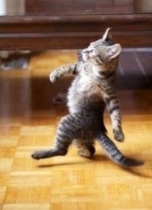
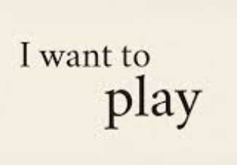

I want to!
Notes:
🍐 This is a Pear Deck Text Slide
🍐 To edit the type of question, go back to the "Ask Students a Question" in the Pear Deck sidebar.
Sometimes people do things completely because they want to. With this type of motivation the only person you are pleasing is you. You are doing something because you love it and you want to, and you don’t expect anything in return.
Type in some leisure activities you do because you really want to.

Slide 5

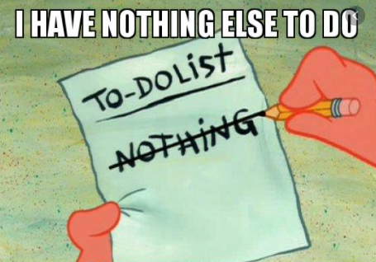
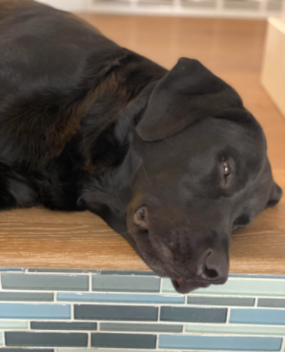
There’s nothing else to do ...
Notes:
This kind of motivation happens when you don’t know what to do, have nothing else to do, or don’t really care. It is like the boy in the video. Everyone feels like this sometimes and it is not a bad thing, it is just life. But if it happens too often you can wind up feeling bored and unhappy much of the time. Nothing else to do motivation can lead to unhealthy things like using alcohol and drugs, or damaging property, or causing harm to yourself or others.
Think back to when you were bored, bring in what they’ve said earlier.

Slide 6


I have a purpose...a goal!
Notes:
🍐 This is a Pear Deck Text Slide
🍐 To edit the type of question, go back to the "Ask Students a Question" in the Pear Deck sidebar.
Sometimes people do things that they know will be good for them. With this motivation you do things you enjoy and you also do them because they lead to accomplishing a goal. For example, when you practice a sport, you are working to get good at the game, or so that you will get faster, and maybe even one day get a sports scholarship. So you do the activity because you want to but you also have a goal in mind.
Type in some activities you do because you have a goal or purpose in mind. Try to focus on leisure activities.

Slide 7
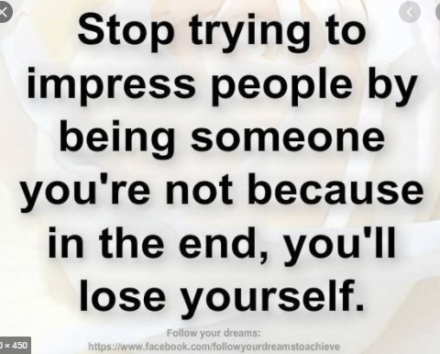
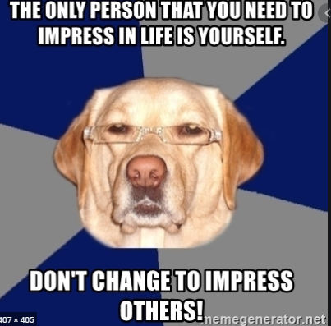
I want to please or impress others...
Notes:
🍐 This is a Pear Deck Text Slide
🍐 To edit the type of question, go back to the "Ask Students a Question" in the Pear Deck sidebar.
Sometimes people do things because they want to impress other people or create an image of themselves. Think about how people try to create an identity on Snapchat or TikTok. It’s like you are creating your own personal brand.
Other times people do an activity because they would feel guilty if they didn’t do it. That might be when your friend wants you to go shopping but you don’t really feel like it, but you do it to please your friend. That is a kind of peer pressure. This type of motivation in complex, and it is also sneaky. You might think you are doing something because you really want to do it, but if you really thought about it, you’d see that it was for what others think.
Just like the ”have to” motivation, this type of motivation can also be good because it might help you try something new that you really enjoy, but your wouldn’t have tried it if you didn’t have some “pressure” from someone else. But if you do it just to please someone or look really cool to others, this can lead to some unhealthy and possibly risky behavior.
Type in some leisure activities you do because you want to please others and would feel guilty if you didn’t or discuss in class.

Slide 8
Identify the Motivation
My friend challenged me to do a new trick on my BMX. A lot of my friends were watching. I didn’t want to look like I was afraid.
I’m working on a painting for the art show at school.
It was cold outside when I came home from school so I just watched TV.
I’m really excited about seeing the movie with my friend this weekend.
This evening I set aside an hour to finish the book I’m reading. It’s really good and hard to put down.
Motivations
Had to
Want to
For a Purpose
To Please Others
Nothing Else to Do
Notes:
Let’s see if you can identify the motivation in these scenarios. Let’s go to Google Meet or just discuss in class.
Read each one aloud, ask for a volunteer to say what motivation it is and why.

Slide 9
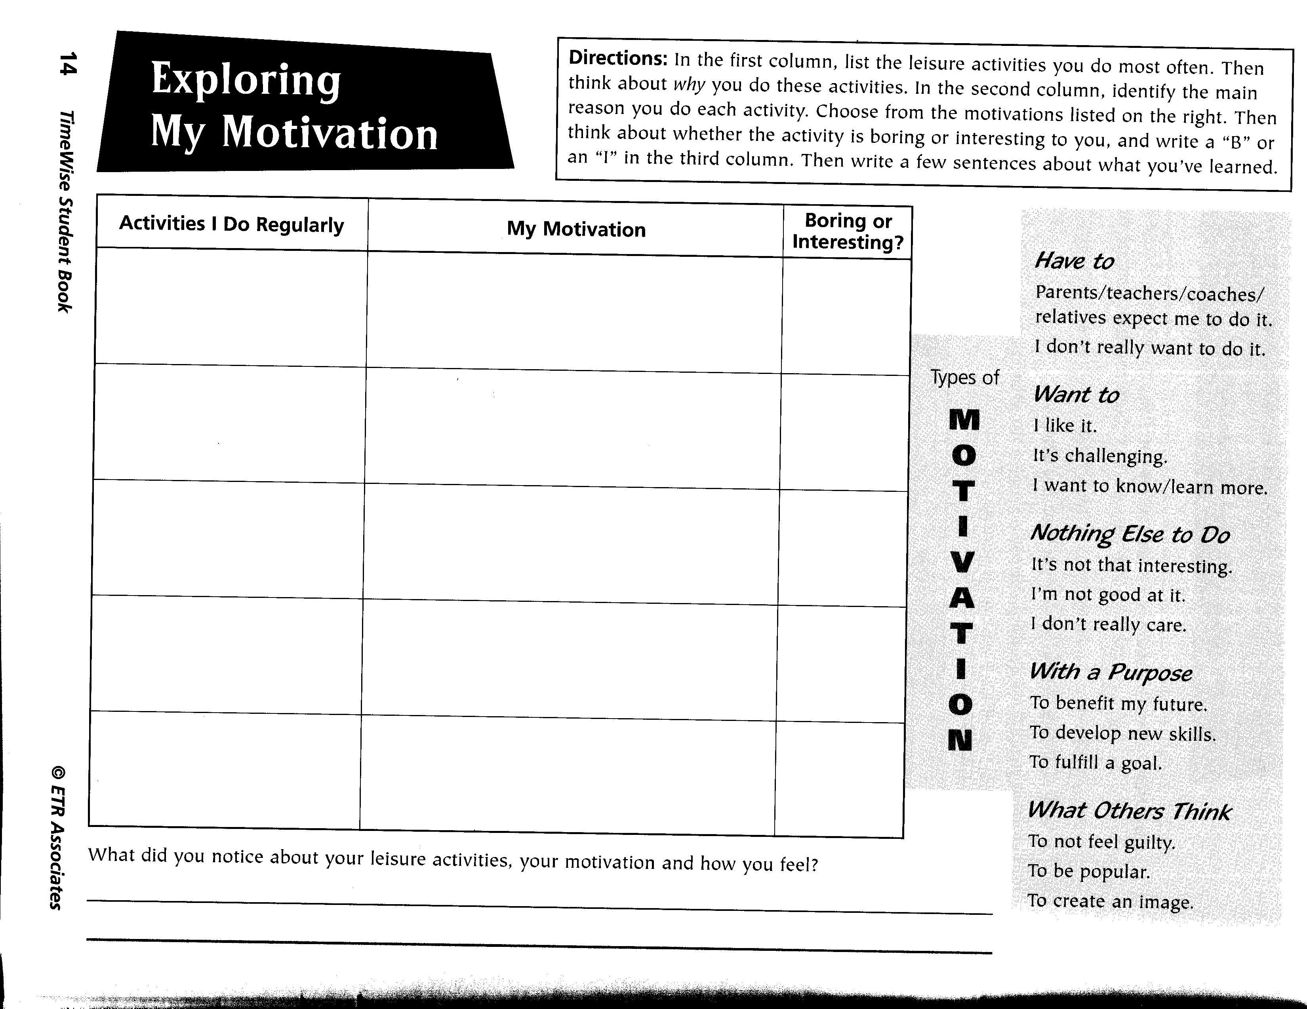
Notes:
We’ve talked about the Live Your Why campaign. As we’ve discussed, it is really important to examine why we do things during the day. Of course, like we’ve said, we all have to do things, But it is good to balance doing things because we have to and because of concern for other people with doing things because you want to or for a purpose.
Let’s take a few minutes to dig deeper and consider why you do the things you do regularly during the day. It can be anything from going to classes to chores to leisure activities.
Write down what you do most often, and why you do it and whether it is boring or interesting. Is there a pattern. When do you feel most interested? Most bored?

Slide 10
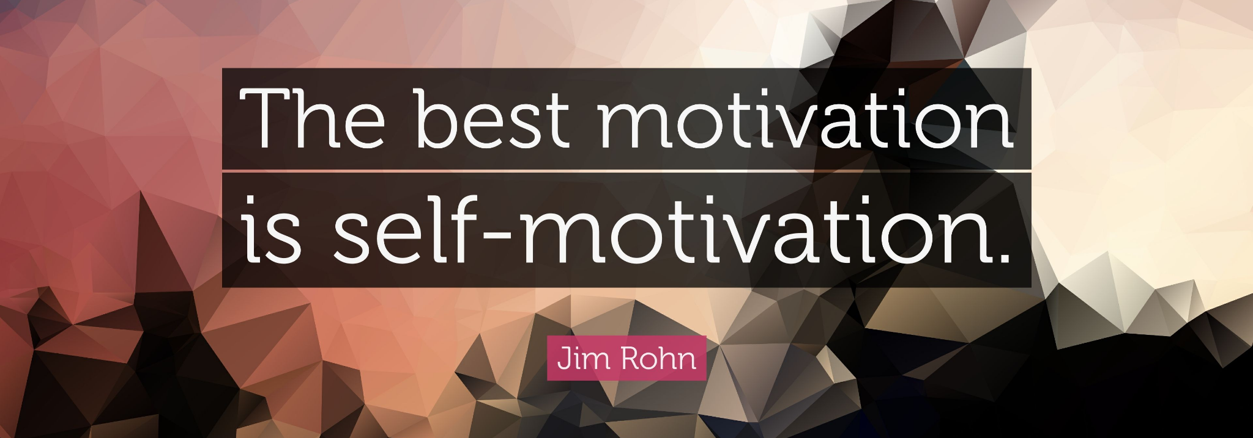
Because I want to, and I’ll find a way to do it!
We’ll discuss how to overcome attitudinal and other roadblocks that get in the way of doing desired leisure activities in the next session.
Notes:
One of the main goals of this program is to help you learn ways that you can take charge of your leisure time. Taking charge means that first you need to analyze how you spend your time, how you feel when you are doing certain activities, and understanding why you do those activities.

Slide 11
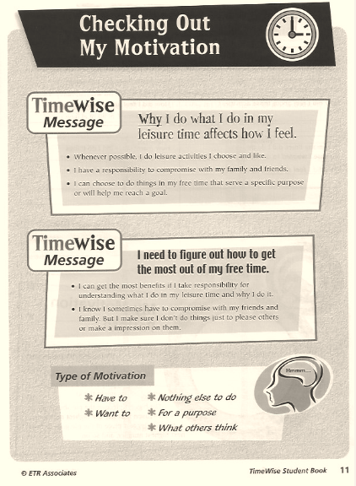
Notes:
🍐 This is a Pear Deck Text Slide
🍐 To edit the type of question, go back to the "Ask Students a Question" in the Pear Deck sidebar.
This is the summary sheet from today’s lesson.
We discussed that doing activities when you really want to do them, and not because someone else wants you to, or that you think you should, are the healthiest, and are the most likely to be interesting to you, and therefore avoid boredom.
Using these ideas, practice taking charge of your leisure time this week. Think about how you can make your leisure more satisfying and interesting. We all have to compromise and do things because we have to or to please others. And sometimes what we do is boring or not very satisfying, and that is just life. Sometimes we can’t do everything we want to. But don’t give up. Taking charge of your leisure time means you should try to have a good balance of doing things doing things because you have a purpose or really want to do them and are really interested in what you are doing. Remember the Live Your Why website. It has some good ideas if you get stuck thinking about what to do. And don’t forget the ideas for turning a boring situation into something more interesting.

Slide 12
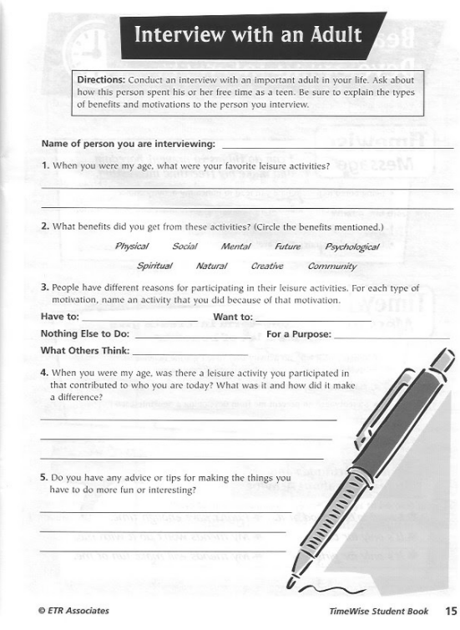
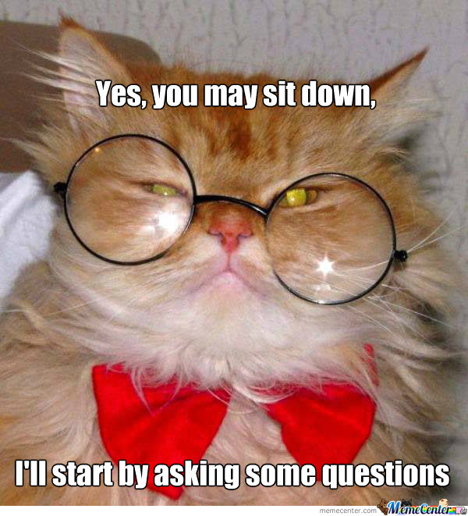
Notes:
Here is an opportunity to find out more about an adult in your life. Set up an interview with a parent, grandparent, caregiver, teacher, coach, etc. to find out some thing about their leisure. We’ll discuss this and talk about overcoming stereotypes and things that get in the way of doing what you want in leisure next time.
Use page 15 in the student book to conduct the interview.

Slide 13
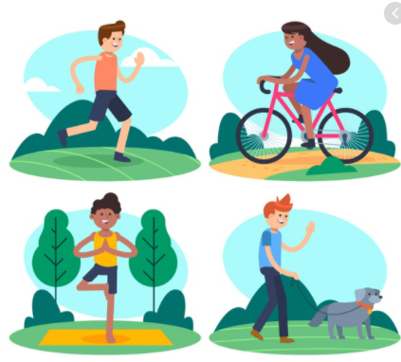
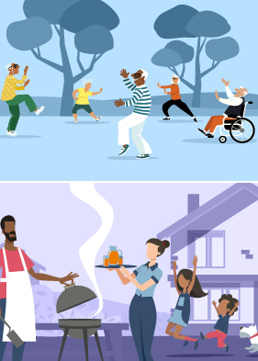
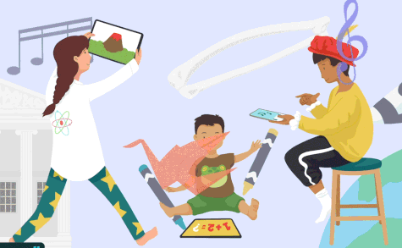
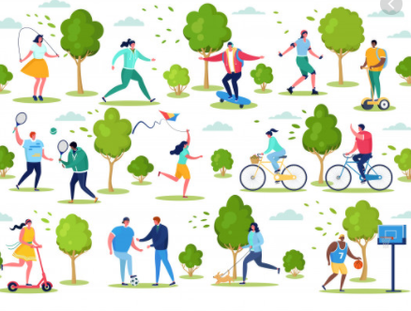
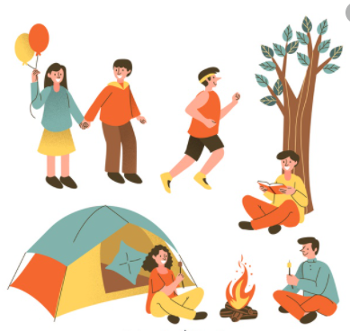
Enjoy your leisure!

