Slide 1
TimeWise: Taking Charge of Leisure Time and Living Your Why …
How to LiveWise!
TimeWise for Lamoille Valley
Spring 2022
Session 3: Boredom and Interest
Notes:
Materials Needed for Session 3: Boredom and Interest
ETR manual and student workbook material:
TW teacher manual pages 31-39
Transparencies 4 (Avoiding Boredom), 5 (Becoming Interested)
TW workbook page 18 (New Interest Inventory), page 19 (Narrowing it Down); page 34 (My Leisure Pyramid)
TW Message: Beating Boredom and Developing Interests (TW workbook page 16)

Slide 2

Today we will discuss being bored and being interested in leisure time, but first let’s review your analysis of your daily journal
Notes:
One of the main goals of this program is to help you learn ways that you can take charge of your leisure time. Taking charge means that first you need to analyze how you spend your time, how you feel when you are doing certain activities, and understanding why you do those activities.

Slide 3

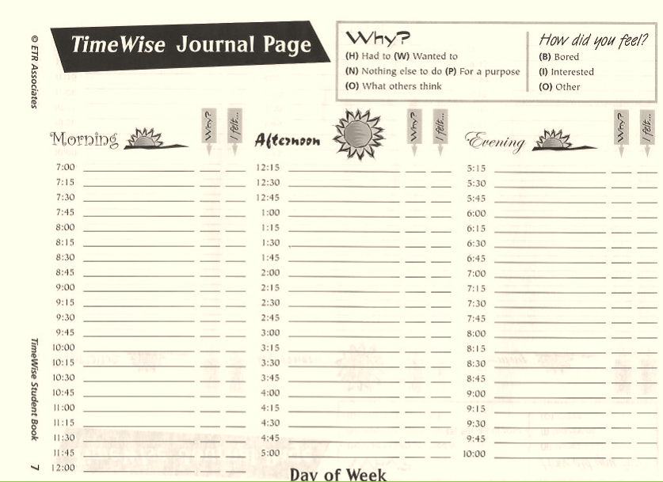
Think about what you discovered about how you spent your time and how you felt about that.
Did anything surprise you?
Notes:
🍐 This is a Pear Deck Text Slide
🍐 To edit the type of question, go back to the "Ask Students a Question" in the Pear Deck sidebar.
Assign a scribe?
Ask students to share via Pear Deck or verbally what they were surprised about. Feel free to also add thoughts in the Pear Deck. Did you learn anything about yourself?
Your pattern of daily activity is important for many reasons. Of course, the more things we do that give us benefits means that we will be healthier and happier. We want to help you identify those things that help you get benefits.
What did find out about why you did your activities during the day. Let’s have a show of hands. How many felt that they did enough tings during the day because they wanted to? What about because they had to? Had nothing to do? For a purpose? What about doing something for what others might think of them?

Slide 4
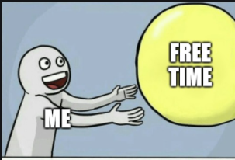
How do you feel about the amount of free or leisure time you had during the days you kept the journal?
Notes:
🍐 This is a Pear Deck Multiple Choice Slide. Your current options are: A: Too much, B: Just about right, C: Not enough,
🍐 To edit the type of question or choices, go back to the "Ask Students a Question" in the Pear Deck sidebar.
How does it compare to the average for middle schoolers, we mentioned last week?

Slide 5
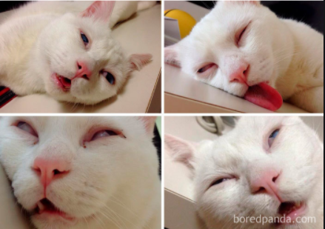
Did you have enough sleep?
Notes:
🍐 This is a Pear Deck Multiple Choice Slide. Your current options are: A: Yes, B: No,
🍐 To edit the type of question or choices, go back to the "Ask Students a Question" in the Pear Deck sidebar.
I know you didn’t have to indicate how much sleep you got, but think about how much sleep you usually get. What do you think? Do you have enough sleep?

Slide 6

How much stress did you have?
Notes:
Healthy leisure can help with stress management.
Adequate sleep can help you enjoy your leisure activities more.

Slide 7
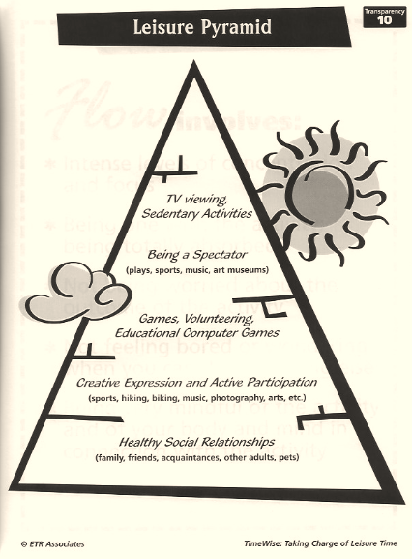
Bottom of Activity
Pyramid or Top?
Thinking about your analysis, drag the purple circle to show if you had more activities on the bottom or the top of the activity pyramid.
More on Top
More on Bottom
Notes:
🍐 This is a Pear Deck Draggable™ Slide.
🍐 To edit the type of question, go back to the "Ask Students a Question" in the Pear Deck sidebar.
It is important to look at our overall pattern of activities. So as you think about your analysis, you should consider whether you had a good balance and variety of activities that would give you as many benefits as possible.
Think about the activity pyramid, did you do more activities that are at the bottom of the pyramid or on the top?
These things can tell you where you might want to make a change in what you are doing.
We asked you about whether or not you got enough sleep because without adequate sleep it is hard to have enough energy to get to the healthier activities, or to get full benefits from what you do. So please try to make sure you are getting enough sleep so you are not feeling tired all the time.
The analysis is a tool you can use to identify your patterns, like not enough or too much free time or not enough sleep. This will help you figure out how you might change things in your daily life to get more of what you want and need.

Slide 8


Interesting or Boring????
What activities did you do that were interesting?
Now write in what activities you did that were boring.
Notes:
🍐 This is a Pear Deck Text Slide
🍐 To edit the type of question, go back to the "Ask Students a Question" in the Pear Deck sidebar.
Either have a discussion about what they found boring and interesting, or use the Pear Deck.
In the first response box, write the word interesting, and then list what activities you did that were interesting.
Add another response box, write the word boring, and then list which activities were boring.

Slide 9
Boooorrrrriiiiinnnngggg
What makes something boring to you?
Notes:
🍐 This is a Pear Deck Text Slide
🍐 To edit the type of question, go back to the "Ask Students a Question" in the Pear Deck sidebar.
Discuss what they felt made their activities boring and then move on to the next slide with some ideas of what does make things boring.

Slide 10
Boooorrrrriiiiinnnngggg!
Things might be boring because:
It’s the same thing over and over.
You don’t know what else to do.
Nothing ever changes.
It’s too easy and there’s no challenge.
It’s easy to keep doing the same thing and it’s hard to be motivated to do something else.
Notes:
Let’s talk about what causes things you do to be boring. This list is on the right hand side of page 17.
Was there anything they mentioned that you can add to this list?

Slide 11
Being Interested
What do you think makes things interesting to you?
Notes:
🍐 This is a Pear Deck Text Slide
🍐 To edit the type of question, go back to the "Ask Students a Question" in the Pear Deck sidebar.
Now discuss what made things interesting to them.

Slide 12
What Makes Something Interesting?
You really like to do it.
You feel good about yourself when you do it.
It’s fun.
There is the right amount of challenge...it’s not too easy and not too hard.
It matches your personality and helps you express who you are.
Notes:
Refer them to the right hand side of page 17 for a list of what makes things boring and interesting.

Slide 13
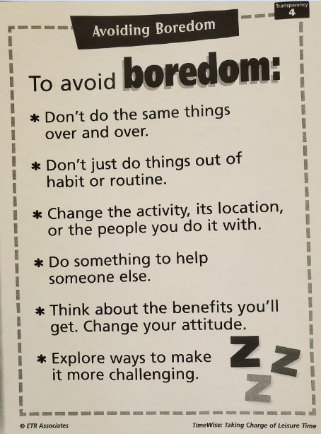

Notes:
🍐 This is a Pear Deck Text Slide
🍐 To edit the type of question, go back to the "Ask Students a Question" in the Pear Deck sidebar.
Let’s talk about how to avoid being bored. This is part of taking charge of your free/leisure time and learning to make good choices about what you do.
Here are some ideas to avoid being bored. You can write these down on the bottom of page 17.
Give examples: changing activity, location, or people, etc.
Walk around the house, go outside, etc
Start doing something new.
Ask for the students to add in Peardeck any examples of what they have done to avoid being bored (move from boredom to being interested).
Some examples of ways to make something more challenging (less boring):
ex. Just shooting a basketball --->having someone play defense on you… time limit? Space limit? kicking on a soccer goal (try only to kick in one corner, etc), My kids instead of just walking along...only on certain lines or tiles or hot lava. driving in a car- we’ve all done this… either playing a game (count how many xxx, ), listening to music/radio/podcast, call someone
You might not find something boring now...but maybe it is not as fulfilling as you would like it to be…

Slide 14
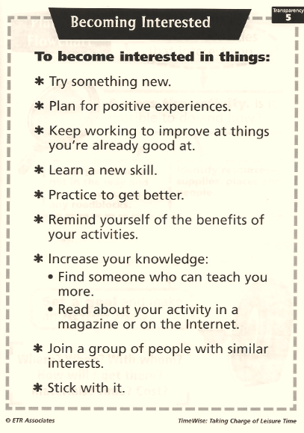

Notes:
Discuss this slide.
Take a look at this website from Healthy Lamoille Valley (some of you may have seen it before or know about this initiative) https://www.healthylamoillevalley.org/liveyourwhy/middlehighschoolactivityworksheets/, “Live Your Why.” It contains a lot of ideas for doing different types of activities that might appeal to you. If you want to try something new, this website might give you some ideas.
Let them click on the link and guide and go to middle school activities. There are different themes on the website. Click around and explore for a few minutes.
You can also suggest some ideas to add to this website!

Slide 15
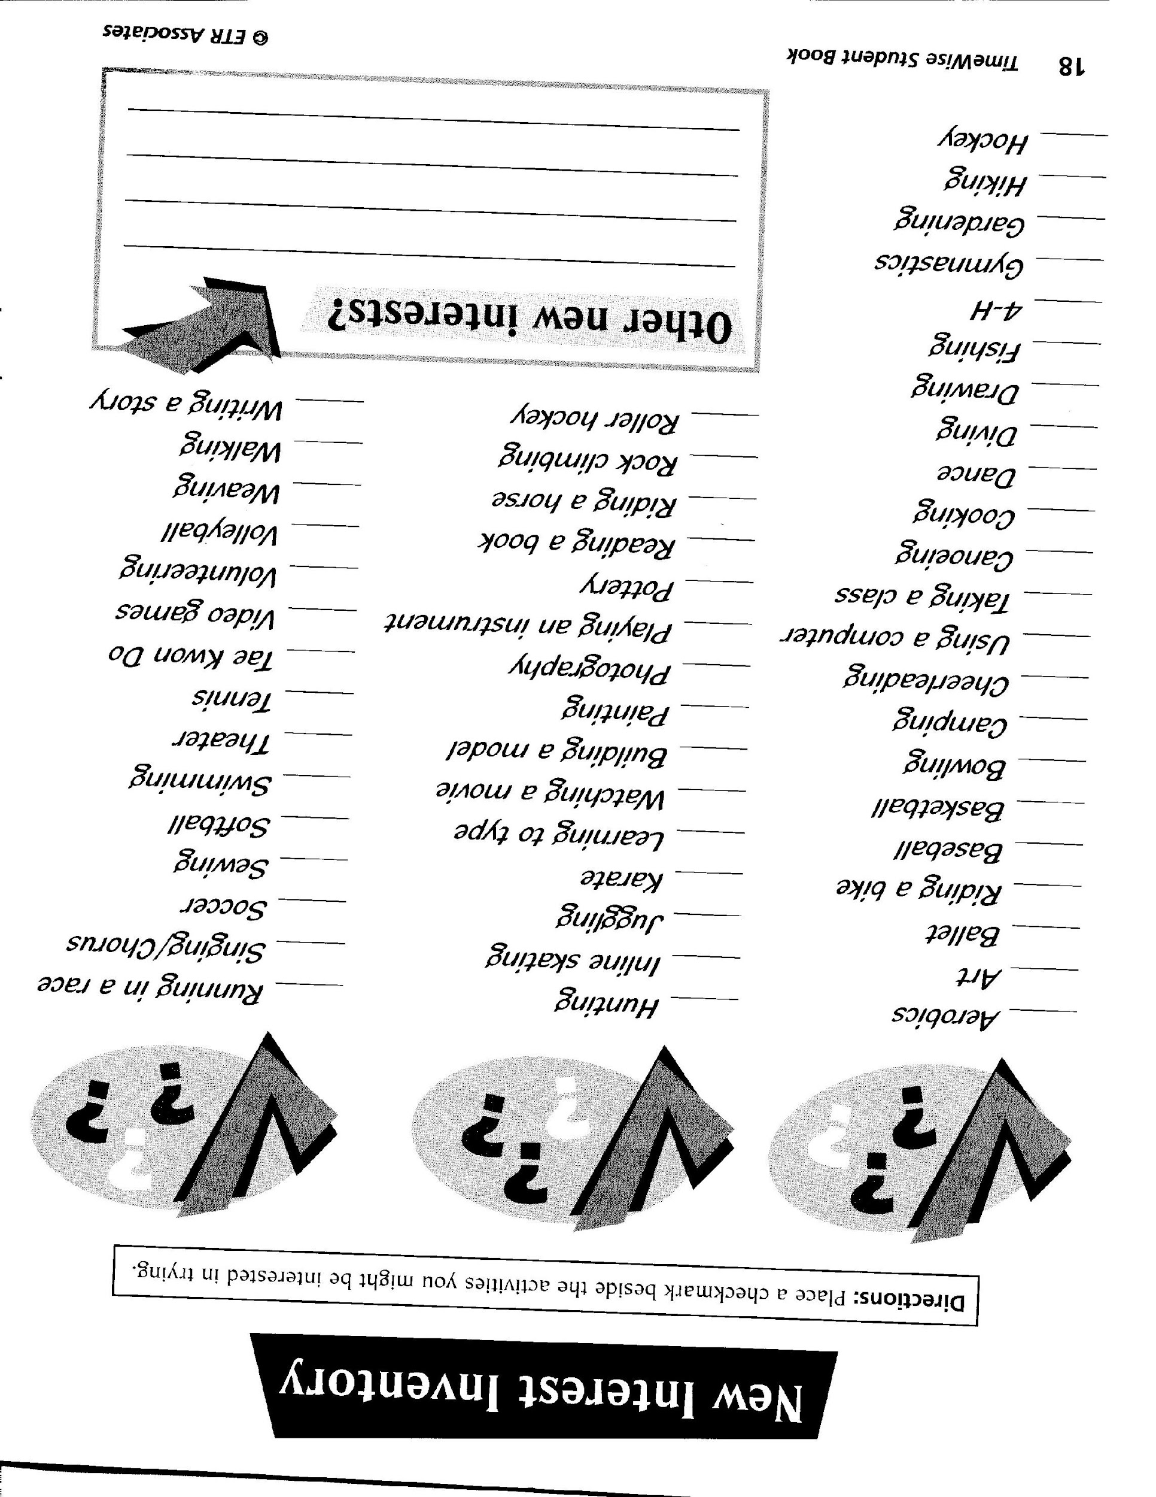
Healthy Lamoille Valley
Live Your Why!
Middle & High School Activity Worksheets
Notes:
Take a look at page 18 in your student workbook. Here is a list of activities that you might be interested in trying. Read through the list and check off any of these that sound interesting to you.
Now, let’s take a look at the Live Your Why website and see if any activities on the website match with your interests. Or maybe you will find something on the website that you would like to try out.
As we move forward with the curriculum you will learn ways to plan to try out new activities.
One thing to keep in mind is that in order to learn a new activity you have to stick with it for a time in order to gain skills and learn to do the activity well. Persistence and not giving up is really important! Then, if after a good try, you find you don’t like it, that is perfectly fine, too, and you can look for something else.

Slide 16
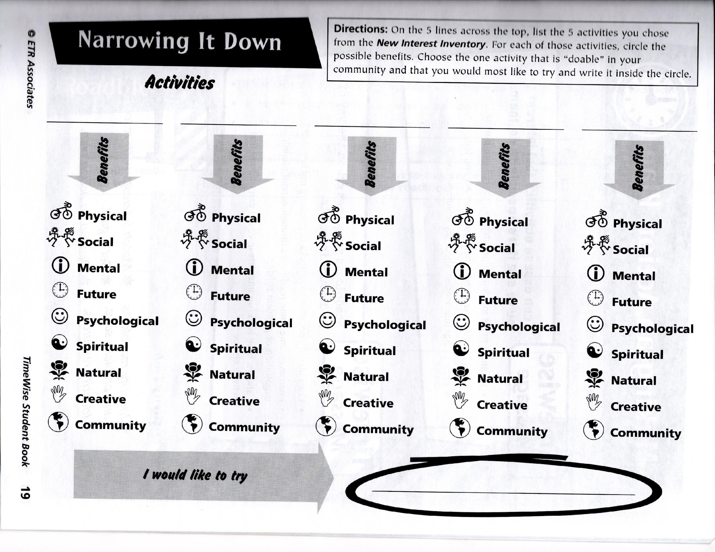

Notes:
Teacher: After you have identified some new interests you might like to try, it will be helpful to narrow it down to one or two that seem to be best fitted to you and that will give you benefits that you don’t have already, or that you need more of. Look at a few (up to five) activities you might like to try, and circle the types of benefits you might get from each activity. Were there one or two activities that look like ones you think would be best for you?

Slide 17

In the next session we will explore why you do what you do in your leisure time.
Notes:
Why you do what you do is directly connected to whether something feels boring or interesting.

Slide 18
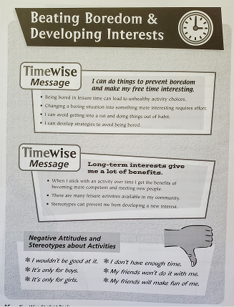
To Summarize:
Notes:
We’ve helped you learn to turn something that is boring, or that is not very satisfying, into something more interesting. Knowing this information and developing skills to do this is a major skill that helps you get the most out of your leisure time.
We will discuss why you do things … that is motivation … in the next session.

Slide 19
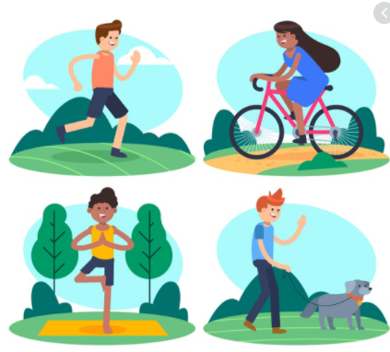



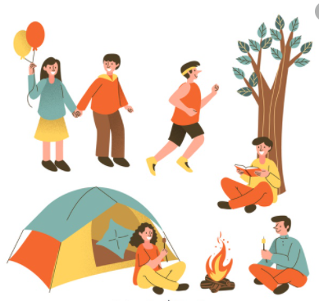
Enjoy your leisure!

