Slide 1
TimeWise: Taking Charge of Leisure Time and Living Your Why …
How to LiveWise!
TimeWise for Lamoille Valley
Spring 2022
Session 2: Benefits of Leisure
Notes:
Materials Needed for Session 2: Benefits
ETR manual and student workbook material:
TW teacher manual pages 14-18
Transparencies 2 (Leisure Time Benefits) and 10 (Leisure Pyramid)
TW workbook page 4 (Exploring My Free Time), page 5; (My Free Time Profile), pages 6-10 (TimeWise Journal Page); page 34 (My Leisure Pyramid); page 12 (TimeWise Journal Analysis)
TW Messages: Exploring Leisure Activities, (TW workbook page 3)

Slide 2

Your leisure activities can give you a lot of benefits.
What do you think the word benefit means?
Write in your response.
Notes:
🍐 This is a Pear Deck Text Slide
🍐 To edit the type of question, go back to the "Ask Students a Question" in the Pear Deck sidebar.
The 5th column on page 14 has to do with the benefits you get from your leisure time because what you do in your leisure time can give you a lot of benefits. What do you think the word “benefit” means?
Write as many things you can think of. Debrief responses and definite benefit as follows.
A benefit is something that produces good or helpful results or effects or that promotes well-being.

Slide 3
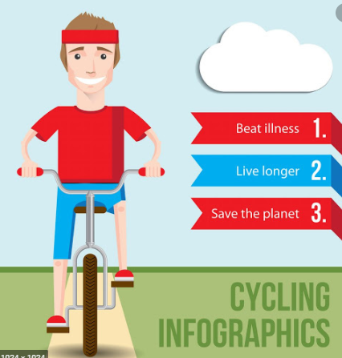
Notes:
For example, there are a lot of benefits to biking. Here are some of them.
You can see benefits can be personal or even for the greater good/environment, etc.

Slide 4
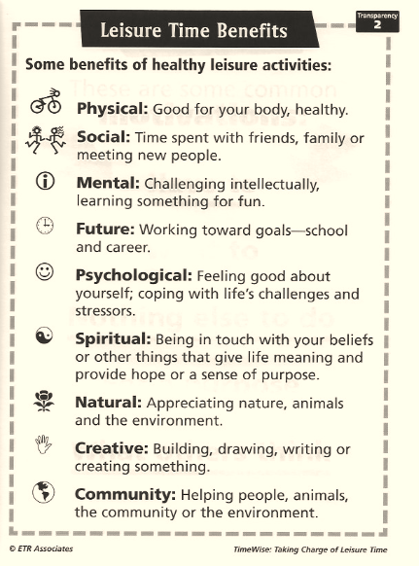
Leisure Time Benefits
Let’s talk about the benefits you get from your leisure.
Notes:
🍐 This is a Pear Deck Text Slide
🍐 To edit the type of question, go back to the "Ask Students a Question" in the Pear Deck sidebar.
Leisure activities have a lot of benefits, that is why they are important. Common benefits of healthy leisure include: Physical, social, mental, future, psychological, spiritual, natural, creative, community benefits. Briefly comment on each one, as noted on the slide.
The healthiest people have a lifestyle that gives them all of the benefits. They make sure they get a variety of activities because one activity alone usually doesn’t give you all of the benefits.
That’s way it is great to have a variety of things you like to do so the benefits add up.
Discuss each of the benefits that can be had from leisure. You might want to share one or two leisure activities you do and what benefits you get from them.

Slide 5
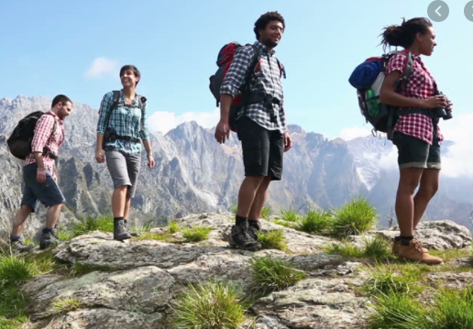
Different Benefits for Different People!
Notes:
🍐 This is a Pear Deck Text Slide
🍐 To edit the type of question, go back to the "Ask Students a Question" in the Pear Deck sidebar.
Not everyone always gets the same benefits from the same activity.
Physical, social, mental, future, psychological, spiritual, natural, creative, community benefits.
Look at the youth in the pictures..What benefits do you think the hiking or drama (which one) youth are getting?
What benefits are the getting when hiking? What about drama?
Are some the same?

Slide 6
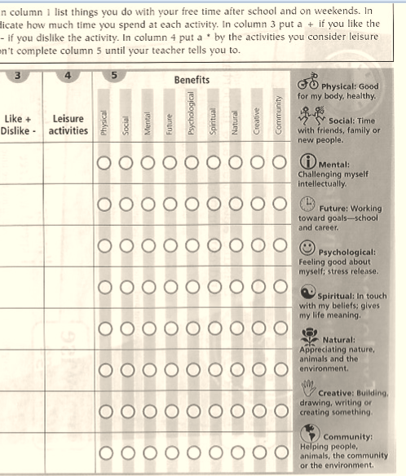
Now think about the activities you wrote in your workbook and mark off the benefits you get.
Notes:
Look at the activities you wrote in the workbook on page 4. Now complete the fifth column to indicate the benefits you get from each activity listed.

Slide 7
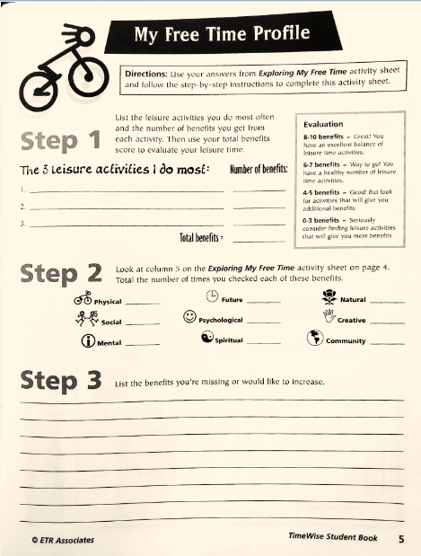
What is Your
Leisure Profile?
What benefits do you want more of?
Notes:
🍐 This is a Pear Deck Text Slide
🍐 To edit the type of question, go back to the "Ask Students a Question" in the Pear Deck sidebar.
Between this class and next, if you are interested you can complete page 5 to begin to understand your leisure profile.
List the three activities you do most and figure out how many benefits you get for each activity and add them up.
Next look at column 5 and total the number of times you checked each of the benefits.
List the benefits you’re missing or would like to increase.

Slide 8
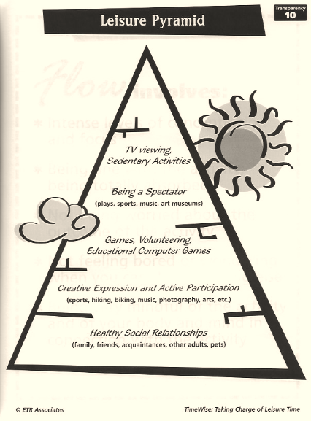
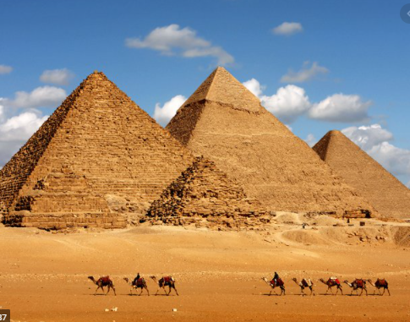
Notes:
🍐 This is a Pear Deck Text Slide
🍐 To edit the type of question, go back to the "Ask Students a Question" in the Pear Deck sidebar.
You want to have a strong leisure profile.
Maybe you’ve studied the pyramids in Egypt. Pyramids are strong structures because they have a strong foundation, and are built up layer by layer. The foundation supports all the layers above it, and each layer is strong enough to hold the layer above it.
Let’s look at this leisure activity pyramid on page 34 (page 34 TW workbook, My Leisure Pyramid; Transparency 10, Leisure Pyramid).
It is another way to look at types of leisure and benefits.
**Just as some foods are healthier for you than others and give you a strong foundation to go about your day, some activities are healthier for you than others and provide the foundation for a healthy leisure lifestyle.
Activities where you use your skills, or you are creative, and/or you really engage with the activity are the ones where you are most likely to get benefits. These foundational activities provide support for the other things you do during the day.
The activities at the top give you the least benefits, even though all enjoy them. It is just they don’t provide as many benefits, like TV viewing. If we do them too many activities on the top and don’t do more things on the bottom, we have a big imbalance of how we spend our time.
One of the reasons the activities toward the top don’t give you as many benefits is because you are not activity engaged when you do them. You are more passive. The activities toward the top are ones that most people feel really engaged and interested, and time flies by when you do them.
THINK ABOUT WHERE DOES TEXTING, TIKTOK OR SNAPCHAT/SOCIAL MEDIA FIT IN?

Slide 9
But...
Something is Missing!
Notes:
🍐 This is a Pear Deck Text Slide
🍐 To edit the type of question, go back to the "Ask Students a Question" in the Pear Deck sidebar.
Something is missing from the pyramid, though. What are other kinds of activities young people do that are not positive?

Slide 10

Some activities are not positive and can cause harm to yourself or to others. Since these are not benefits they go under the pyramid.
Can some activities in the pyramid bring harm to yourself or others? How?
Notes:
There are many activities people do that cause harm to themselves or other people.
They are not on the pyramid because that are not considered positive leisure activities that give benefits.
Ask students to identify activities that can cause harm to self or to others.
Add to what they suggest if they miss some:
Examples of activities that can cause harm to yourself are substance abuse; dangerous high-risk activities; and too much or not enough sleeping, eating, relaxing, or exercising.
Activities that can cause harm to others include substance misuse, inappropriate competition, bullying, gossip, fighting, hurting animals, breaking the law, and so on.
It is important to know that activities can have a range of benefits but can also have negative outcomes as well. For example, if you do too much of an activity, like too much social media or gaming, even though there are benefits, it could prevent you from doing something else that is more fulfilling.

Slide 11

Whose Responsibility Is It?
Think about when you were in 3rd grade.
Who was responsible for what you did in your leisure time?
How about now?
Notes:
Shifting gears now.
Let’s think about whose responsibility is it to get benefits and engage in more leisure activities at the bottom of the pyramid?
Before you answer, there is a difference between relying on someone, like an adult or friend to help you get to an activity, and taking responsibility for what you do.
So think about who’s responsible for what you do in your leisure time? You or other people? Who are the other people? Parent, coach, teacher, sibling, friend, self.
Show answers through Google Meet.
Think about how you might have answered that in 3rd grade. It is important for you to know that as you get older, you are responsible for your own leisure time. In fact, you will become responsible for all of your actions and behaviors. This is part of making good and healthy decisions.

Slide 12
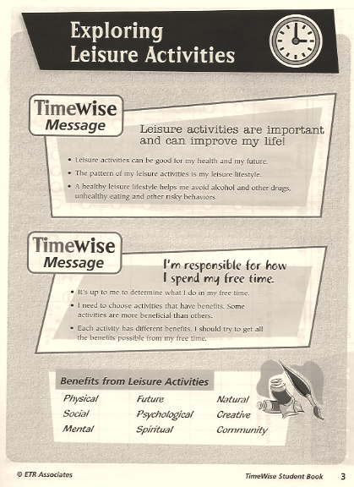
Summary
Notes:
Take a look at TW Messages: Exploring Leisure Activities on page 3 (TW workbook page 3).
This is a summary of what we’ve covered today.
You can refer back to this when you want a refresher of what we’ve covered.

Slide 13
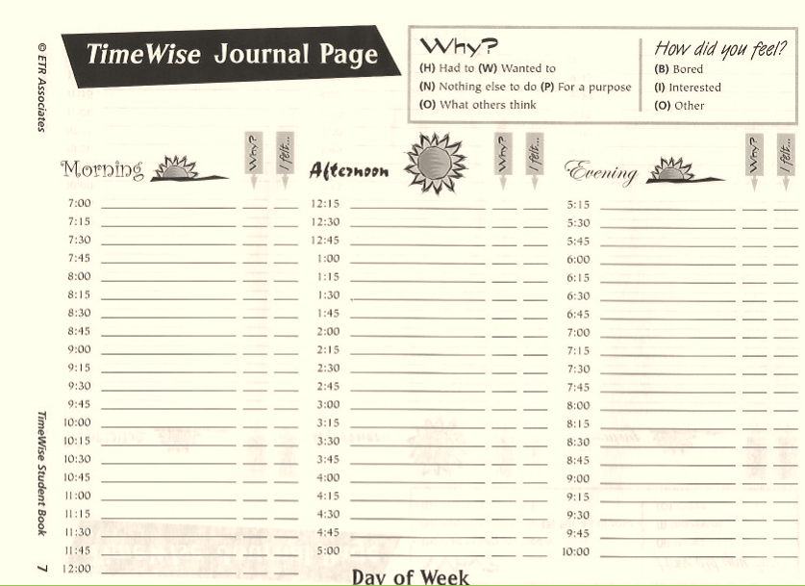
Let’s Explore How You Spend Your Time!
Notes:
For the next session (or do as an in-class activity) we’d like you to complete the TimeWise Journal (pages 6-10 TW workbook) and then as an option, complete the TW Journal Analysis on page 12 (TW workbook). See page 18 in the teacher’s manual and Master 1.
Have students look at the directions on page 6 TW workbook and discuss how to complete the activity. [Go over the columns, what they mean, and how to fill out the journal.] See example on one completed on next page.
The purpose of doing this journal is for you to get an accurate sense of how you spend your time why you did it, and whether you were bored, interested in what you were doing, or felt something else.
See page 6 in the student book for an example of how to complete the journal page. For example, you can see that one of the columns has to do with whether you get bored with the activity or are really interested in what you are doing. The other column asks you why you did the activity. That is, did you have to do it, want to do it, do it for a specific purpose, do it to influence what others might think of you, or do it because you had nothing else to do.
If there is time in-class, you can give students time to start the journal and hopefully they will complete the pages during the week.
It is ideal if they can complete a few days worth of journal pages that include at least one weekend day, if not both. It is also better if they can complete the journal frequently during the day so they don’t have to rely on their memory.
You might say: It is best if you fill out the journal a few times during the day so you don’t forget what you’ve done and how you feel.
They will have to take their student books home with them if they are going to fill it out during the day, and remember to bring it back with them.

Slide 14
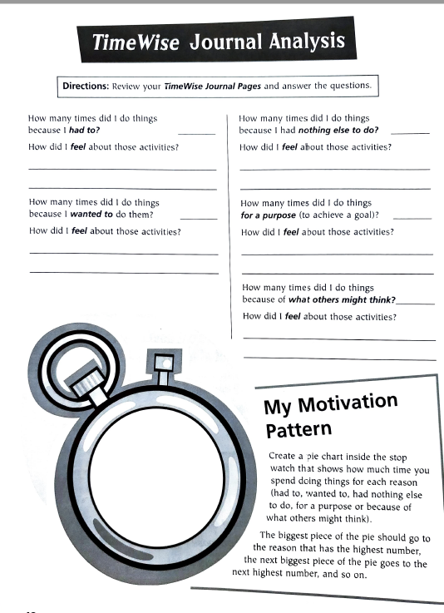
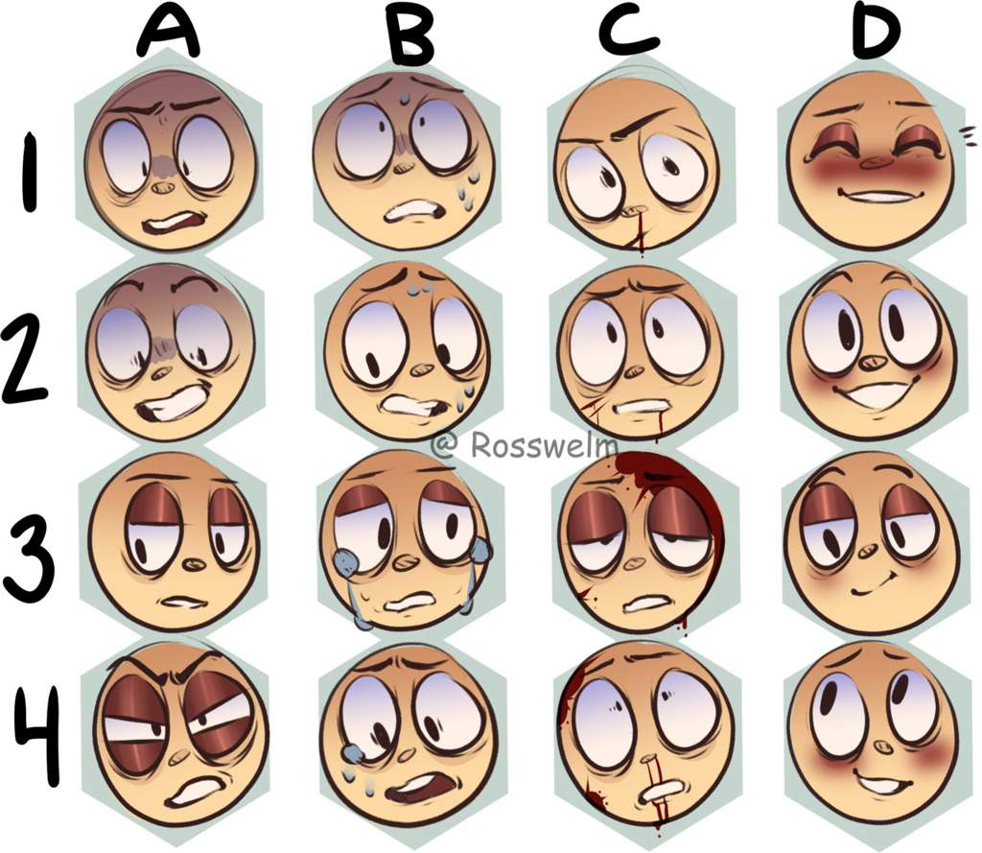
Analyze TimeWise Journal: How did you feel and when?
Notes:
This analysis sheet on page 12 will help you analyze how you really spend your time.
This is optional for students, but they might find it interesting. An example of a pie chart is on the next page.
Often people are surprised when they keep a journal like this because what their perception is of what they do with their time is often very different when they actually take time to write down everything they do.
It will also help you understand why you might be doing things and how you feel when you are doing them. It is best if you fill out the journal a few times during the day so you don’t forget what you’ve done and how you feel.

Slide 15
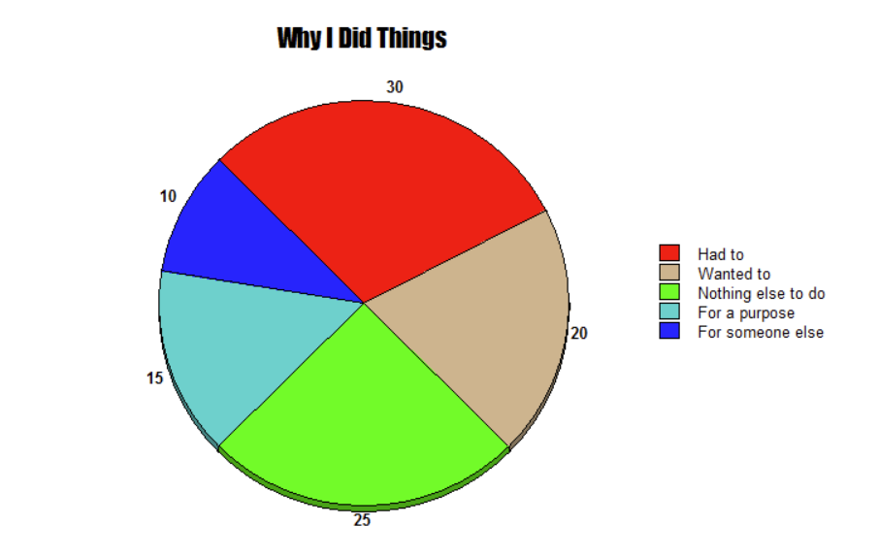
Notes:
In the next session we will talk more about what you found out from completing your journals, and talk about what things are boring and interesting, and why.

Slide 16
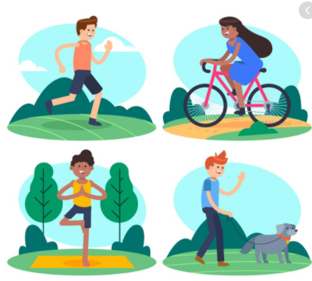
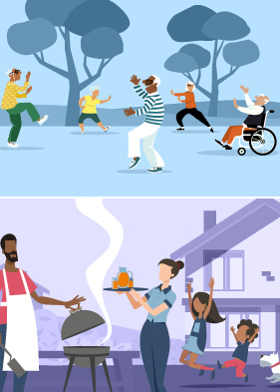
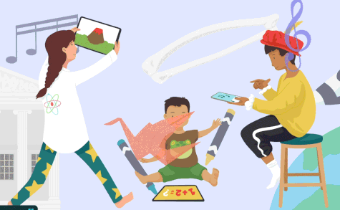
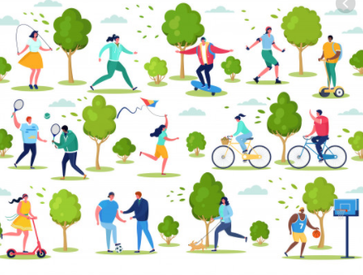
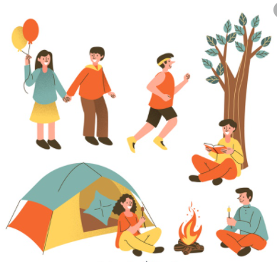
Enjoy your leisure!
Notes:
We’ll see you next session. Meanwhile, enjoy your leisure and have fun with the take away activities.

