Slide 1
TimeWise: Taking Charge of Leisure Time and Living Your Why …
How to LiveWise!
TimeWise for Lamoille Valley
Spring 2022
Session 1: Introduction and Exploring My Leisure
Notes:
Note: text written using italics is information or instructions for the teacher. Text in regular font suggests things the teacher might want to say. There is more information for each session in the teacher’s manual.
TW materials used in Session 1:
Session 1: Introduction
ETR manual and student workbook material:
TW teacher manual pages 9-12
Transparency 1 (Learning Lifelong Leisure Skills)
TW workbook page 4 (Exploring My Free Time)
TW Messages: Exploring Leisure Activities, (TW workbook page 3)

Slide 2
TimeWise: Taking Charge of Leisure Time
Welcome to TimeWise!
Leisure time challenges…
We can’t do what we want to.
Things are boring and we don’t know what else to do.
We do things but we’d rather be doing something else.
But of course, hopefully often we love what we do in our leisure time. The next slide will introduce the topics we’ll cover.
Notes:
These sessions have been developed to help you get the most of your free or leisure time.
Distribute the Student Workbooks. Perhaps keep them in the classroom for use at next session.
These sessions are about,
what you do in your leisure time,
how you feel about your leisure time,
and how you can make it even better.
We are hoping that through these sessions you’ll learn lifelong skills that you can use to get the most out of your leisure time.
We know that sometimes it is challenging to find something to do that we really enjoy or sometimes to have time.
Sometimes we just can’t do things,
sometimes what we do is boring,
sometimes we do things but would rather be doing other things,
and sometimes we are bored and don’t know what to do.
And, fortunately, sometimes we love what we are doing and really enjoy our leisure time.
We hope that you gain useful knowledge and skills over these three sessions.
There is more material in these books than we have time to cover. We’ve selected a number of worksheets that we think will provide you with the most information. In the entire book, there are 6 main lessons and 9 additional lessons. Each lesson has a summary sheet with the main takeaway information for each lesson.

Slide 3
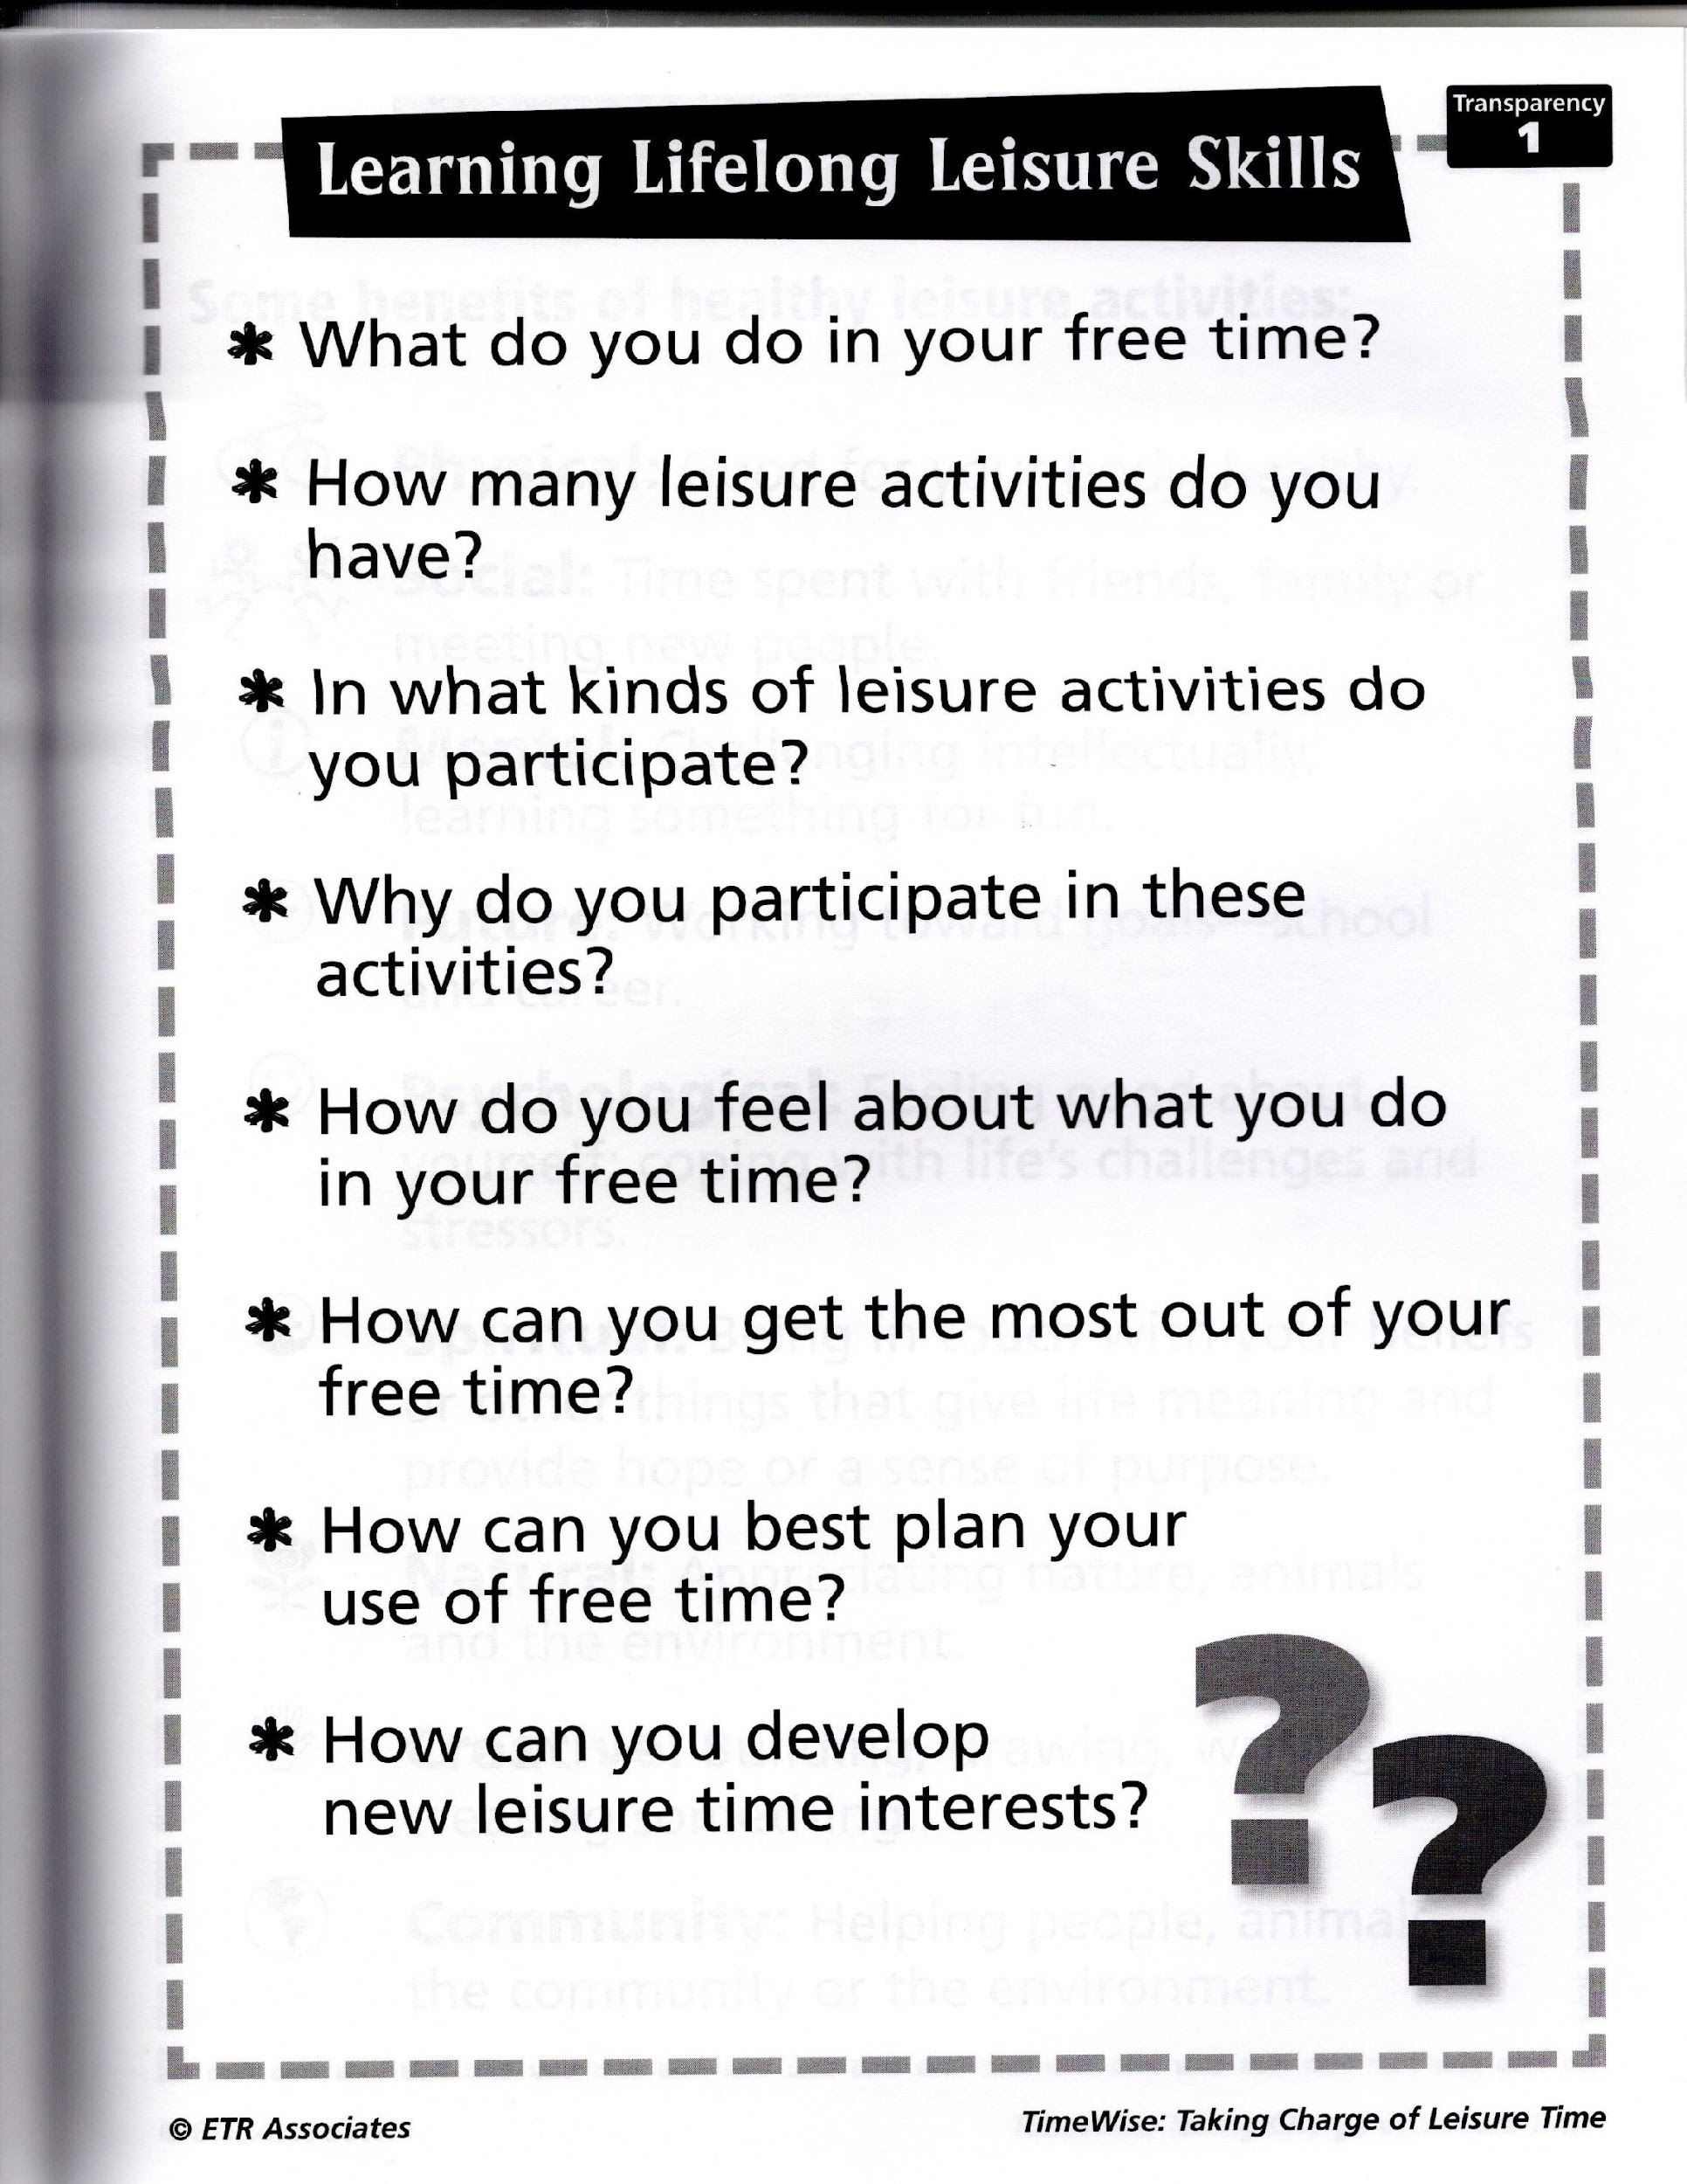

Slide 4
First Question!
Let’s talk about what we mean by the word leisure.
What comes to mind when you see or hear the word leisure? How would you describe leisure to someone?
Notes:
🍐 This is a Pear Deck Text Slide
🍐 To edit the type of question, go back to the "Ask Students a Question" in the Pear Deck sidebar.

Slide 5
Free Time and Leisure…What is the Difference?
What do you think the difference is between free time and leisure?
Notes:
Ask students if they have any ideas about the difference between the two terms.

Slide 6
Something to Think About!
Free Time
No obligations
But! Often there are chores or obligations in free time
“Blank Page”
Time away from being in school or work
Leisure
[Time, Activity, State of Mind]
Freedom to choose
Meaningful
Social or individual
Fun
Relaxing
Satisfying
Interesting
Learning
Free Time
Leisure
Notes:
The reason for this slide is to help students think about qualitative differences in how they can spend unobligated time. This is definitely a nuanced and challenging discussion because both free time and leisure can be associated with negative emotions and outcomes. However, leisure is “supposed” to be positive and healthy. It is often defined as time, but that doesn’t distinguish between free time where there are still things you have to do. Some people think of leisure as being certain activities, but a problem with that is some activities done in free time really are freely chosen and don’t produce a positive experience. Most people believe that leisure is a state of mind that comes from a person freely choosing to do what give them pleasure, fun, and/or satisfaction.
As you can see, there is certainly an overlap between the two terms, and often they are used interchangeably.
We will also use them interchangeably sometimes, but what we really want to focus on is healthy leisure that gives you benefits and that is completely enjoyable to you.
An important point with regard to leisure is that leisure is most enjoyable if you are doing something (or nothing but relaxing) because you CHOSE to do it and you are not doing it because you have to or you are doing it to please someone else.
A lot of people think leisure means you’re relaxing and doing nothing. And of course, there is nothing wrong with that! We all need to have time to relax and do nothing.
But leisure is a lot more than that and can be a very healthy thing or it can be unhealthy, based on a person’s choices. It also can be engaging or boring. So, what you do in your leisure time matters, and what you don’t do also matters. For example, kids who have a variety of activities they do like sports, nature-based activities, creative activities, and social activities probably get more benefits than kids who only play sports all the time. It’s also important to have a balance and variety of doing things alone and doing things with a variety of other people, like friends, siblings, and parents.
For these sessions when we use the word leisure, we mean that leisure is what you do in your free time. So, when you don’t have to do something like, homework or chores, you have free time and you get to choose something to do!
But sometimes that is a challenge because we may not know what to do. So, we sleep, eat, or just hang out or do nothing.
We/you can use that free time in ways that are fun, exciting, creative, physically active, and social. Also, you can learn things or help others. Therefore, you can get a lot of benefits from your leisure time.

Slide 7

Thinking About Lifelong Leisure Skills – Let’s Explore!
Here are some questions we’ll address:
What do you do in your free or leisure time?
Why do you participate in these activities?
How do you feel when you participate in leisure activities?
How can you avoid boredom and develop interests?
How can you get the most out of your leisure activities?
How can you overcome things that get in your way of doing leisure activities that you want to do?

Slide 8

Live Your Why!
https://www.healthylamoillevalley.org/liveyourwhy/middlehighschoolactivityworksheets/
Notes:
We are also going to introduce you to the Healthy Lamoille Valley program, Live Your Why!

Slide 9
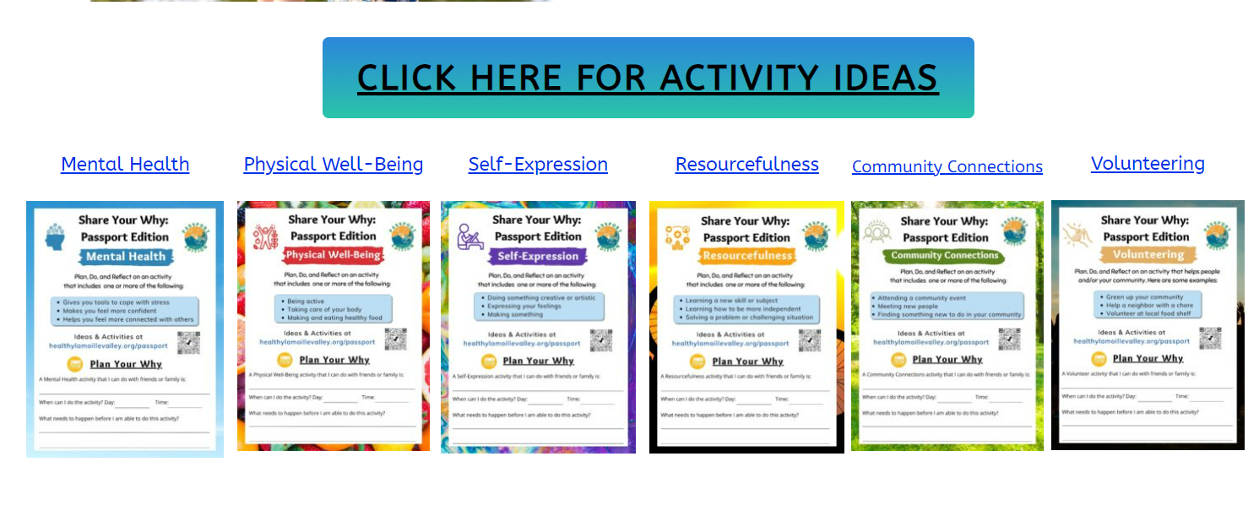
Live Your Why Passport Edition
Notes:
And we’ll integrate LYW Passport Edition with the TimeWise lessons.
Call up the website and briefly show students what there is on the website.

Slide 10

Exploring My Leisure
Notes:
The first session has to do with
helping you explore what you do in your leisure time,
why it is important,
and how to get more benefits from your leisure time.

Slide 11
Let’s Share What Our Favorite Leisure Activities Are
What are your very favorite leisure activities?
Notes:
🍐 This is a Pear Deck Text Slide
🍐 To edit the type of question, go back to the "Ask Students a Question" in the Pear Deck sidebar.
Ask students to share what their favorite leisure activity is, and how often they get to do that activity.
Observe if there are common activities or if students have unique activities.
Next ask them what activities they do most often.
Feel free to share what you love to do, too!

Slide 12
How many hours of free/leisure time do you think you have each day? (Write a number)
Notes:
🍐 This is a Pear Deck Text Slide
🍐 To edit the type of question, go back to the "Ask Students a Question" in the Pear Deck sidebar.

Slide 13
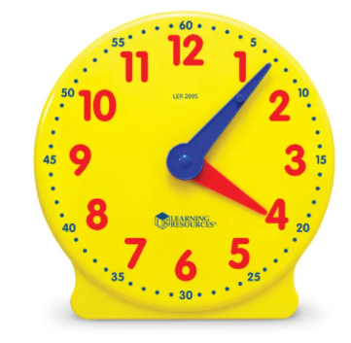
Middle school students typically have 5 ½ to 6 hours a day of leisure time!
Notes:
Think about this: Middle school students typically have 5 ½ to 6 hours a day of leisure time.
Do you think you have this much free time?
Sometimes people are surprised to find out how much leisure time they actually have.
We’ll give you a chance to find this out for yourselves in a take away activity that you’ll get to do.
We’ll explain this at the end of the session.

Slide 14
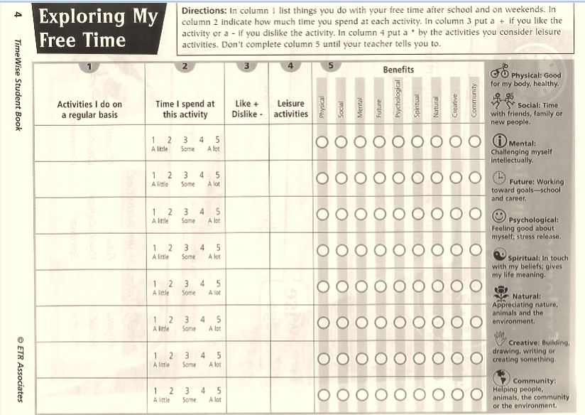
Time to Explore Your Free Time!
Notes:
Let’s find out what you do with that time.
Please turn to page 4. Complete the “Exploring My Free Time” activity (page 4 in TW workbook), but leave column 5 blank for now. That is about benefits and we’ll talk about that in the next session.
Briefly talk them through how to complete the activity. Use an example so that they stay with you for the explanation and don’t start doing the assignment.
Suggest a minimum of 3 activities. If they finish three, they can add more or go back to this later.
Ask them to share any thoughts they have about the activities they’ve listed and how much time they spend on them.

Slide 15
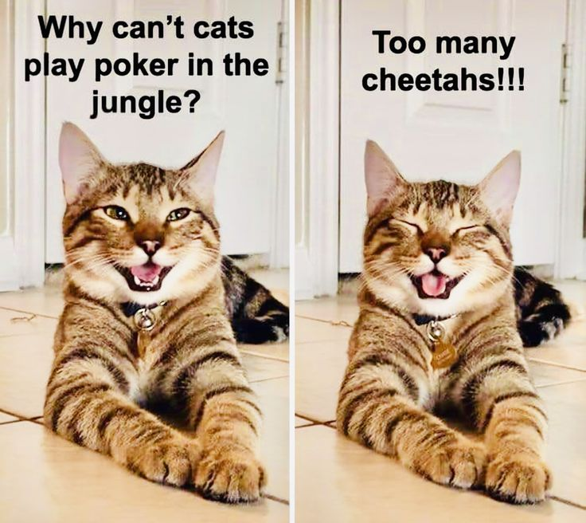

In the next session we will discuss why having healthy leisure is important.
We will also explore the benefits you can get from your leisure.

Slide 16
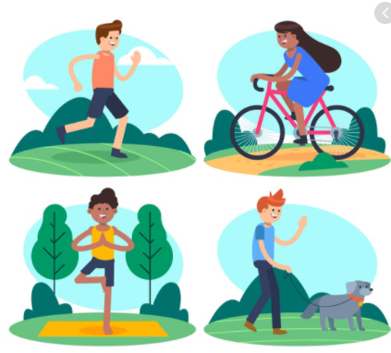
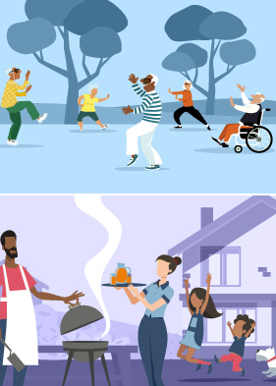
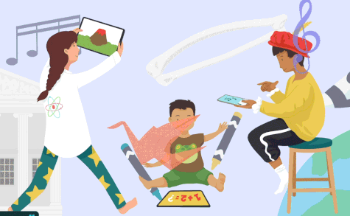
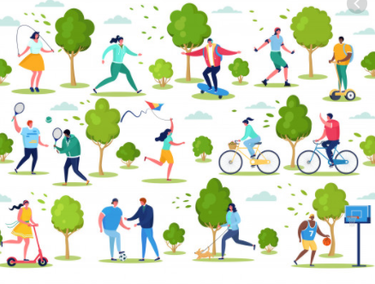
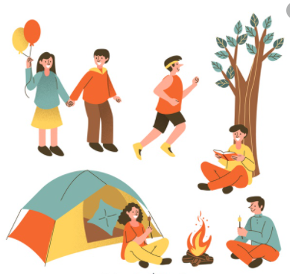
Enjoy your leisure!
Notes:
We’ll see you next session. Meanwhile, enjoy your leisure and have fun with the take away activities.

