Slide 1

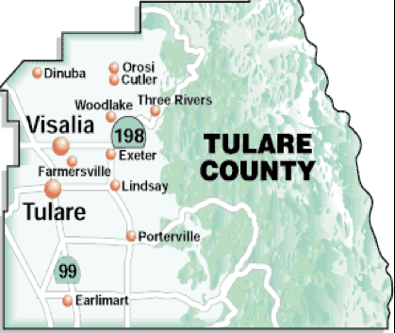
Federal Deficits, Asset Bubbles, and the Economic Outlook
Focus on Tulare County & City of Visalia
Social Narratives / Economic Realities
Christopher Thornberg, PhD
Founding Partner, Beacon Economics
June 2026

Slide 2

Beacon Economics
  Economic research firm founded in 2006 with a commitment to letting the data determine the answer.
  Impact studies, Policy Analysis, Regional Development and Revenue Forecasts
A Tale of Two Economies
  What we think is happening in our economy (our social narrative or “lived experience”)
  What is actually happening in our economy (our objective statistical reality)
  Good choices and smart policies start with the correct narrative.
Social Narratives
Social Narrative
Economic Reality
Slides available by using QR code at end of presentation, or email Kristen@beaconecon.com

Slide 3
2026: Competing Narratives

Slide 4
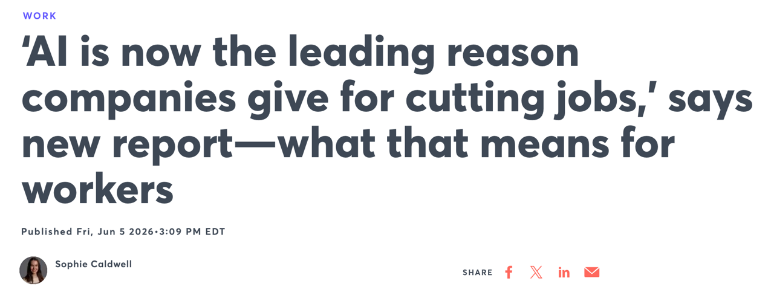
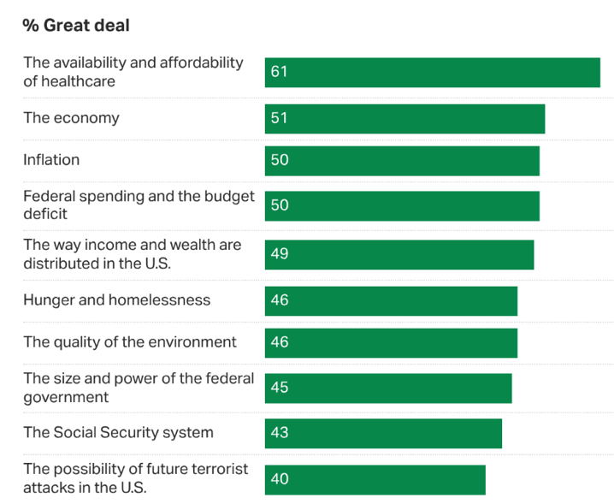
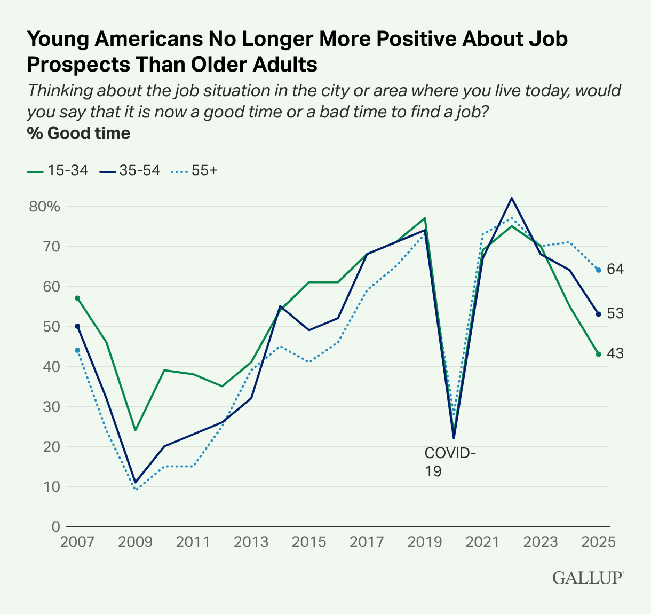

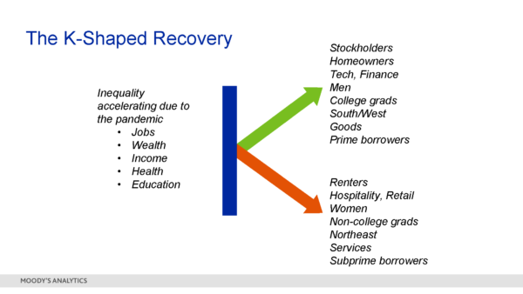

The 2026 Narratives
What People are Worried About (Gallup)

Slide 5
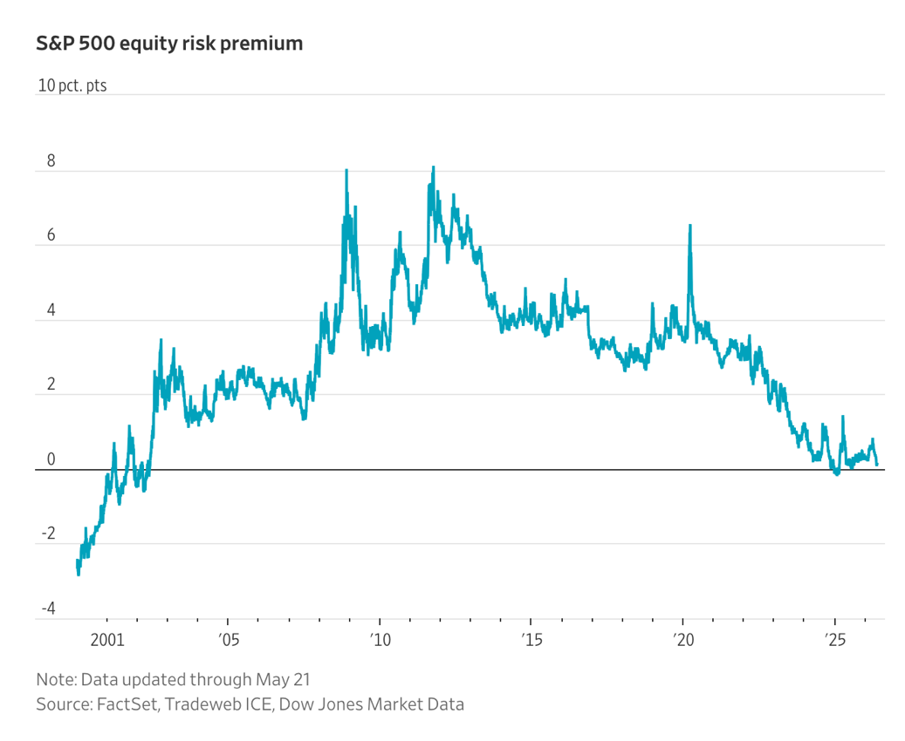
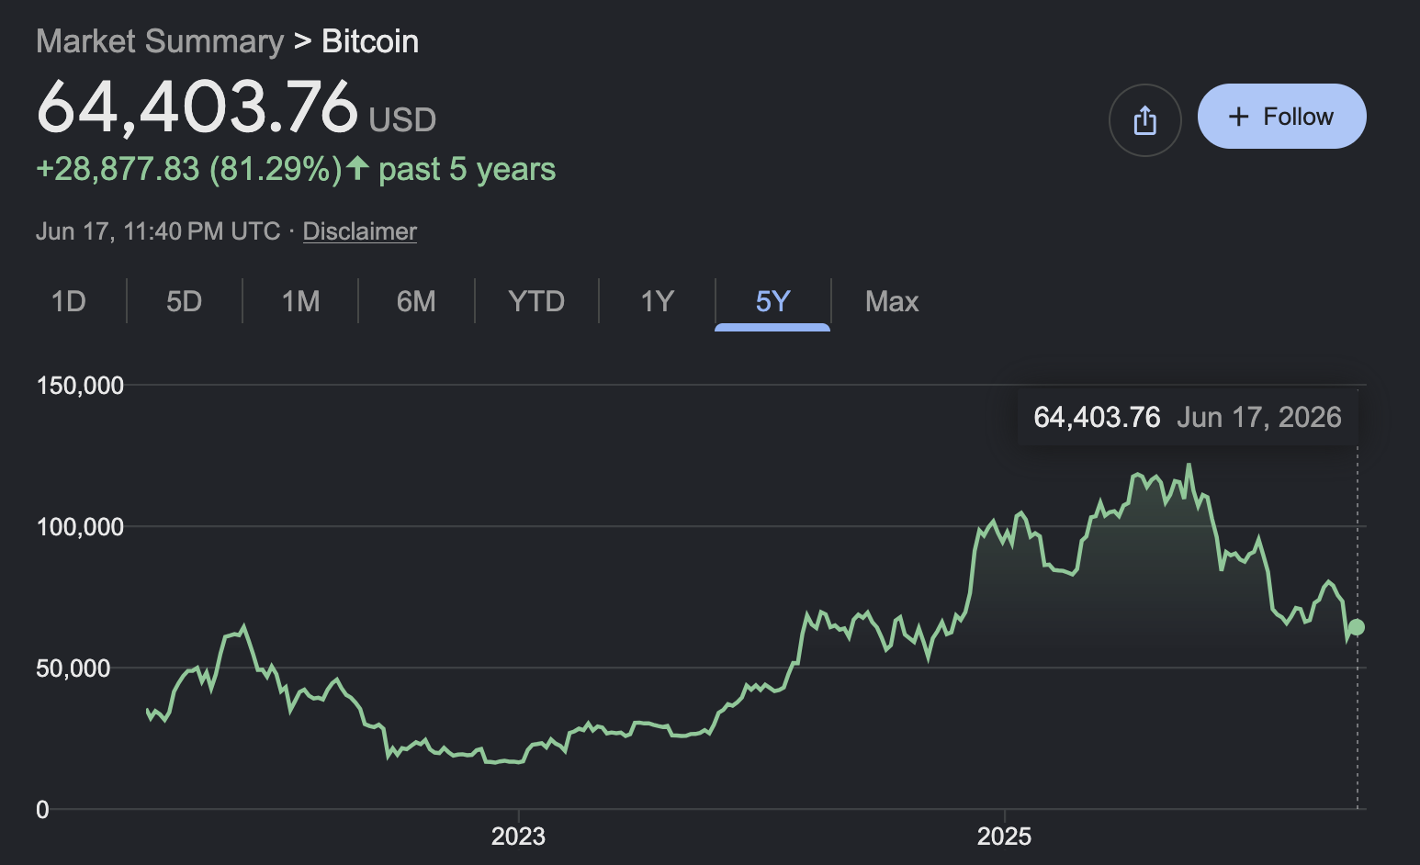
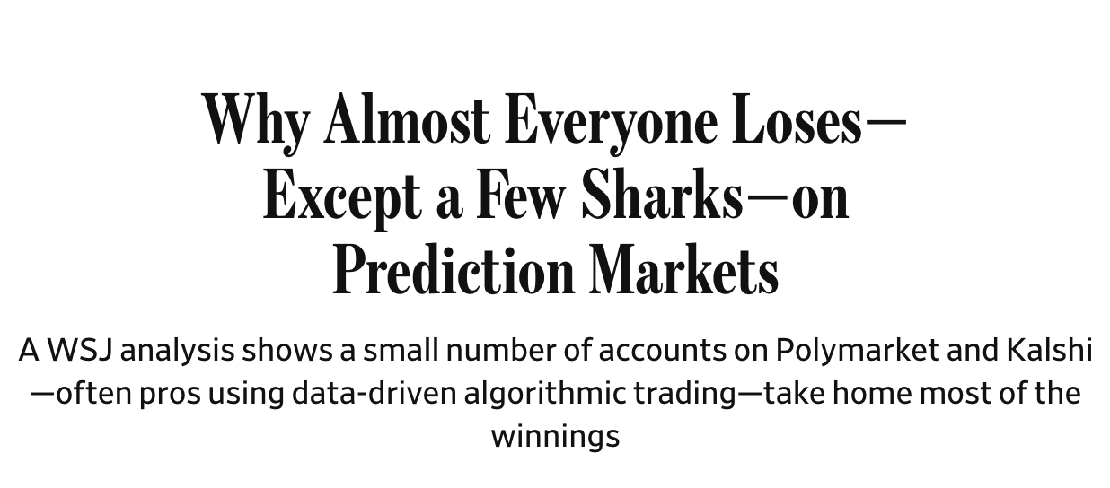


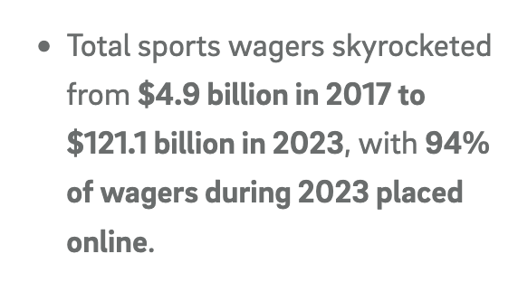
That Other Economic Narrative
US Corporate Profits and Growth (SAAR) | 2019 | 2025
 | Q4 | Q4 | Shares
Total | 2513.1 | 4352.1
Rest of the world | 509.9 | 627.1
Domestic industries | 1913.4 | 3840.5 | 101%
Financial | 576.7 | 989.8 | 21.4%
Utilities | 4.0 | 54.9 | 2.6%
Durable goods M | 199.3 | 433.4 | 12.1%
Computer Prod | 74.7 | 187.6 | 5.9%
Nondurable goods | 163.0 | 326.2 | 8.5%
Wholesale trade | 131.4 | 229.6 | 5.1%
Retail trade | 173.1 | 415.8 | 12.6%
Logistics | 39.8 | 96.8 | 3.0%
Information | 139.9 | 317.7 | 9.2%
Other nonfinancial | 486.1 | 976.4 | 25.4%

Slide 6

The Beacon Outlook 2026
Economic Trends: Still pointing up…
  Household / Business finances still strong
  More fiscal and monetary stimulus being through at the economy
  Major drags: population growth stalled, political uncertainty
California & the Central Valley
  State growing well on the intensive margin
  Local growth outpacing the state because of young growing labor force
  Slowing local population growth a function of national immigration
Beware the Imbalances
  Strong finances a function of public deficits and financial bubbles
  Even a small disruption in capital inflows could set off a fiscal crisis
Blame the Power of the Narrative
  Common sense policies are prevented by broken narratives
  The rise of populism in the age of abundance

Slide 7
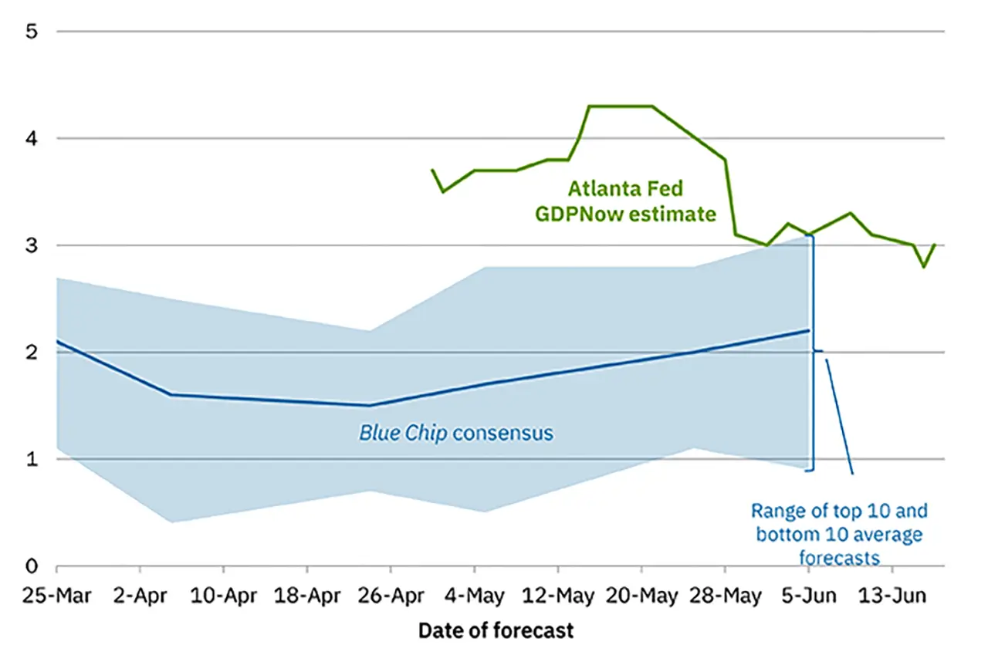
GDP Growth: Slowing into 2026
GDP Growth by Contribution | 2023 | 2024 | 2025 | 2026 Q1
GDP | 2.9 | 2.8 | 2.1 | 1.6
Final Demand | 2.9 | 3.2 | 2.4 | 2.8
Consumption | 1.7 | 2.0 | 1.8 | 1.0
Goods | 0.4 | 0.6 | 0.7 | 0.1
Services | 1.4 | 1.4 | 1.1 | 0.9
Fixed investment | 0.6 | 0.5 | 0.5 | 1.1
Structures | 0.5 | 0.0 | -0.2 | -0.2
Equipment | 0.2 | 0.2 | 0.4 | 0.9
Intellectual | 0.3 | 0.2 | 0.3 | 0.6
Residential | -0.4 | 0.1 | -0.1 | -0.2
Net exports | 0.5 | -0.4 | -0.2 | -1.3
Exports | 0.3 | 0.4 | 0.2 | 1.3
Imports | 0.1 | -0.8 | -0.4 | -2.6
Government | 0.6 | 0.7 | 0.2 | 0.7

Slide 8
Consumers: Still Having Fun!

Slide 9
Travel, Tourism and the $US
+ 27% in 10 years

Slide 10
Consumer Debt Situation: Steady

Slide 11
Record HH Income and Net Worth

Slide 12
The California Slowdown
+ 86k / Year
+ 171k / Year

Slide 13
California Spending & Incomes

Slide 14
Household Income

Slide 15
City / County Taxable Sales
MSA | Q4-25 ($ Mil.) | 1-Year Chg. (%) | Chg. Since Q4-19 (%)
California | 2,322.7 | 1.2 | 24.7
Stockton | 64.8 | 3.9 | 73.3
Fresno | 60.6 | 3.1 | 41.8
Modesto | 32.5 | 2.3 | 29.8
Sacramento | 150.8 | 1.1 | 30.0
Yuba | 8.4 | 0.3 | 27.0
San Luis Obispo | 18.1 | 0.0 | 28.8
Salinas | 24.0 | -0.4 | 26.3
Madera | 6.6 | -0.5 | 41.2
Bakersfield | 55.9 | -1.0 | 40.3
Merced | 10.9 | -1.1 | 21.7
Visalia | 29.0 | -1.3 | 38.2
Hanford | 6.3 | -5.4 | 29.2

Slide 16

A K-Shaped Recovery?
Income and Spending by
Household Income Quintile
Real Household Incomes by Age
 | 2004 | 2014 | 2024
15 to 34 Years | $63,276 | $63,042 | $83,514
Share of HHs | 23.0% | 21.2% | 20.2%
35 to 54 Years | $91,188 | $87,694 | $111,226
Share of HHs | 41.2% | 35.9% | 33.7%
55 Years + | $55,240 | $60,243 | $69,553
Share of HHs | 35.9% | 42.9% | 46.2%
 | Avg HH Income 2024 | Real Growth 14-24
Lowest | $18,460 | 22.8%
Second | $49,380 | 23.4%
Middle | $84,390 | 21.3%
Fourth | $136,800 | 21.1%
Highest | $316,100 | 26.5%
Top 5% | $560,000 | 30.9%

Slide 17

Gross vs Net Income

Slide 18



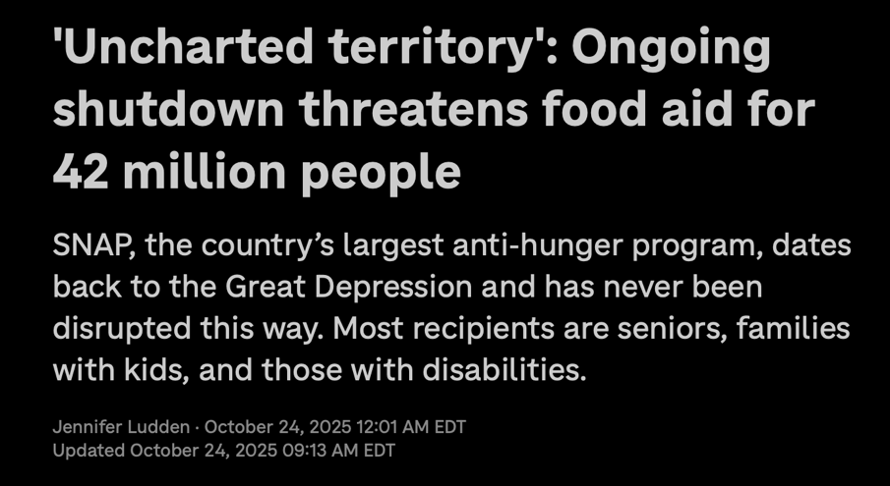
What about the cost of food & shelter?

Slide 19
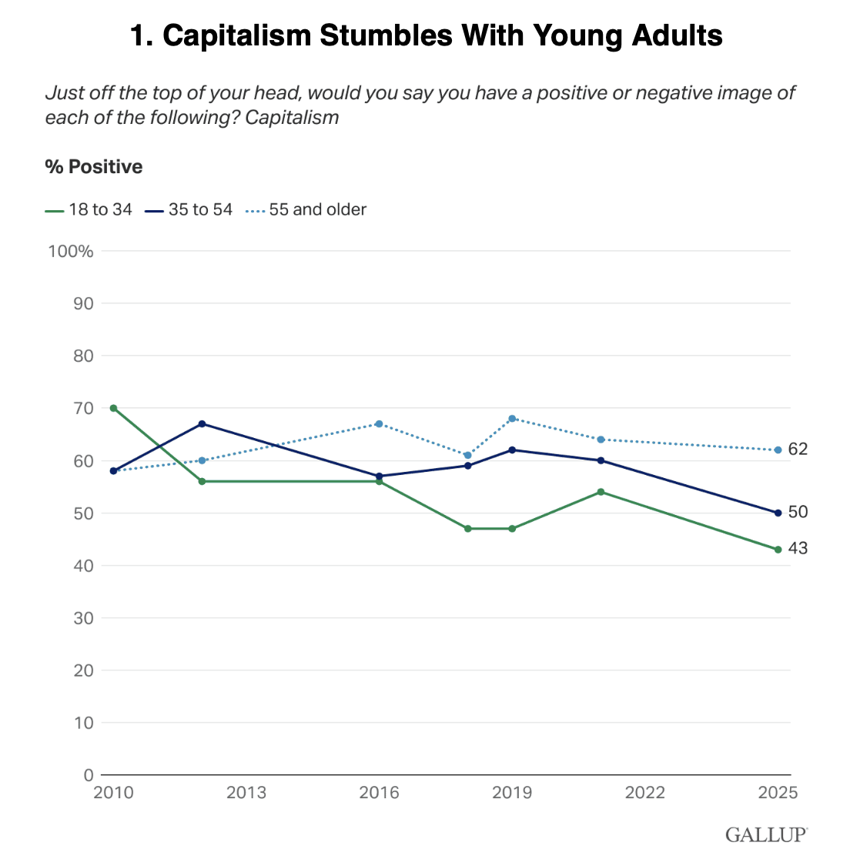
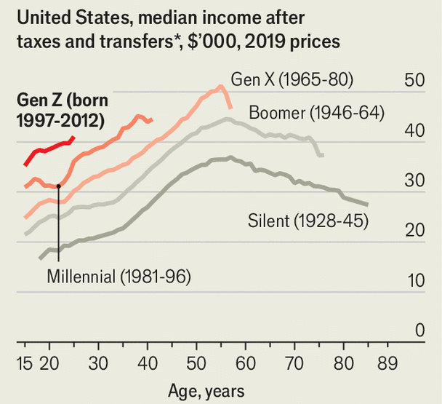
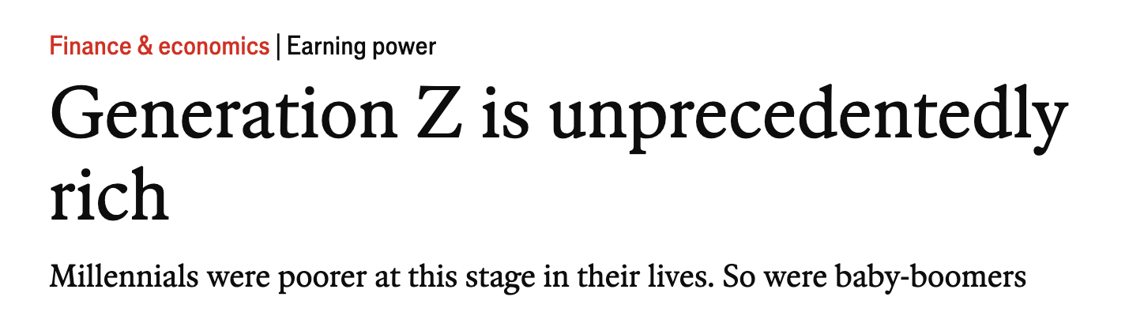
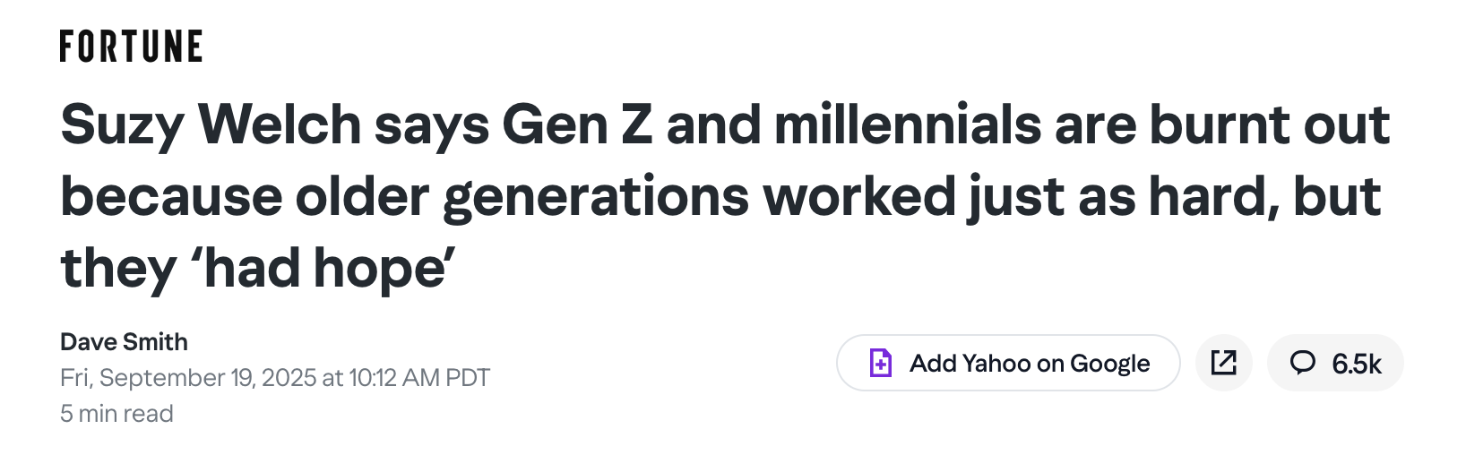
And Poor Gen Z?

Slide 20
State Inequality?
Official Poverty Estimates ACS
 | California Incomes by Race / Age 2019-24
By Race | HHs |  | Income
Households | 13,798 | 4.9% | $100,149 | 24.5%
Hispanic | 4,405 | 12.5% | $83,179 | 30.7%
Black | 817 | -0.5% | $71,211 | 29.1%
Asian | 2,200 | 16.4% | $130,548 | 25.4%
White | 5,730 | -6.7% | $110,258 | 19.6%
By Age
25 to 44 yr | 4,725 | 6.3% | $110,732 | 28.5%
45 to 64 yr | 4,967 | -1.3% | $115,871 | 22.8%
65 years + | 3,713 | 11.9% | $71,673 | 22.8%
 | Pov Rate 2024 | Ch 14-24
Fresno | 18.3% | -9.4%
Tulare | 20.3% | -8.3%
San Bernardino | 12.5% | -8.1%
San Joaquin | 12.8% | -8.1%
Sacramento | 12.0% | -6.2%
Los Angeles | 13.3% | -5.4%
San Diego | 10.0% | -4.7%
Alameda | 8.7% | -3.8%
Monterey | 13.8% | -3.4%
Contra Costa | 8.4% | -2.1%
Santa Clara | 7.0% | -1.4%
San Francisco | 11.3% | -0.7%
San Mateo | 7.1% | -0.2%

Slide 21
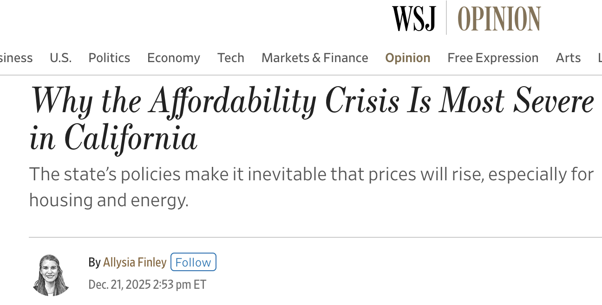
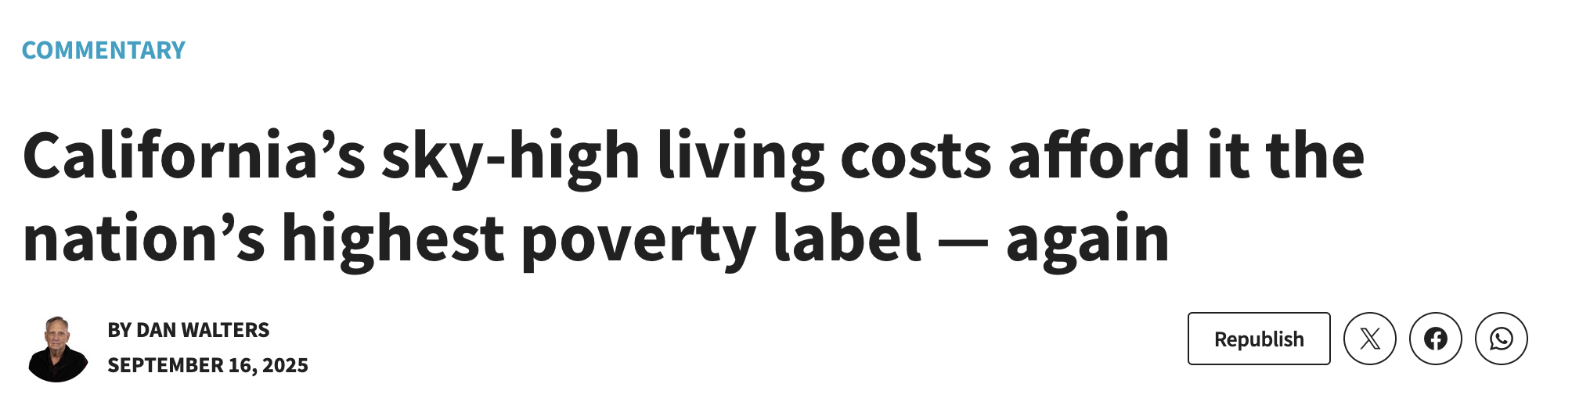
Affordability?
 | 2024 |  | 2024
United States | 100.0 | Sacramento | 106.7
SF-Oakland | 115.6 | Riverside | 106.4
Los Angeles | 113.6 | Stockton | 105.1
Napa | 112.6 | Yuba City | 104.2
San Diego | 111.9 | Modesto | 104.1
Oxnard | 110.5 | Fresno | 102.2
San Jose | 110.4 | Hanford | 101.6
Santa Cruz | 109.9 | Chico | 101.2
Salinas | 109.0 | Bakersfield | 100.9
Santa Maria | 108.8 | Redding | 100.7
San Luis Obispo | 108.6 | Visalia | 99.8
Vallejo | 108.5 | Merced | 98.3
Santa Rosa | 107.8 | El Centro | 95.2

Slide 22
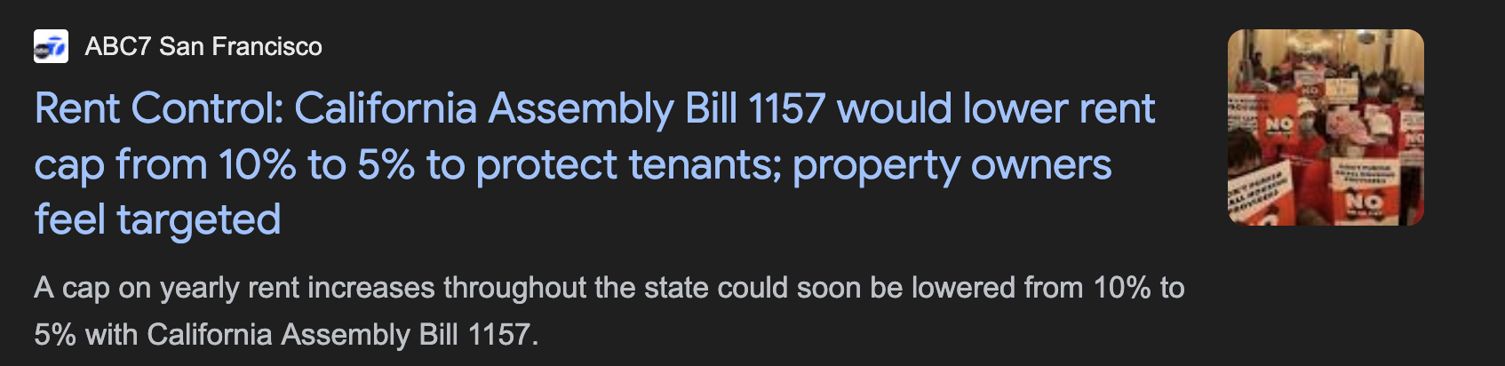
State Housing Affordability
Median Rent as a % of HH Income | 2019 (%) | 2024 (%)
United States | 29.3 | 30.9
California | 31.7 | 33.1
San Francisco | 22.3 | 24.7
Santa Clara | 27.6 | 27.4
Alameda | 29.1 | 30.7
San Joaquin | 31.5 | 32.1
Sacramento | 32.4 | 33.0
Orange | 32.1 | 33.6
San Diego | 32.7 | 33.9
Los Angeles | 33.3 | 34.0
Contra Costa | 30.7 | 34.3
Riverside | 33.2 | 34.9
Fresno | 33.0 | 35.0
Kern | 33.7 | 35.1
San Bernardino | 33.0 | 35.3

Slide 23
Household Income & Poverty
Household Income | Visalia City
 | 2024 | 10-Year Chg. (%)
Total | 49,287 | 19.1
Under $25k | 4,801 | -53.9
$25k-$49k | 7,078 | -32.1
$50k-$74k | 9,469 | 26.9
$65k-$99k | 6,837 | 24.7
$100k-$149k | 11,433 | 142.1
$150k-$199k | 3,427 | 208.5
$200k and + | 6,242 | 256.9

Slide 24
Home Prices and Asking Rents
Apartment Asking Rent | Q1-26 ($) | 1-Yr Growth (%) | Change since Q4-19 (%)
United States | 1,776 | 0.2 | 19.4
Yakima | 1,130 | 4.5 | 27.6
Visalia | 1,432 | 2.0 | 25.3
Fresno | 1,484 | 1.8 | 33.7
Bakersfield | 1,404 | 1.4 | 32.2
Salinas | 2,296 | 1.1 | 28.0
Merced | 1,278 | 0.7 | 25.8
Stockton | 1,720 | 0.1 | 19.2
Sacramento | 1,867 | -0.1 | 22.4

Slide 25
Affordability

Slide 26
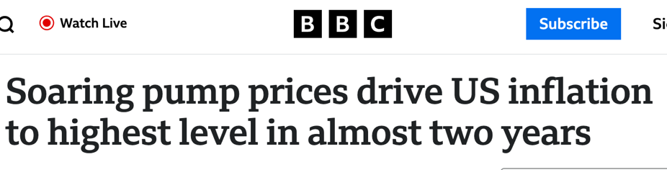
Where is Inflation at?
2 Years Inflation (Avg) | inflation | Cont.
Total | 3.0%
Housing and utilities | 3.9% | 23.9%
Health care | 2.9% | 16.0%
Finance / insurance | 5.7% | 15.6%
Food services accom | 3.3% | 8.0%
Gasoline and energy goods | 7.0% | 5.8%
Groceries | 2.1% | 5.1%
Transportation services | 4.0% | 4.6%
Recreation services | 3.4% | 4.5%
Recreational goods | 2.2% | 2.5%
Clothing and footwear | 1.4% | 1.3%
Furnishings and durables | 1.2% | 1.0%
Motor vehicles and parts | 0.3% | 0.4%

Slide 27
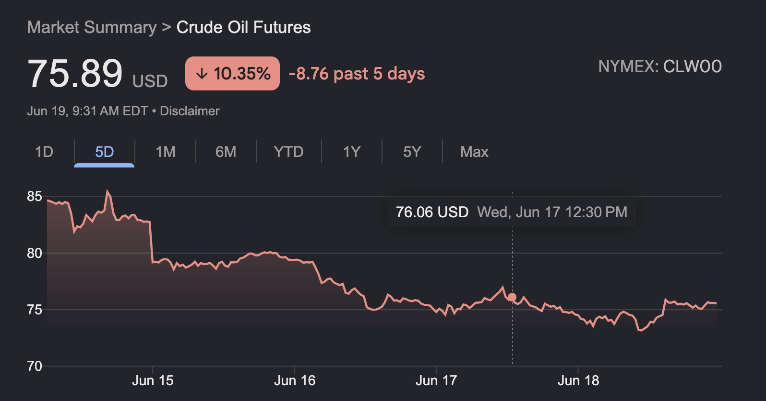
Oil and gas prices?

Slide 28
Ameliorating Factors

Slide 29
The Insurance Issue
Consumer Insurance Inflation
Why is insurance so expensive?
  Higher Claim Costs (more sophisticated products)
  More Claims (climate / behavior)
  Reinsurance Costs
  Regulatory and compliance costs
  Litigation issues: number of cases, nuclear verdicts
  Insurance industry financial losses driven by rising rates
 | Ann Gr 19-22 | Ann Gr 22-26
Total | 3.19% | 3.40%
Life Ins. | 2.28% | 5.11%
Home Ins. | 1.62% | 7.44%
Health Ins. | 1.41% | 2.73%
Auto Ins. | -0.02% | 7.00%

Slide 30
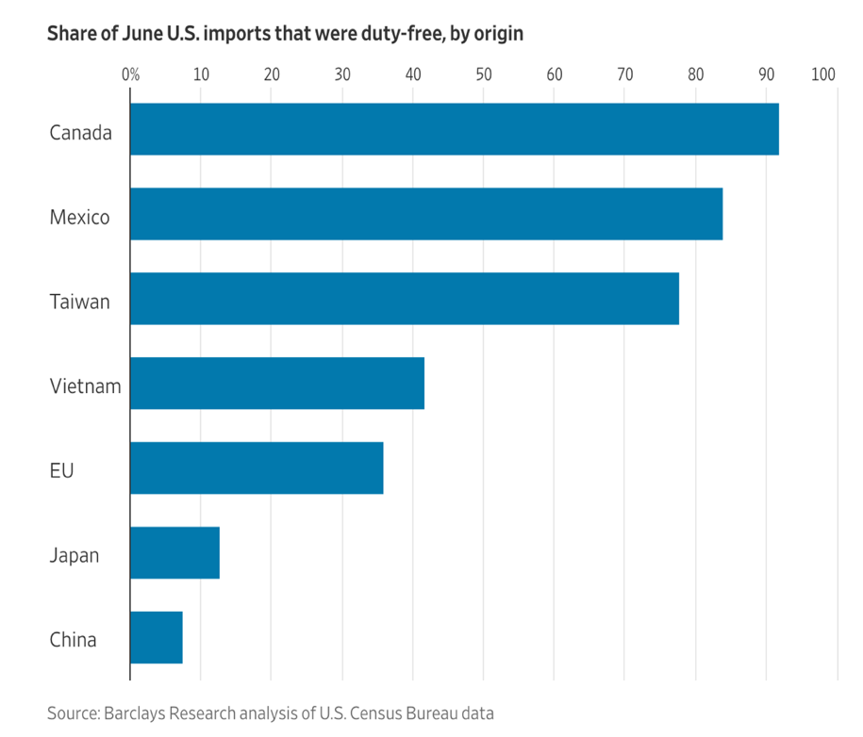

The Tariff Impact?
Country | Exports (% GDP) | Imports (% GDP) | Total (% GDP)
United States | 11 | 15 | 26
Brazil | 18 | 17 | 35
China | 20 | 17 | 37
Japan | 22 | 22 | 44
India | 22 | 25 | 47
Russia | 27 | 20 | 47
United Kingdom | 31 | 33 | 64
France | 31 | 34 | 65
Canada | 33 | 34 | 67
Italy | 35 | 33 | 68
South Korea | 44 | 42 | 86
Germany | 47 | 41 | 88
Switzerland | 75 | 68 | 143
Belgium | 85 | 82 | 167
Netherlands | 93 | 83 | 176
Singapore | 174 | 147 | 321

Slide 31
California Agriculture Exports
Country | Apr-26 YTD Exports ($ Mil.) | YTD Chg. (%) | 2019 to 2025 Chg. (%)
CA Ag Exports | 7,933 | 13.6 | 9.7
Canada | 1,121 | 6.0 | -3.0
Mexico | 686 | 7.0 | 48.4
Japan | 698 | 0.4 | -3.0
India | 545 | 17.4 | 73.2
Korea, Republic Of | 571 | 1.9 | 12.8
Germany | 425 | 37.9 | 16.3
Vietnam | 188 | 72.1 | 129.5
Spain | 350 | 30.6 | -4.6
United Arab Emirates | 158 | -21.8 | 28.6
Netherlands | 247 | -14.9 | 22.7

Slide 32
Tulare Agriculture
Tulare County | 2024 Value ($ Mil.) | 1-Year Chg. (%)
Total | 8,344.1 | 6.1
Fruit & Nut Crops | 4,086.7 | 1.3
Livestock & Poultry Prod. | 2,277.5 | 10.9
Livestock & Poultry | 1,220.9 | 23.6
Field Crops | 530.4 | -4.3
Nursery Products | 107.4 | -1.6
Apiary Products | 85.4 | 7.2
Vegetable Crops | 33.1 | -14.5
Industrial Crops | 2.8 | -29.8
Seed Crops | 0.0 | -100.0

Slide 33

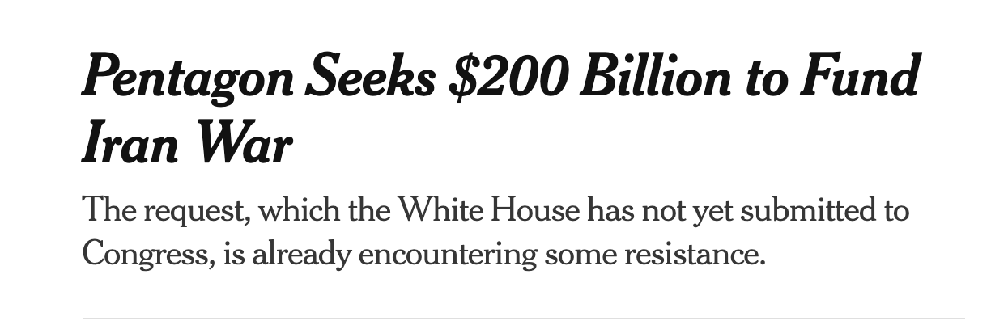

Federal Deficit & Debt
$120,000 per person, $330,000 per HH

Slide 34
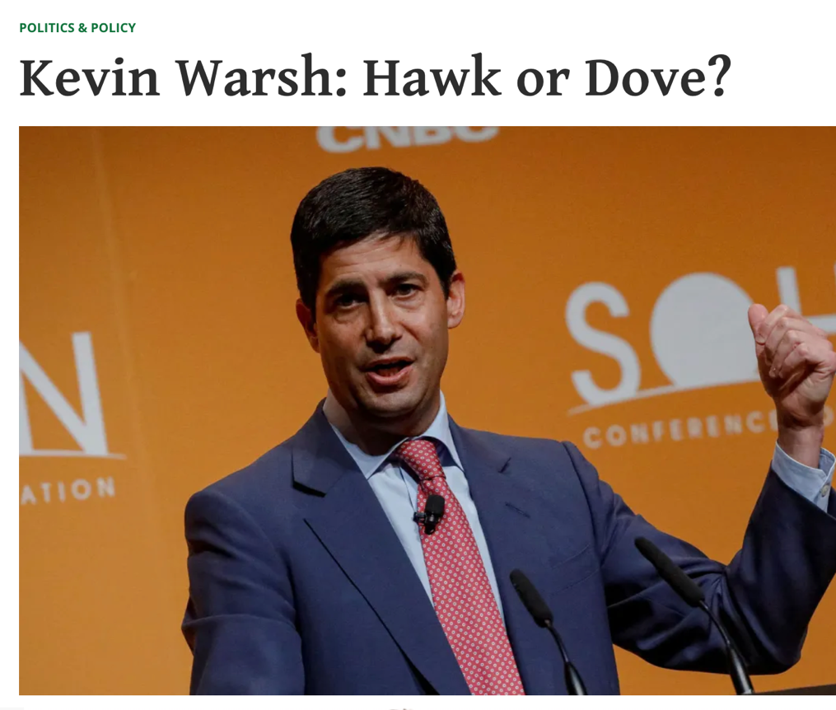
The Fed’s Directional Shift

Slide 35
Interest Rates & Capital Availability

Slide 36
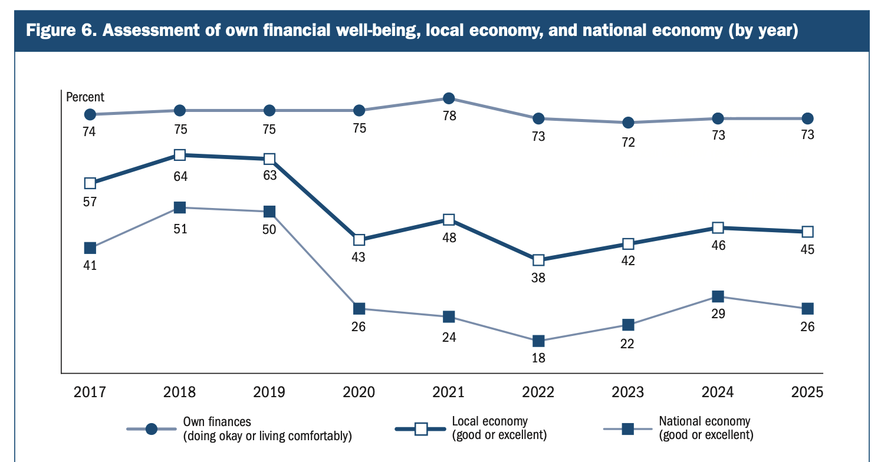




How do narratives go astray?
Type | 1 | 2
Style | Emotional | Deliberative
Rules | Heuristics | Deduction
Speed | Fast | Slow
Energy | Low | High
Some Examples of Cognitive Biases
Anchoring bias
Availability heuristic
Confirmation bias
Egocentric bias
Extension neglect
False priors
Framing effect
Logical fallacy
Prospect theory
Moral Nodes: Social issues that blind us emotionally

Slide 37
Labor Markets: Flat

Slide 38
Labor Markets: Cold, not collapsing…
Pandemic

Slide 39

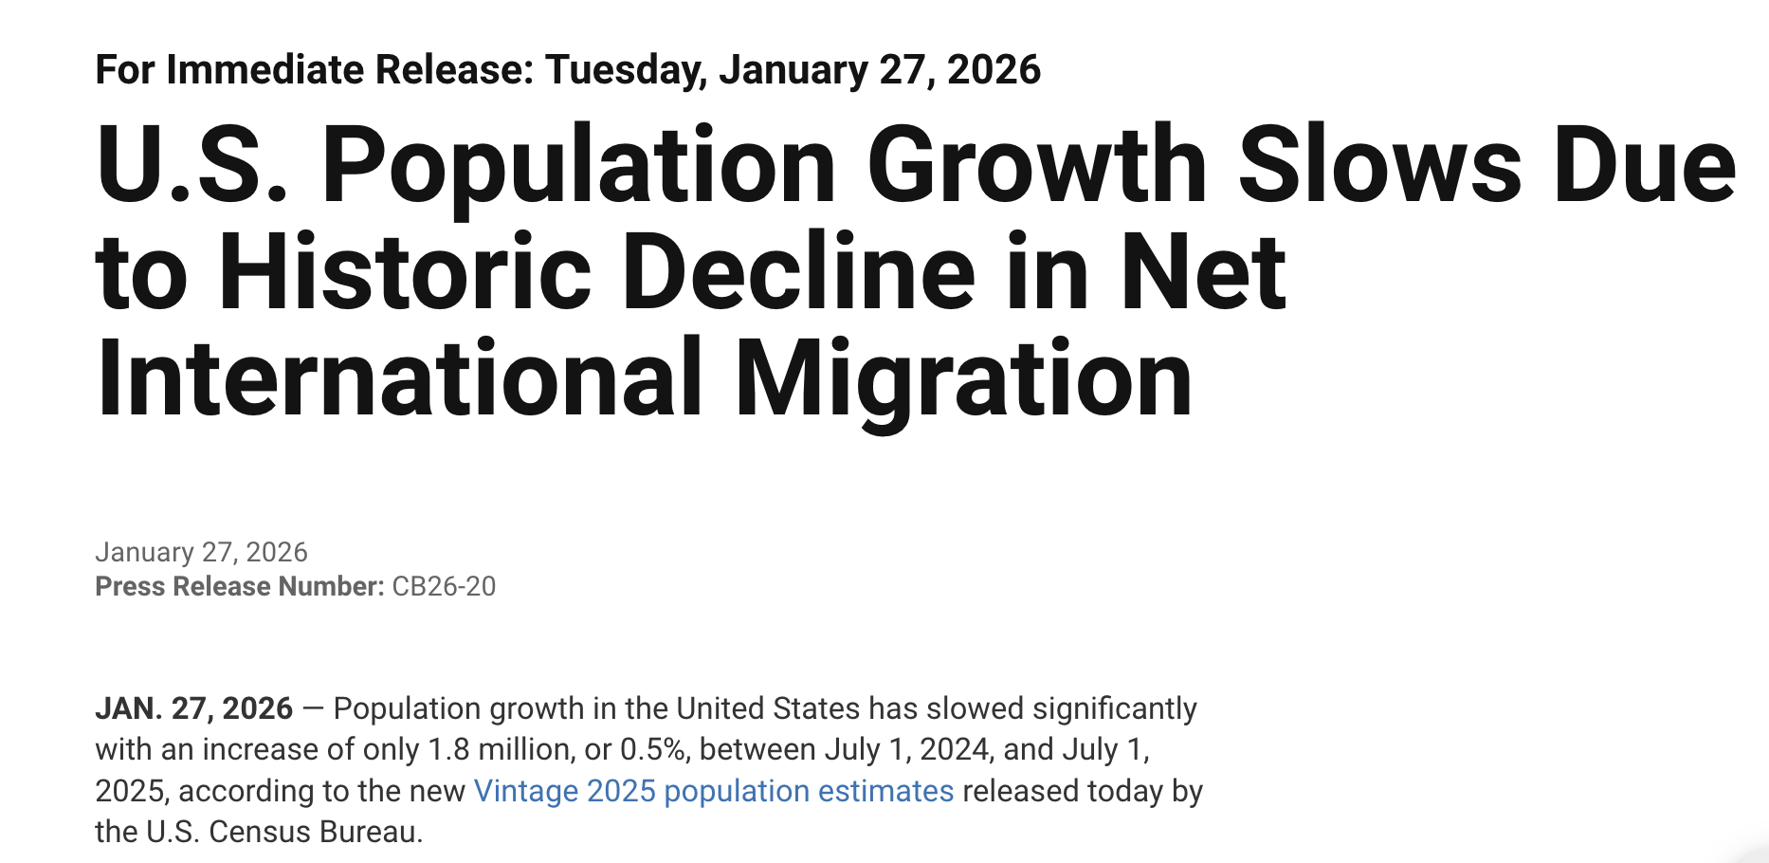
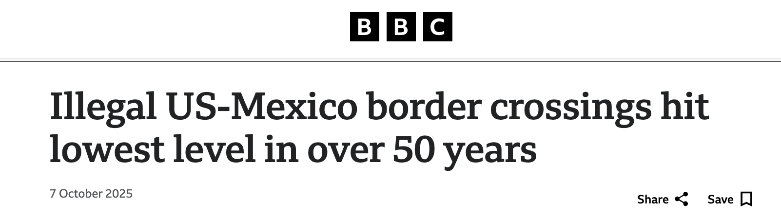
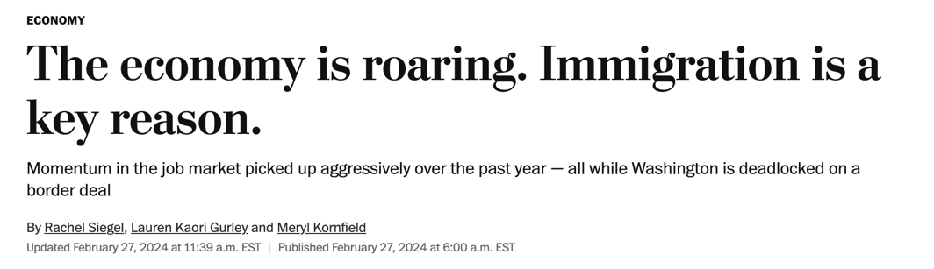
Labor Supply Challenges

Slide 40
California’s Labor Force Problem
Location | Jun-25 LF (000s) | 1-Year Chg. (%) | Chg. since Feb-20 (%) | Nbr. since Feb-20 (%)
US | 170,380 | 1.4 | 3.5 | 5,963
Texas | 15,850 | 1.5 | 11.5 | 1,823
Utah | 1,846 | 0.6 | 11.4 | 210
Arizona | 3,794 | 1.4 | 8.4 | 319
Nevada | 1,682 | 2.0 | 7.0 | 118
Oregon | 2,212 | 0.7 | 5.7 | 126
Colorado | 3,283 | 0.4 | 4.7 | 154
Washington | 4,034 | -0.8 | 1.4 | 56
California | 19,841 | 0.9 | 1.1 | 218

Slide 41
California’s “Fleeing” Population?

Slide 42
Population and Migration
California | CA 2024 Est. | CA 5-Year Chg. (%) | US 5-Year Chg. (%)
Labor Force by Age | 20,601 | 1.8 | 5.5
24 and Under | 2,532 | -0.5 | 5.3
25 to 44 | 9,544 | 1.6 | 7.0
45 to 64 | 7,196 | -0.1 | 1.6
65 and Over | 1,326 | 20.9 | 18.2
Labor Force by Edu | 16,743 | 0.8 | 4.6
Less than HS | 1,992 | -5.9 | -3.0
High School | 3,234 | 0.4 | -1.2
Some College | 4,301 | -9.1 | -3.3
Bachelor's plus | 7,217 | 10.6 | 15.8
- 2,400,000 residents

Slide 43
Regional Nonfarm Employment
MSA | Apr-26 Emplt (000s) | 1-Year Chg. (%) | Chg. since Feb-20 (%)
United States | 158,829 | 0.2 | 4.1
California | 18,159.7 | 0.6 | 2.8
Merced | 78.4 | 3.3 | 8.7
Fresno | 450.7 | 1.7 | 8.8
Bakersfield | 304.6 | 1.2 | 8.2
Stockton | 288.5 | 1.0 | 12.6
Salinas | 150.8 | 0.9 | 3.1
Modesto | 192.4 | 0.8 | 4.5
Visalia | 145.0 | 0.6 | 9.0
Inland Empire | 1,728.0 | 0.5 | 8.1
Sacramento | 1,107.8 | 0.4 | 6.4
Yakima | 89.6 | 0.3 | 2.1

Slide 44
Industry Employment
Industry | Visalia |  | LQ
 | Apr-26 Emplt (000s) | 1-Year Chg. (%)
Total Nonfarm | 145.0 | 0.6 | 1.0
Education/Health | 25.6 | 5.2 | 1.0
Wholesale Trade | 4.5 | 5.0 | 0.8
Other Services | 3.8 | 3.0 | 0.7
Leisure and Hospitality | 14.5 | 2.4 | 0.9
Government | 36.5 | 2.0 | 1.7
Retail Trade | 17.4 | 1.5 | 1.2
Information | 0.6 | 0.3 | 0.2
Logistics | 9.8 | -0.9 | 1.5
NR/Construction | 7.2 | -1.0 | 0.9
Manufacturing | 12.4 | -2.0 | 1.1
Financial Activities | 3.2 | -2.7 | 0.4
Professional/Business | 9.4 | -14.5 | 0.5

Slide 45
Industrial Occupied Stock
Industrial Vacancy Rate | Q1-26 (%) | 1-Yr Change (pp) | Change since Q4-19 (pp)
United States | 7.5 | 0.5 | 2.4
Fresno | 4.2 | 0.3 | 0.5
Salinas | 5.3 | -2.5 | 3.6
Yakima | 5.9 | 2.4 | 4.4
Merced | 7.0 | -1.0 | 3.4
Sacramento | 7.6 | 1.1 | 3.4
Stockton | 9.5 | 0.6 | 4.1
Bakersfield | 10.9 | 1.1 | 7.1
Visalia | 11.6 | 1.3 | 7.6

Slide 46
City Employment
City of Visalia | 2025 Jobs | 1-Year Chg. (%) | 6-Year Chg. (%) | LQ
Total | 71,510 | -0.3 | 8.5 | 1.00
Government | 9,565 | 6.1 | -16.7 | 0.92
Health Care | 11,587 | 2.8 | 42.7 | 1.11
Wholesale Trade | 2,588 | 1.9 | 2.3 | 0.93
Retail Trade | 7,914 | 1.2 | 2.9 | 1.12
Prof, Sci, and Tech | 1,959 | 0.7 | 15.8 | 0.40
Accom and Food Services | 6,827 | 0.5 | 15.6 | 1.05
Construction | 4,551 | -0.1 | 38.8 | 1.20
Logistics | 4,464 | -2.9 | 77.6 | 1.47
Manufacturing | 4,346 | -2.9 | -0.2 | 0.75
Admin Support | 4,261 | -3.4 | -2.7 | 1.03
Finance and Insurance | 1,155 | -4.8 | -41.6 | 0.40
Agriculture | 8,492 | -6.0 | -0.9 | 14.94

Slide 47
Population
Location | 2026 Total Population | 1-Year Change (%) | 10-Year Change (%)
California | 39,592,978 | -0.1 | 1.4
Tulare County | 489,610 | 0.2 | 6.2
Unincorporated | 136,582 | -0.1 | 97.4
Merced | 99,435 | 0.8 | 22.1
Clovis | 129,889 | 0.2 | 20.4
Tulare | 72,936 | 0.6 | 16.1
Dinuba | 26,566 | 1.6 | 12.2
Bakersfield | 422,853 | 0.4 | 11.4
Woodlake | 8,168 | 1.6 | 11.2
Visalia | 148,302 | 0.2 | 10.8
Fresno | 560,948 | 0.1 | 6.8
Porterville | 63,719 | -0.3 | 5.3
Lindsay | 12,712 | -0.9 | 1.8
Salinas | 159,866 | -0.6 | -0.2
Exeter | 10,287 | -0.2 | -1.5
Farmersville | 10,338 | -0.7 | -1.9

Slide 48
Labor Force
Location | Apr-26 LF (000s) | 1-Year Chg. (%) | Chg. since Feb-20 (%)
United States | 169,995 | -0.6 | 3.2
California | 19,720.1 | -0.4 | 0.5
Yakima | 125.7 | 1.4 | -6.6
Merced | 124.1 | 0.0 | 5.1
Bakersfield | 412.4 | -0.2 | 4.5
Fresno | 547.5 | -0.4 | 6.0
Sacramento | 1,194.9 | -1.0 | 5.2
Modesto | 254.0 | -1.0 | 2.8
Salinas | 221.3 | -1.1 | 0.0
Stockton | 373.8 | -1.4 | 7.3
Inland Empire | 2,221.9 | -1.4 | 6.4
Tulare | 217.7 | -2.0 | 3.9

Slide 49
Job Postings and Labor Force
Visalia City LF | Visalia 2024 Est. | Visalia 5-Year Chg. (%) | CA 5-Year Chg. (%) | US 5-Year Chg. (%)
Labor Force by Age | 77,223 | 24.7 | 1.8 | 5.5
24 and Under | 10,366 | 44.4 | -0.5 | 5.3
25 to 44 | 40,319 | 37.3 | 1.6 | 7.0
45 to 64 | 21,775 | -3.1 | -0.1 | 1.6
65 and Over | 4,707 | 63.6 | 20.9 | 18.2
Labor Force by Edu (> 25 years old) | 62,117 | 19.8 | 0.8 | 4.6
Less than HS | 5,359 | -5.7 | -5.9 | -3.0
High School | 18,868 | 47.2 | 0.4 | -1.2
Some College | 20,506 | -12.2 | -9.1 | -3.3
Bachelor's plus | 17,365 | 73.5 | 10.6 | 15.8

Slide 50
Residential Permits
Location | 2025 Permits (Units) | 1-Year Chg. (%) | 6-Year Chg. (%)
California | 103,856 | 2.3 | -5.8
Tulare County | 1,790 | 23.7 | -4.4
Visalia | 686 | 19.3 | -1.9
Tulare | 456 | 16.3 | -21.9
Unincorporated | 340 | 33.9 | 83.8
Porterville | 190 | 25.8 | 69.6
Woodlake | 73 | 305.6 | 55.3
Dinuba | 43 | -8.5 | -81.8
Lindsay | 2 | -80.0 | -77.8
Exeter | 0 | 0.0 | 0.0
Farmersville | 0 | 0.0 | 0.0

Slide 51


Our inclination for negative narratives
Type I vs Type II errors
 | Threat | No Threat
Worry | Fine | Stressed
Don't Worry | Eaten | Fine
Outrage increased engagement
Divisive content spread faster
Recommendation systems pushed users toward extremism
Emotionally activating material kept users online longer

Slide 52

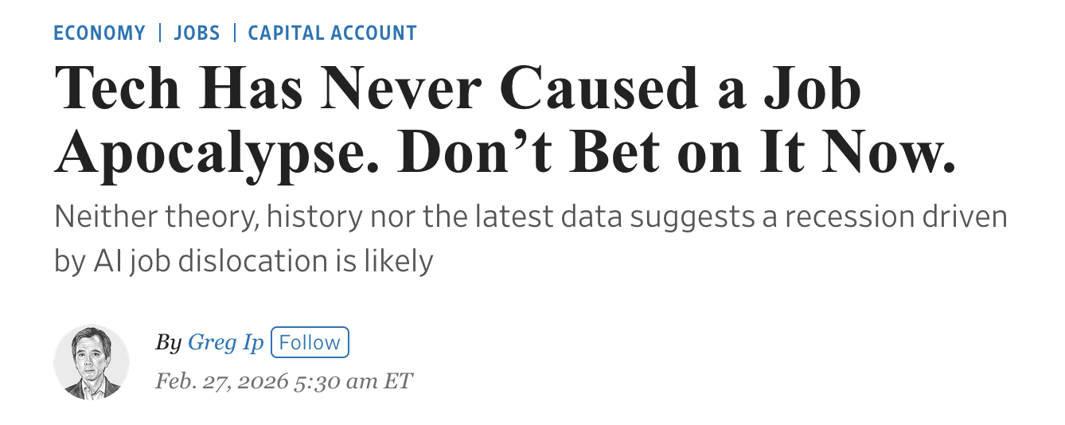
What about AI?
“March of the Machine Makes Idle Hands” — The New York Times (1928)
“The Automation Jobless” — Time Magazine (1961)
“The Robots Are Coming—and So Are the Layoffs” — The Washington Post (1983)
“The End of Work?” — The Economist (2003)
“47% of U.S. Jobs at Risk of Automation” — widely reported after Oxford study (2013)
“AI Could Replace Millions of Jobs” — The Washington Post (2023)
Many waves of transformative technologies
  The Industrial revolution, Railroad, Electricity, Automation / Robotics, the telephone, Digital Communication (the internet) and now AI
  Past cycles: broad based gains in real incomes
It takes time
  The technology needs improvement
  Infrastructure has to be invested in
  It takes time to integrate into human systems
Financial problems are par for the course
  Risky investments promote speculation
  Financial industrial complex rides enthusiasm

Slide 53
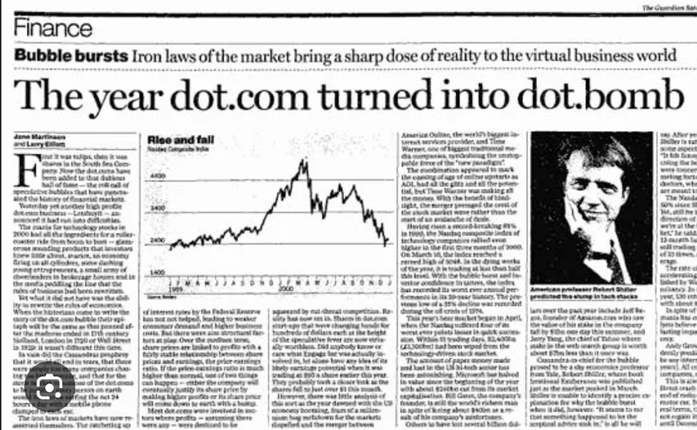
Data Centers and IT Investment

Slide 54
The Difference Between 2001 and 2026…
Deficit Closing?
$15,000 per household per year
Higher Taxes: 9% of Household Disposable Household Income
Reduced Spending: 25% of total current Fed expenditures

Slide 55

The Wealth / Income Mirage

Slide 56
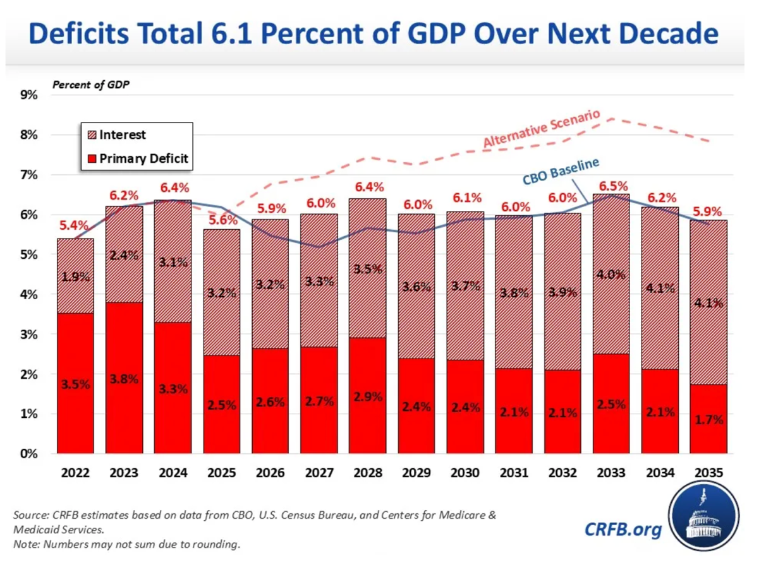
What will reset the focus on the deficit?
Tariff Removal
Forecast: 4% 10 Year forever
Primary Spending Balance?

Slide 57
US Reliance on Foreign Capital

Slide 58

Growing Risks
  For a copy of slides, please use the QR Code
Economic Trends: Picking Up
  Drags: reduced labor supply, political and economic uncertainty
  Strengths: Household & business finances, inflation / rates down
  Business Investment / Spending solid
  More fiscal and monetary stimulus being thrown at the economy
Beware the Imbalances
  Strong private finances from public deficits and asset bubbles
  Growing external imbalances are the weak link in the chain
  The biggest imbalance is the gap between narratives and reality

Slide 59
Get In Touch With Us:
  Kristen@beaconecon.com
  Beaconecon.com

