Slide 1

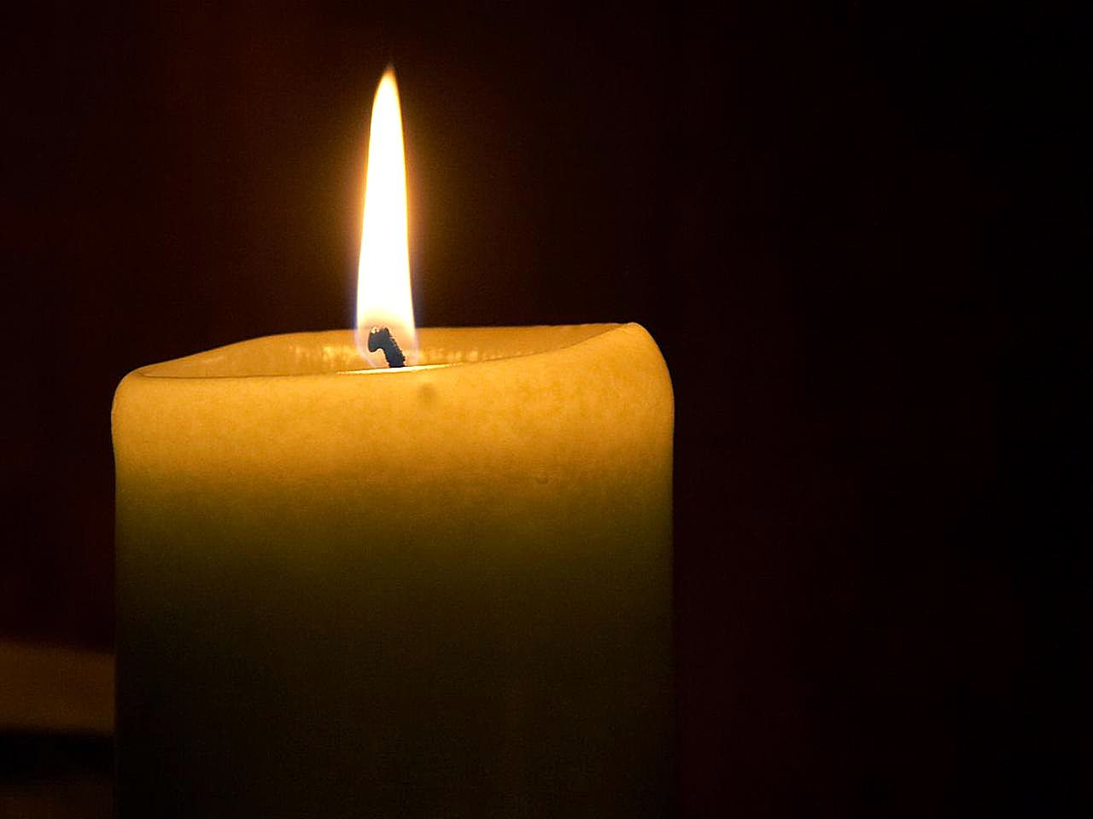
Our Lady’s Catholic Primary School
In the name of the Father, and the Son and the Holy Spirit
This Photo by Unknown Author is licensed under CC BY-NC

Slide 2
Prayer Tree
Amen,

Slide 3
The gospel according to Mark
All: Glory to you O Lord
This is the gospel of the Lord
All: Praise to you Lord Jesus Christ.

Slide 4
Discuss how Jesus was so impressed with the little the widow had but she gave it anyway.
She placed her faith in God to provide for her, even though she had given the little she had to the Church.
What do we have that we can give? Not always money.
Can we give our time? Our service? Buddies and pupil groups.

Slide 5
Remembrance Worship 2024
11 o’clock
11th day
11th month

Slide 6




Slide 7

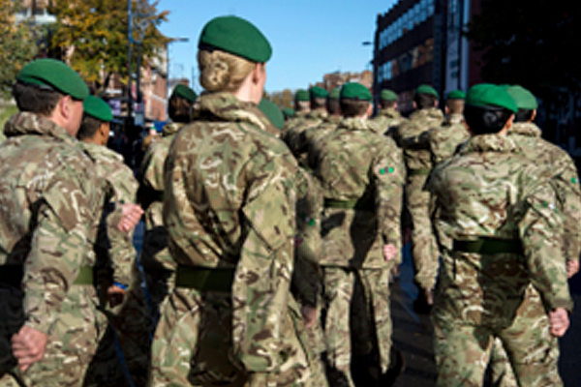
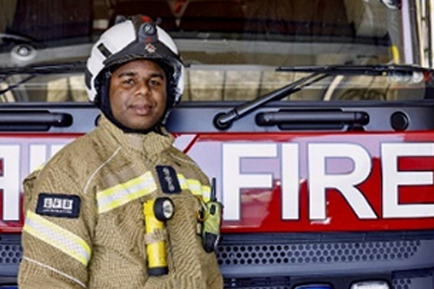
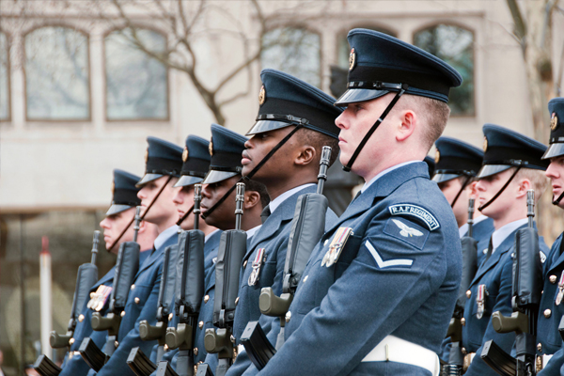
What is service?
Notes:
LO To understand what service is
Main Input
Give pupils one minute to reflect on the images displayed, ask pupils: Q What can you see in these pictures? Who are these people and what do you think they are doing? Take a few suggestions.
Next ask pupils: Q What do you think all these people have in common? Responses may include: their jobs involve helping other people/they work during emergency situations/they save lives/they protect and look after other people
Elicit the idea that they are all involved in helping others in a certain type of way. All these people are doing jobs that involve protecting others
Extension question:
Ask pupils to consider how each of the people in the images help to protect others: Who might they be protecting? How might they be protecting them?
Take it further classroom activity:
Provide pupils with the images on this slide. In pairs/small groups, ask pupils to annotate around the images with their ideas in response to the following questions:
Who are they protecting?
How do they protect others?
Take feedback, inviting each group to share their ideas with the rest of the class. Ask pupils to discuss in pairs/small groups what would happen if we didn’t have anyone doing these jobs? Take feedback as a whole class.

Slide 8
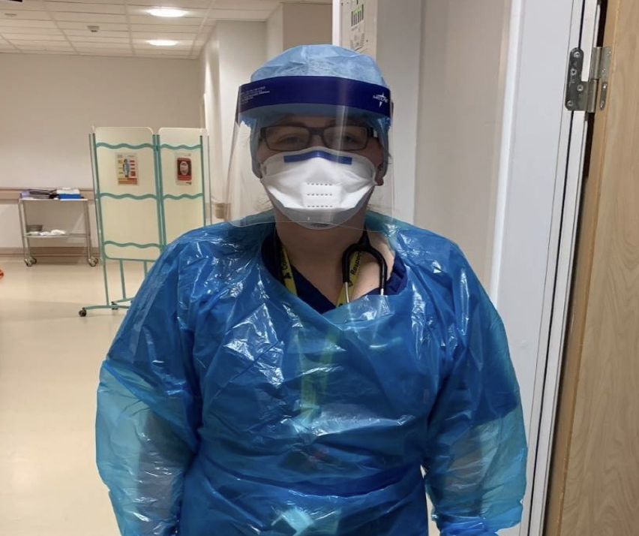
Case study
‘It was a case of 12-hour long day or night shifts. I was very tired!’
Question:
How does Emily help to protect others?
Emily
Doctor on maternity ward
Serving during the pandemic
Notes:
LO To discuss different types of service
Main Input
Introduce Emily.
Emily is a doctor who works in a maternity unit, taking care of pregnant women and helping to deliver new babies.
This picture shows Emily working in her hospital during the pandemic.
Before the pandemic, Emily split her time between the antenatal ward, the delivery suite and the postnatal ward, looking after her patients through pregnancy, birth and aftercare. Emily would often work during night shifts and be on call to help care for emergency patients in A&E
During the pandemic, Emily continued to work on the maternity ward but her job changed quite a bit. Many of the other doctors on her ward were asked to help look after Covid patients. As a result, instead of 14 Doctors on her maternity ward, there were only 5 of them left. This meant Emily had to work more and for much longer shifts to ensure that pregnant women and their babies were still cared for. She found it exhausting but all of the staff on the ward worked together as a team and helped to keep each other going.
Q Ask pupils: how does Emily help to protect others? Responses may include: saving lives during emergencies, keeping women and babies safe, helping babies to be born healthy and well, protecting mothers and babies from covid
Read the quote to the pupils and ask Q: How might Emily have felt when the pandemic changed her job? What do you think it was like working during this time?

Slide 9
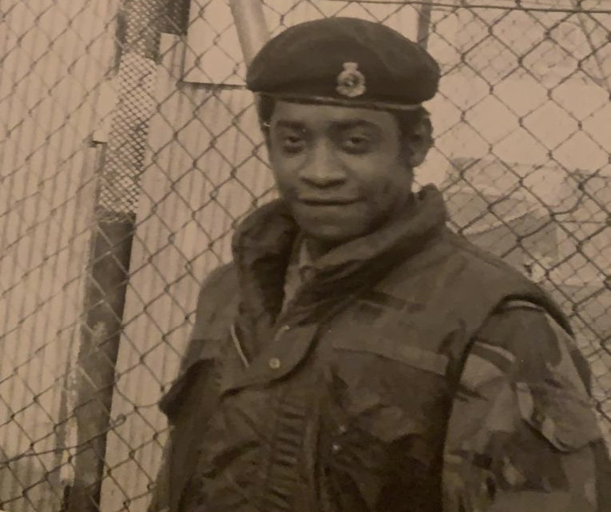
Case study
‘We had to help the injured out of their collapsed home.
It is not easy but it is very rewarding to help and protect others. ’
Owen
Royal Army Medical Corps
Served during the Falklands war
Question:
How did Owen help to protect others?
Notes:
LO To discuss different types of service
Main Input
Introduce Owen
Owen was about 14 years old when he came to the UK from Jamaica to live with his aunt
Owen joined the Royal Army Medical Corps (Medical branch of the British Army) in 1969, when he was just 17 years old
Owen was called up to serve in the Falklands war (In April 1982, a conflict which began in the Falkland Islands between the United Kingdom and Argentina) His job as part of the Medical Corps was to give medical support to the soldiers during the conflict
Owen remembers one fatal attack on British ships. 59 men were killed instantly and 135 casualties were rescued from the water in dinghies and brought to Owen’s medical centre by helicopter. He and his fellow staff helped treat all 135 injured men.
Q How did Owen help to protect others? Responses may include saving lives, keeping soldiers safe, helping the effort to achieve peace
Read the quote aloud to the pupils. Q How do you think it felt for Owen, being in that situation?
Take it further classroom activities:
Read the following passages from Owen’s case study:
Embarkation:
Leaving from Southampton, Owen says “I will never forget that day. It was like the whole of the UK was there to see you.” He was struck by the sheer size of the QE2 and remembers carefully negotiating the narrow gang-plank which wobbled badly. He recalls “sweating, because you are carrying your whole life with you.” Each soldier had his full kit, his suitcase and his weapon.
The voyage:
The 16 Field Ambulance’s training continued on board the ship, that held 4000 soldiers and 750 crew. The men took it in turns to run laps of the boat – three times around the deck was equal to a mile – and do sit-ups and press-ups. Owen says “That’s when I sat down and wrote my will. That’s when I really realised I was going to war…. I was glad to retrieve that letter when I got back.”
Discuss as a class: What might Owen have been feeling when he boarded the ship? Why?
Why did Owen decide to write his will? How do you think he felt writing it? Why?
What does this tell you about what it can be like to serve?

Slide 10
Making sacrifices in service
They help us.
Sacrifice is when an individual does something to protect another person or community even though it means they might suffer themselves.
Notes:
Main Input:
Ask pupils Q: What challenges do you think Emily and Owen have faced whilst serving? Responses may include risk to their own lives (Emily through increased exposure to Covid and Owen through risk of injury or death during war); exhausting and stressful; witnessing distressing situations and death; keeping calm during emergencies; loosing time with their own families and friends to help others
Explain to pupils that service often comes with sacrifice. A sacrifice is when someone does something to help protect others even it means they suffer themselves. When someone serves in order to help protect others, it can come with risks to their own lives – whether that’s risk of illness/injury or death or risk of loosing time with their family and loved ones.
Extension Question:
Ask Pupils: Q Why do you think people like Emily and Owen are willing to make sacrifices to serve? Responses may include: they are passionate about helping others; they share qualities of selflessness, care for others etc.; they find it rewarding to help others; they believe it’s their duty
Take it further classroom activity:
Display Emily and Owen’s images and remind pupils of who they are and their stories of service. Provide pairs/small groups with a sheet of paper and ask them to write the word sacrifice in the middle. Ask pupils: What sacrifices have Emily and Owen made in order to protect others? Invite pupils to record their ideas on their sheets of paper. Take feedback as a whole class and invite groups to share their ideas. Ask the class: What sort of qualities do you think you need to serve? (e.g. courage) In a different coloured pen/pencil, ask pupils to add to their paper with words they would use to describe Emily and Owen.

Slide 11



Remembering Service
We remember all those from across Britain and the Commonwealth who help protect us, our communities and our country.
Notes:
Main Input
Hold a one minute’s silence and invite pupils to take time to remember, thinking about all those who serve or have served to protect us, our communities and our country.
You might like to ask questions and offer suggestions aloud to the pupils during the silence to help guide their reflection:
Who would you like to give thanks to this Remembrance? Why?
Can you think of someone who has helped you, a friend or a family member? You might like to think back to what it was like during lockdown, and who may have helped you.
You might like to think about the many ways that those serving in the emergency services, help us to stay safe. What would the world be like, without them serving during emergencies
.

Slide 12
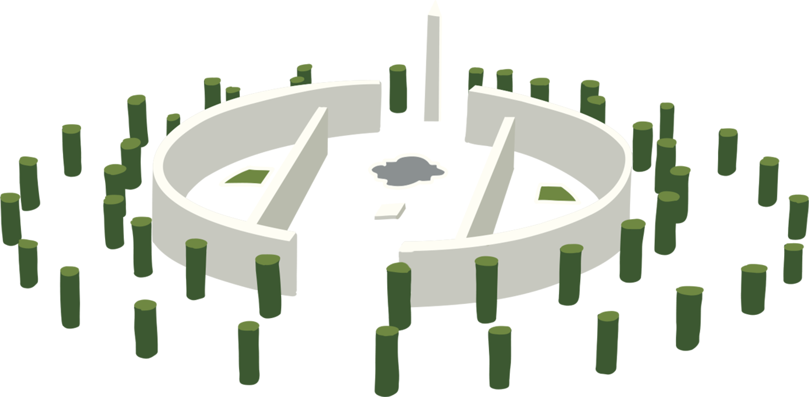
Why do we Remember?
Notes:
LO To understand why Remembrance takes place
Main Input
Explain to pupils that Remembrance is when we remember all those that protect us, our communities and our country.
If delivering this assembly on Remembrance day (11th Nov), explain that today is known as Armistice Day and every year on this day, we pause at 11am for 2 minutes and remember the service and sacrifice of others. Explain that the other national day of Remembrance is Remembrance Sunday, which takes place on the second Sunday in November. However, remembrance is a personal choice and there are many different ways to remember – it can be any time of year and in any way.
Ask pupils Q: thinking about what we have learnt about service z, what do you think Remembrance is about? Why do people take time to remember?
Responses may include: remembering the ways people serve/help/protect others, remembering those who have made sacrifices to help others/ have lost their own lives when serving, giving thanks to those who have served/helped to protect others, spending time thinking about how we can help others.

Slide 13

Q: Can you think of a time recently when you helped somebody?
Q: How did it feel to offer help to others?
Notes:
Main Input
As pupils enter assembly, display the questions on the slide and ask pupils to reflect on them as they wait for everyone to join.
To begin the assembly, ask a couple of pupils to share their act of help and explain their motivations for wanting to help someone. Q: What made you decide to help? Q: How did it feel to offer your help to someone else?
Explain that today’s assembly is going to be looking at a special type of help called service, that we take time to think about during Remembrance.

Slide 14
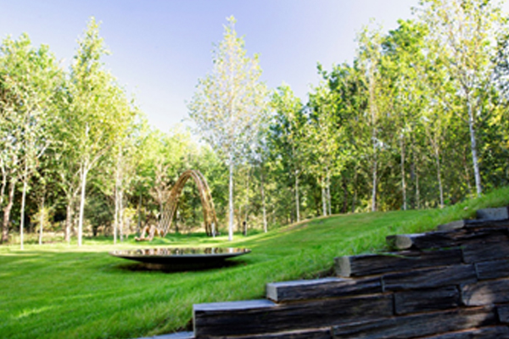
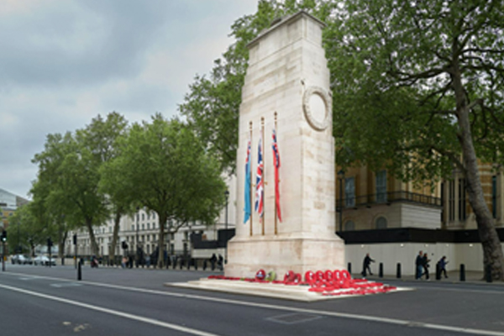
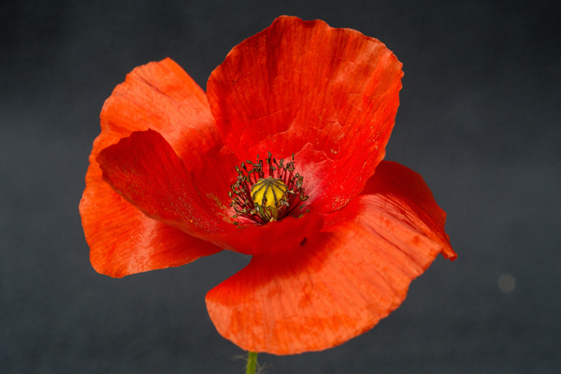
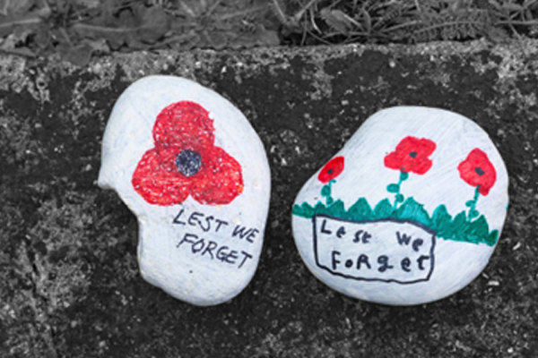
We all helped by buying a poppy.
Notes:
LO To reflect on how we can remember service this year
Main Input
Invite pupils to think about ways that they would like to remember the service and sacrifices of those who help to protect us Ask pupils: What could we do to take part in Remembrance this year?
You might like to ask some follow up questions to elicit more response: Can you think of examples of service within our community? How could we take time to remember this service and give thanks?
Ideas may include:
Writing a thank you letter to those in service within the local community i.e. local emergency services
Inviting members of the local community/family members in to talk to the children about their role in service
Creating a Remembrance display (poppies, poems, thank you notes)
Visit a local war memorial/ research local community members who have been involved in war/conflict
Research into family history to find examples of service
Holding a remembrance event (this could be a Remembrance service or a Remembrance thank you tea) and inviting along members of the local community i.e. police/fire officers
This may act as a starting point, but pupils can continue to plan their ideas in the classroom.

Slide 15

Notes:
LO To reflect on how we can remember service this year
Main Input:
Remind pupils of what they reflected on at the very beginning of the assembly: times they have helped others. One way of taking part in Remembrance, and honouring those who serve, is to think about what we can learn from them and their actions. Being kind towards other people, helping others and being thankful are all ways to help make other people’s lives better – and help towards building a peaceful future. Before pupils leave the assembly, ask them to reflect on what they could do to help people around them: at home, at school or within the local community.
Take it further (classroom activity)
Set up an act of help box. Invite pupils throughout the week, to add appreciation notes to the box – giving thanks to someone who has helped them that day. At the end of the week, share the acts of help as a class. Reflect: How did it feel to receive help from others? How did it feel to help others?

Slide 16
How do you give SERVICE to others?
At home?
At school>

Slide 17
Dear Lord
We pray for peace in the World.
We especially pray for peace in Ukraine and the Middle East countries.
We ask you to bring the leaders of the World together to bring peace all over the World.
Our Father, who art in Heaven …

Slide 18
Hymn – Make me a channel of your peace

Slide 19
Make me a channel of Your Peace
Make me a channel of Your peace,
Where there is hatred,
Let me bring Your love,
Where there is injury,
Your pardon Lord,
And where there’s doubt
True faith in You.

Slide 20
O Master grant that I may never seek,
So much to be consoled as to console,
To be understood as to understand,
To be loved as to love with all my soul.

Slide 21
Make me a channel of your peace,
It is in pardoning
That we are pardoned.
In giving to all men
That we receive,
And in dying that
We’re born to eternal life.

Slide 22
O Master grant that I may never seek,
So much to be consoled as to console,
To be understood as to understand,
To be loved as to love with all my soul.

Slide 23
Make me a channel of your peace,
Where there’s despair in life,
Let me bring hope,
Where there is darkness
Only light
And where there’s sadness
Ever joy.

Slide 24
O Master grant that I may never seek,
So much to be consoled as to console,
To be understood as to understand,
To be loved as to love with all my soul.

Slide 25
Your mission today and this week:
To be of SERVICE to someone
Do a simple job for them – at home or at school

