Slide 1


Welcome back everyone
HAPPY NEW YEAR
January 2025
We aspire that through the love of Jesus everyone should have life and have it to the full.

Slide 2


Sign of the Cross
In the name of the Father
and of the Son
and of the Holy Spirit
Amen

Slide 3
Opening prayer
We thank you Lord for bringing us back together time.
We thank you for our family and friends we have joined with over the holidays.
We thank you God for giving us the special gift of your Son on earth that we have just celebrated.
Amen

Slide 4
Gospel Reading
The Gospel according to:
All: Glory to You O Lord
This is the gospel of the Lord
All: Praise to you Lord Jesus Christ

Slide 5
The Feast of The Epiphany
Epiphany is the Christian celebration that marks the Three Kings finding Jesus by following the star.
Epiphany is a moment of revelation. A time when some significant understanding occurs.

Slide 6
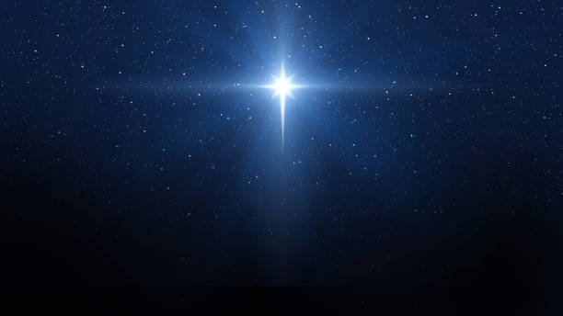
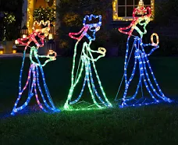
The three kings searched for Jesus
They followed the star.
They asked others on their way.

Slide 7

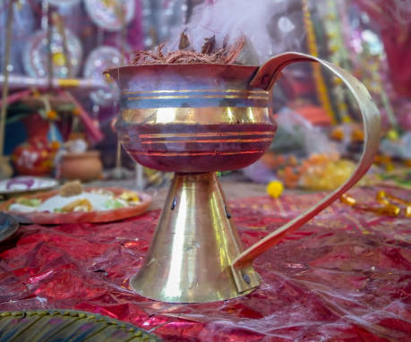
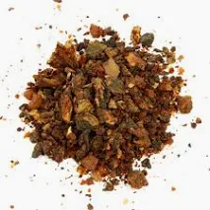
Gold
Frankincense
Myrrh

Slide 8
What gifts could you give Jesus?

Slide 9
My mission for you …
TODAY - give Jesus the best gift of showing Grateful and Generous

Slide 10
Prayer
God our Heavenly Father
We thank you for sending your son Jesus so that he could live on earth and show us the way to live.
Our Father …

Slide 11
Hymn
A New Commandment, I give unto you

