Slide 1

Our Lady’s Catholic Primary School
Collective Worship
Spring Term 2nd half
We aspire that through the love of Jesus everyone should “have life and have it to the full.”

Slide 2


Opening prayer
In the name of the Father
and of the Son
and of the Holy Spirit
Amen

Slide 3
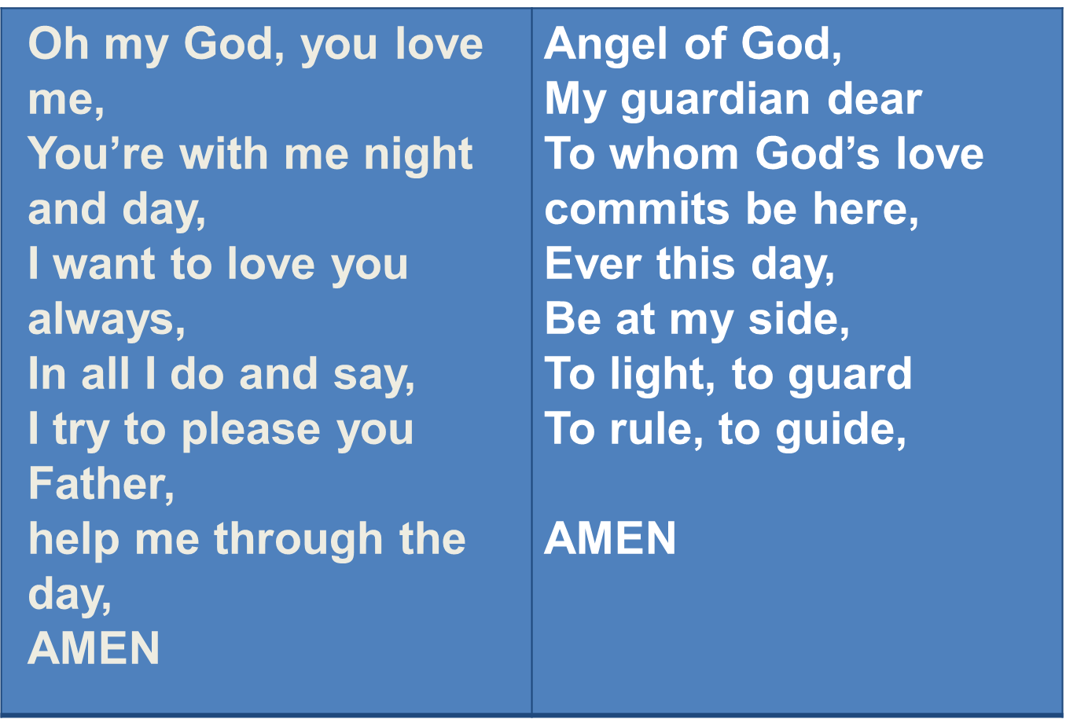
We offer our prayers to God today

Slide 4
Gospel Reading
This is the Gospel according to Luke
All: Glory to you O Lord.
The Gospel of the Lord
All: Praise to you Lord Jesus Christ

Slide 5
Gospel
youtube film jesus is tempted by the devil in the desert - Google Search

Slide 6
How is Lent going?

Slide 7
Mission

Slide 8
Dear Lord,
Help me to FAST from the things that are not good and FEAST on the things that are.
FAST from being unkind – FEAST on being kind.
FAST from hurting feelings of others – FEAST on being caring.
FAST from stopping everyone playing together – FEAST on everything joining together.
FAST from saying negative things about people – FEAST on saying kind things about others.

Slide 9
Hymn – Make me a channel of Your peace
Make me a channel of Your peace,
Where there is hatred,
Let me bring Your love,
Where there is injury,
Your pardon Lord,
And where there’s doubt
True faith in You.

Slide 10
O Master grant that I may never seek,
So much to be consoled as to console,
To be understood as to understand,
To be loved as to love with all my soul.

Slide 11
Make me a channel of Your peace
Where there's despair in life let me bring hope
Where there is darkness, only light
And where there's sadness, ever joy

Slide 12
Make me a channel of Your peace
It is in pardoning that we are pardoned
In giving to all men that we receive
And in dying that we're born to eternal life

