Slide 1

Our Lady’s Catholic Primary School
We aspire that through the love of Jesus everyone should
“have life and have it to the full.”

Slide 2


Sign of the Cross and thanks
In the name of the Father
and of the Son
and of the Holy Spirit
Amen
Opening prayer

Slide 3
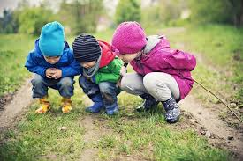

Curious and Active

Slide 4
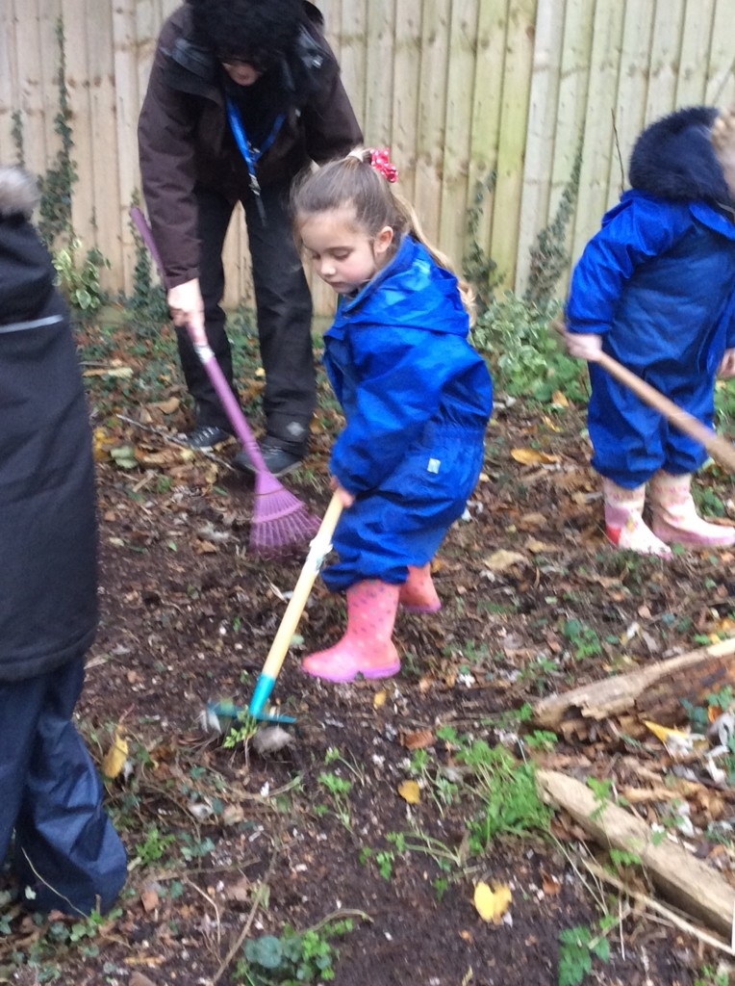
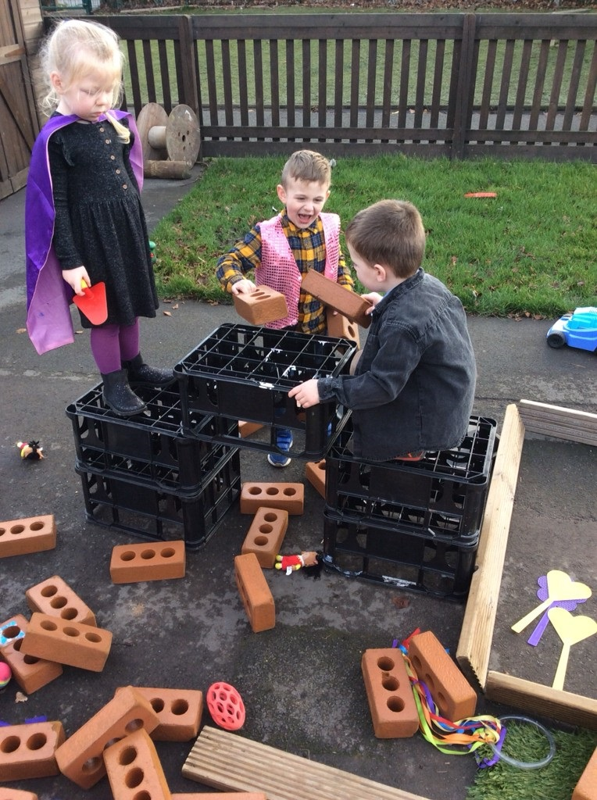

Slide 5
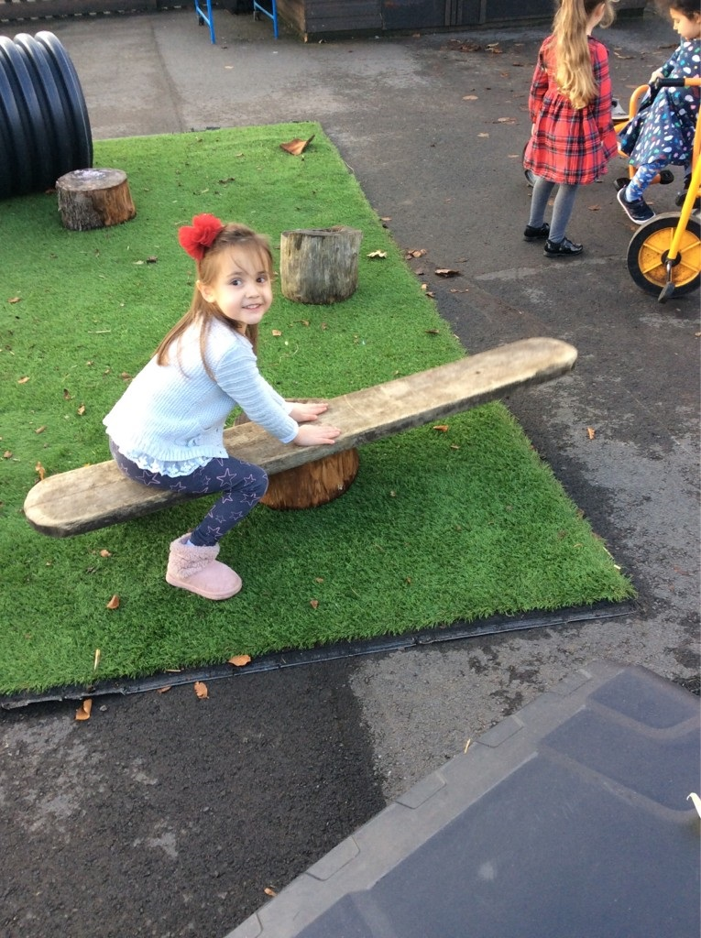
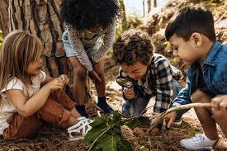
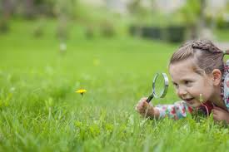

Slide 6
How can you be curious?
Try new things.
Focus and WONDER …. about things
Read about your subjects at school

Slide 7
History – find out – research
Geography – the same
Learn to cook
Think of something you would really like to do and find out how to start.

Slide 8

Be curious about God and about our faith.
Take an active interest in your RE lessons and discussions.
Be curious about other religions.

Slide 9
Mission
Look at what activities are going on in your local area and ask you parent if you can join one.
Rainbows/Brownies/Cubs and Scouts
Hinton Centre
Halo Swimming Pool
Halo Leisure Centre
Football Clubs/Gymnastics/Dance

Slide 10
Closing Prayer
Dear Jesus
Help us to use our health and our energy to be CURIOUS and ACTIVE.
Help to open our minds to new ideas so that we can all
“have life and have it to the full.”

Slide 11
Hymn
If I were a butterfly …

