Slide 1

Our Lady’s Catholic Primary School
We aspire that through the love of Jesus everyone should
“have life and have it to the full.”

Slide 2


Sign of the Cross and thanks
In the name of the Father
and of the Son
and of the Holy Spirit
Amen
Opening prayer

Slide 3
Prayers
Oh my God, you love me, You’re with me night and day, I want to love you Father, In all I do and say, Help me through the day, AMEN | Angel of God, My guardian dear To whom God’s love commits be here, Ever this day, Be at my side, To light, to guard To rule, to guide, AMEN

Slide 4
The Gospel
This is the Gospel according to Mark
All: Glory to you O Lord.
The Gospel of the Lord
All: Praise to you Lord Jesus Christ

Slide 5
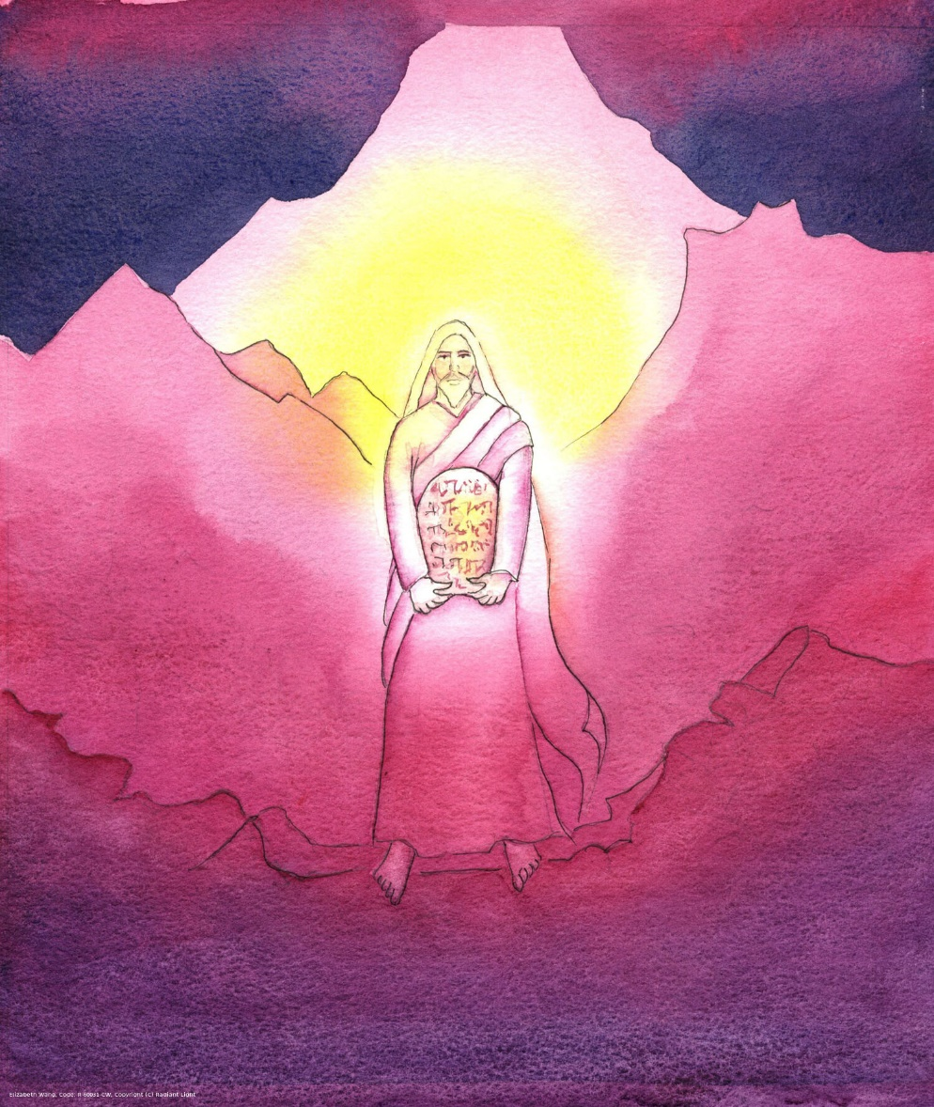
Moses receives the Ten Commandments
Love the Lord your God, with all your heart, your mind and your strength.
Love your neighbour as yourself.

Slide 6
Virtues for Autumn 2
INTENTIONAL | PROPHETIC
Know your own mind – what you Value – and live according to it. Following God’s word and teachings. | Talk openly about your views and your Values. Trying to influence others. Using God’s words to teach others.

Slide 7
Main Prophets in The Bible
Isaiah Ezekiel
Jeremiah Daniel
Advised people how to live according to God‘s word.

Slide 8
Mission today/this week
Be INTENTIONAL
Think of something you feel is important and follow it.
INTEND – plan to do something about it.
Think of the Gospel – how can you show you LOVE GOD or LOVE YOUR NEIGHBOUR?

Slide 9
Prayer
God of LOVE,
Help us to be INTENTIONAL about how we live.
Guide our thoughts and our actions to be truly INTENTIONAL and follow your words.
Help us to LOVE our neighbours as you have taught us, as we say …
Our Father, who art in Heaven …

Slide 10
Hymn - A New Commandment
A new commandment I give unto you:
That you love one another
As I have loved you,
That you love one another,
As I have loved you.

Slide 11
By this shall all know
That you are my disciples –
If you have love one for another.
By this shall all know
That you are my disciples –
If you have love one for another.

Slide 12
A new commandment I give unto you:
That you love one another
As I have loved you,
That you love one another,
As I have loved you.
End

