Slide 1

Our Lady’s Catholic Primary School
We aspire that through the love of Jesus everyone should
“have life and have it to the full.”

Slide 2

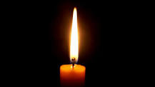
Sign of the Cross and thanks
In the name of the Father
and of the Son
and of the Holy Spirit
Amen

Slide 3
Opening Prayer
God of love, help us to recognise the importance of all children – wherever they live –
Amen.
Morning Offering …

Slide 4
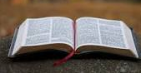
Gospel reading
The Gospel according to Mark
Glory to you O Lord
The Gospel of the Lord
Praise to you Lord Jesus Christ

Slide 5
Gospel reflection:
In today's reading Jesus shows the disciples how important children are. Can you remember what Jesus says?
Jesus says that anyone who welcomes a child, welcomes him. What do you think that means?

Slide 6
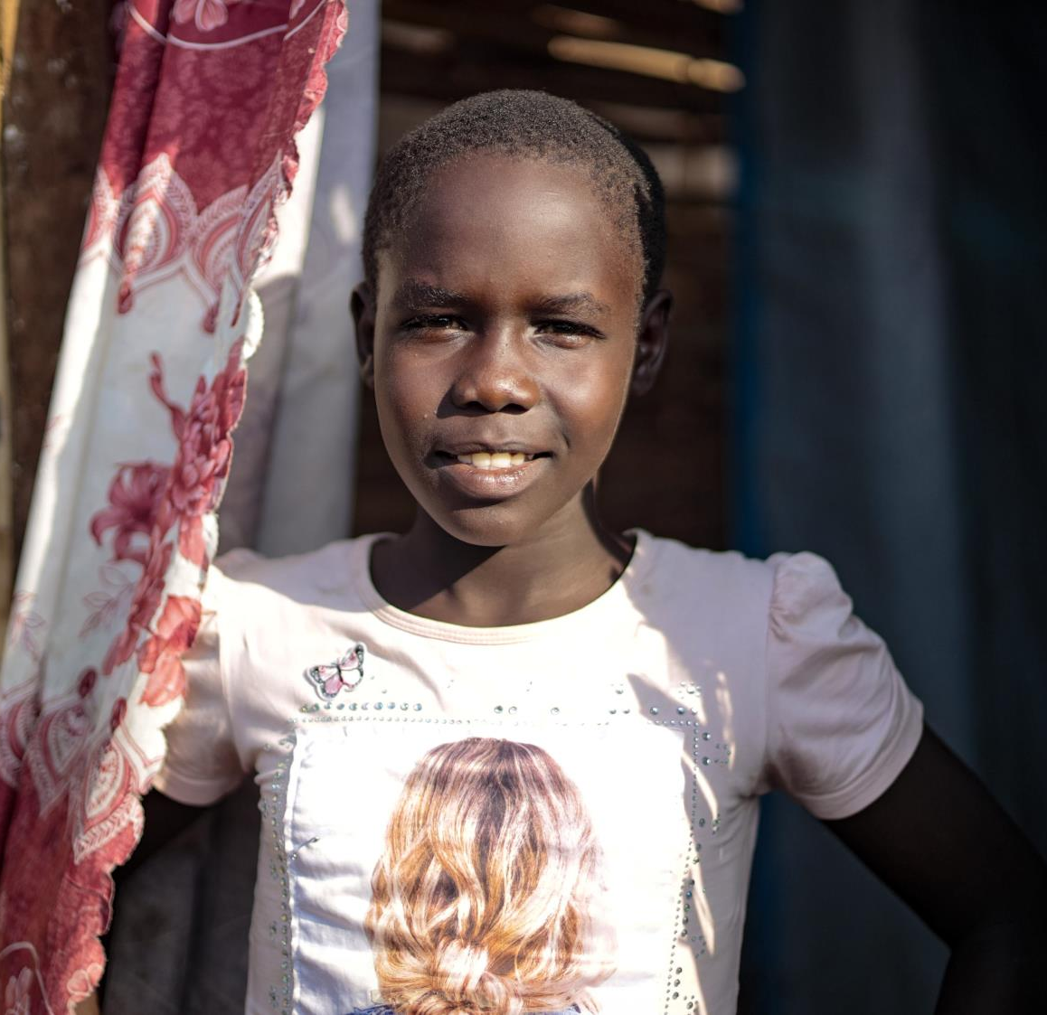
Victoria is 10, she lives in South Sudan, a country in Africa. • "I go to school and my friends are my blessing,” she says. “Being in school makes me happy. • "My favourite sport is football. My favourite subjects are English and Science. Education gives me hope. With education I will be clever and will be independent when I'm older

Slide 7
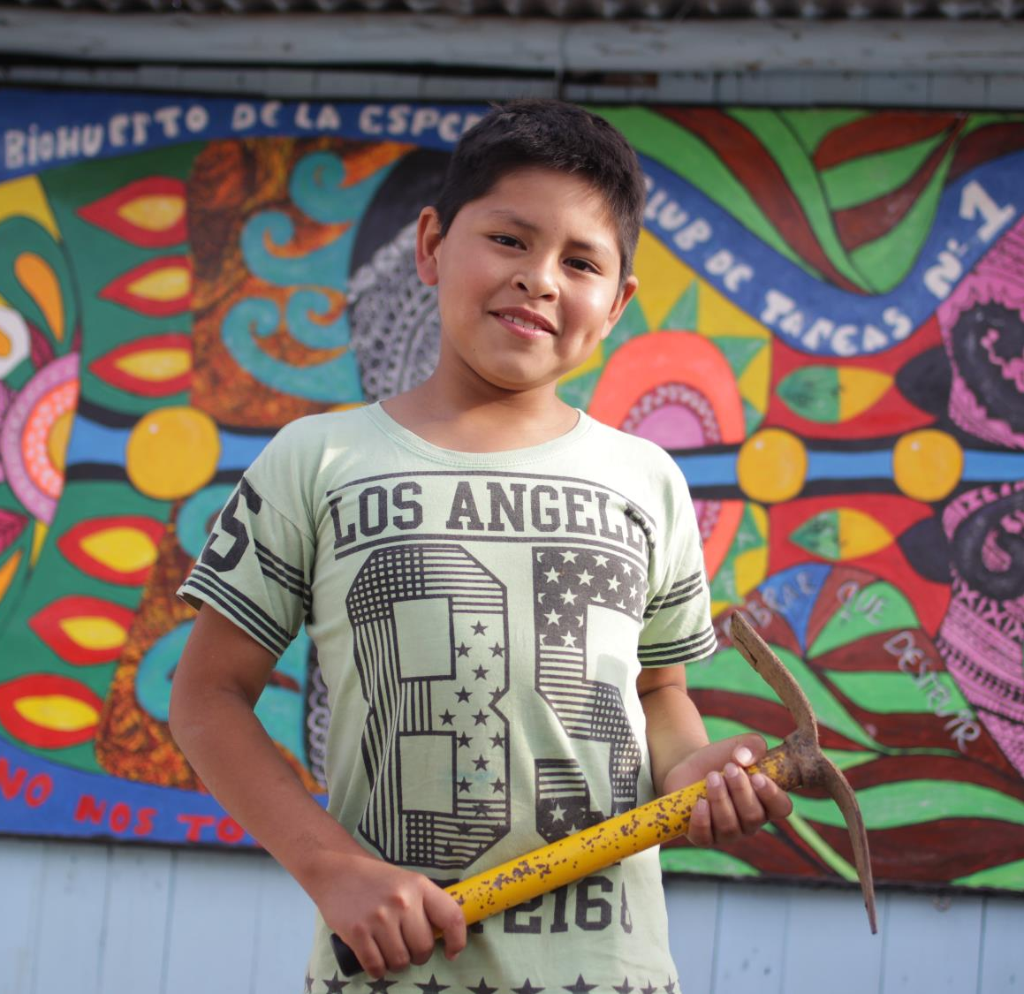
Jean-Pierre is 10, he lives in Peru, a country in Latin America. He has a cheeky grin and likes playing games, especially marbles.
Jean-Pierre loves to go to book club and read about superheroes. After school he helps take care of the school garden. He wants to be a teacher.

Slide 8
Jesus is in all of us. No matter who we are, where we come from, whether we are rich or poor, old or young. Even the youngest person is special and important because they are loved by God.
Children around the world are different. But each one of them is special and important.
We all need Jesus in our lives.

Slide 9
Jean-Pierre lives in Peru, a country in Latin America. He has a cheeky grin and likes playing games, especially marbles. He loves to go to book club and read about superheroes. After school he helps take care of the special school garden. He wants to be a teacher.
What things do you have in common with Victoria and Jean-Pierre? What things do they do or like, that you do or like too?
What will you do this week to show that all people are important no matter who they are?

Slide 10
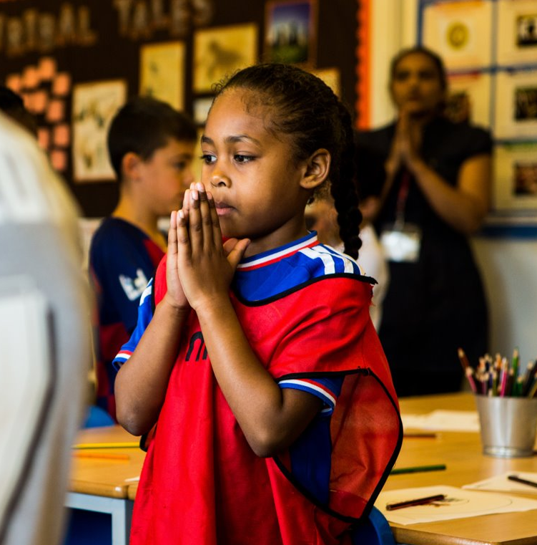

Final Prayer
God of love,
help us to recognise the importance of all children, no matter where in the world they come from. Amen.

Slide 11
We pray for all children throughout the world: that they may be valued and loved, and have the chance to build a brighter future. Lord, in your mercy…
Hear our prayer.
God of hope, we know all people are important, because they are loved by you. Show us how to help others to see this too, so that the world can be a fairer place for all your children. Amen.

Slide 12
Mission
Draw or write something you wish for yourself in life or for another child.
Show a child in our school how important they are today.
Tell at adult at home what our Gospel Worship was about today.

Slide 13
Hymn
Lord make me an instrument of your peace …

