Slide 1

Our Lady’s Catholic Primary School
Collective Worship
Spring Term 2nd half
We aspire that through the love of Jesus everyone should “have life and have it to the full.”

Slide 2


Opening prayer
In the name of the Father
and of the Son
and of the Holy Spirit
Amen

Slide 3
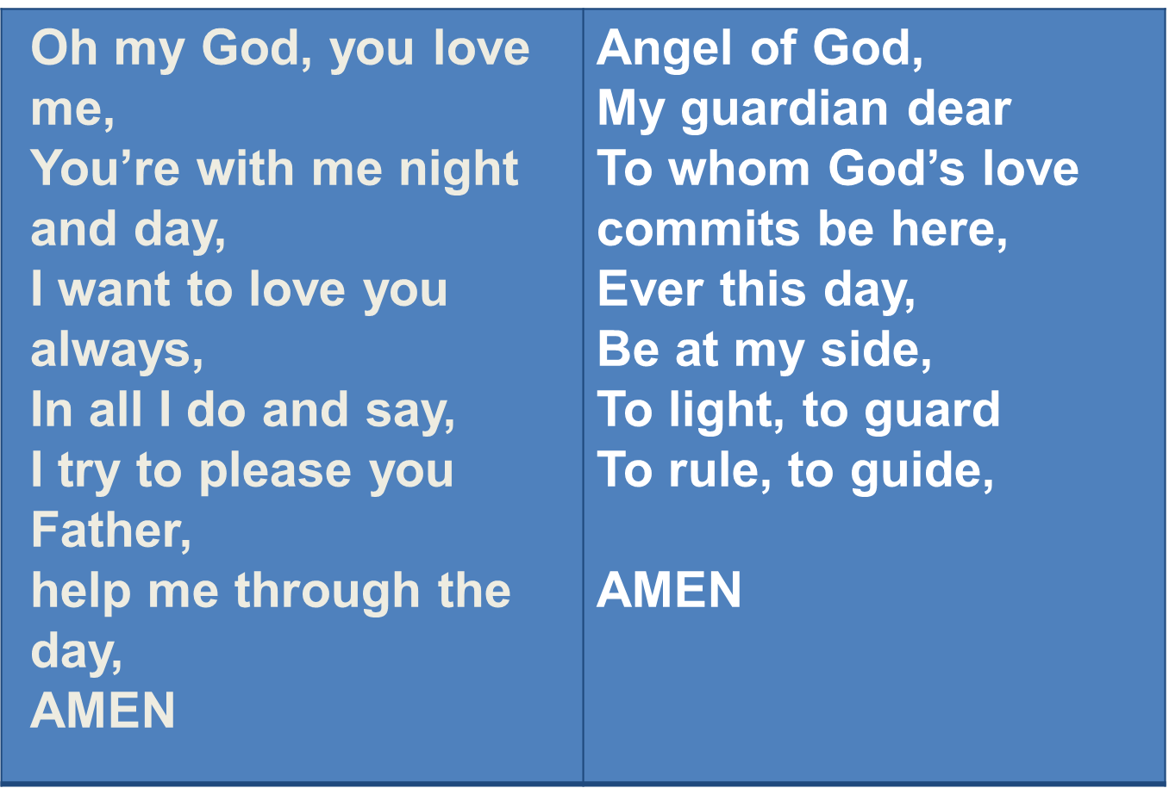
We offer our prayers to God today

Slide 4
Gospel Reading
This is the Gospel according to Luke
All: Glory to you O Lord.
The Gospel of the Lord
All: Praise to you Lord Jesus Christ

Slide 5
The Transfiguration of Jesus
Superbook 'The Transfiguration of Jesus' Teach Us to Pray Clip 1080p HD

Slide 6
Mission
Be attentive
Be discerning

Slide 7
Prayer
Dear Lord
Help me to follow your ways and to always be attentive and discerning.
Help me to pray and listen when I pray so that I can follow your guidance.
Help me have a good LENT and to stop all the things I do that are not good and do more of those that are. FAST and FEAST.
Our Father, who art in Heaven …

Slide 8
Hymn

