Slide 1

Our Lady’s Catholic Primary School
We aspire that through the love of Jesus everyone should
“have life and have it to the full.”

Slide 2

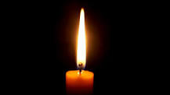
Sign of the Cross and thanks
In the name of the Father
and of the Son
and of the Holy Spirit
Amen
Opening prayer

Slide 3
Prayers
Oh my God, you love me, You’re with me night and day, I want to love you Father, In all I do and say, Help me through the day, AMEN | Angel of God, My guardian dear To whom God’s love commits be here, Ever this day, Be at my side, To light, to guard To rule, to guide, AMEN

Slide 4
The Gospel
This is the Gospel according to Luke
All: Glory to you O Lord.
The Gospel of the Lord
All: Praise to you Lord Jesus Christ

Slide 5
Gospel – Jesus is Baptised
What do you know about Baptism?

Slide 6
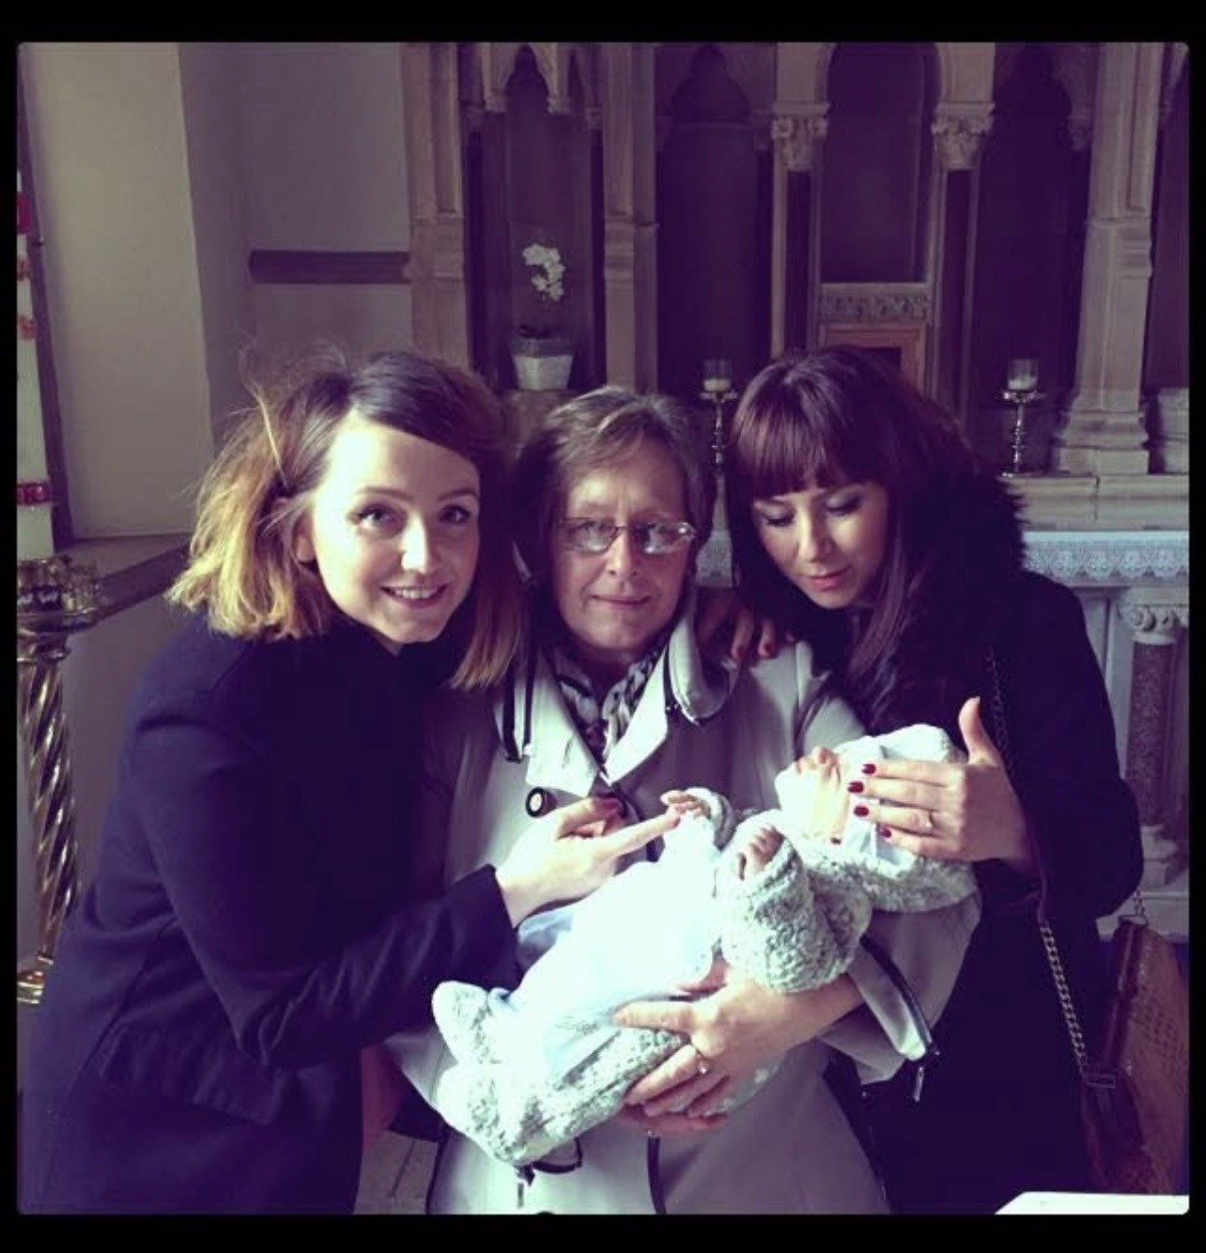
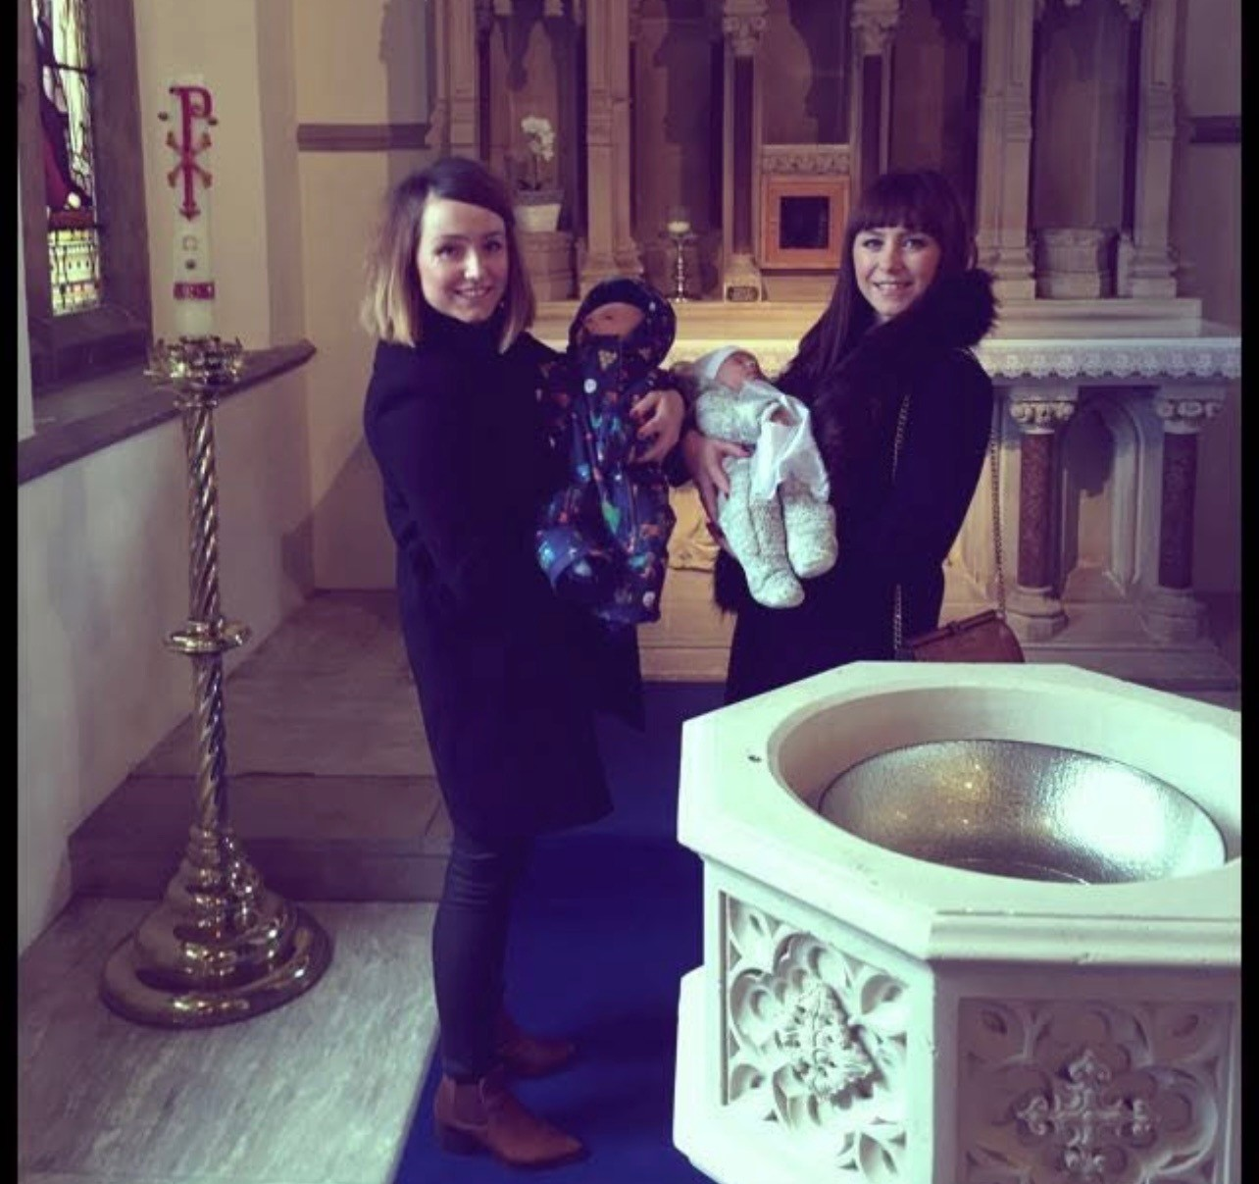
Baptism

Slide 7
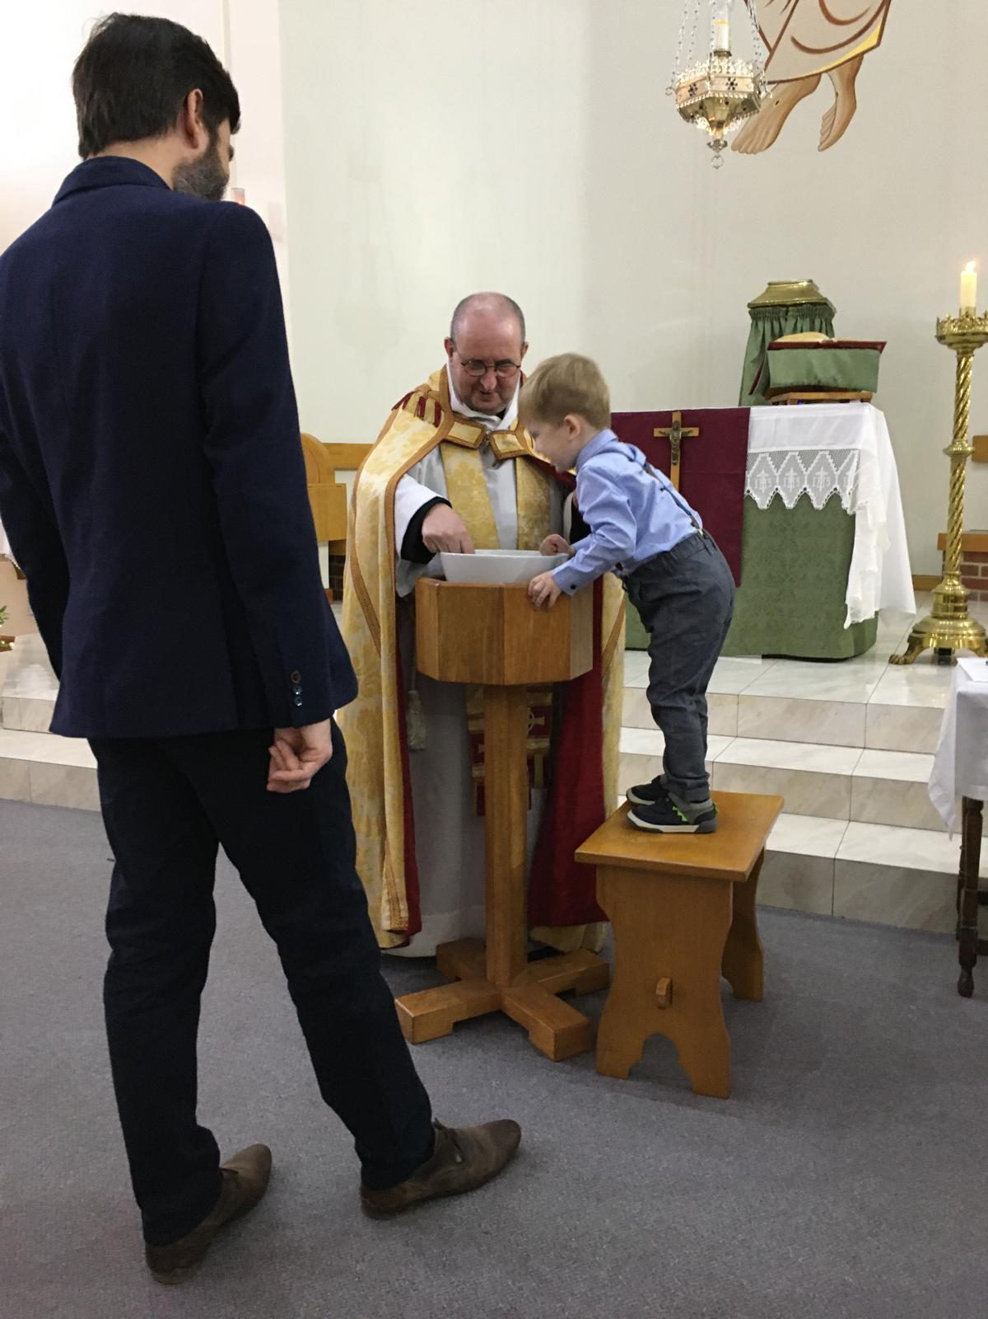
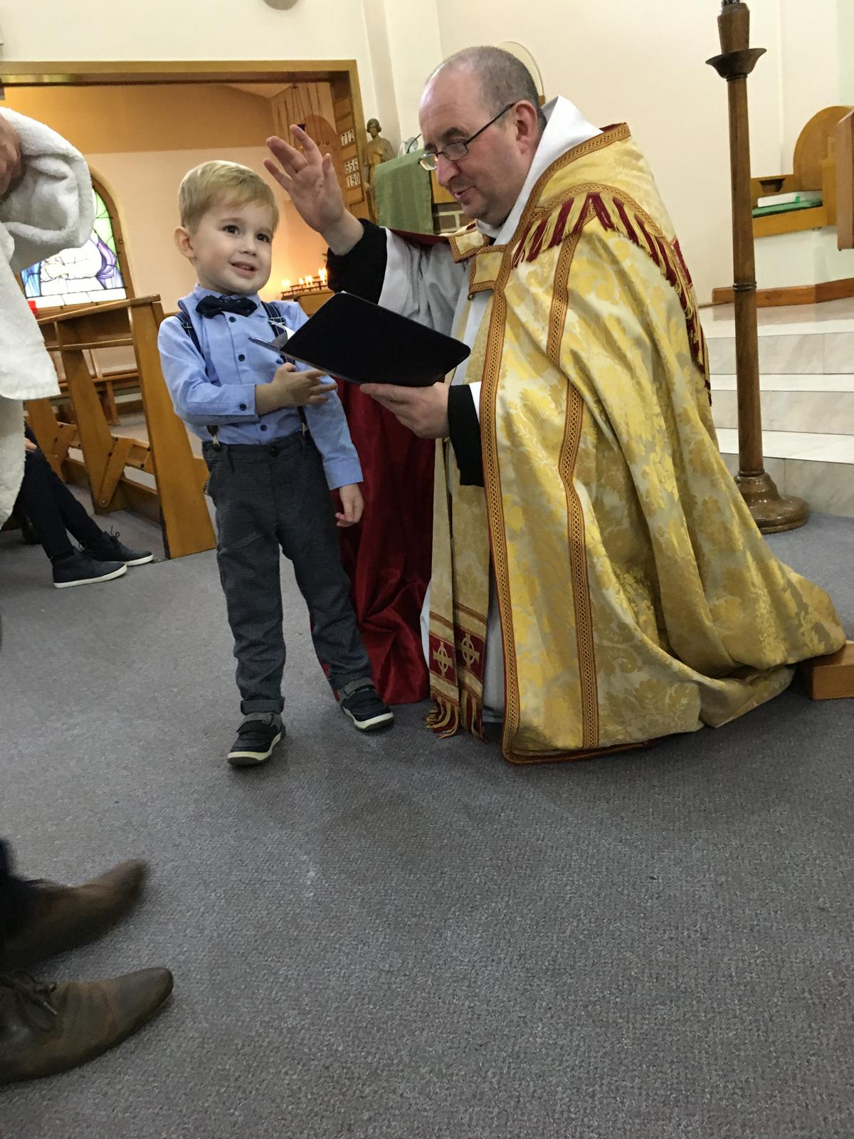
Baptism

Slide 8
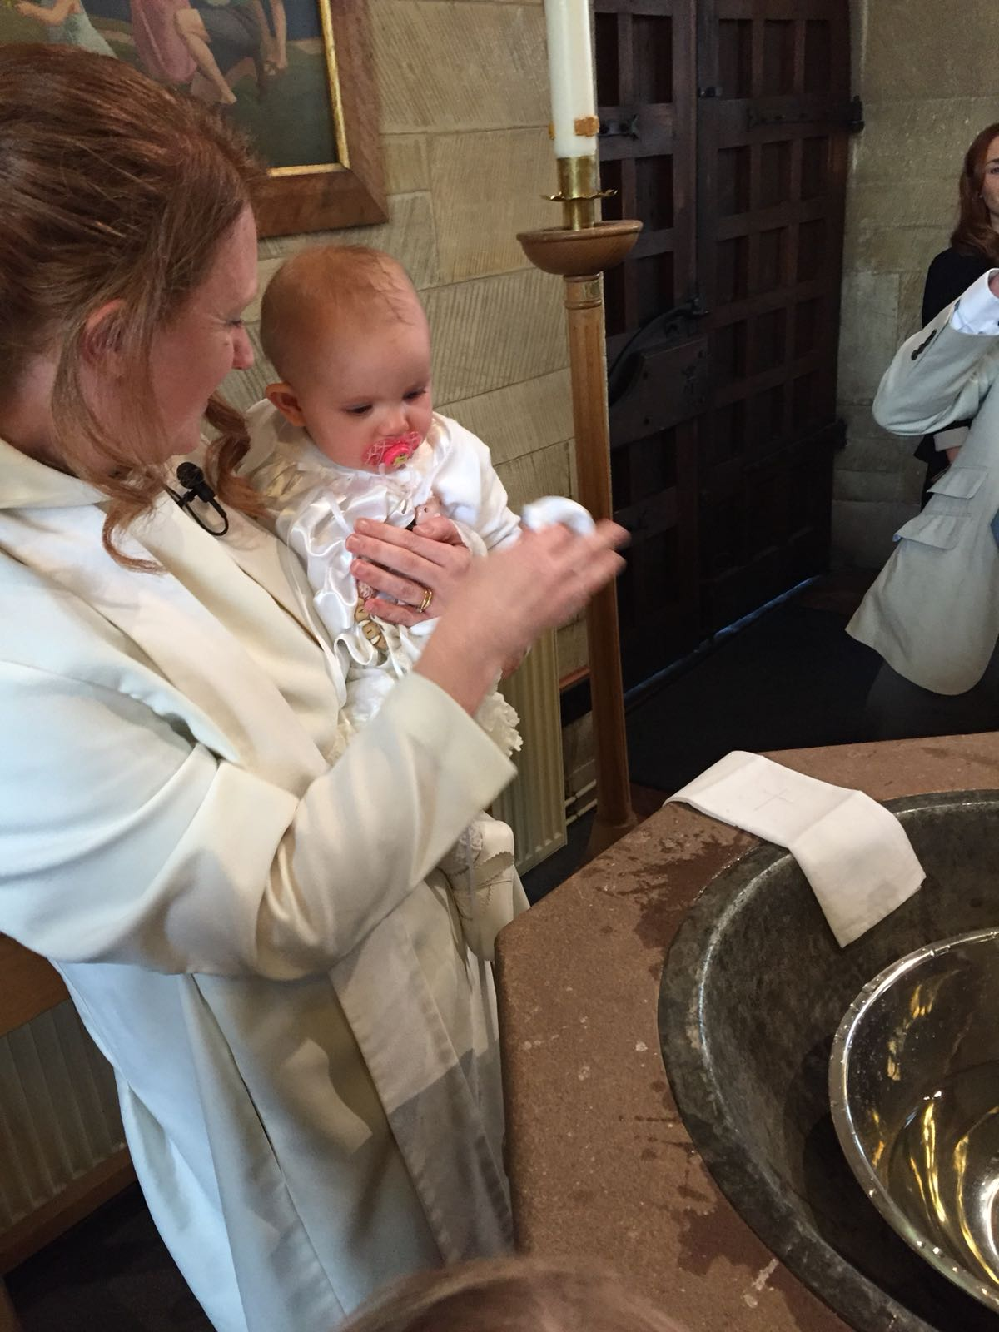
Baptism

Slide 9
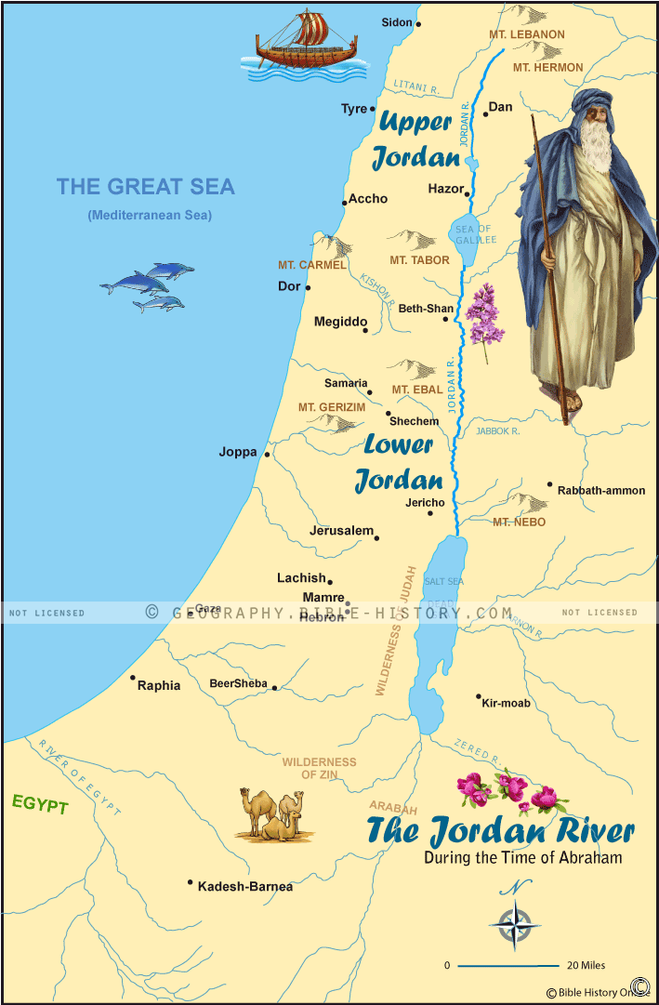
Jesus is Baptised in the River Jordan
This Photo by Unknown Author is licensed under CC BY-SA

Slide 10
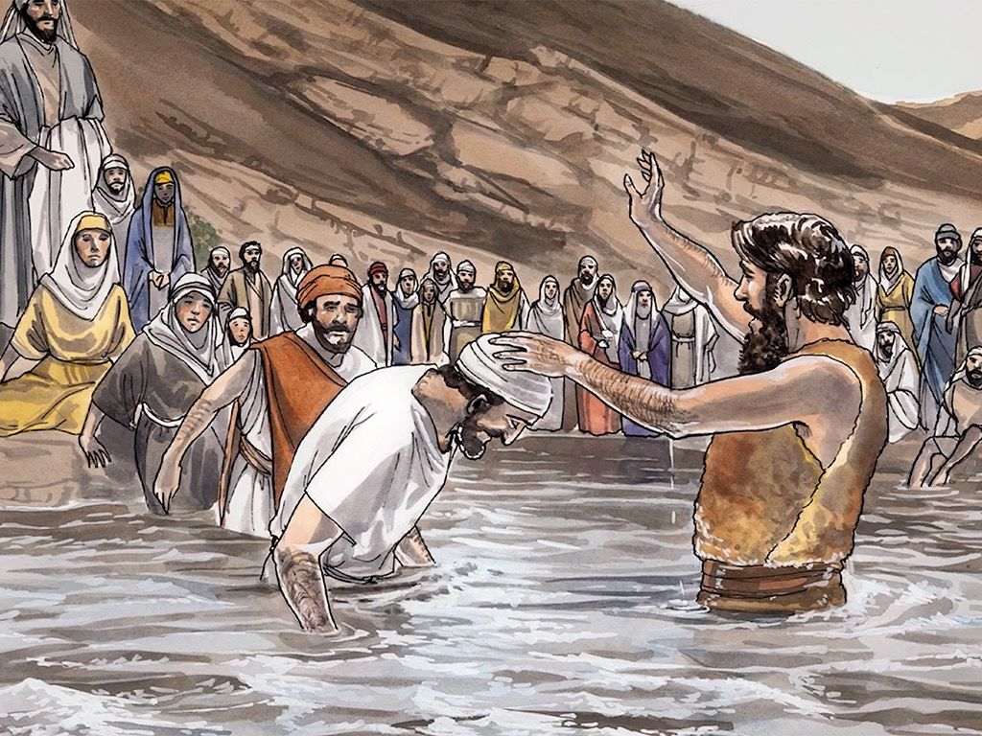
Jesus being Baptised by John the Baptist
This Photo by Unknown Author is licensed under CC BY-SA-NC

Slide 11

Holy Spirit
You are my beloved Son, with whom I am well pleased.
This Photo by Unknown Author is licensed under CC BY

Slide 12
Gospel
“I baptise you with water, but someone is coming who is much greater than I am. I am not good enough to even untie his sandals. He will baptise you with the Holy Spirit and fire.”
“You are my dear Son. I love you and I am pleased with you.”

Slide 13
Mission today/this week
Help someone.
Thank God for being Baptised – for faith being passed on by your family.
Thank people who lead you in your faith.

Slide 14
Hymn - A New Commandment
A new commandment I give unto you:
That you love one another
As I have loved you,
That you love one another,
As I have loved you.

Slide 15
By this shall all know
That you are my disciples –
If you have love one for another.
By this shall all know
That you are my disciples –
If you have love one for another.

Slide 16
A new commandment I give unto you:
That you love one another
As I have loved you,
That you love one another,
As I have loved you.
End

