Slide 1

Our Lady’s Catholic Primary School
We aspire that through the love of Jesus everyone should
“have life and have it to the full.”

Slide 2


Sign of the Cross and thanks
In the name of the Father
and of the Son
and of the Holy Spirit
Amen

Slide 3
Prayers
Oh my God, you love me, You’re with me night and day, I want to love you Father, In all I do and say, I'll try to please you Father, Help me through the day, AMEN | Angel of God, My guardian dear To whom God’s love commits be here, Ever this day, Be at my side, To light, to guard To rule and guide, AMEN

Slide 4
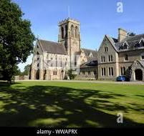
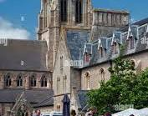
Goodbye Prayers and blessings
Father Andrew

Slide 5
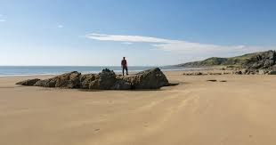
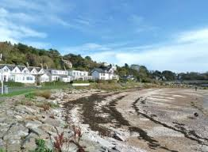
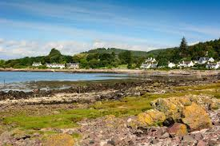
Goodbye Mrs May

Slide 6
Prayer

Slide 7
Shine Jesus Shine
Shine, Jesus, shine,
Fill this land with the Father's glory;
Blaze, Spirit, blaze,
Set our hearts on fire.
Flow, river, flow,
Flood the nations with grace and mercy;
Send forth Your word,
Lord, and let there be light.

Slide 8
As we gaze on Your kingly brightness
So our faces display Your likeness.
Ever changing from glory to glory,
Mirrored here may our lives tell Your story.
Shine on me, shine on me.

Slide 9
Shine, Jesus, shine,
Fill this land with the Father's glory;
Blaze, Spirit, blaze,
Set our hearts on fire.
Flow, river, flow,
Flood the nations with grace and mercy;
Send forth Your word,
Lord, and let there be light.
End

