Slide 1
Closing the Gap
Apostolic Christian Counseling and Family Services
877-370-9988 www.accounseling.org info@accounseling.org

Slide 2
Objectives
1. Teen/adult relationship training
2. Precautions and guidelines
3. Next steps

Slide 3
Relationship Training
Connect
Turn toward.
Basic Need: To be connected.
Learn who they are.
Basic Need: To be known.
Esteem them highly.
Basic Need: To be cared for.
Know
Care

Slide 4
Connect
Know
Care
Schedule meetings (1 per month is ideal)
Participate together: take a walk, hike, fish, run
Over food: breakfast, coffee, lunch, ice cream
Share an activity: attend event, extra curricular
Run an errand: shop, delivery
Work on project: split firewood, bake rolls, paint a fence
Big Picture:
Connection is more important than time and venue.
Teen comfort is more important than your comfort.
Parents comfort is more important than teen comfort.
Communicate with parents.

Slide 5
Connect
Know
Care
“I Feel”
“I think”
The Facts
“I am”
The facts…
What do you like to read?
What do you like to watch?
What do you like about school?
What do you dislike about school?
What are you proud of?
If you could fix any problem in the world, what would it be?
What do you hope to do after high school?
What are you looking forward to next week?
If you could go anywhere in the world where would it be?
Trust
Start with the facts…

Slide 6
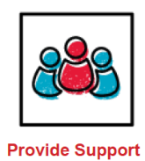
Connect
Know
Care
Connect me with people and places that broaden my horizons.
Show me that I matter to you.
Five Elements
Treat me with respect and give me a say.
Push me to keep getting better.
Help me complete tasks and achieve goals.
Copyright © 2017 by Search Institute. All rights reserved.

Slide 7
Be someone I can trust.
Really pay attention when we are together.
Make me feel known and valued.
Praise me for my efforts and achievements.
Inspire me to see possibilities for my future.
Expose me to new ideas, experiences, and places.
Introduce me to people who can help me grow.
Definitions
Expect me to live up to my potential.
Push me to go further.
Insist I take responsibility for my actions.
Help me learn from mistakes and setbacks.
Take me seriously and treat me fairly.
Involve me in decisions that affect me.
Work with me to solve problems and reach goals.
Create opportunities for me to take action and lead.
Guide me through hard situations.
Build my confidence to take charge of my life.
Defend me when I need it.
Put in place limits to keep me on track.
Copyright © 2017 by Search Institute. All rights reserved.

Slide 8
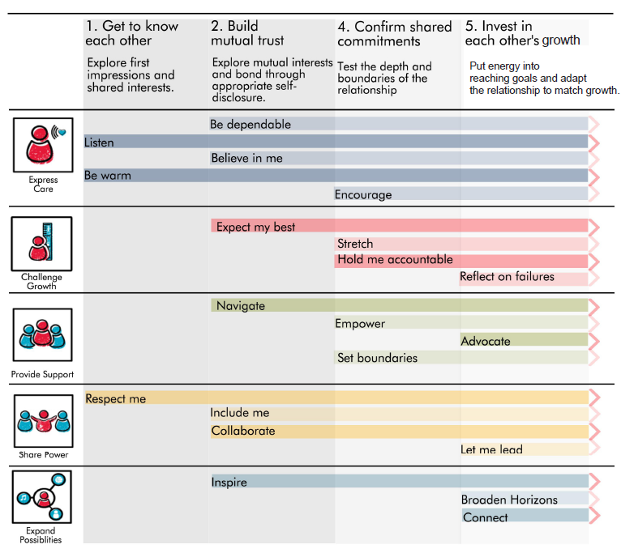
Developing Relationship in Action
Copyright © 2017 by Search Institute. All rights reserved.

Slide 9
Precautions and Guidelines
Precautions and Guidelines
Child and Youth Protection Policy
Purpose of Policy:
1. To communicate the risk and to reduce the potential for physical or sexual abuse / misconduct within the Apostolic Christian Church (ACC) and its activities.
2. To continue to provide a safe and secure environment for all.
3. To provide a system to respond to alleged victims of sexual abuse.
4. To reduce the potential for false accusations.

Slide 10
Child and Youth Protection Policy
Definitions of Abuse:
Physical abuse includes intentional or deliberate behavior that causes bodily harm.
Sexual abuse includes any sexual activity where consent is not or cannot be given. This includes sexual contact that is accomplished by force or threat of force, regardless of the age of the participants, and all sexual contact between an adult and a child, regardless of whether there is deception or the child understands the sexual nature of the activity. Sexually abusive acts include, but are not limited to: exposure, voyeurism/inappropriate looking, and showing sexually explicit material to a child.
Child emotional abuse is defined as verbal or non-verbal conduct including mental exploitation, degrading communication, or humiliating or threatening conduct that may or may not include bullying or as defined by state law.
Physical abuse, sexual abuse, inappropriate sexual contact as defined above includes:
Conduct between an adult and a minor; and
Conduct between a minor and a minor.

Slide 11
Child and Youth Protection Policy
Response to Sexual (or Physical) Abuse Allegations:
The Apostolic Christian Church will respond promptly to investigate any accusation of sexual abuse within the church. All accusations of abuse will be taken seriously. It is important to be appropriately respectful to the needs and feelings of both those who allege sexual abuse and those who have been accused of sexual abuse.

Slide 12
Adult Encouragers
Encourage your teen…
Godward
Parentward
Churchward
Don’t be discouraged by…
Silence
Disinterested faces
One way conversations
Limited feedback

Slide 13
Next Steps
Reach out to your teen.
Introduce yourself
Express the honor you felt for being asked.
Agree on communication mode.
Exchange phone numbers
Text, WhatApp, SnapChat ☺
Set a place and time for meeting.
Ask their birthday and put it on your calendar.
Prepare a few conversation starting questions.

Slide 14
Resources
ACCFS Discussion Aids:
https://www.accounseling.org/discussion-aids/
ACCFS Mentor resources:
https://www.accounseling.org/mentor/
Professional consultation required?
Call ACCFS: 309.263.5536
Physical, emotional, or sexual abuse
Suicidal thoughts or plans
Physical harm to self
Threats of harm to others
Questions?:
Lisa Monagle, Andy Feucht, Will Nussbaum,
Ben Luginbuhl, Matt Kaufmann

