Slide 1


Slide 2
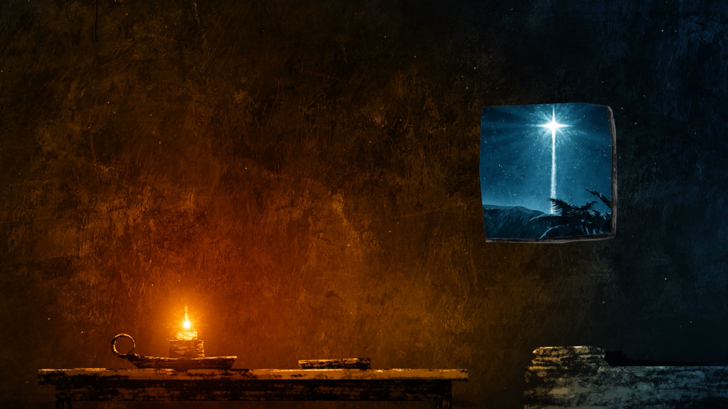
Hope Promised: A Light in the Darkness
Isaiah 9:1-7

Slide 3
Darkness In Israel
Background
  Israel, Judah, King Ahaz
  Isaiah 8:20-22
  Darkness
  “No More Gloom”

Slide 4
A Light Of Hope
Birth Announcement (v. 6)
A Light Of Hope
A Light Of Deliverance
Prophetic Perfect Language

Slide 5
Response To The Light
God Blesses The People
  Increased Believers
  Increased Joy
    Harvest
    Victory
  Peace

Slide 6
The Birth Announcement
A Child Will Be Born
  Humanity
A Son Will Be Given
  Deity
  Isaiah 7:14

Slide 7
The Birth Announcement
“Christ’s being born and
given to us is the great
foundation of our hopes,
and fountain of our joys, in times of greatest grief and fear.”
Matthew Henry

Slide 8
The Messiah Will Govern
The Government Will Be On His Shoulders
Zechariah 14:9 And the Lord will be king over all the earth; in that day the Lord will be the only one, and His name the only one.

Slide 9
The Messiah
Wonderful Counselor
Mighty God
Everlasting Father
Prince of Peace

Slide 10
The Kingdom
Increase In Peace
Reestablishes The Throne of David
Rule Of Justice & Righteousness
Eternal Reign

