Slide 1


Slide 2
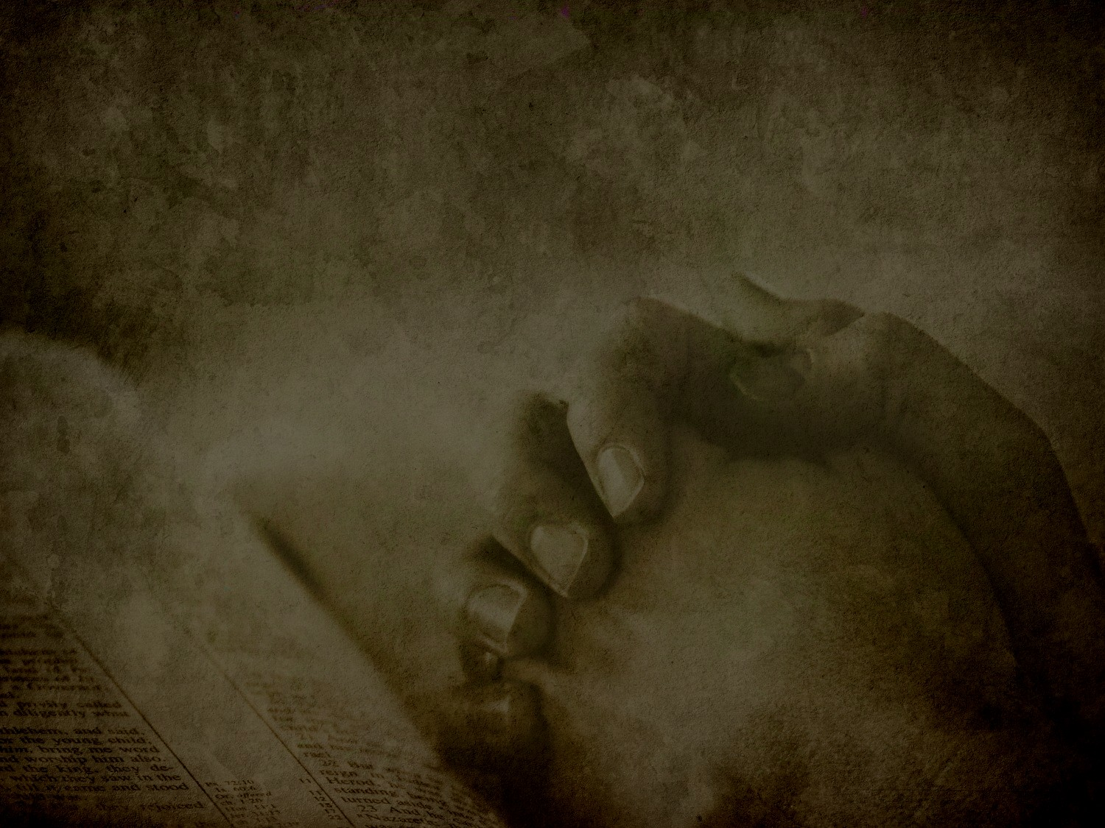
Awaken: To Reverence Pausing To Worship
Matthew 6:9b

Slide 3
It’s Not About Us!
Normally We Rush To Our Request
“Seek God’s Face, Not His Hands” (Dr. R.T. Kendall)

Slide 4



Slide 5
Hebrews 4:16
Therefore let us draw near with confidence to the throne of grace, so that we may receive mercy and find grace to help in time of need.

Slide 6
“Hallowed be Your name”
Treated As Holy
Psalm 111:9 …Holy And Awesome Is His Name.
Psalm 103:1 Bless the Lord, O my soul, And all that is within me, bless His holy name.

Slide 7

What Is In A Name?
Identity
Yahweh
Jehovah

Slide 8
What Is In A Name?
Reputation
Proverbs 22:1 A good name is to be more desired than great wealth, Favor is better than silver and gold.

Slide 9
“Our Father”
Treated As Holy
Worship, Praise, & Adore His Name
PSALM 115:1 Not to us, O Lord, not to us, But to Your name give glory Because of Your lovingkindness, because of Your truth.

Slide 10
Psalm 34:3
O magnify the Lord with me, And let us exalt His name together.
Speak
Witness
Pray
Sing

Slide 11
Our Reputation Should Reflect Our Fathers
“You shall not take the name of the Lord your God in vain, for the Lord will not leave him unpunished who takes His name in vain.” Exodus 20:7

Slide 12
Our Reputation Should Reflect Our Fathers
“I am the Lord, that is My name; I will not give My glory to another, Nor My praise to graven images.”
Isaiah 42:8

Slide 13
A Call To Worship
God’s Name Is To Be Treated As Holy
Live Holy: You Are His Child
Let Others See Jesus In You

