Slide 1
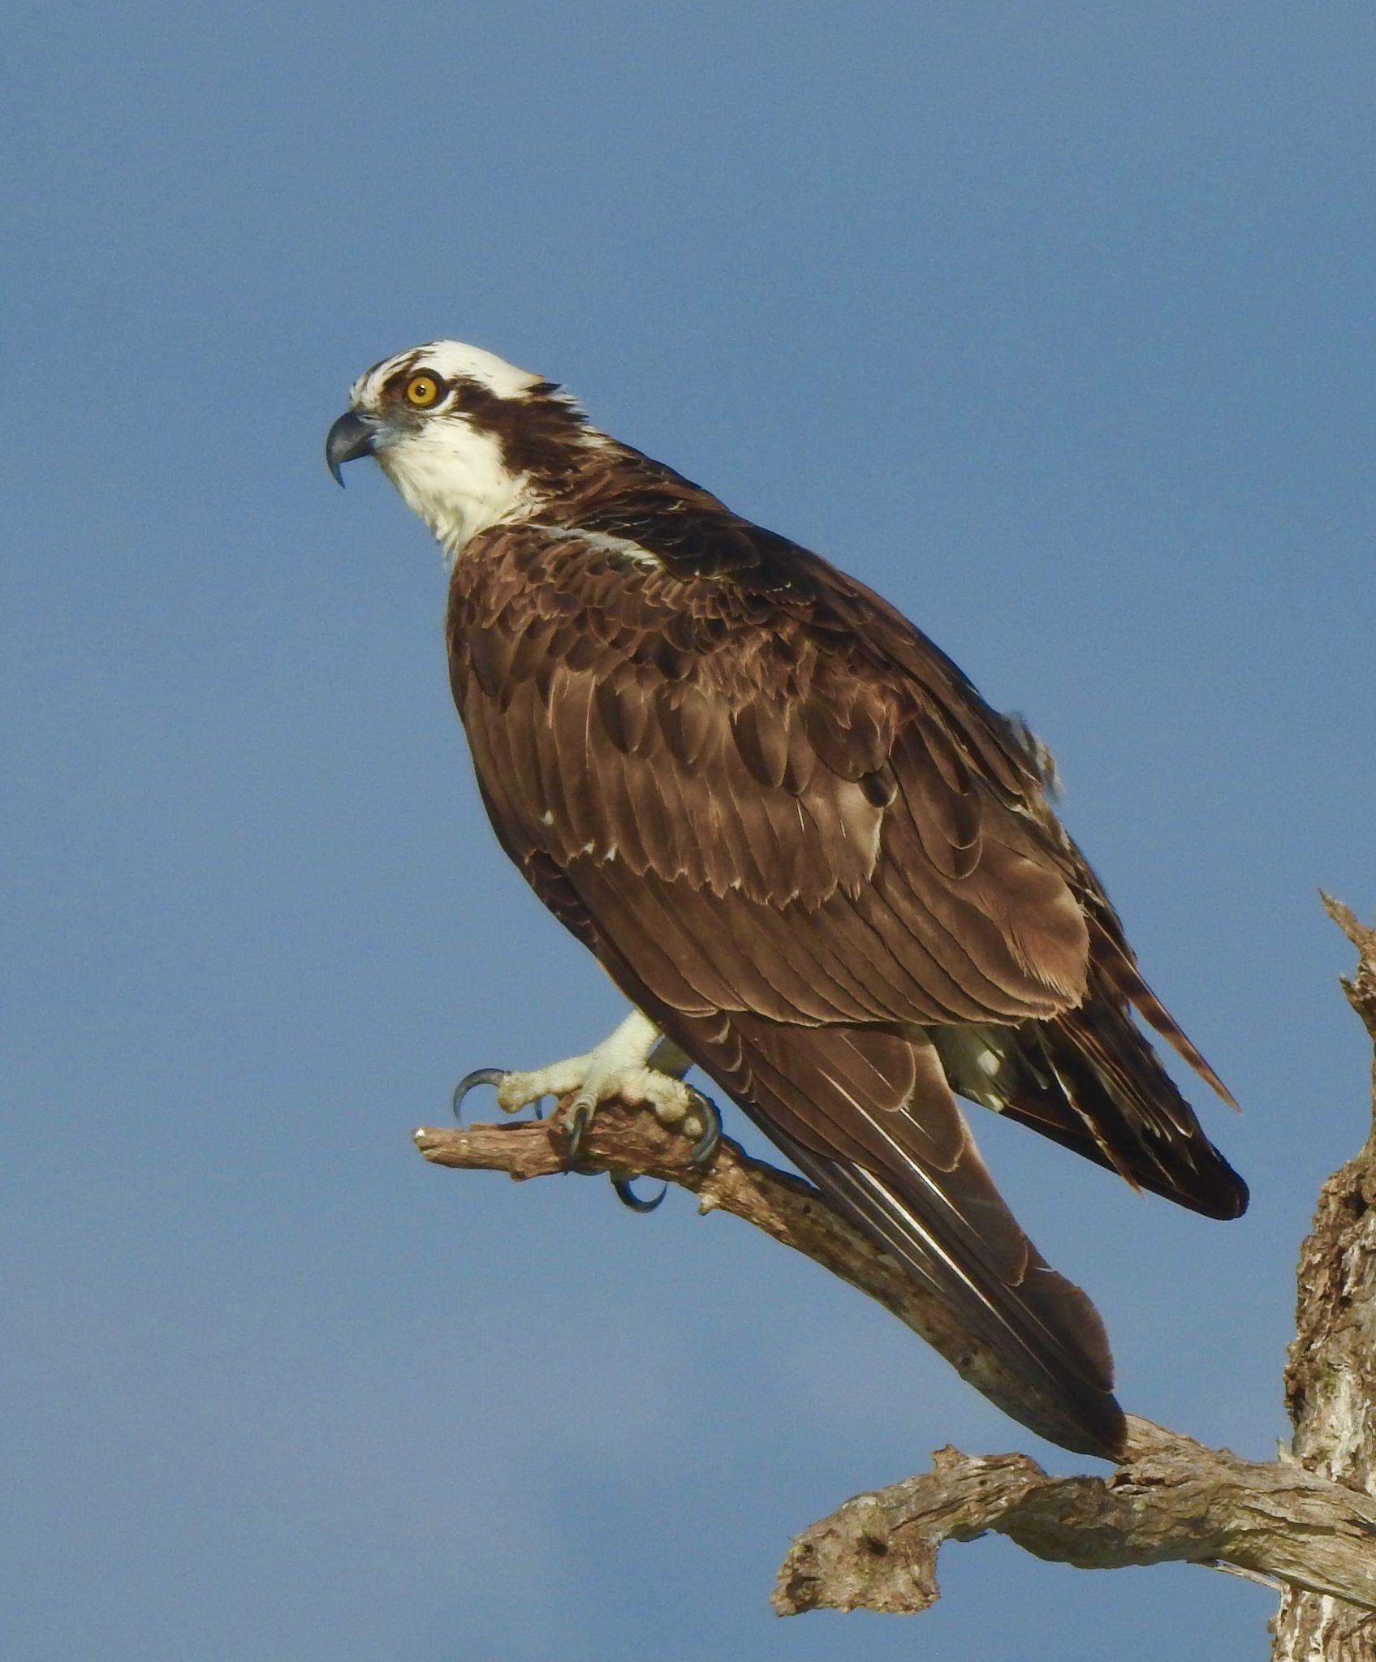
Nest
Monitor
Training
&
Information
Session 2026
Nest Monitor Training Meeting
January 13, 2026

Slide 2
Nest Monitoring…A New Chapter
In order to guarantee the future success of TIOF’s mission, a request was made to join SCCF, the premier environmental organization in Southwest Florida.
SCCF is committed to continuing TIOF’s mission.
TIOF is committed to supplying nest monitors and nest maintenance workers and leaders to continue these key functions of the mission.

Slide 3
What is Happening?
TIOF is handing over to SCCF the work of its mission of preserving ospreys.
Nest monitoring and maintenance will continue under new leadership.
The importance of accurate, consistent data collection remains a top priority.
Restoring and improving osprey nesting habitat is a key part of the ongoing mission.

Slide 4
How will it all work ?
We’ll learn as we go.
TBD Many details are still being developed. Here is what we know so far.
Today’s meeting will provide some answers and initial training. Follow-up training sessions may be scheduled in the future
Nest Monitors will use materials and procedures previously developed.
New monitoring options will be introduced with participation on a voluntary basis this year.
All monitors report to and communicate to SCCFospreys@gmail.com
Bob will coordinate nest construction needs with builders and installers. Those communications should go to him and Amanda amanrique@sccf.org

Slide 5
Who is doing what? Introductions…
Amanda ~ (SCCF Osprey Program Coordinator)
Audrey ~ (Bird Biologist)
Kelly ~ (Director of Coastal Wildlife (TIOF’s new home in SCCF))
Kealy ~ (Director of Coastal Watch)
Becky ~ (Coordinator for Nest Monitoring)
Bob ~ (Coordinator for Nest Installations and Maintenance)

Slide 6
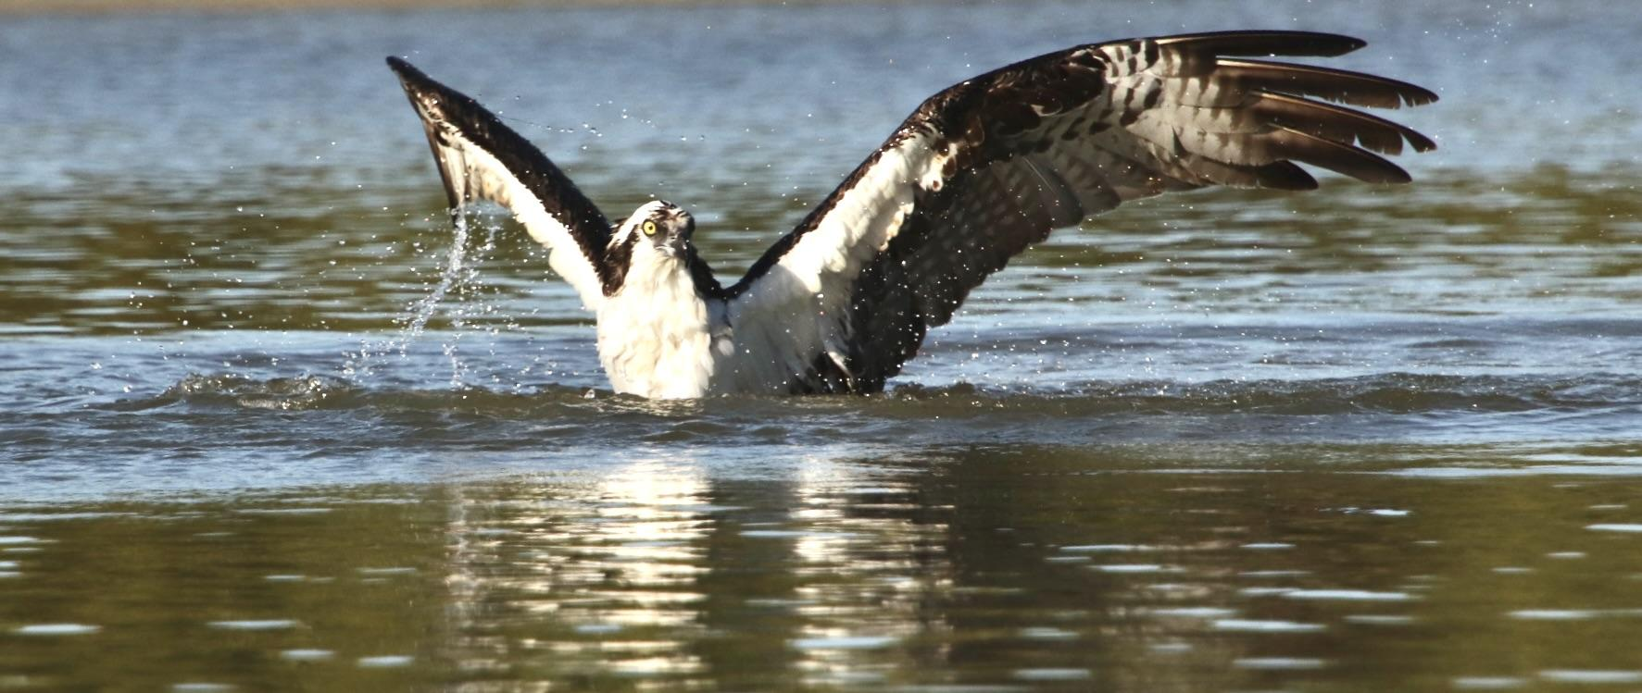
Nest Monitor
Training

Slide 7
Nest Monitor
Training Components
Purpose and need for monitoring
Osprey Watch (one part of the picture)
Observations - timing and responsibilities
Observation notes & data
Reporting expectations and deadlines
WHAT did The Nest Monitor See?
Q & A
Thank YOU!

Slide 8

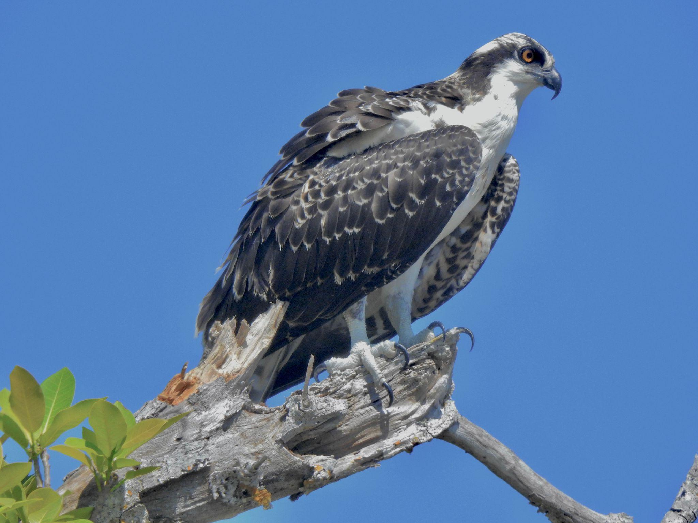
It’s all about the birds!
We monitor to protect what we love….OSPREYS!
They live among us and allow us into their lives.
That is why HOW we monitor matters.

Slide 9
Why We Monitor…
To obtain population data which determines the status of the osprey species
Tp communicate possible violations to “active nests”
To obtain bi-weekly data about developmental milestones
To identifying age-appropriate surrogate nests for orphaned chicks
To make it possible to support enforcement of legal protections for ospreys.
To make a difference! Making “nest success” trends visible to Water Quality decision-makers and regional media outlets educates the public and policy makers alike.

Slide 10
Monitoring is about collecting data.
The accuracy and consistency of observations is critical because the conclusions drawn from the analysis of the data matter!
The role of the monitor is to be “ A Citizen Scientist.” (That doesn’t mean you can’t have fun out there!)
That is why HOW we monitor matters.

Slide 11
The power of the Data
The osprey is a sentinel species. Nest productivity is a key indicator of species health. The data we gather enables us to understand the health the osprey population, and also the heath of the ecosystem we share with them. The notes you take and the data we gather are important parts of the BIG Picture!

Slide 12
What is Osprey Watch?
A Global database for the reporting of osprey breeding success.
The mission of Osprey Watch is to collect information to use to address three of the most pressing issues facing aquatic ecosystems including global climate change, depletion of fish stocks, and environmental contaminants.
The website and database are managed by The Center for Conservation Biology in Williamsburg, VA.
An app for real-time reporting is in progress.

Slide 13
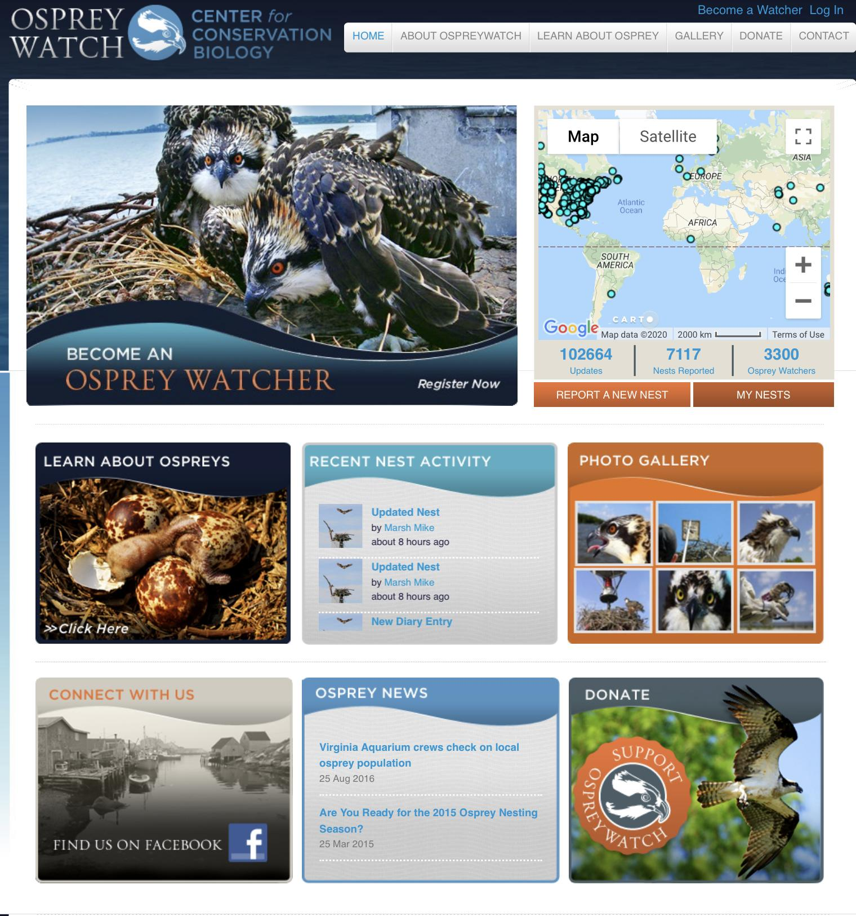
www.osprey-watch.org
Anyone can join!

Slide 14
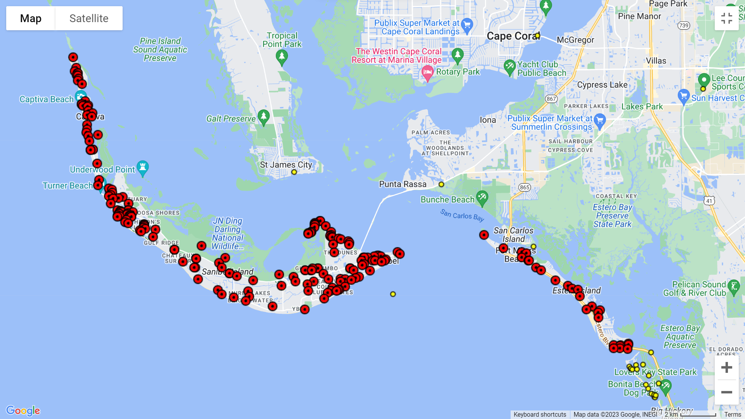
TIOF-monitored nests in Osprey Watch

Slide 15
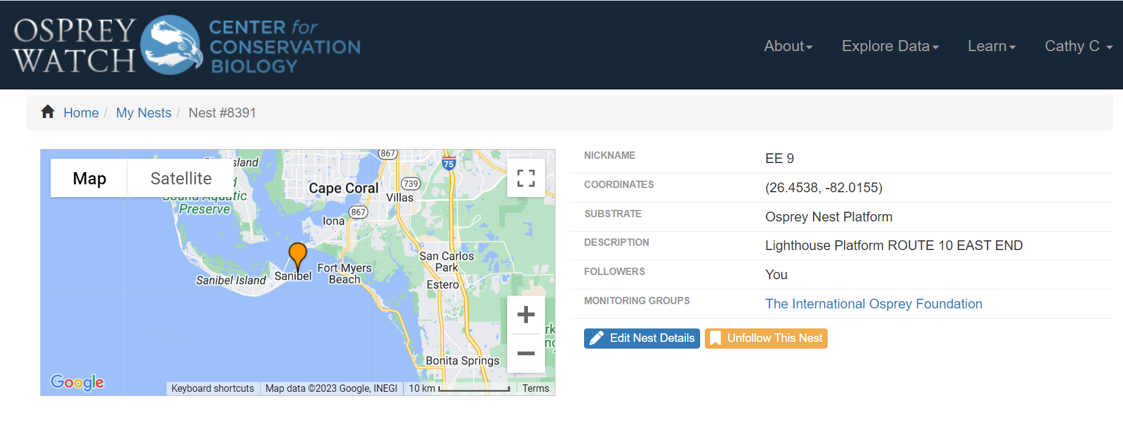
Osprey Watch – Screenshots
GPS coordinates in decimal degrees (not degrees-minutes-seconds)

Slide 16
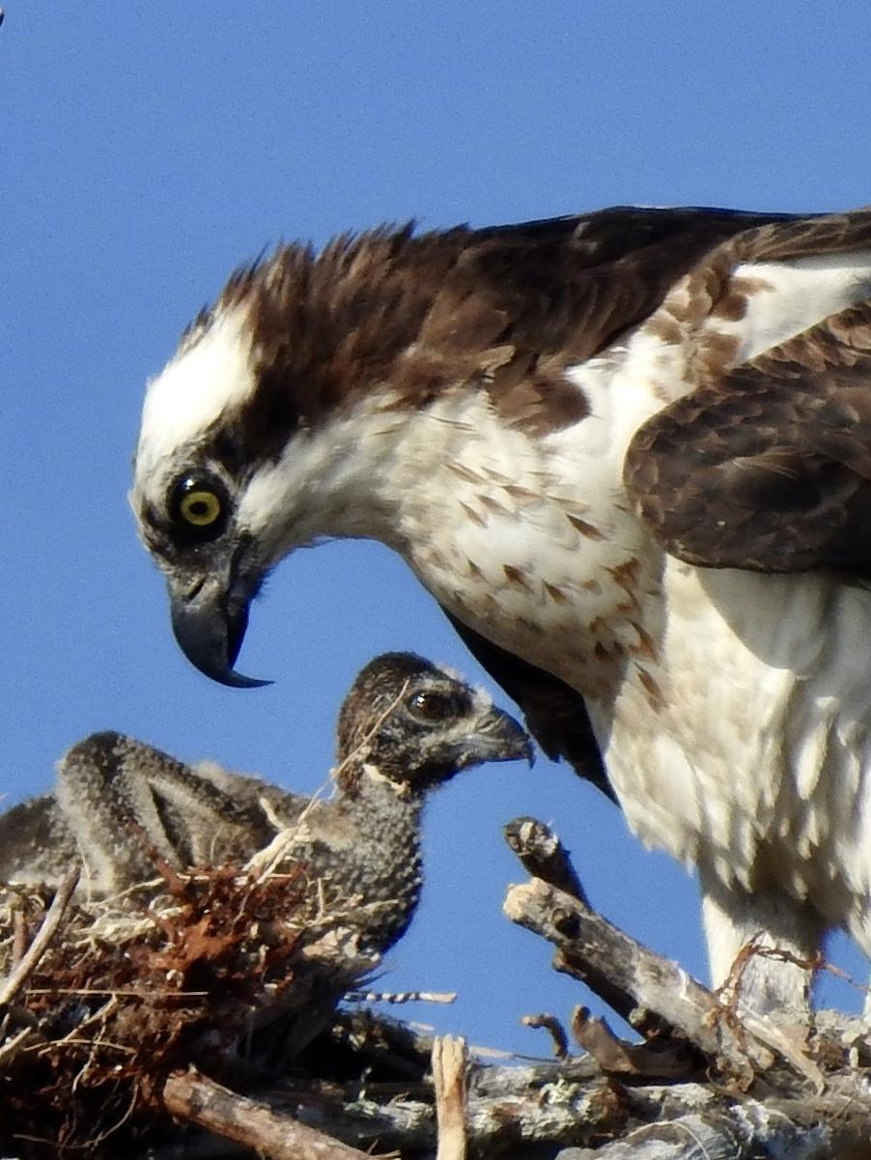
What Data is Required for Osprey Watch?
Milestone events in the breeding chronology of the nest are observed.
Your data is entered on the activity report forms.
That data then will be tabulated for the annual project report and used to calculate breeding statistics.

Slide 17
Osprey Milestones…
Date of pair arrival - Look for 2 adults on the nest.
Date of egg laying - Females will lay 1 - 4 eggs at a rate of one egg every 1 - 2 days. Not typically visible due to height of nests in our area.
Date of incubation initiation - After laying, incubation starts. Look for adults taking turns sitting low in the nest incubating eggs. The incubation period can last 35 - 43 days. (Note date to start looking for chicks.)

Slide 18
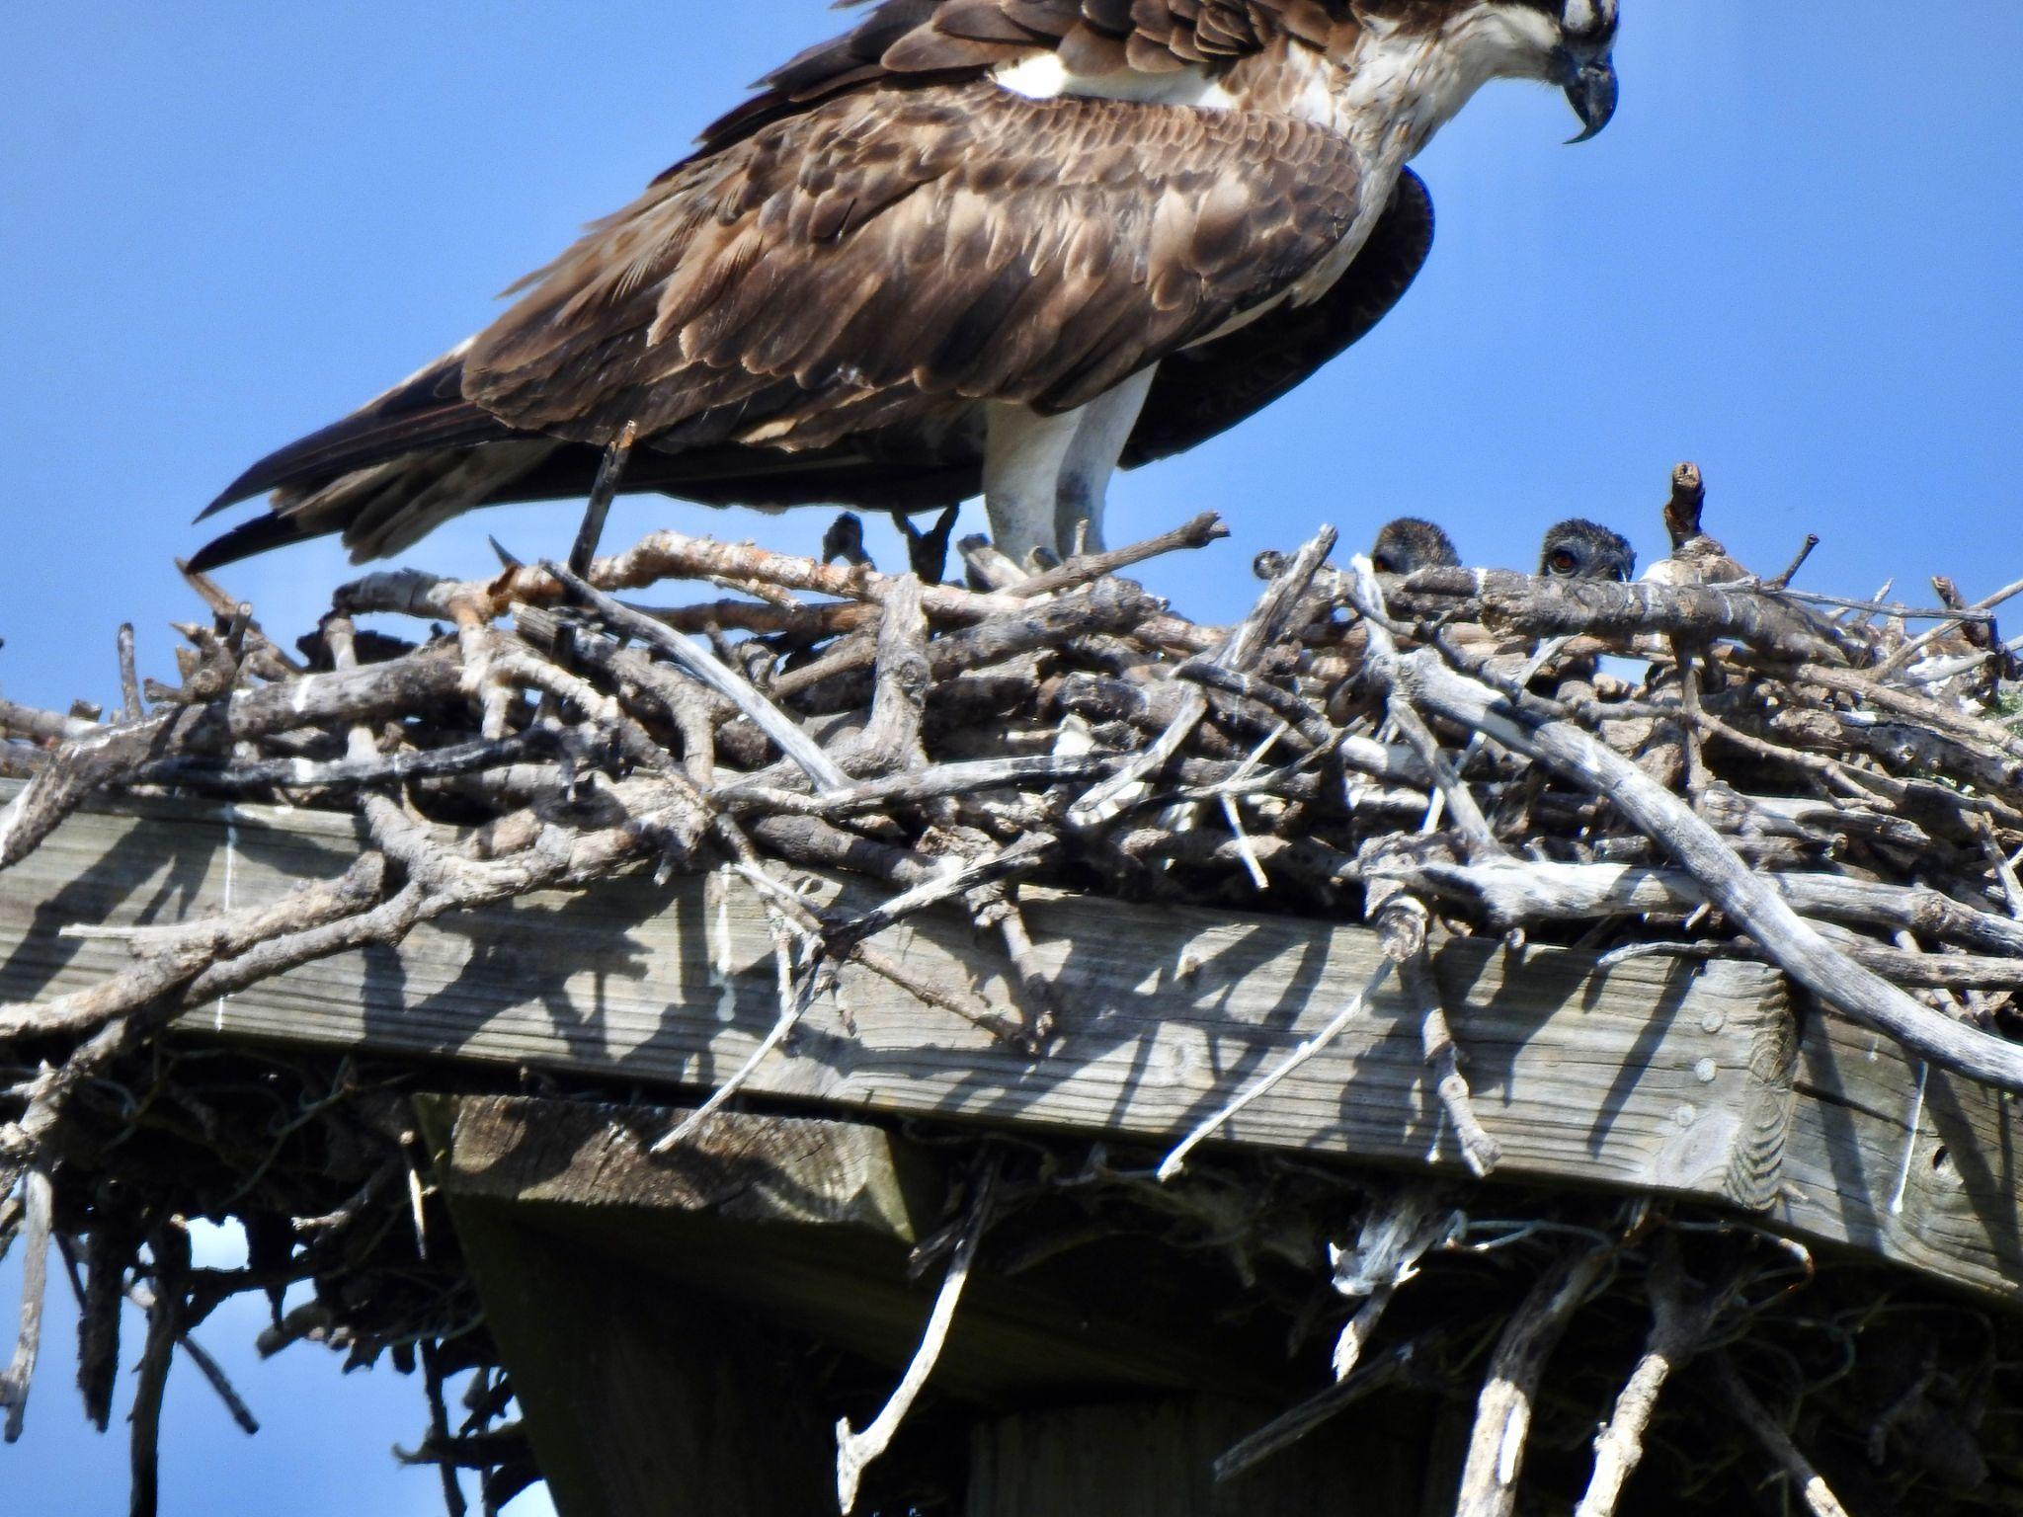
More milestones…
Date of clutch hatching - Look for adults bringing food to the nest and making "head bows" into the center. Chicks typically can't be seen until they are 2 - 3 weeks old, so feeding behavior is the only way to know chicks are there.

Slide 19
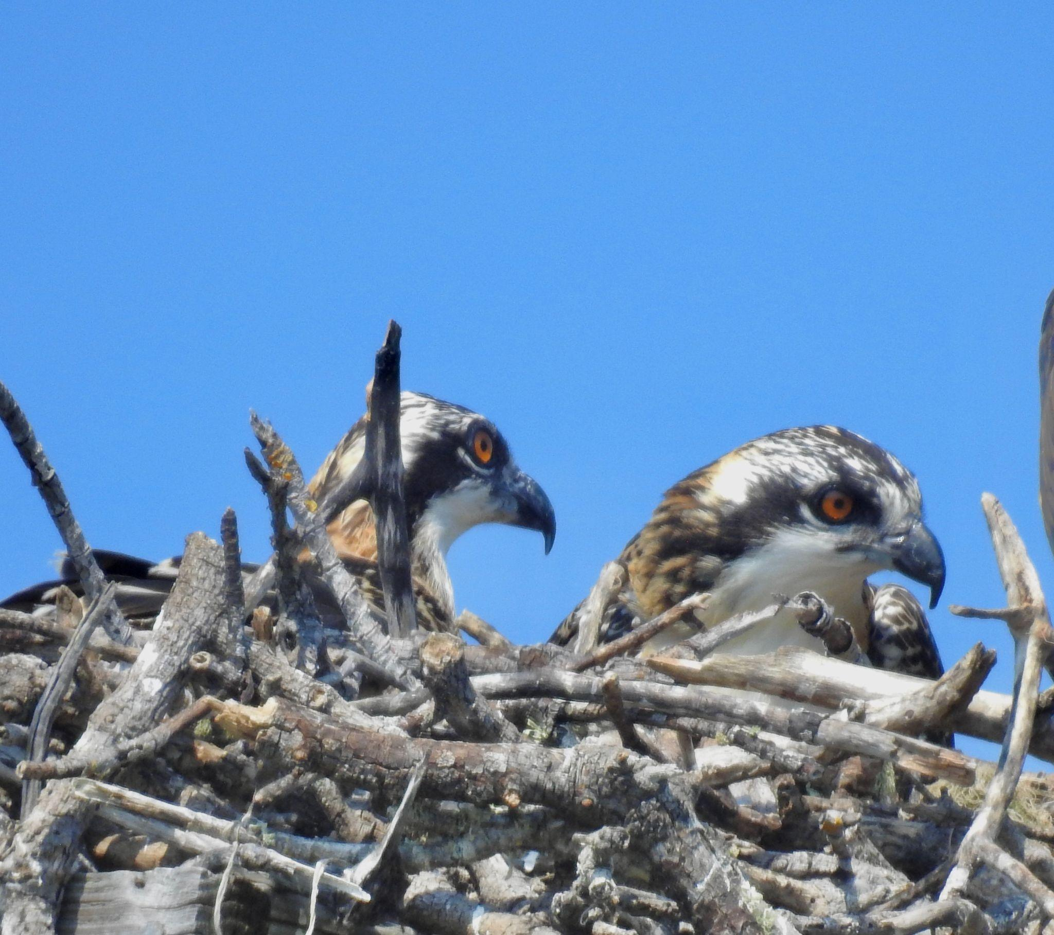
Number of nestlings - Count the number of chicks in the nest before they learn to fly.
Around 4 weeks after hatching, look for the heads of chicks to show over the rim of the nest, particularly when adults bring food to the nest. Other times they lie flat and are harder to see.
More milestones…

Slide 20
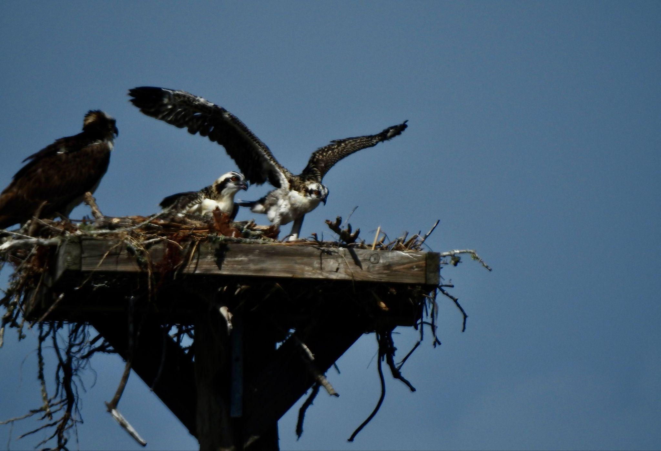
More Milestones…
Number of fledglings - Chicks begin flying around 7 - 8 weeks old and are still fed by the adults. Count the number of chicks who have successfully left the nest fledged (fledged = flying)

Slide 21
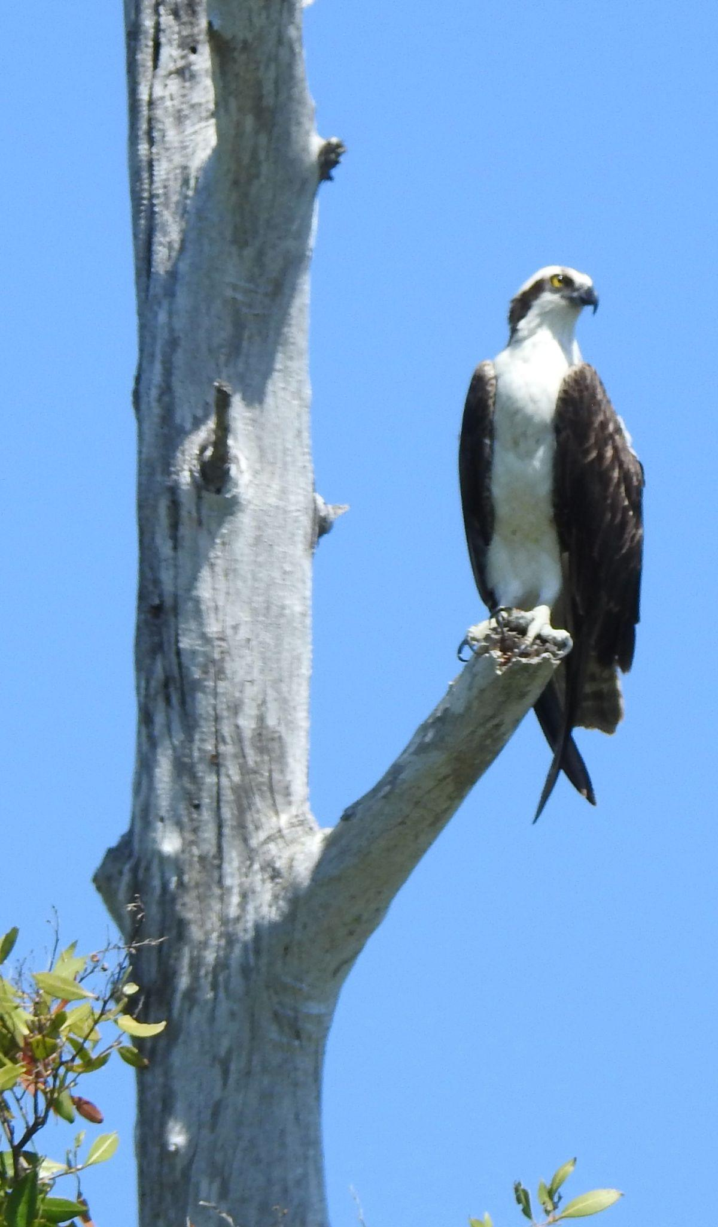
Final milestones…
Date chicks last observed at nest - Record the date that the last chick left the nest. Enter the date when all chicks are gone.
Date of nest failure - Not all nests will fledge chicks. Look for signs of nest failure like adult abandonment, adults no longer incubating eggs or feeding young.

Slide 22
Final milestones…
Date of nest failure - Look for signs of nest failure like adult abandonment, adults no longer incubating eggs or feeding young.
Reason for nest failure- Possible reasons include, egg failure, injury of one of the adults, or loss due to weather or predation.
Additional information - includes photos and nesting diary (additional details of your observations, e.g. vocalizing, mating, feeding, exercising of wings).

Slide 23
How we monitor …OBSERVATION
Timing & Responsibilities
Nest monitors should visit their nests every two weeks in season until chicks are suspected and/or sited. After chicks are present a minimum frequency is weekly.
Nest monitors should record their observations on the data sheets provided or on SURVEY 123, the program SCCF is introducing. All data sheets need to be turned in at the end of season. Weather, nest conditions and anecdotal information gathered is very helpful during analysis.

Slide 24
OBSERVATION: Timing & Responsibilities
CONTINUED
Nest monitors should :
Spend a minimum of 5-10 minutes at a nest site in order to maximize the chance of observing varying behaviors.
Take accurate and informative notes as to what they observe. Whenever possible, create an anecdotal record that includes gender of birds seen, the location of birds, vocalizing, and mating or feeding behaviors, any signs of predation or other problems.

Slide 25
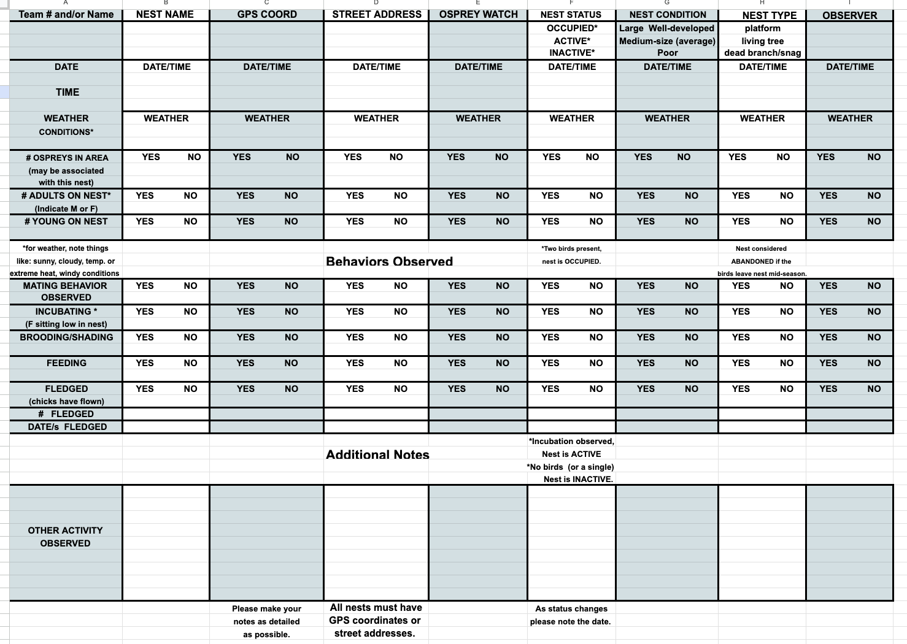

Slide 26

Submit your observations online!
Survey123… it’s easy as 123!
Let’s try it!

Slide 27
Communication throughout the season
Send an email after you have completed your monitoring for the week to SCCFOspreys@gmail.com
Include major observations and amount of time spent monitoring.
Ex: Hello, I have completed my route for Team 1 for the week and observed two occupied nests and one nest where birds displayed incubation behavior. I spent 1 hour on my route.
If you find any new nests, send details in your email report.
email We will send monthly updates to all volunteers to keep everyone updated on the seasons progression

Slide 28
Current issues with previously submitted data
For all nests (at start of season), we need a status report.
Nest type, (natural snag, platform, chimney/roof nest, utility pole)
Condition of nest (size and quality need to be noted, eg. large well-developed, or not much nesting material)
Status of nest (abandoned, occupied, active) This may change throughout season and changes should be noted and dated.

Slide 29
Current issues with submitted data continued
All data sheets need to be submitted at the end of season, not just summary reports & numbers.
Problem: Without the full data sheets, some information can’t be entered into Osprey Watch
Problem : Some data sheets have not been submitted at all for nests without chicks and some have only reported fledgling totals by phone and other key data is missing.
Problem : Some monitors failed to submit any data sheets for some of their nests for years.

Slide 30
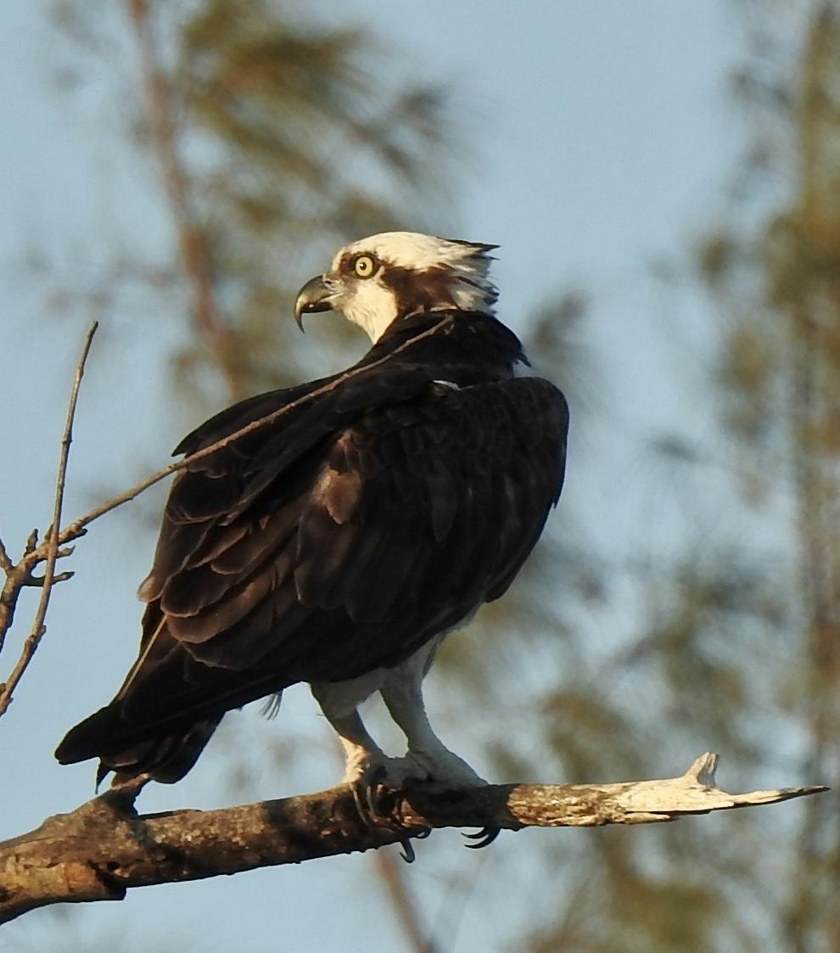
Current issues with submitted data continued
Data sheets have been lacking in details needed to render judgements about osprey welfare.
Examples of “Lack of detail” for birds in our area:
What is the osprey doing? Is the bird on a nearby branch or flying high in the sky?
This information is needed to show that the bird is associated with the nest being monitored (We need to show that 2 birds are at the nest for it to be considered occupied.

Slide 31
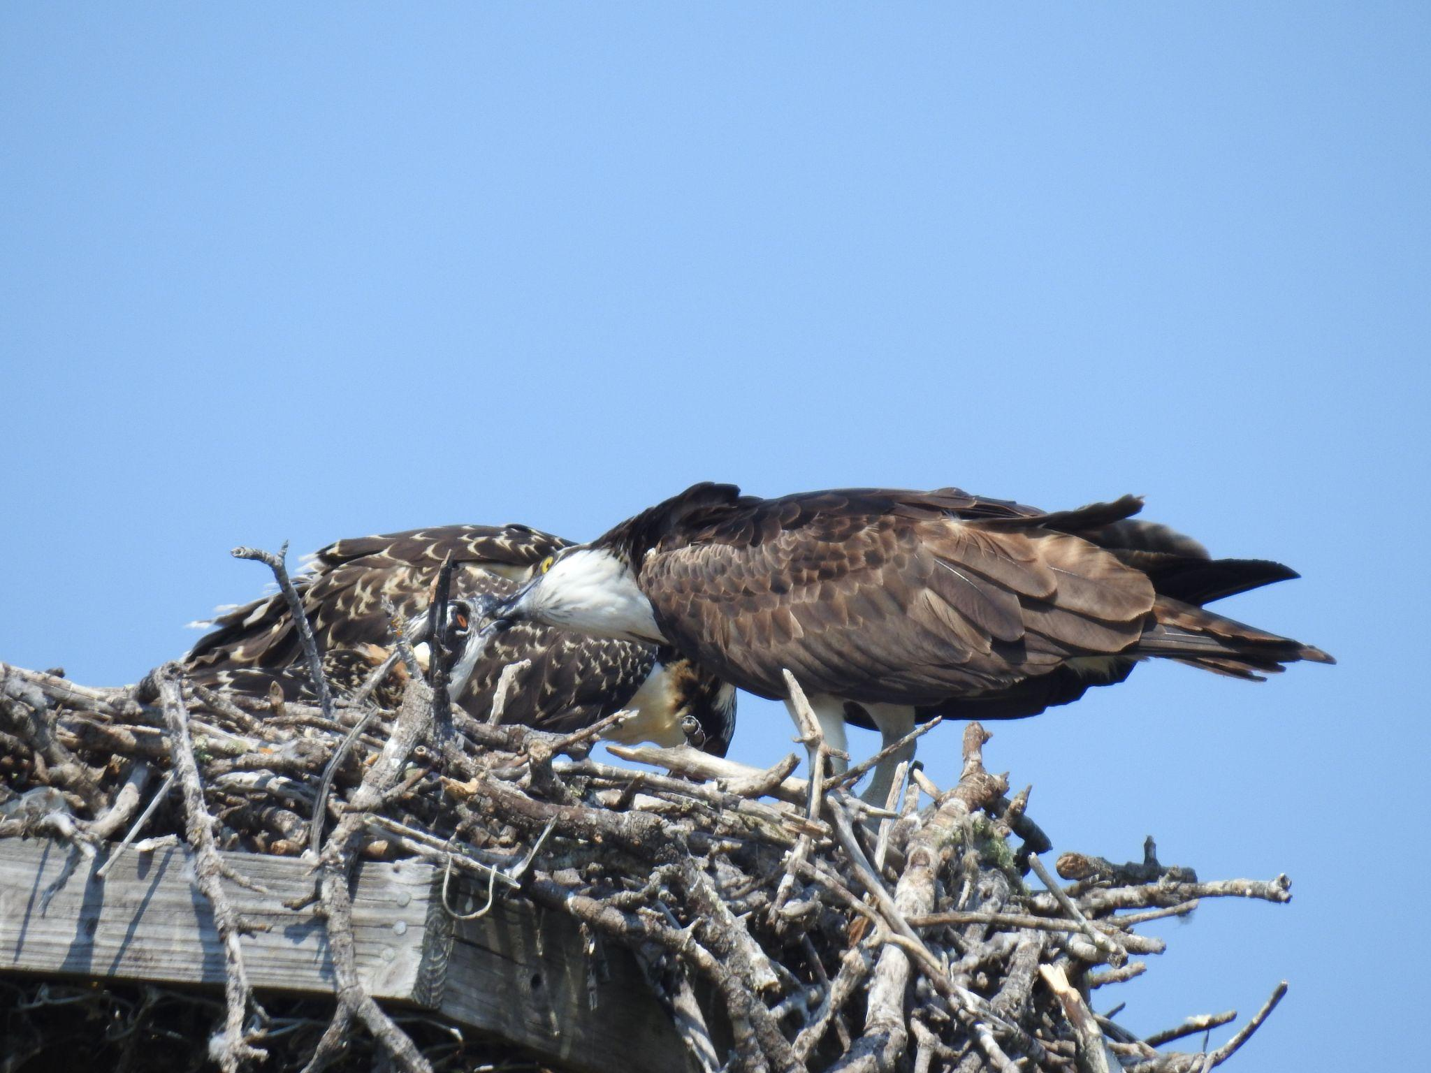
Current issues with submitted data continued
Fledgling information is the most important!
Monitors need to be able to differentiate between adults and chicks. (Adults and nestlings are often the same size in spring. )
Please ask for assistance if you need help with this.

Slide 32
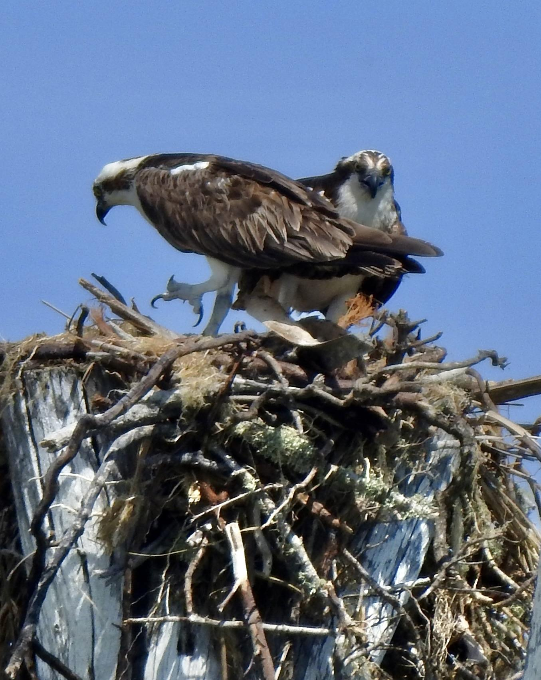
Current issues with submitted data continued
Data needs to be specific & definitive. Please don’t put a “?” for “Fledged information.”
Provide whatever information that you have, e.g. date last seen. (If you have reason to think it did not fledge/survive (e.g.– noticing if the chick healthy or sickly) note that in your observations.

Slide 33
Current issues with submitted data continued
Fledging: If you observe a chick at the nest one day and then it’s not present at the next visit, you need to confirm whether the chick fledged or died by returning again in the near future to verify.
Go back to the nest on the same day (or soon after) to make sure that the chick is still alive.(Fledglings rarely go far and will return to the nest.)

Slide 34
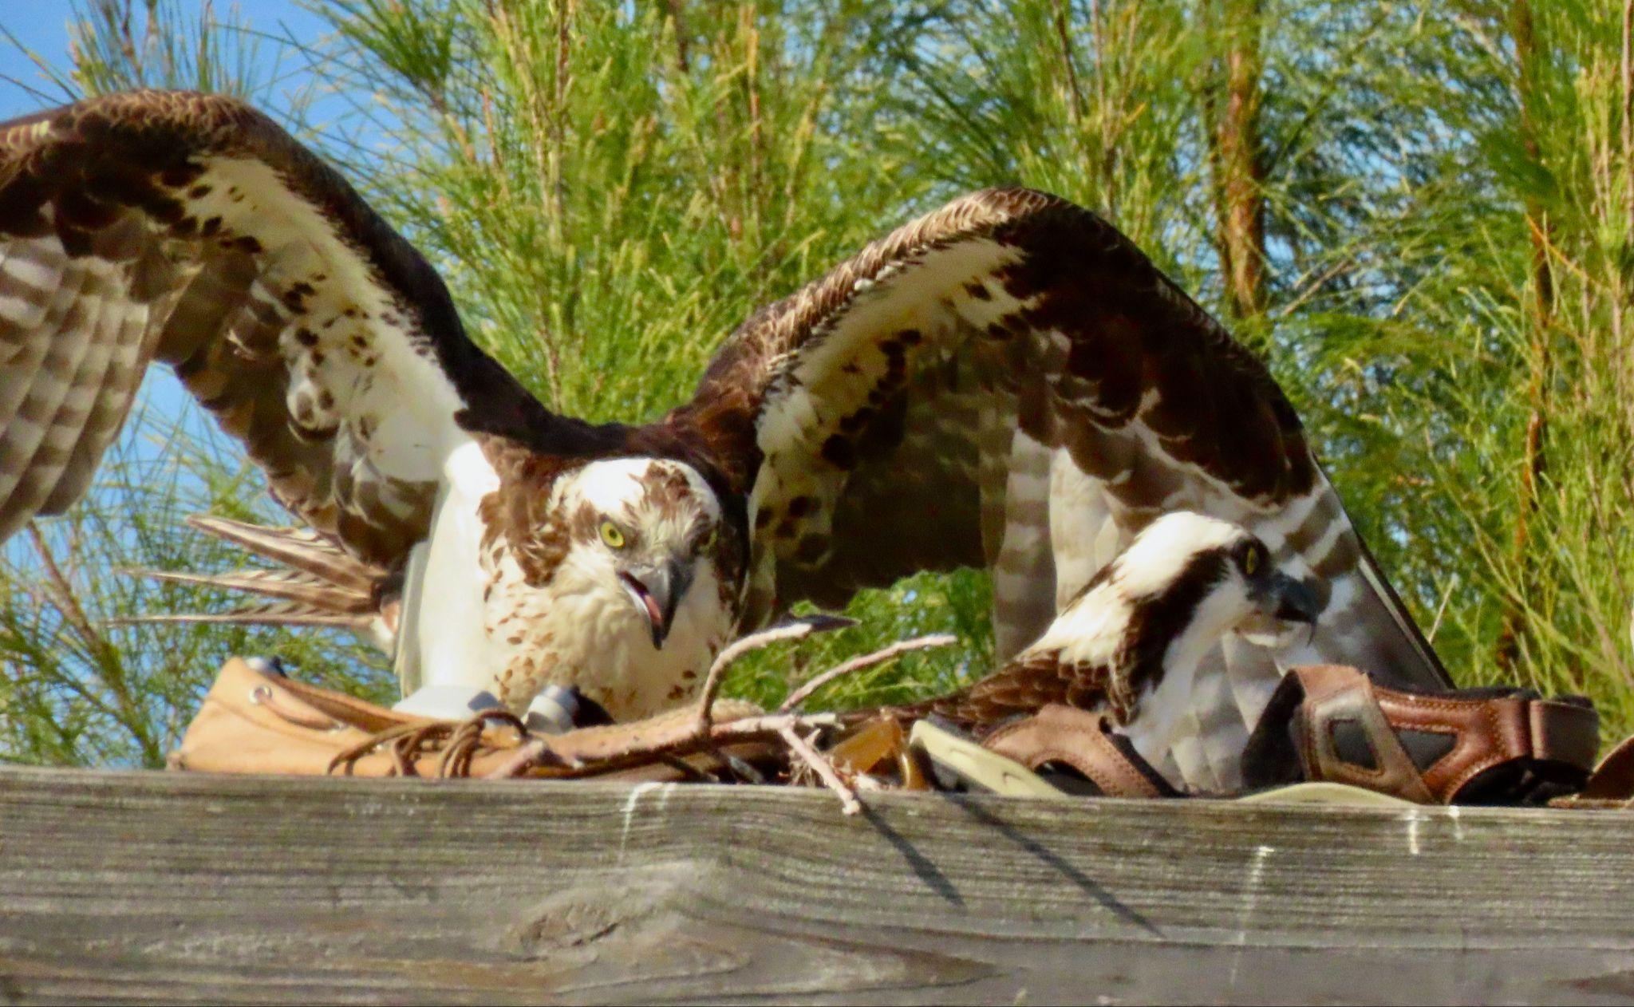
Current issues with submitted data continued
End of season reporting is crucial.
If you are unable to monitor at end of season, let the nest monitor coordinator know so someone can be assigned to obtain the data. Turn over your data sheets at that time to the coordinator so the new monitor can continue the notes.

Slide 35
What do we do with Nest Monitor Data?
Enter it into the Osprey Watch database
Calculate for end-of-season nesting success, & reports in the newsletter and compares it to historical data
Report information to the City of Sanibel
Identify Research needs & purposes
It’s important to know historically-active nests to provide information to research partners for potential research

Slide 36

What did the
Nest Monitor see?

Slide 37
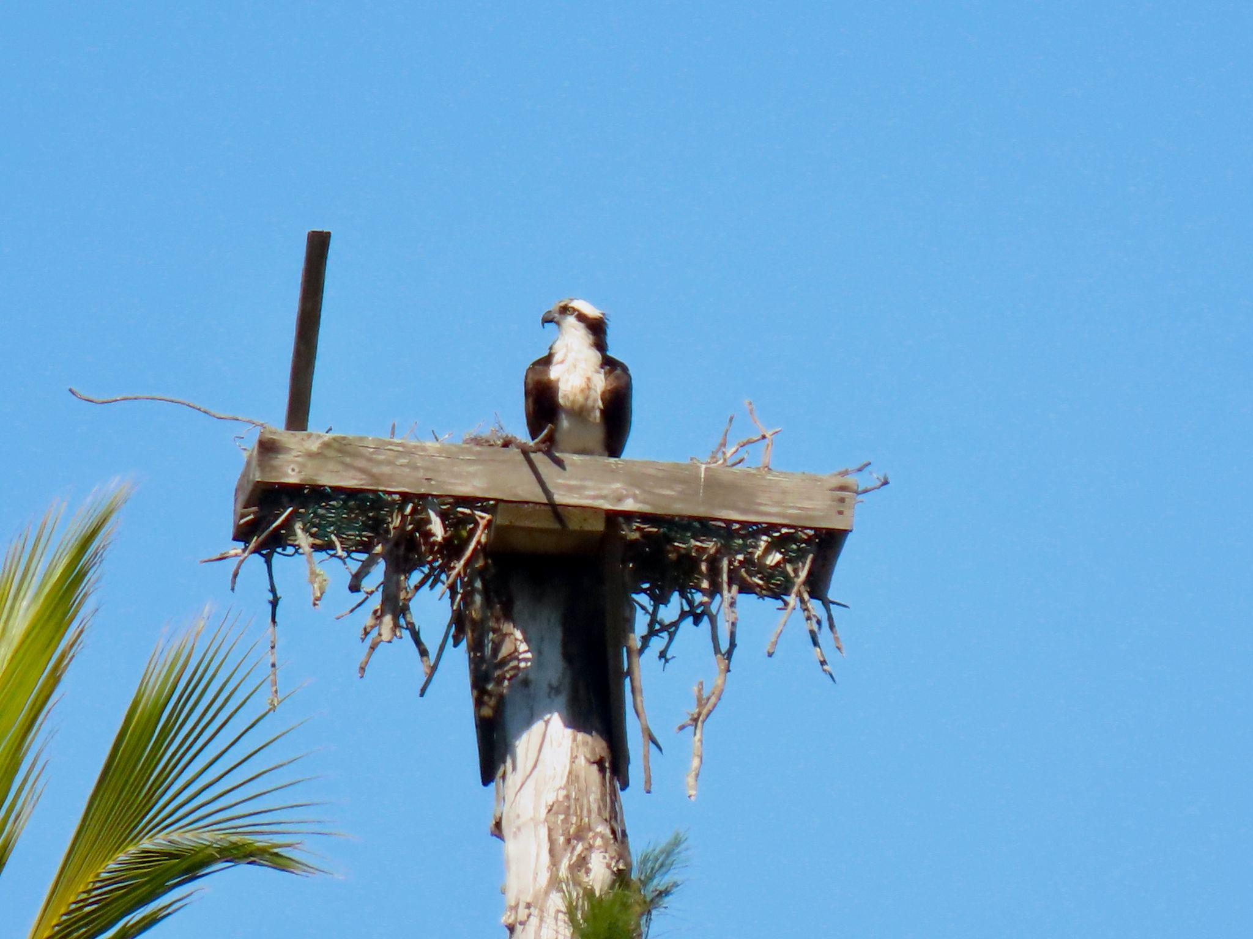
Nesting season begins with the return of the birds.
What monitoring information does this photo tell you ?

Slide 38
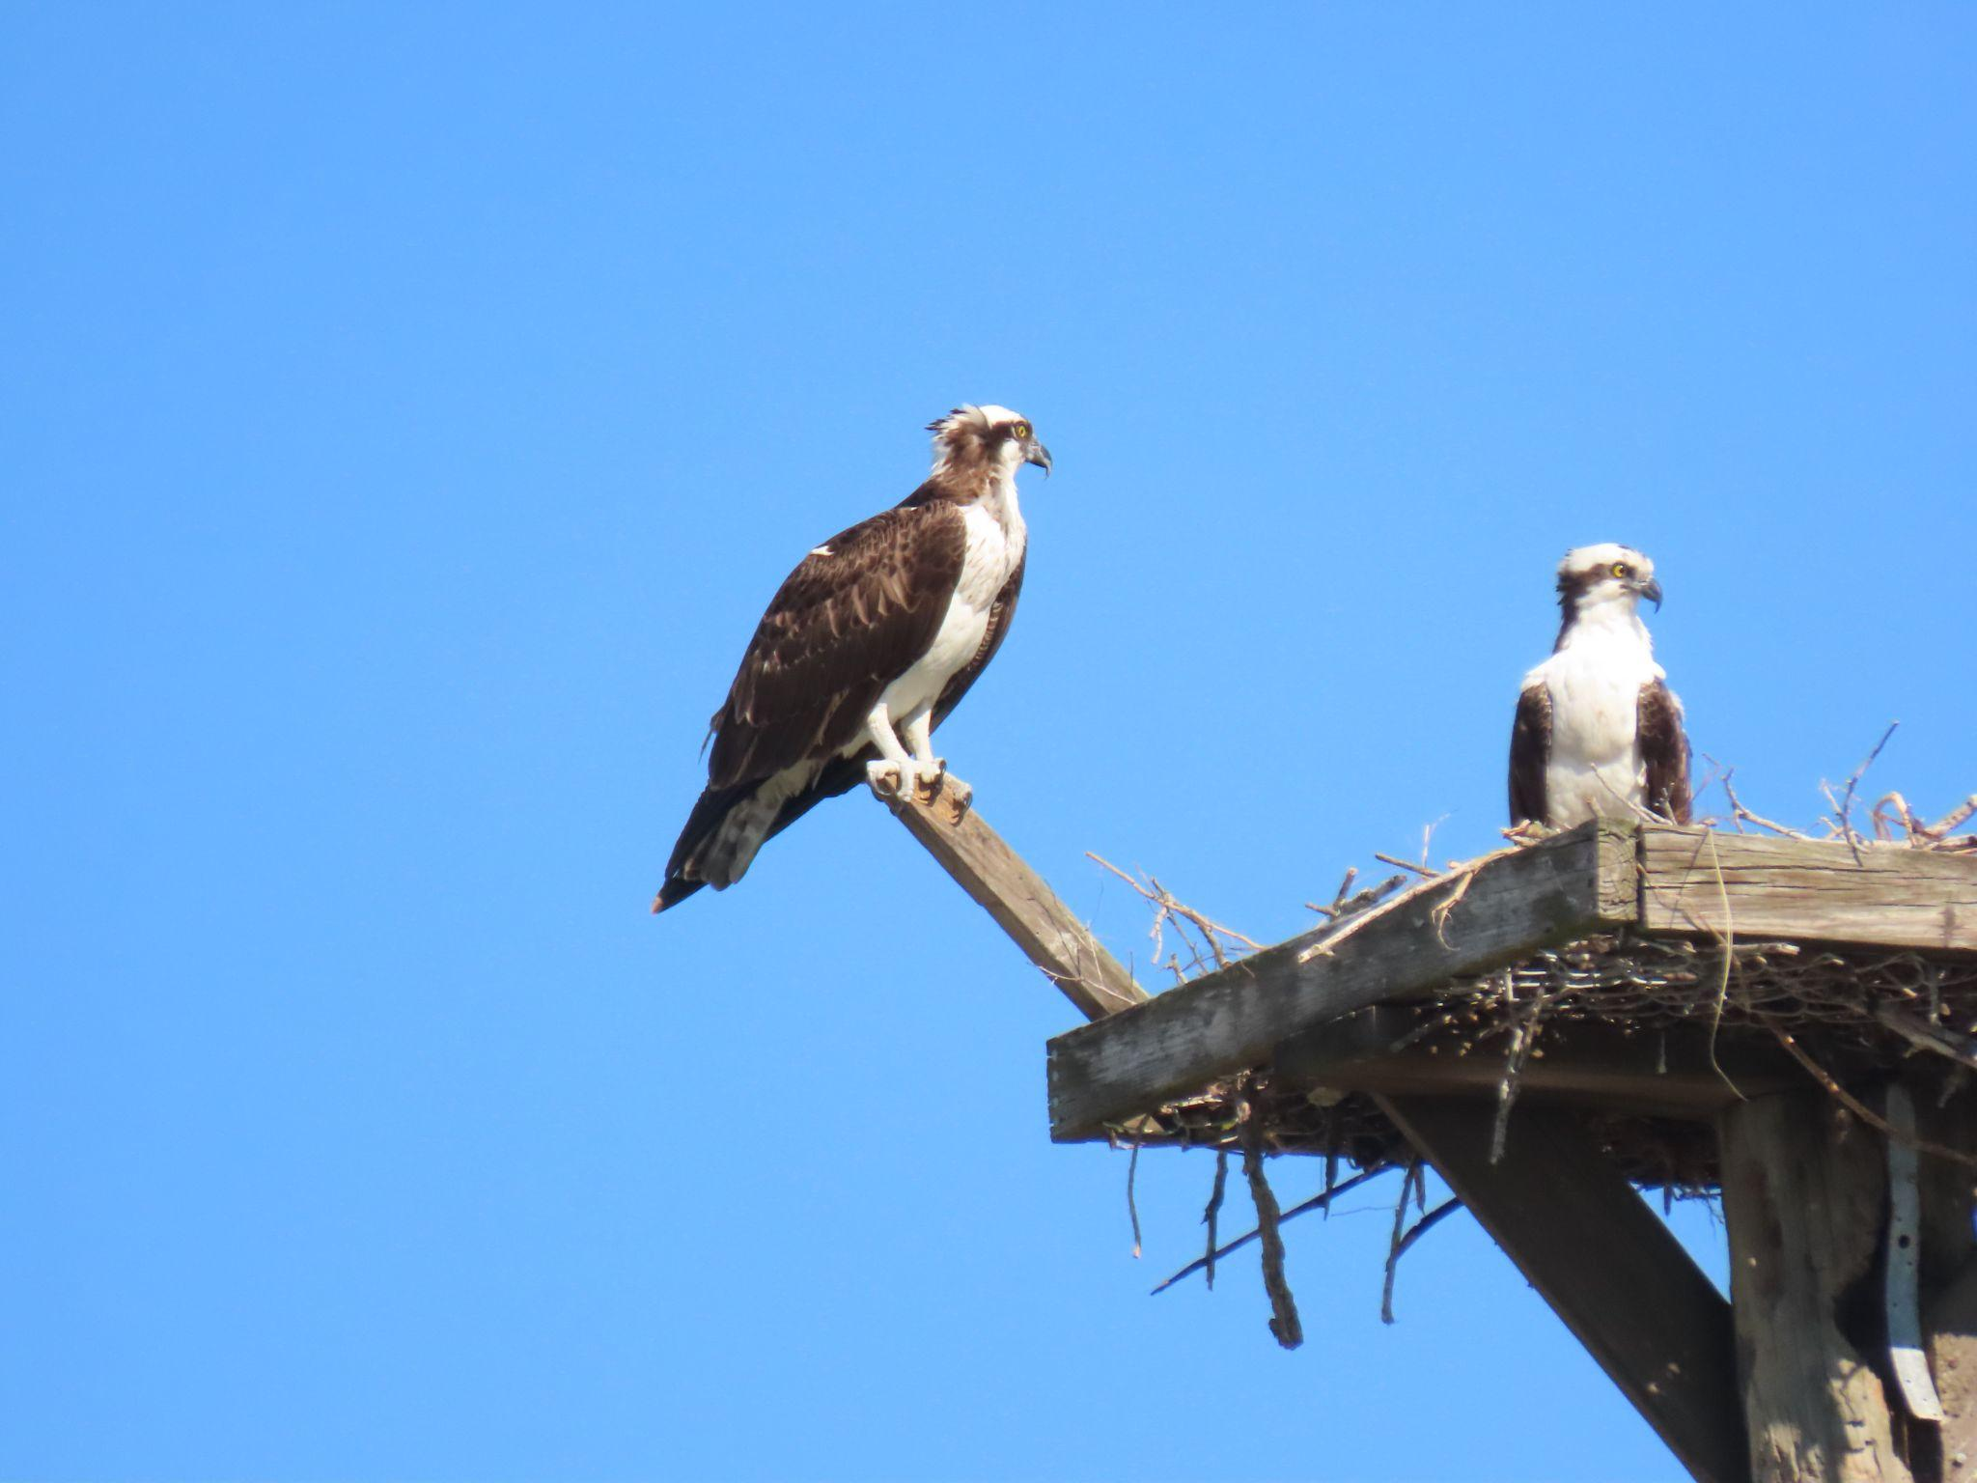
What does this photo
tell you ?

Slide 39
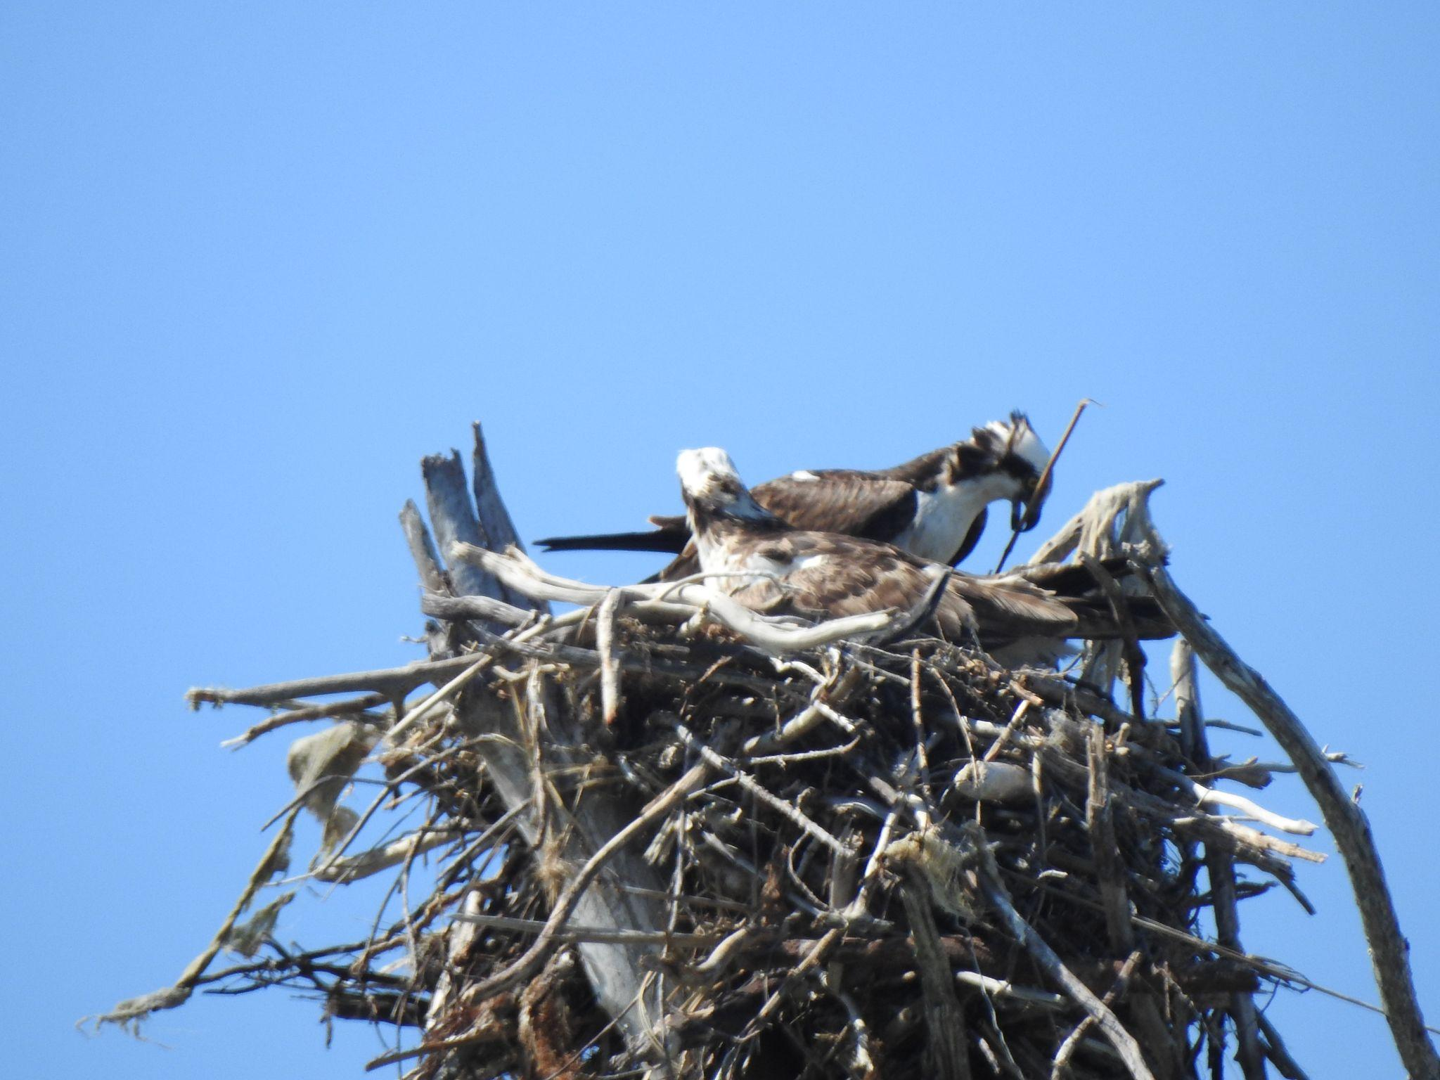
What monitoring information does this photo tell you?

Slide 40
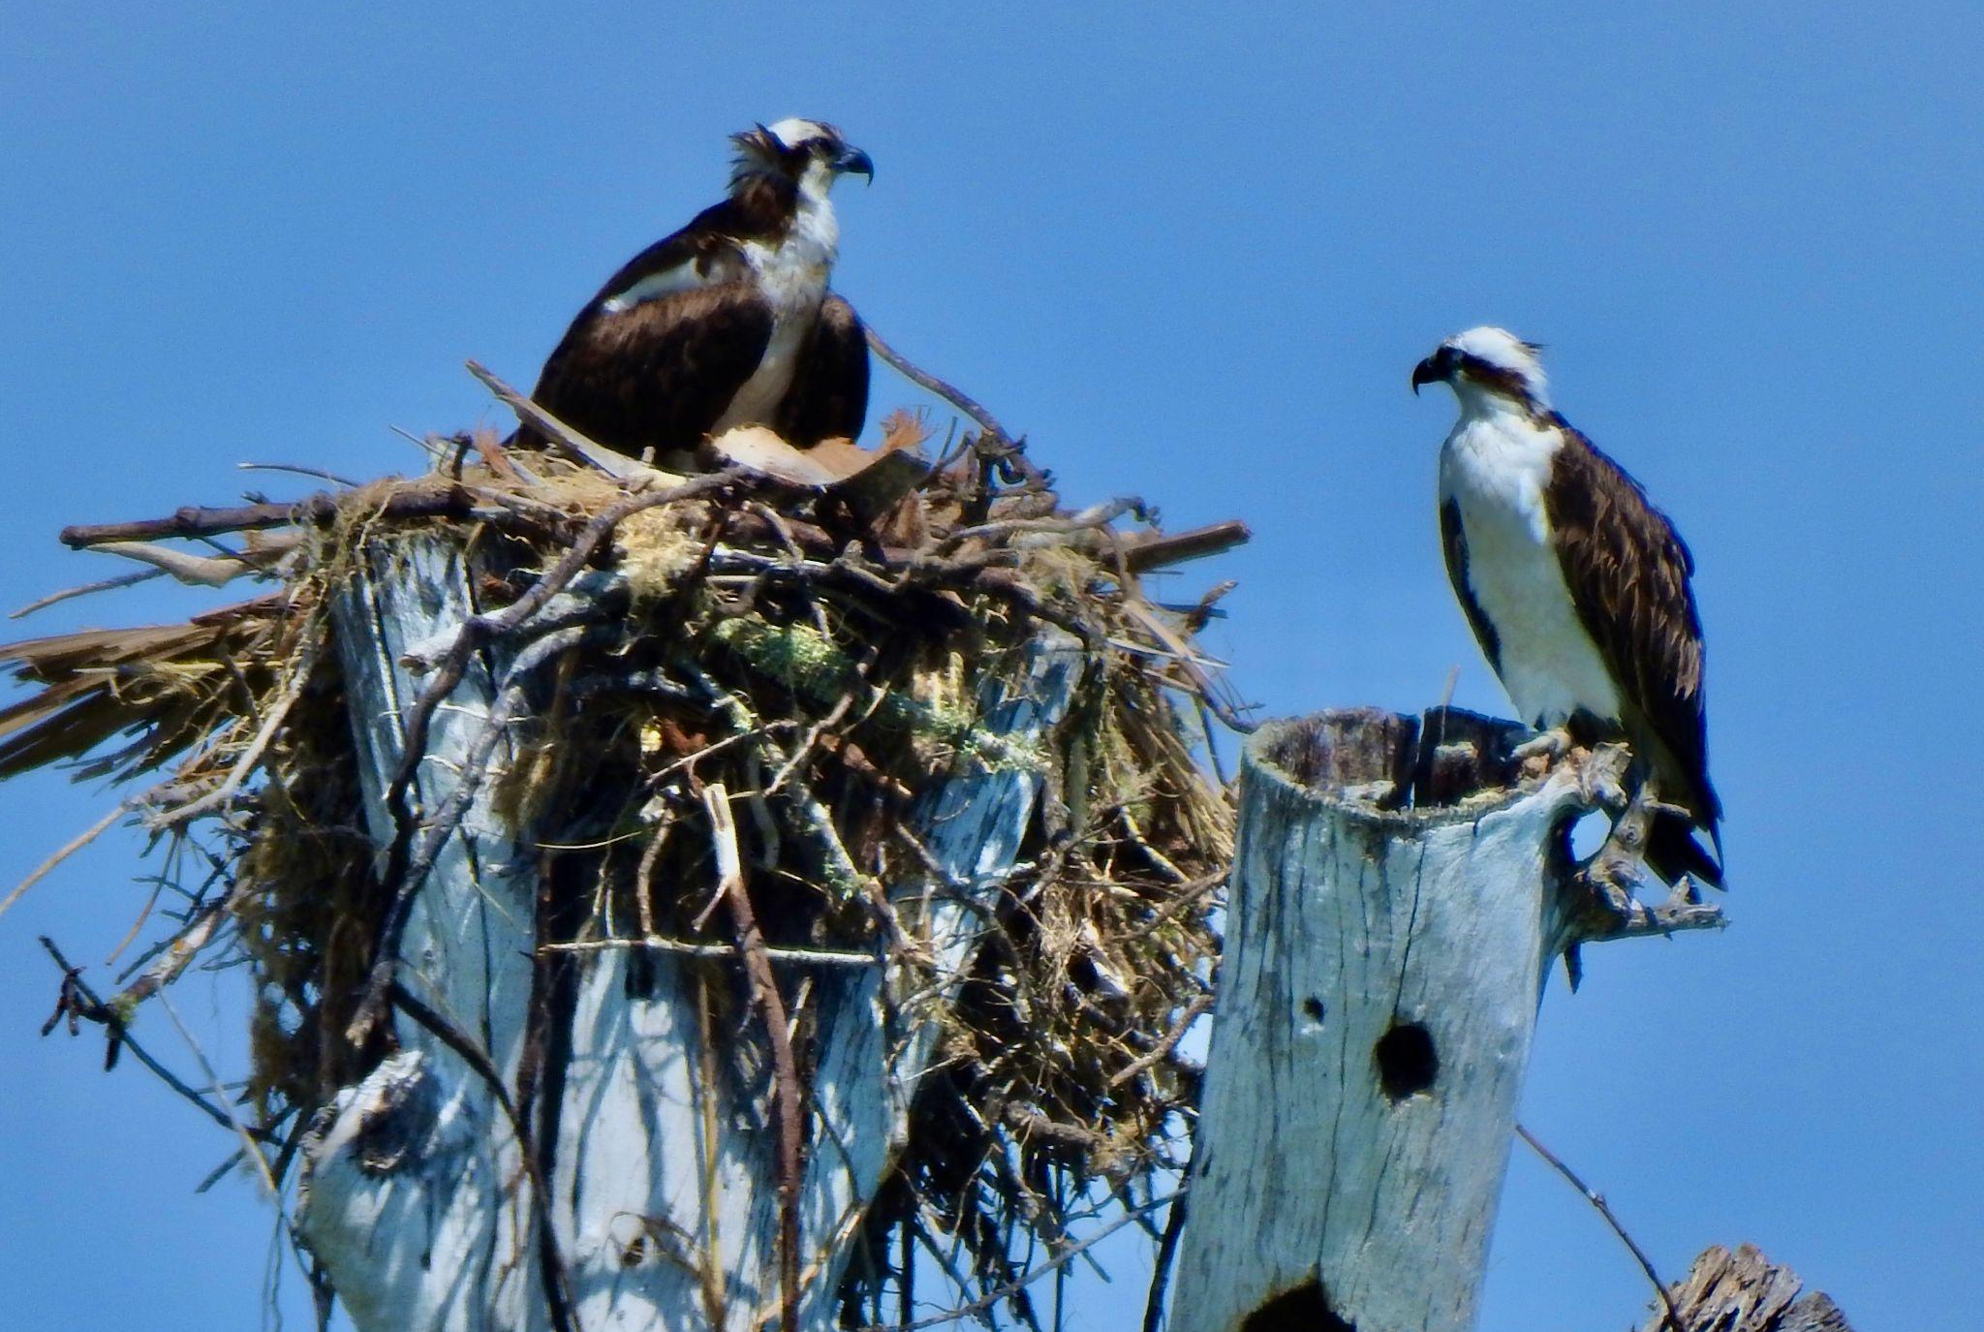
What does this photo
tell you ?

Slide 41
Is this nest…
New?
Active?
Occupied?
All of the
Above?

Slide 42
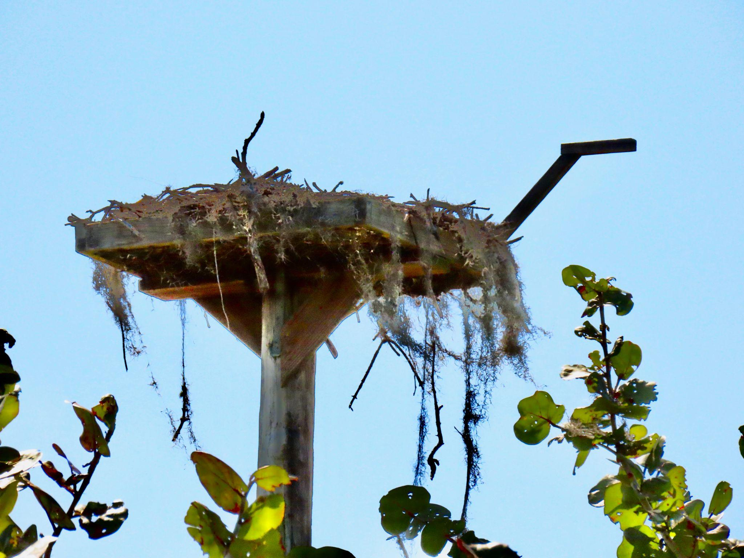
What does this photo
tell you ?

Slide 43
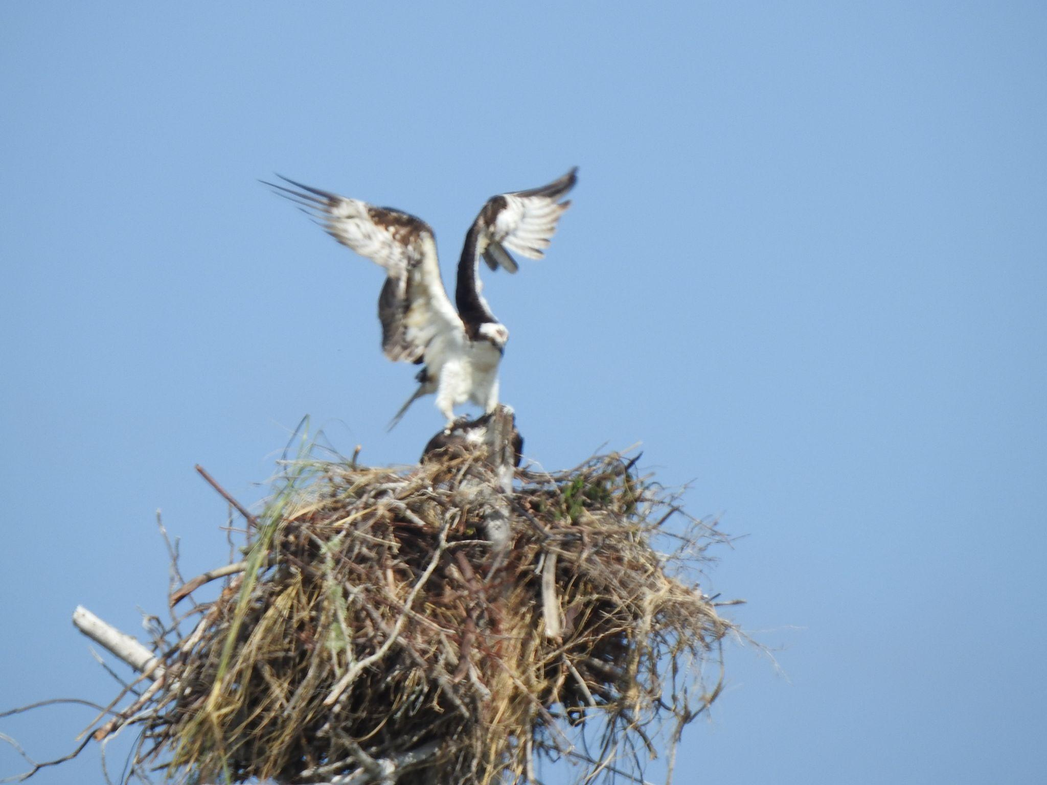
If you are very lucky, you will get to see this:

Slide 44
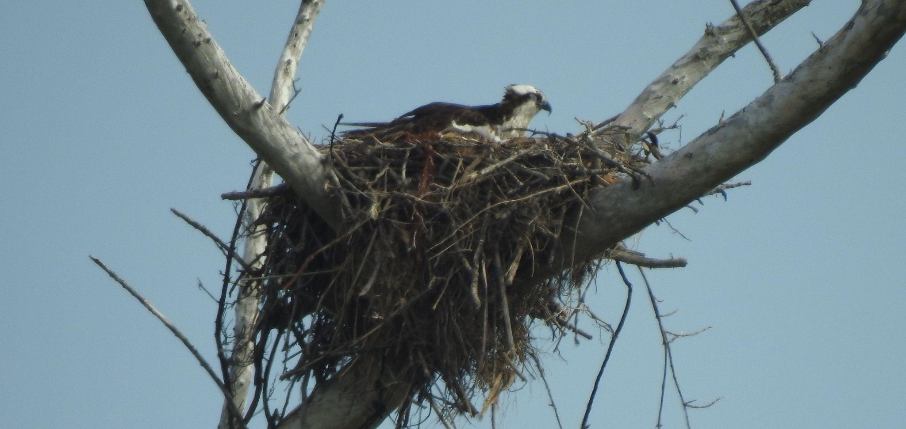
This photo contains key information. What is it?

Slide 45
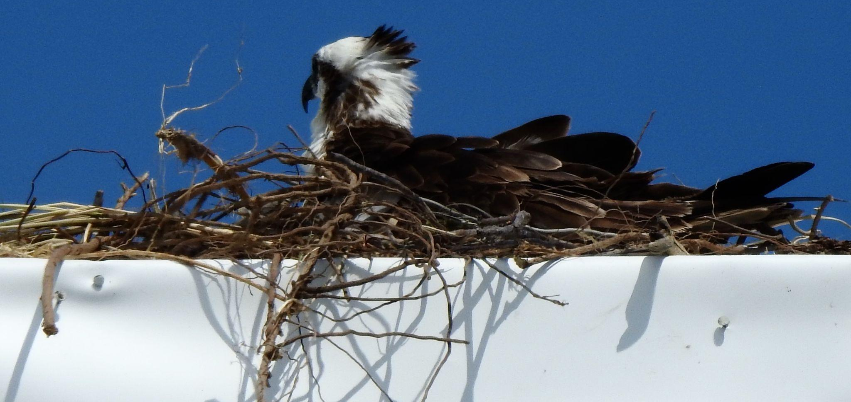
This photo contains key information. What is it?

Slide 46
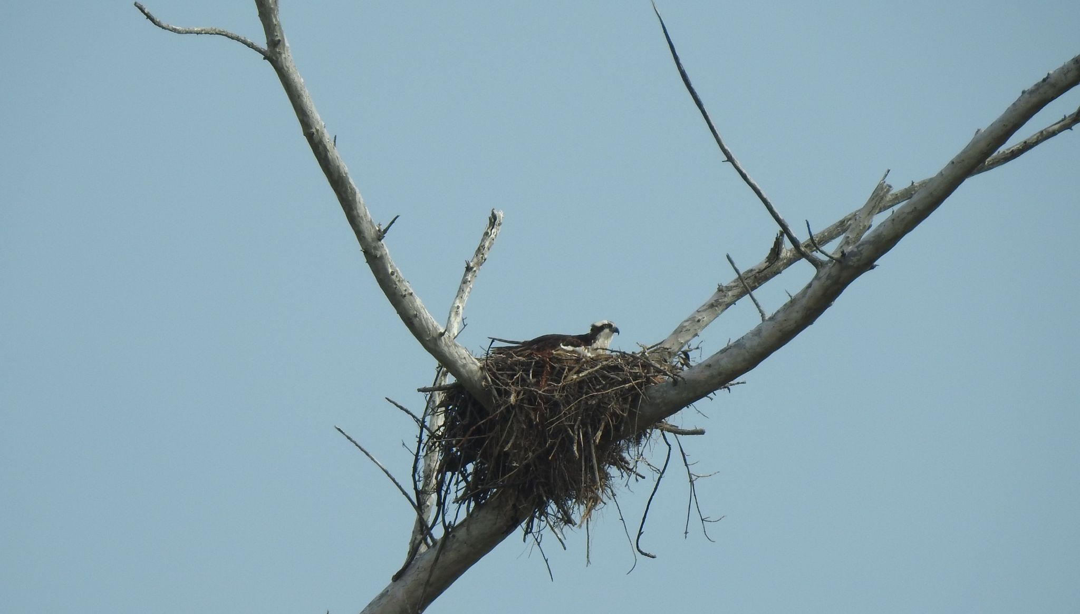
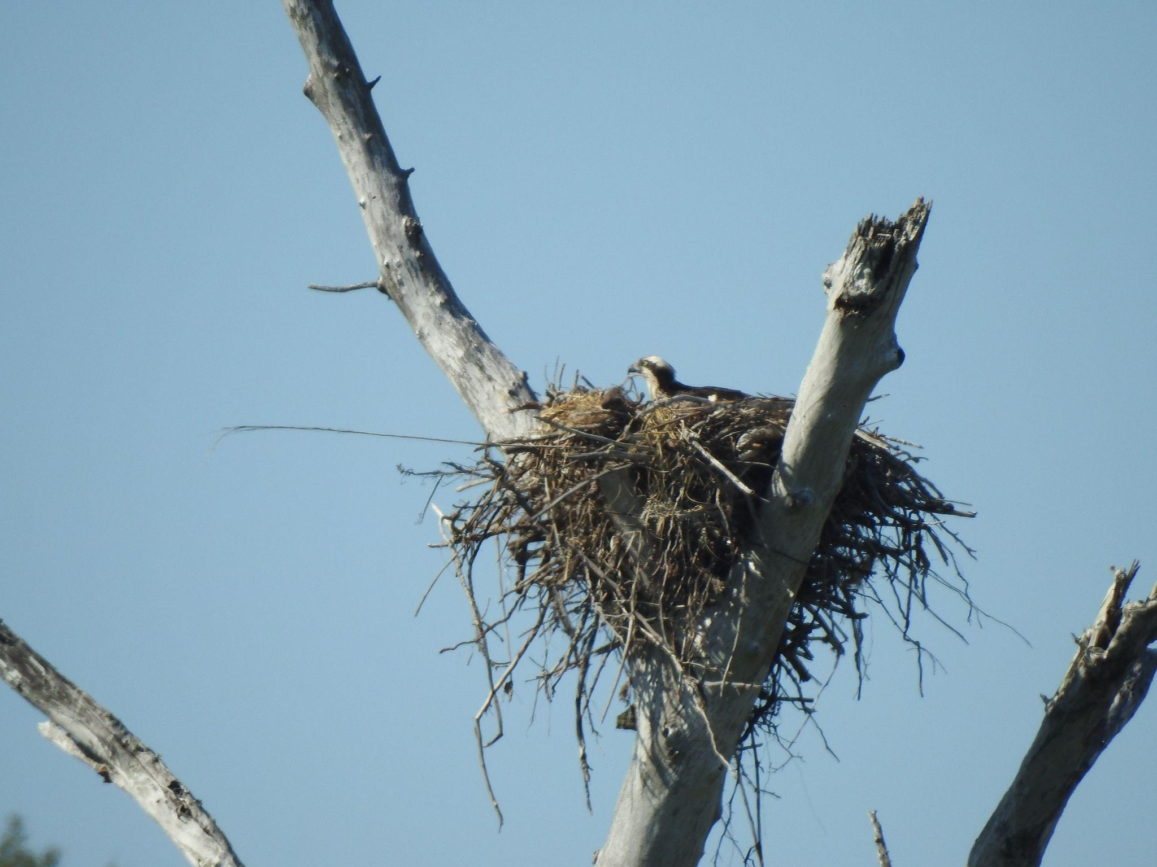

Slide 47
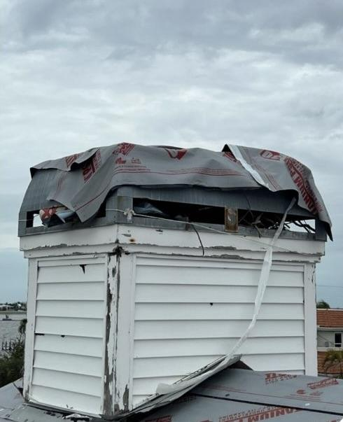
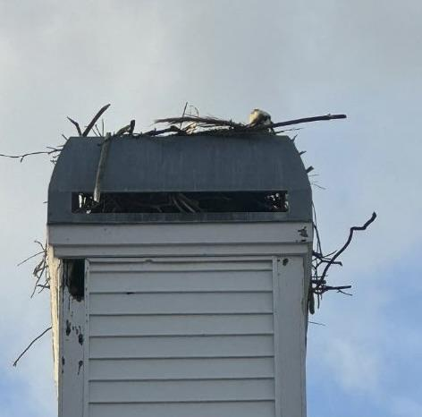
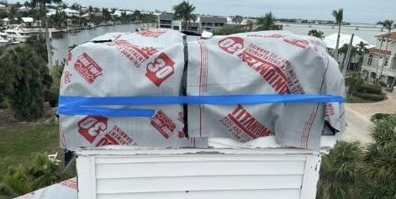
Ospreys nest everywhere.

Slide 48
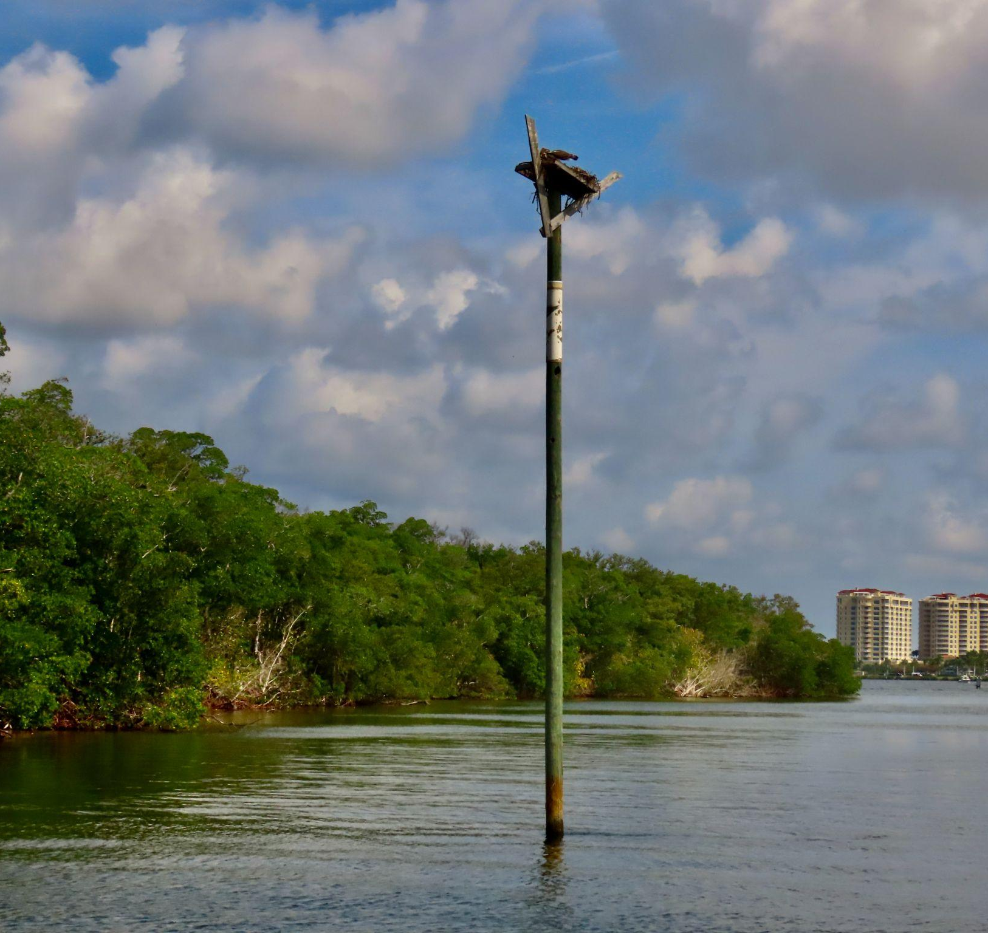
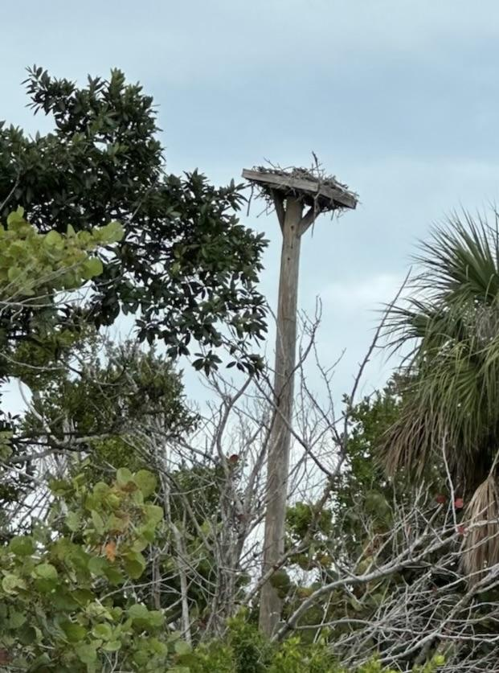
Same problem??

Slide 49
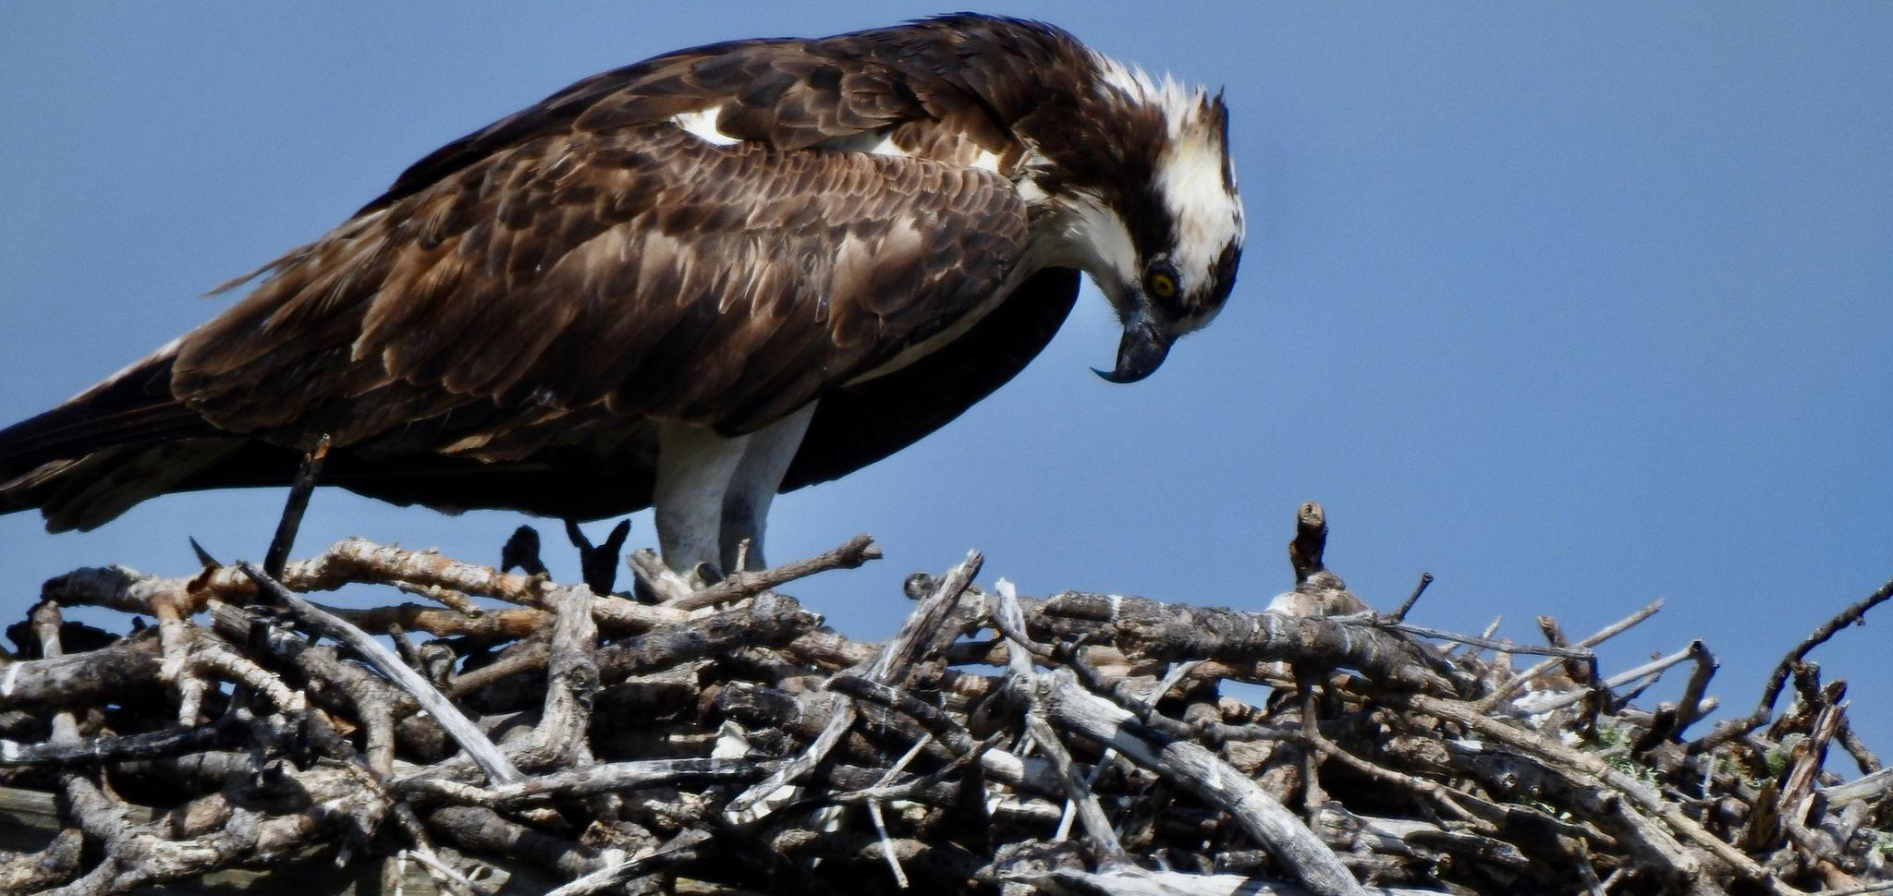
This photo contains key information. What is it?

Slide 50
What do you see ?

Slide 51
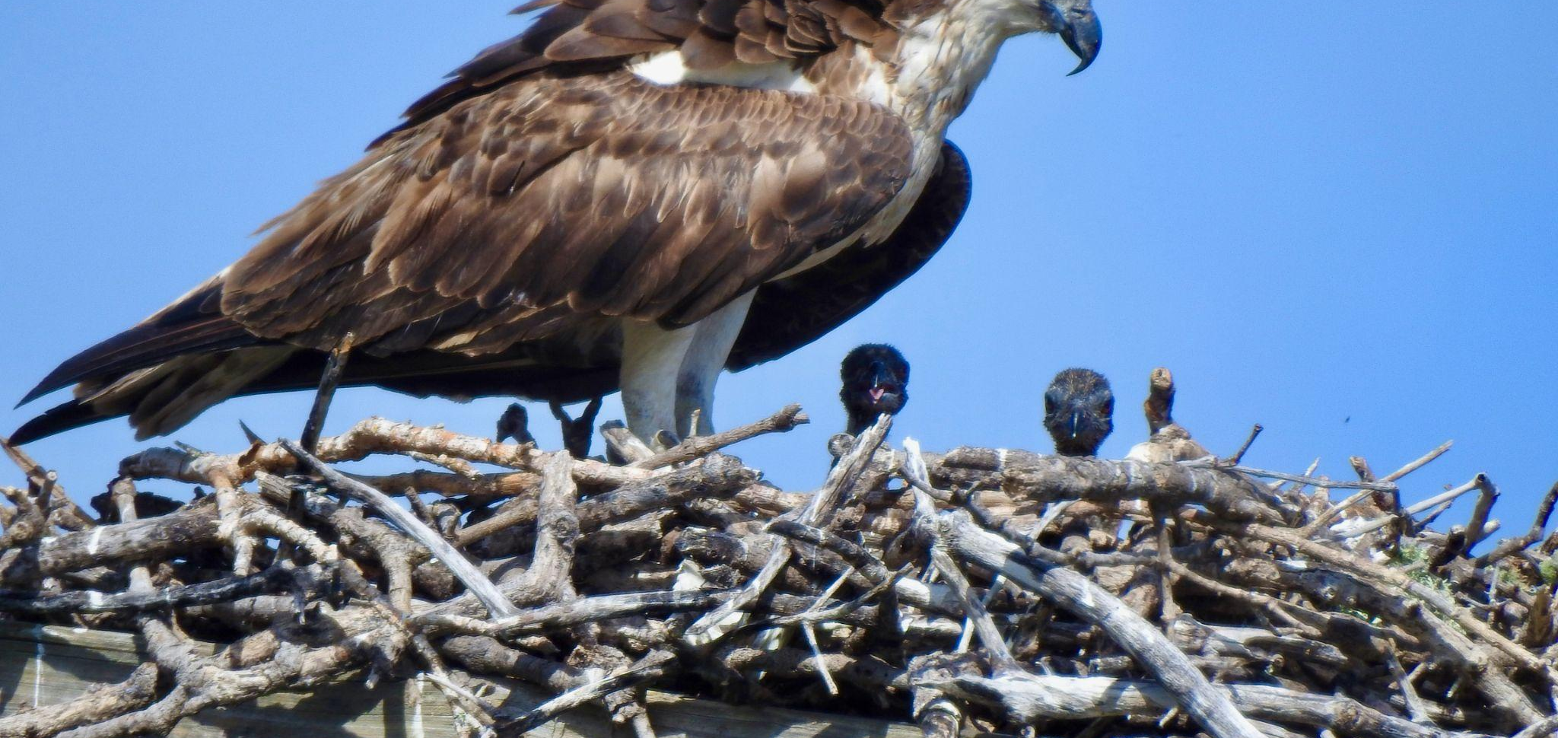
The first time you see a hatchling is very special.

Slide 52
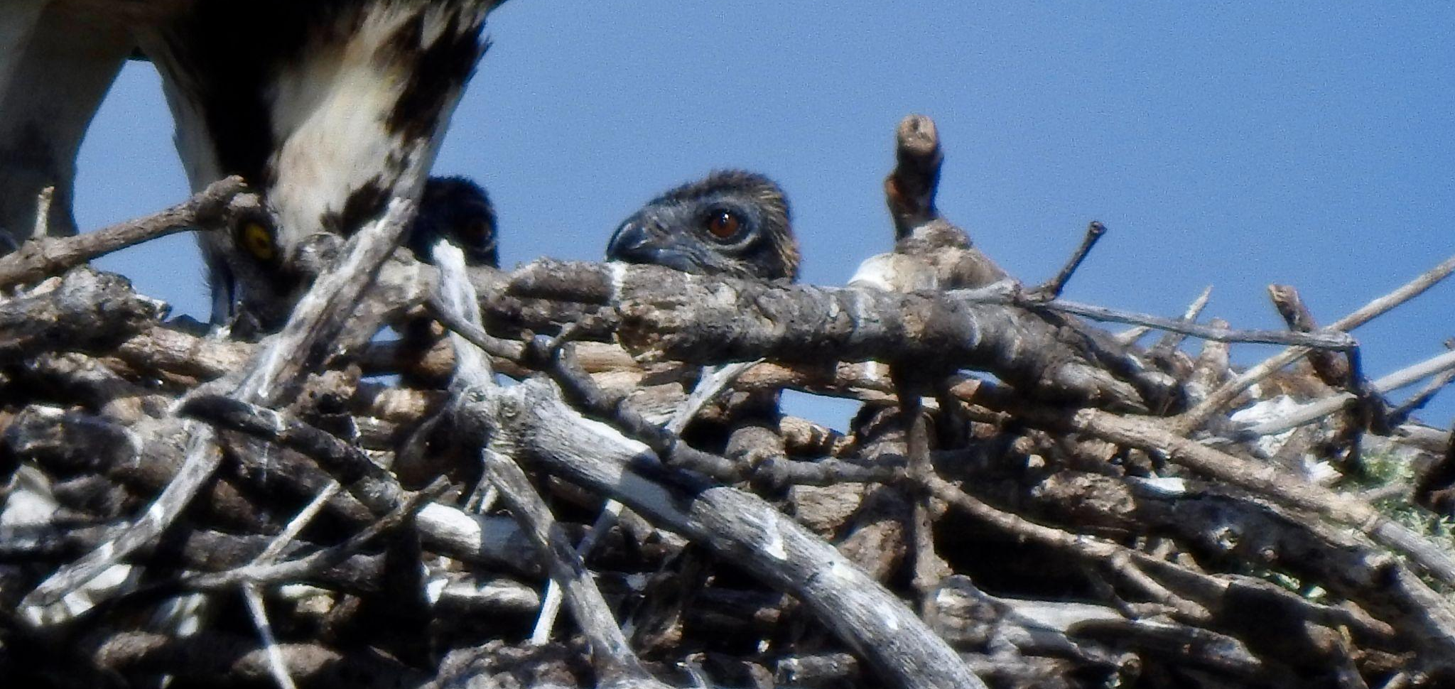
Enjoy the moment!

Slide 53
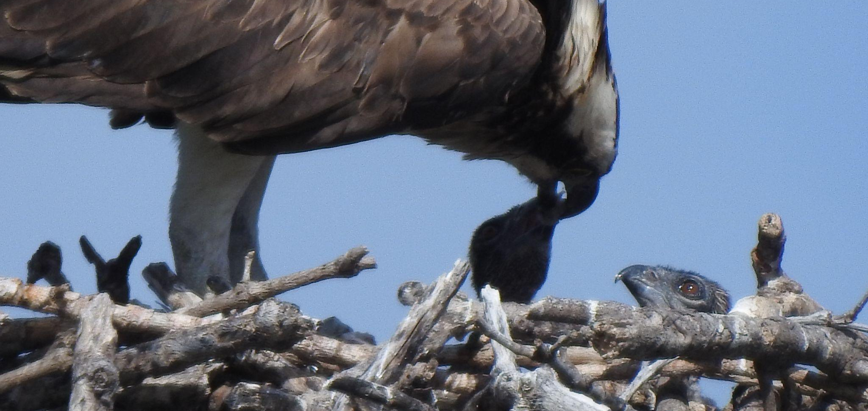
You should make note of this behavior.

Slide 54
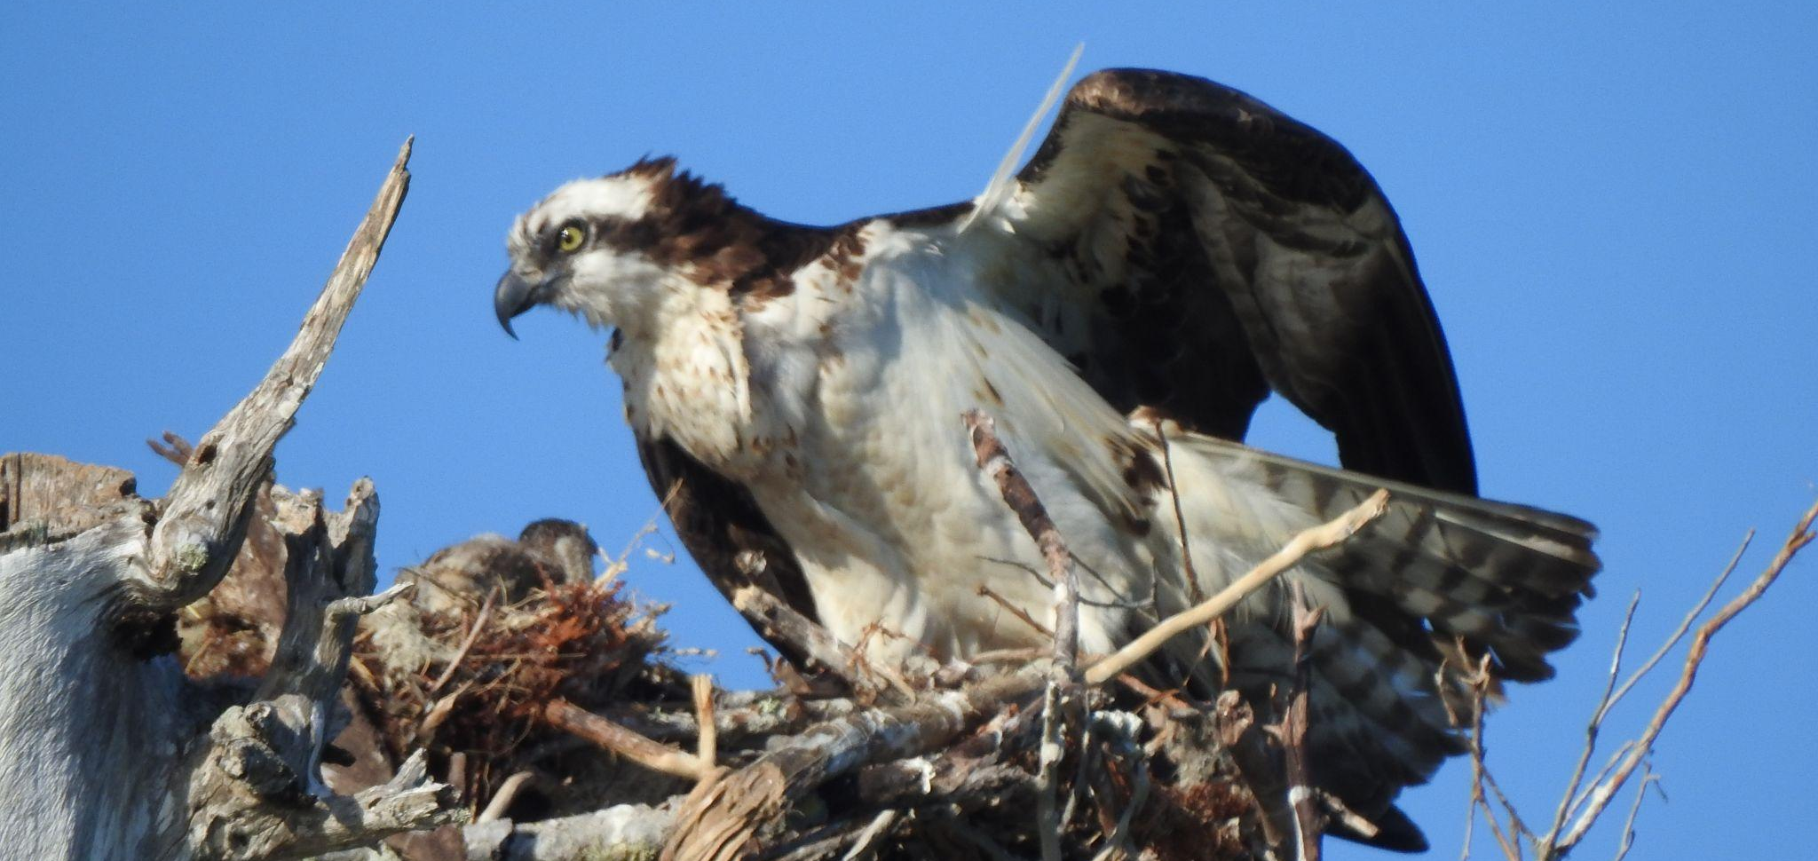
Anything to note here?

Slide 55
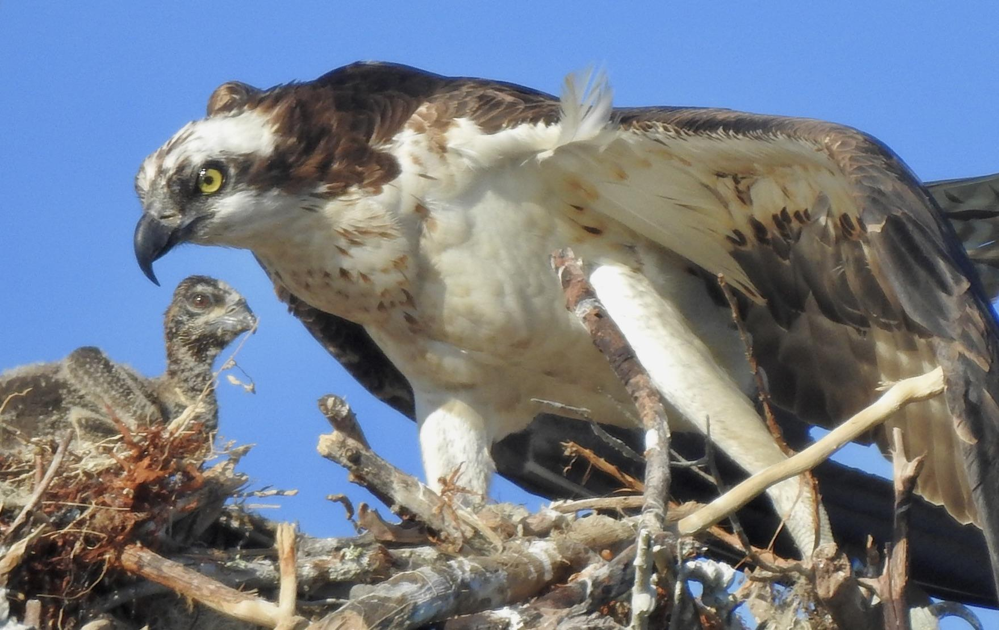
Apparently….yes!

Slide 56
Osprey may be a fierce raptor, but when it comes to parenting, they are exceedingly attentive and gentle.

Slide 57
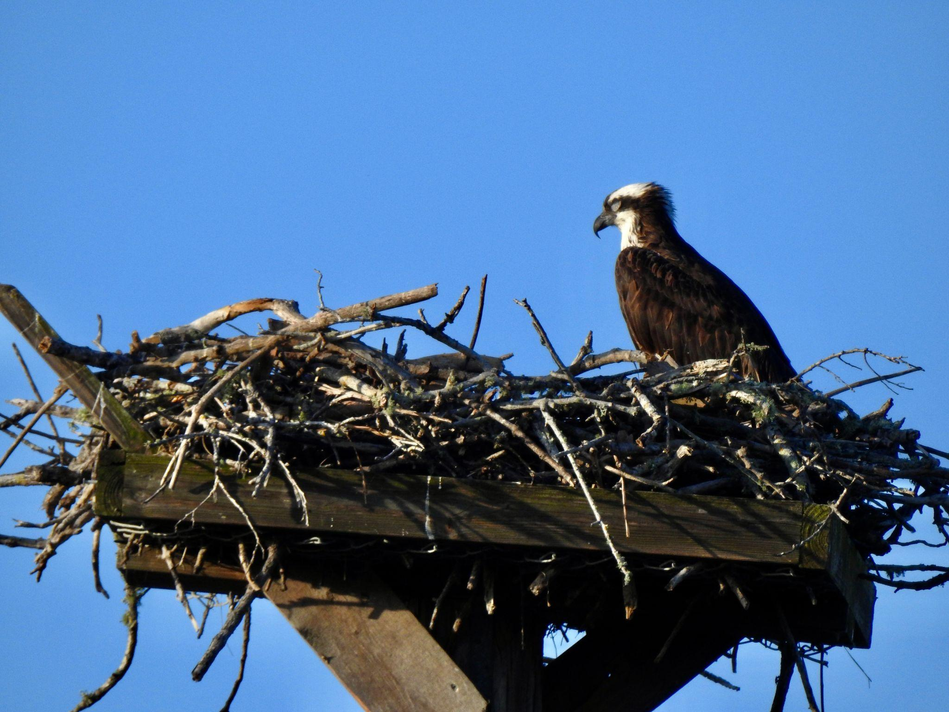
It is important to spend a period of time observing at each nest.

Slide 58
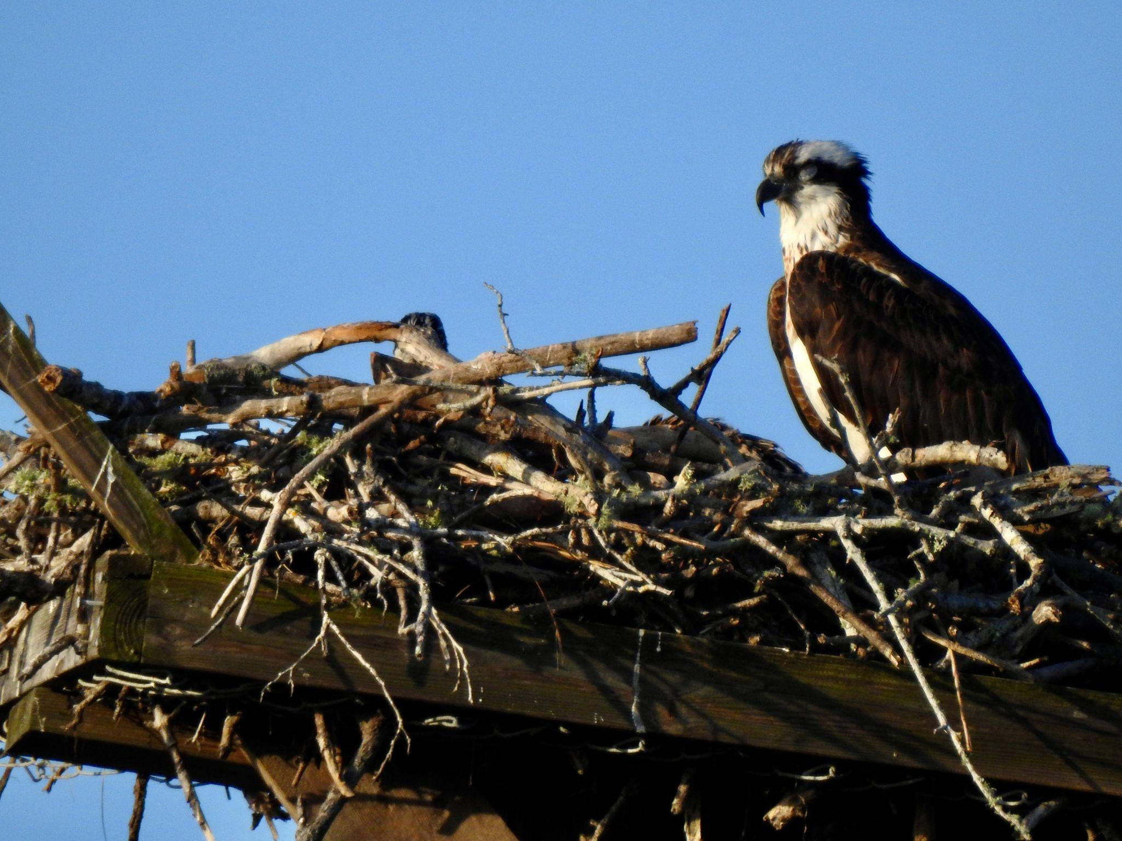
After awhile you will become quite good at noticing even the smallest, yet significant changes in what you are seeing.

Slide 59
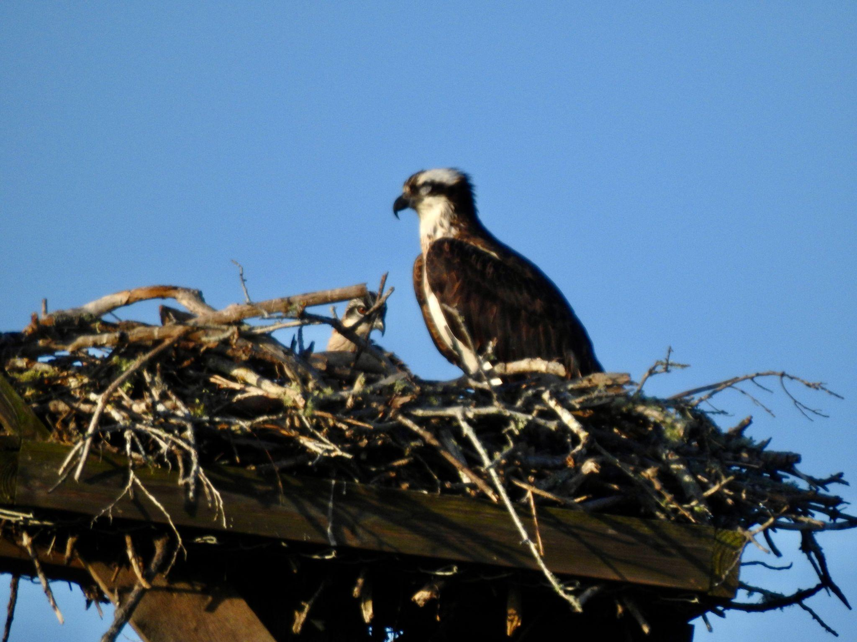
There is something to notice all the time!

Slide 60
What
are you noticing now ?

Slide 61
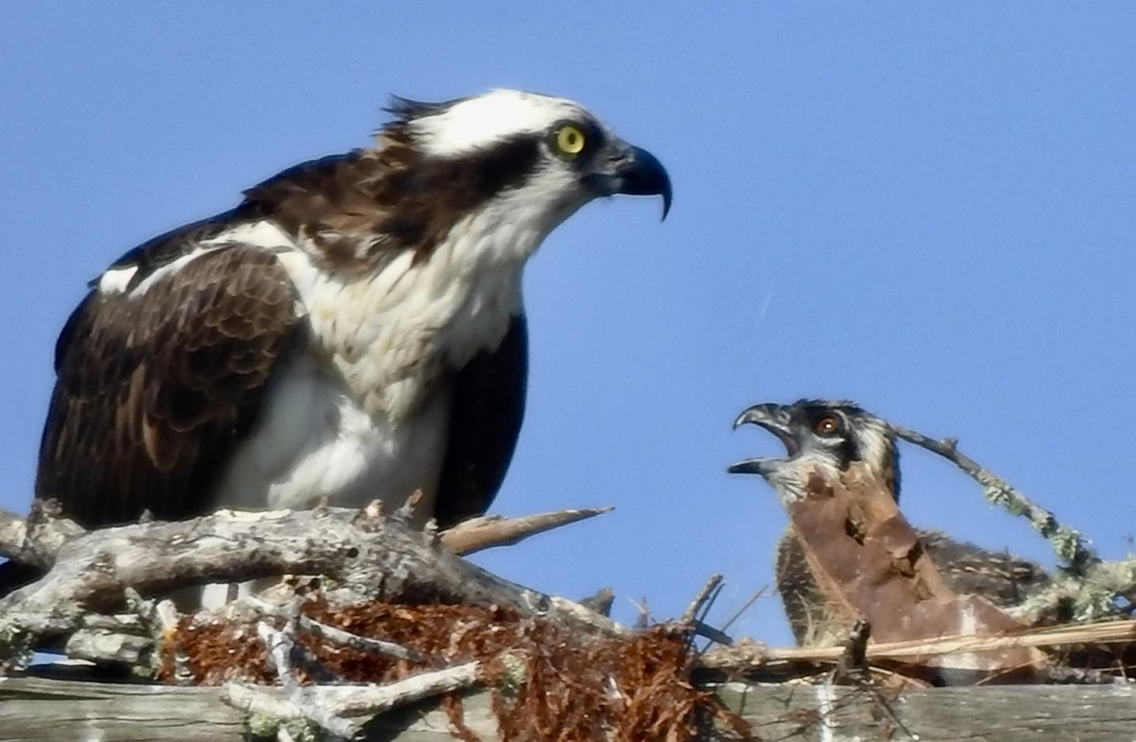
What is going on here?

Slide 62
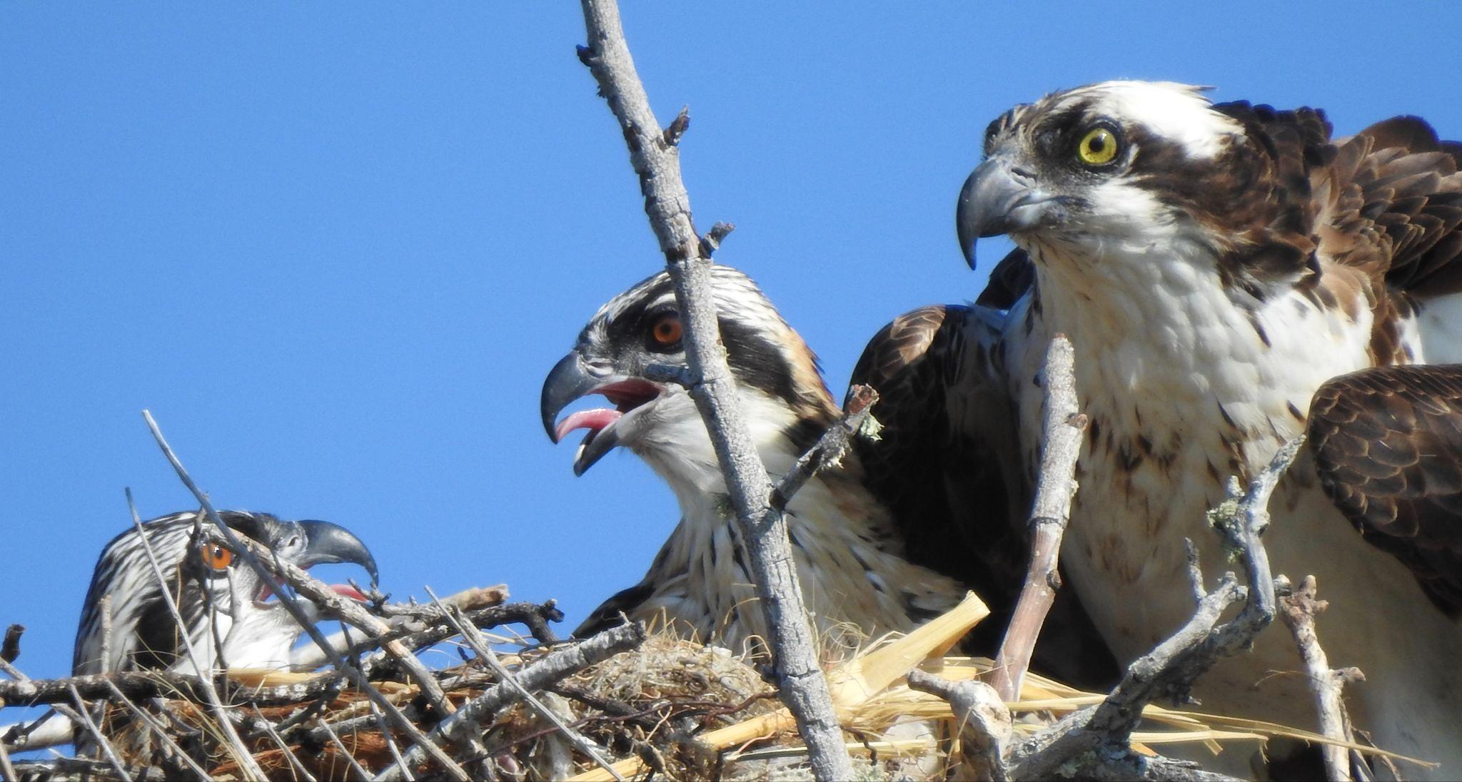

Slide 63
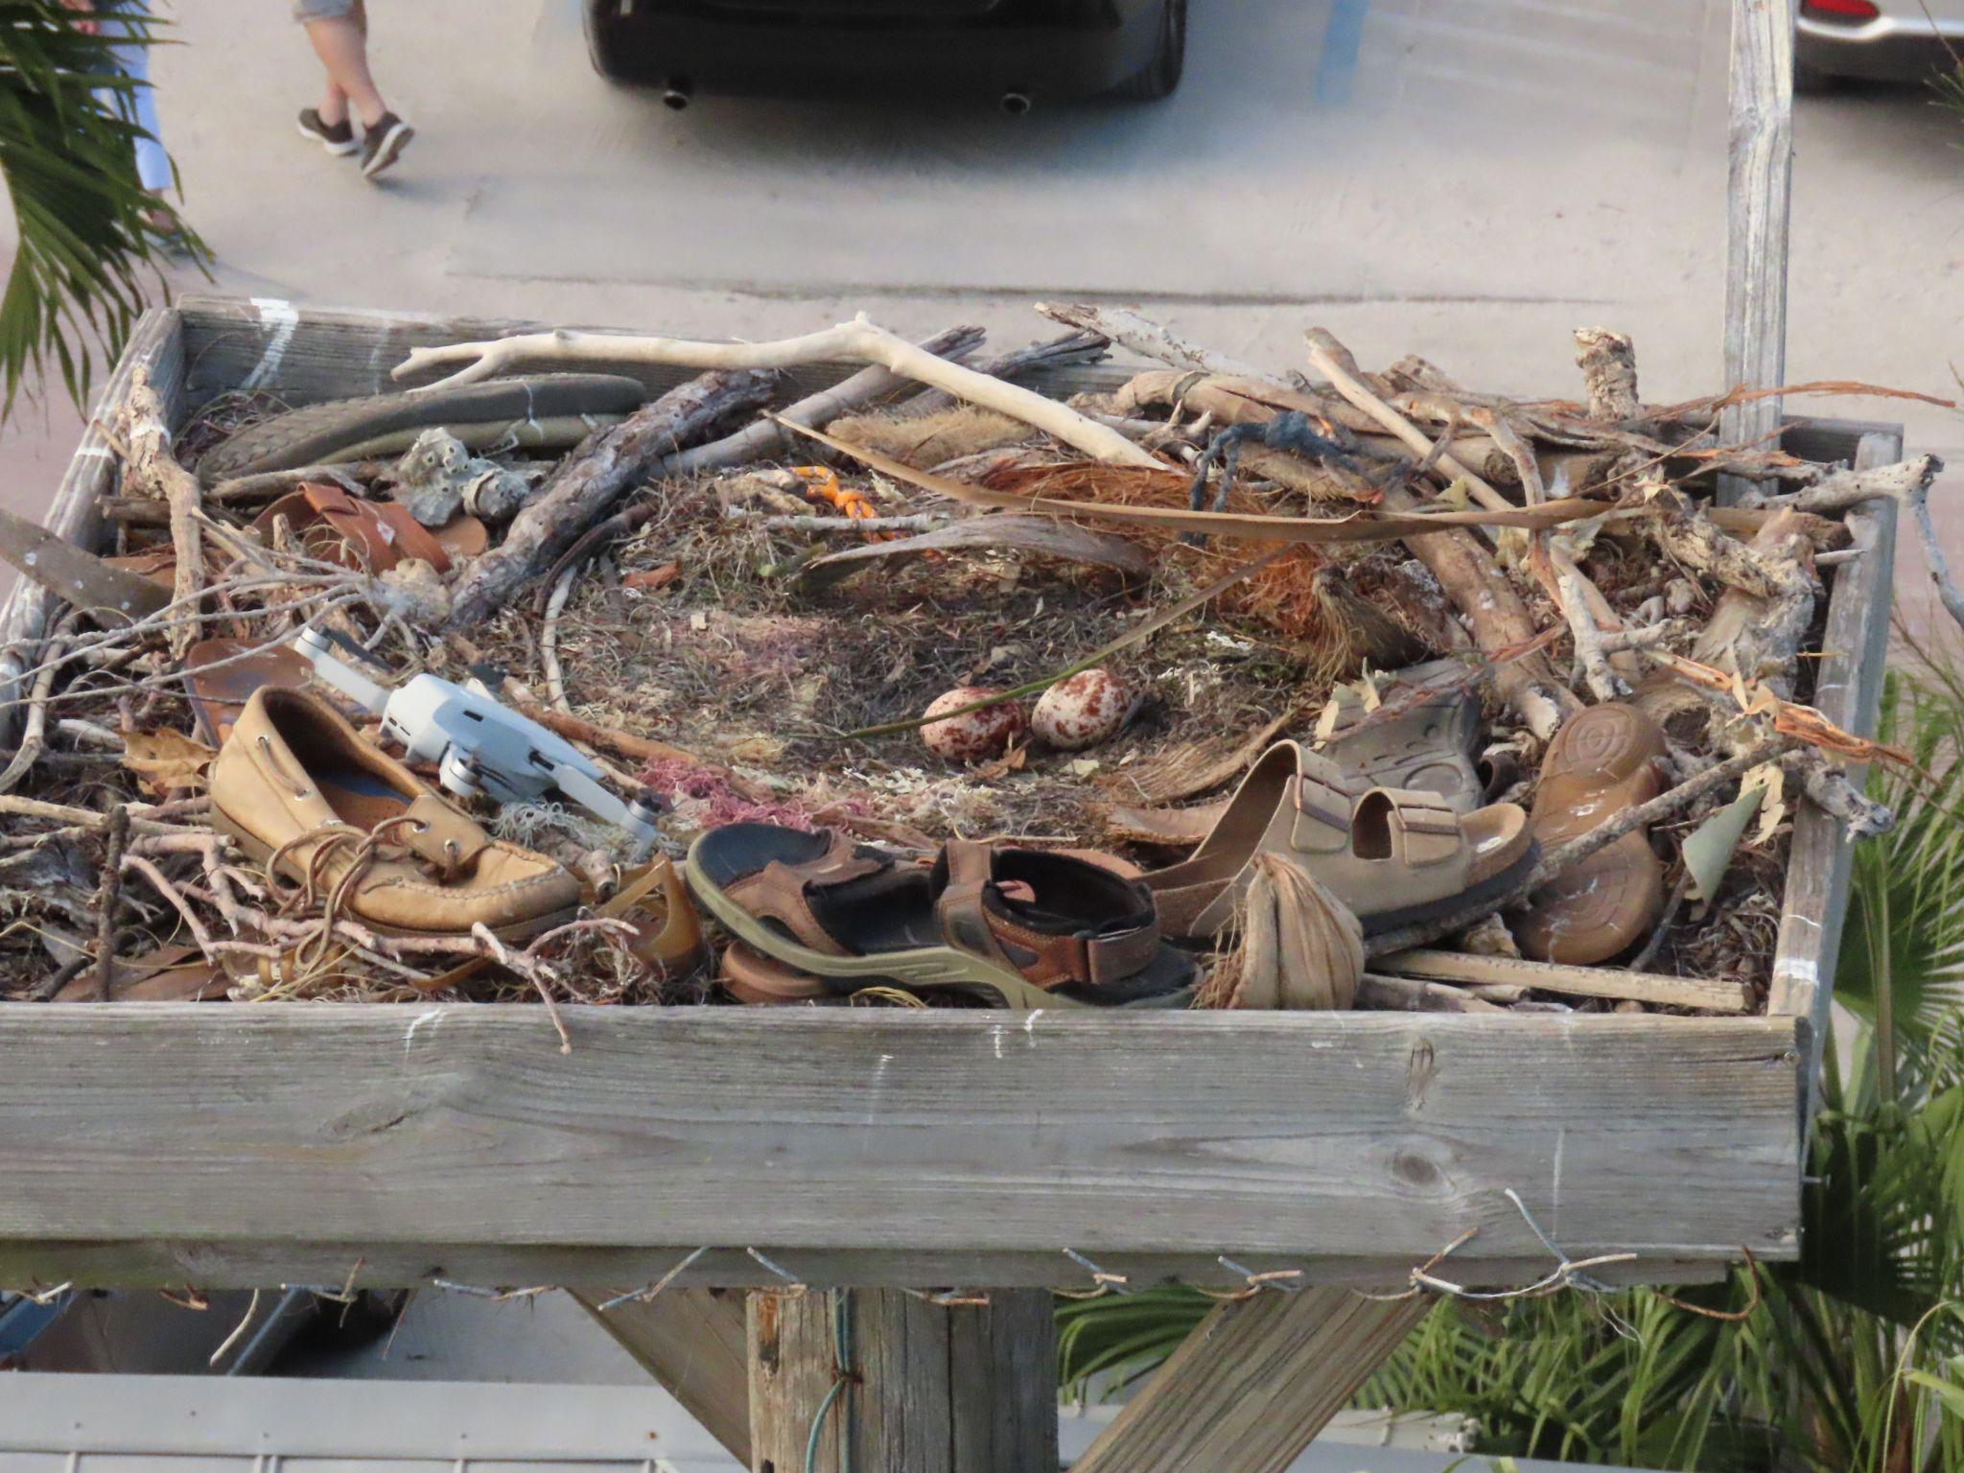

Slide 64
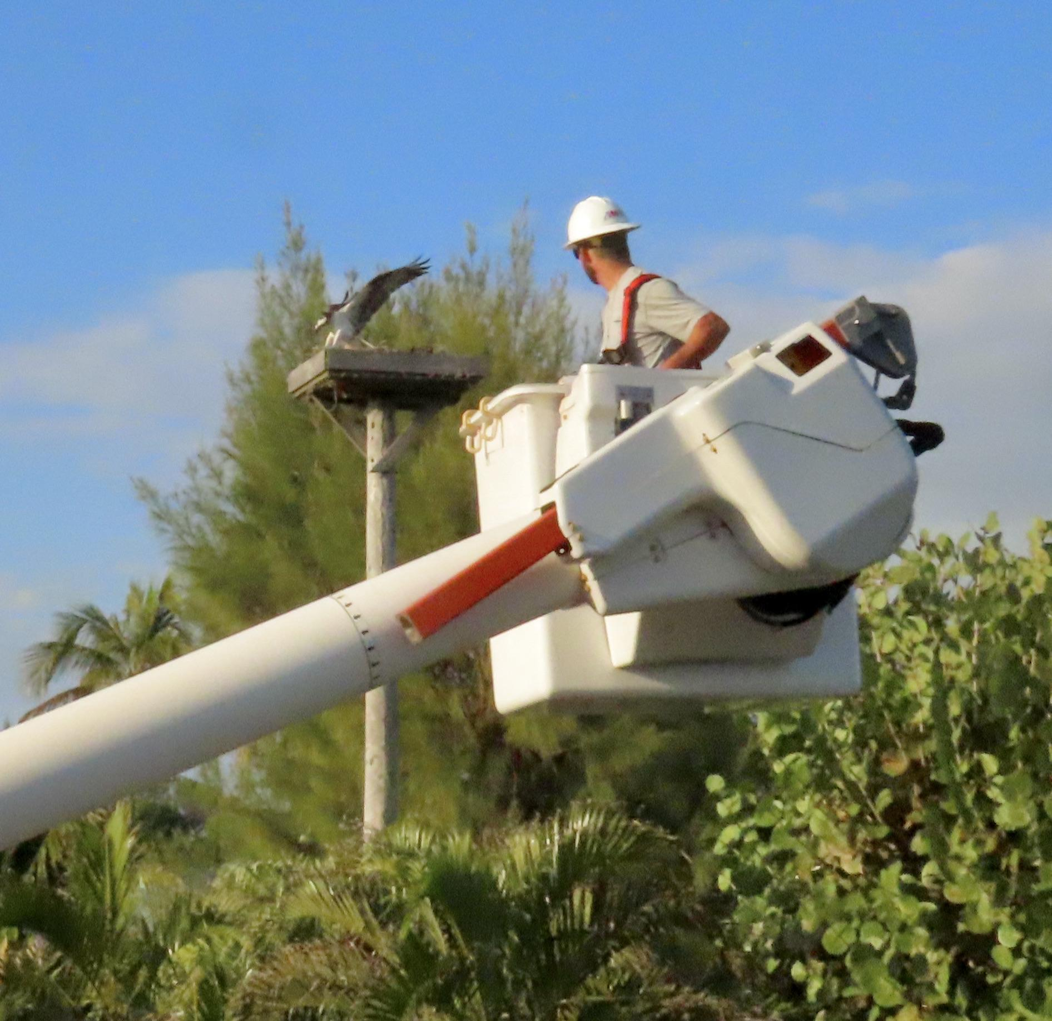

Slide 65


Slide 66
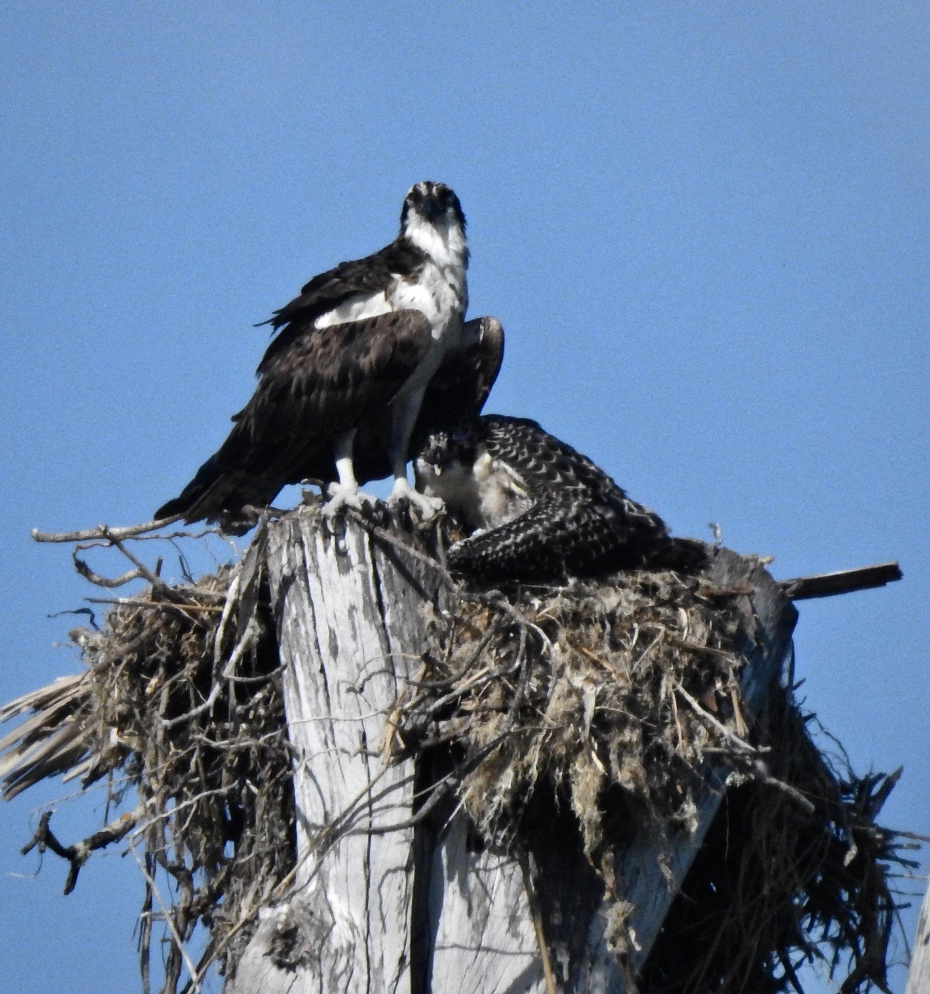
What
are you noticing now ?

Slide 67
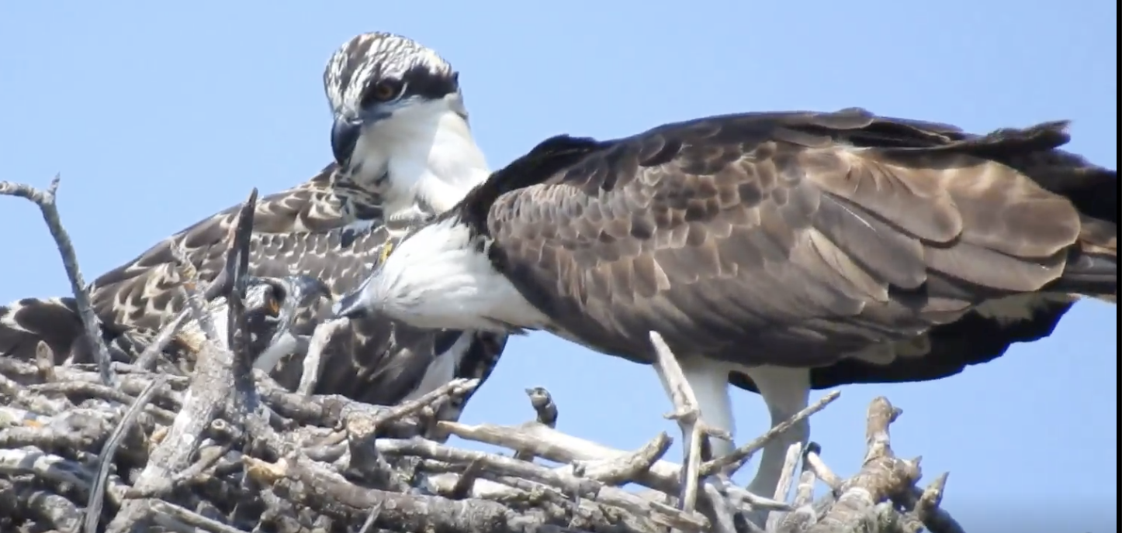
What
are you noticing now ?

Slide 68
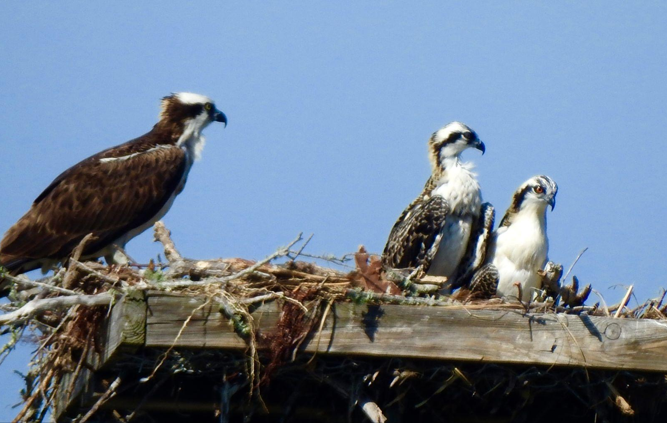
Nestlings are now easier to see since they have grown so much.
How old do you think these nestlings are?

Slide 69
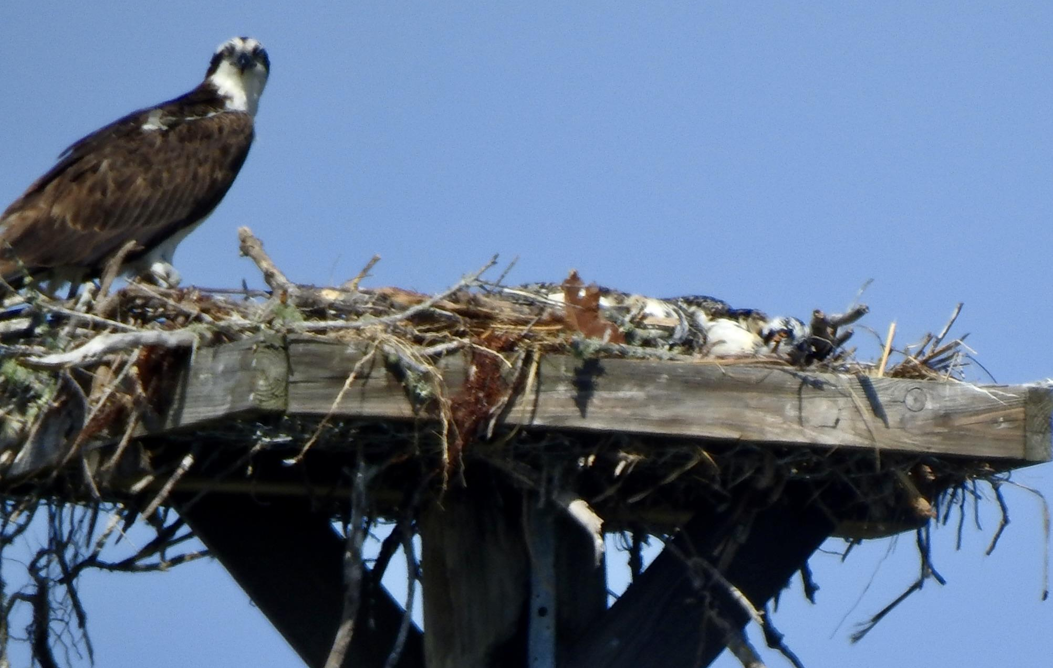
One day you will see what looks like an adult on an empty platform.
What happened to the chicks? Have they fledged?

Slide 70
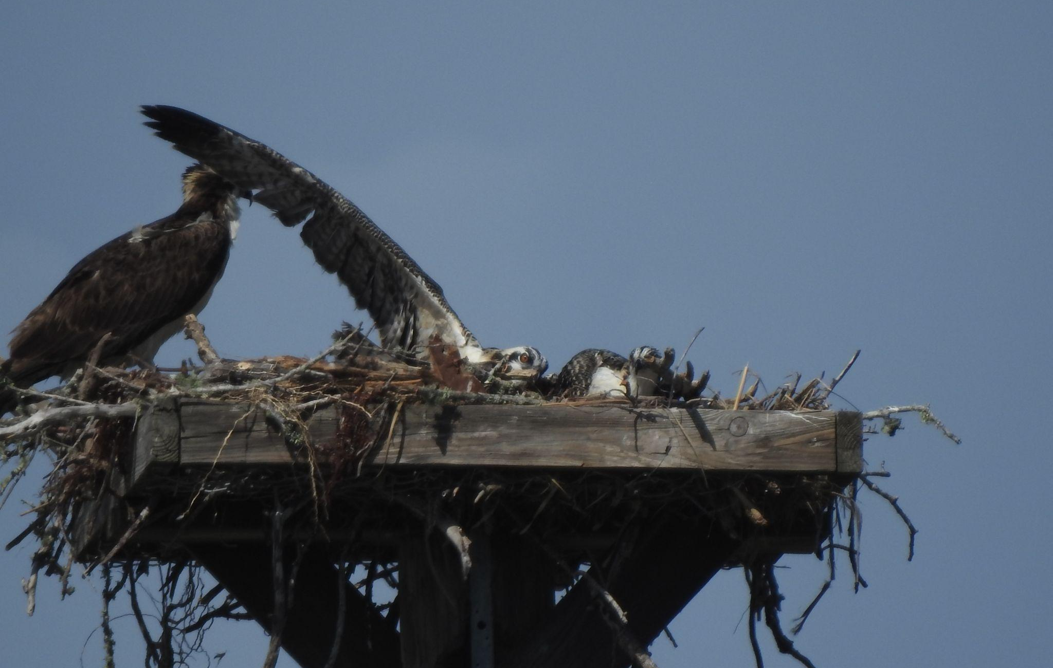
The platform is not empty!
What’s going on here?

Slide 71
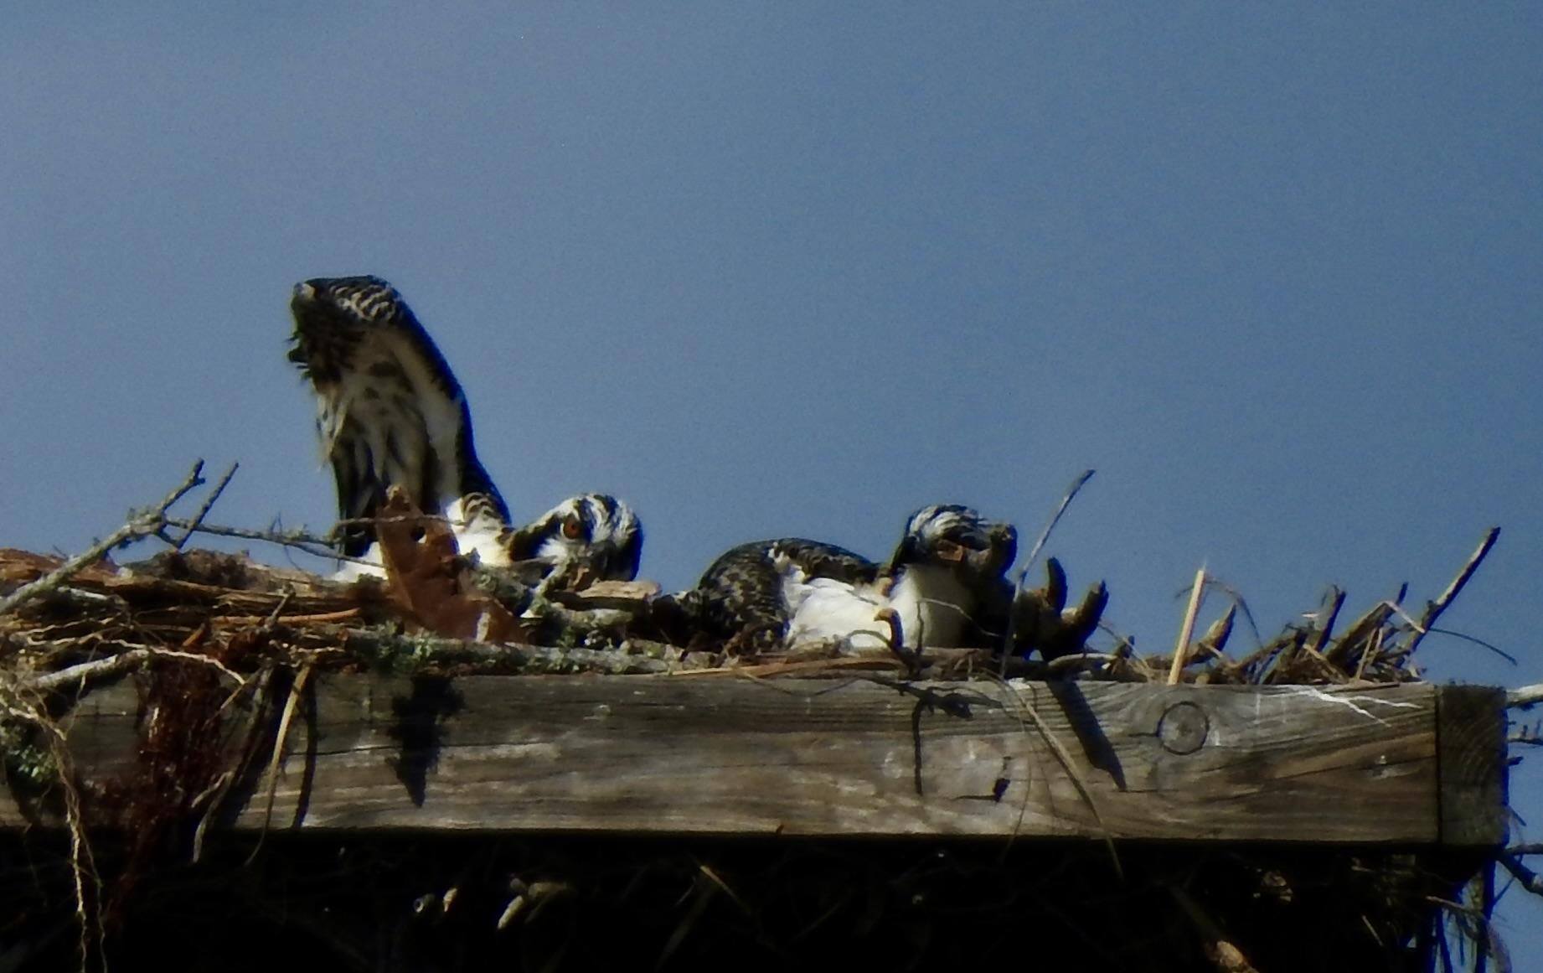
Something
appears to be not working very well.
What’s going on here?

Slide 72

My turn!

Slide 73

I’m
Ready!!
Let’s
go!!

Slide 74


Slide 75

Your Special Nest !
Following
The
Clues!

Slide 76
Driving along Wildlife Drive in an area we all have been through countless times before, but this time, through a
tiny opening in the trees… A new nest!

Slide 77

Finding a new nest can be an exciting adventure!

Slide 78

To obtain the new nest location information…
Using a smart-phone and the Google Maps app set on Satellite, drop a pin by touching the screen. Take a screenshot.

Slide 79

This location was sited safely from Wildlife Drive without going off-road. The distance is an estimate, but it is reasonably accurate for our purposes. GPS information is also displayed on this screen. You will need to record on your data sheet for Osprey Watch since there is no street address.

Slide 80

What do you see here?

Slide 81

What do you see now?

Slide 82

Ospreys are banded to monitor status and trends of their migratory populations. Measurements of their beaks, tail, wing and the size of the hallux claw (their largest talon) are also taken. Keep an eye out for bands when you are monitoring.

Slide 83

Any questions?

Slide 84












Light blue
Pale green
Dark green
Orange
Brown
Maroon

Slide 85

Thank you !
It takes a village! Your work helps us to serve the ospreys and meet our mission goals.
PRESERVE
RESEARCH
EDUCATE

