Slide 1







Welcome to
The Presbyterian Church Fredericksburg, VA
We are so glad you have joined us this morning!

Slide 2
Times of Worship
10:30am in the Sanctuary or follow the YouTube link on our website

Slide 3
Is This Your First Sunday?
Summer Schedule
10:30-11:30 am
11:30 am
Worship
Lemonade on the Lawn

Slide 4
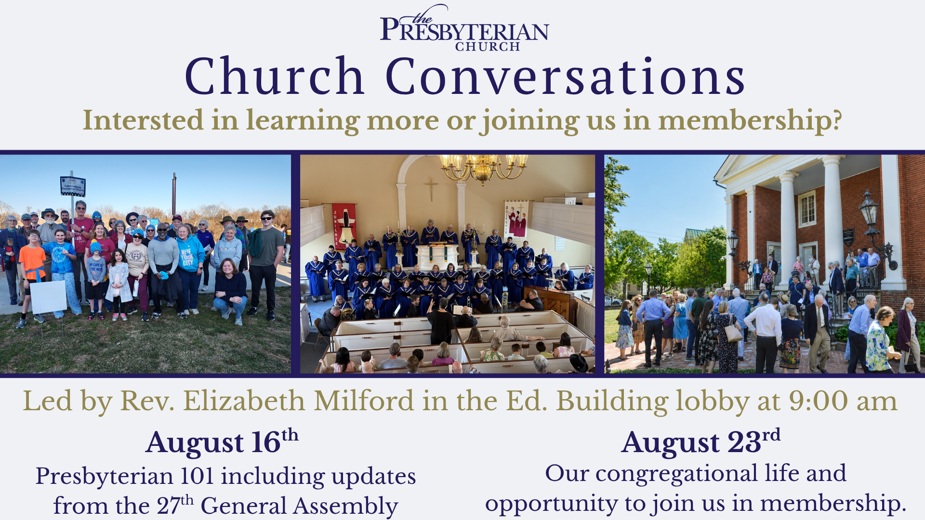

Slide 5



Slide 6
LIFT
Living In Faith Together

Slide 7


Slide 8
Hospitality and Fellowship

Slide 9



Slide 10
Welcome to
The Presbyterian Church Fredericksburg, VA
We are so glad you have joined us this morning!

Slide 11
Outreach Opportunities

Slide 12
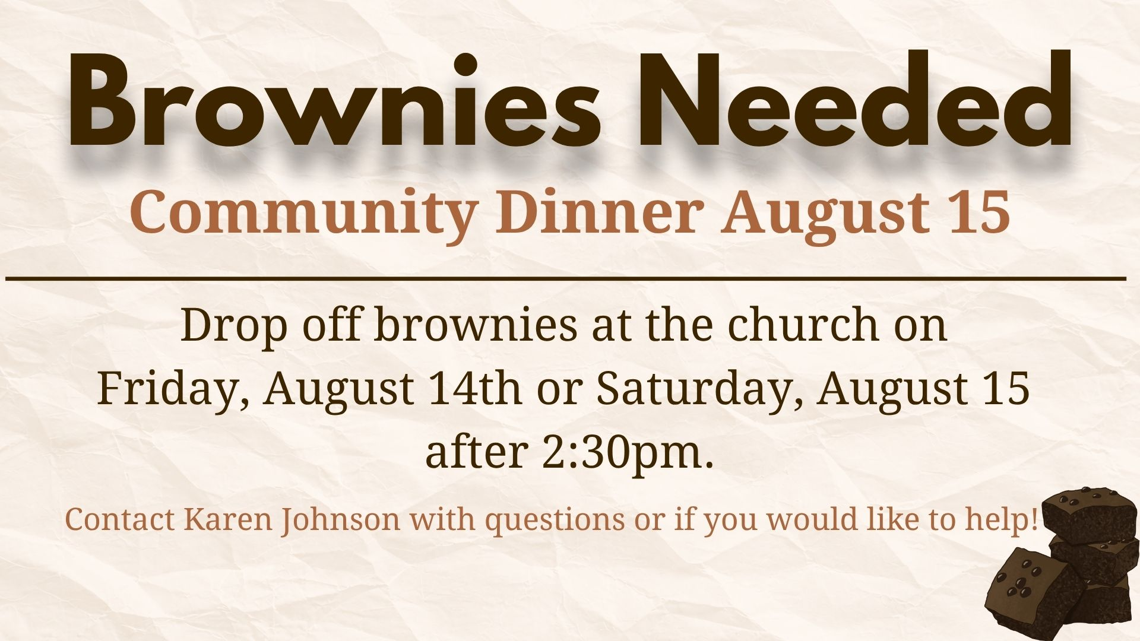

Slide 13


Slide 14


Slide 15
Help hungry Micah neighbors this summer
Volunteers are needed this summer to give out Micah Grab and Go lunches to our unhoused neighbors every Friday from 11:30 a.m. to 1 p.m. from the back porch of the Row Houses here on the church campus.
Scan the QR code to sign up under “Micah Grab N Go Lunch”
Or contact Jim Toler, to join the team!

Slide 16
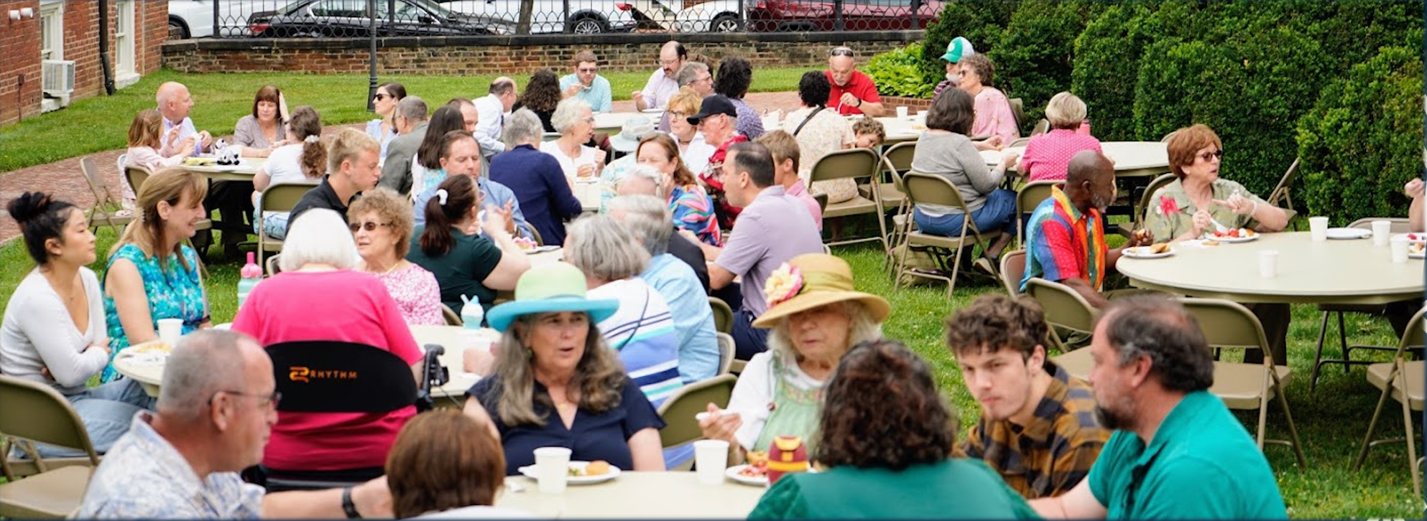
The Life of Our Church

Slide 17


Slide 18
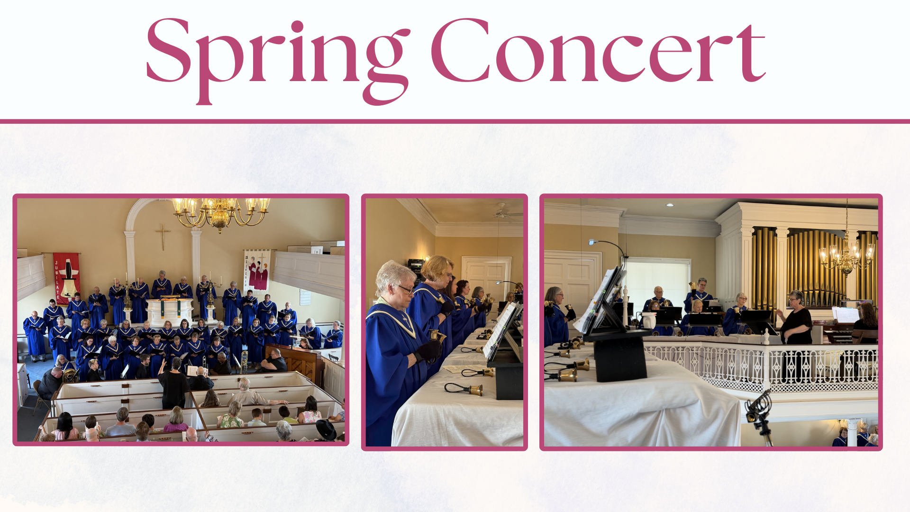

Slide 19
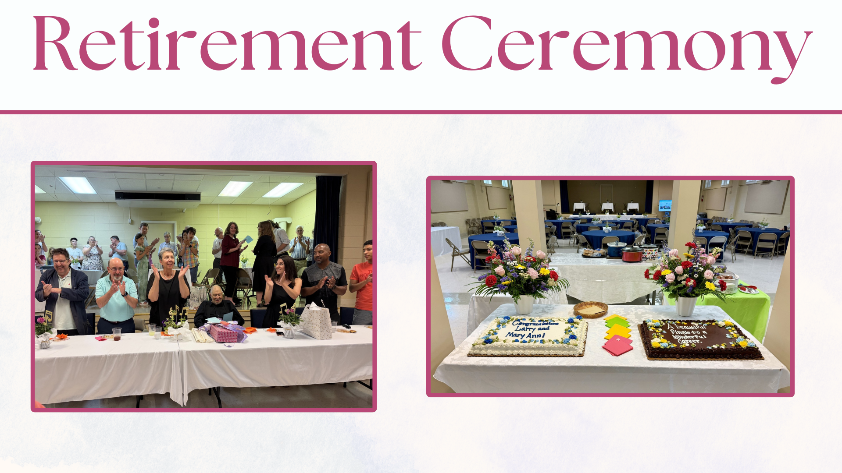

Slide 20
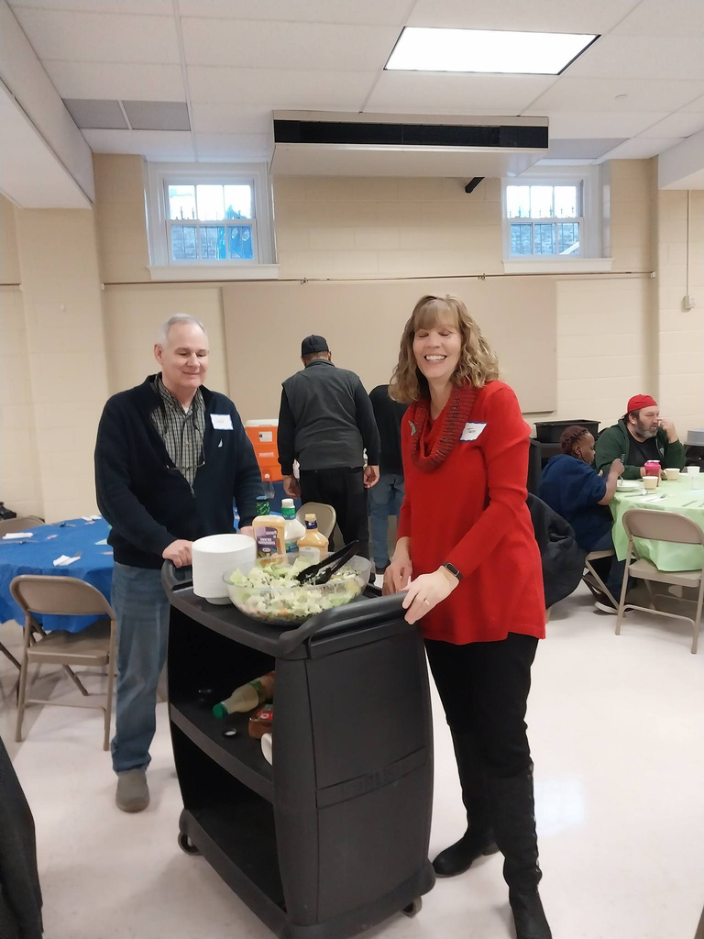
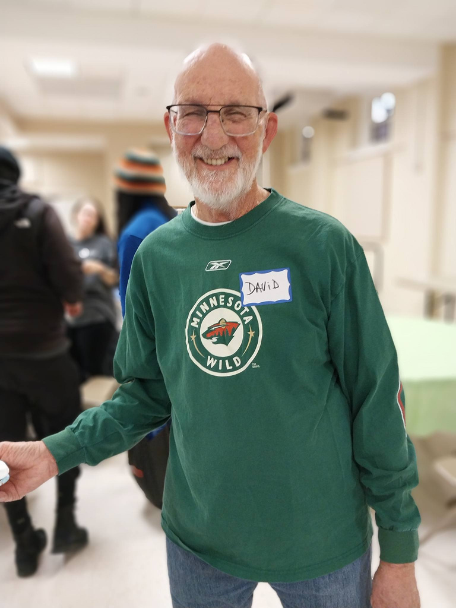
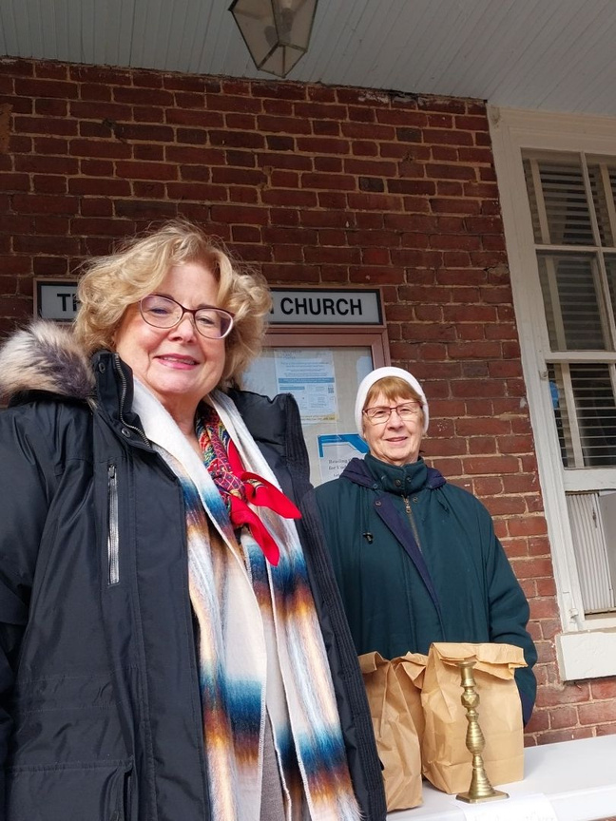
Community Outreach

Slide 21
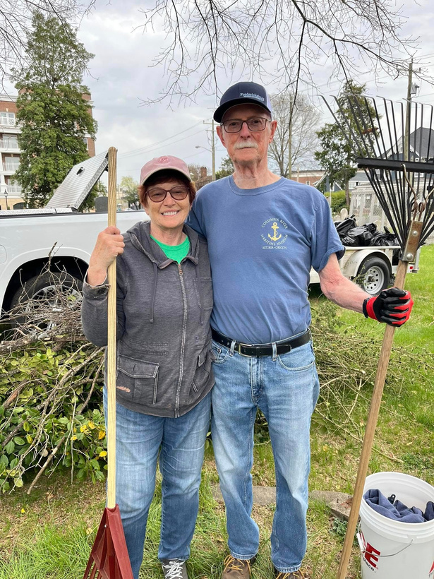
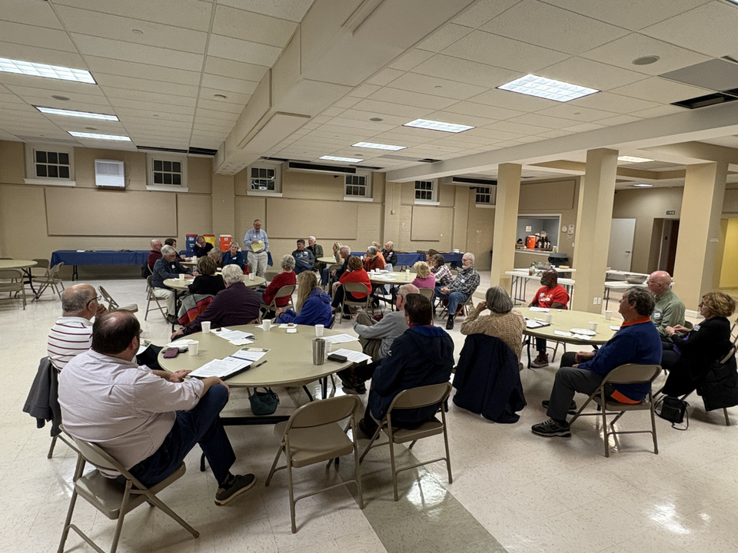
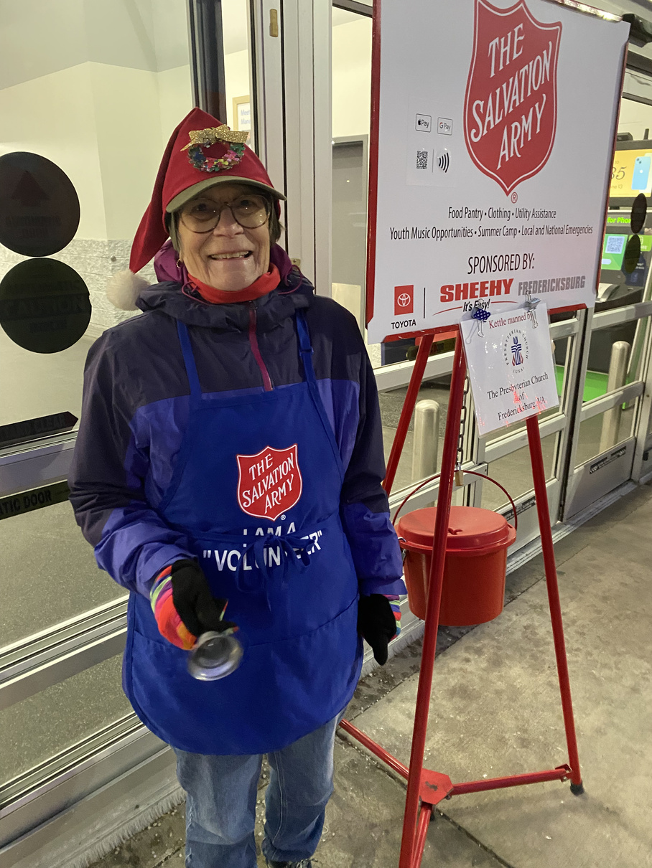
Community Outreach

Slide 22
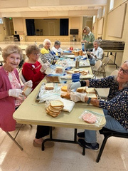
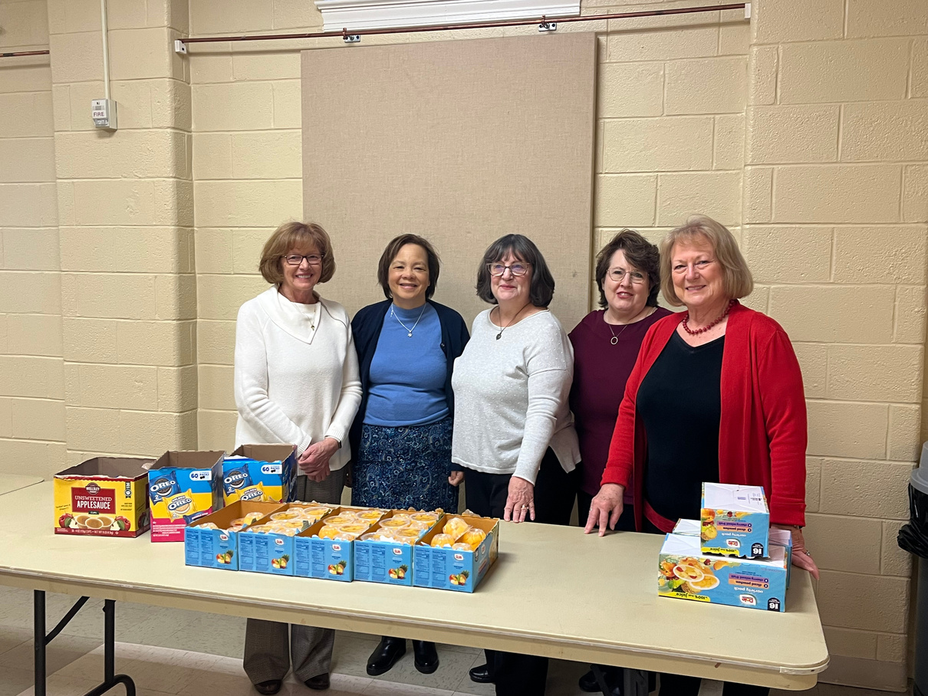
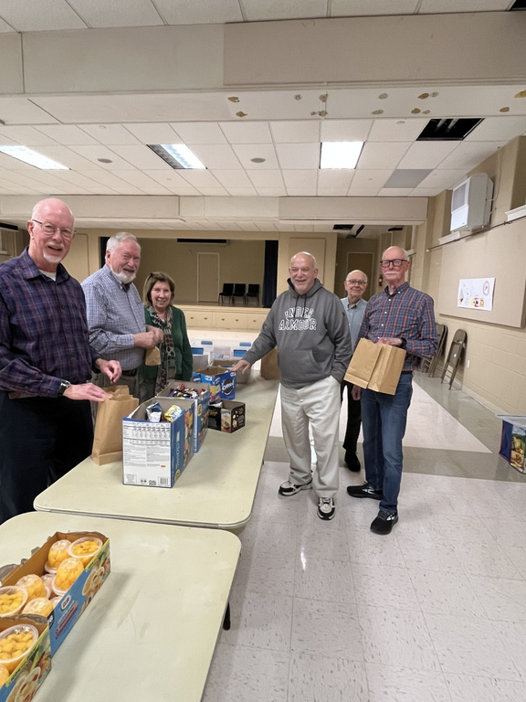
Micah Lunch Making

Slide 23
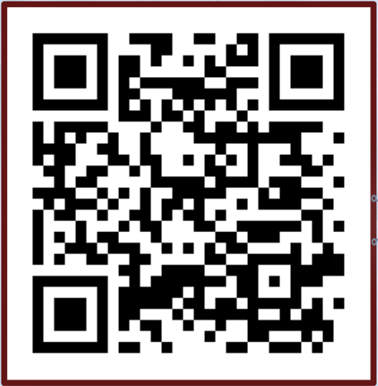
Find us Online
Scan the QR code for our website

Slide 24
For All Our Announcements
Go to our website or see the paper insert of the announcements in the bulletin.

