Slide 1
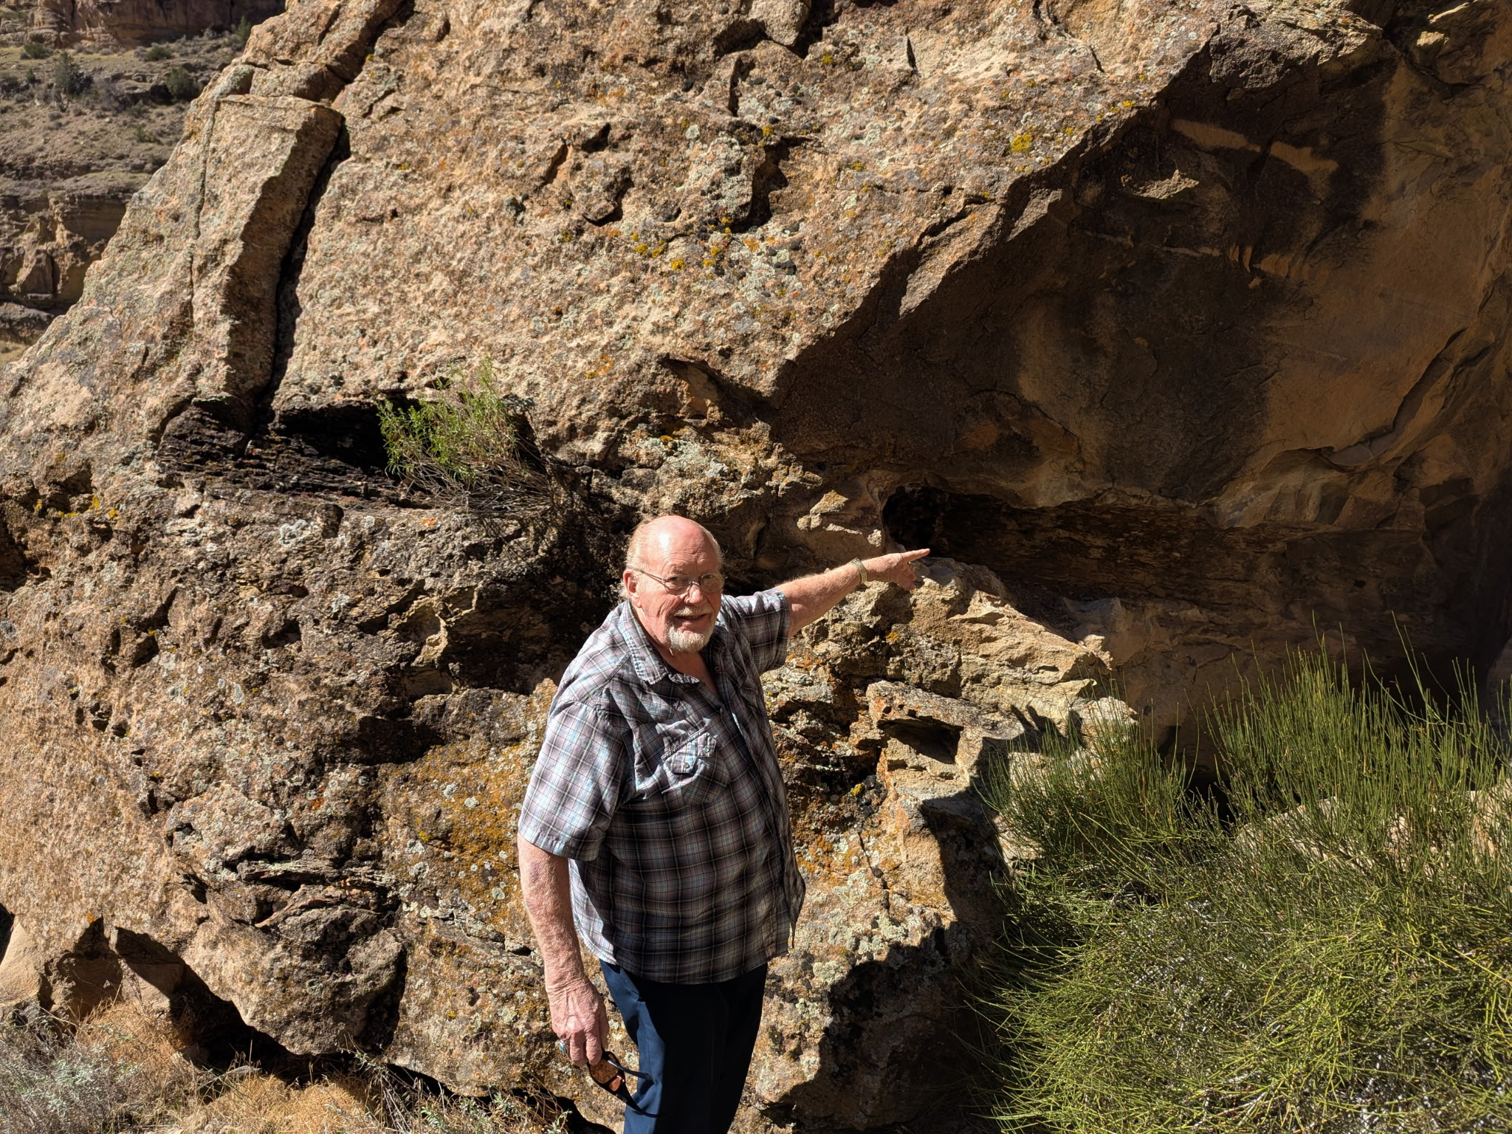
WHAT IS THIS PETRIFIED LOG DOING IN THE MIDDLE OF A HUGE ROCK?

Slide 2
INSTRUCTIONS:
For public presentations, you can delete the pages with text over the black background. These pages are for your benefit, so you have an idea what you can say for the pictures following.
Permission is granted to duplicate and use this presentation.
FOREIGN TRANSLATIONS: You are encouraged to translate the text into another language and make them available to other Christian leaders. We can make those translated files available for distribution.

Slide 3
Greetings. My name is Chuck Anderson. I’m the editor of Discovery News.
Sometimes we stumble across some pretty amazing things in pretty unexpected places!

Slide 4
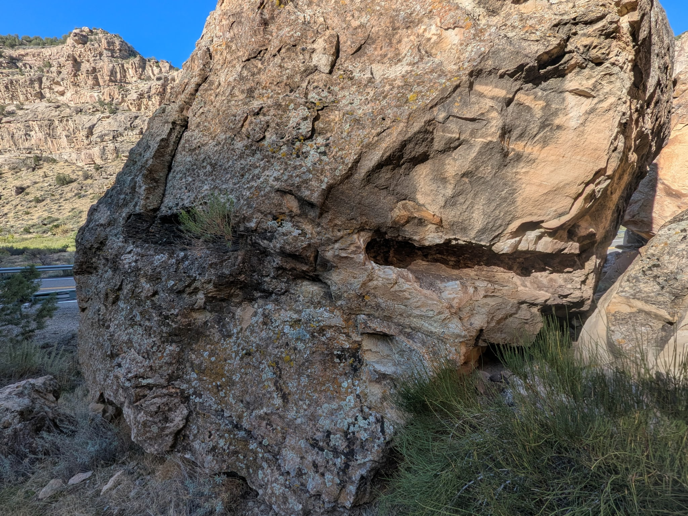


BREAKING NEWS!

Slide 5
Do you see anything unusual in this rock?

Slide 6
A friend of mine recently took me on a short hike just off Colorado Hiway 65 in Plateau Canyon, east of Grand Junction.
He had discovered this petrified log encased right in solid rock.

Slide 8
We have to ask:

Slide 9
WHAT IS THIS PETRIFIED LOG DOING IN THE MIDDLE OF A HUGE ROCK?

Slide 10
Well . . . the answer is quite obvious . . .

Slide 11
At one time there had to have been a massive flood with tsunami waves of water and mud that destroyed everything in its path . . . including billions of animals, vegetation and even trees.
This tree was knocked down and encased in mud which turned into rock . . . and the tree also became petrified wood or rock.

Slide 13
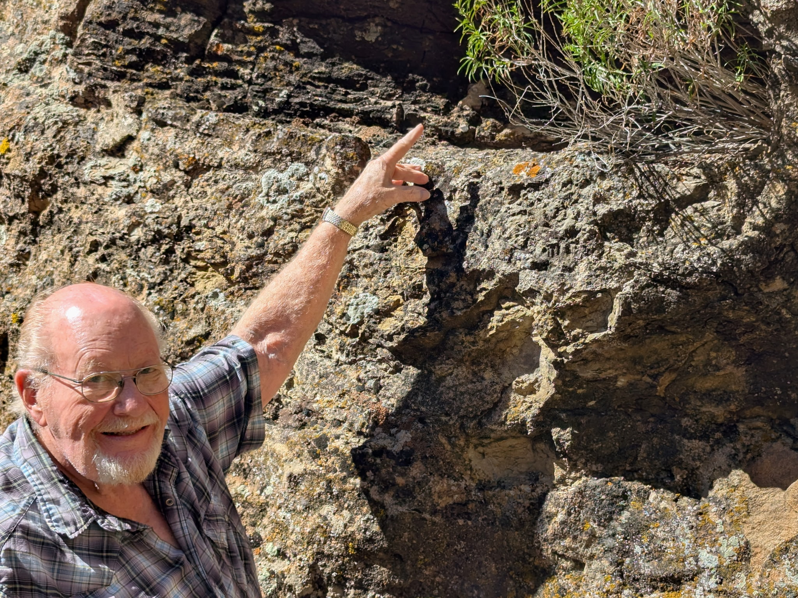
THIS PETRIFIED LOG ENCASED IN THE MIDDLE OF A ROCK TELLS OF A HUGE FLOOD AND TSANAMI MUD FLOWS!

Slide 14
Can you imagine . . .

Slide 15
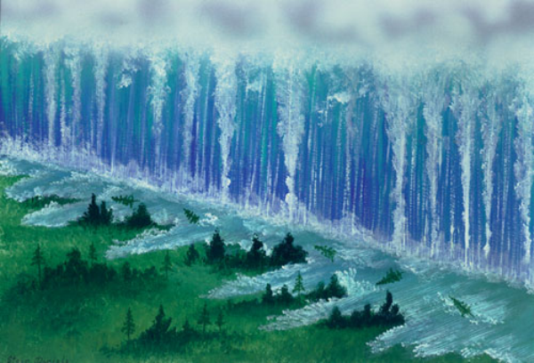
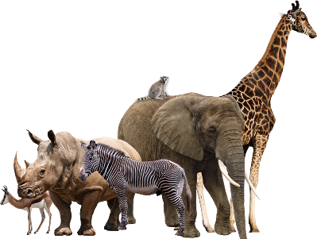

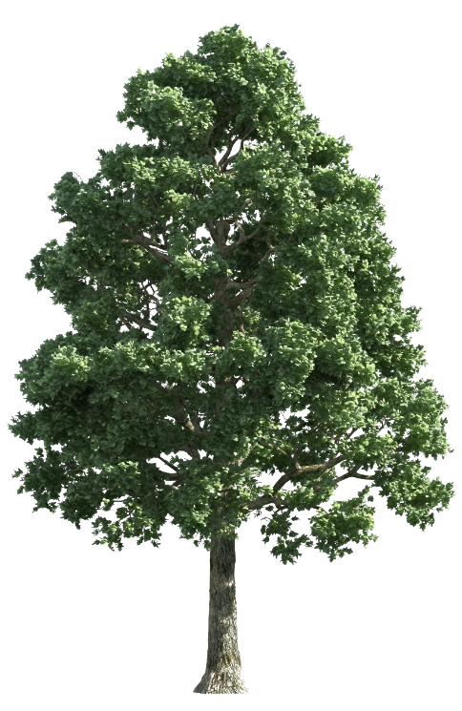
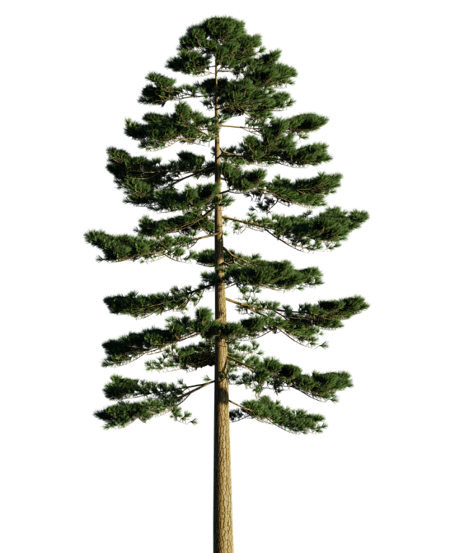
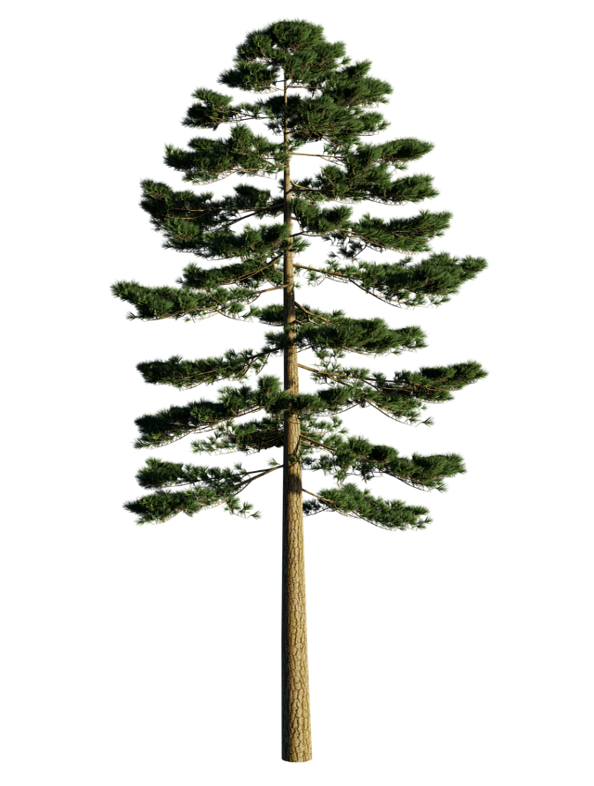


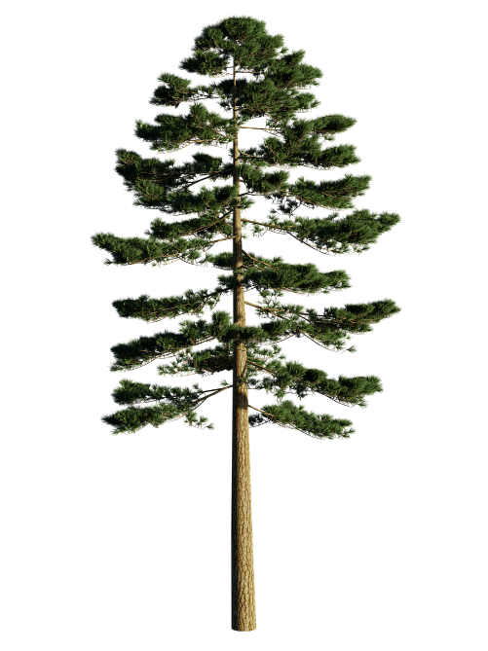
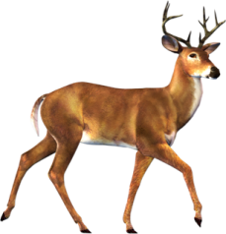

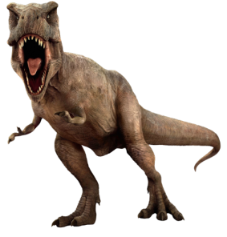



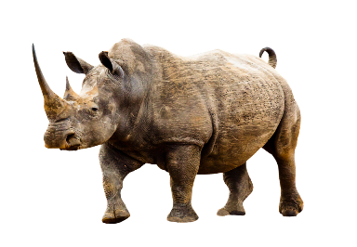
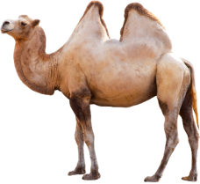
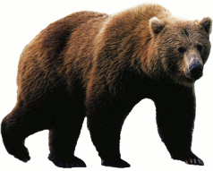

Can you imagine TSUNAMI WAVES of water and MUD racing around the world at incredible speeds and destroying everything in their paths?

Slide 16
Can you imagine TSUNAMI WAVES of water and MUD racing around the world at incredible speeds and destroying everything in their paths?
The water and mud burst forth from cracks all over the earth. Layers of mud hundreds of feet deep covered the earth!

Slide 17
Can you imagine TSUNAMI WAVES of water and MUD racing around the world at incredible speeds and destroying everything in their paths?
Trees would be knocked over and instantly buried in mud along with everything living in the path of the mud and water flood.

Slide 18
Layers of mud hundreds of feet deep covered the earth!

Slide 19
Genesis 7:11-12 -
The water and mud burst forth from cracks all over the earth. Layers of mud hundreds of feet deep covered the earth!

Slide 20
Genesis 7:11-12 - “ . . . all the fountains of the great deep were broken up, and the windows of heaven were opened. And the rain was upon the earth forty days and forty nights.”
The water and mud burst forth from cracks all over the earth. Layers of mud hundreds of feet deep covered the earth!

Slide 21
The water and mud covered everything . . . including all the animals, trees, and even humans!

Slide 22
The San Andreas fault that runs through the Mojave Desert shows water erosion that must have occurred when the great fountains of the deep were opened and the flood began . . .

Slide 23
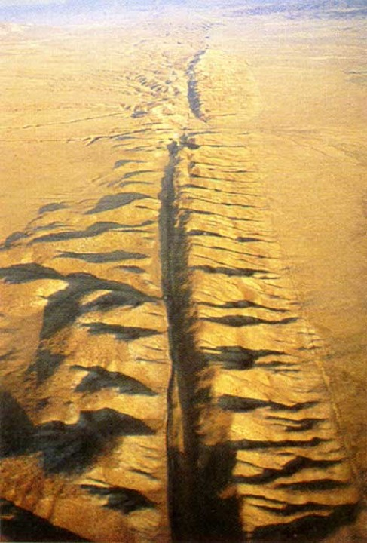
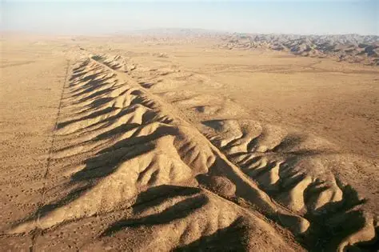
Water erosion along the San Andreas fault.

Slide 24
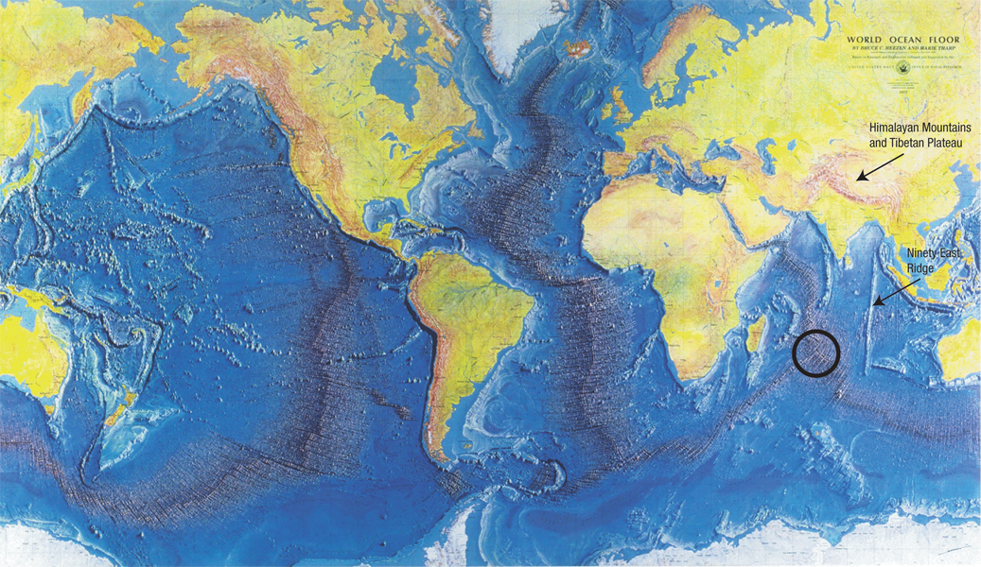
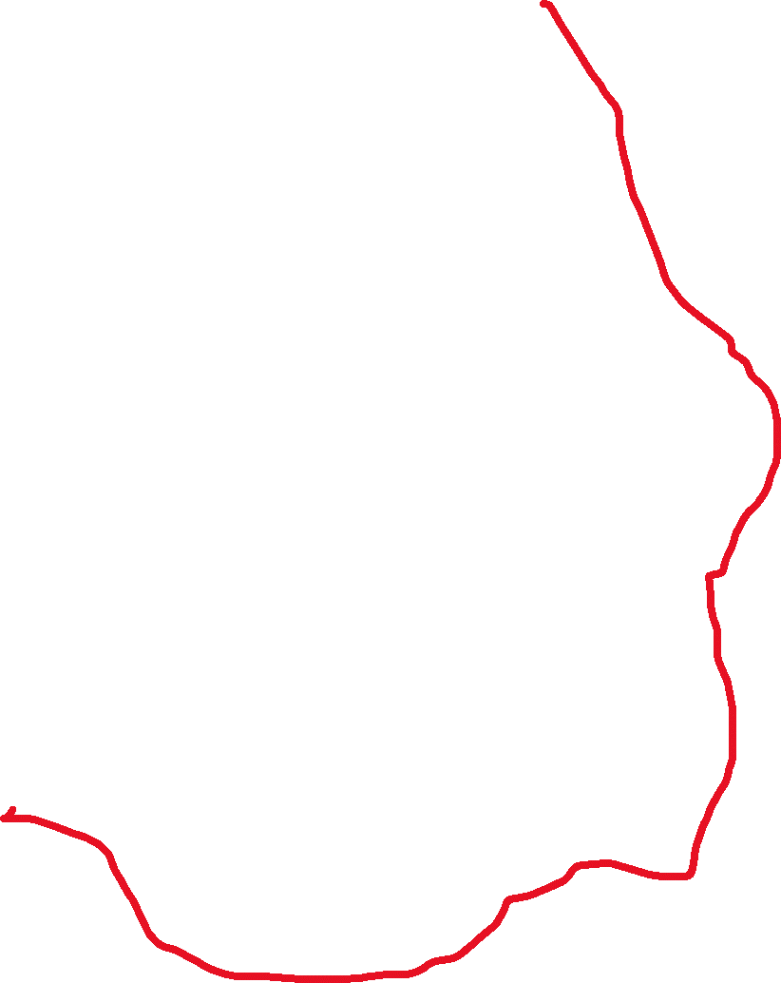


















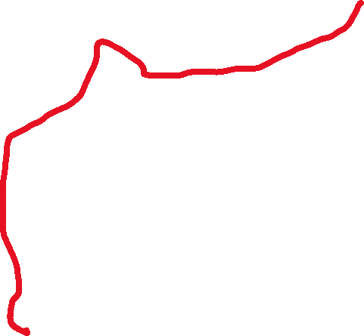
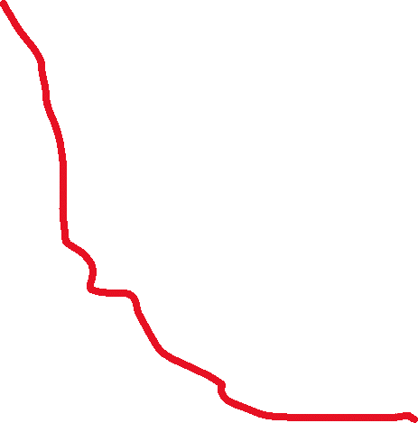









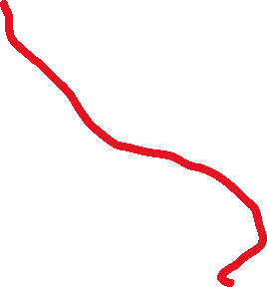




Scientists tell us that there are hundreds of these cracks or fault lines that run under the oceans.

Slide 25
Before the flood, there were hills . . . But apparently not the high mountain peaks that we see today.
This may surprise you . . .

Slide 26
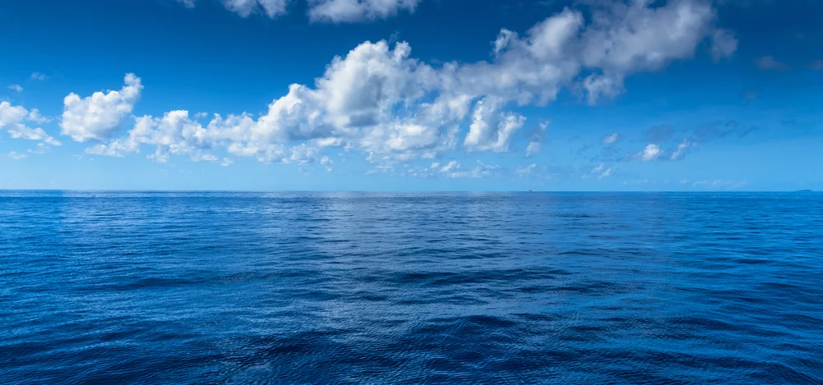
If the surface of the earth was relatively flat . . . With no high mountain peaks . . . and no deep canyons in the ocean . . .there would be over 8,000 feet of water all over the earth . . .

Slide 27
8,000 feet of water all over the earth is a lot of water. That a mile and a half deep!
That’s enough water for a world-wide flood like the Bible records in Genesis chapters 7 and 8.

Slide 28
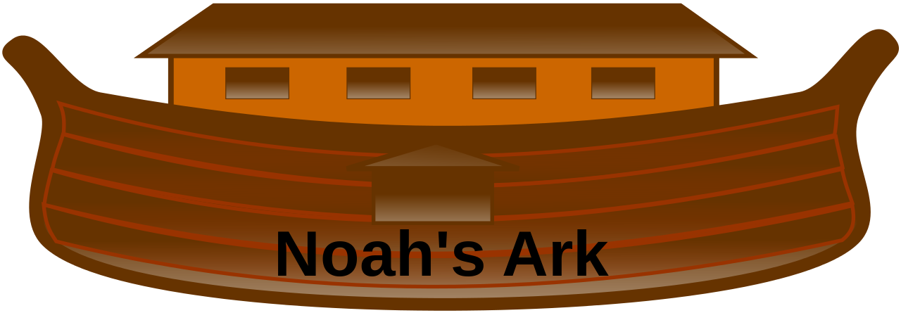
8,000 feet of water all over the earth is certainly enough water to create a world-wide flood like the one described in the Bible in Genesis chapters 7 & 8.

Slide 29
Many geologists believe that the Rocky Mountains and other high, jagged mountain peaks, rose up and the deep canyons in the oceans were formed in the not too distant past.

Slide 30
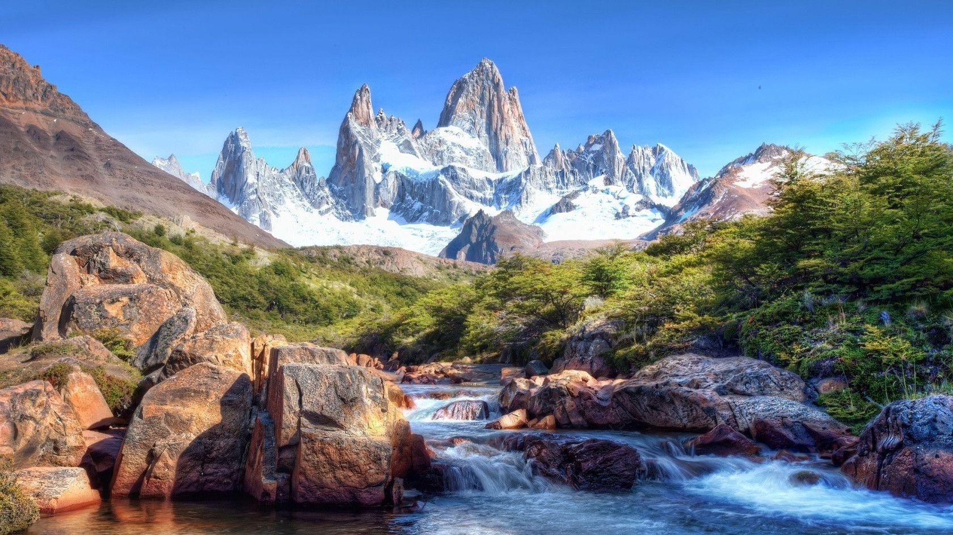

Slide 31
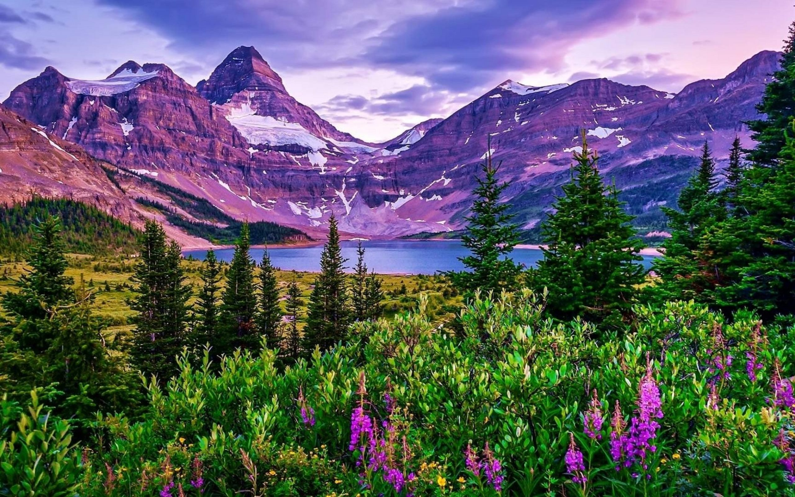
Many geologists believe that the Rocky Mountains and other high, jagged mountain peaks, rose up and the deep canyons in the oceans were formed in the not too distant past.

Slide 32
Many believe that this occurred at the end of Noah’s Flood and that is what caused the water to rush off and carve the many canyons that can be seen all over the west including the Grand Canyon and Black Canyon of the Gunnison in Colorado.

Slide 33
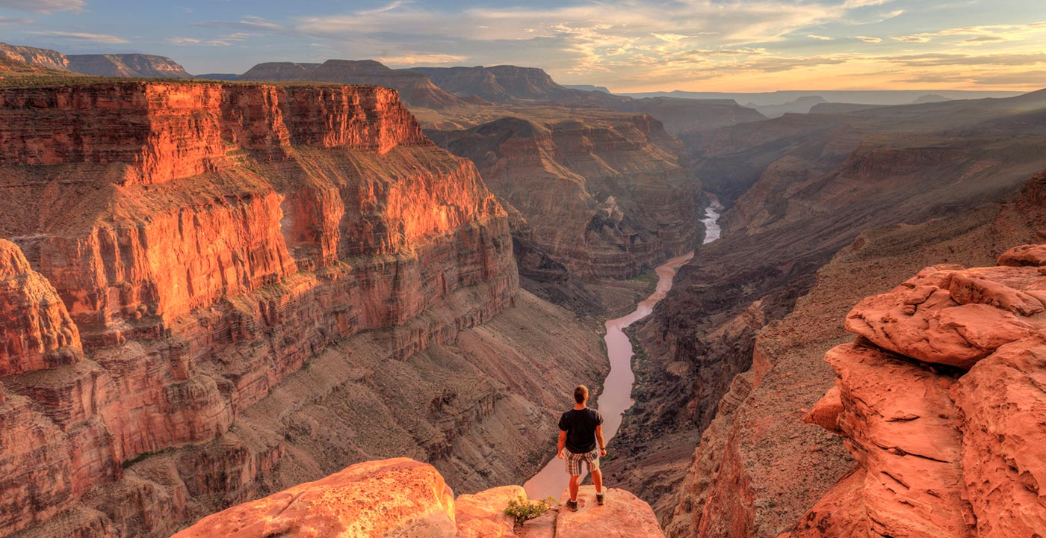

Slide 34
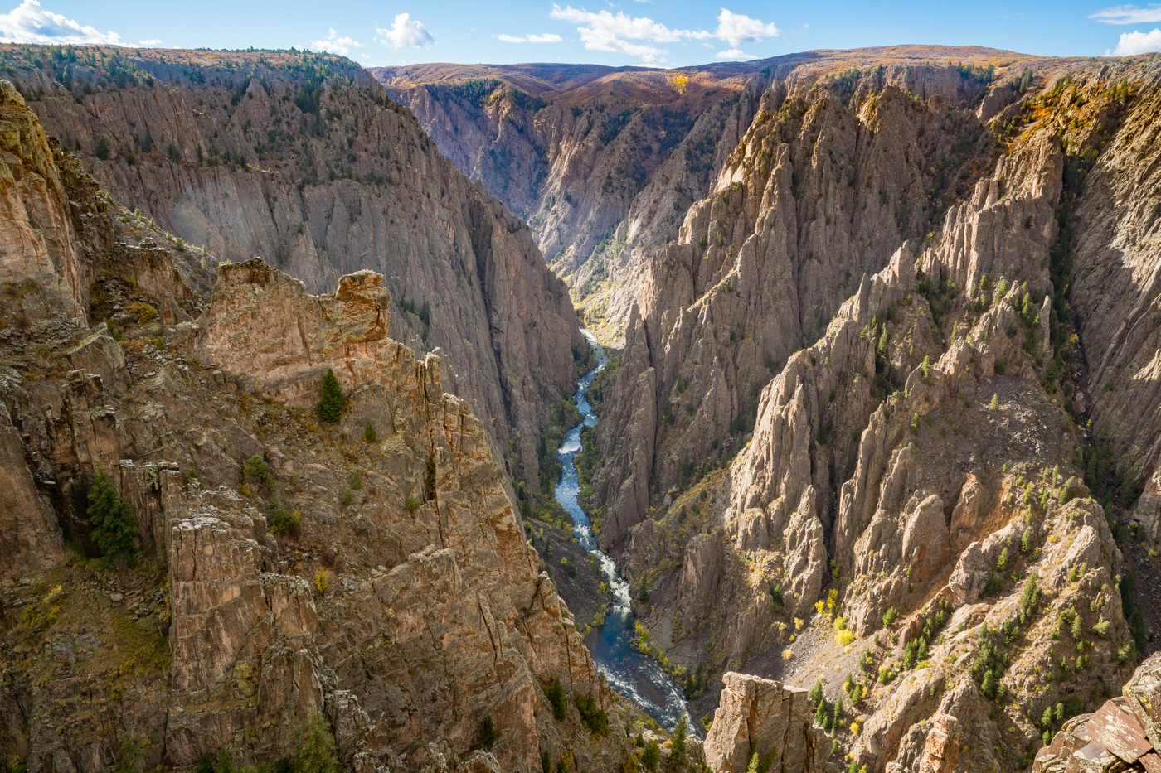

Slide 35
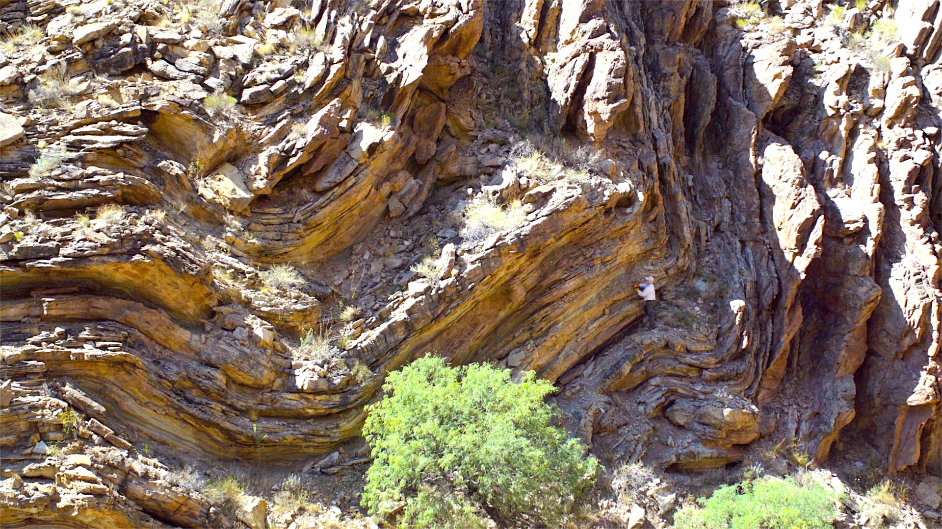
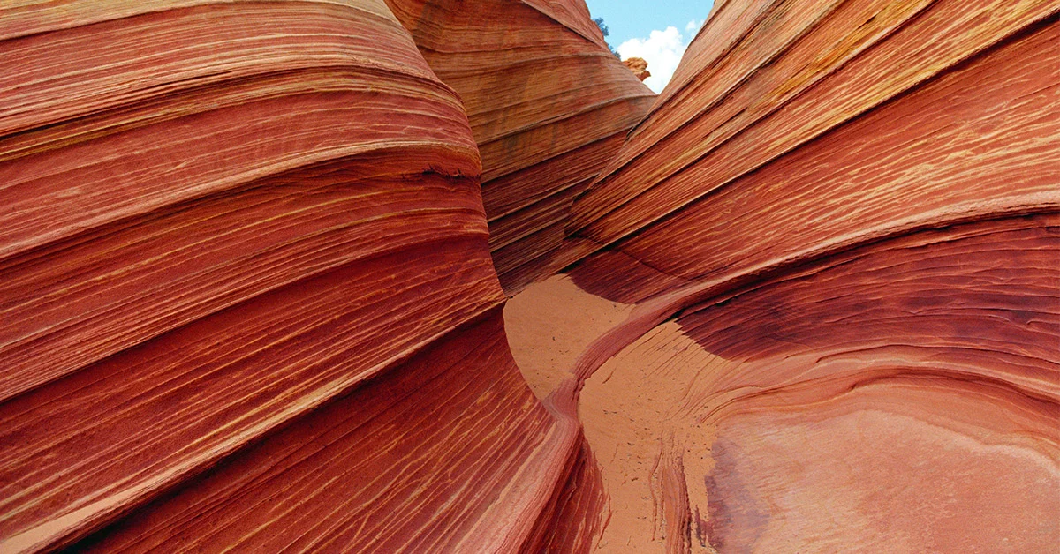
Evidence of a massive, world-wide flood can be seen all over the world! These bent rock formations were formed in layers of mud that turned into solid rocks.

Slide 36
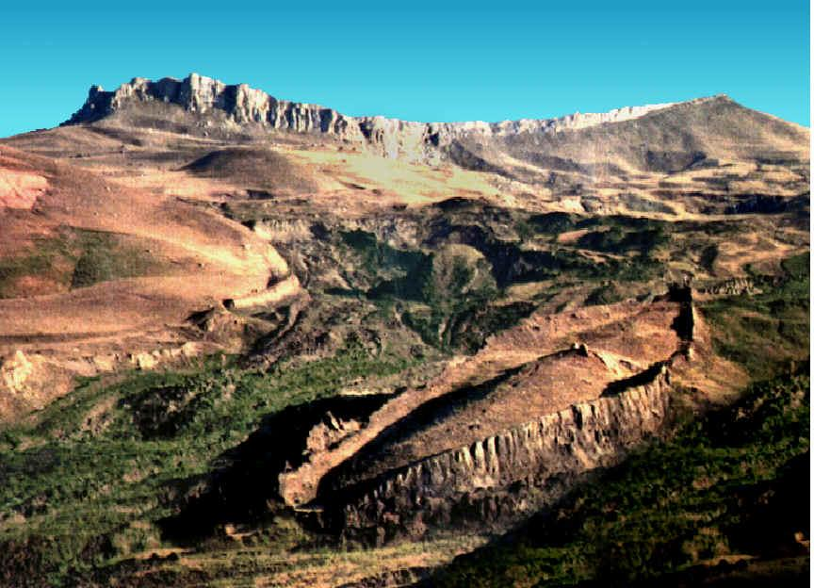

You can trust the Bible . . . there WAS A WORLD-WIDE FLOOD in the days of Noah!

Slide 37
You can find many more videos and articles about the FLOOD and many other fascinating subjects at www.Discovery.Global
You will want to check out . . .

Slide 38


Slide 39


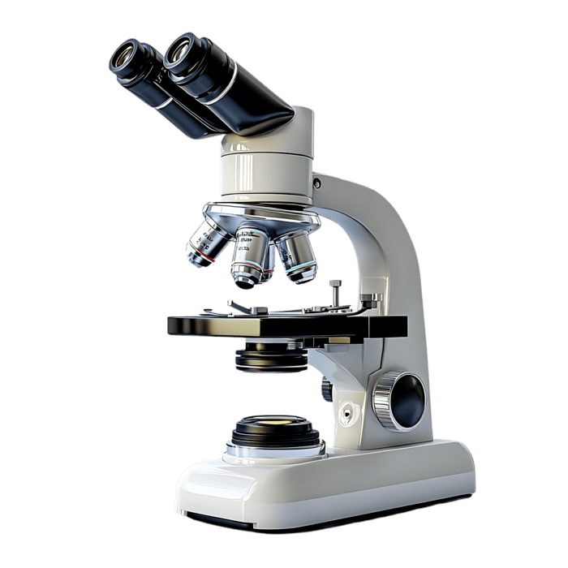

The Bible and SCIENCE
www.Discovery.Global
Does the Bible contradict true SCIENCE?

Slide 40

ARCHEOLOGY
www.Discovery.Global
BIBLICAL DISCOVERIES

Slide 41
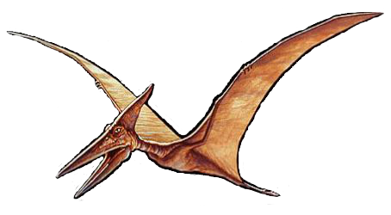
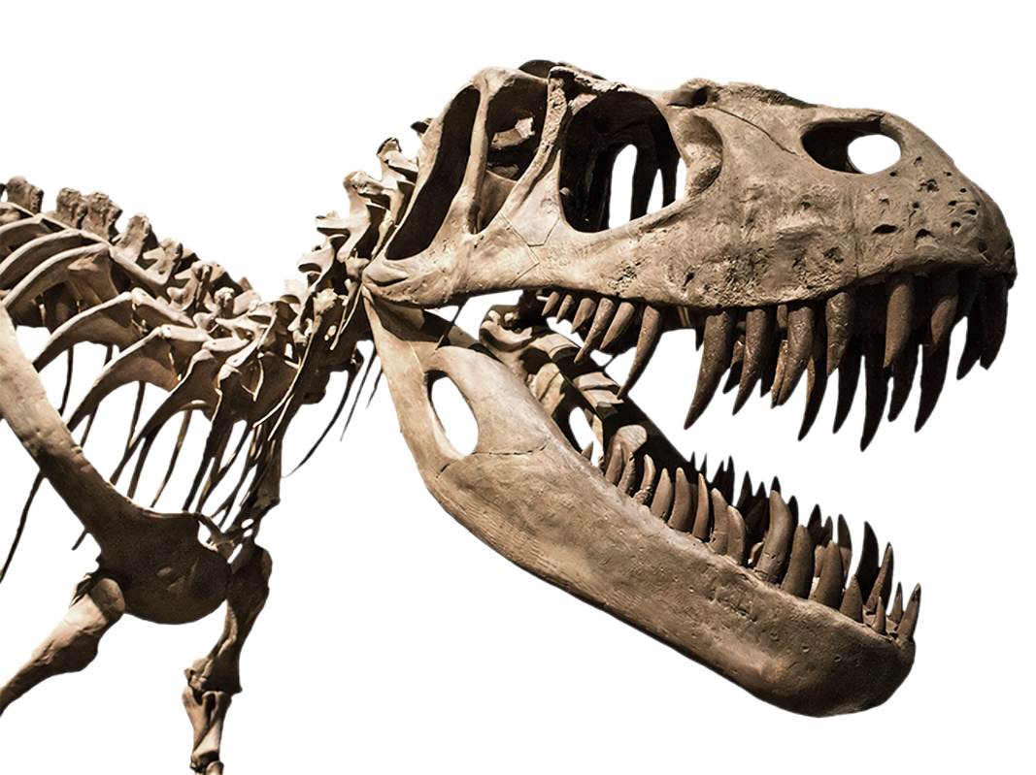
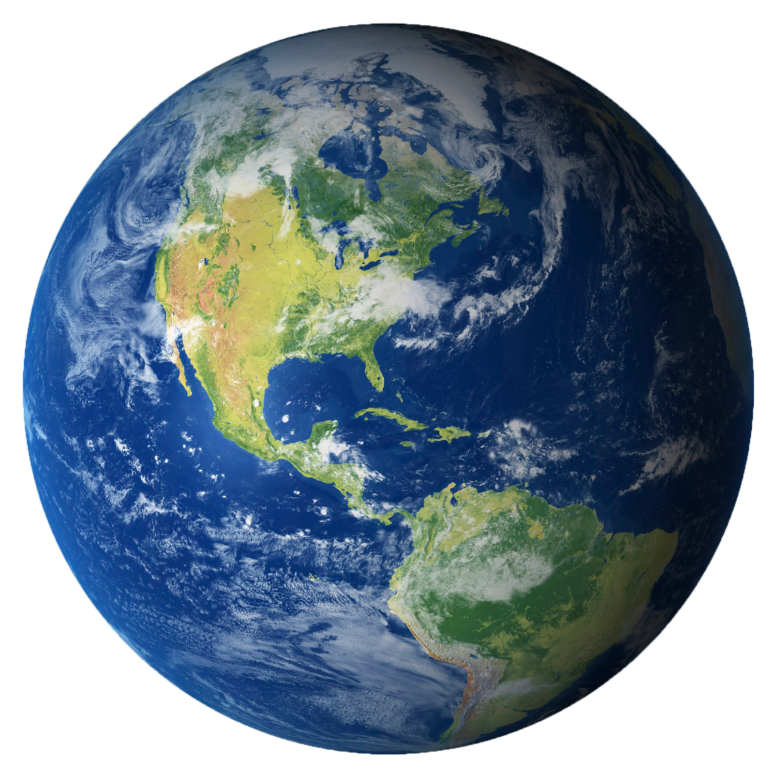
AGE OF PLANET EARTH
www.Discovery.Global
DINOSAURS and FOSSILS

Slide 42






FULFILLED BIBLE PROPHECY
www.Discovery.Global
ISLAM
ISRAEL
KINGS OF THE EAST
RUSSIA
ISRAEL and GENTILE NATIONS

Slide 43
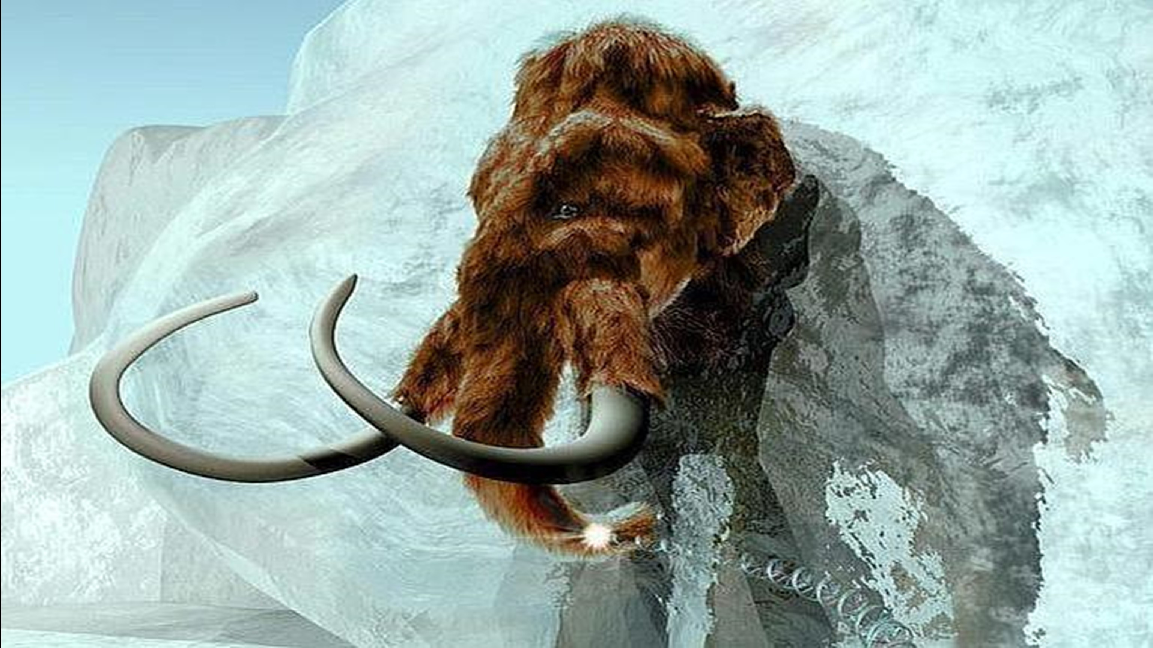
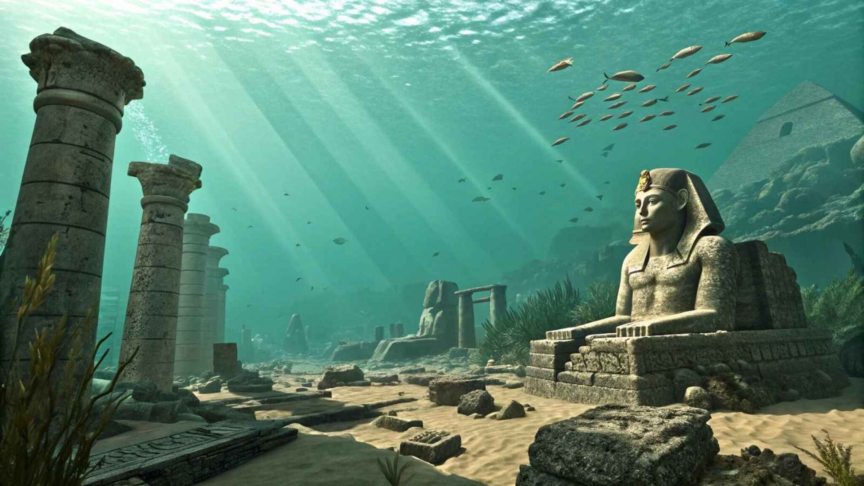
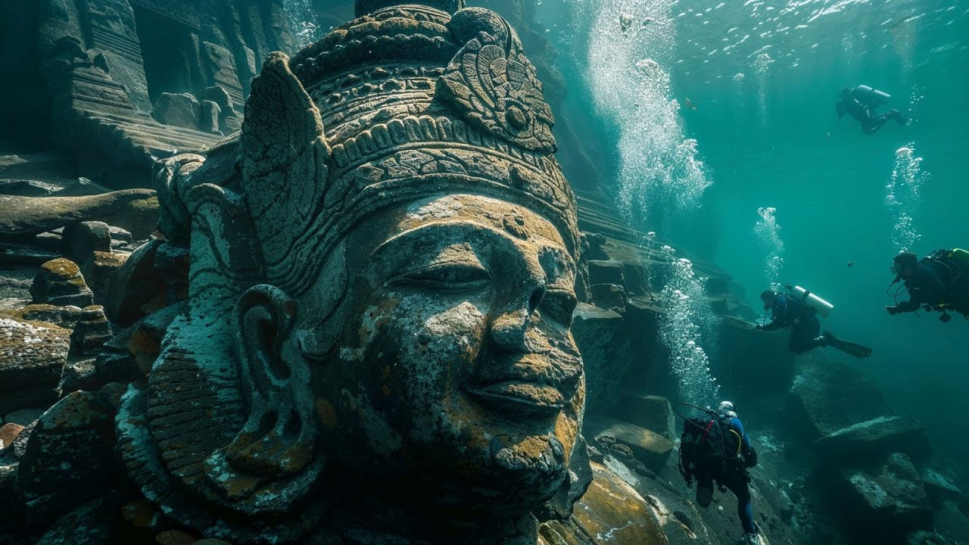
www.Discovery.Global
?
?
MYSTERIES OF THE FLOOD

Slide 44
We have also printed booklets which we want to make available to you for distribution and all we ask is for a free will offering of any size to help us cover the cost of mailing. You can request copies at . . .
DiscoveryNews1@ aol.com
(303) 564-7581

Slide 45



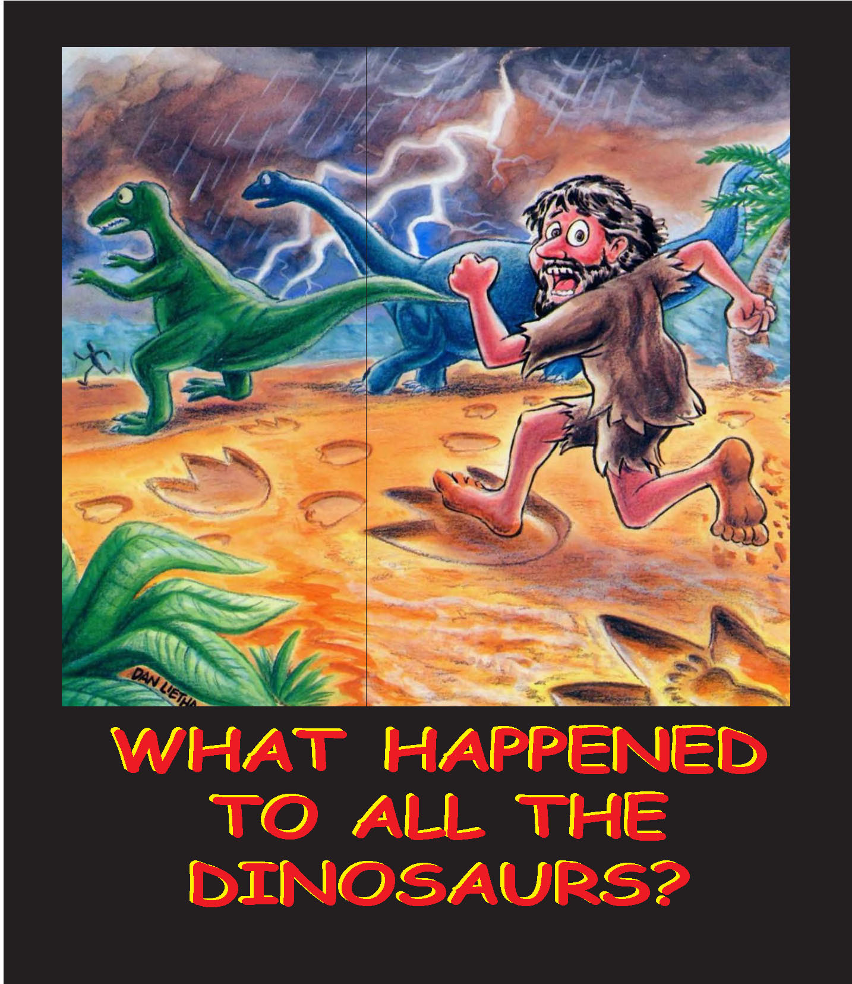
DiscoveryNews1@aol.com
(303) 564-7581

Slide 46
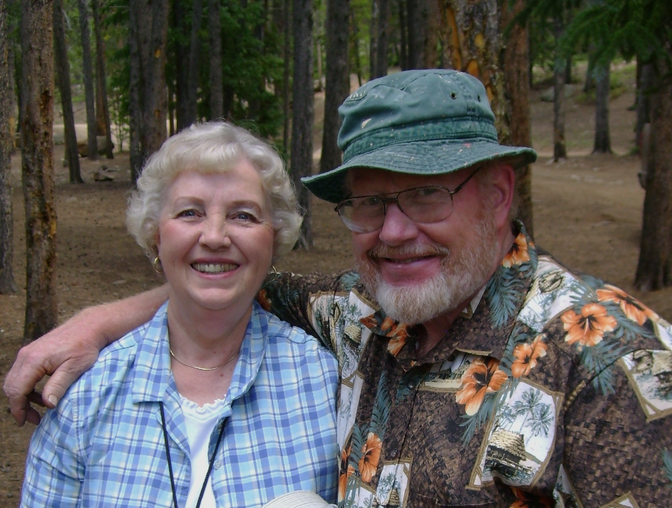
DiscoveryNews1@aol.com
(303) 564-7581

