Slide 1
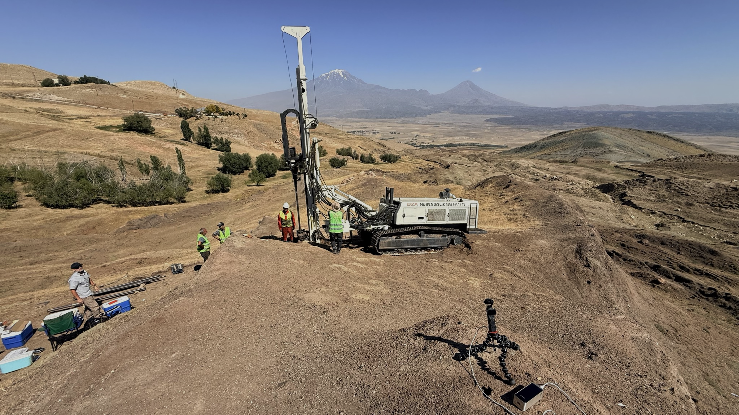

BREAKING NEWS!
The 2026 Noah’s Ark Research Project

Slide 2
INSTRUCTIONS:
For public presentations, you can delete the pages with text over the black background. These pages are for your benefit, so you have an idea what you can say for the pictures following.
Permission is granted to duplicate and use this presentation.
FOREIGN TRANSLATIONS: You are encouraged to translate the text into another language and make them available to other Christian leaders. We can make those translated files available for distribution.

Slide 3
BREAKING NEWS!
The 2026 Noah’s Ark Research Project

Slide 4
Greetings. My name is Chuck Anderson. I’m the editor of Discovery News.
For a number of years now, I have been reporting on some of the Biblical Discoveries that help verify the absolute accuracy of the Bible . . .

Slide 5


BREAKING NEWS!

Slide 6
. . . things like evidence of Sodom and Gomorrah
. . . Chariot wheels in the Red Sea
. . . the split rock at Horeb where Moses struck the rock and water gushed out for over 1 million Hebrews and all their animal flocks

Slide 7
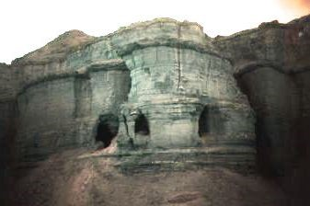
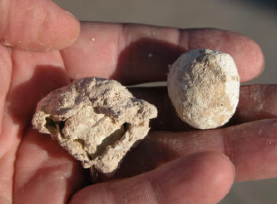
Sodom and Gomorrah
Sulfur brimstones

Slide 8
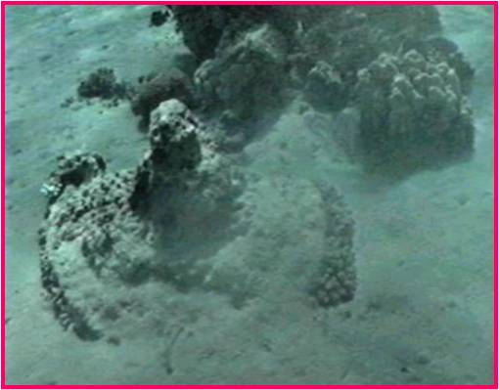
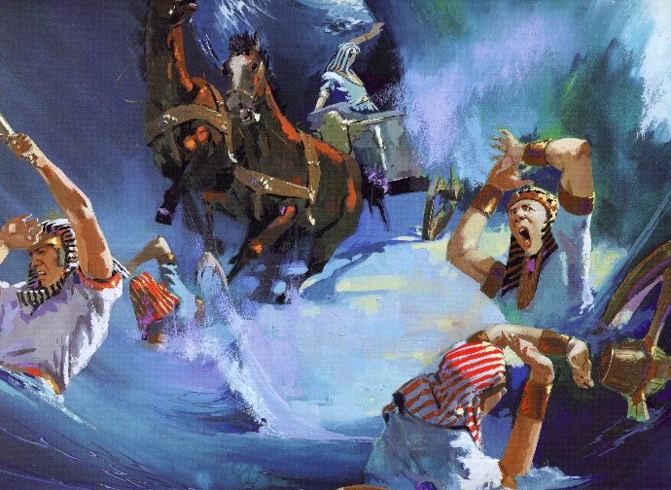
CHARIOT WHEELS in the Red Sea

Slide 9
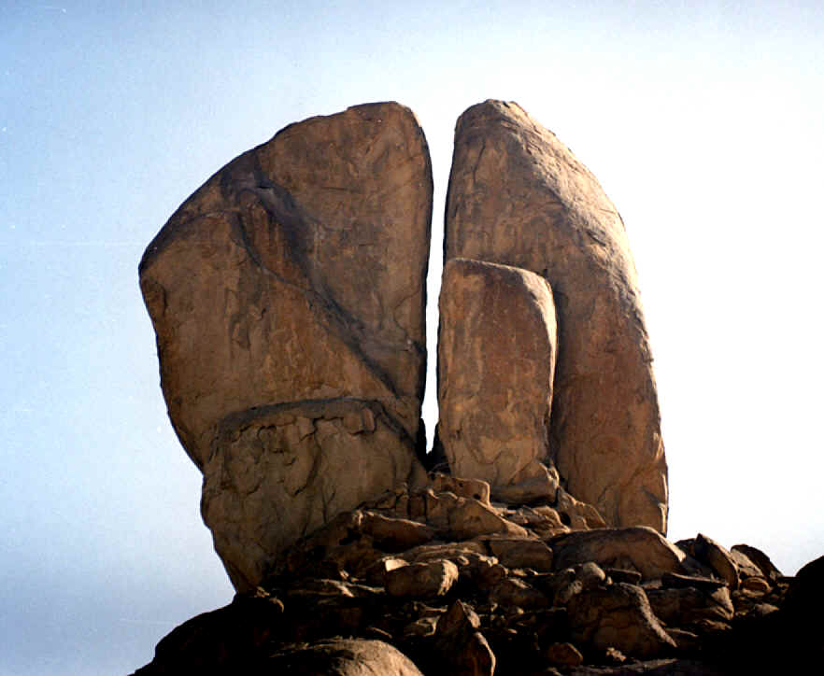
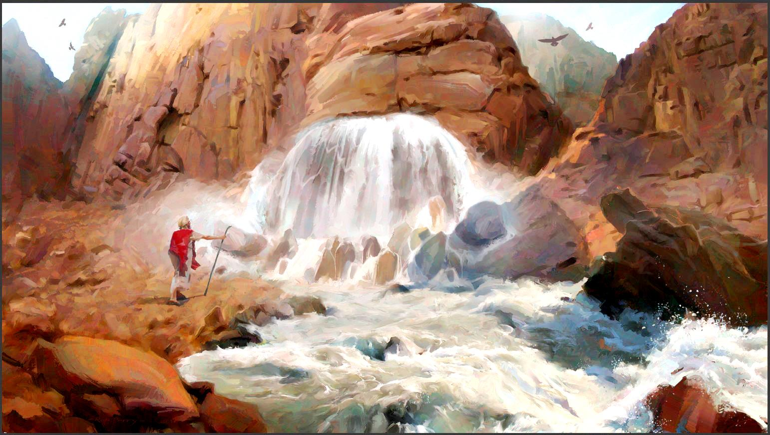
Split Rock at Horeb

Slide 10
. . .the real Mt. Sinai where the Lord came down like the fire of a burning furnace and melted the rocks on the top of the mountain.
. . . The Garden Tomb outside the walls of Jerusalem where Jesus was buried for three days and three nights. The empty tomb is just a short distance from Golgotha, the place of the skull.

Slide 11
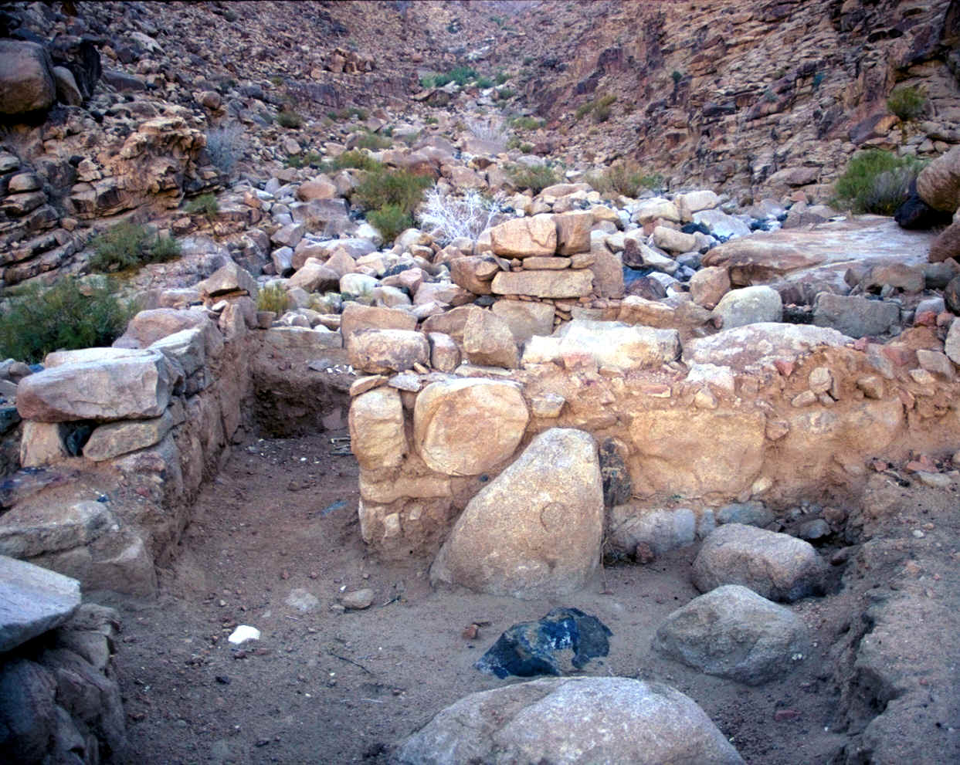
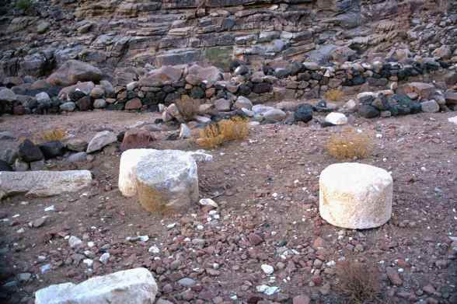
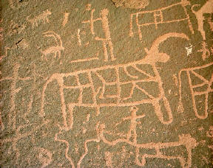
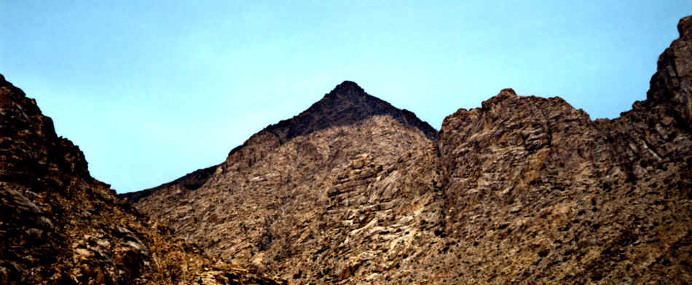
Mountain burned black
Sacrificial altar area
The real Mount Sinai in Saudi Arabia

Slide 12
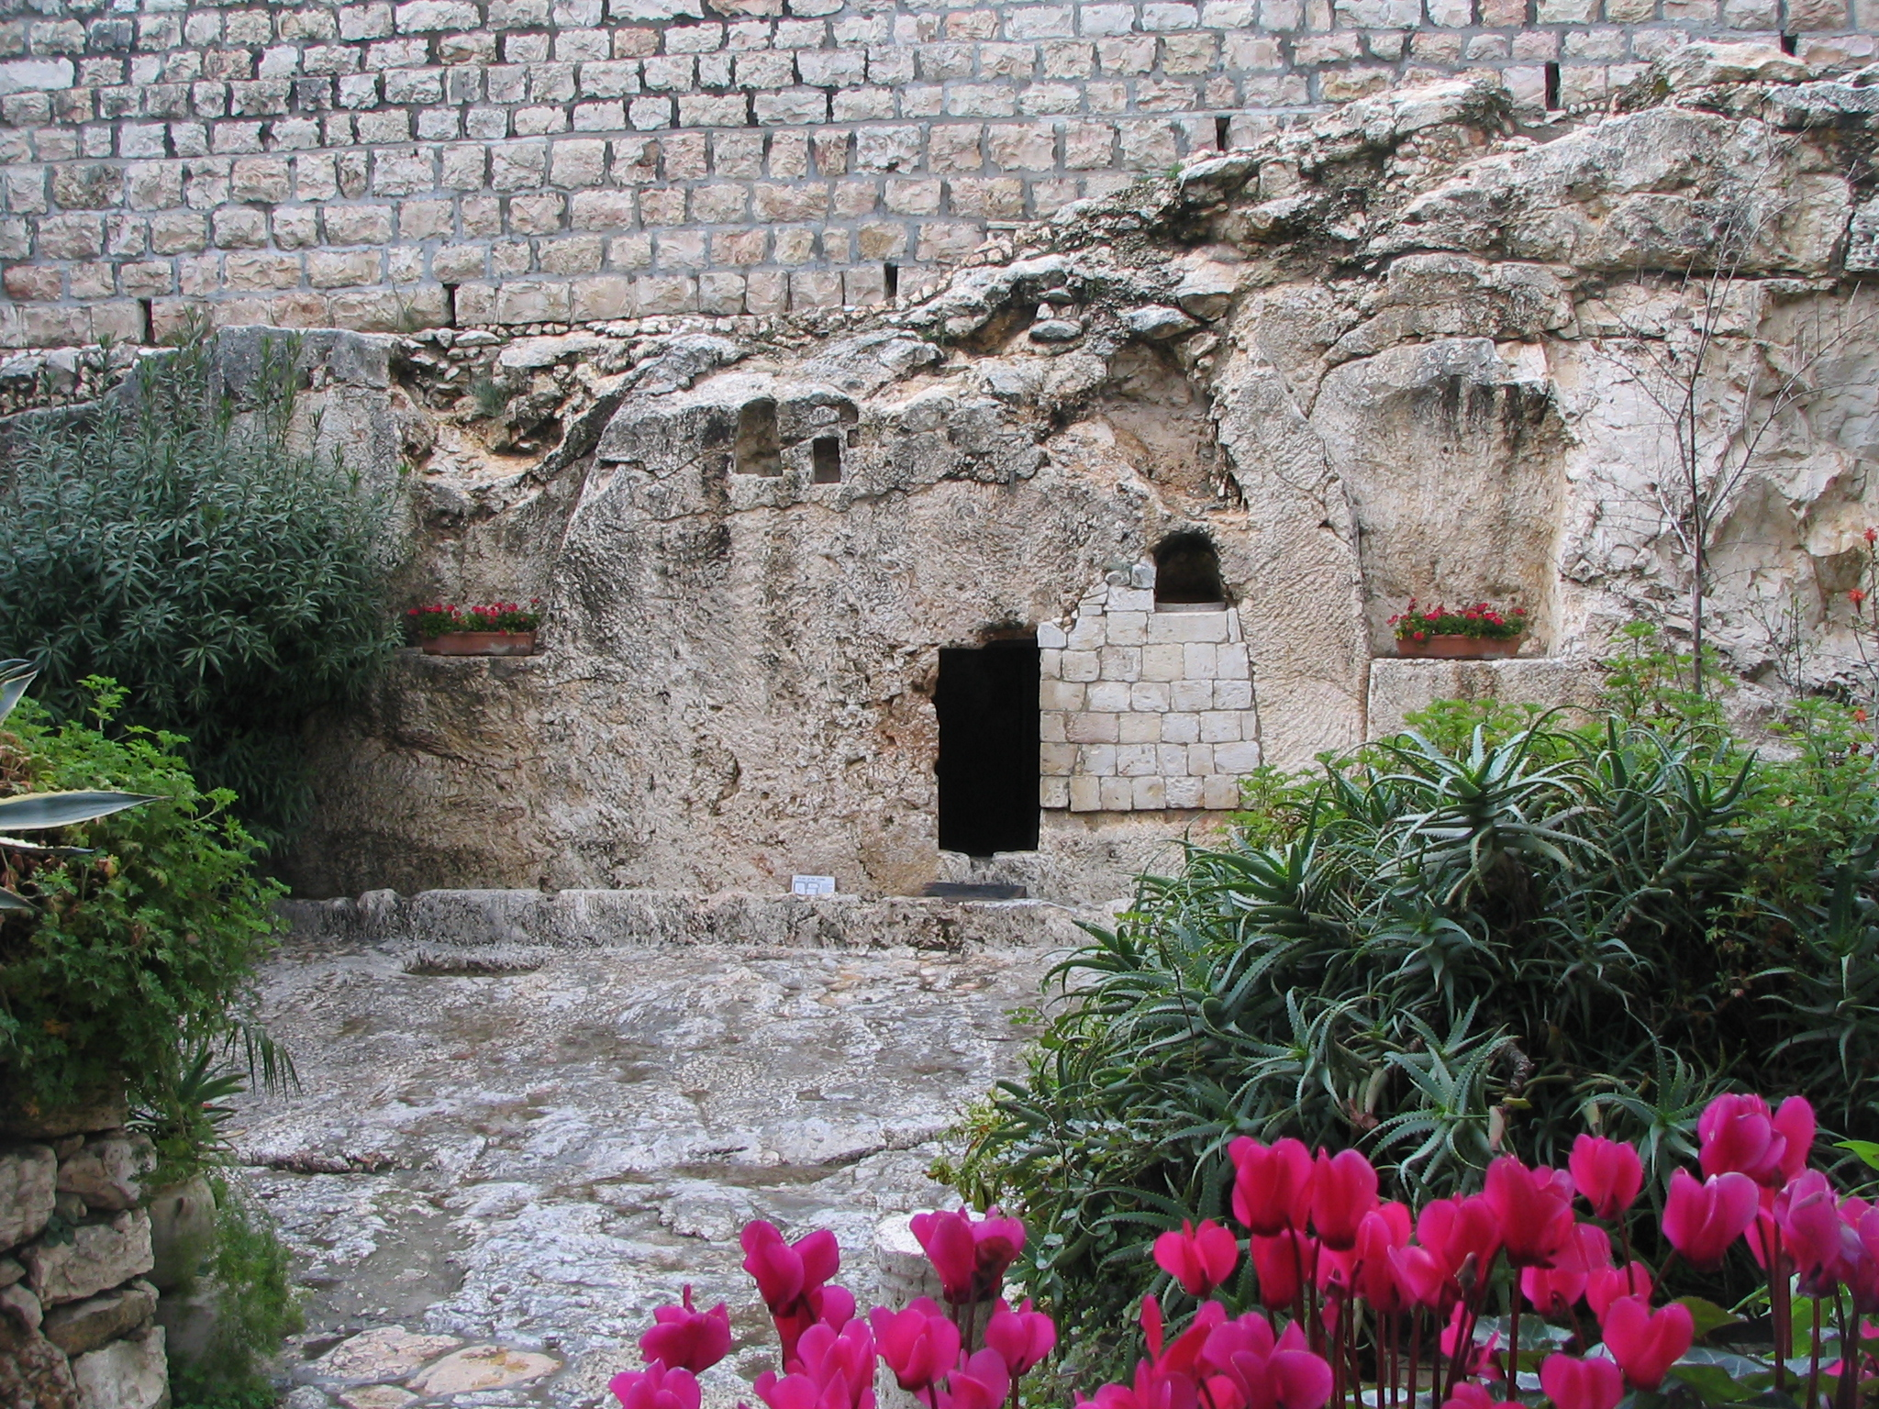
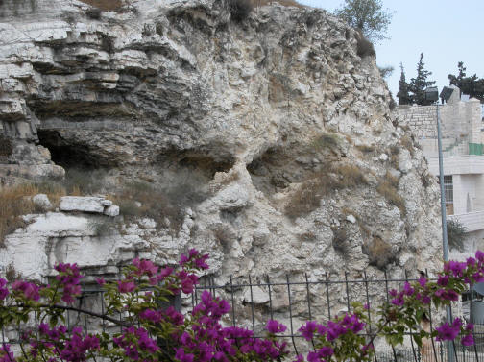
Garden Tomb where Jesus was resurrected after 3 days.
Golgotha, the place of the skull near the Garden Tomb.

Slide 13
But one of the most exciting News Breaks is the recent development and verification process of Noah’s Ark in the foothills of Mount Ararat in eastern Turkey.
It is called The 2026 Noah’s Ark Research Project.

Slide 14
BREAKING NEWS!
The 2026 Noah’s Ark Research Project

Slide 15
You might wonder WHAT’S SO EXCITING ABOUT THAT?
First . . . Let me give you a little background on the search for Noah’s Ark . . .

Slide 16
BREAKING NEWS!
?
The 2026 Noah’s Ark Research Project

Slide 17
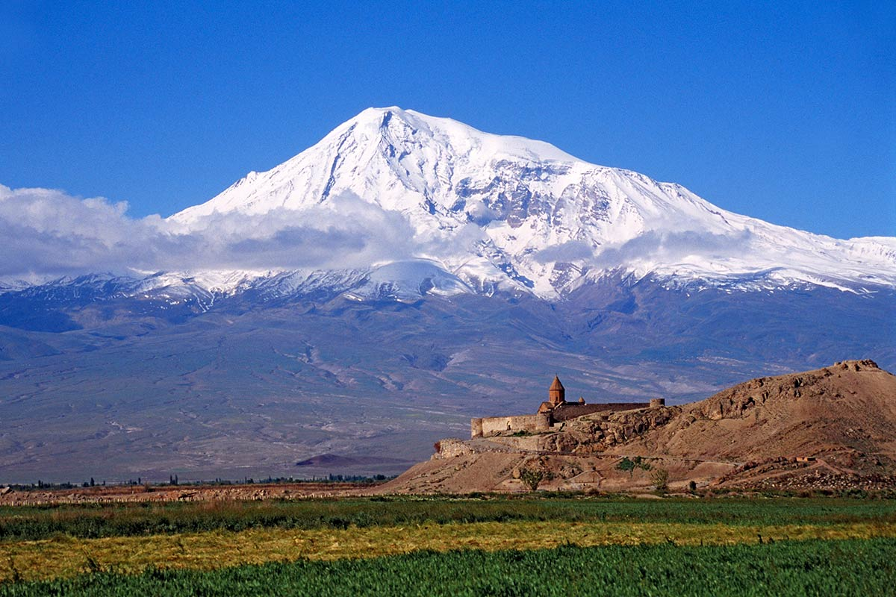
16,854’
For years, explorers have been searching for Noah’s Ark in the snow, high up on the steep slopes of Mt. Ararat in eastern Turkey.

Slide 18
Many men have died trying to climb that steep and dangerous mountain.

Slide 19
Imagine large animals like elephants, hippos, and dinosaurs trying to come down from this dangerous mountain!

Slide 20
?
Why would God rest the Ark in a place that would be nearly impossible for the animals to leave safely?

Slide 21
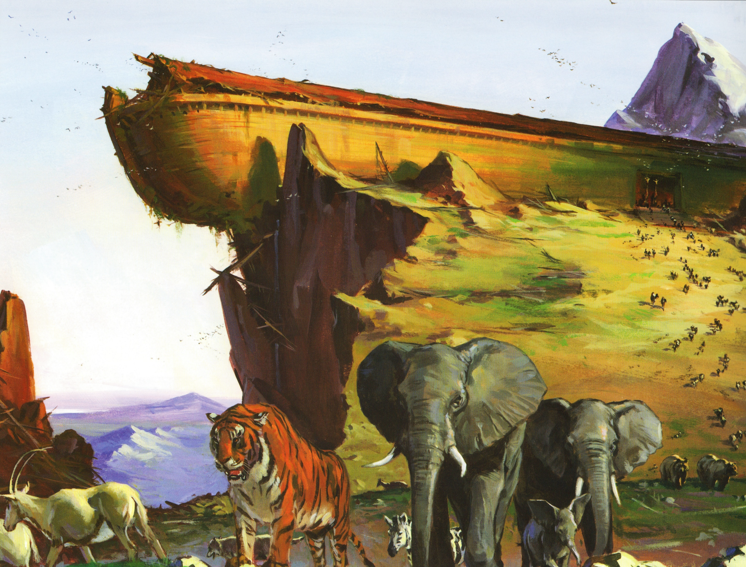
Genesis 8:4 – “And the ark rested in the seventh month, on the seventeenth day of the month, upon the mountains of Ararat.”

Slide 22
Genesis 8:4 – “And the ark rested in the seventh month, on the seventeenth day of the month, upon the mountains of Ararat.”

Slide 23
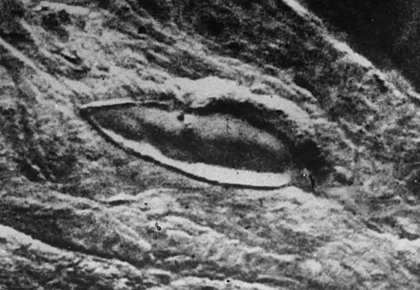
In 1949 a Turkish military aircraft took this aerial photo at a site in the foothills near Mount Ararat.

Slide 24
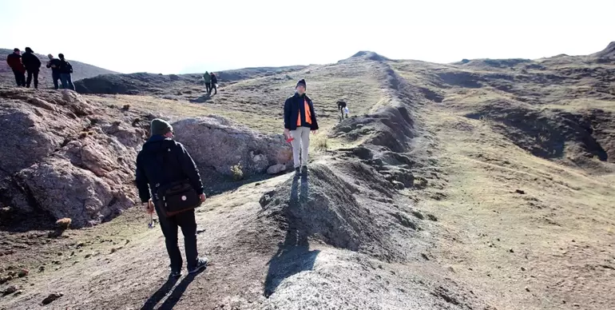
Later, several geologists visited the site but rejected the idea that it was the remnants of Noah’s Ark. They declared it was a natural rock formation . . . “just a pile of rocks.”

Slide 25
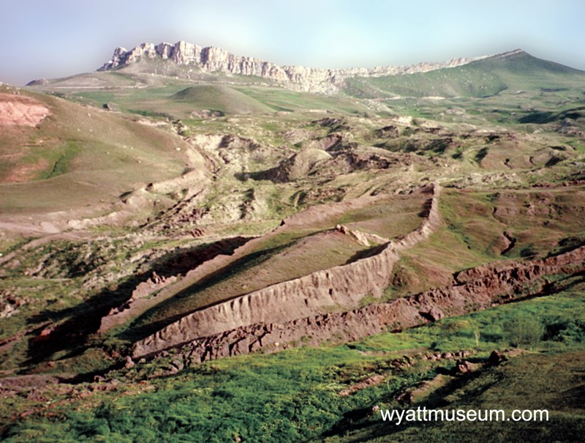
So for years it was pretty much ignored.

Slide 26
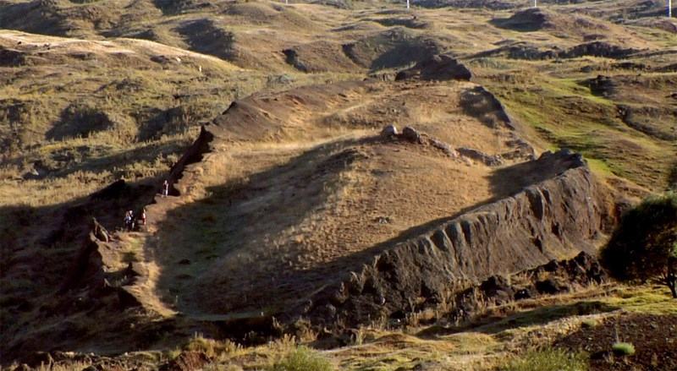
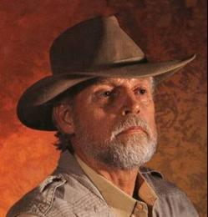
In 1978, an explorer by the name of Ron Wyatt began extensive research at the Ark landing site.

Slide 27
He was convinced that the shape was like that of a huge boat.

Slide 28
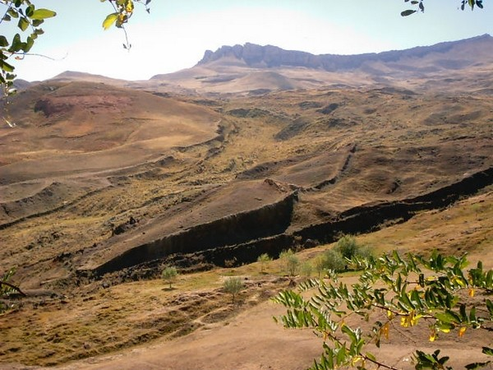
He believed that the ark had settled in mud which turned to rock and left the outline of the Ark.

Slide 29
The dimensions of that rock formation are exactly like the dimensions written in the Book of Genesis!

Slide 30
300 cubits x 50 cubits = 515’ long x 75’ wide
The dimensions of that rock formation are exactly like the dimensions written in the Book of Genesis!

Slide 31
Wyatt even made a small model of what he thought the ark may have looked like . . .
He patterned the model after the shape of the rock formation in Turkey.

Slide 32
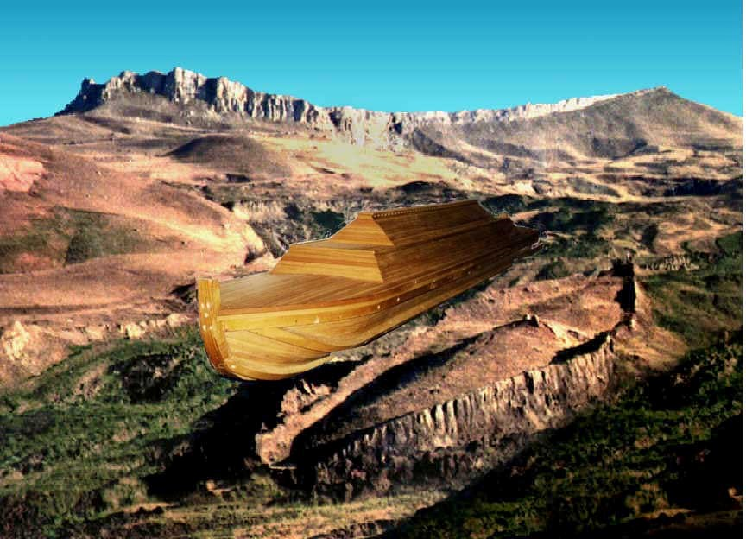
Ark model
Rock outline of the Ark

Slide 33
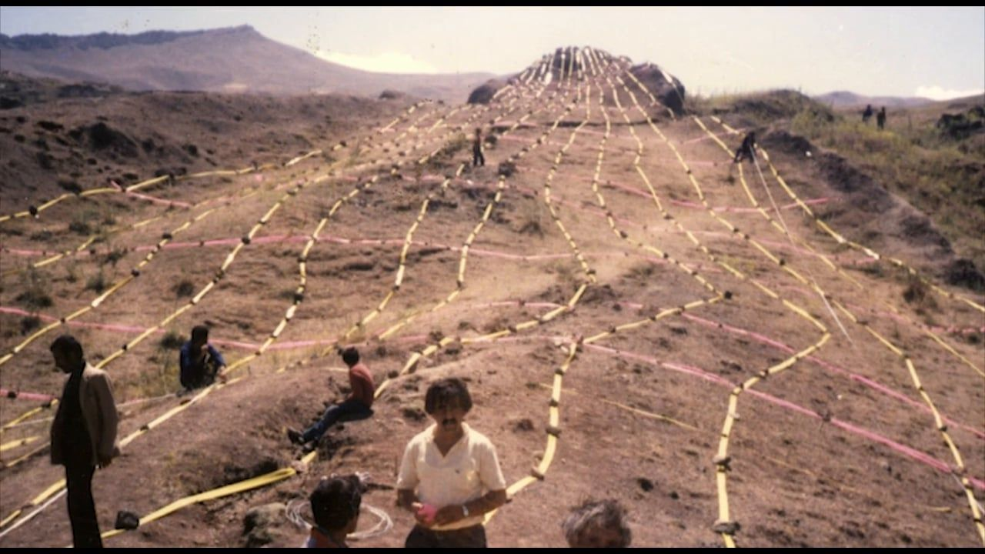
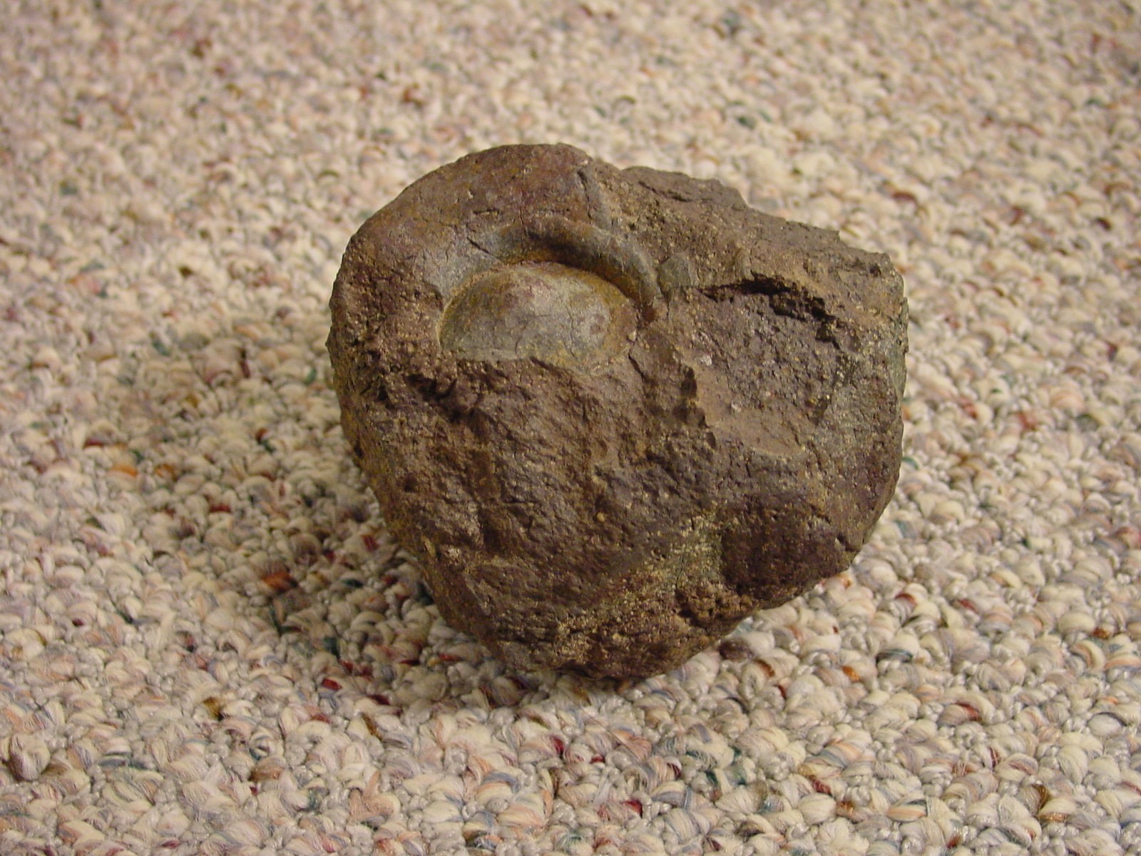
Metal rivets and metal fragments were found in the soil across the site which suggested a possible beam layout.

Slide 34
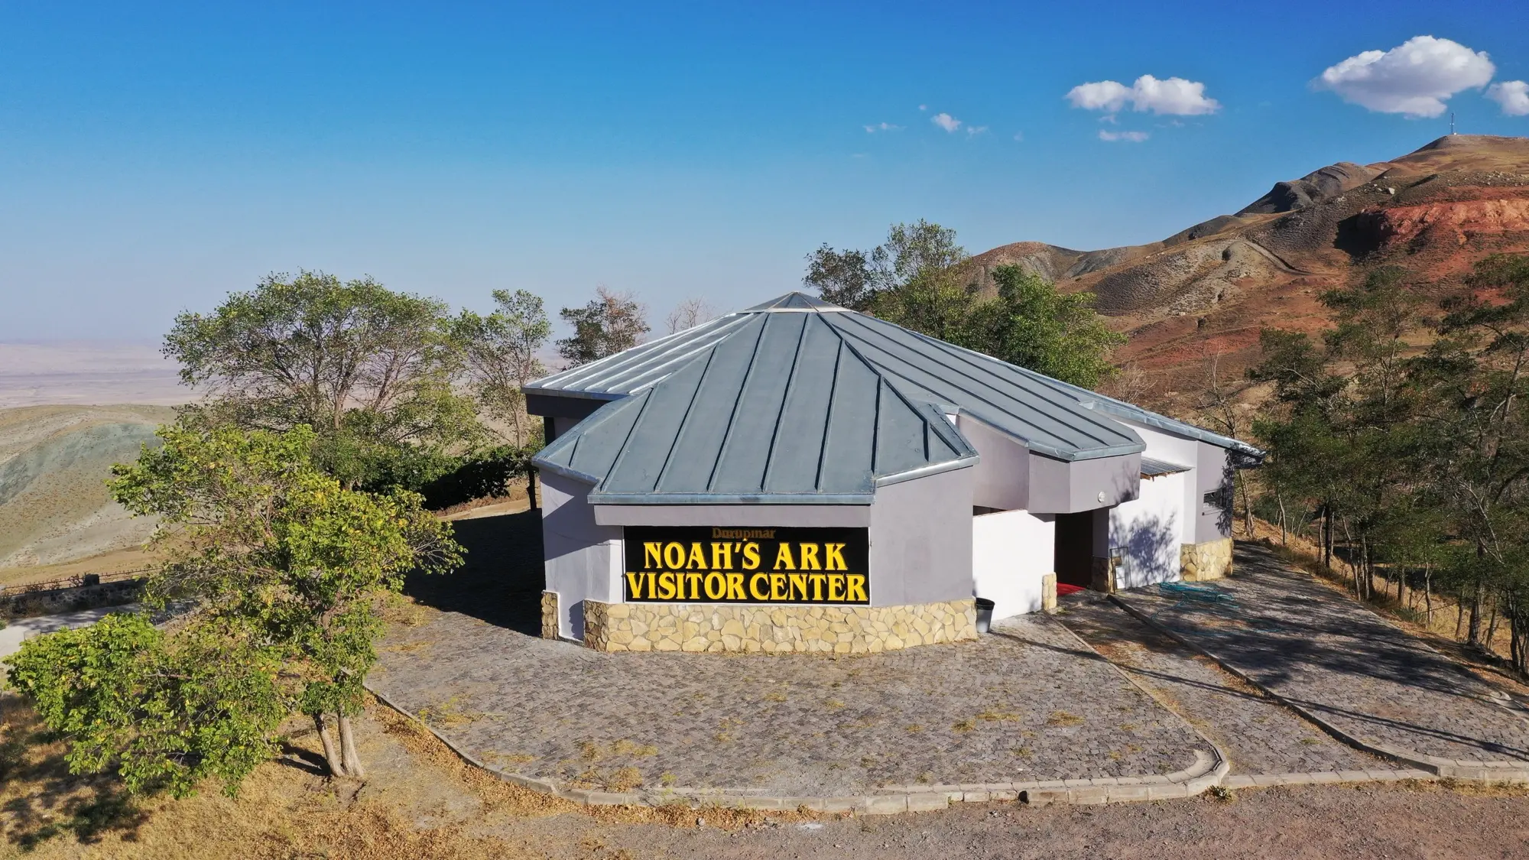
When the Turkish Government dedicated the site as a national park in 1987, a laminated petrified wood plank was detected by underground radar and dug up by soldiers who were there.

Slide 35
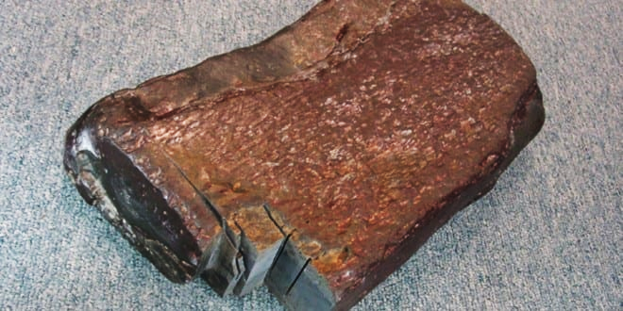
When the Turkish Government dedicated the site as a national park in 1987, a laminated petrified wood plank was detected by underground radar and dug up by soldiers who were there.

Slide 36
Laminated or layers of wood is evidence that this was a man-made structure.

Slide 37
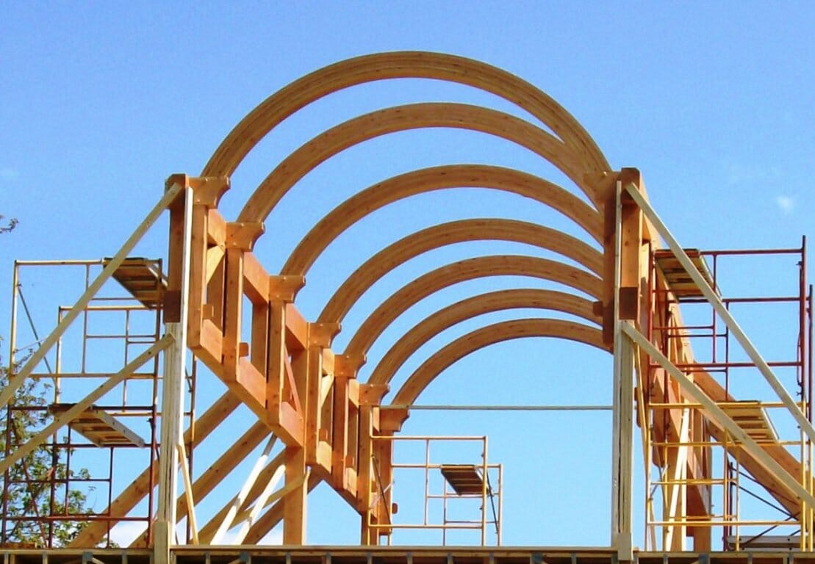
Laminated or layers of wood is evidence that this was a man-made structure. We use multi-layered laminated wood beams in construction today.

Slide 38
I visited Ron Wyatt’s widow in 2006.
Mary Nell was in possession of the laminated petrified wood plank . . . and one of the metal rivets that was also discovered on the site.

Slide 39
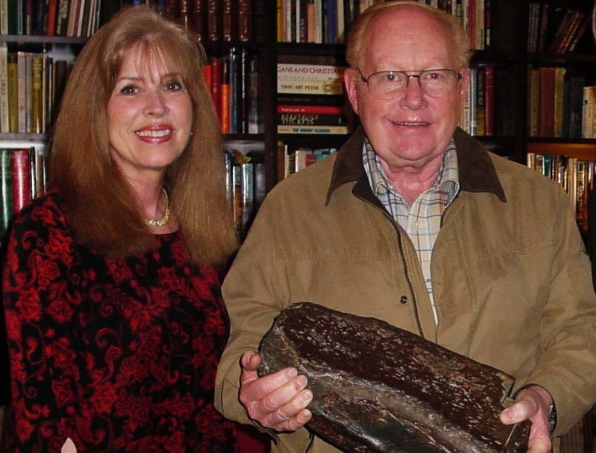
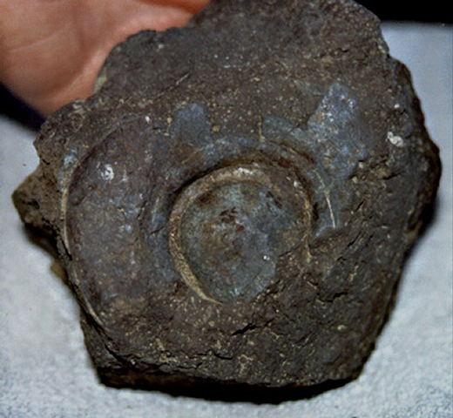
Mary Nell Wyatt

Slide 40
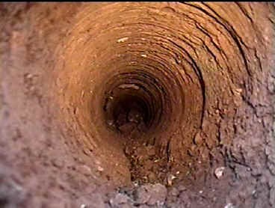
Core drilling at the Ark site revealed animal hairs and dung located far below the surface of the ground.

Slide 41
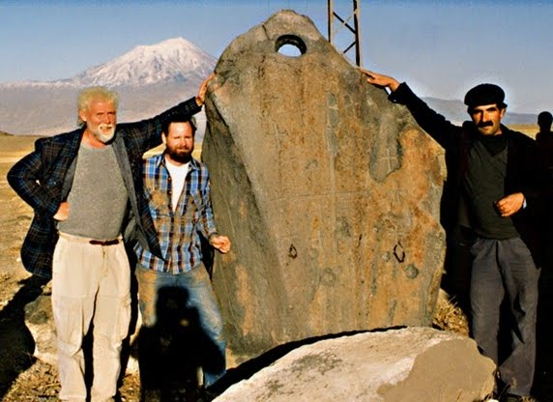
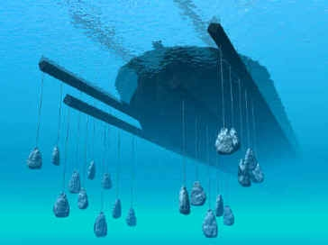
Numerous “drag stones” were also located in the area. The stones were used to stabilize the ark and keep its bow facing into the waves.

Slide 42
1980’s – 1990’s
Numerous “drag stones” were also located in the area. The stones were used to stabilize the ark and keep its bow facing into the waves.

Slide 43
1980’s – 1990’s
The idea that this was the landing site of Noah’s Ark has been debunked and ridiculed ever since.

Slide 44
It is interesting that the possible site of Noah’s Ark is at a much lower elevation than the 16,854 feet, snow covered mountain . . .

Slide 45
Elevation 6,575’

Slide 46

Elevation 6,575’

Slide 47
Genesis 8:11 – “The dove came in to Noah in the evening, and lo, in her mouth was an olive leaf plucked off . . .”
Elevation 6,575’

Slide 48
Olive trees do not grow up at 16,854 feet elevation!
Elevation 6,575’

Slide 49
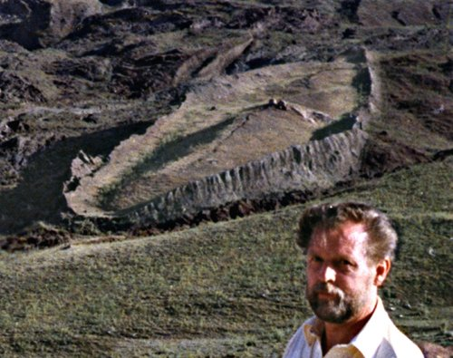
Rod Wyatt didn’t have all the professional credentials as a licensed architect . . . and his research was never verified by “professionals” nor an independent third-party lab before he died in 1999.

Slide 50
But in June of 2026 there was a wonderful break-through in the verification process that this was, indeed, the remnants of Noah’s Ark.

Slide 51
BREAKING NEWS!
The 2026 Noah’s Ark Research Project

Slide 52
BREAKING NEWS!
In June 2026 official permission was granted by the Turkish government to do ground penetrating research at the Noah’s Ark Site in eastern Turkey.

Slide 53
Andrew Jones is the director of Noah’s Ark Research Project and after years of seeking permission to do scientific research at the site, he entered an agreement of with the Sivas Cumhuriyet University, in Sivas, Turkey.

Slide 54
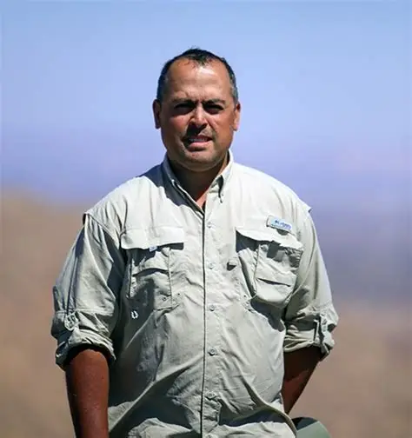
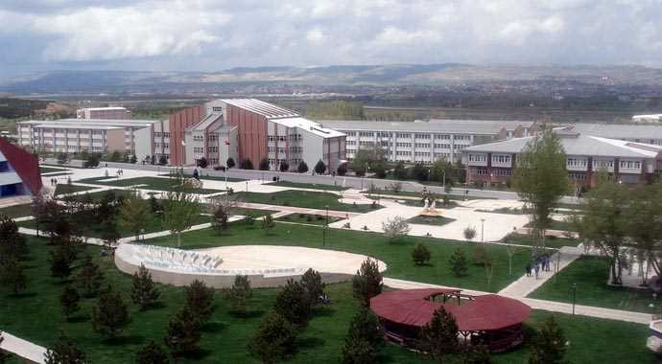
Sivas Cumhuriyet University Sivas, Turkey
Andrew Jones, Director Noah’s Ark Research
The 2026 Noah’s Ark Research Project

Slide 55
Dr. Cenker Atila, Professor at the University, agreed to oversee the project which ads professional credibility to the research.

Slide 56

Sivas Cumhuriyet University Sivas, Turkey
Dr. Cenker Atila Professor and Archeologist
The 2026 Noah’s Ark Research Project

Slide 57
BREAKING NEWS!
Equipment was immediately moved onto the site and the research began.

Slide 58
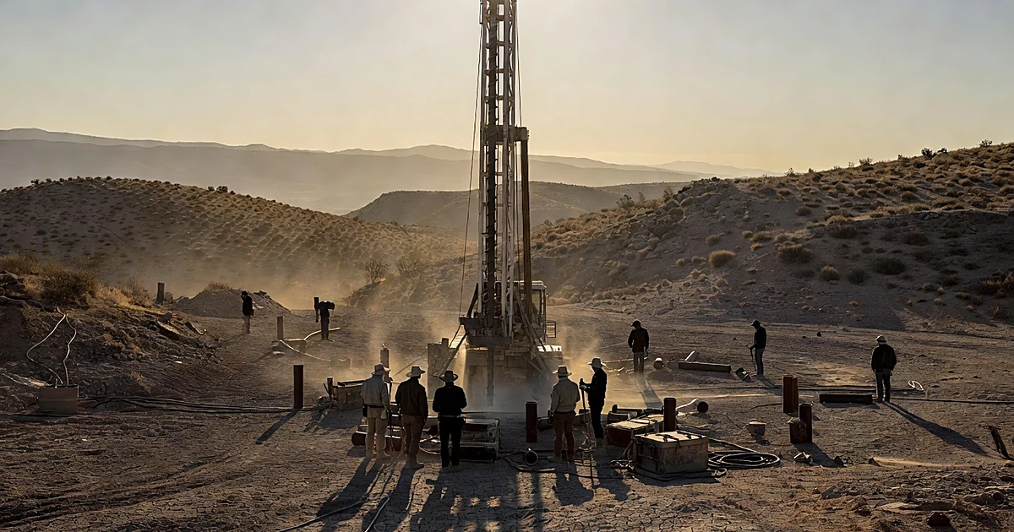
Core Samples revealed that this is in fact, a man-made object: NOT SOLID ROCK!

Slide 59
Ground radar scans revealed “organized subsurface patterns” / 90 degree corners / possible rooms and corridors.

Slide 60
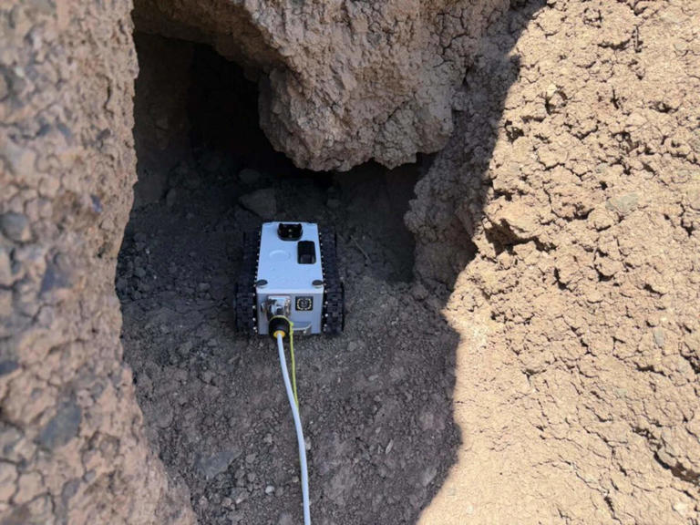
Robots were used to gather additional evidence from open underground “tunnels” discovered at the site.

Slide 61
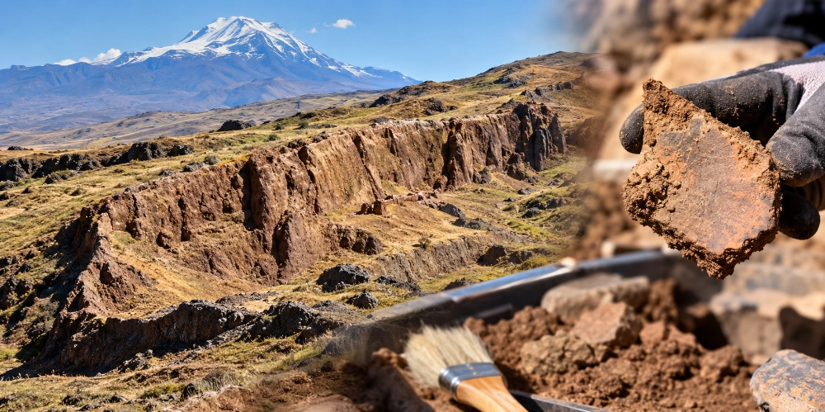
Man-made pottery chards were also recovered which tells us that this was a more than a natural rock formation!

Slide 62
Official, independent lab verifications of all samples and discoveries will be released in the spring of 2027!

Slide 63
The world may reject all the evidence, but everything points to the fact that this is the remnants of Noah’s Ark.

Slide 64
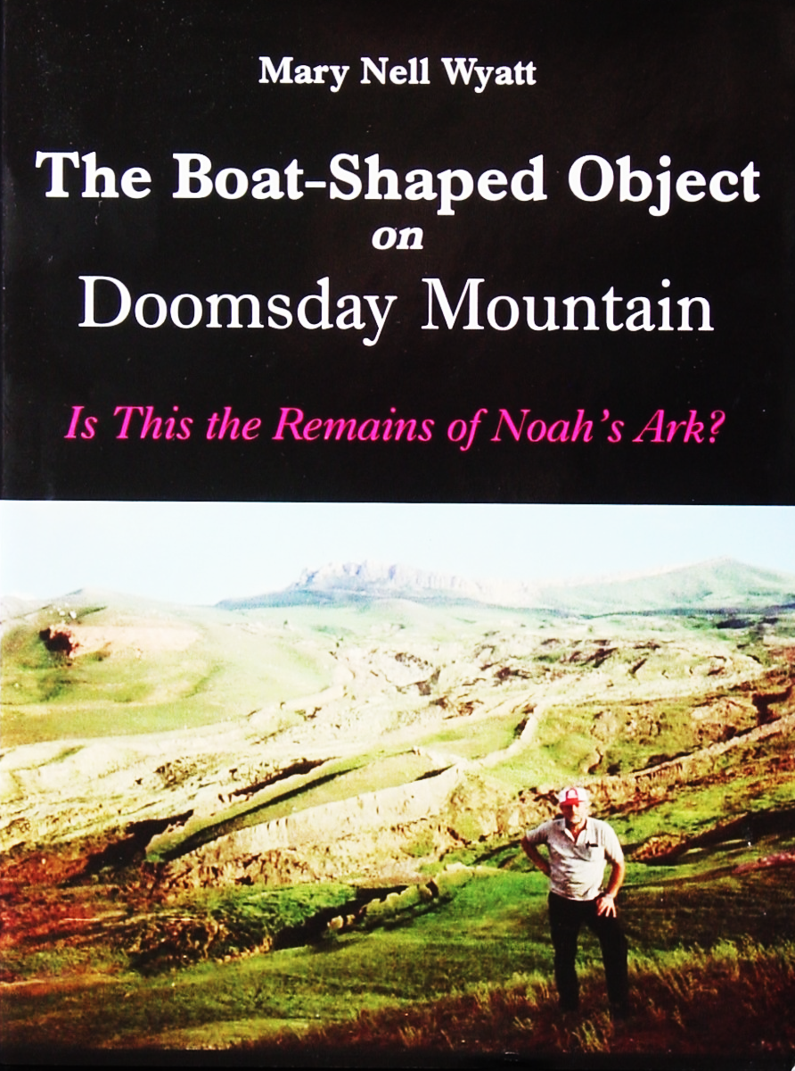
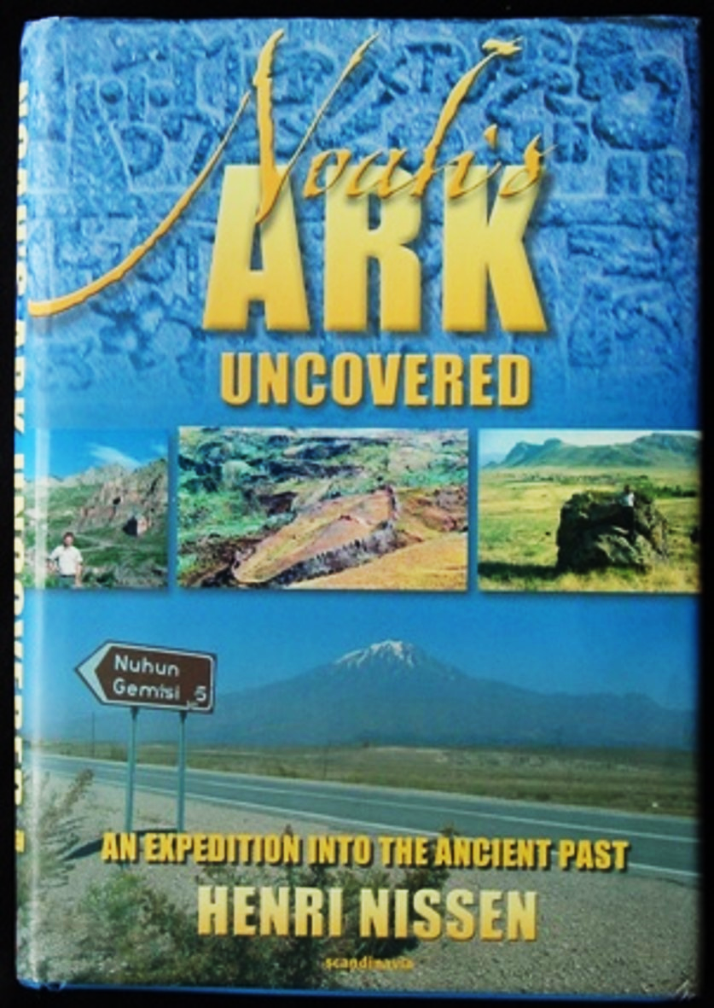
Video

Slide 65
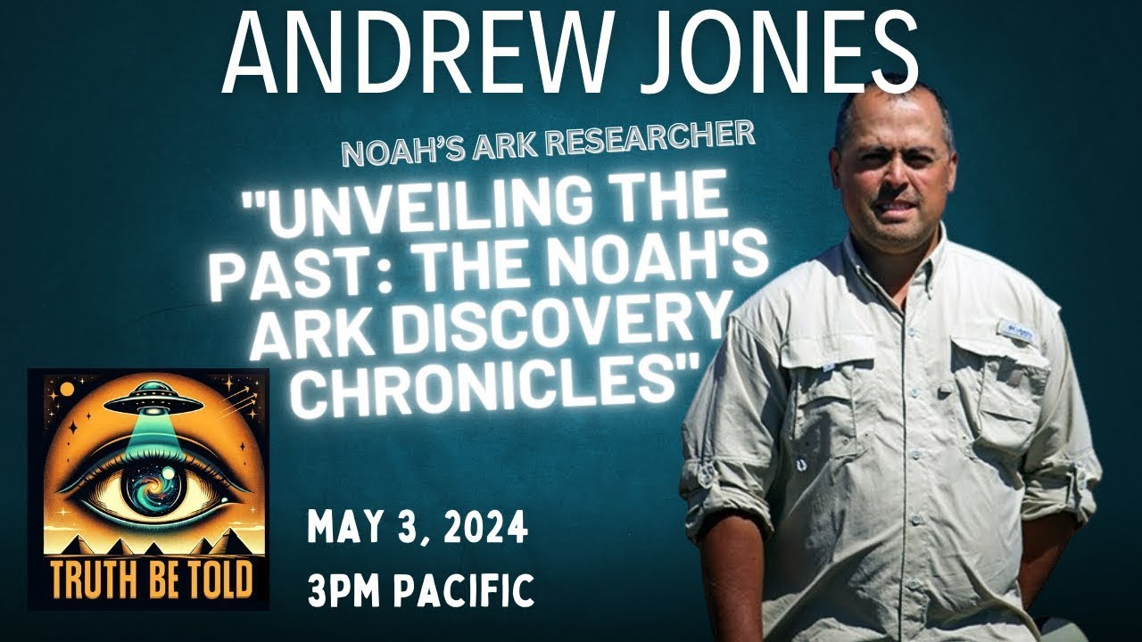
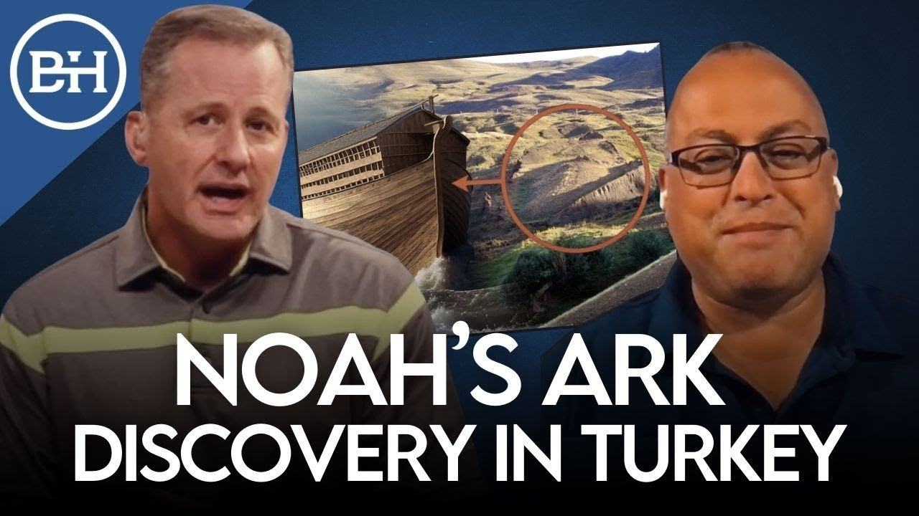
Google: Noah’s Ark Research Project

Slide 66

You can trust the Bible as the Word of God!

Slide 67
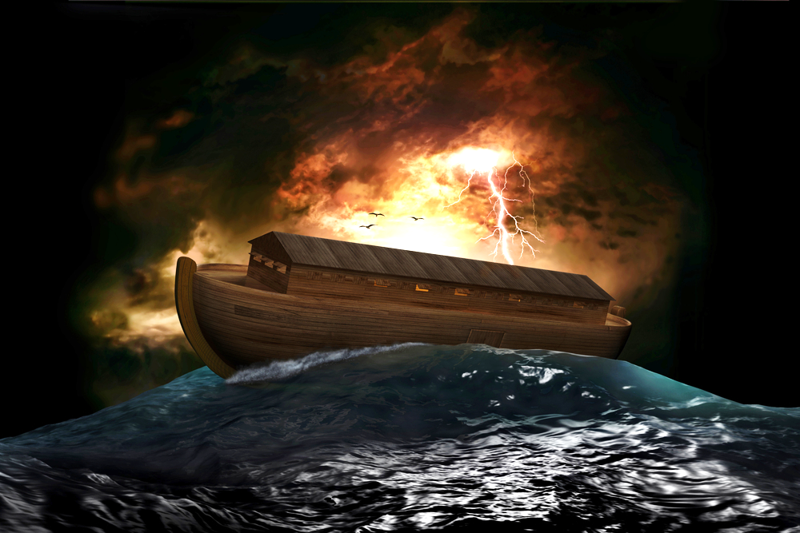
There are some GREAT MYSTERIES associated with the NOAH’S FLOOD . . . and you can see other videos at www.Discovery.Global

Slide 68
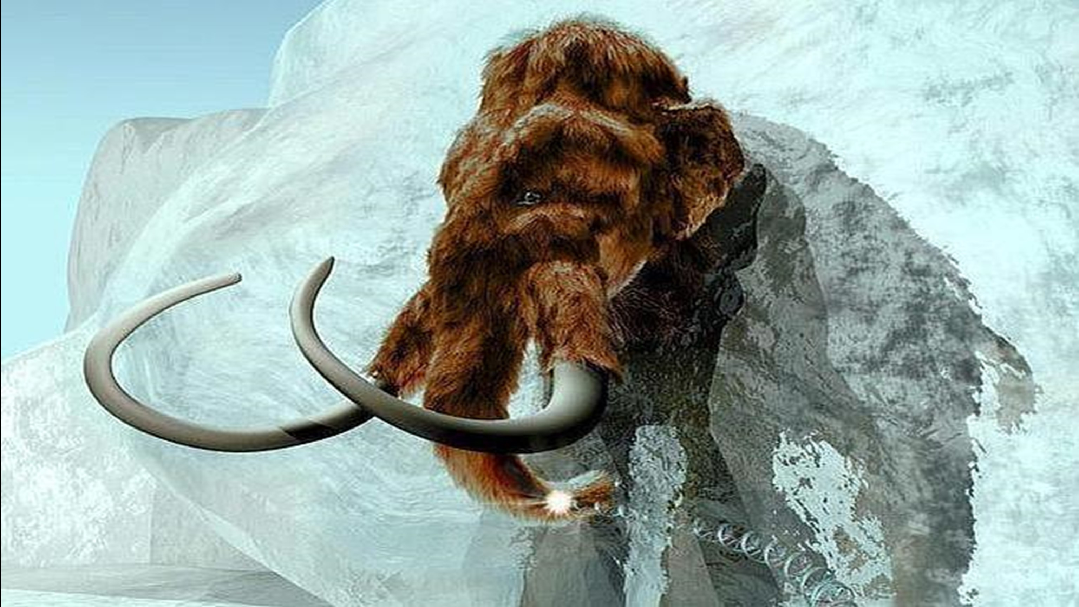
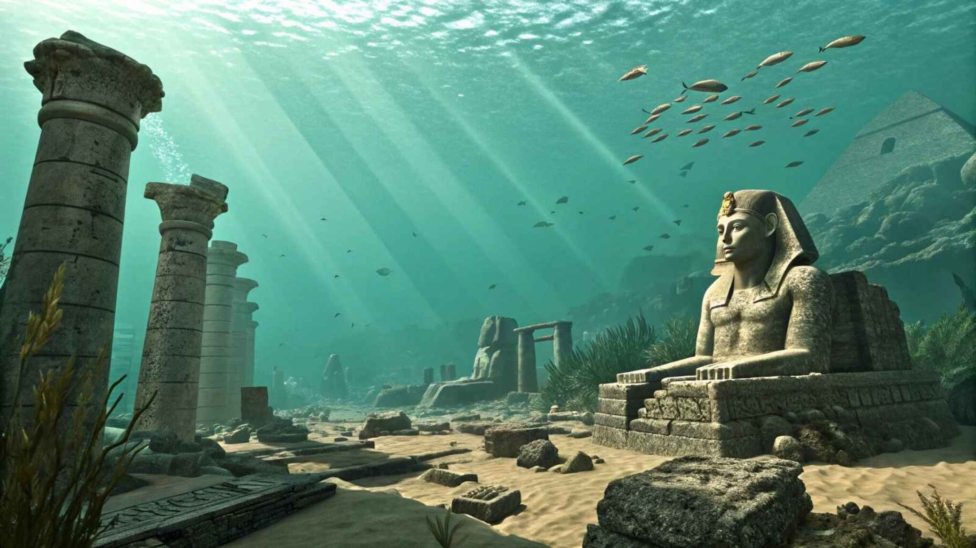
There are some GREAT MYSTERIES associated with the NOAH’S FLOOD . . . and you can see other videos at www.Discovery.Global
?
Mammoths in ice
Underwater cities

Slide 69
I would encourage you to pass this video to your friends and families . . .
. . . And you can request FREE illustrated gospel literature at (303) 564-7581

Slide 70




FREE illustrated gospel literature available at (303) 564-7581

Slide 71
BREAKING NEWS!
www.Discovery.Global

Slide 72
BREAKING NEWS!
Please pass this information on to you friends and family!

