Slide 1


Cheshire West & Chester Parent Carer Forum
Special Educational Needs and or Disability (SEND)
2025/26 Survey Results & Further Analysis
April 2026

Slide 2
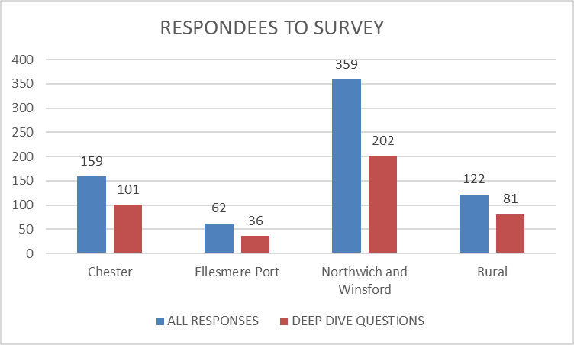
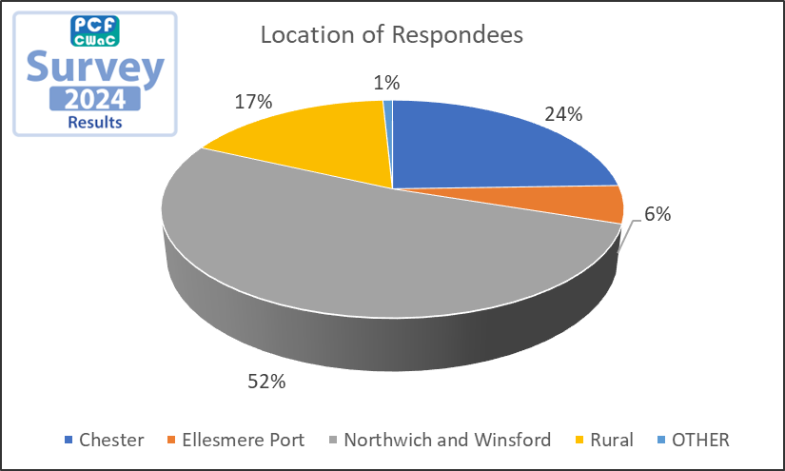
Q1: Please enter your postcode
23%
9%
51%
17%

Slide 3

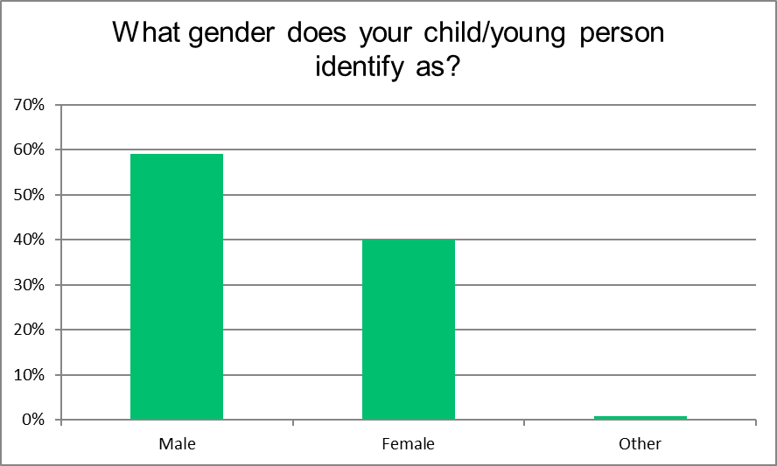
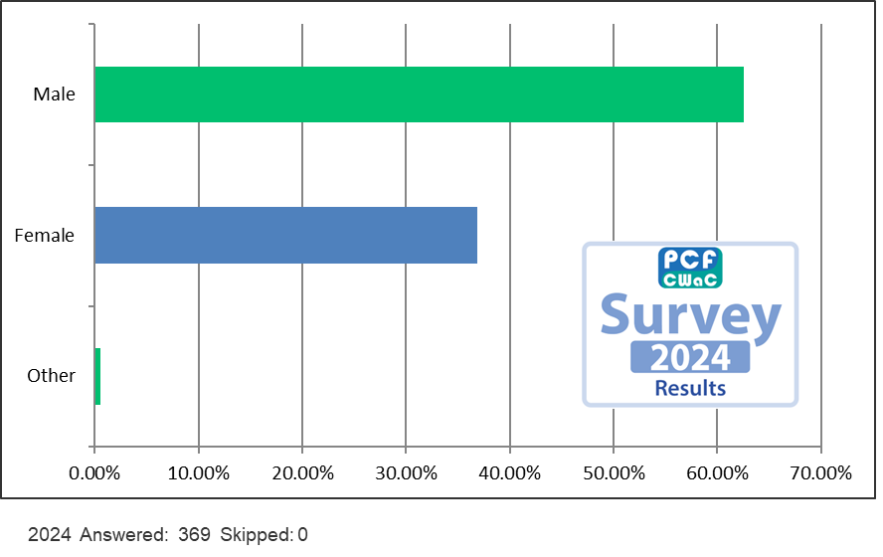
Q2: What gender does your child/young person identify as?

Slide 4
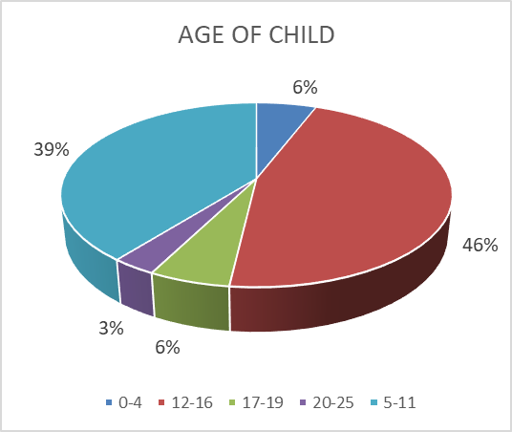
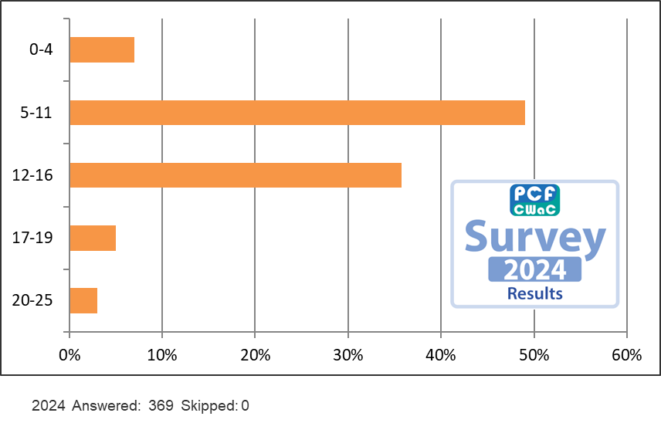
Q3: What age range is your child/young person?

Slide 5
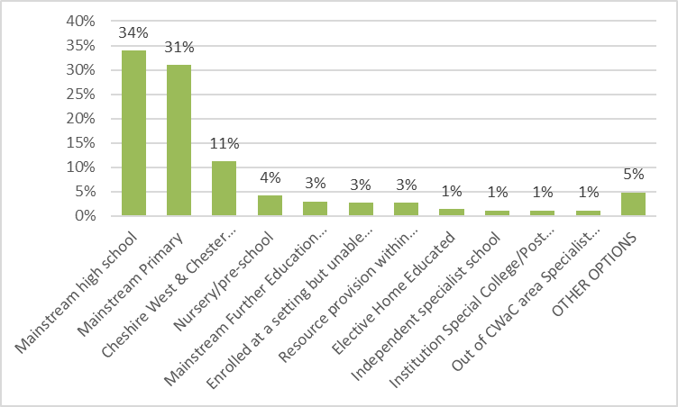
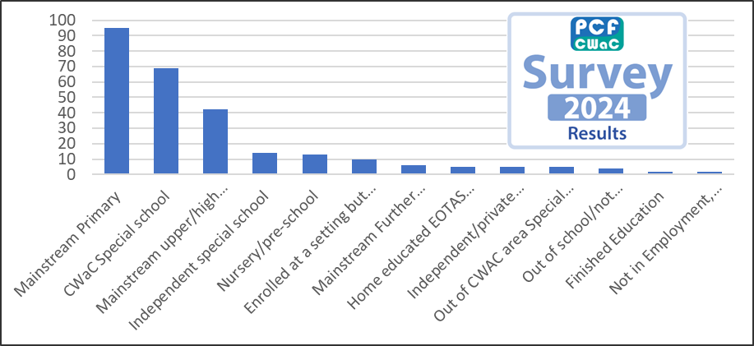
Q4: Which type of educational setting does your child/young person attend?
Tick as many as apply.

Slide 6
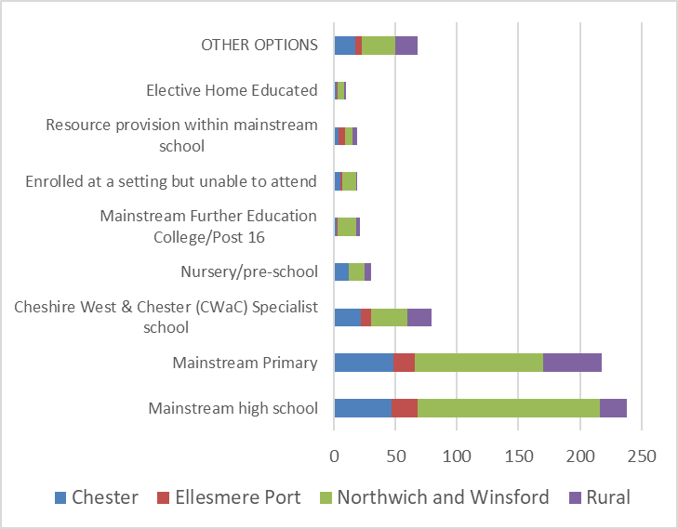
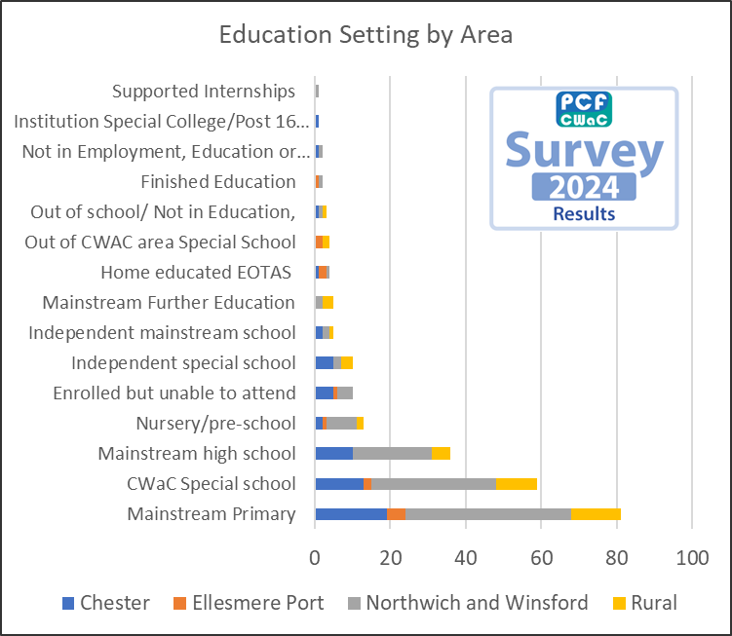
Q4: Which type of educational setting does your child/young person attend?
Further Analysis:

Slide 7
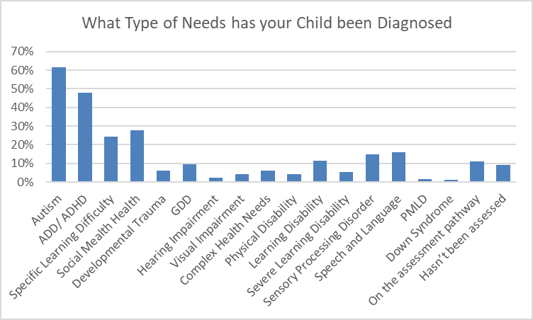
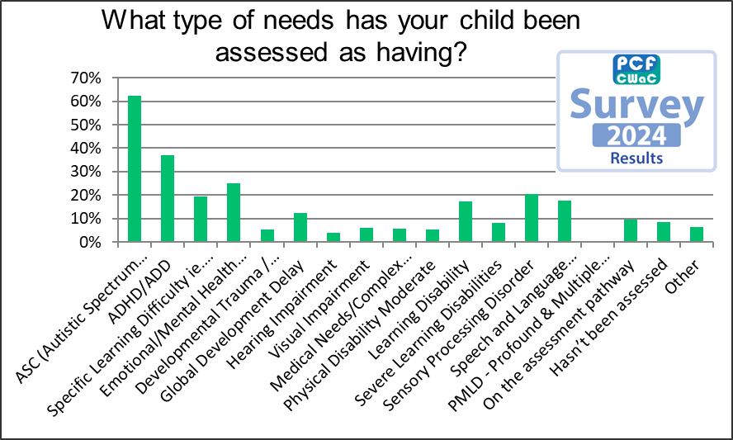
Q5: What type of needs has your child been assessed as having?

Slide 8

Q5: What type of needs has your child been assessed as having?
Further Analysis:
Autism
207
Autism/ ADHD
225
ADHD
111
Other 159
Aside from the marked increase of respondees. The only marked difference to this chart from last survey is the increase of 23% of ADD/ADHD and Autism diagnosis.
Other 159

Slide 9
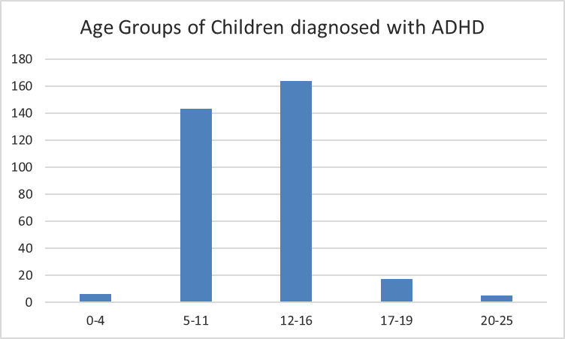
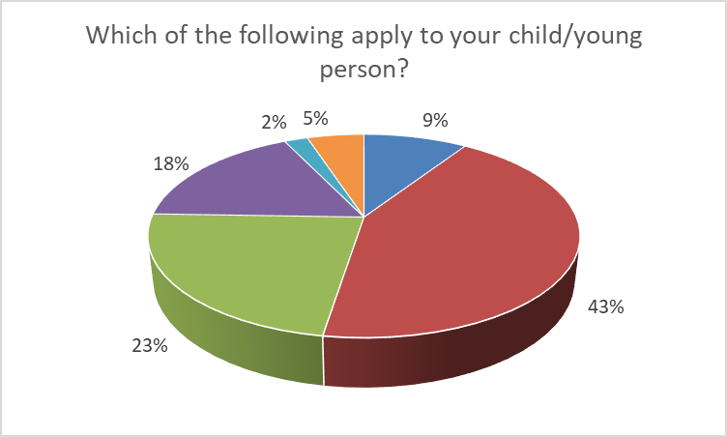
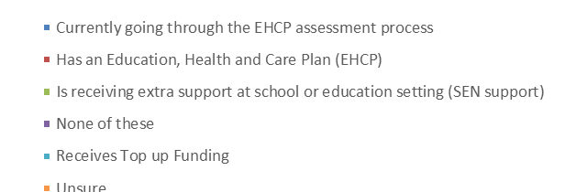
Q5. ADHD Deep dive on Educational setting
49%
43%
2%
5%
1%
Other 159
Of the 703 respondees, 338 children have been diagnosed with ADHD (48%)

Slide 10
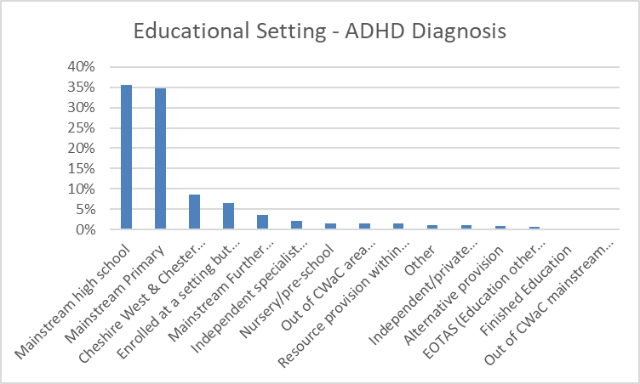
Q5. ADHD Deep dive on Educational setting

Slide 11
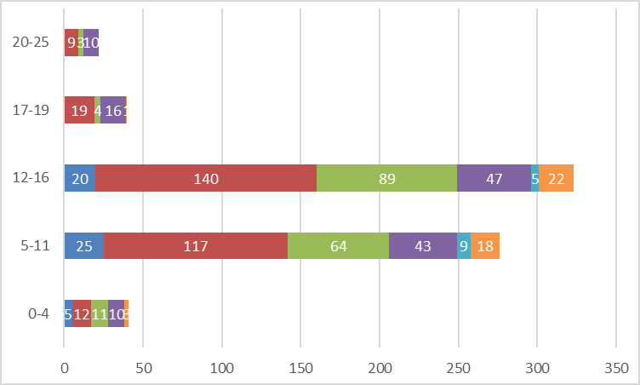
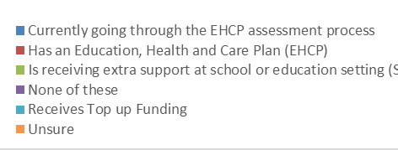
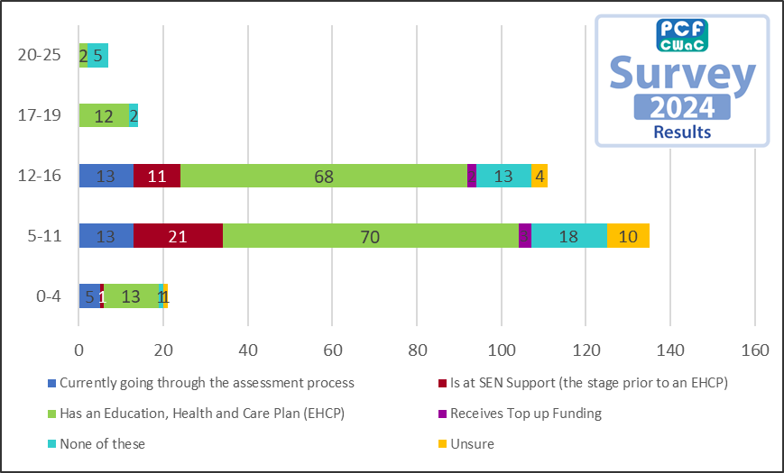
Q6: Which of the following apply to your child/young person?
Age groups
3%
6%
46%
39%
6%

Slide 12
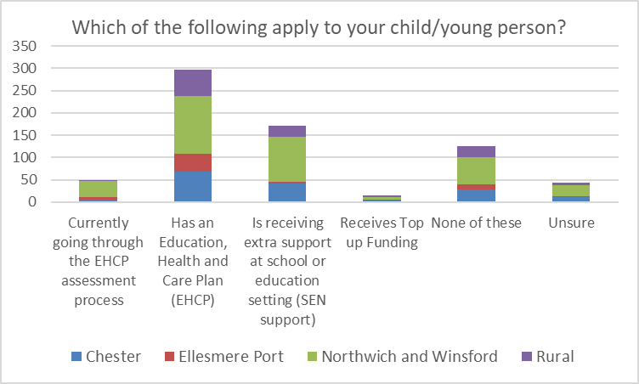
Q6: Which of the following apply to your child/young person?
Further Analysis:
Compared to the last survey, the number of children receiving extra support at school has increased by 15%. Additionally, the number of children who receive none of these has increased by 12%.

Slide 13
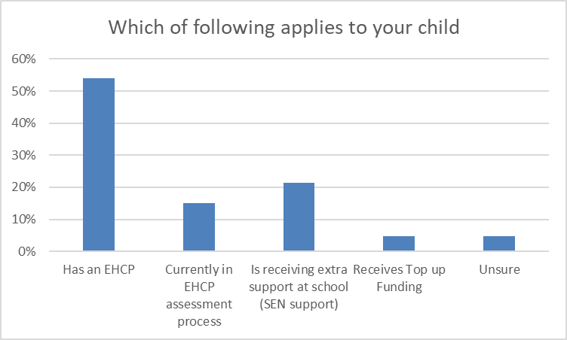
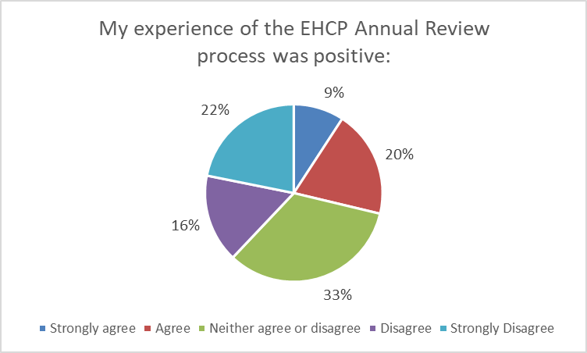
Q6. Mainstream Education and EHCP
Further Analysis:
Analysis of Child in Mainstream education 477 respondees; of those 126 have an EHCP, but only 87 went on to answer final questions of the Annual Review process.
20%

Slide 14
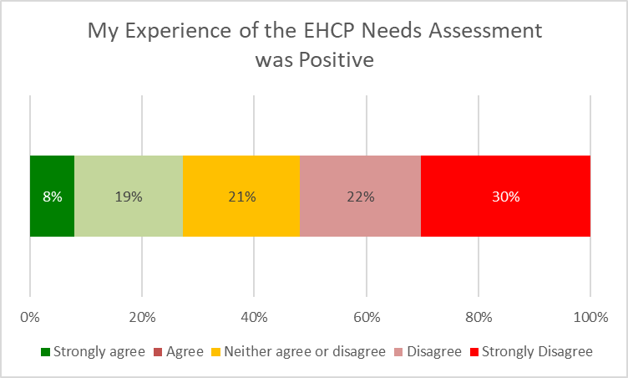
Q6. Mainstream Education and EHCP
Further Analysis:
Analysis of Child in Mainstream education 477 respondees; of those 126 have an EHCP, but only 87 went on to answer final questions of the Annual Review process.

Slide 15
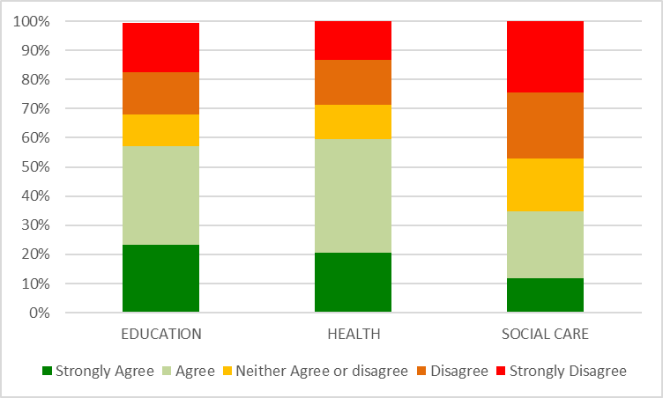


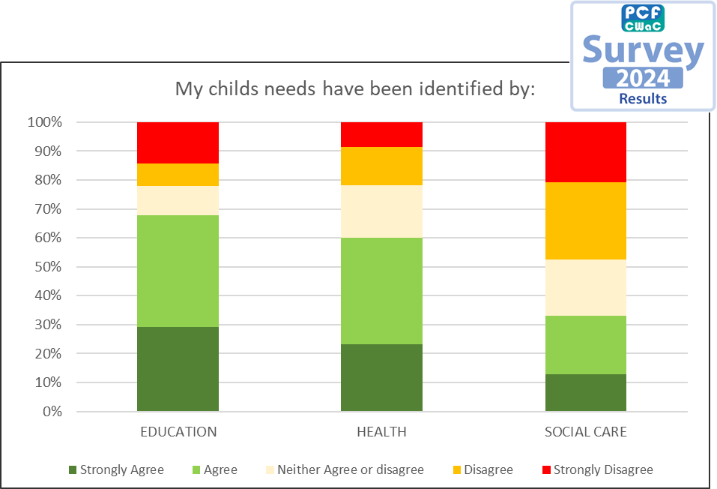

Q7: My child's needs have been identified by:

Slide 16
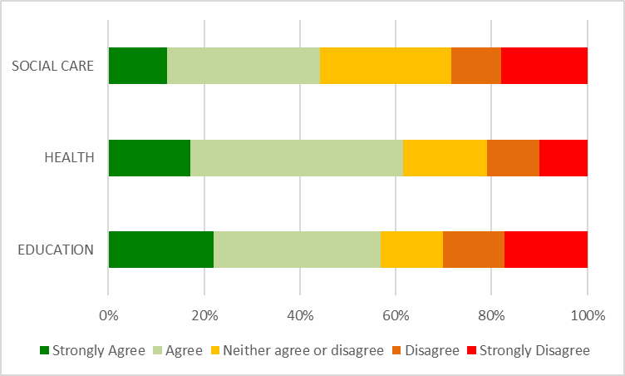
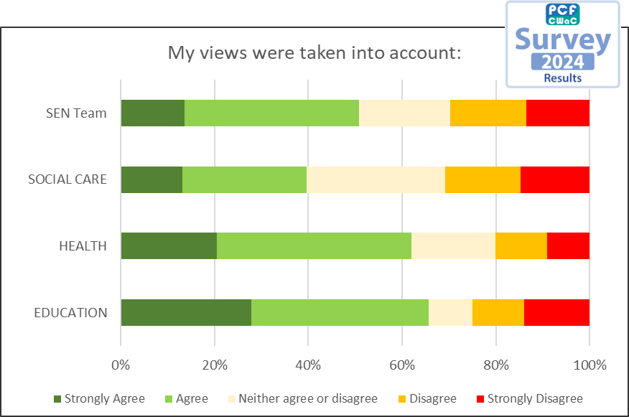
Q8: My views were taken into account when my child/young person's needs were identified by:

Slide 17
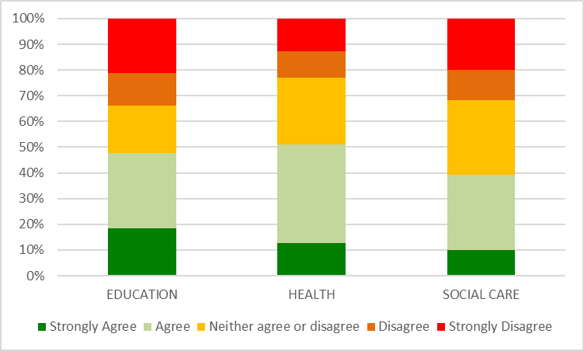
Q9: My child's/young person's views were taken into account when their needs were identified by
New Question for 2026

Slide 18
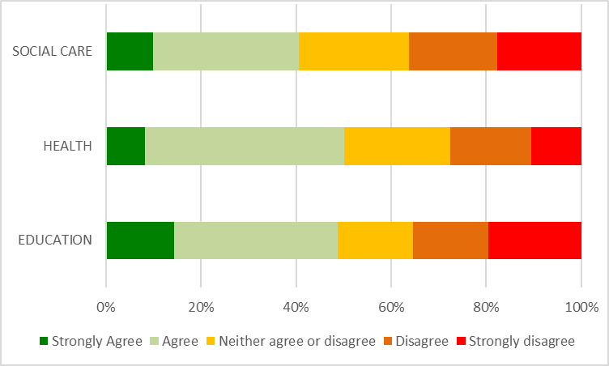
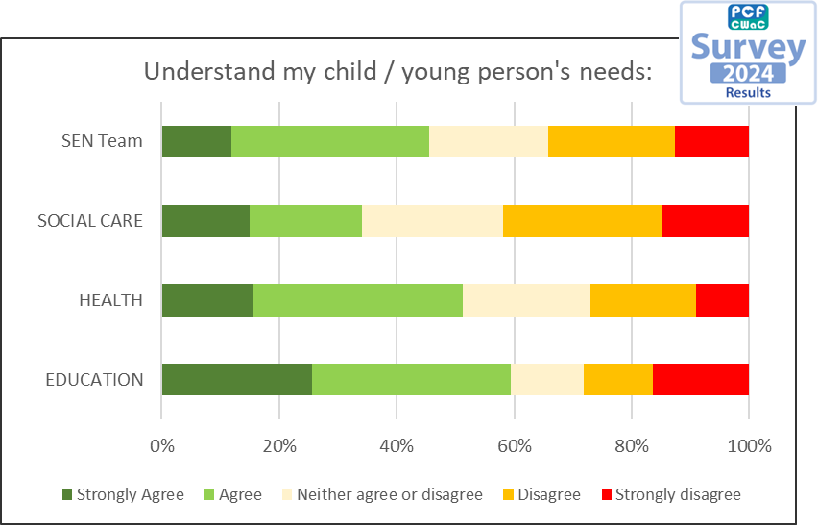
Q10: Health, Education and Social Care understand my child/young person's needs

Slide 19
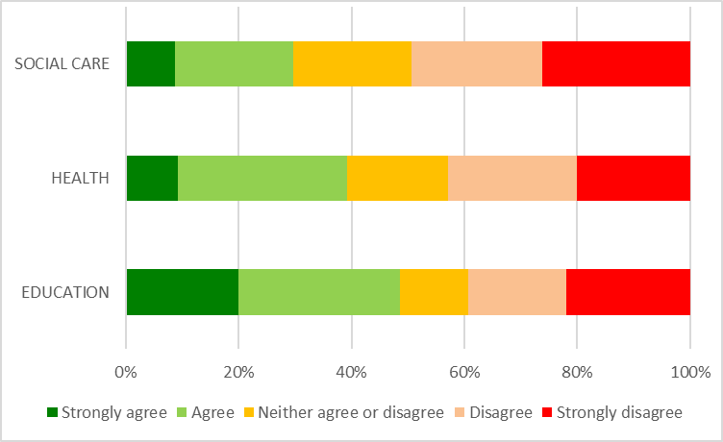
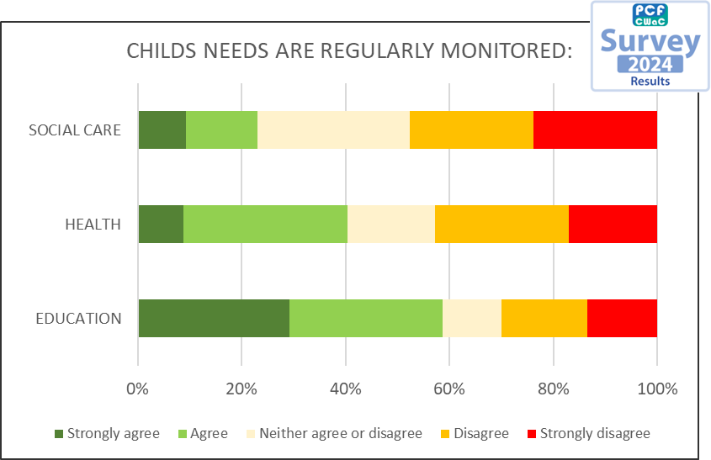
Q11: My child’s needs are regularly monitored and assessed by:

Slide 20
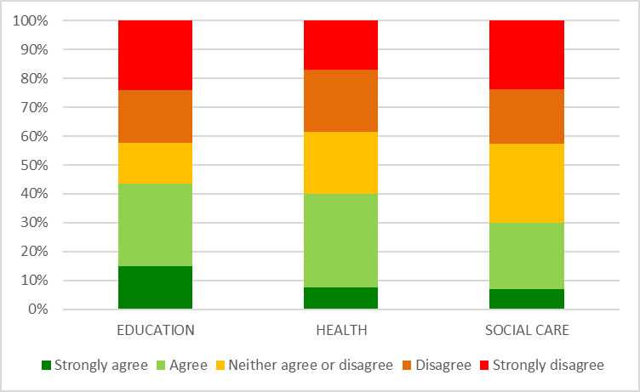
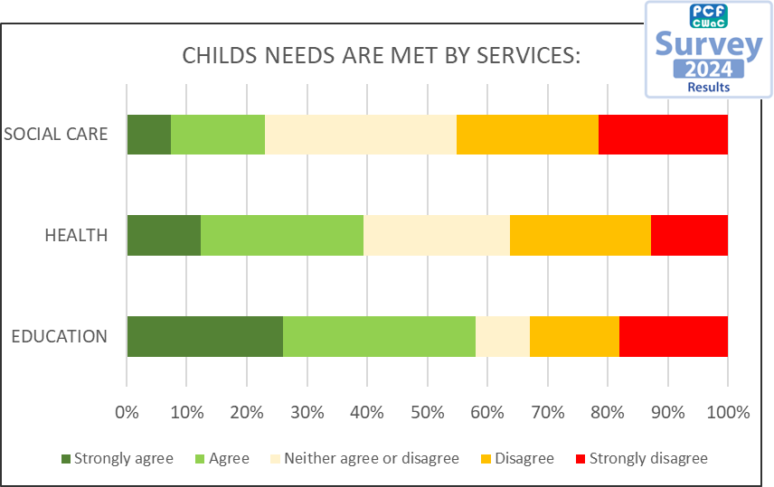
Q12: My child’s needs are met by the following service areas:

Slide 21
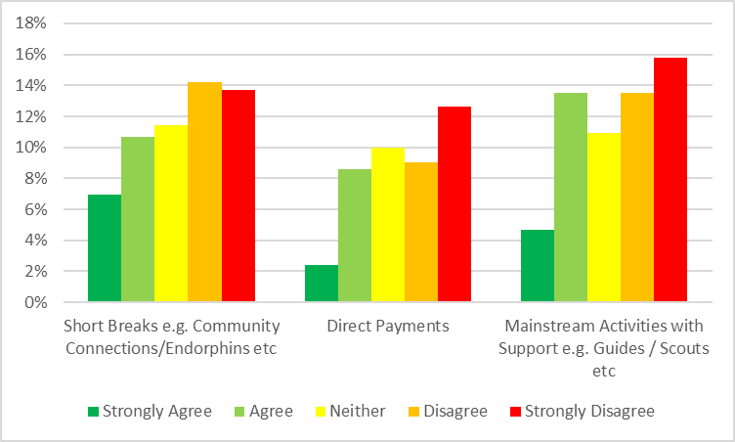
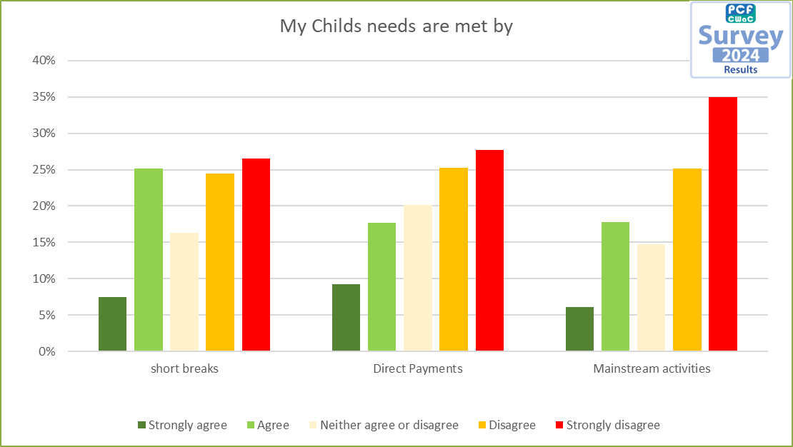
Q13: My child's needs are met by:

Slide 22
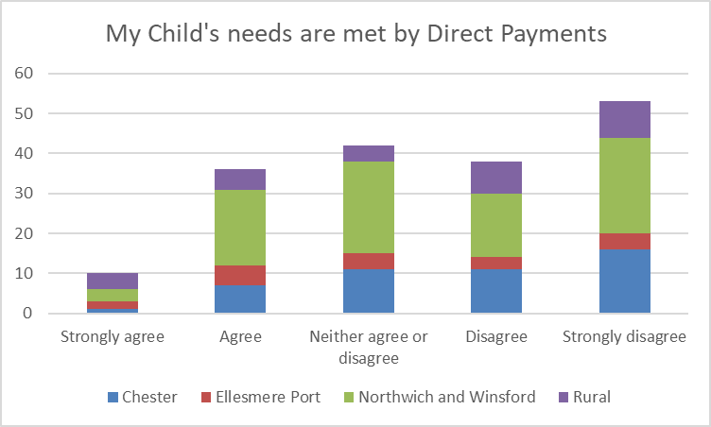
Q.13 Direct Payments Profile
Further Analysis:
Split by Locality is:
Chester – 26%
Ellesmere Port – 10%
Northwich – 47%
Rural – 17%
Split by Age Group
0-4 – 6%
5-11 – 40%
12-16 – 41%
17-19 – 7%
20-25 – 6%
51% of respondees using Direct Payments, their child has ADHD; 68% have Autism.
30%
20%
23%
21%
6%

Slide 23
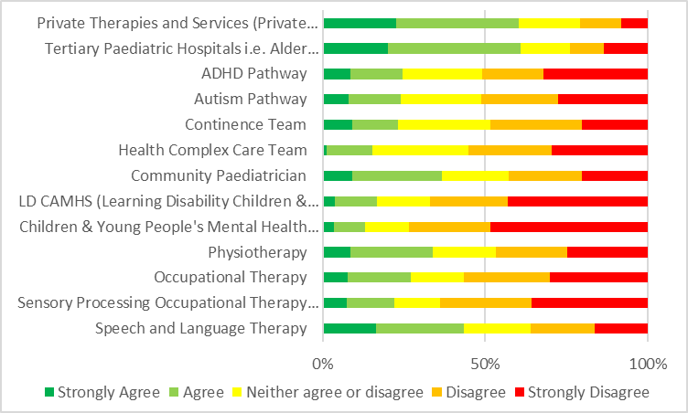
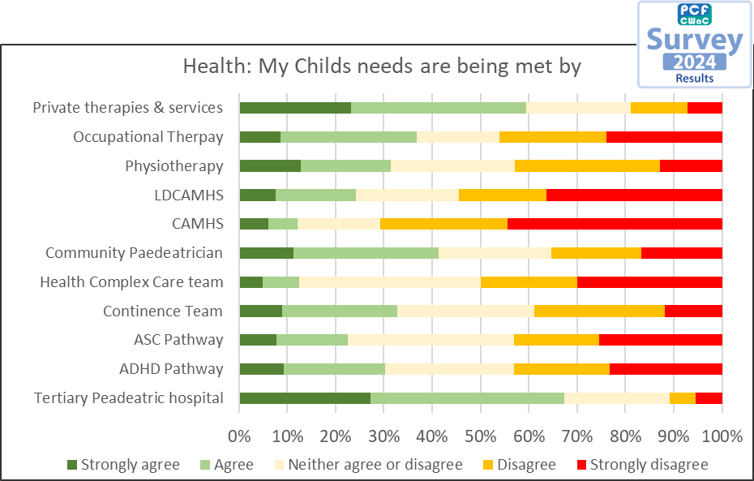
Q14: Health: My child's needs are being met by:

Slide 24
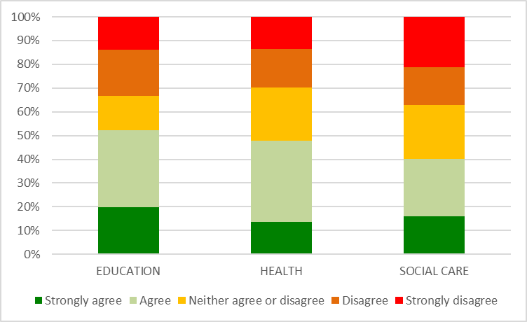
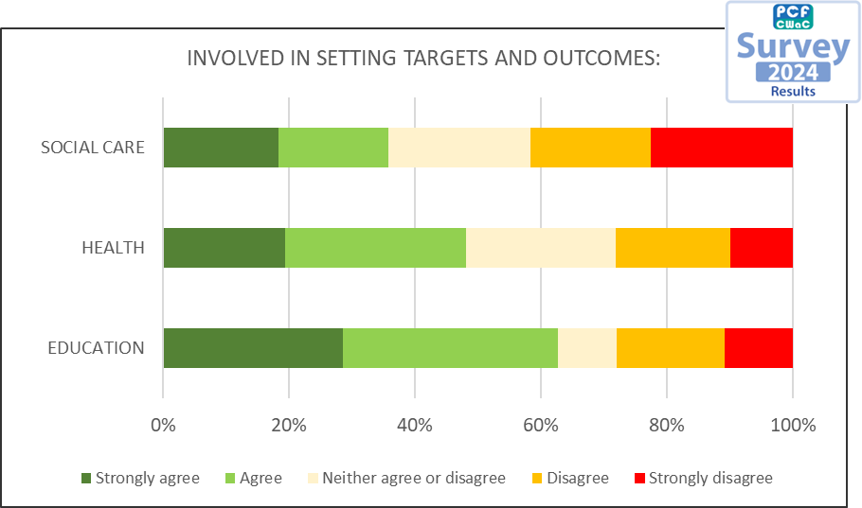
Q15: I am involved in setting targets and outcomes for my child/young person

Slide 25
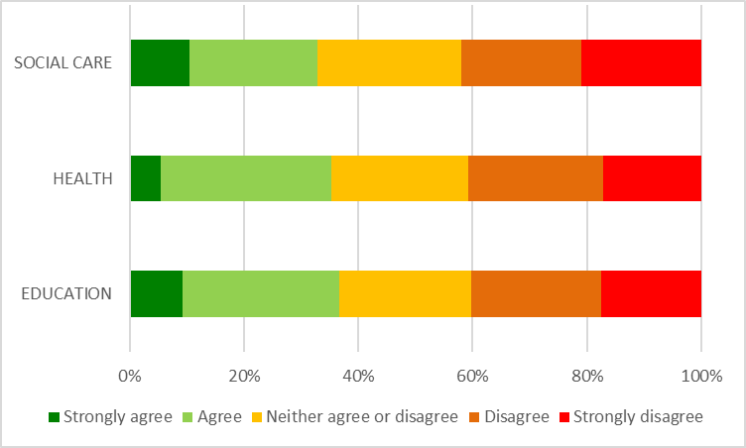
Q16: My child/young person is involved in setting their own targets and outcomes:
New Question for 2026

Slide 26
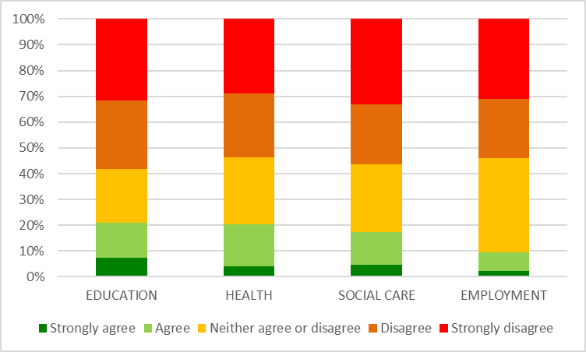
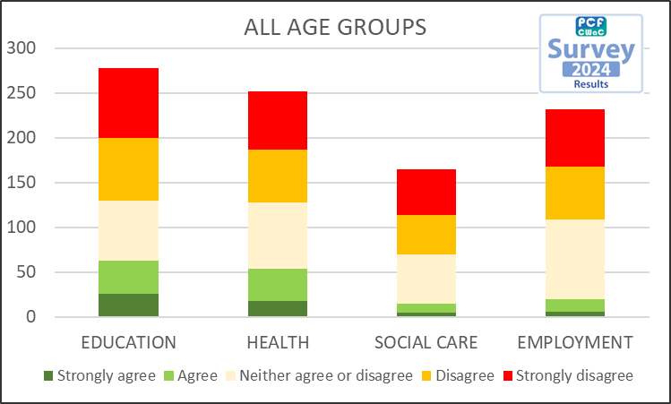
Q.17 I feel confident that my child's needs will be meet when transitioning to adulthood?
56% and 46% respectively don’t agree that their childs Education and Health settings will meet need as they transition to adulthood. Similar negativity was seen in the 2024 survey.

Slide 27
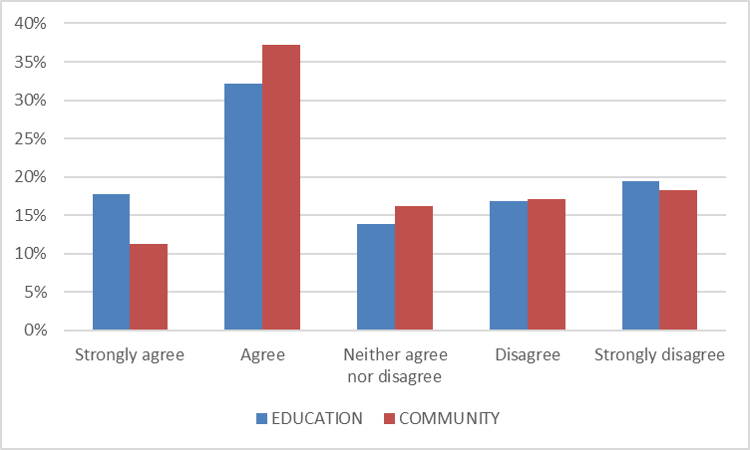
Q18: Does your child/young person feel included in their:
New Question for 2026

Slide 28
Q19: What does good inclusion look and feel like for you and your family?:
Key Themes from Parent Responses
1. Being Listened To and Understood
Many parents emphasised the importance of their child and family being heard by professionals, with a desire for genuine listening and action.
Quotes:
"Their voice is being heard and listened to."
"Listening. Understanding she & us are experts of her. Individual tailored plans that are monitored & reviewed regularly."
"To be listened to and not dismissed."
"That we have the confidence that we are being listened to and our views are acted upon by professionals.”
2. Accessibility and Reasonable Adjustments
Parents want physical and social environments to be accessible, with adjustments made proactively and without stigma.
Quotes:
"Accessibility (physical). Options for quieter smaller settings."
"Having an education environment that is accessible. He is academically able but does not cope in a mainstream high school. Such a waste and of talent and has a huge impact on his future."
"Safe spaces for children who don't have any concept of danger, eg, parks which are completely fenced off with one exit which can be watched by the responsible adult."
3. Acceptance and Belonging
Inclusion is described as feeling accepted, not judged, and being able to participate without being singled out.
Quotes:
"Same opportunities as neuro typical peers, understanding of needs and making allowances as necessary whilst not singling out or giving preferential treatment. Just feeling accepted for who he is/we are."
"Being fully part of something without being singled out."
"Feel a sense of belonging."
"Not being made to feel different for behaviours that are out of our control. Not being treated differently because of a diagnosis when it suits the setting. Not judging people.”
4. Support and Proactive Communication
Parents value regular, proactive communication and support from schools and services, rather than having to fight for every adjustment or piece of information.
Quotes:
"A plan adopted and recognised by all agencies."
"Regular communication and feedback about settling/progress/concerns etc."
"Conversation with parents about what works well and what adjustments can be made to make it even better."

Slide 29
Q19: What does good inclusion look and feel like for you and your family? Continued..:
5. Opportunities for Participation
Inclusion means being able to access activities, clubs, and community life, with appropriate support.
Quotes:
"Having activities available that we can actually access in the community."
"My child should be able to partake in activities that any other child can do. Those activities should be accessible."
"Being able to join in - it’s that’s simple -being able to join in though does mean adjustments and support needs to made - which is less simple.”
6. Barriers and Challenges
Some parents expressed frustration at the lack of true inclusion, feeling isolated or having to constantly advocate for their child.
Quotes:
"Inclusion is just that - being included - it is not happening. Despite the best efforts of the professionals, tick boxing and lack of funding has undermined all of this."
"We barely leave the house due to mental health failing due to severe delays in getting support when we first asked for it."
"I do not feel included. I want these social experiences to be accessible at times that are accessible with the adaptations not having to feel like a battle every step in the way."
7. Individualised and Neuroaffirming Approaches
Parents want their children to be seen as individuals, with strengths recognised and support tailored to their unique needs.
Quotes:
"Good inclusion looks like my child being understood as an individual, with their needs anticipated and supported without stigma."
"Treating our daughter as an individual, asking her what she needs, providing sensitive & informed support which builds confidence (practitioners need to be PDA literate & able to build a strong & trusted connection), validating & promoting her strengths, connecting via special interests, treating her as an intelligent young adult."
"Looking at SEN through the mental health lens. We feel included when we speak about worry or stress instead of ‘bad behaviour’. When the child is put first, before any academic targets. Where neuroaffirming language is used consistently, and where accommodations are made as a standard and don’t have to be asked for."

Slide 30
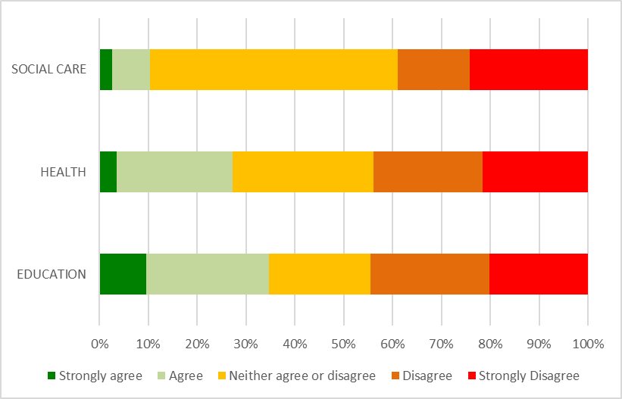
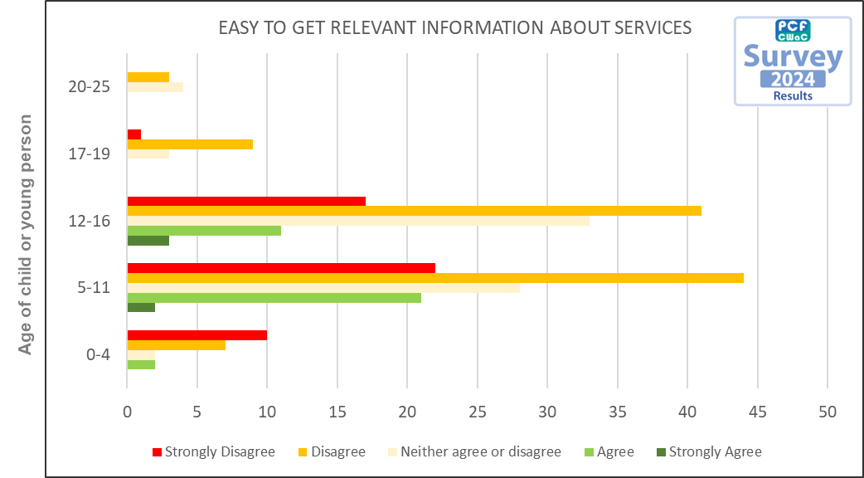
Q20: I find it easy to get the relevant information about services

Slide 31
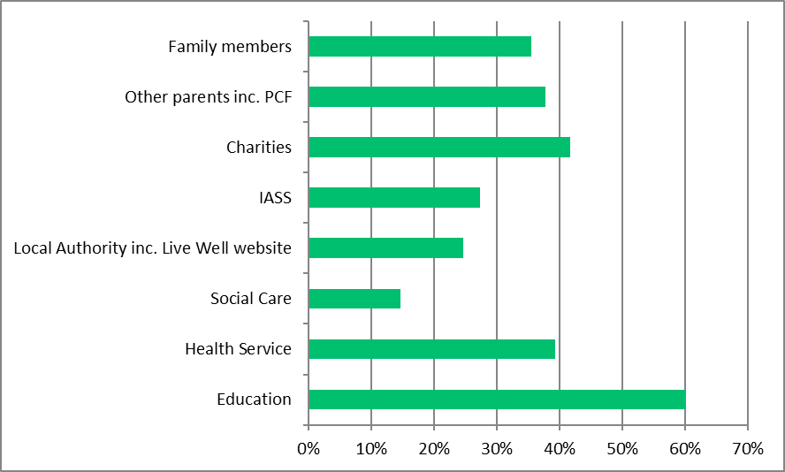
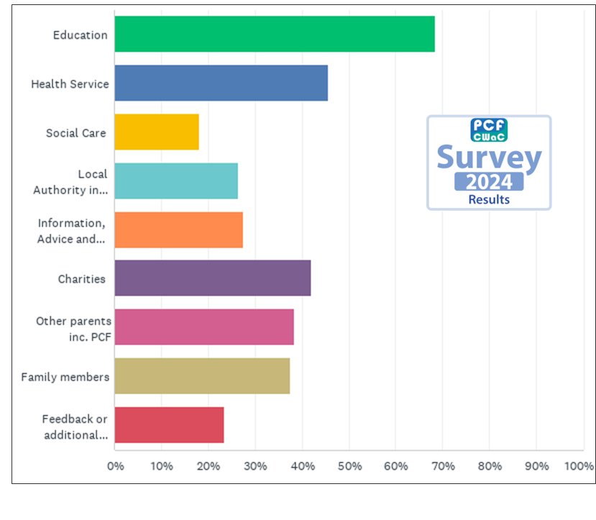
Q21: I would go to the following for support and advice

Slide 32
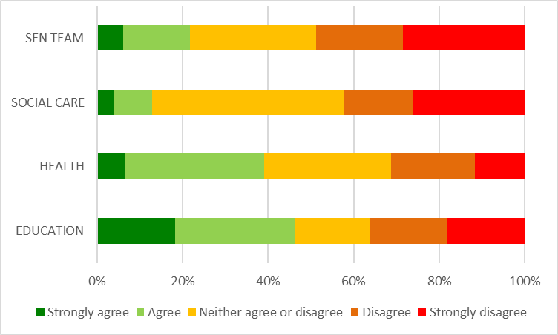

Q22: I am satisfied with Communication about my Child/Young Person from:

Slide 33




Q22. Mainstream Education and EHCP
Further Analysis:
There is a marked difference between the level of communications received from those families in the EHCP process and those outside of it.

Slide 34


Q23: If you have used Cheshire West and Chester Local Offer (The Live Well website), how well did you find what you were looking for?
70% of respondees have not used or heard of the Local offer or didn’t answer the question.
Of the 30% that have, only 10% found it easy and quick – increased four-fold from last survey. The remaining 90% struggled with the site.

Slide 35

Q24: How do you want general information communicated to you?
Further Analysis:
Location of Respondents

Slide 36


Q25: I have found the complaints procedure easy to access

Slide 37

Q26: I find it easy to access services

Slide 38
Q27: What are the gaps and barriers for your child accessing services?
On Waiting Times and Access:
"Very Slow times at the council for approving need for specialist equipment like a special chair my son needed at home and at nursery."
"The wait time for assessment."
"Waiting lists, the fact there isn’t flexibility and it can mean taking my son out of nursery or having further time off work."
"Long wait lists, no services for those with ASC/ADHD and no LD."
"Waiting lists are too long.”
On Funding and Resources:
"Lack of funded, fully trained 1:1 support. Lack of small high school settings. Lack of resources e.g. equipment to support sensory needs (I have provided this to school, paying for it myself)."
"Funding such as Community Connections is valued but has not kept pace with rising costs, limiting access to activities, wrap-around care, and short breaks."
"Expense."
On Information and Communication:
"Awareness. Nobody has told us what support and services are available, besides website addresses."
"Lack of information from all settings on what is out there to support my child. Totally rubbish."
"No information seem to have to jump through hoops."
"No communication, no direction of guidance or support."
"Not being given any information to start with."
"I don't know what we need or where to find the help."
On Eligibility and Criteria:
"There is a missing service as we seem to never meet the criteria for most services and asking for help constantly and never getting any."
"Not deemed as severe so repeatedly refused SALT."
"No clear contacts or path to follow. Told that they 'don't meet criteria'. Unclear on how to access services."
"High needs based criteria.”

Slide 39
Q27: What are the gaps and barriers for your child accessing services? Continued….
On School and Professional Understanding:
"School ignoring parents, ignoring the child's non verbal communication and assuming they know the child better as if all children with ASC are the same."
"The lack of understanding from his school."
"Lack of adequately trained staff in local high schools have been the biggest barrier."
"School appear to be overwhelmed, too many children that require assistance so many are overlooked."
"The school SENCO dept is not proactive. Some class teachers don't seem to understand that not all students learn in the same way."
On Service Coordination and Consistency:
"Services are very disjointed and heavily rely upon parents joining them up."
"Constant red tape, waiting lists, lack of communication between services."
"Everything seems a fight and a battle there doesn't seem to be support at all. We're just left."
"Finding a service to take responsibility for its users is the main hurdle as every service wants you to go to another service.”
On Mental Health and Suitability:
"Not enough mental health support that my child really needs to access."
"There isn't a fit for purpose provision for teenagers with moderate mental health issues. CYPMHS won't accept referrals until the need is incredibly high and this leaves a gap for young people who are entitled to no help but are in danger from their struggles."
On Family Burden and Advocacy:
"As a family we have been offered no support despite 3 autistic people living in the same household- 2 children and one adult. When I have sought support I'm just told there is little point referring to CAMHS as waiting lists are so long they only see the most severe cases."
"I have to search for relevant services mainly using social media."
"We don't know what we are doing, what's the next steps, what I should be doing, and what he needs. I am literally feeling round for something useful in a room with no light."
Selected at random and anonymised for reporting purposes, the following represents a sampling of the hundreds of comments we've received and reviewed.

Slide 40


Q28: My experience of the EHCP: Needs assessment was positive
Compared to the 2024 survey results, the experience many respondees had was less positive. With a downwards trend from Strongly agree/Agree to a negative experience. In fact this is the 2nd survey in succession where the EHCP experience has got worse for respondees. With Strongly Disagree increasing from 25% in 2022, 27% in 2024 to 32% in 2026.

Slide 41

Q28: My experience of the EHCP: Needs assessment was positive by Age Group
32%
21%
Of particular note is the negative experience had by children in the 12-16 age category. 62% of respondees with children in this age category, rated their experience negatively.
16%
22%
10%

Slide 42
Q28. Mainstream Education and EHCP
Analysis of Child in Mainstream education 477 respondees; of those 126 have an EHCP, but only 87 went on to answer final questions of the Annual Review process.

Slide 43


Q29: My experience of the EHCP: Annual review process was positive
Overall, the respondees experience of the annual review process has worsened. With many more being indecisive about the experience and more rating it poorly. And similarly to EHCP Needs assessment, this continues a trend of results becoming worse in the 3rd survey.
Age:

Slide 44

Q29: My experience of the EHCP: Annual review process was positive by AGE

Slide 45


Q30: Do you know what the EHCP Hub is?

Slide 46


Q31: If you have used the used the EHCP hub, please rate how satisfied you are with it?
2024 Answered: 369 Skipped: UPDATE

Slide 47


Q32. If your child accesses transport how satisfied are you with the service?
When compared to 2024 results, Highly satisfied has reduced from 44% to 35%; with dissatisfied and Very dissatisfied increasing from 23% to 31%.
2024 Answered: 369 Skipped: UPDATE

Slide 48
Q33: Summary of Positive Experiences with SEND Services - Key Themes & Direct Quotes
1. Individual Staff Making a Difference
"The plan writer was very helpful."
"Good response from his Paediatric Doctor when I requested a review of his medication dosage... I was called back same day and my concerns felt heard. Immediate adjustment to medication."
"Our support worker has been fantastic at helping us fight the battles with school and most importantly always been empathetic and respectful in her language."
"The SEND nurse who was in post at Cheshire West was amazing but she has now left."
"Rebecca Measures at Weaverham High school was super helpful and really helped as my son was struggling."
"The educational psychiatrist was very supportive and listened."
2. School and SENCO Support
"Incredible SEN staff in the two schools my son attended."
"The second Primary school my son attended were flexible in their approach and put a good transition to high school package in place for my son."
"Senco at his school is great."
"School know what to do and can point us towards the best option."
"My child is well looked after and has always been positive regarding the SEND services in school. They help him immensely."
3. Charities and Community Services
"Parent Carer Forum meetings are very useful."
"Space is Excellent. Parent carer is excellent too. Just about to start using disability positive and APS."
"The charity Caft is very inclusive and is a brilliant place for children with SEND."
"Koala charity has massively supported us."
"LIVE Cheshire and SPACE provide inclusive, supportive after-school and holiday provision that my child really enjoys."
"Community Connections is a fabulous service. The staff are friendly and helpful."
"Disability Positive was very helpful."
"Petty pool outdoor centre runs holiday clubs and they were very supportive and inclusive."
"Endorphins were lovely and very understanding."

Slide 49
Q33: Summary of Positive Experiences with SEND Services - Key Themes & Direct Quotes
Continued…
4. Health and Therapy Services
"The therapies are great such as O.T and SALT but not enough staff and they discharge quickly."
"SaLT input provided at school is good."
"The OT was wonderful. She contacted me in October 2024 after he had started high school to see if anything had changed for him."
"The Physiotherapist, Occupational Therapist and Orthotist are excellent."
"Play Therapist on the Children's Ward at the Countess of Chester was brilliant at supporting my son to have his Immunisation."
5. Information, Advice, and Support Services (IASS/PCF)
"IASS have been brilliant. EHE officer also brilliant."
"IASS service great."
"The SENDIASS team have been extremely helpful in the past."
"PCF are brilliant and the Sen team respond quickly."
"The parent carer forum has been a great source of information."
"The PCF keep me informed. If it wasn't for them I wouldn't know what was happening in SEND or what was available for support."
6. Transport and Practical Support
"They sort out transport."
"Transport are really responsive. LD CAMHS are really supportive. Pinewood respite are fantastic."
"Transport team resolved our safeguarding issue. They were very helpful."
Selected at random and anonymised for reporting purposes, the following represents a sampling of the hundreds of comments we've received and reviewed.

Slide 50
Q33: Summary of Positive Experiences with SEND Services - Key Themes & Direct Quotes
Continued…
Summary Table of Frequently Mentioned Positive SEND Services
Service/Area Example Quotes
School/SENCO "Senco at his school is great.”
"Incredible SEN staff in the two schools my son attended."
Charities/Community "Space is Excellent.”
"Koala charity has massively supported us."
Health/Therapies "The OT was wonderful.”
"SaLT input provided at school is good."
IASS/PCF "IASS have been brilliant.”
"PCF are brilliant and the Sen team respond quickly."
Transport "Transport are really responsive.”
"They sort out transport."
EHCP/Reviews "My son's EHCP matches his needs.”
"Annual reviews are lovely held by the school."
7. Positive Experiences with EHCP and Reviews
"My son's EHCP matches his needs which has supported the schools in providing what he needs to succeed."
"Annual reviews are lovely held by the school very positive and much different to others and expectations."
"The communication with Annual Reviews and SEND has been positive."
Selected at random and anonymised for reporting purposes, the following represents a sampling of the hundreds of comments we've received and reviewed.

Slide 51
Q34: Summary of Negative Experiences with SEND Services - Key Themes & Direct Quotes
1. Long Waiting Times and Delays
"Still awaiting diagnosis. Very very slow with no communication."
"Been waiting 2 years to see PEADs and still not heard anything, been let down so many times."
"Waiting lists so long and children are suffering in silence in education because they don’t have the right support."
"It takes forever to get an appointment, results, support. Issues first identified 3 years ago still waiting for support, this has cost him the enjoyment of primary school."
"Waiting lists, passing responsibility between GP, school, ADHD pathway waiting times, Autism pathway waiting times, lack of school resources."
2. Poor Communication and Lack of Information
"Communication from school is extremely poor. Communication from social care is extremely poor."
"No communication, no direction of guidance or support."
"The SEN team are not fit for purpose, they don’t have the child’s best interest at heart, they lie, they fabricate the truth."
"I have had zero communication from anyone."
"We have had no proactive communication or support whatsoever & feel very alone with the challenges we face."
3. Lack of Support, Being Ignored, and Having to Fight for Help
"I had to advocate for the right support and recognition for my child."
"My son only receives a 30 minute appointment with ADHD Nurse twice a year."
"My child masks at school and although having significantly slower processing, school did not highlight anything of concern. Without my fight for a diagnosis, he would not have been put forward for exam adjustments."
"We keep trying to cope on our own. We have tried some of the services listed and it’s not been very helpful because we get passed around."
"You block every single avenue. Everywhere we’ve tried to turn we’ve been rejected or ignored or passed from dept/dept or just told to wait for years."
"Not listened to/heard - constant fight to get what’s needed - passed around staff as none is responsible - pushed and pushed to see if you’ll give in - not supportive - not child centred."

Slide 52
Q34: Summary of Negative Experiences with SEND Services - Key Themes & Direct Quotes
Continued…
4. Inconsistent or Inadequate Provision
"Support for children with Dyslexia is non-existent. Money goes towards other disabilities and this seems to be the bottom of priority."
"The therapies are great such as O.T and SALT but not enough staff and they discharge quickly."
"Short breaks and wrap-around provision have been inconsistent, with cancellations, early finishes, and affordability creating barriers to access."
5. Barriers to Access and Lack of Signposting
"I have no idea what is available. My husband and I work and support sessions are all in normal working hours."
"Services aren’t easy to find."
"I only found out about parent carer forum very recently. I found out about SENDIASS very recently as well. Very little advertised support or signposting."
"Websites feel like you need to know what you're looking for first."
"If you don’t know where to look it’s intimidating."
6. Negative Experiences with EHCP Process
"The EHCP had a number of errors. Docs created by LDCAMHS had multiple errors."
"EHCP keeps getting denied even though he does need one to progress to high school."
"We had to appeal and use mediation, then go to tribunal. We eventually were awarded the right support."
"Delayed EHCP, being ignored, having to constantly chase email responses, rude staff telling me my child is not disabled enough for specialist placement."

Slide 53
Q34: Summary of Negative Experiences with SEND Services - Key Themes & Direct Quotes
Continued…
Summary Table of Common Negative SEND Service Experiences
Service/Area Example Quotes
Waiting Times "Still awaiting diagnosis. Very very slow with no communication."
Communication "No communication, no direction of guidance or support."
Lack of Support "I had to advocate for the right support and recognition for my child."
Inconsistent Provision "Support for children with Dyslexia is non-existent."
Barriers to Access "Services aren’t easy to find."
EHCP Process "EHCP keeps getting denied even though he does need one to progress to
high school."
Fragmented Services "The services are not connected. I never even knew there was an SEN
team to contact."
Negative Attitudes "The LA SEND team are rude, gaslight parents, don’t reply don’t follow their
own policies."
Financial Barriers "Go into debt to secure private reports as it’s the quicker option."
Other "CWAC school transport let us down massively and it's been nearly six months
of my daughter struggling."
7. Lack of Joined-Up Working and Fragmented Services
"The services are not connected. I never even knew there was an SEN team to contact. School are rubbish and don't sign post to anything, I have to sign post them most of the time."
"No cohesion between services."
"Different services communicating."
"Things are deliberately not communicated even when we are proactive. There is a learned helplessness as a consequence."
8. Negative Attitudes and Lack of Empathy
"The LA SEND team are rude, gaslight parents, don’t reply don’t follow their own policies or the law."
"Nobody is really interested. Just drug them up and off you go."
"I don’t believe they have enough training with ASD. I've been shocked with some of the comments made."
Selected at random and anonymised for reporting purposes, the following represents a sampling of the hundreds of comments we've received and reviewed.

Slide 54


EDUCATION

Slide 55

HEALTH

Slide 56

SOCIAL CARE

Slide 57


Q35. Have you heard of the Parent Carer Forum?

Slide 58


Q36: How satisfied are you with the way the PCF represents the views of parents/carers of children & young people with SEND

