Slide 1

Early Years, Sleep & Toileting
4th December 2025

Slide 2

Agenda
Welcome
Starting well
Early Years Specialist Teaching Service
Continence team
Koala – Sleep Service
Parent Carer Forum - Update

Slide 3

Starting Well 0-19 Service

Slide 4









Starting Well 0 – 19 Service
(up to 25 with SEND)
Children’s
Centre Offer and Early Years
Groups
0 to 5
Healthy Child
Programme
And Family Nurse
Partnership
5 to 19
Healthy Child
Programme

Slide 5


The Children’s Centre Core Purpose
Aim is to improve outcomes for young children and their families, focusing on the most disadvantaged families to reduce inequalities in:
• Child development and school readiness
• Parenting aspirations and parenting skills
• Child and family health and life chances

Slide 6

Antenatal Contact
New Birth Visit (10-14 days)
6-8 week review
1 - year developmental review
2 - year developmental review
Parenting Journey
Mandate contacts

Slide 7
Parenting Journey Open access
Duty 09.00-17.00
Open Advice Clinics
Chat health – parent and young person text messaging service
Baby Massage
Introduction to solid foods – workshop
Sleep – workshop
Parenting Puzzle

Slide 8

Parenting Journey
Targeted support
Focus Groups
Home Learning
Let’s Explore
Allocated Health Visitor
SEND Practitioner– bespoke pieces of allocated work

Slide 9
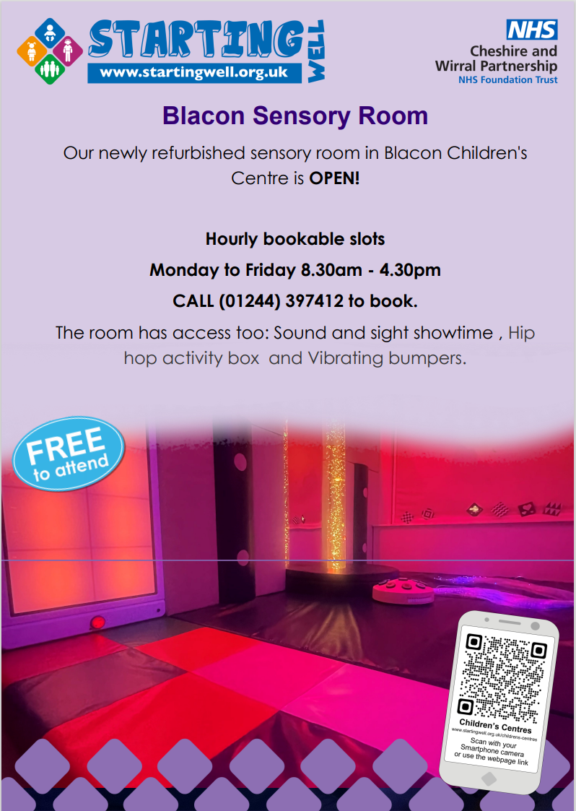

Sensory Rooms
Blacon Children’s centre
Lache Children’s Centre
Stanlaw Abbey Children’s Centre
Wharton Children’s Centre
Victoria Road Children’s Centre
Please call the centre number to book your slot!

Slide 10
Starting Well Service
Vision and Hearing Screening
School Entry Assessment
National Child Measurement Programme
High School Drop-in
School Engagement
Public Health Promotional Events
Youth Service Engagement
Young Persons CHAT HEALTH
5 to 19
Healthy Child
Programme

Slide 11
Helping us shape services
Advisory Board – Parent Representatives
Annual Census
Let’s Hear It - Katie Wilson (katie.wilson24@nhs.net)

Slide 12
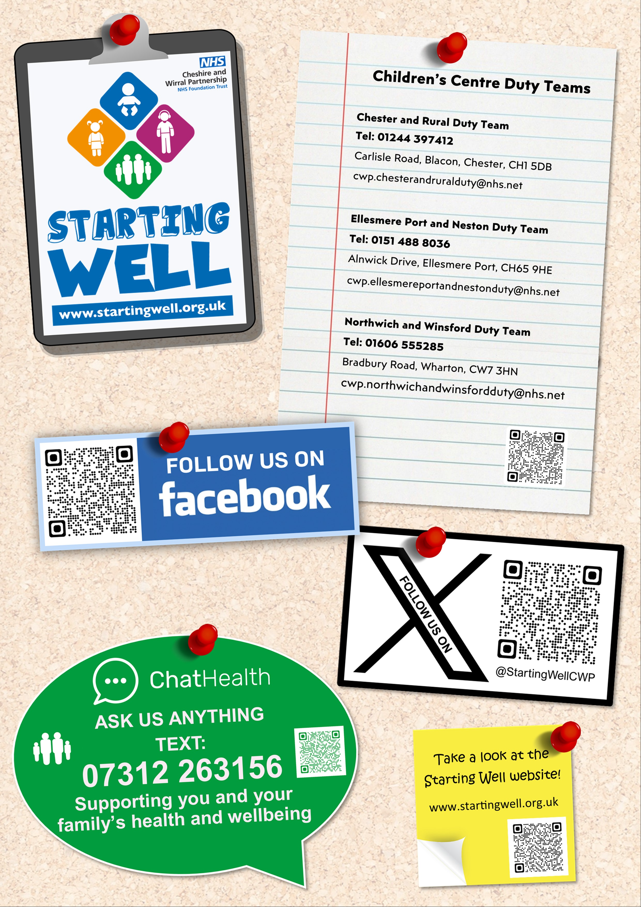
What's on…
How to contact us…
Duty
Duty email
Chat health – Parent/carer
Chat health – Young person
www.startingwell.org.uk
Facebook

Slide 13


Slide 14
Thank you Any Questions?

Slide 15


The Early Years Specialist Teaching Service (EYSTS)

Slide 16
Who are we?
A team of experienced specialist education professionals, who provide advice and support for Early Years providers to help them support and successfully include children with Special Educational Needs and Disabilities (SEND).
The team consists of Specialist Teachers, who have overall responsibility for assessing children's needs and offering support to EY providers.
and
Specialist Support Assistants, who under the direction of a Specialist Teacher promote the development of EY providers' capacity to meet children's needs by modelling strategies and supporting Inclusion Plans.

Slide 17
Purposes and Roles of EYSTS
The purpose of settings referring to the EYSTS is to ensure that any special educational needs are identified early, and that appropriate support is put in place.
To support EY practitioners and providers to ensure that practice is inclusive.

Slide 18
EY providers can refer to the service if they feel they need additional advice or support. Referrals are triaged and we evaluate whether the situation is at a point where our involvement can make a positive impact.
We would expect EY providers to already be using reasonable adjustments and good Early Years practice.
Parents cannot refer into the service this must come from EY providers; as we do not support in the home.

Slide 19
Criteria for EYSTS referral
Complex or severe learning difficulties / social communication differences.
Support will be considered on an individual needs led basis rather than the number of reviews of the Inclusion Plan.
Age – from the term after the child’s second birthday.
A child does not require a diagnosis to be referred.
EY providers can also refer to the service for SEND advice and setting support to improve practice and provision for all SEND children.

Slide 20
Process for referral to EYSTS
Referrals are made by the Early years provider.
This must be in agreement with parents/ carers.
Any concerns should be raised and documented in the Inclusion Plan.
This must be signed and dated.
Settings send the completed Inclusion Plan and any supporting documents to panel admin.

Slide 21
Referral process
The child will then be added to the next available panel for allocation.
Information around our support is shared by the EY provider and not directly from EYSTS.
The Inclusion Plan is also used to support Early Years funding applications and Education, Health and Care Needs Assessments.

Slide 22
Possible outcomes from submitting a referral to EYSTS
The referral is triaged by the EYSTS team. Providers may be contacted for more information.
A referral to a new service of professionals may be recommended.
Providers may be directed to specific training, drop-in sessions or offered advice over the telephone/ via email.
A visit to the EY provider by a Specialist Teacher or/and a Specialist Support Assistant (SSA) is likely to be arranged.

Slide 23
What does EYSTS support look like?
Specialist assessment, advice and support for EY providers to enable them to support children with SEND.
Advice on next steps in an agreed format- this is determined case by case.
Direct intervention in settings to model practice, to upskill EY providers to implement strategies to enable them to support individual & groups of children.
Attendance at AFI meetings where appropriate.
Work with a range of professionals to ensure a co-ordinated approach to support a child's learning needs.

Slide 24
What does EYSTS support look like?
Advice for EY providers of how to involve families in decision making around intervention and strategies to support their child’s special educational needs.
Support for transitional phases within the Early Years Foundation Stage.
Support and advice on strategies once an EHCP is written, if needed.
Sharing of specialist SEND resources and guidance.
Training and drop-in advice sessions for Early Years Providers.

Slide 25
Role of EYSTS in ECHNA & funding
EYSTS can in some cases be asked to provide information during an Education Health and Care Needs Assessment (EHCNA).
This may be a separate document or in the form of input into the Inclusion Plan following attendance at an Action For Inclusion meetings or when verbal advice has been given.
EYSTS is not involved in the management or organisation of the EHCNA process, Inclusion funding decision making or school placement arrangements.

Slide 26

LiveWell
Early Years Specialist Teaching Service | Live Well Cheshire West
Special Educational Needs and Disability (SEND) Local Offer | Live Well Cheshire West

Slide 27
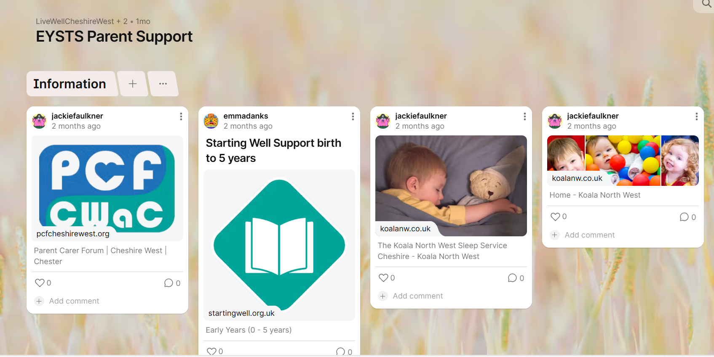
Padlets
EYSTS Parent Support

Slide 28


Further support
Special Educational Needs and Disability Information, Advice and Support Service (SENDIASS) | Live Well Cheshire West
Early Help Navigator Service | Live Well Cheshire West

Slide 29
Introduction to the Children's Continence Service
Cheshire and Wirral Partnership NHS Foundation Trust

Slide 30
About the Service
• A specialist service supporting children and young people with bladder and bowel difficulties.
• Provides assessment, treatment, and ongoing management.
• Works closely with families, schools, and healthcare professionals.

Slide 31
The Team
Lindsey McDonough Continence and Urology Team Manger
Katie Farrell Children’s Specialist Nurse – specialises in bowel issues
Ondrea Roberts Children’s Specialist Nurse – specialises in bladder issues
Alice O’Reily Nurse Associate – specialises in night-time wetting
Skyla Spencer Nursery Nurse – specialises in toilet training children with additional needs

Slide 32
Conditions We Support
• Daytime wetting
• Night-time wetting (enuresis)
• Constipation and soiling
• Delayed toilet training
• Complex continence needs

Slide 33
Referral Criteria
• Children and young people aged 0–19 registered with a GP in Cheshire or Wirral.
• Referrals accepted from GPs, health visitors, school nurses, and other professionals.
• Families can also seek guidance through health professionals.

Slide 34
What We Offer
• Comprehensive bladder and bowel assessments.
• Individualised treatment plans.
• Education and support for families.
• Collaboration with schools and community services.

Slide 35
Contact Information
• CWP Children's Continence Service
Tel. 0151 488 8231
Email. Cwp.paediatriccontinence@nhs.net
Websites.
Starting Well - Children’s and Young Peoples Continence :: Cheshire and Wirral Partnership NHS Foundation Trust
ERIC – Home - ERIC

Slide 36
Koala NW Sleep Support
© Koala North West (2025). All rights reserved. Do not reproduce.

Slide 37

WHAT IS SLEEP?

Slide 38
Children and Sleep
‘Around 40% of children have sleep problems’ Blunden et al 2004
Additional needs 40-80%
Co-existing medical problems eg asthma, epilepsy, eczema, acid reflux?
Snoring (most or every night) 12% Powell, 2010
Sleep walking, night terrors 3-4%
Obstructive sleep apnoea 0.5-3%

Slide 39
The Importance of sleep
Mental health
Physical health and obesity
Education – poor concentration and learning, poor behaviour
Parents – stress, irritability, depression, relationships, work
Siblings – disturbance, grumpy parents
Cost to society – work, health needs

Slide 40
Possible Causes of disturbed sleep
Lack of routine/poor routine
Inability to self-settle
Anxiety issues
Hunger
Thirst
Medical Issues
Discomfort
Exercise too close to bedtime
Genuinely not tired
Sensory issues
Too hot/cold
Sleep disorders
Over stimulation at bedtime
Low melatonin levels

Slide 41
Possible Causes of Sleep Issues... cont
Diet
Teething
Bed wetting
Inappropriate napping
Sleep associations
Parental anxiety
Use of screens prior to bedtime

Slide 42
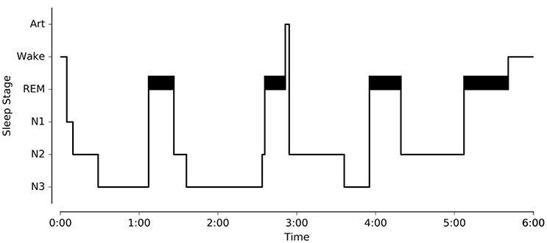
Sleep Stages Hypnogram
Notes:
The two main stages of sleep are REM (rapid eye movement) and Non-REM sleep.
Non-REM sleep is made up of 3 stages:
Stage 1 is where you experience light sleep, when you are nodding off.
Stage 2 is deeper sleep.
Stage 3 (slow wave sleep) when you are in a deep sleep and may find it difficult to wake.

Slide 43
Partial Wakings
Often, we are not aware of these, we simply turn over and go back to sleep.
It is important to recognise that:
- Children who have not learned to settle themselves may wake fully at this point.
- Or a child who partially wakes in a different environment to the one where they fell asleep may wake fully.

Slide 44
Melatonin: ’The Hormone of Darkness’
Naturally occurring hormone produced by the pineal gland in the brain
Controlled by circadian clock, levels rise at night and fall at dawn
Synthetic melatonin

Slide 45
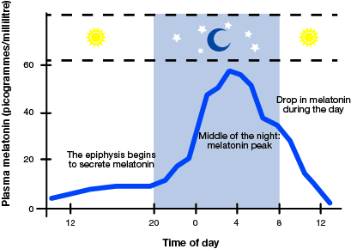

Slide 46
Impact of Sleep Deprivation
Sleep deprivation is a form of torture
Many of the families we meet are in crisis as a result of exhaustion
It impacts on the whole family
There is very little support for families who are sleep deprived

Slide 47
Statistics and Sleep
Sleep problems are more prevalent than reported
Parents feel judged so don’t report
There is a lack of expertise available around sleep issues – who do you ask?
Many parents feel children will ‘outgrow’ the problems or it is part of a child’s ‘condition’

Slide 48
Our Approach
A Behavioural approach
A positive approach to bedtime
Parents are the experts on their children
We offer support and empower families to make changes if they choose to
To really listen
We are qualified Sleep Practitioners that have completed additional training to specialise in neurodiverse sleep support.

Slide 49
Support available
Within Cheshire and Wirral we are commissioned by the nhs to offer support to families of a child who is on the pathway for or diagnosed autistic or with ADHD with their sleep.
Ellesmere Port and Wirral we can support all sleep as part of our universal offer.

Slide 50
The offer
6 -week in person small group course
6-week online group course
6-week 1-1 phone or teams support

Slide 51
How to access support
Phone 0151 608 8288 to self register
Email admin@koalanw.co.uk
Ask your GP or paediatrician for a referral

Slide 52

Sleep Hygiene

Slide 53
Importance of Sleep Hygiene
‘Sleep hygiene is a variety of different practices that are necessary to have normal, quality night time sleep and full daytime alertness’
National Sleep Foundation

Slide 54
What makes a good bedtime routine
Should be calm and consistent
Needs to be interesting for the child
Hand eye co-ordination activities are good for promoting relaxation
Consider whether a bath is appropriate
Visual timetables can help
Once your child has gone to their room they should not go back into the living room
No screens in the hour before bedtime
Keep hugs and kisses and stories to the same length each night
Use a set phrases “It’s night time, go to sleep”

Slide 55
Regular Sleep Pattern
Important to maintain a regular sleep/wake pattern
Getting up the same time in the morning and going to sleep the same time each evening can have a huge impact on better sleep.

Slide 56
Screens and Sleep
Screen activity is highly stimulating and best avoided an hour before bed
Screens also give out light which for some children can interfere with melatonin production

Slide 57
Exercise and Sleep
Exercising too close to bedtime can release feel good hormones and wake us up
Consider whether a child is getting enough exercise during the day
Limit physical activities in the hour leading up to bedtime

Slide 58
Food and Sleep
Are children genuinely hungry?
Do you need to put supper time into the routine?
Consider what they are eating too – sugary snacks are best avoided
Sleepy foods can help!

Slide 59


What your child eats during the day impacts their sleep during the night. Avoid sugary snacks and anything containing caffeine.
Almonds contain magnesium promotes both sleep and muscle relaxation. They also help to keep blood sugar levels stable overnight.
Bananas are an excellent source of magnesium and potassium. They also contain tryptophan an amino acid that helps us to sleep but don’t forget fruit contains sugar too. Blend one banana with one cup of milk or soya milk to make an ideal bedtime drink.
Dairy, yogurt, milk and cheese contain tryptophan helping us to nod off more easily. Calcium is effective in stress reduction and it’s not true . . cheese doesn’t give you nightmares!
Oatmeal makes an excellent suppertime choice, it’s cheap and easy to prepare and has sleep inducing qualities. It's rich in calcium, magnesium, phosphorus, silicon and potassium, all of which can help to promote better sleep. You could even add some banana on top.
Cherries particularly tart cherries have been found to naturally boost melatonin production. Drinking a glass of cherry juice (available at most natural foods stores) has been proven to aid sleep. Alternatively try a serving of fresh, frozen or dried cherries before bedtime.
Cereal not only is it a healthy snack, but it may also help you snooze. Complex carbohydrate-rich foods increase the availability of tryptophan in the bloodstream. Avoid sugar-coated cereals though, these will give your child a sugar rush and wake them up!
Notes:
Discuss hot chocolate has caffeine in a small amount but that too much for a young child. Blackcurrant drinks a no

Slide 60

Positive Bedtimes
Keep calm
Remember fight or flight
Breathe!
Give warnings that bedtime is approaching
Use clues such as music, sandtimers
Never use the bedroom as a sanction
Use positive language

Slide 61

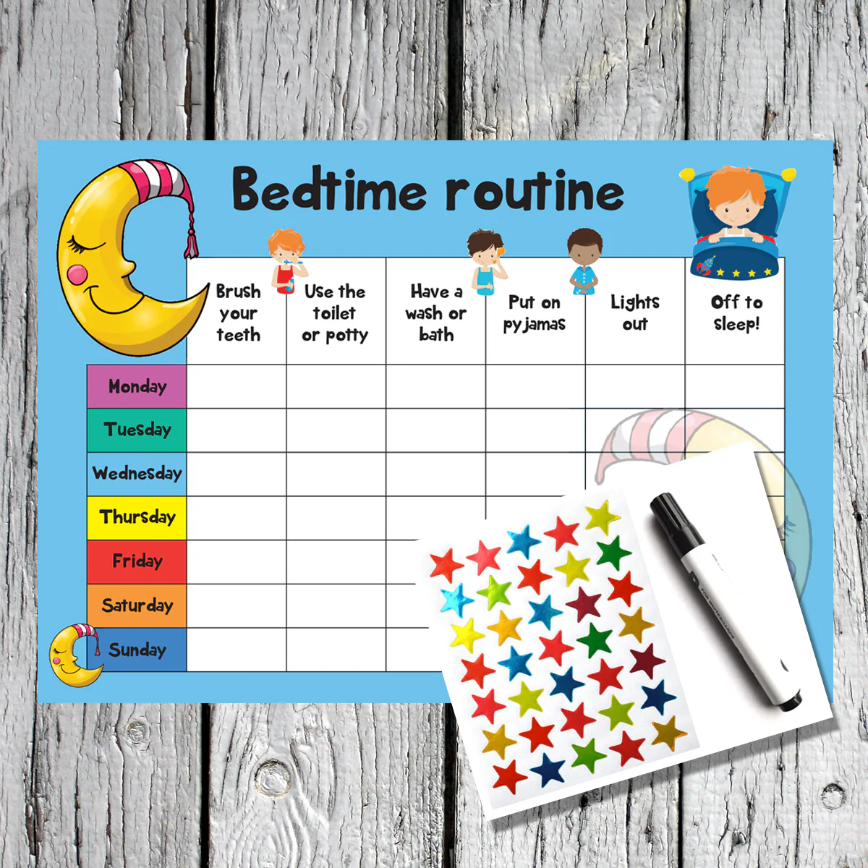
Other Tools
Reward Charts
Hand holders – Gloves
Hair holders – swimming cap
Sleep fairies
Time appropriate routines
Scheduled waking's
Teaching the difference between night and day

Slide 62



Questions?

Slide 63




Slide 64


Themes from 2024
Communication – Navigating the system
EHCP Process – Compliance rate
Wait times – Leading to children in crisis
Lack of Access to Services - Wrap around care/Short Breaks
Eligibility Criteria – Equity across the borough
Emotional Toll on parents
Notes:
Basic levels of communication – answer emails, phone parents back
System changes – Family Hubs for SEND parents across the borough to get answers
EHCP Process –
6% compliance rate
Special School FULL – add in numbers – the life boats are sinking
Sufficiency
Where can we help – Parents voices baked in to help build the confidence that the provision that is being created meets need , communication around this …
Children and families in mental health crisis – no access to services which keeps children out of education
Where can we help – Co-produce reasonable adjustment attendance policy with parent lived experience baked in
Lack of access to services –
Talk about the solutions – special school offer/transport restriction/Direct payment restriction lifted

Slide 65


Dates for the diary
December 15th Soft launch
January 6th big push
February 6th Closing date

Slide 66






Slide 67


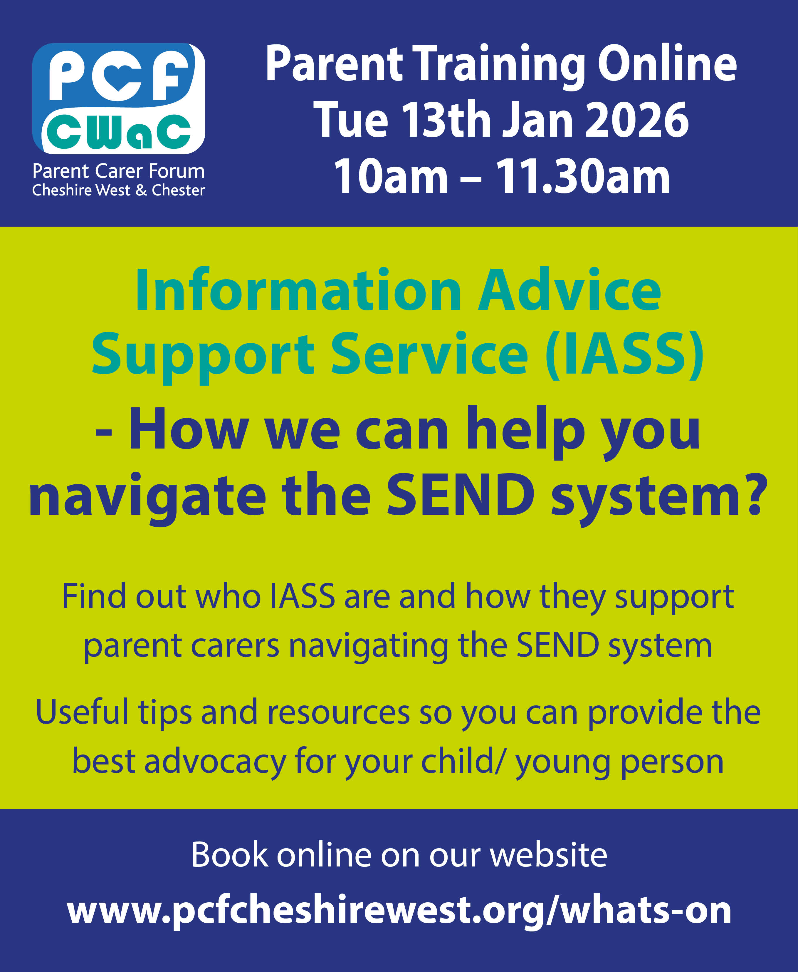


Slide 68


What Went Well?
What Didn’t Go well?
Thank you!
Even Better If?

