Slide 1

PCF Survey Results -Themes
PCF Partnership Board meeting
15th June 2026
Notes:
Hello everyone. Today I'm presenting the findings from the PCF Survey 2026, touching on the key themes and how we can do further analysis.

Slide 2
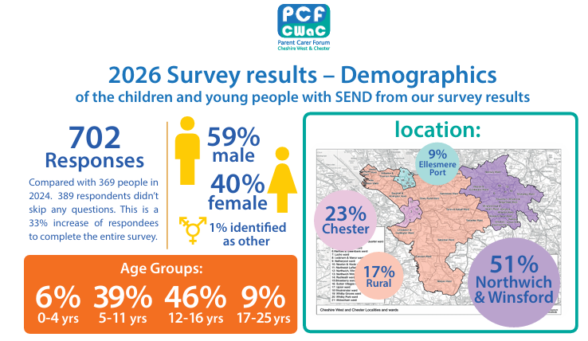
Demographics
Notes:
A quick look at who responded. Over 700 from all ages and areas in the borough. A 48% increase since the 2024 survey. This gives us confidence that the results are broadly representative of the families we support across the area."

Slide 3
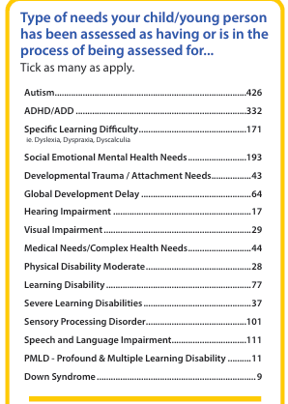
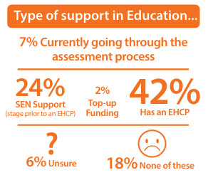
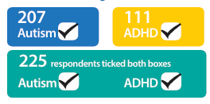
Type of need & Support
Notes:
Since the last survey is the increase of 23% of dual Autism/ADHD diagnosis.

Slide 4

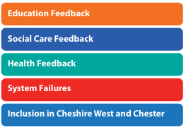
“lead to inconsistent experiences and outcomes for children and young people with Special Educational Needs.” OFSTED 2026
Key Themes
Notes:
"This survey breaks down feedback by service area and overall themes to understand how our systems are working for families and like Ofsted found, it shows inconsistent experiences and outcomes."

Slide 5

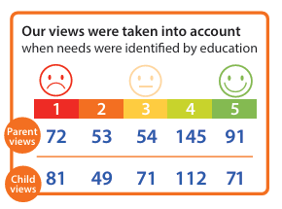
Key Themes
Notes:
Education "Many families feel safe and supported, but too many report feeling unheard, with needs not recognised or unmet and not kept informed about changes to the support their child receives ."

Slide 6

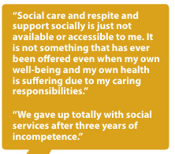

Key Themes
Notes:
Social care "39% of families struggle to access social care — they don't know what they're entitled to or where to turn."

Slide 7
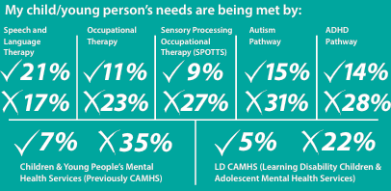

Key Themes
Notes:
Health & waiting times "The wait for specialist input causes real harm, by time support is there things have escalated. Sensory OT, Autism, ADHD and mental health pathways are the worst reported."

Slide 8
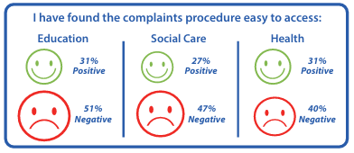
Key Themes
Notes:
System failures "Families report delays, poor communication and a broken EHCP process, when things go wrong and families turn to the complaints process which a third of families found difficult across all three services

Slide 9
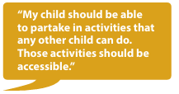
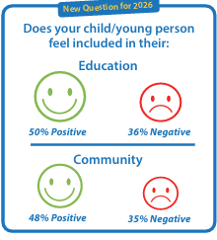
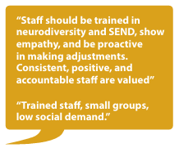
Key Themes
Notes:
Inclusion "Following the council's 2024 inclusion commitment, responses show inconsistency across education and the community — families told us what good looks like.“ We use this to measure success next time.

Slide 10


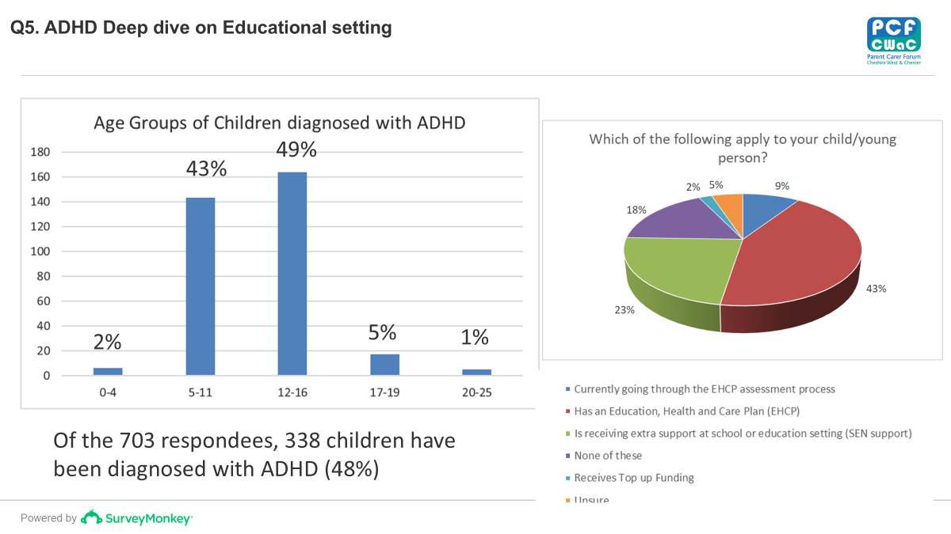
Notes:
Further analysis "Full data broken down by geography, age group and type of need here's an example of what we can do with it."
"Of 338 families with an ADHD diagnosis, 18% are receiving no support — no EHCP, no SEN support, no top-up funding. That's a significant gap."

Slide 11

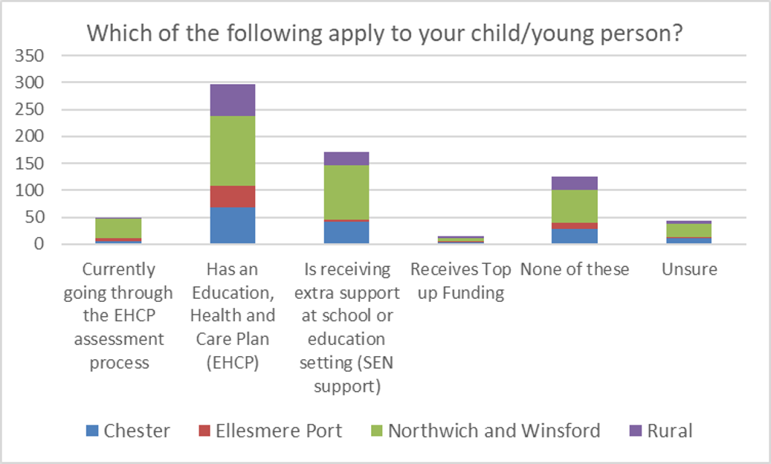
Compared to the last survey, the number of children receiving extra support at school has increased by 15%. Additionally, the number of children who receive none of these has increased by 12%.
Notes:
"Compared to our last survey, children receiving extra support at school has increased by 15% — but in the same period, children receiving no support at all has also increased by 12%. The gap is widening."

Slide 12
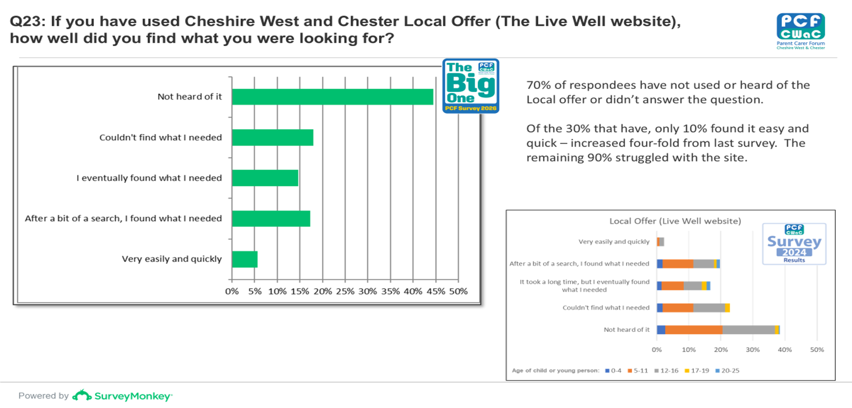

Slide 13


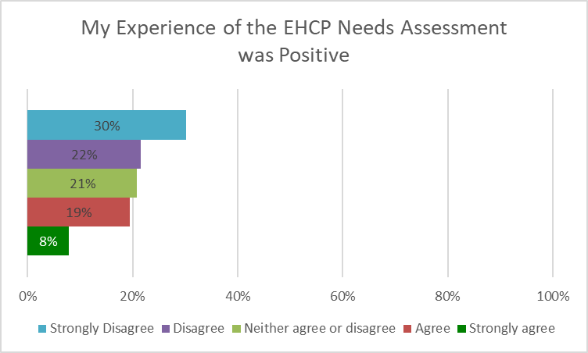



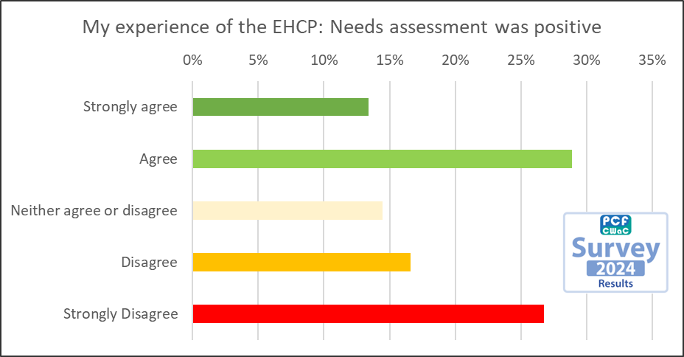
Q28: My experience of the EHCP: Needs assessment was positive
Compared to the 2024 survey results, the experience many respondees had was less positive. With a downwards trend from Strongly agree/Agree to a negative experience. In fact this is the 2nd survey in succession where the EHCP experience has got worse for respondees. With Strongly Disagree increasing from 25% in 2022, 27% in 2024 to 32% in 2026.

Slide 14
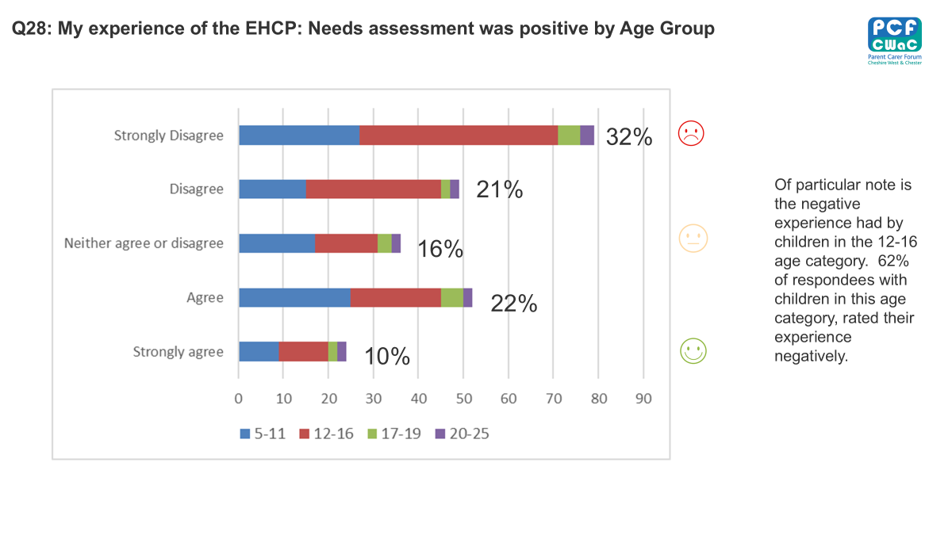

Slide 15
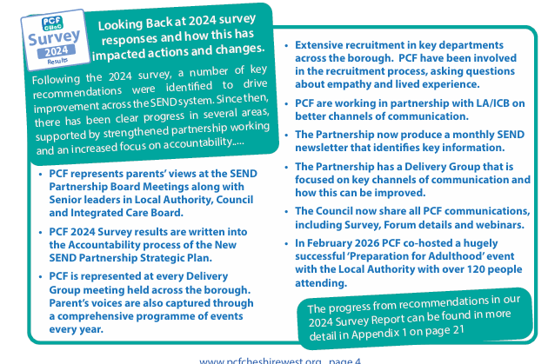
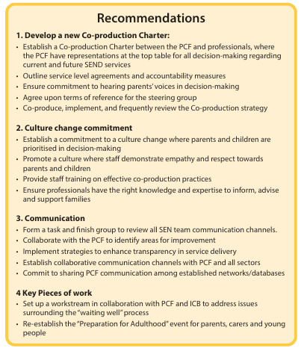
Notes:
Co-production charter & Culture Change: PCF now sits on the SEND Partnership Board, the 2024 survey results are written into the Strategic Plan, and we are represented at every Delivery Group. We co-produced The Pledge now known as the Commitment, and PCF is now part of the recruitment process, asking candidates directly about empathy and lived experience."
Communication The partnership started to produce SEND newsletters with waiting time and compliance updates, and the Council shares all PCF communications across their networks."
Key work “We asked for better support while waiting— we co-produced the 'Knowing Me' profiling tool and Co-presented , over 120 people attended our Preparation for Adulthood event."

Slide 16
Questions
• What are your thoughts about the PCF survey results? Are there any surprises?
• Is there anything anyone would like a deeper dive into?
• How are we going to make sure that the results are at the heart of our forward thinking and planning?

