Slide 1

Cheshire East Autism Team in association with the
Autism Education Trust
Joan Sherry (CEAT)

Slide 2
Practical classroom adaptations for neurodivergent Reception students
Top 10 Tips!

Slide 3

1) Know your student!
Every neurodivergent child is an individual. Getting to know them should always be your starting point.
Communicate with parent/carers
One Page Profile (OPP)

Slide 4

Communication with parent/carers
Keep the lines of communication open between home and school.
Strengths, interests, communication etc. – what are they like at home?
If parent/carers are flagging up an issue at home that you’re not seeing in school – believe them and take action.
Notes:
Tell the ‘do aww’ story (Barry Prizant – Uniquely human)
Take action – do two things 1) speak to the young person 2) check that you have in place the 10 strategies in this presentation

Slide 5
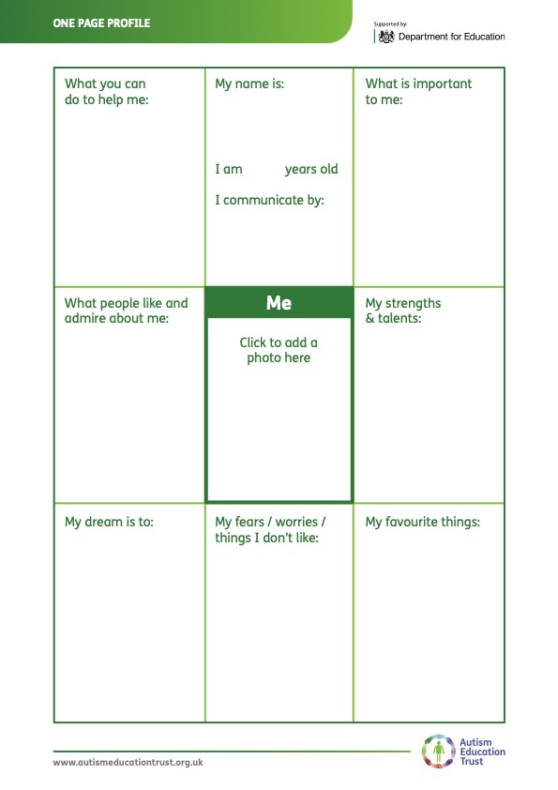
One Page Profile
Strengths
Interests
Learning Style
Dreams
Sensory differences
Where support is needed
Notes:
You may not be the person who creates this with the student, but you absolutely need to know what it says. This is your ‘key’ to engagement and success
‘superhero’ story about boy who wanted to be invisible

Slide 6
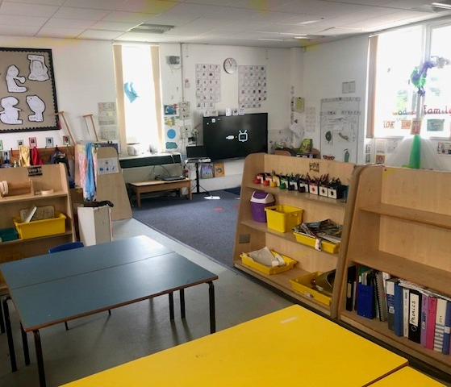
2) Set up your classroom
Environmental audit
Displays
Lighting
Window blinds
Noise
Labelling (pictures)
Tidiness/clutter
What are you wearing?

Slide 7

3)

Slide 8
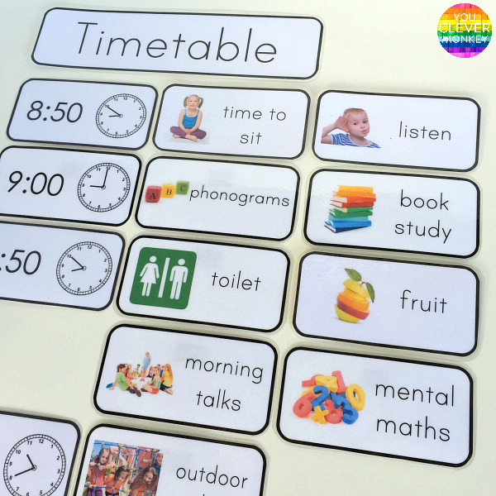
Use visuals because they…..
Give information – To answer the who, what, why, where, when questions.
Provide structure – Communicate what is happening and when throughout the day, week, month. This can help reduce anxiety around the unknown.
Support transitions – Visual strategies can be very helpful in supporting neurodivergent pupils to stop one activity and start another, or move from one environment to another.

Slide 9
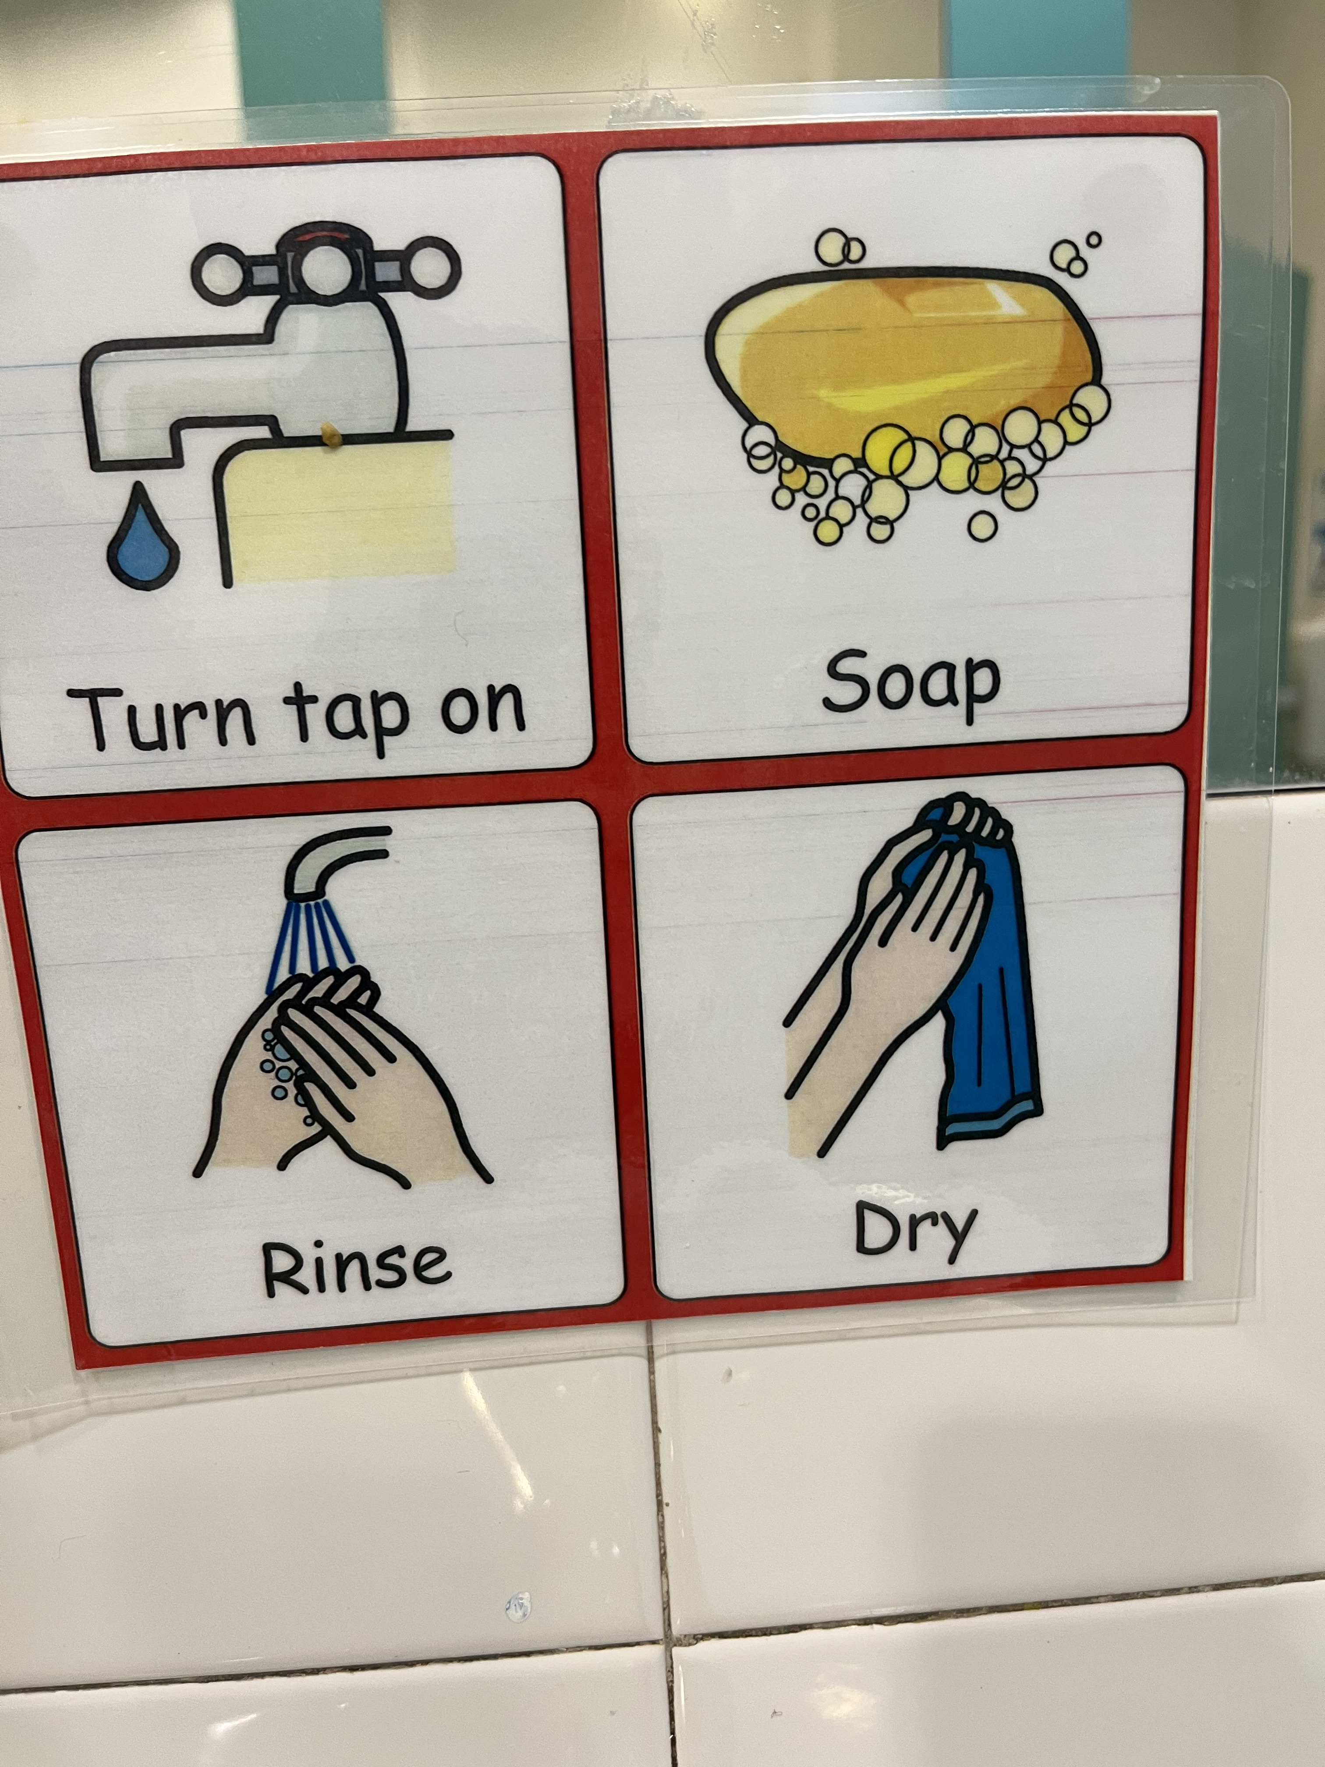
And to …..
Teach routines and/or new skills – Think ‘flat pack’ furniture!
When the pupil can see what they need to do and in what order, this helps them to learn the routine and minimize mistakes.
Organise the space in the environment – Clear visual strategies to communicate the purpose of a particular space (e.g. art, music etc.).
Be more independent in the environment – Providing an organised, structured and well labelled environment helps pupils to know where to find the things they need, and where to put them when it is time to tidy.

Slide 10
And to …..
Stay on task – ADHD pupils can struggle with remembering what the current activity is and staying involved with it until it is completed. What does it mean to be “finished?”
Aid memory – Remembering what to do and/or when.
Clarify verbal information – Autistic pupils can interpret language very literally and struggle to infer what is meant from what is said (the words used) and the way it is communicated. Using visuals can help clarify the message and helps to eliminate confusion.

Slide 11
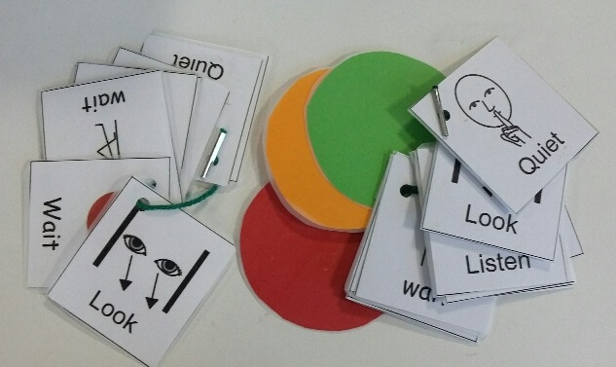
And to …..
Manage time – Time is invisible. Timers and clocks turn time into something pupils can see. Use something concrete and visual e.g. stopwatch, sand timer.
Communicate rules – These might be generic rules (e.g. class rules) or social rules. Autistic pupils have differences in social understanding that many of us acquire instinctively.
Assist pupils in coping with change –Preparing pupils when something will be different from what they normally expect can reduce anxiety around the unknown.

Slide 12
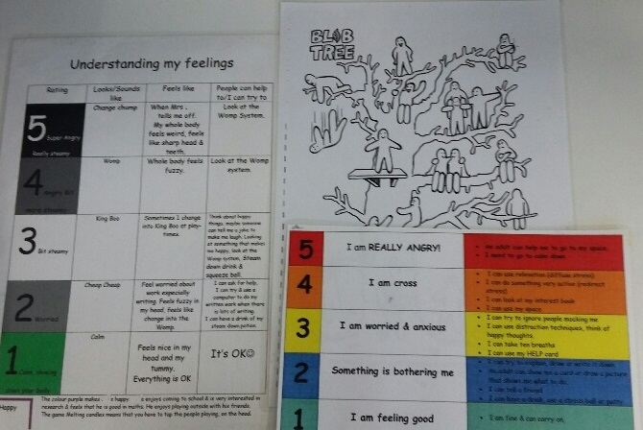
And not forgetting, to…
Explain social situations – Providing social information e.g. social rules, both verbally and with a visual support can help pupils understand a variety of social situations.
Give choices – Let pupils know what their options are, what is available/ not available.
Support self-regulation – Pupils need to learn how to cope when they get anxious or encounter a problem. Strategies such as visual imagery can help with this.
Communicate emotions – Helping pupils to translate emotional responses into pictures or written language gives an opportunity to explain, clarify or validate how they are feeling.

Slide 13

4) Seating
Ask the young person where they would like to sit and why (or observe)
They may be happier sitting on their own to complete tasks
Some neurodivergent pupils benefit enormously from sitting with a friend or supportive peer
Keep distractions (visual and auditory) to a minimum
Consider sensory differences in respect of seating
This Photo by Unknown Author is licensed under CC BY-SA-NC
Notes:
Room to stand and move; standing desks; wobble cushions; carpet time; consider the sensory impact of sitting next to other children – smell, movement, tactile
Girl who liked to sit at the front on the end of the row with her back to the wall
Sitting on the carpet – edging back to rest against a table

Slide 14

5) Warn about changes
Tell the pupil what has changed and why and indicate what will happen instead (with a visual!)
Comic strip conversations
Social stories
Traffic Lights
Timers
Music
Notes:
Understand how your autistic student processes the world – talk to them about what helps them – Luke being supported by the pattern of space between desks giving him a pathway to his seat

Slide 15
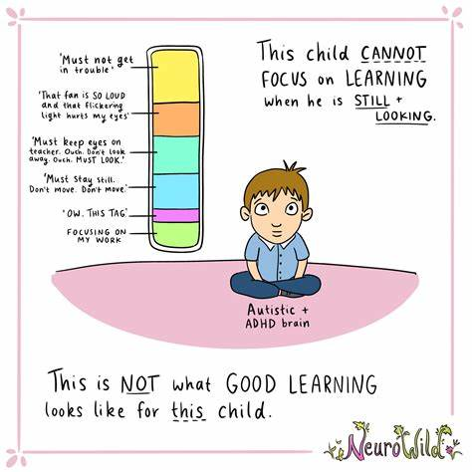
6) Support attention and processing
How are we describing ‘good listening’?
Neurodivergent pupils need time to process language.
Keep instructions / language consistent and allow time to answer questions (supported by visuals)
Avoid use of ‘lollipops’ or ‘wheels’.
We may need to teach joint attention skills (Attention autism; intensive interaction; etc.)
Build in pre-emptive breaks which are adapted to the child’s sensory needs
Notes:
Does good listening mean looking at me?
Many autistic young people find this too stressful. They listen best whilst drawing or fiddling ( I know that Mary Patricia is doing her good listening because she is using her doodle pad; I can see that Patrick Joseph is doing his good listening because he’s using his fiddle toy; I can see that Philomena is doing her good listening because she’s looking at me)
Does good listening mean sitting still?
Many autistic young people process language better when they move

Slide 16
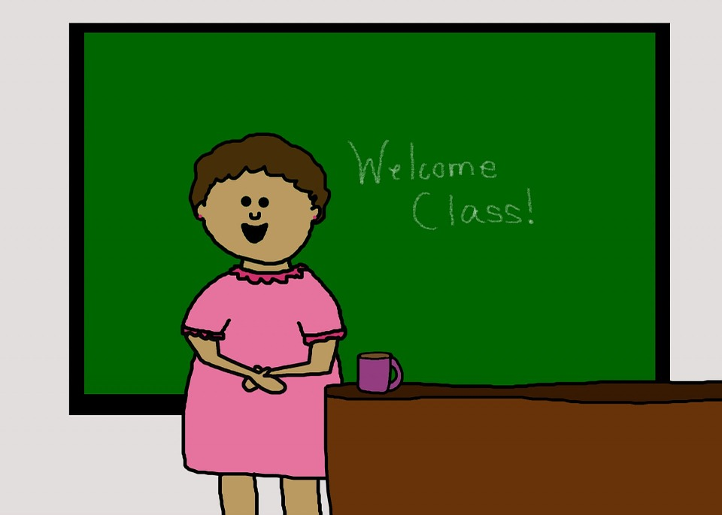
7) Monitor your communication
Check the following
  Your voice is not competing against background noise.
  You pause between sequences to allow processing time.
  One instruction at a time is given.
  Sarcasm or hints are avoided.
  Metaphors and other figures of speech are explained.
  Instructions given are unambiguous.
  Avoid rhetorical questions.
Notes:
Be careful of ‘stereo input’ i.e. TA simultaneously translating whilst the teacher is talking
Unambiguous instructions –
chewing gum example – told to empty his mouth, but not told not to chew gum in the lesson;
art lesson example – I want this room to look like it did when I walked in this morning
Avoid rhetorical questions – do you want to finish you maths now or do you want me to keep you in at break to do it?

Slide 17
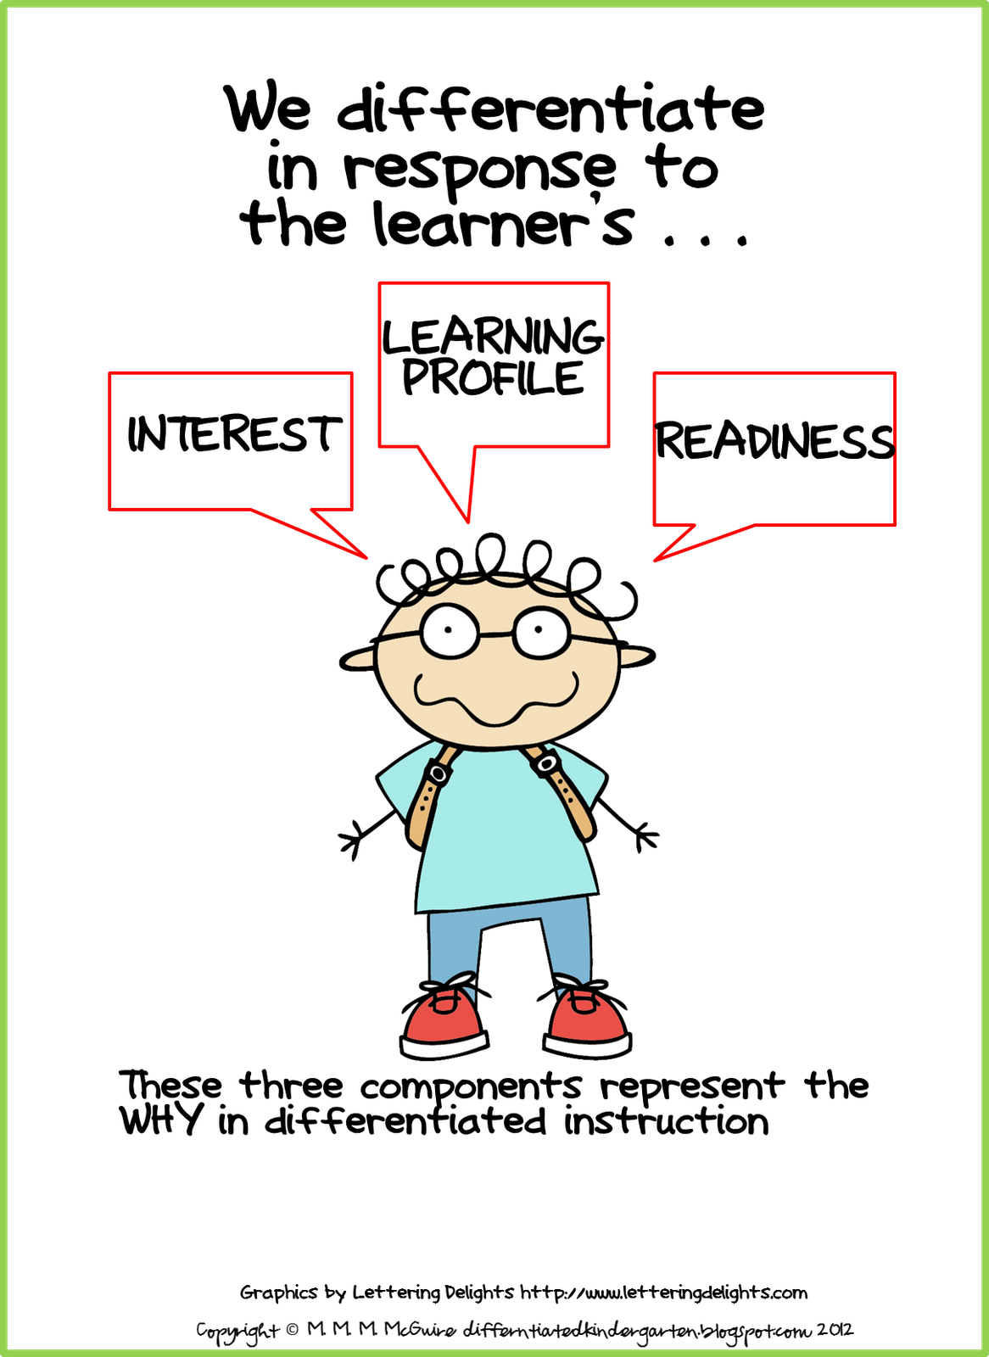
8) Adaptive Teaching!
Tasks must have meaning and purpose for the neurodivergent student (Phonics)
Attention needs to be ‘captured’
Does the student know why they have been given the task to complete? (is it interesting? Is it fun?)
Can the learning objective be achieved using the young person’s special interests?
Consider separating handwriting from literacy
Notes:
Dyslexic students and writing
Writing from a different perspective – Titanic example; Dr. Who

Slide 18

9) Support play/social interaction
Determine child’s social skills level (AET progression framework could be used)
Teach play skills – appropriate for the child
Teach sharing and provide some ‘non-sharing’ time and resources
Provide visual guide – who is doing what and when?
Keep groups small.
Minimise group activities.
Teach neurotypical children how to support and value their neurodivergent peers
This Photo by Unknown Author is licensed under CC BY-ND
Notes:
Little boy and the farm; boy building a ‘world’; have time during the day when they don’t have to share; ADHD children and rejection
Harry and the tracing at the window

Slide 19

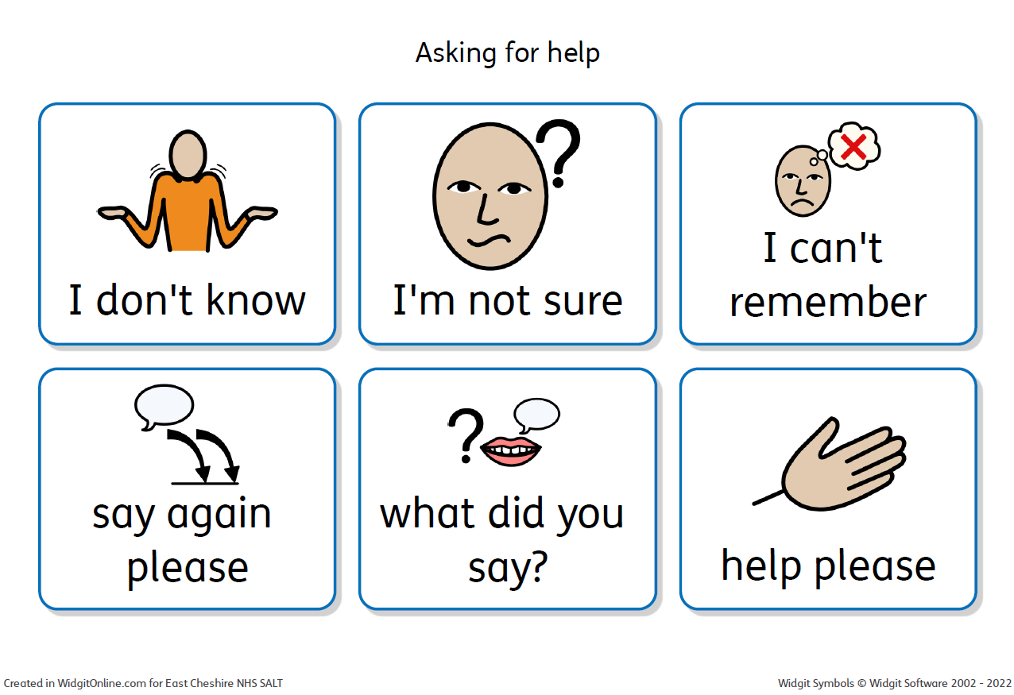
10) Support and encourage asking for help
Teach students that it’s okay not to know the answer or to get something wrong.
Teach them how to recognise when they are ‘stuck’.
Then teach them how to ask for help.
Respond positively to questions, especially when the young person may not have been able to attend to verbal directions and seeks clarification or repetition.
Asking for help applies to you too!
Notes:
Asking a question repeatedly or to which they know the answer may be a need for reassurance or an indicator of anxiety
Be aware of the stress of too much challenge however – having walked through a battle field without getting shot, you might be elated, but you wouldn’t choose to repeat the experience!

Slide 20

To Summarise
Know your student
Set up your classroom
Use visuals
Seating
Warn about changes
Support attention and processing
Monitor your communication
Adaptive teaching
Support social development and understanding
Teach how to ask for help
Notes:
We grow and thrive when the environment is right and we receive the correct nourishment and support

Slide 21

Our mission is to build a bridge between the neurodivergent world and the neurotypical world, so that ideas, understanding and support can flow in both directions making the world a better place for all of us.
Neurodivergent inclusive classroom environments and teaching strategies benefit all students (and make us better practitioners!)

