Slide 1
AGM and Transport
Wednesday 16th July
10am – 11.30

Slide 2
Housekeeping

Slide 3
Annual Report - Highlights
Growth
Financials
Service Level increases
More opportunities for parents to meet up
Partnership for Inclusion of Neurodiversity in Schools PINS
Engagement Opportunities – SIP and Learn
Accountability
Priorities for 2026

Slide 4
Annual Report – Reach

Slide 5
Annual Report – PCF Blogs

Slide 6
FINANCIALS
IN
OUT
£17,500
£17,415
DIFFERENCE - £85

Slide 7
Partnership for Inclusion of Neurodiversity in Schools PINS
Funded by NHS England
4 Schools involved in first phase
What was involved
Lesson Learnt – Sensory Boxes
Next Stages – 3 Schools in Northwich

Slide 8
Engagement Opportunities

Slide 9
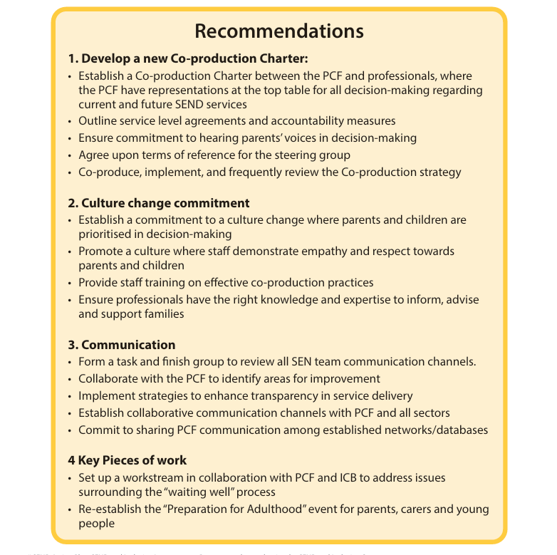
Outline Accountability Measures

Slide 10
New SEND Strategy Governance

Slide 11
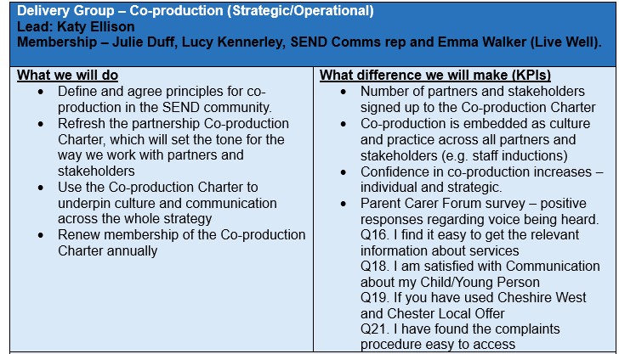
Outline Accountability Measures

Slide 12
SEND Strategy Governance

Slide 13
New Co-Production Charter

Slide 14
The journey so far

Slide 15
Our Pledge
Guiding Principles – what matters to you the most
Accessible information
Parents/carers are equal partners
Transparent decisions made in partnership
Empathy and understanding
Joined up thinking
Clear processes, adequately explained
Relationships built on trust
Proactive rather than reactive culture
Personalised communication
Jargon free, accessible language
Managed expectations
Information sharing
We know what is important to you regarding culture and communication, so now we need you to help set the tone for how we communicate with you, how we value your contribution and how you can expect to be treated.
Please tell us below the change you want to see. What should be our Pledge to you?

Slide 16
Snapshot of pledges received
What is just a ‘booked in 1 hour call’ in a busy professionals’ diary can be for a parent something that has huge meaning, it is long awaited and can have huge consequences. Help that parent feel that you recognise the importance of each meeting / call
Clarity of processes – who's doing what, when – who is the point of contact for each stage
I appreciate not having to have to choose my words carefully and always be on guard
I want to have all the information I need and take it away to process and have an open door to return to with any questions that arise
Build transparent and trusting relationships with parents / carers
Don’t overpromise things. Manage expectations and be realistic
Invite the voices of parents / carers and treat us as equal partners
Provide honest timescales, tell us the timescale you hope to achieve and communicate it clearly

Slide 17
Priorities for 2026
Assist in embedding Co-Production
Assist in helping to improve communication
Growth the reach of the Forum – Bus Stops
Empower Parents
Coffee Events
Virtual Forums
In Person Forums
PCF Bi Annual Survey January 2026

Slide 18
Meet up Opportunities in 2025/6
💻 Virtual Events
PCF Who Are We? & Meet the Directors
Early Years – Sleep & Toileting
Benefits & Support
Short Breaks & Charitable Support
🏛 In-Person Events
Neurodiversity Forum Northwich
Preparation for Adulthood Ellesmere Port
Education, Inclusion & Mental Health Chester

Slide 19
Meet up Opportunities in 2025/6
Virtual Parent Training
Empowerment & Communication
SEND Law
Support in Education
Coffee Events

Slide 20
Summary

Slide 21
Home to School Transport AGM - Parent Carer Forum
16 July 2025

Slide 22
Background
Demand for transport is rising faster than anticipated, largely due to the increase of EHCP’s. In 2023 it was estimated that spend on Home to School Transport service would grow by £10.4m in CW&C by 2028.
The Targeted Transport Programme was initiated to support the services in understanding how the demand pressures could be alleviated
Specialist and national peer advice has been sought to manage the situation, but there isn’t an obvious single solution.
CW&C need to ensure that they can respond appropriately and meet statutory duties to provide travel assistance that is integrated and sustainable.

Slide 23
What’s New
The Independent Travel Training (ITT) scheme has been reinstated for children, young people and adults, to give the confidence they need to travel independently.
Individuals will be considered for ITT if they currently receive travel assistance from the Council and have access to a suitable route to access education, day services, or employment.
Take up of this offer is not mandatory - if individuals do not wish to participate in ITT, their current travel assistance arrangements will remain in place.
To date, we have received a positive response to the additional choice of ITT.
The Council has accessed existing capital funding and purchased 6 additional vehicles to expand its internal fleet, which will provide consistency and quality of provision.

Slide 24
What Has Happened So Far?
Review carried of all SEND home to school transport routes. The aim was to ensure routes are as efficient as possible while continuing to meet the needs of children and families.
Meetings with schools – to go through proposed changes and ensure they meet the individual needs of each child
Continued exchange of information between the SEN Team and Transport Commissioning as EHCP’s are finalised for September
The Transport Commissioning Service (TCS) began to tender revised routes. The end of July will be the final tender phase, therefore the 25 July will be the final cut off date for when the SEN Team can submit travel requests through to TCS for transport to be ready for the start of September. Any requests after this date are highly unlikely to have transport in place for the start of the new school year.

Slide 25
Communications
The majority of letters to families advising of their child’s travel arrangements for September have now been sent. Where there are changes to the arrangements, this may include:
A new driver or Passenger Assistant
A different vehicle
Adjusted pick-up and drop-off times
Operators should be contacting families to arrange meet and greets over the summer.
If you have not been contacted by your driver over the summer please contact Transport Commissioning: sentransport@cheshirewestandchester.gov.uk

Slide 26
Contacts
sendschooltravelassistance@cheshirewestandchester.gov.uk if you have a query regarding your child's eligibility for travel assistance
sentransport@cheshirewestandchester.gov.uk if you have not received a letter about your child's travel arrangements
schoolplanningandpolicy@cheshirewestandchester.gov.uk if you have a query regarding a personal travel budget (PTB) or a transport appeal
traveltraining@cheshirewestandchester.gov.uk if you would like to enquire about independent travel training (ITT)

Slide 27
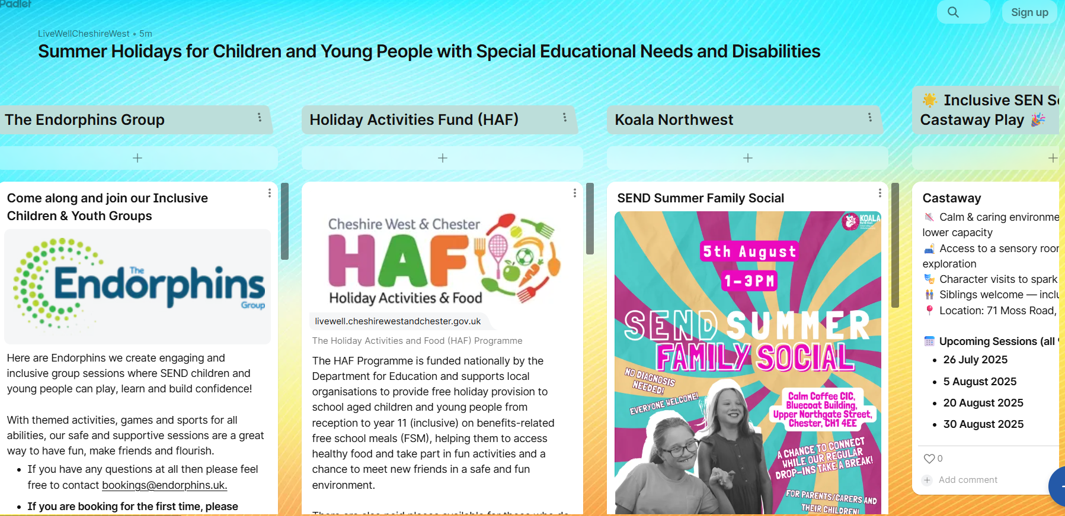
Summer Holiday
https://padlet.com/LiveWellCheshireWest/summer-holidays-for-children-and-young-people-with-special-e-drf50c1p2r1jtax1

Slide 28
Contact Us
Join Us Here!

