Slide 1


In collaboration with St Helens, Sefton and Cheshire West and Chester PCF Natalie Skillicorn, Monica Wright, Sue Swinchin and Vanessa Usai
C&M PINS Project
Partnership for Inclusion of Neurodiversity in Schools
Session 2
Embracing difference
What it’s like to be me and what school is like for me
Looking at differences in how pupils behave and how staff respond differently and the positive and negative impact this can have

Slide 2

How it feels to be me
C&M PINS Project
“Before school I feel terrible. I hate getting dressed because of the uniform. Everything about school. I hate nobody will play with me, the work is too hard and I can’t have breaks. In school I feel like I’m in a dream and the teacher doesn’t listen or help. When I get home from school, I get angry but I don’t know why, but I like it better at home, it’s much better.”
“I feel anxious and have butterflies in my tummy. I feel scared in case I get told off. When I get home, I feel happy as I know the day is over and sometimes I feel happy about the day, but mostly because it’s over.”
“I feel really nervous and then I feel worried, nervous and scared at school. After school, I feel free and safe.”
The following 5 questions (set by PINS project leaders & PCF’s) have been answered by primary aged children, who either have a diagnosis or are on neurodevelopmental/ADHD pathway

Slide 3

C&M PINS Project
How would you describe your needs to a teacher?
“I would say can I have some help as my brain feels busy and overwhelmed.”
I couldn’t so my mum and dad would or Mrs *****(SENCO). I know I have one of those education plans so that will tell them.
I wouldn’t because they wouldn’t do anything and if I knew they would listen, I wouldn’t know how to describe it anyway
I wouldn’t
I don’t know
I cant, I hate asking for help, it makes me nervous
I don’t know. My teacher should know.

Slide 4
C&M PINS Project
What things at your school helped you?
“The hub and sensory breaks when I’m allowed to have them.”
Sensory breaks, a number scale for how I’m feeling, emotions chart on my desk
I don’t know. My teacher helps me
Fidgets
Mrs *****, she was my TA in Y4. Time to adjust. When everybody didn’t shout and scream. Sitting me at the front and pairing me with my friends
Wobble cushion, time to clam down and move about
The hub and sensory breaks when I’m allowed to have them

Slide 5
C&M PINS Project
Did anything at school make you worry?
Being bullied, seeing my friends being bullied, going on the traffic lights and going into reflection. Also speaking to staff
"I worry about loads, I worry that it's too loud and I don't like it in the cloakroom because it's so busy and my peg is at the back. I worry that my work will be wrong, I worry about that a lot, and even though I have my ear defenders the hall is still really loud at dinner time. I worry that everyone else is better at stuff than me and that my friends won’t play with me.”
Not really
(conversation shut down as expresses lots of worries at home)
The children don’t understand how I feel and they pick on me. I worry about making noises and getting told off by the teacher. I worry about shouting out the answers in class in case I get it wrong or say the wrong thing
Assemblies, PE, lunchtime, buddying. Unknown situations, not knowing people, changes and new things
Everything! The windows are too close to the road and always getting told off and sent to reflection
The rain chart, then the ATL’s. Asking for help

Slide 6
C&M PINS Project
Did anything make it hard for you at school?
“Too many people, asked to do too many things. Too much work and the teachers don’t understand”
Having to leave my mum at the school door. Speaking to the staff is very hard to do
Why do I have to answer these stupid questions anyway? I don’t know the answers, I don’t know what you mean
Other children. When teachers forgot and expected me to talk. Being expected to do what everyone else did. Not being given time to adjust to new things happening. When routine changed and what was expected didn’t happen
Not really
(although often states at home that the work and having to concentrate is hard)
Where I am sat can make it difficult
The teachers and the work is too hard

Slide 7
C&M PINS Project
Can you think of anything school could do to make it easier and better for you?
“Having more equipment in school to help me calm down or help me when my head is busy. A place to be myself without the other children looking at us because we need to spin or act daft.”
Teachers that help me and not shout at me all the time. Easier work and more sensory breaks
To listen to me when I try to speak to staff. They could explain things a lot more easier, like the work and to me when I need to understand things better
More time with Mrs *****. Not having lunch in the hall. Not buddying at all
Quiet, less smells
Less people, only Kahoot lessons instead of work

Slide 8
C&M PINS Project
Next, we put forward 5 questions to the parent and
carers of the children, to gain their views and experiences of their child’s primary school journey

Slide 9
C&M PINS Project
How would you sum up your child’s experience of primary school?
“Overall positive. This is down to an amazing SENCO, Head Teacher and her teachers. It was also down to my child not giving up and her love of learning pushing her to put her mask on and get on with the day. Year 4 was extremely difficult as it was before her situational mutism diagnosis and when we were suspecting she was autistic. Once they started to understand my child, they put things in place to support her and it got better for her. In Yr4 she was lonely, emotional, upset until support measures were put in place but it took time to get better for her. As my child is academic and enjoys learning and is non disruptive there have been few issues with behaviour. It is more socially she has struggled and fitting into an expected format because everyone else does”
On a whole , the school is being very accommodating – adding extra staff, regular catch up with parents. My child struggles, especially with it being so structured
Not the greatest, I don’t feel like his needs have been met or listened to
Very challenging. Lots of hurdles, upset and frustration
Very hard and stressful. Going through 6 years of not being heard has taken its toll on all our mental health and health in general
Heartbreaking watching him walk in everyday knowing he’s struggling and its being unseen
The lack of communication from school has been horrendous

Slide 10
C&M PINS Project
What helped your child day to day?
“Routine, understanding what was coming next. Offering alternatives if she was unable or didn't want to participate. Having a trusted adult who gave up her lunchtimes to support my child and her social struggles. Patience from all school staff. Educating her peers and others who looked after her in school. Us getting support as her parents to help her. Small adjustments in who she was sat with, where she was sat, not buddying, time with the Yr4 TA.”
His wobble cushion and sensory breaks when he had them. He also had a lovely TA that really got him and she even sent out photos of what his new classroom would look like, which he has never had before
Another thing that really helped is when a teacher is understanding of your child’s needs and the are supportive, but there definitely isn’t enough knowledge
Not much, other than when he gets to work out of the classroom in small groups.
Nothing
I put positivity notes into my child’s lunch box for her to read and a draw a heart for her to press and know we’re sending her a hug when she needs one
Communication with teachers and TA’s

Slide 11
C&M PINS Project
What did your child find difficult?
“My child found mornings difficult, the uniform knowing uncertainty was coming. Other children and their behaviours. Lunch Hall, noise and smells. Buddying younger children. PE, getting changed for PE, people watching her. Being unable to communicate when she was struggling. Assemblies, the noise, trips, non-uniform days, dress up days. Going in the classroom door.”
Expectations, class noise, work load, constant demands, lack of sympathy and knowledge with teachers, felling of uniform, constant reflections and telling off, lack of communication
Not feeling safe at school and having none to talk to or ask for help as no one understood how he felt
Going to school is really difficult. Our daughter finds it difficult to trust and speak to staff as they have let her down for many of her primary years
The work, the social interaction with others. Asking the teacher for help as he thought they would laugh at him or tell him off
School work, friendships, Bowie
Rules and regulations, demands and requests

Slide 12
C&M PINS Project
How was your experience of your child’s school?
“Very positive. They really cared about my child and wanted the best for her. Her wins and achievements were theirs too. Her SENCO was great but so stretched with a class to look after as well. Sometimes they got it wrong but discussed situations with us and made changes. They listened and did their best to help my child. We know we and my child are very lucky to have this experience as not all do.”
We ‘ve had ups and downs depending on the teacher. There has been a lot of parent pushing things and flagging issues. There is a lack of understanding in schools for children with neurodevelopmental conditions, which leads to the children suffering
So far they have gone above and beyond my expectations and are seeming to be on the ball and very helpful
I was made to feel like a crazy mum, never taken seriously , never listened to until my son finally got a teacher who wanted to understand him. A teacher with their own personal experience of ND and this showed
It has been the hardest, stressful journey we have been on. The guilt it brings hurts and you struggle to get through your own day having the added weight and stress
I feel like I am treated as a nuisance because I am always going in and asking for things or how my child is doing.
Ok

Slide 13
C&M PINS Project
What would you say the school did well?
“Kept communication open with us. Told us what was coming up so we could work with my child to figure out what would work best. They kept regular meetings to review progress. Everyone knew my child and how she needed to be supported. Got better over time planning and preparing. We never felt bad for getting in touch about the small things or anything.”
There was one teacher that finally agreed with my concerns, and he saw what I saw. Thanks to him, my son got referred.
I have to say, that I struggled to answer this and this is sad to hear. But my daughter amazes me with her education and how she is achieving through all her struggles. So I would have to say for her education, school did well
Compassion – when the see it for themselves
The one teacher who agreed to implement a communication book and how they began to understand my child from the regular communication and factors I would highlight, based on his day
Excellent communication and a very understanding head and pastoral
Offering pastoral and hub services

Slide 14
C&M PINS Project
The previous slides were presented on PINS year 1 and represented the voice of St Helens and Sefton families. We can now add to this themes from year 1 PINS parent survey and parent engagement sessions from Cheshire West and Sefton.

Slide 15

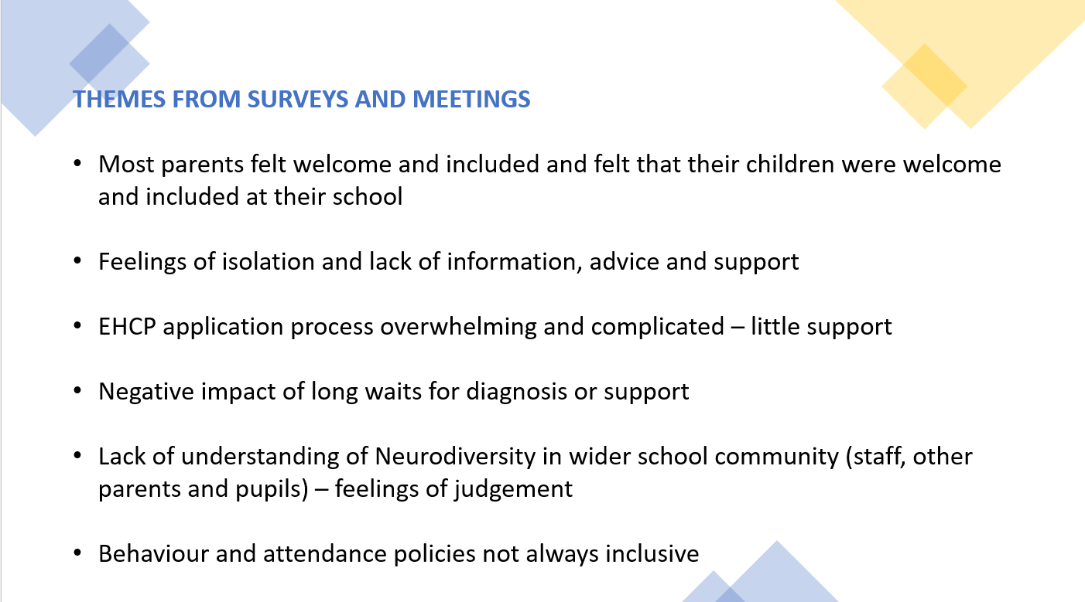

C&M PINS Project
Here’s what they said…
Communication
Communication Books
Regular communication with parents
Find triggers and understand the child
Ensure they feel safe and understood
Listening to parents and acknowledge / take ownership when mistakes have been made
Training and support
Staff fully trained and understanding
Better resource for children
Schools to access training from local services available
Make school a positive experience so children thrive
More TAs trained in SEN
Educate on acceptance of differences, make school environment more inclusive
Breaks
Movement breaks for all children not just SEND
Curriculum
Lower demand and curriculum to suit all
Reduce demand and pressure
Classroom
Smaller class sizes
Less structure in early years
More support in classroom
Better SEND provision

Slide 16
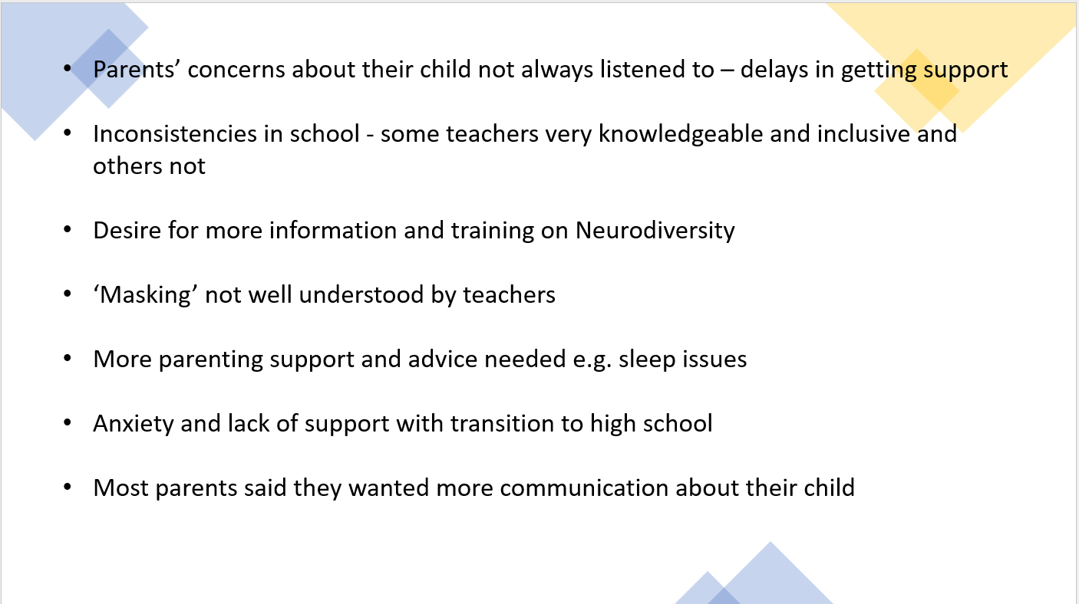
C&M PINS Project
Here’s what they said…
Communication
Communication Books
Regular communication with parents
Find triggers and understand the child
Ensure they feel safe and understood
Listening to parents and acknowledge / take ownership when mistakes have been made
Training and support
Staff fully trained and understanding
Better resource for children
Schools to access training from local services available
Make school a positive experience so children thrive
More TAs trained in SEN
Educate on acceptance of differences, make school environment more inclusive
Breaks
Movement breaks for all children not just SEND
Curriculum
Lower demand and curriculum to suit all
Reduce demand and pressure
Classroom
Smaller class sizes
Less structure in early years
More support in classroom
Better SEND provision

Slide 17
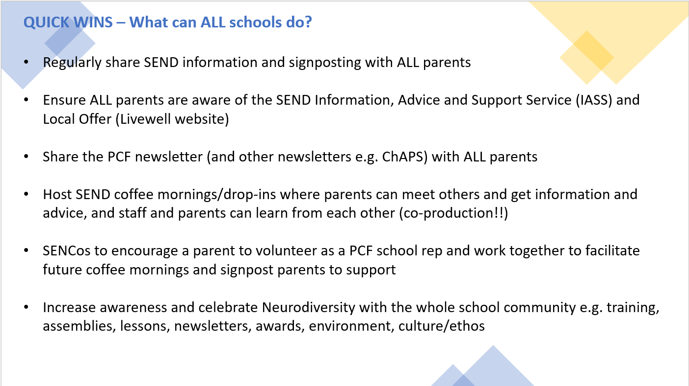
C&M PINS Project
Here’s what they said…
Communication
Communication Books
Regular communication with parents
Find triggers and understand the child
Ensure they feel safe and understood
Listening to parents and acknowledge / take ownership when mistakes have been made
Training and support
Staff fully trained and understanding
Better resource for children
Schools to access training from local services available
Make school a positive experience so children thrive
More TAs trained in SEN
Educate on acceptance of differences, make school environment more inclusive
Breaks
Movement breaks for all children not just SEND
Curriculum
Lower demand and curriculum to suit all
Reduce demand and pressure
Classroom
Smaller class sizes
Less structure in early years
More support in classroom
Better SEND provision

Slide 18
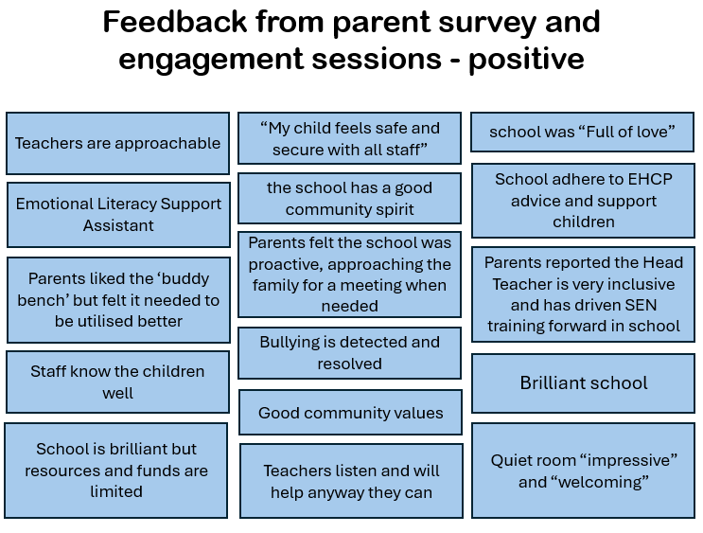
C&M PINS Project
Here’s what they said…
Communication
Communication Books
Regular communication with parents
Find triggers and understand the child
Ensure they feel safe and understood
Listening to parents and acknowledge / take ownership when mistakes have been made
Training and support
Staff fully trained and understanding
Better resource for children
Schools to access training from local services available
Make school a positive experience so children thrive
More TAs trained in SEN
Educate on acceptance of differences, make school environment more inclusive
Breaks
Movement breaks for all children not just SEND
Curriculum
Lower demand and curriculum to suit all
Reduce demand and pressure
Classroom
Smaller class sizes
Less structure in early years
More support in classroom
Better SEND provision

Slide 19
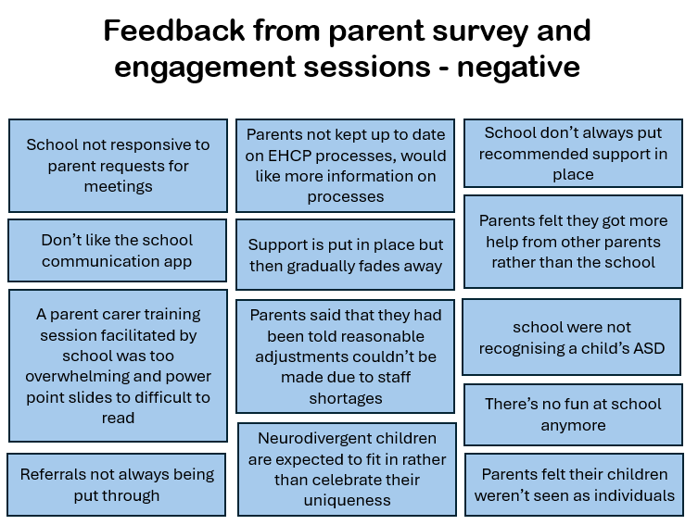
C&M PINS Project
Here’s what they said…
Communication
Communication Books
Regular communication with parents
Find triggers and understand the child
Ensure they feel safe and understood
Listening to parents and acknowledge / take ownership when mistakes have been made
Training and support
Staff fully trained and understanding
Better resource for children
Schools to access training from local services available
Make school a positive experience so children thrive
More TAs trained in SEN
Educate on acceptance of differences, make school environment more inclusive
Breaks
Movement breaks for all children not just SEND
Curriculum
Lower demand and curriculum to suit all
Reduce demand and pressure
Classroom
Smaller class sizes
Less structure in early years
More support in classroom
Better SEND provision

Slide 20
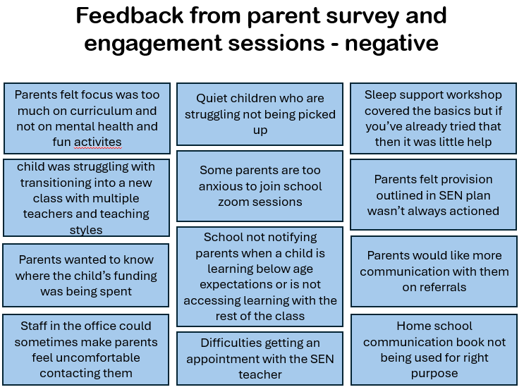
C&M PINS Project
Here’s what they said…
Communication
Communication Books
Regular communication with parents
Find triggers and understand the child
Ensure they feel safe and understood
Listening to parents and acknowledge / take ownership when mistakes have been made
Training and support
Staff fully trained and understanding
Better resource for children
Schools to access training from local services available
Make school a positive experience so children thrive
More TAs trained in SEN
Educate on acceptance of differences, make school environment more inclusive
Breaks
Movement breaks for all children not just SEND
Curriculum
Lower demand and curriculum to suit all
Reduce demand and pressure
Classroom
Smaller class sizes
Less structure in early years
More support in classroom
Better SEND provision

Slide 21
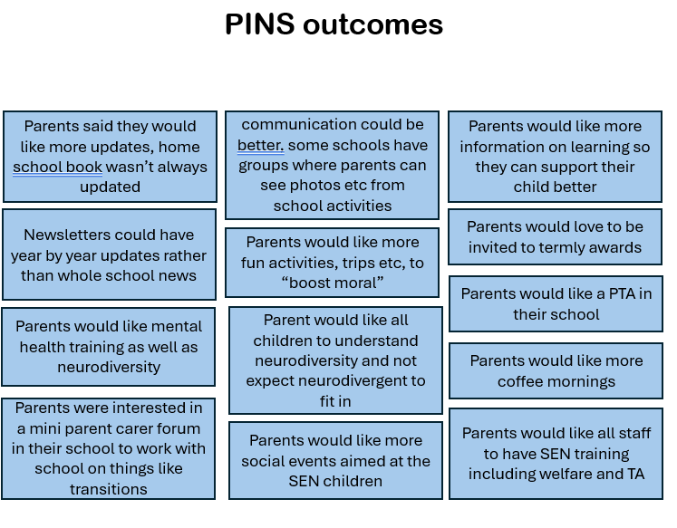
C&M PINS Project
Here’s what they said…
Communication
Communication Books
Regular communication with parents
Find triggers and understand the child
Ensure they feel safe and understood
Listening to parents and acknowledge / take ownership when mistakes have been made
Training and support
Staff fully trained and understanding
Better resource for children
Schools to access training from local services available
Make school a positive experience so children thrive
More TAs trained in SEN
Educate on acceptance of differences, make school environment more inclusive
Breaks
Movement breaks for all children not just SEND
Curriculum
Lower demand and curriculum to suit all
Reduce demand and pressure
Classroom
Smaller class sizes
Less structure in early years
More support in classroom
Better SEND provision

Slide 22

C&M PINS Project
Questions and comments

Slide 23
C&M PINS Project
Thank you for listening

Slide 24
C&M PINS Project
Questions and comments

