Slide 1


Partnerships for Inclusivity of Neurodiversity in School
Total Communication and Visual Support
Nicola Beech and Catherine Toft
Speech and Language Therapists

Slide 2

Agenda
Total Communication Approach
Understanding
Expression
Blanks Levels
Key Strategies

Slide 3

Figures
(RCSLT, Autism Education Trust, British Dyslexia Association, DfE)
7-10 % children have developmental language disorder
10 % primary school aged children have SLCN
3-5 % children have speech sound disorder
1 in 3 EHCP have ASD as main need
3-5 % children have ADHD
3.6 % children in primary school have EHCP
5-10% primary school aged children are dyslexic
Notes:
Current figures which show the high levels of SLCN we are now seeing in schools, which includes SLCN as a primary need but also where this may part of a wider neurodevelopmental profile.
According to Autism Education Trust In England, there are 166,041 autistic pupils in schools (as of a 2024/25 report), an 8% increase since 2020, with most in mainstream settings
High percentage of autistic children have SLCN
3 in every classroom

Slide 4

How communication occurs
Means
Reasons
Main means:
Speech
Signs/gestures
Symbols/pictures
Reading/writing
Non-verbal
Eye-contact
Pointing
Facial expression
Body language
Intonation
Augmentative and Alternative Communication (AAC)
Why we communicate:
Socialising
Expressing pain
Expressing likes/ dislikes
Emotions
Give instructions
Indicate pleasure
Express wants/ needs
To give information
Get attention
Acknowledge/ protest
Comment
Clarify
Opportunities
Giving opportunities:
Getting face to face with child
Pausing and pacing
Offer a little bit
Make deliberate mistakes
Offering choices
Intensive interaction
Access to AAC
Different communication partners
Notes:
Reasons why: need a purpose or motivation to communicate. To comment on a game or request something or ask for help. Create situations where communication is needed and meaningful
Opportunities when where: children need chances throughout the day, embed communication into daily activities not just structured therapy tasks. Group work, partner work, routines and who with

Slide 5
Total Communication
“Total Communication” describes an approach that strives to create a supportive means of communication to understand and be understood‟ (Royal College of Speech and Language Therapists)
Ref: Hertfordshire Partnership NHS Trust
Notes:
Catherine
This means that pupils and staff are encouraged to use all available forms of communication to support children’s understanding and ability to express themselves
Help children to access learning and express themselves in ways that work for them.

Slide 6
Why we value all forms of communication
To be an authentic communication partner
To develop meaningful relationships with pupils
To meet the child at their stage of communication development
To allow the child to express themselves in a way that feels natural to them
Notes:
Yes we want to develop their stage of communication but it is first and foremost it is important to value any communication attempts or methods. We can extend on their development through modelling.
An authentic communication partner refers to someone who interacts with a person (often a child or individual with communication difficulties) in a way that is natural, supportive, and conducive to meaningful communication. This person facilitates genuine, back-and-forth communication in real-life contexts, respecting the individual’s abilities, preferences, and communication style. The goal is to foster authentic, meaningful exchanges, rather than just teaching or practicing isolated skills.

Slide 7
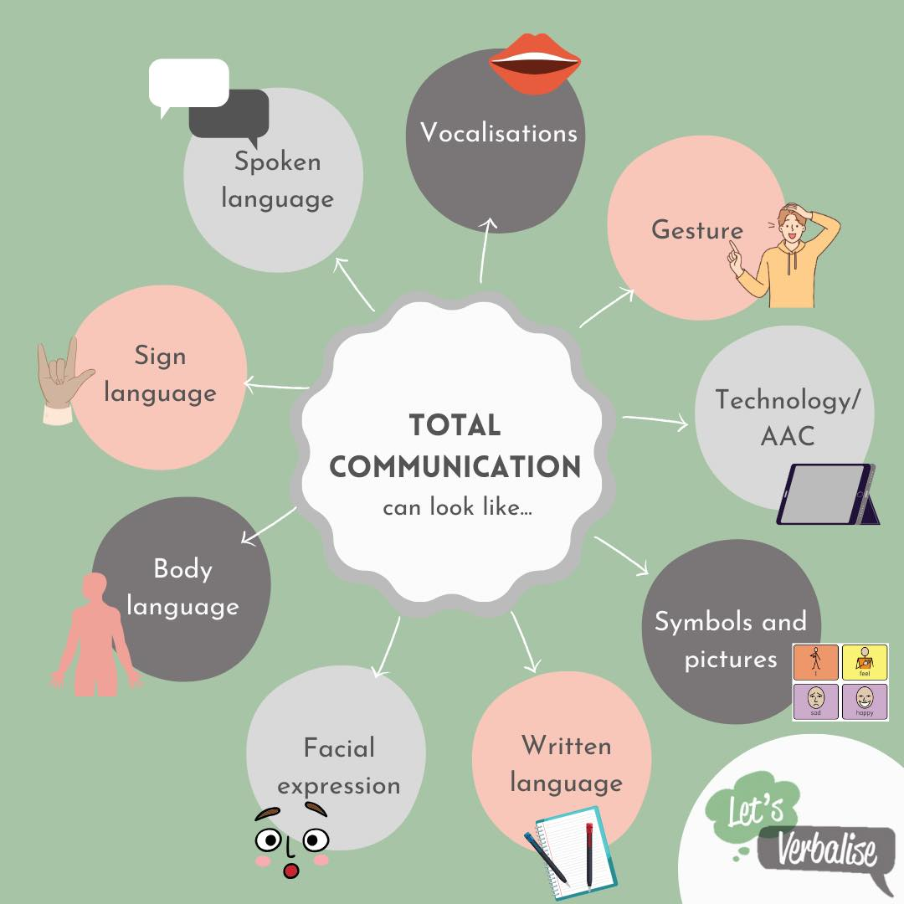
Different ways of communicating
Notes:
All valid ways of communicating
Speech is not the goal for everyone
Don’t pressure children to speak- don’t want to be saying use your words, value the method they are using
Acknowledge all communication attempts
Be consistent across staff and settings
Assume child understands more than they can express

Slide 8

Adult use of visuals
-Calendars/diaries/planners
-Lists
-Phones
-Post it notes
Why do we use these resources?
Notes:
Give predictability about what will happen
To remember/remind
Help organise and proritise

Slide 9
What visuals do you use in the classroom to support understanding?
Notes:
In the chat
Gesture
Sign
Demonstrating tasks
Photos/diagrams
Now next
Choice board
Visual timetable
Traffic lights
Timers
Labels
Colour coding
Task lists
Social stories
Word maps

Slide 10

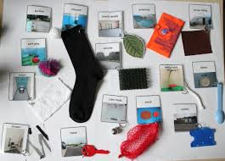
Visuals to support understanding
Objects of reference
Visual timetable
Now / Next
Traffic lights
Key word signing
Now | Next

Slide 11


Social Stories
Task Lists
Demonstrating
Timers
Colour coding
Labelling
Whiteboard- pictures/writing

Slide 12
Benefits of Visual Support
Helps children to understand daily routine and what is going to happen next
Reduces anxiety and uncertainty
Helps children to understand spoken language and instructions
Supports memory and retention of information
Help us to have a better understanding of the environment
Supports attention and focus
Helps children to structure their written work and learn new vocabulary
Helps children to understand what might happen in a situation or at an event
Notes:
Calendar, now/next board, visual schedule
Task planner
Labels
Social stories
Spoken language is temporary- visuals stay!

Slide 13
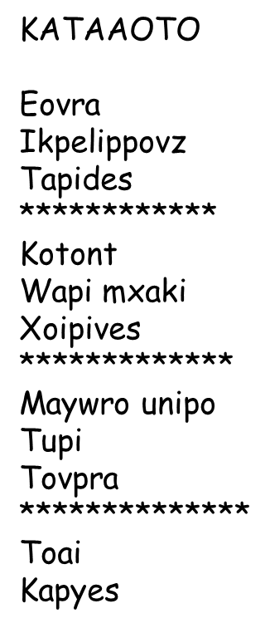


Slide 14
KATAAOTO
Eovra
Ikpelippovz
Tapides
************
Kotont
Wapi mxaki
Xoipives
*************
Maywro unipo
Tupi
Tovpra
**************
Toai
Kapyes
Notes:
Now what would you like?
Simple change now gives you a means to express yourself

Slide 15
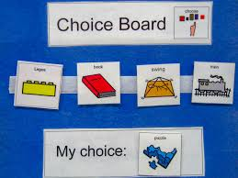
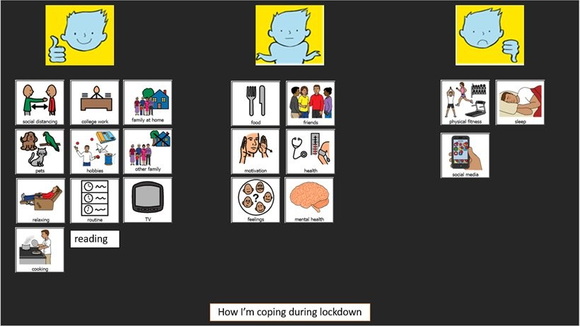
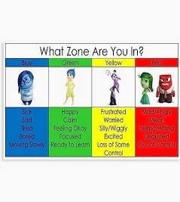
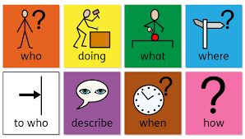
Visuals to support expression
Choice boards
Talking Mats
Story board
Colourful semantics
Zones of regulation
Notes:
Task specific visuals: Story boards- e.g. news telling -help structure and organise stories, when retelling a past event
Colourful semantics- to help build sentences
Zones of regulation: colour coded- help to understand emotions but also help to express emotions e.g. lollipop, own personal visual that can use to indicate to others how feeling
Choice board- help make a choice, helpful for children find it difficult to initiate preference, give autonomy. Used throughout the day in different context e.g activity/food/place/person
Talking mats- help express likes/dislikes, emotions,

Slide 16
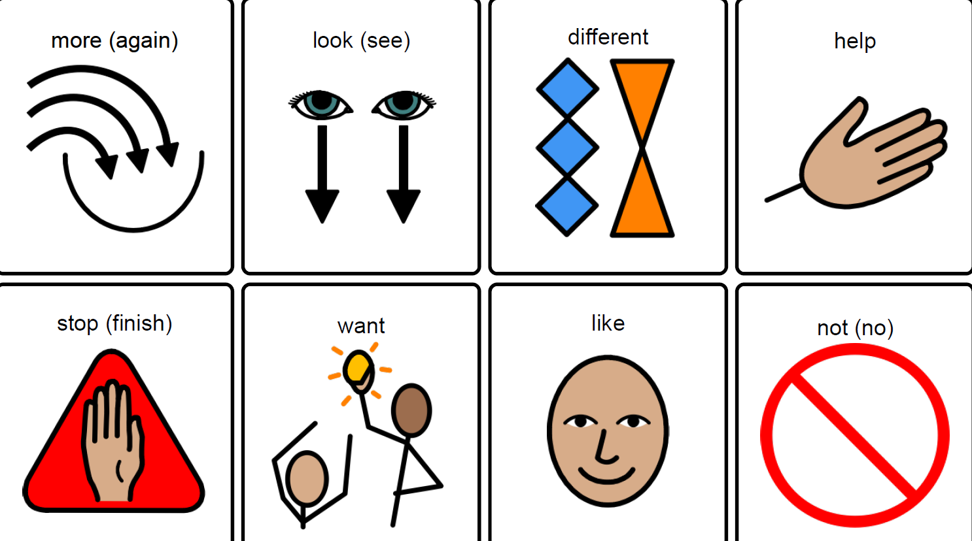
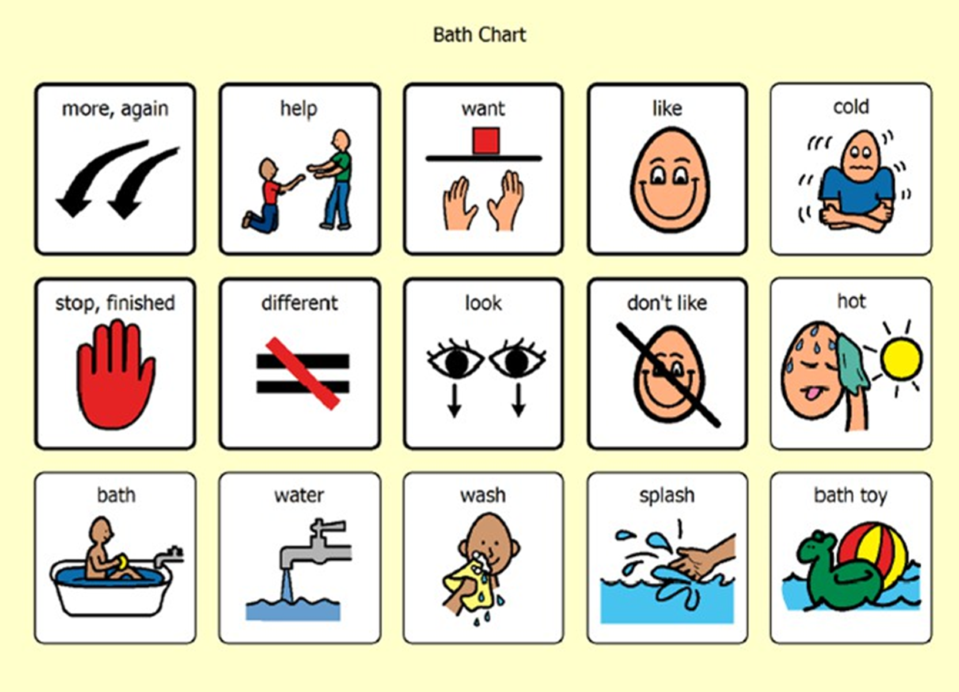
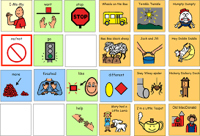
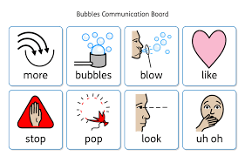
AAC
Notes:
What is AAC? Communication system that supports or replaces speech. Helps people to communicate their needs, feelings, thoughts and ideas.
Communication boards: point to symbols to comm message
Low tech- paper based resources, always available
Hi tech- electronic devices, unlimited vocab , when ore complex comm is required
MODEL MODEL MODEL- in play, break, lunch, structured tasks, interactions

Slide 17
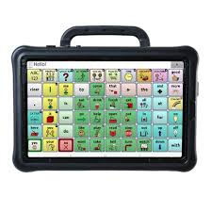

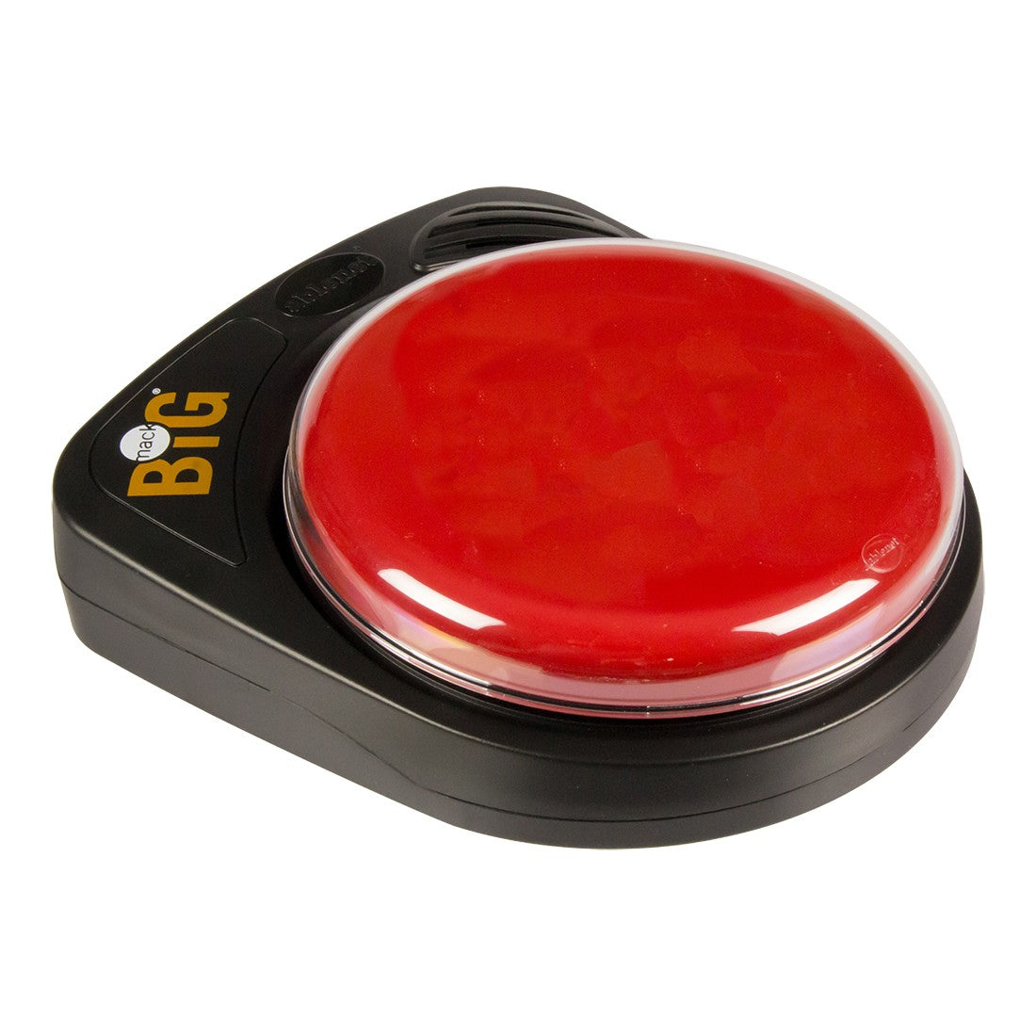
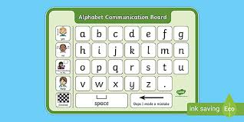
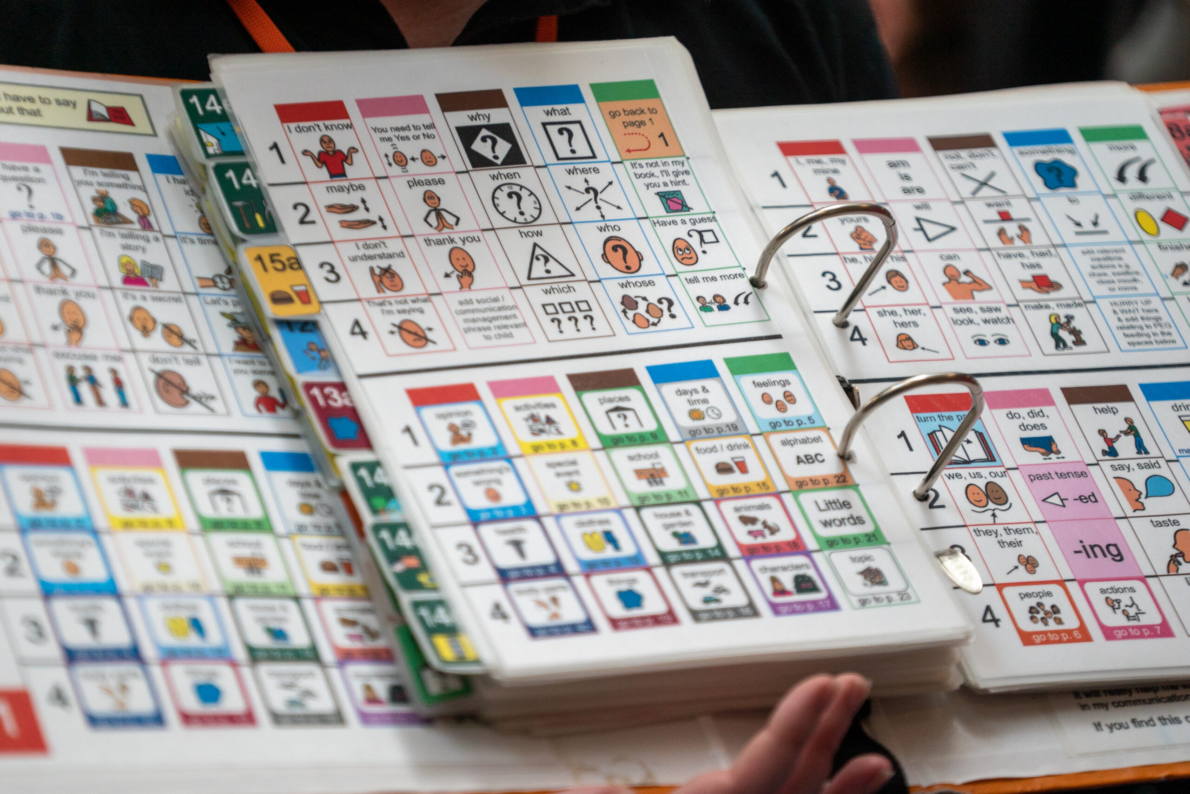

AAC
Notes:
Tablets- APPS like Prolo2go, speech generating devices,
Big mack- record voice, single button e.g. register, making simple requests like help/ more
Writing- may be preferred method
Communication book- ordered into categories e.g. places, people, emotions, food
Signing- important for comm partners to understand signs

Slide 18
Total Communication Approach: Expression
Accept and value all forms of communication
Gives children a voice
Reduce demands
Can help children communicate about things outside of their immediate environment
Helps children to communicate for a wider range of functions
Allow them to engage in reciprocal communication with others
Notes:
Why? Giving them a voice for children difficulties using spoken lang for whatever reason- anxiety, language disorder, unclear speech
Reduce demands if child is dysregulated, find it difficult to formulate sentences, formulate speech sounds, for children who are situationally mute- provides with a voice
to make choices or decisions
- to express preferences/feelings
- to share information/interests
- to ask questions
- Express complex thoughts
- Participate socially
Control their environment
Communication isn’t just functional, its for social reasons to connect with others as well. RECIPROCAL COMM- IMPORTANT FOR CHILD’S WELLBEING. If cp respond, shows their comm is valued and understood
If aac user- Ensure available at all times Look for opportunities in class that child can comm using aac- to ask for help, register, sharing ideas, responding to questions, making choices.
Teach peers how to communicate with aac user

Slide 19
Symbolic understanding
Symbolic understanding is the ability to understand that one thing can represent another — for example, that a word represents an object, or that a toy cup can stand for a real cup.
Why is this important? Knowing a child's level of symbolic understanding can help us to use the appropriate level of visual support

Slide 20

Symbolic understanding
Real - easiest to understand
Objects - the real thing, then miniatures
Photographs Coloured Pictures
Line drawings - black and white
Symbols - simple line drawings that represent an object/place/idea
Gestures/sign language - used to support the words but are as temporary as words
Words/written words
Less Real - Hardest to understand
Notes:
The more concrete representations do not disappear quickly, tap into different areas of the brain and learning styles, are portable reinforcing the spoken word and should be paired with the spoken word

Slide 21
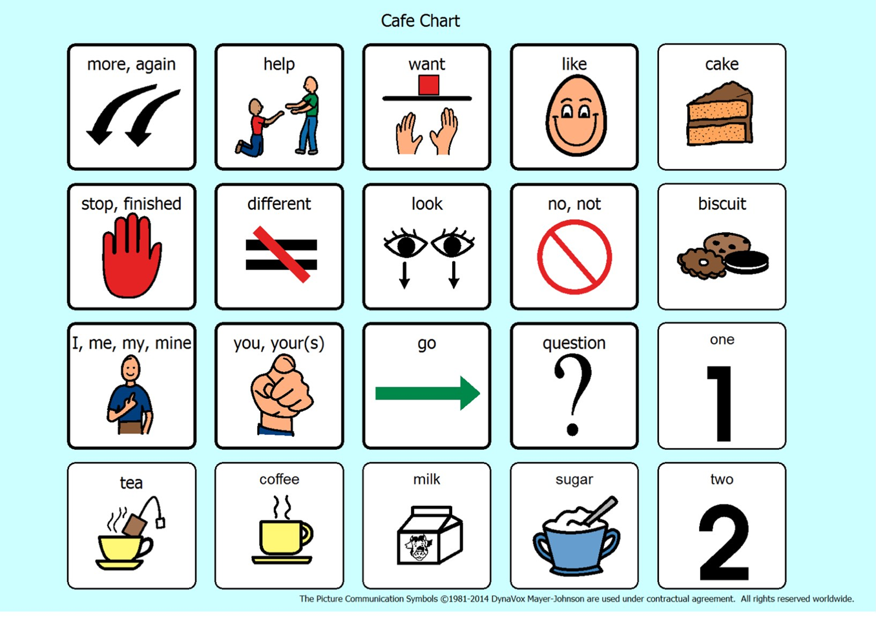
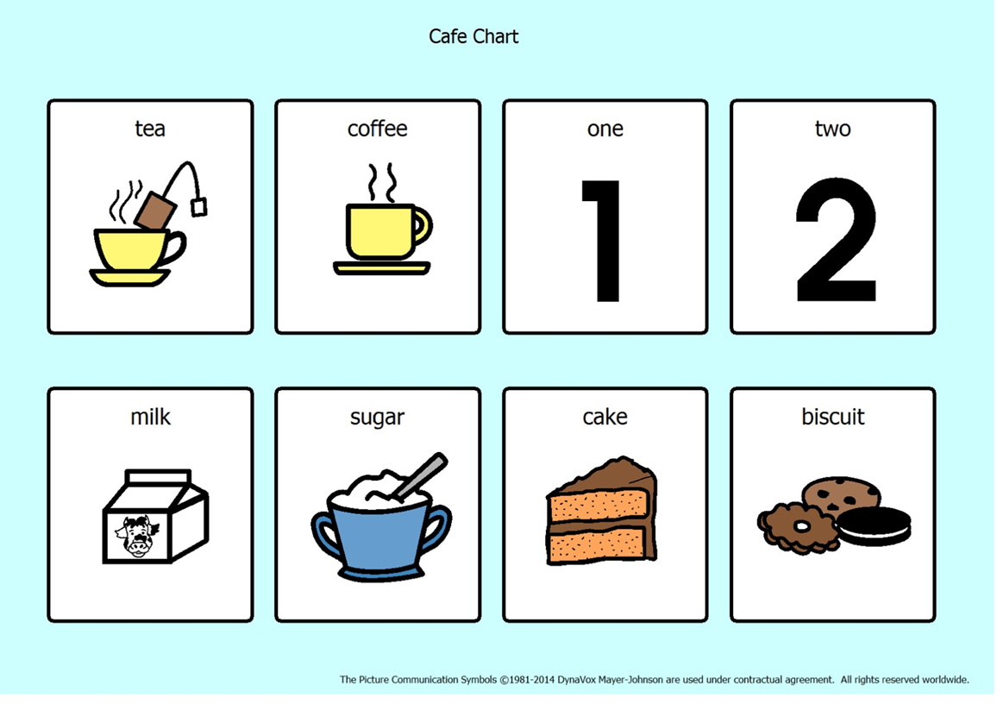
Communication Boards
Core Vocabulary
Fringe Vocabulary
Model model model
Be consistent
Don’t direct
Ensure accessible- travels with child
Share with parents
Notes:
Catherine
Expose children to symbols
Core- functional vocab
Keep symbols in same place
Ensure it is always available
Give lots of time to initiate/repsond
“For most of us who develop speech, we are exposed to models of spoken language from the day we are born. In fact, we have around 9-12 months of having language modelled to us until we being to use spoken words. By hearing the language modelled we begin to assign meaning to words. We should aim to replicate this ‘immersive’ language environment for AAC users by modelling their AAC system consistently alongside spoken language.
Fringe- specific to topic
Vary number of symbols on each page
Allow communication for range of functions
Ace centre gudiance

Slide 22
Blanks Levels
A framework describing four levels of language comprehension — from simple, concrete questions to complex, abstract reasoning.
Blanks Levels
Level 1 | Naming | 60 % 3 year olds understand level 1 and 2
Level 2 | Describing Who? What? Where?
Level 3 | Talking about Stories and Events Sequencing, predicting and understanding emotions | 65% 5 year olds understand level 3 and 4
Level 4 | Solving Problems justifying answers, explaining causes, and making inferences

Slide 23
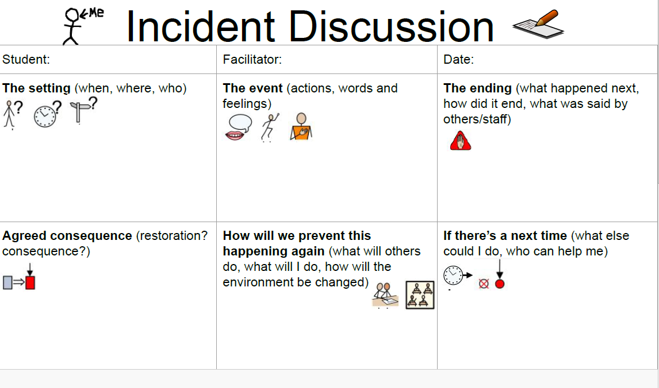

Slide 24
“A communication-friendly classroom should make communication as easy, effective and enjoyable as possible”
The Communication Trust
Be consistent and persistent in use of visuals
Use the right language level- reduce verbal overload
Pair the spoken word with visual and written representations
Comment and model to elicit/develop language not questions
Value all communication attempts
Make visuals accessible and meaningful
Allow time to process
Communicationis everybody's responsibility
Multi-sensory approach to learning new words
Notes:
Interpret communication attends
Model model model

Slide 25

Any Questions?

