Slide 1


Understanding needs in the mainstream classroom neuro-diversities and neurodevelopmental conditions
PINS term 1
Dr Christine Wee
Consultant Child Psychiatrist
Centre for Autism Neurodevelopmental Disorders and Intellectual disability
Honorary Senior Lecturer - University of Chester Medical school
Notes:
Types of needs present in main-stream classroom
Not covering MH or ID today (mainstream)

Slide 2
Note on terms used
(Neuro-affirmative language)
Identity first language preferred– autistic person , a deaf person.
1
Person first – “Child with autism” used more by parents, professionals
2
Person first language preferred – person with intellectual disability
3
Autism Spectrum Disorder – ICD 11 diagnostic criteria.
4
Notes:
I am using ASD when discussing ICD 11
From surveys done:
Autistic not weird survey 7500 2022
Kenny 2015
Coproduction work
Different pops used diff terms.
NHSE language guide for new framework for autism assessment in slides at end

Slide 3
Neurodiversity
What is the difference between neurodiversity and a neurodevelopmental diagnosis?
Why needs led support ?
Common Neurodevelopmental conditions
  Autism
  ADHD
  FASD
  Tics
  Developmental Language Disorder
  Demand avoidance
Co occurrence and Differential diagnosis
Group discussion reasonable adjustments
Notes:
Covering other aspects – later this term or in second term such as sensory and food sensitivities /ARFID
Only one hour lecture – please email on which further topics might also need to be covered

Slide 4
Neurodiversity
The term was first coined by Judy Singer (1998) in her thesis:
“A biological truism that refers to the limitless variability of human nervous systems on the planet, in which no two can ever be exactly alike due to the influence of environmental factors”
Notes:
Copy of reprinted thesis at Macc. CANDDID office Beech House

Slide 5
Neurodiversity as a paradigm
Diversity not deficits
Neurodiversity rejects the view that divergence from the norm is a flaw requiring correction. (Walker 2012)
Lack of accommodation in the environment leads to barriers and impacts
Education, mainstream schools
Health – hospital environments
Mental health .
Notes:
Originates from the social model of disability

Slide 6
What is the difference between being neuro-divergent and having a neurodevelopmental diagnosis?
Diagnosis –
syndrome –
with prognosis / negative impact –
use internationally accepted
diagnostic , consistent across culture,
research based (WHO – ICD 11)
Neurodivergent
Developmental trajectory or information processing is not typical ( different from the neurotypical population)
Does not mean that symptoms reach diagnostic threshold for a “disorder”
NB – people with a neurodevelopmental diagnosis are also neurodivergent
Notes:
Neurotypical
Neurodiverse
Neuro-divergent

Slide 7
Why needs led support ?
Increasingly recognise that people may have differences information processing
The neurodiversity movement – emphasises recognising the strengths.
But these may also cause barriers to people – and require reasonable adjustments
A needs based approach to SEN is required (CAF 2014)
It was known that CYP may have aspects of diff ND – not meet diagnostic criteria but require support (sub clinical features)

Slide 8
Challenges associated with neurodivergence include:
attentional capacity,
functional skills,
memory and learning,
psychomotor skills,
executive functions,
social competence,
emotion regulation
impulse control,
academic achievement (Catroppa et al., 2017; Morie et al., 2019).
Notes:
Challenges – functional impairments

Slide 9
Neurodevelopmental disorders
Behavioural and cognitive disorders
Significant difficulties in the acquisition and execution of specific intellectual, motor, language, or social functions.
They arise during the developmental period
Involve the development of the CNS (or injury, disease, or other insult to the central nervous system, when this occurs during the developmental period)

Slide 10

Symptoms and behaviors associated with a particular neuro-developmental disorder can change as children grow and mature
Neurodevelopmental disorders affect 10 to 15% of all births [5], and prevalence rates are increasing worldwide
Prevalence of people with sub-clinical features – are increasing even faster
Notes:
Atladottir HO, Gyllenberg D, Langridge A, Sandin S, Hansen SN, Leonard H, et al. The increasing prevalence of reported diagnoses of childhood psychiatric disorders: a descriptive multinational comparison. Eur Child Adolesc Psychiatry. 2014;24(2):173–83.
Grandjean P, Landrigan PJ. Neurobehavioural effects of developmental toxicity. Lancet Neurol. 2014;13(7):330–8.

Slide 11
Neurodevelopmental Disorders in ICD-11
6A00 Disorders of Intellectual Development
6A01 Developmental Speech or Language Disorders
–6A01.0 Developmental Speech Sound Disorder
– 6A01.1 Developmental Speech Fluency Disorder
– 6A01.2 Developmental Language Disorder
6A02 Autism Spectrum Disorder
6A03 Developmental Learning Disorder
6A04 Developmental Motor Coordination Disorder
6A05 Attention Deficit Hyperactivity Disorder
6A06 Stereotyped Movement Disorder
6A0Y Other Specified Neurodevelopmental Disorders
Notes:
Dorothy Bishop discussion of differences in Models / approach health vs educational professionals.

Slide 12
Other ND disorders in ICD 11
8A05.00 Tourette Syndrome
8A05.01 Chronic Motor Tic Disorder
8A05.02 Chronic Phonic Tic Disorder
FASD (Other specified neurodevelopmental disorders)

Slide 13
Neurodevelopmental disorders
Co occur more frequently than would be expected by chance due to :
genetic,
Epigenetic
Neurobiological
environmental.
Notes:
(Dewy 2018 )

Slide 14
Autism
1% prevalence
1/54 in US
Increasing prevalence for multiple reasons

Slide 15
Autism : Diagnostic Criteria ICD-11
1) Reciprocal Social interaction and Social Communication
Persistent deficits in initiating and sustaining social communication and reciprocal social interactions that are outside the expected range of typical functioning given the individual’s age and level of intellectual development. Specific manifestations of these deficits vary according to chronological age, verbal and intellectual ability, and disorder severity.

Slide 16
Autism : Diagnostic Criteria ICD-11
2)Persistent restricted, repetitive, and inflexible patterns of behaviour, interests, or activities that are clearly atypical or excessive for the individual’s age and sociocultural context.

Slide 17
Autism : Diagnostic Criteria ICD-11
3)The onset of the disorder occurs during the developmental period, typically in early childhood, but characteristic symptoms may not become fully manifest until later, when social demands exceed limited capacities.
4)The symptoms result in significant impairment in personal, family, social, educational, occupational
or other important areas of functioning.
Some individuals with Autism Spectrum Disorder are able to function adequately in many
contexts through exceptional effort, such that their deficits may not be apparent to others.
A diagnosis of Autism Spectrum Disorder is still appropriate in such cases.

Slide 18
Autism
ICD 11
New section on hyper- or hypo-reactivity to sensory input or unusual interest in sensory aspects of the environment:
Adverse responses
specific sounds or textures
bright light
Excessive interest
smelling or touching of objects
visual fascination - lights or movement
Rarely auditory ?
Note sensory sensitivities were excluded from ICD-10

Slide 19
Challenges and outcomes
Often harder to recognise in females – you may miss clues from the person that they need your help in making reasonable adjustments.
Men and women may camouflage their differences – it is important to ask what would help, rather than assume.
Co-morbid ADHD / other NDC can impact on presentation and description of traits/symptoms
Communication differences – they may not explain their problems easily.
Impact on mental/ physical health ( in part due to access to health care) – leads to a significantly shorter average lifespan than non-autistic population

Slide 20
Autism in girls
Autistic girls are more likely to 'mask' their autistic traits (though the stress of doing so can result in anxiety and overwhelm)
At school, autistic girls may be more likely to be part of a friendship group
Academic achievement may mask difficulties they are facing in other areas.
Repetitive behaviours and intense interests in autistic girls may be similar to those of non-autistic women and girls, such as twirling hair and reading books ( difference in intensity)
https://www.autism.org.uk/what-we-do/acceptance-and-awareness/now-i-know-campaign

Slide 21
Demand avoidance
“Demand avoidance” – type of behaviour
“persistent and marked resistance to 'the demands of everyday life’, which may include essential demands such as eating and sleeping as well as expected demands such as going to school or work”
Seen in autistic people or people with Intellectual disability or other neuro-diversities.
The Royal college of psychiatry (child psychiatry division) – define PDA as part of the autism spectrum and not as a separate diagnosis.
Reflecting the different ways autism presents in each individual

Slide 22
PDA
Classically – PDA were seen as not presenting as typically autistic
Latest ICD 11 diagnostic criteria – acknowledges that autistic people may with effort camouflage their differences in certain settings.
PDA has not been recognised as a separate diagnosis in international diagnostic guidelines ( moved towards seeing autism as a heterogenous diagnosis , rather than individual sub-groups – like aspergers’)
Alder Hey position statement – require a Dx of Autism to be made first – before using the term PDA in report.
The PDA profile is helpful as it is important to recognise demand avoidance in children and analyse causes and triggers and offer needs-based support/ intervention.
Notes:
Covered later this term.

Slide 23
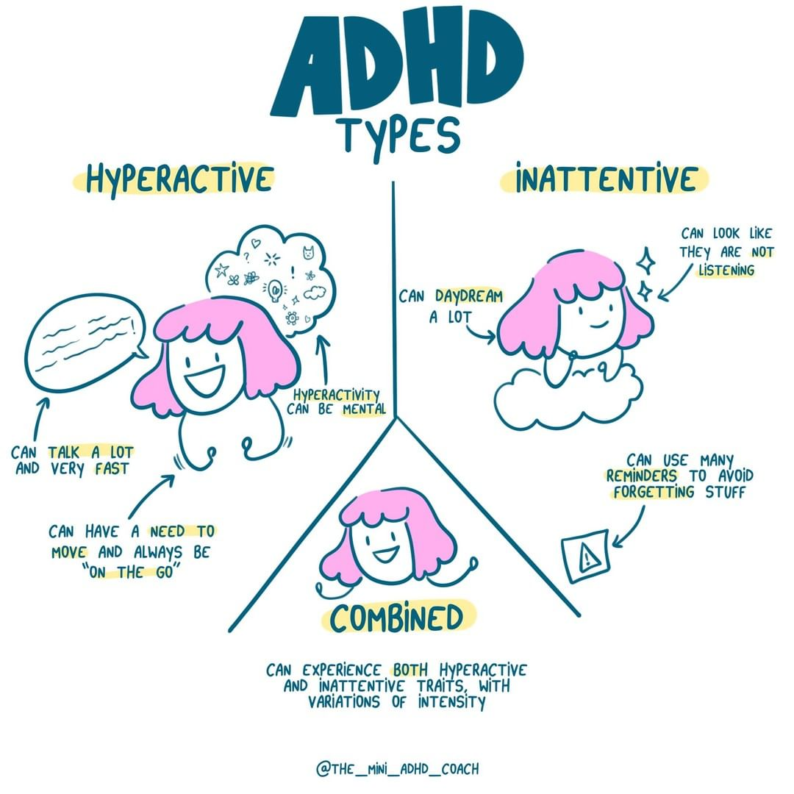
Attention Deficit Hyperactivity disorder (ICD 11)
A persistent pattern (at least 6 months) of inattention and/or hyperactivity-impulsivity.
That has a direct negative impact on academic, occupational, or social functioning.
There is evidence of significant inattention and/or hyperactivity-impulsivity symptoms prior to age 12,
The degree of inattention and hyperactivity-impulsivity is outside the limits of normal variation expected for age and level of intellectual functioning.
Manifestations of inattention and/or hyperactivity-impulsivity must be evident across multiple situations or settings (but may vary)
Symptoms are not better accounted for by another mental, behavioural, or neurodevelopmental disorder and are not due to the effect of a substance or medication.

Slide 24
Jacques O'Neill: ADHD and me
www.bbc.co.uk/bitesize/articles/zt9b46f

Slide 25
ADHD
The global prevalence is around 5- 7.2%
Male to female around 2.3 to 1
May be under-recognised in girls.
Girls more commonly have the inattentive presentation and have lower comorbidity with oppositional defiant disorder (ODD) and conduct disorder
ADHD has been associated with poverty, lower family income, and lower social class in the US, the UK, and other countries
Key risk factors include: family history of ADHD, low birth weight, maternal smoking during pregnancy, and male gender.

Slide 26
ADHD Associated factors
mild mood symptoms (dysphoria, mood lability, irritability, boredom)
difficulty with peer interactions
low self-esteem
working memory (i.e., short-term memory) impairment
processing speed impairment (i.e., the rate at which information is dealt with)

Slide 27

Tics / Tourette s'
•Can you stop blinking?
•Can you stop a sneeze?
•Can you stop a yawn?
•Can you stop a cough?
•Try to read a book while you twitch your head repetitively every few seconds.

Slide 28
Tics / Tourette s'
Repetitive motor or vocal actions
Biological condition (Identical twins 70-95% concordance)
Wax and wane may change form over time.
The child may be unaware of them
Premonitory urge
Chronic motor / vocal tics
Tourettes' syndrome
Coprolalia – rare
"Tourette s' syndrome plus – high co-occurence with other NDC

Slide 29
Reasonable adjustments: example- tic disorders.
Don’t ask child to suppress them/ call attention to tics
Impact is most often due to reaction of people around them
Model acceptance
Give option of leaving the room
Seating arrangements
Extra support / supervision if bullying / teasing
Organisation and focusing in class
Consider other learning or ND needs that may co exist
Other reasonable adjustments as needed – e.g . or impact of tics on classroom work.
Notes:
Effort of suppression may impact on ability to work
Often may suppress in certain situations

Slide 30
Fetal Alcohol Syndrome
There are now national guidelines and agreement on FASD
FASD is preventable and needs all professionals across all settings to engage with women without stigma
3% of the population has FASD and there will be 1-2 in every school year group
FASD does not stop at 18 – support with employment, housing , social care, criminal justice, as well as repeating assessments and mental capacity assessments may be needed

Slide 31
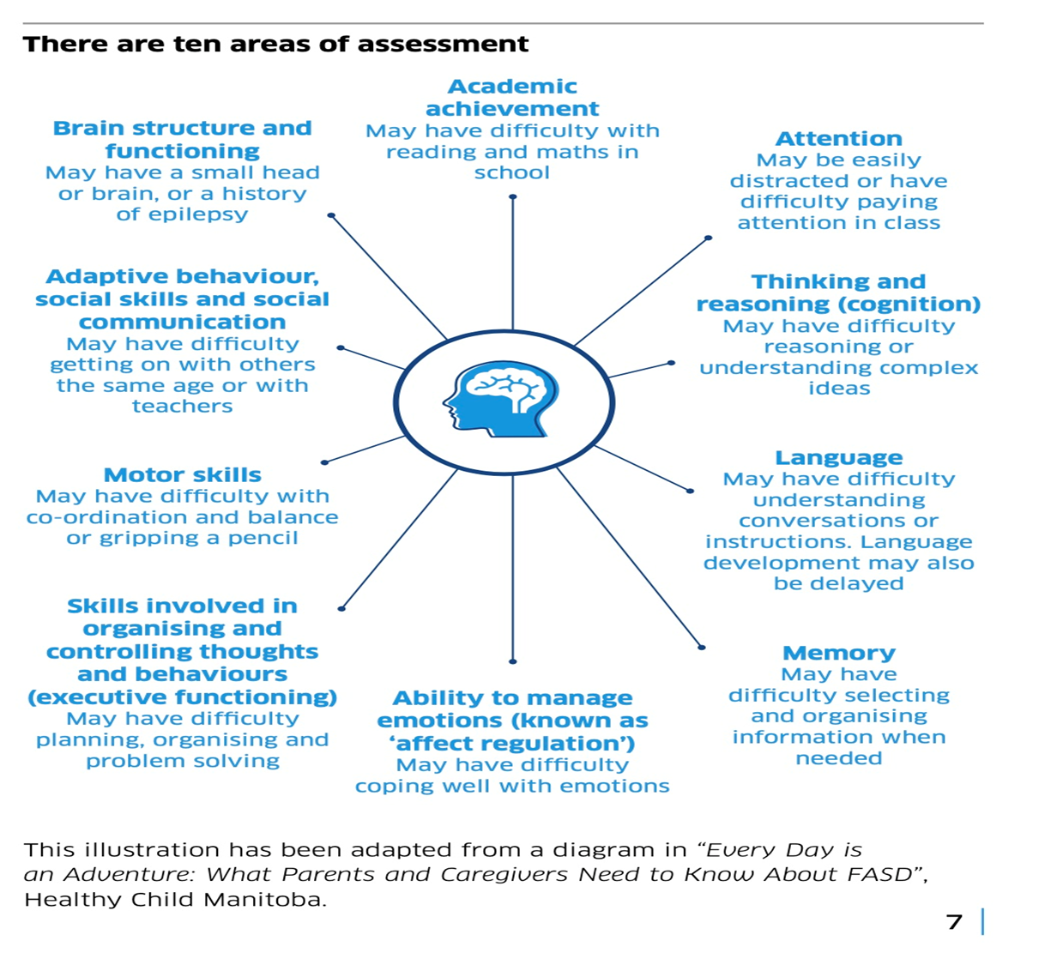

Slide 32
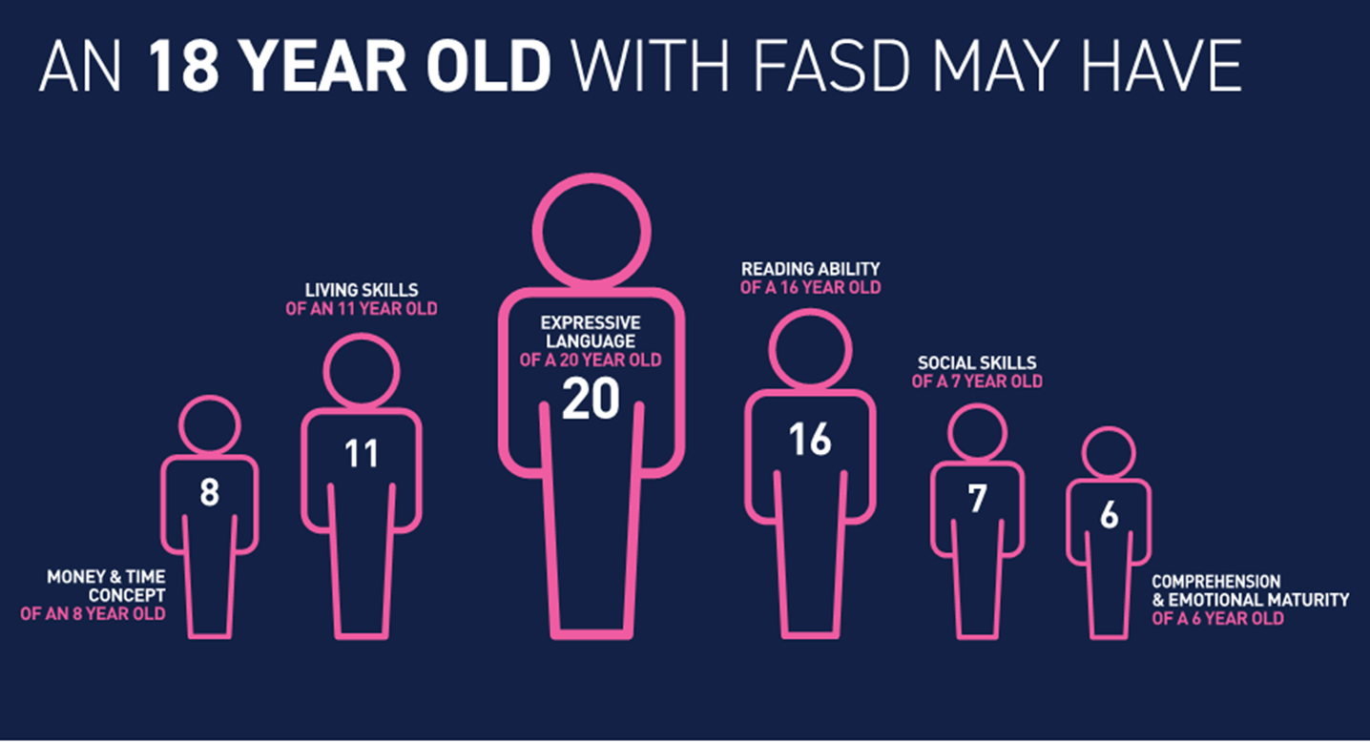

Slide 33
Developmental Language Disorder
Long term difficulties in being able to use and understand language.
If they speak more than one language, it will impact on all of these.
It may affect expressive language
Range of vocabulary.
Understanding and retaining information
Reading and writing.

Slide 34
Developmental Language disorder v Autism
•Individuals with DLD are usually able to initiate and respond appropriately to social and emotional cues and to share interests with others, and do not typically exhibit restricted, repetitive and stereotyped behaviours.
•If an autistic persons language abilities are markedly below what would be expected on the basis of age and level of intellectual functioning, you can give a diagnosis of DLD in addition if:
Impairment of "pragmatics" PLUS impairment of receptive and/or expressive language.

Slide 35
Developmental co-ordination disorder
Also known as developmental dyspraxia or dyspraxia.
Impaired coordination of physical movements
Deficits in fine or gross motor skills movements interfere with activities of daily living.
Learning and execution of coordinated motor skills is substantially below that expected given the individual's chronological age.
clumsiness, slowness, catching objects, using cutlery, handwriting, riding a bike, use of tools or participating in team sports or swimming
Diagnosis only given if no other neurological cause
Onset is in early childhood.
It is life long condition
Affects about 5% of the population.

Slide 36
Co-occuring conditions and ND
Co-occurence is the norm for neurodevelopmental conditions.
There are high rates of both symptoms and disorders co occurring for NDC
Twin studies – autism – higher rates of ADHD or Learning difficulties
Siblings of autistic children have higher risk for neurodevelopmental disorders such as ADHD, DCD, learning disorders, tic disorders, and psychiatric disorders.
Similar findings for children with ADHD and Tic disorders

Slide 37
Differential diagnosis and Neurodevelopmental conditions
A child is having difficulties with concentrating in class
What else might you want to know?
What might be causing this?

Slide 38
Differential diagnosis and ND
Same symptoms can be caused by:
Different neurodevelopmental conditions
Different environmental issues
Issues – within the child , or in the greater system
Neurodevelopmental conditions can present differently in each child
The way they present can be affected by the presence of other NDC or neurodiversities
Developmental stage of the child.
Notes:
Eg ADHD / Autism

Slide 39
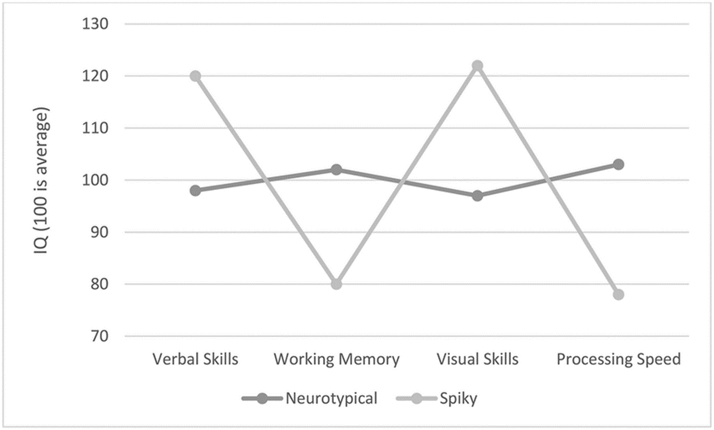
Importance of person centred support
“When you ve met one autistic person, you ‘ ve met one autistic person”
NDC present differently in individuals
Variable and spikey cognitive profile is typical of NDC.

Slide 40

Group discussion
What reasonable adjustments might be helpful for an autistic young 11 year old in school?

Slide 41

Initial Reasonable adjustments for neuro-divergent children
Ordinarily available provision/ Quality first teaching
“The range of activities, experiences and strategies offered as basic good practice/quality first teaching for children with special education needs/disability in line with the SEN Code of Practice”.
Multi –modal communication methods
Seating position in the class
Use of differentiated materials
Repeat instructions – check understanding
Give time to process instructions
Positive reinforcement

Slide 42
Initial Reasonable adjustments for neuro-divergent children
Sensory environment
Clear communication
  Unambiguous language
  Chunk information – avoid multi part instructions
  Home/school communication
Times / structure for those requiring low stimulus environment
  ( e.g lunch time / clubs )
Asking the child or parents what works.
Consistency across environment.

Slide 43
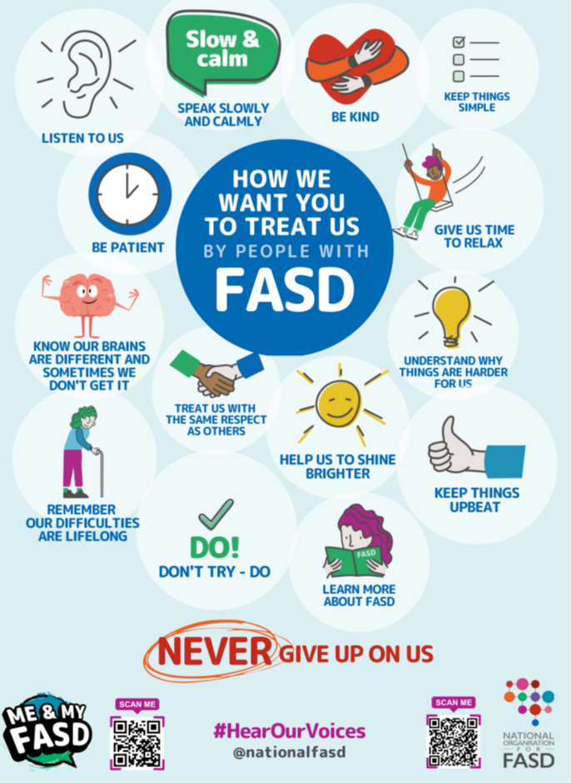
Reasonable adjustments examples: FASD

Slide 44
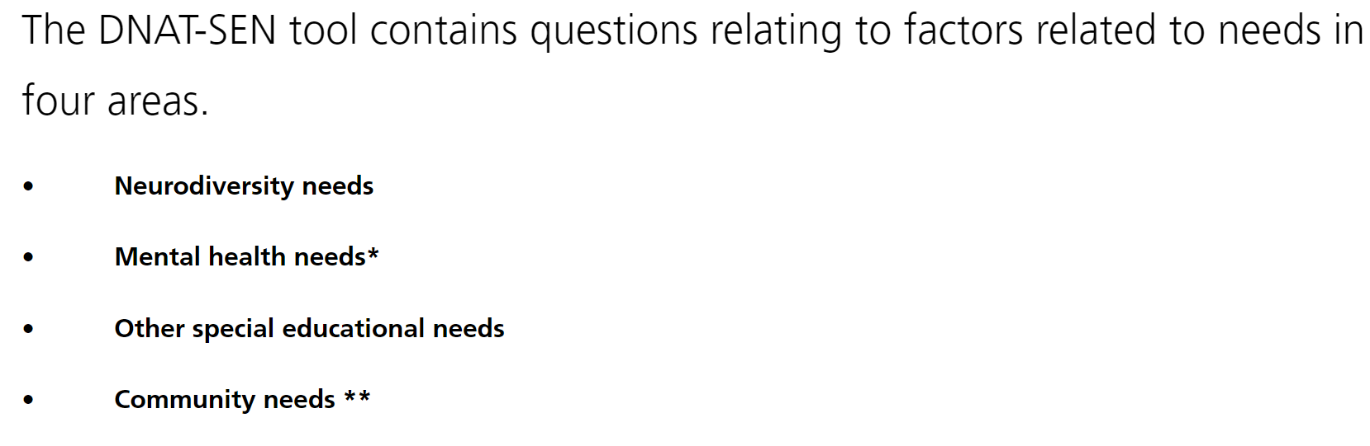
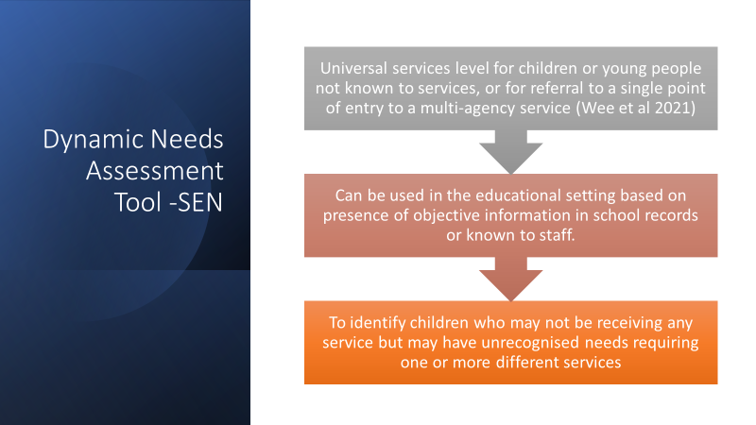

The Dynamic needs assessment Tool – SEN
Validation pilot.
Dynamic Needs Assessment (DNAT-SEN) Tool :: Cheshire and Wirral Partnership NHS Foundation Trust (canddid.nhs.uk)

Slide 45
Summary
Neurodevelopmental disorders/ conditions are increasing in prevalence
Introduced some of the NDCs
Neurodivergent – without reaching diagnostic criteria is also increasing
A significant proportion of the population will be neurodivergent ( higher than the proportion having a diagnosis)
Needs based SEN is important – and does not require a diagnosis

Slide 46
Links
GOS tourettes information pack
https://www.gosh.nhs.uk/conditions-and-treatments/conditions-we-treat/tourette-syndrome/tourette-syndrome-information-pack/
ADHD foundation
https://www.adhdfoundation.org.uk/wp-content/uploads/2022/03/Teaching-and-Managing-Students-with-ADHD.pdf
Autism in girls checklist
https://www.staffordshire.gov.uk/Education/Access-to-learning/Graduated-response-toolkit/School-toolkit/Communication-and-interaction/Social-communication-autism/SEN-support-in-school/Autism-in-Girls-checklist.pdf

Slide 47

Any questions?

