Slide 1
Neurodiversity and Trauma Lynsey Boggan RNLD, Nurse Consultant Aaron Hobson Clinical Nurse Specialist ADHD

Slide 2
Agenda
Differential diagnosis and comorbidity
Neurodiversity vs Trauma
Presentation of Trauma in Autistic population

Slide 3
Differential Diagnosis

Slide 4
Similar presentations
Global Developmental Delay (GDD)
Intellectual Disability (ID)
Attention Deficit Hyperactivity Disorder (ADHD)
Depression
Social Anxiety Disorder (SAD)
Obsessive Compulsive Disorder (OCD)
Trauma; Adverse Childhood Experiences (ACEs)

Slide 5
Comorbidity
The simultaneous presence of two or more conditions
In general population, 40% meets criteria for a psychiatric disorder at least 1x, whereas up to 69% in ASD population
ADHD, anxiety most common co-occurrence in childhood
Depression more common co-occurrence ND adolescents and adults

Slide 6
ASD and ADHD
Shared genetic pre-disposition (both are neurodevelopmental conditions)
30-50% of individuals with ASD manifest ADHD symptoms
About 2/3 of individuals with ADHD show features of ASD
Notes:
Reseearch thinks this may be higher but need to evidence in 2 domains

Slide 7
Presentations | ASD | ADHD
Impulsivity | May exhibit impulsive behaviours but this is related to difficulty with social understanding rather than impulsivity per se. | May interrupt conversations. May struggle waiting their turn. Can react quickly to situations without thought of consequences.
Hyperactivity | May manifest as excessive movement and restlessness, especially in response to sensory stimuli. | Excessive fidgeting, restlessness and difficulty staying seated.
Inattention | May appear inattentive, especially in social situations where they may be focused on their own interests. | Difficulties in sustaining attention, being easily distracted and making careless mistakes.
Repetitive Behaviours | Repetitive behaviours such as hand-flapping or rocking are common (can sometimes be misconstrued for ADHD) | Less about specific motor actions and more about repetitive thoughts or difficulties in shifting attention.
Social Challenges | Challenges in understanding social cues, making eye contact and engaging in reciprocal interactions. | May experience difficulties due to impulsive behaviours and trouble taking turns.
Sensory Sensitivities | Common and can result in string reactions to sensory inputs. | May also experience sensory difficulties but these are typically less pronounced.

Slide 8
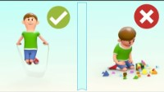
Differences ASD/ADHD

Slide 9
Depression
Limited to no social interest/responsiveness
Limited use of appropriate social skills
Limited motivation
SIGECAPS: Sleep, Interest, Guilt, Energy, Concentration, Appetite, Psychomotor agitation, Suicide

Slide 10
ASD vs Depression
Similarities
Flat affect
Distinguishing
Increased social functionality prior to the onset of depression
Sleep disturbance
Social withdrawal
Reduced desire to communicate
Examine restricted interests and repetitive behaviours

Slide 11
ASD and Depression
Individuals with ASD’s risk of comorbidity with depression are high (10-50%)
Difficult to diagnose because impairment of communication skills can mask depression symptoms
‘higher functioning’ ASD are more self-aware which poses higher risk for developing depression

Slide 12
Social Anxiety
Fear of social situations that involve other people
Pervasive disorder causing fear and anxiety in most areas of individual’s life
Lifetime prevalence of 12 %
Similar to ASD in that both create reluctance and limited success in social interactions

Slide 13
ASD vs Social Anxiety
ASD
Individual generally does not know what to do in social situation
Social Anxiety
Individual knows what to do in social situation
Can’t perform due to less effective strategies
Strong interests, behaviours, and/or sensory concerns
Can’t perform in moment due to anxiety
No presence of strong interests, behaviours, and/or sensory concerns
Increased social performance in safe and comfortable environments

Slide 14
ASD and Social Anxiety
50% of children with ASD show clinical levels of social anxiety
Anxiety amplifies the core symptoms of ASD and triggers additional behavioural issues
Children with comorbid ASD and social anxiety have higher levels of aggression because of the inability to monitor and inhibit behaviour

Slide 15
Obsessive Compulsive Disorder
Typically begins in childhood or adolescence
About 30% of ASD also have OCD
2% Prevalence in general population
Uncontrollable obsessive thoughts
Anxiety
Compulsive behaviours

Slide 16
ASD and OCD
Stereotyped or repetitive behaviours
Obsessive behaviours or interests
Increased anxiety when a routine or ritual is interrupted
Participate in routines or rituals to regulate behaviour

Slide 17
ASD vs OCD
ASD
Obsessions are with thematic interests and desired thoughts
OCD
Obsessions are unwanted, intrusive thoughts
Repetitive actions are a source of comfort or pleasure
Not bothered by thoughts and behaviours
Not bothered by social view of others
Compulsions to reduce anxiety or fear from thoughts
Want to stop thoughts and behaviours
Frequently ashamed of rituals and how others view them

Slide 18

Understanding the impact!
Can you put yourself in the shoes of someone with ASD?
‘I don’t have a problem with ASD just the rest of the world seems to’ quote from young person with diagnosis.

Slide 19
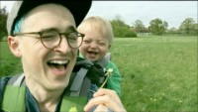
The central theme of attachment theory is that primary caregivers who are available and responsive to an infant's needs allow the child to develop a sense of security. The infant learns that the caregiver is dependable, which creates a secure base for the child to then explore the world.
Attachment
Buzz and the Dandelions - YouTube
C
Notes:
Matt from Busted

Slide 20

Attachment
“An affectionate bond between two individuals that endures though space and time and serves to join them emotionally” (Bowlby, 1955)
Style of relating, which secures the best parenting available under the circumstances, behaviour of the child is a ‘survival strategy’.
A persistent blueprint for how the child grows up, thinks about themselves, other people & the world around them: e.g. if parents are unavailable to child, the child could grow up to see others as unreliable and may present as overly independent and avoid asking for help.
Attachment patterns are activated at times of stress- We often see this playing out in clinical settings.
C

Slide 21
Internal working models
Self:
Lovable
Worthy
Effective
Others:
Available
Loving
Interested
Responsive
Positive
Others:
Unavailable
Neglectful
Rejecting
Unresponsive
Hostile
Self:
Unlovable
Unvalued
Ineffective
Uninteresting
Negative

Slide 22

What can affect a secure attachment?
Parental mental health
Pregnancy and birth experiences
Illness- baby or parent could be severely unwell and unable to have prolonged contact- for example babies in ITU who need to remain isolated to protect them from germs.
Giving birth after a previous miscarriage
Expectations of having a baby not being in line with reality
K
Notes:
when women have very difficult / traumatic experiences in childbirth / preclamsia /Hyperemesis gravidarum (HG)/ relationship difficulties due to pregnancy, this can impact on the early days of parenting and bonding with their child

Slide 23
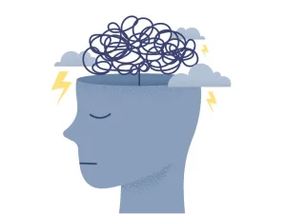
Adverse Childhood Experiences
Exploitation
Parental abandonment (separation)
Bereavement
Bullying
Physical abuse
Sexual abuse
Domestic violence exposure
Psychological maltreatment
Neglect
Notes:
ACEs – IPA

Slide 24
Trauma what is it?
Trauma is an emotional response to an adverse event.
Symptoms such as: impulsivity, hyperactivity, distractibility, poor concentration, racing thoughts and emotional reactivity can also been seen in a hyper arousal state following trauma.
There are generally 3 types of trauma these are :
Acute - results from a single incident.
Chronic – repeated and prolonged exposure such as domestic violence or abuse.
Complex- exposure to multiple traumatic events that are severe and pervasive

Slide 25
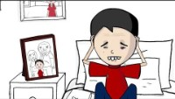
Prognosis of ACEs

Slide 26
What makes recognising complex trauma challenging?
It is subjective and that child’s stress response depends on:
Developmental age when the trauma occurred
Severity and duration of the trauma
Risk factors for example inconsistent home environment
Protective factors for example appropriate social network and consistent schooling
Temperament of the child (siblings exposed to the same events may present differently).

Slide 27

Noticing attachment style within a school setting
Within your classroom does parent…
Follow child’s lead
Initiate interaction
Respond to child in timely fashion
Notice or comment on child’s activity
Wait for child’s response, and follow it, not rushed, not intrusive
Respond to emotion in their child
Talk appropriately in front of their child
Show emotion congruent with the situation
Manage conflict
Offer positives
Demonstrate affection toward the child?
K

Slide 28
School settings Observing non-verbal information
Eye contact
Body posture
Level of activity
Facial expressions
Attunement
Warmth
Fun
Criticism
Coldness
Anger
C

Slide 29

School Setting
Questions to ask yourself?
How does the child communicate their needs to their parent?
How does the parent respond?
Who does the child go to, to have their needs met? Do they go the parent or someone else?
Does the child appear relaxed & comforted
How does the child then react towards the parents?
Does the child try to look after their parent?
C

Slide 30
ADHD Vs Trauma

Slide 31
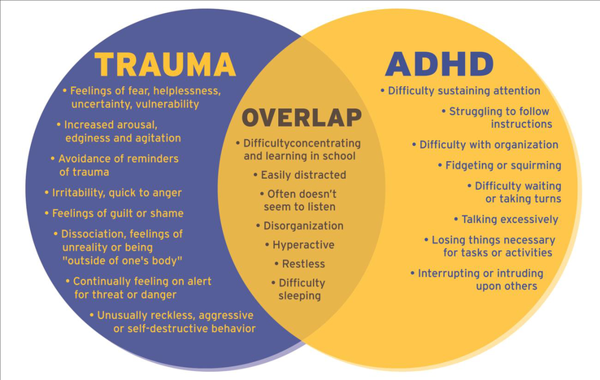
Notes:
Can we diagnose both trauma and ADHD? What would happen if we got it wrong? ADHD
Difficulty sustaining attention even in calm, neutral, or enjoyable situations
Easily distracted by any external or internal stimulus
Poor task persistence, organisation, and working memory across contexts
Trauma
Attention difficulties are often state-dependent
Hypervigilance leads to scanning for threat rather than global distractibility
Concentration improves when the child feels safe and regulated
Clinical clue: In trauma, inattention often improves in low-arousal, predictable environments.

Slide 32
Why is there an overlap?
As a response to trauma the developing brain can cause hypervigilance i.e. alertness for behaviours, activities or events that can be perceived as threatening this can often be mimic the hyperactivity and distractibility in ADHD.
Inattention and daydreaming may be disassociation or subconscious avoidance of trauma triggers.
Reactions to trauma such as intrusive thoughts and memories may present as agitation and anxiety which may be mistaken impulsivity and aggression as seen in ADHD.
Developmental studies of the brain for ADHD and maltreatment in children show significant similarities of the brain that are affected, (those responsible for emotional regulation, memory, decision making concentration and social processing).
Both can co-exist although complex trauma may be missed due to poor history taking and under reporting. Children with trauma may have more severe ADHD symptoms and not respond as well to medicine management.

Slide 33
Considerations
ADHD
Neurodevelopmental condition with symptoms present before age 12
Difficulties are persistent, pervasive, and cross-situational
Often a long-standing pattern noted from early childhood
Symptoms remain relatively stable over time, though expression changes with age
Trauma-related difficulties
Symptoms typically emerge after exposure to an adverse or overwhelming event
Clear temporal link to trauma (acute or chronic)
Functioning may have been age-appropriate prior to trauma
Symptoms may fluctuate depending on safety, stress, and reminders
Key distinction: ADHD is developmental and lifelong; trauma responses are acquired and context-dependent.
Notes:
We do full psychological formulation to explore these differences and agree a diagnosis

Slide 34
How does it affect assessment diagnosis and treatment
Case Study
A person who presents with the core symptoms of ADHD (pervasive hyperactivity, inattention and impulsivity), which is causing significant problems in daily life
The principal causes may be genetics and trauma, we are unable to change genetics and interventions around the trauma may take considerable time to show any effect if they can engage with the therapy at all, if we treat the ADHD with methylphenidate, it will most likely treat the symptoms rapidly and markedly.
Enabling better engagement with any trauma therapy. The ADHD management will not treat the trauma symptoms for example flashbacks.
Hypervigilance although considered a core component of the trauma may well show an improvement with Methylphenidate. Ideally, the optimal formulation is to treat symptomology and cause although treating the ADHD will show rapid impact on symptoms.

Slide 35
Interventions
Response to Structure and Intervention
ADHD
Responds well to:
Predictable routines
Behavioural strategies
ADHD medication (when indicated)
Trauma
Responds best to:
Safety, relational consistency
Trauma-informed care
Psychological therapies (e.g. TF-CBT)
ADHD medication alone may be ineffective or poorly tolerated
Clinical clue: Poor response to ADHD strategies should prompt trauma exploration.

Slide 36
Co-occurance
Co-occurrence (Very Common)
Trauma and ADHD frequently co-exist
ADHD increases vulnerability to adverse experiences
Trauma can exacerbate executive difficulties
Dual formulation is often required rather than “either/or”

Slide 37
ASD Vs Trauma

Slide 38
ASD and ACEs
Percentage of people diagnosed ASD with 4 or more ACEs is 10.2% vs general population 5.1%
ASD increases risk for maltreatment, lower Crown Prosecution Service (CPS) reporting rates
Risk factors for this:
Social communication impairments
Risk for exploitation or coercion
Parental stress and parent-child relationship
Lack of social support
Notes:
Increased number and severity of ACEs lead to higher risks of developing post-traumatic stress.

Slide 39
PHYSICAL ABUSE | SEXUAL ABUSE | DOMESTIC VIOLENCE EXPOSURE | PSYCHOLOGICAL MALTREATMENT | NEGLECT
Cognitive difficulties Behavior problems Aggression Defiance Delayed play skills Peer rejection Avoidance of adults Poor social interaction skills Difficulty making friends Suicidality Psychiatric disorders Poor interpersonal skills Hopelessness Low levels of intimacy Low self-esteem Attention problems Suicidal behavior Physical Abuse of own children Self-destructive behavior Anxiety Dissociation Poor self-concept Hostility Disruptive behavior | Emotional immaturity Social withdrawal Sexualized behavior Excessive masturbation Genital exposure Family/peer conflicts Difficulty separating Poor peer relationships Anxiety Fears Obsessions Tics Depression Guilt Low self-esteem Hostility/anger Tantrums Aggression Learning difficulties Poor attention/concentration Problems sitting Eating difficulties Enuresis Encopresis Headaches | Anxiety Changes in temperament Depression Suicide Trauma/stress reactions Negative emotions Aggression Delinquency Regressive behavior Alcohol/drug use High levels of physical activity Socially naïve Shyness/withdrawal Social incompetence Low empathy Hostility in interpersonal relationships Achievement problems Poor problem-solving skills Poor conflict resolution skills Deficits in adaptive behavior Increased vigilance for threat Poor parenting | Interpersonal difficulties Social incompetence Antisocial functioning Aggression Difficulties making and retaining friends Difficulties with peers Sexual maladjustment Low empathy Social phobia Academic problems Impaired moral reasoning Lack of creativity Deficits in problem solving Disruptive classroom behavior Lack of impulse control Noncompliant behavior Self-abusive behavior Anxiety Low self-esteem Dependence on adults for help in daily tasks Hypertension Metabolic syndrome Inflammatory diseases | Disturbed parent-child relationship Disturbed peer relationships Receptive and expressive language deficits Cognitive difficulties Low levels of flexibility Withdrawal Ineffective coping Physical and verbal aggression Attention problems Conduct problems Noncompliance Difficulty discriminating emotion Negative affect Failure to thrive Illegal behavior Psychiatric disorders Risk for school drop-out Chronic diseases Somatic complaints

Slide 40
PHYSICAL ABUSE | SEXUAL ABUSE | DOMESTIC VIOLENCE EXPOSURE | PSYCHOLOGICAL MALTREATMENT | NEGLECT
Cognitive difficulties Behavior problems Aggression Defiance Delayed play skills Peer rejection Avoidance of adults Poor social interaction skills Difficulty making friends Suicidality Psychiatric disorders Poor interpersonal skills Hopelessness Low levels of intimacy Low self-esteem Attention problems Suicidal behavior Physical Abuse of own children Self-destructive behavior Anxiety Dissociation Poor self-concept Hostility Disruptive behavior | Emotional immaturity Social withdrawal Sexualized behavior Excessive masturbation Genital exposure Family/peer conflicts Difficulty separating Poor peer relationships Anxiety Fears Obsessions Tics Depression Guilt Low self-esteem Hostility/anger Tantrums Aggression Learning difficulties Poor attention/concentration Problems sitting Eating difficulties Enuresis Encopresis Headaches | Anxiety Changes in temperament Depression Suicide Trauma/Stress reactions Negative emotions Aggression Delinquency Regressive behavior Alcohol/drug use High levels of physical activity Socially naïve Shyness/withdrawal Social incompetence Low empathy Hostility in interpersonal relationships Achievement problems Poor problem-solving skills Poor conflict resolution skills Deficits in adaptive behavior Increased vigilance for threat Difficulty regulating emotions Poor parenting | Interpersonal difficulties Social incompetence Antisocial functioning Aggression Difficulties making and retaining friends Difficulties with peers Sexual maladjustment Low empathy Social phobia Academic problems Impaired moral reasoning Lack of creativity Deficits in problem solving Disruptive classroom behavior Lack of impulse control Noncompliant behavior Self-abusive behavior Anxiety Low self-esteem Dependence on adults for help in daily tasks Hypertension Metabolic syndrome Inflammatory diseases | Disturbed parent-child relationship Disturbed peer relationships Receptive and expressive language deficits Cognitive difficulties Low levels of flexibility Withdrawal Ineffective coping Physical and verbal aggression Attention problems Conduct problems Noncompliance Difficulty discriminating emotion Negative affect Failure to thrive Illegal behavior Psychiatric disorders Risk for school drop-out Chronic diseases Somatic complaints

Slide 41
Psychology Service
Consultation to explore presentations
Coventry Grid Interview (CGI)
Routine
1 | Do they have problems with birthdays and Christmas and find it hard to share the excitement? | ASD
2 | Do they get distressed, or avoid anniversaries of life events times such as Christmas, possibly because of difficult memories (as opposed to the social and sensory of gatherings and the change in routine)? | ATT
3 | Does everything tend to revolve around his or her special interests? | ASD
Difficulties with eating
4 | Is food restricted by texture or colour? | ASD
5 | Is restricted diet about maintaining sameness? | ASD
6 | Does your child hoard food or binge eat? | ATT
Notes:
As part of psychology review we may use Coventry grid to guide the conversation – tool very helpful to help screen and identify what may be happening for a CYP

Slide 42
Attachment Case study
4 year old girl currently living with her paternal Grandmother (Nan).
Brief history. Removed from mums care at 3yrs. Whilst mum was pregnant there was concerns about substance misuse. Social care became involved whilst mum was pregnant and when L was born she and mum went to a mother and baby unit for assessment.
L stayed with mum until she was 3 (sibling born in that time) – came into Nan’s care following concerns around neglect.

Slide 43
Why referred for ASD assessment?
Difficulties with L’s language/repetitive behaviours: repeating herself all the time e.g., what's outside, is that a dog? When given an answer would continue to ask.
Doesn’t like loud noises – goes into a panic when she hears sudden noises.
Constantly shutting doors – It is as though it being open makes her uncomfortable.
Would become hysterical when she needed something or demands not immediately met. Lost her temper quickly when first living with grandparents would hit herself when upset.
Would eat food really quickly or become extremely distressed during meal times and was fussy with food.
Hated being left alone.

Slide 44
What had happened when with mum?
Missing meals – if L didn’t like what food was offered she wouldn’t be offered an alternative. Hostile meal times at mum’s.
Parents arguing – mum losing her temper with the children and shouting at them. Would ignore L if L was struggling/not doing as mum asked.
Concerns around animals at home – dangerous dogs.
Concerns about who the children were coming into contact with.
Long periods of time being left alone.

Slide 45
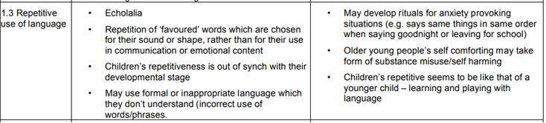
Coventry Grid
an attempt to summarise the differences between the behaviour of children with Autistic Spectrum Disorder and those with significant attachment problems. It is based upon clinical work with children rather than research. (Moran, 2015)

Slide 46
Outcome of assessment
L did not get a diagnosis of ASD
Huge improvements in language after coming into Nan’s care
Coventry grid highlighted a number of behaviours linked to attachment difficulties
Relationships improved since having better/ secure attachments
Behaviours better now that positive reinforcement in place – less need for ‘meltdowns’

Slide 47
Common Challenges
Social difficulties = ASD
Trauma can produce social withdrawal, mistrust, limited reciprocity, flat affect, and reduced exploratory play—without primary autism mechanisms.
Rigid/controlling = ASD
Controlling behaviour may be attachment/trauma-based (predictability = safety).
No single event = not trauma
Developmental trauma often has no discrete index event; the pattern is chronic threat/relational harm.
Trauma history excludes ASD
ASD and trauma frequently co-occur, and autistic children may be more exposed to adversity (e.g., bullying, exclusion, exploitation, restraint).

Slide 48
Autism and PTSD
Autistic people are more likely to report symptoms of PTSD.
Rates of probable PTSD in autistic people (32-45%) are higher than those in the general population (4-4.5%) (Rumball et al. 2020; Rumball et al. 2021; Haruvi-Lamdan et al. 2020)
Autistic people may be more likely to experience traumatic life events, particularly interpersonal traumas such as bullying and physical and sexual abuse.
Notes:
The risk of PTSD is higher for groups who are more likely to be exposed to traumatic events

Slide 49
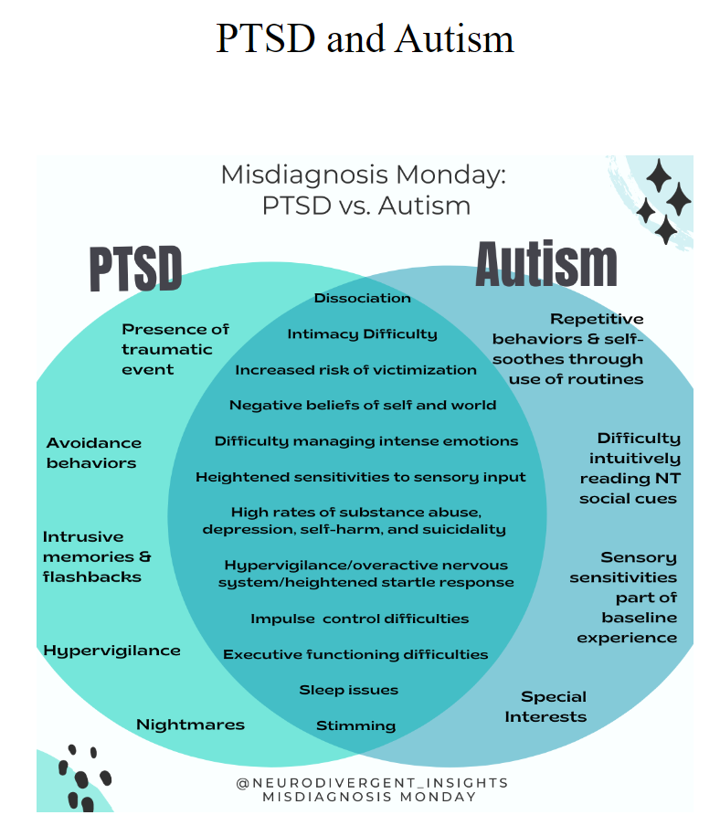
Notes:
Given the high rate of co-occurrence, it is more likely that missed diagnosis happens (vs. misdiagnosis). A missed diagnosis happens when a person’s PTSD is accurately diagnosed while their underlying neurotype (autism) remains missed. When they do co-occur this creates some additional complexity in the clinical presentation. I’ll cover these topics as well as provide clinicians will some ideas on how to adapt traditional trauma treatment for the Autistic person in mind.

Slide 50
Statistics
Rumball et al. (2020) study found that approximately 60% of autistics reported probably PTSD in their lifetime (compare this to 4.5% of the general population) (Rumball, 2020).
Haruvi-Lamdan et al., 2020 study found that 32% of their Autistic participants had probable PTSD compared to 4% of the non-autistic population
Fenning et al., 2019 research demonstrated that autistic children had more reactive nervous systems. This aligns with similar research that has identified the autistic nervous system to be less flexible (Thapa and Alvares, 2019). Less flexible nervous systems have a more difficult time coping with acute stressors and may contribute to increased hyperactivation of the nervous system following trauma.
Neurodivergent (ADHD/Autism) neurobiology is more vulnerable and reactive: (Beauchaine et al., 2013)

Slide 51
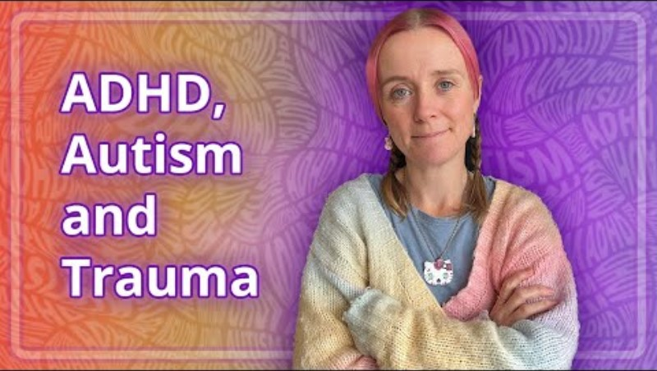
Autistic point of view
ADHD, Autism and Trauma - YouTube

Slide 52
Trauma and autistic people
Experiences an autistic YP can have may feel traumatising, even when someone else might not see any “trauma”.
Autistic YP are more vulnerable to traumatising experiences e.g., abuse; bullying, due to lifelong stigma.
Many autistic YP experience PTSD, sometimes from behaviour by alleged friends or from family.
Flashbacks, dissociation? Delayed emotional processing? Often mistaken for ‘drama’, ‘attention seeking’, ‘behaviour’, ‘refusal to comply’, ‘deliberate elopement’, ‘refusal to speak’, ‘tantrums’, ‘being controlling’, ‘being unreasonably antisocial’.

Slide 53
Autistic experience of Trauma
Autistic people often have a more heightened experience of trauma due to:
Sensory sensitivities
Communication and social interaction differences
Distress around changes to routines
Distress if prevented from taking part in repetitive and restricted behaviours such as stimming
Neurological and genetic factors
Detailed focused processing (in other words a tendency to focus on the details of a situation)
Increased rumination (unable to stop thinking about negative feelings and thoughts), inflexible thinking and avoidance
Emotion regulation difficulties.
(Kerns et al 2015; Hoover 2015; Haruvi-Lamdan et al 2018)
Notes:
More likely to experiences ACES but also have trauma in relation to their autism
Micro traumas that they experience daily
Autistic people who mask are more likely to be diagnosed ⁠⁠with PTSD while their neurotype goes missed. ⁠⁠This means they are less likely to receive Autistic-adapted treatments for their PTSD
likely to experience elevated baseline levels of anxiety due to social and sensory overload. Sensory overload is caused by a different sensory processing system where certain everyday sensory experiences cause pain, hypervigilance and difficulty concentrating.
Social overload is caused by social confusion due to problems with ‘theory of mind’ (perspective-taking), being misunderstood, criticised or rejected by peers, and a tendency to misinterpret benign social experiences as being threatening.
autism is associated with a cognitive style called ‘weak central coherence’ which is a tendency to focus on details at the expense of missing the “big picture.” We have found that clinically this can lead to an over-focus on certain negative aspects of life, whilst missing the parts of life that are going well. For example, a belief that one is a failure because of making a single mistake, whilst ignoring all the times they were successful. Unhelpful cognitive appraisal styles such an the one described, but also black-and-white thinking, (for eg, “he made a mean face therefore he is a mean person”) and catastrophising (for eg, able to jump to the worst possible conclusion in a nano-second), are common in autism, and are implicated in the development of stress and trauma-related disorders.

Slide 54
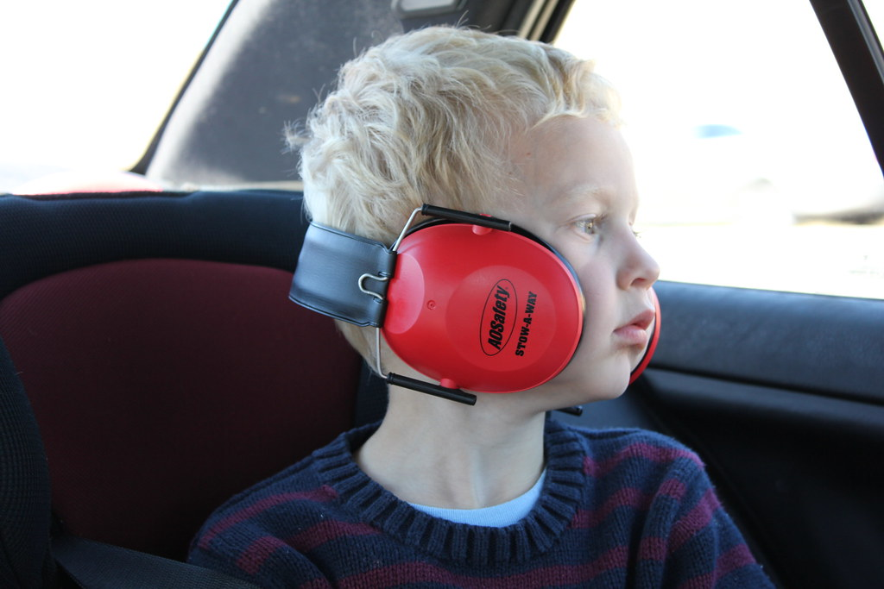
Causes of Autistic trauma
ACES
Fire alarms
Fireworks
Paperwork / admin tasks
Loss of family pet
Marginalisation
Bullying / harassment
Strangers' comments
Notes:
Aces are far more likely to be experienced, vulnerability , exploitation, physical abuse, sexual abuse, radicalisation ect..

Slide 55
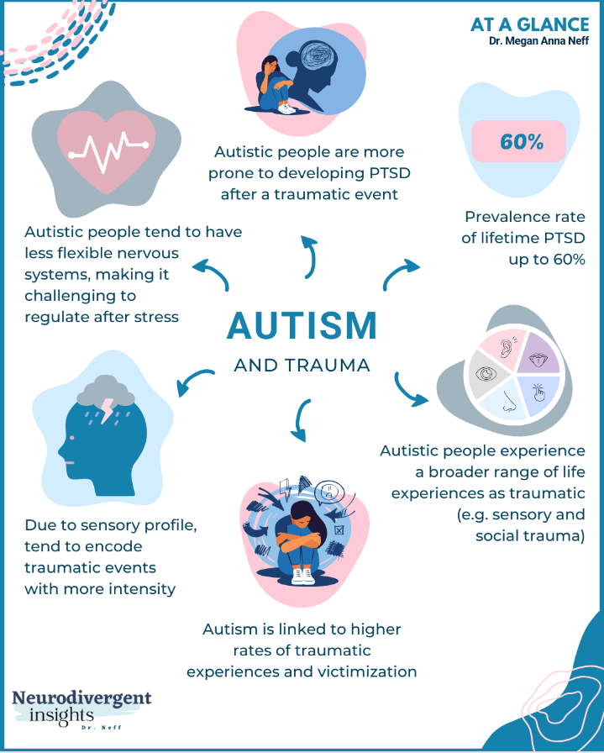

Slide 56
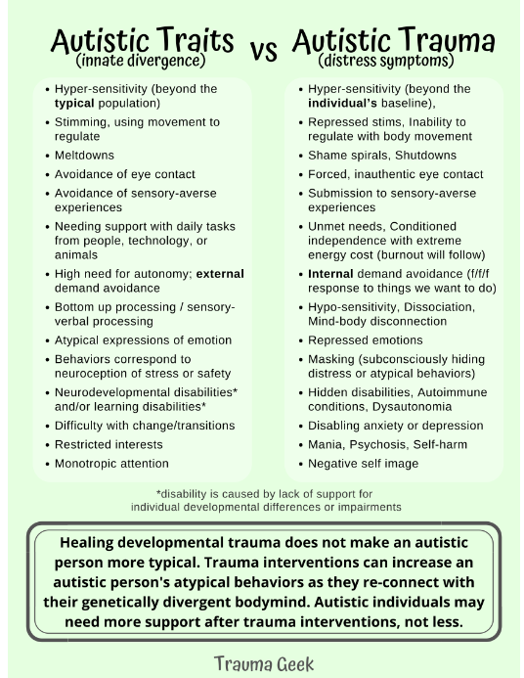

Slide 57
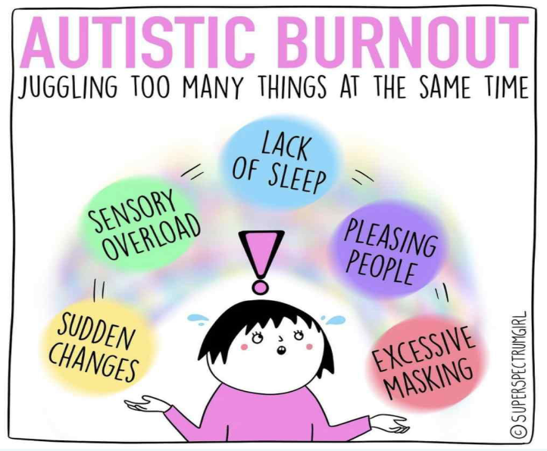
Autistic Burnout
Burnout, the informal label for a state of exhaustion that comes from the stress of coping with difficult sensory and social settings; it is distinct from anxiety and depression”
Royal College of Psychiatrists, Report -autistic adults CR228 (2020)

Slide 58
Professionals can support autistic people to manage the legacy of trauma and improve quality of life
Create safety in the relationship.
Co-regulation of the nervous system is essential.
Take time, exercise patience, and show genuine care.
Consistency and transparency in relationships.
Be curious about different and accumulating layers of marginalisation a person might experience.
Practise ‘power-with’ strategies through collaboration, choice and voice.

Slide 59
Summary
Presentations of neurodivergent conditions can be difficult to interpret
There is lots of overlap between potential causes of a child’s presentation
Trauma is more prevalent in neurodivergent people
Referral and assessment is important to ensure the CYP receives the support they need.
Notes:
https://www.youtube.com/watch?v=HZOfjMXNPik
https://www.youtube.com/watch?v=yRYl9Bf0yhs
https://www.youtube.com/watch?v=4gA-w2e21Ag
https://www.youtube.com/watch?v=riS53sCbLfo

Slide 60


Slide 61
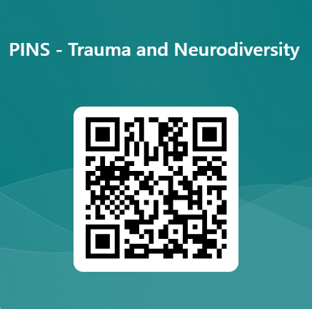
Post-Training Evaluation
https://forms.office.com/e/5Stm3qjc2H

