Slide 1

Parent Carer Forum
Who are we and meet the directors
Tuesday 30th September

Slide 2

Agenda
10am - 10:15am Meet the Parents
10:15am – 10:45am Director of Education & Inclusion, Sal Thirlway
10:45am – 11:05am Lisa Aldred, how local Parent Carer Forums (PCF) feed into the National Network PCF & Co-production
11:05 am 11:15am Your local PCF
11:15am – 11:30am PCF events & Survey updates

Slide 3

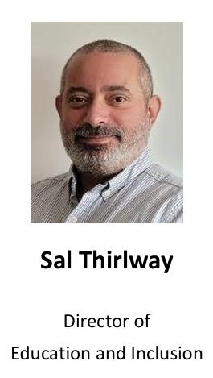
Meet The Director of Education and Inclusion

Slide 4

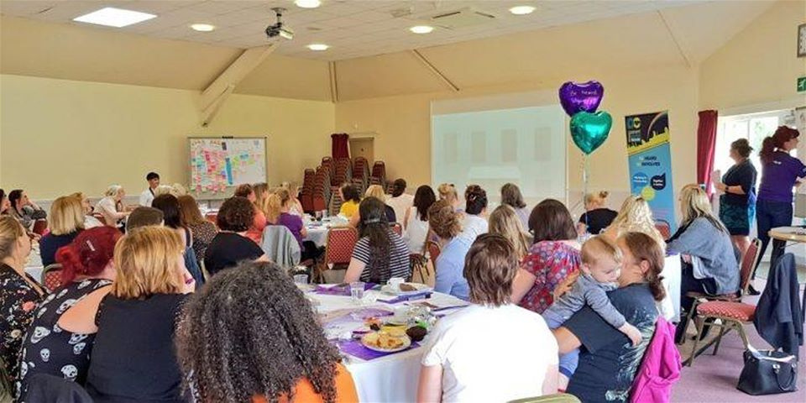


Introduction to Parent Carer Forums &
Coproduction

Slide 5
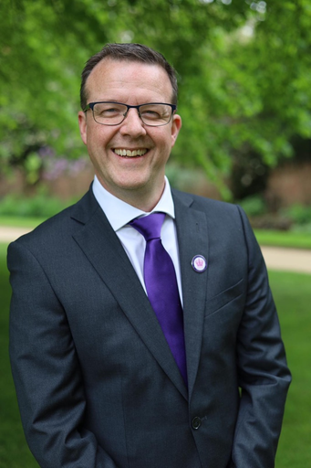
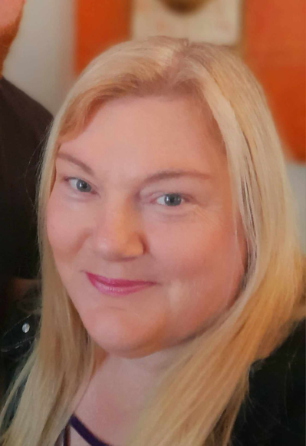

Introductions
Martin Mc Andrew
Lisa Aldred

Slide 6

Introductions
Lisa Aldred
Martin Mc Andrew
THE STRATEGIC REPRESENTATION
DFE GRANT / SUPPORT
Administration of the DfE Grant
Supporting Forums
offering telephone and email advice and support, and face to face support if necessary.
Representative of the North West Forums on the National Steering Group
30 days a year

Slide 7


Today we are talking about ...
An Introduction to:
What is a Parent Carer Forum?
What is Co-production?

Slide 8
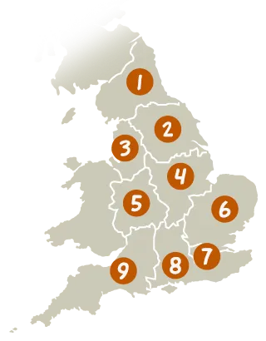
What is a Parent Carer Forum?
SEND Code Of Practice 1.13
  Representative local groups of parents and carers of children and young people with special educational needs and /or disabilities (aged 0-25)
  1 Parent Carer Forum per Local Authority area. This forum is funded by a grant from DfE for £17,500
  A forum is entitled to take up whatever structure they choose such as a Consitituted group, Charity ,Community Interest Company etc.

Slide 9


What a DfE Parent Carer Forum is
Paragraph 1.13 SEND code of practice:
“Parent Carer Forums are representative local groups of parents and carers of children and young people with disabilities who work alongside local authorities, education, health and other service providers to ensure the services they plan, commission, deliver and monitor meet the needs of children and families”
Forums focus is on
participation
and co-production.
They are
solution focused.
Forum represent
the collective voice
of parent carers,
feeding back their
experiences
of local services
Forums are independent from the Local Authority. Where they receive funding to support participation by the LA, they do so with this understanding
Forum provide challenge when things need to improve and work with providers to try to find solutions

Slide 10



What a DfE Parent Carer Forum is not
Not
advocates
for
individual cases
Not a
Support
Service
Not a
Protest
Group

Slide 11

However.....
Supportive of each other
Standing
up for what is right
Speak
up for
the many

Slide 12



Not in a fight!

Slide 13

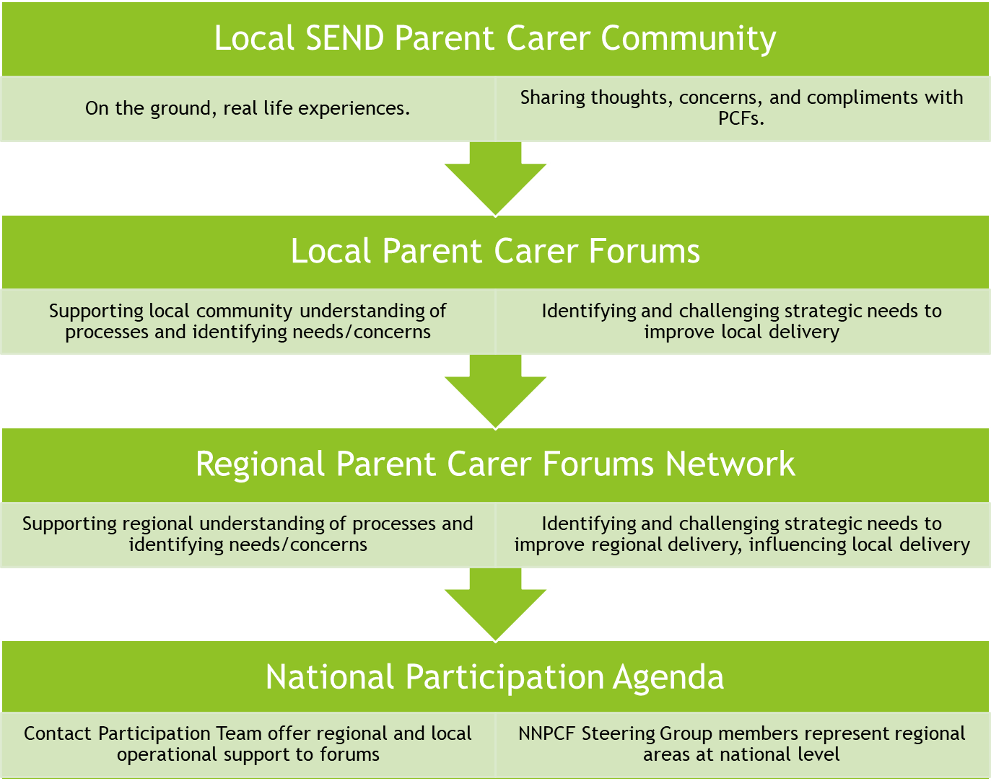



8

Slide 14

North West Forums
Cheshire & Mersey
Cheshire East
Cheshire West and Chester
Liverpool
Sefton
St Helens
Halton
Knowlsey
Warrington
Wirral
Lancashire & West Cumbria
Blackburn With Darwen
Blackpool
Lancashire
?Cumbria?
Greater Manchester
Bolton
Bury
Manchester
Oldham
Rochdale
Salford
Stockport
Tameside
Trafford
Wigan
3 Clusters
23 Forums
? Members

Slide 15

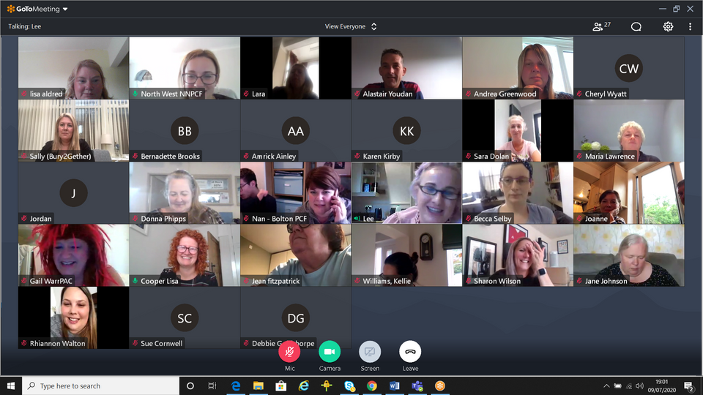
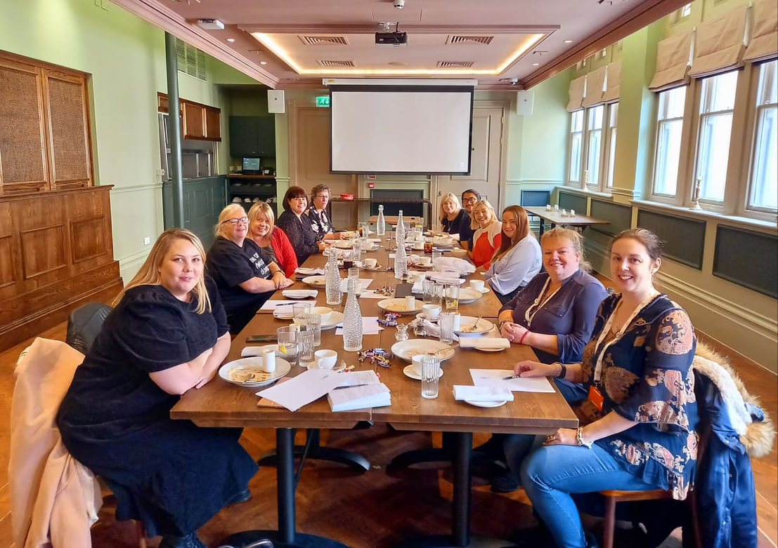
Regional

Slide 16

National
NNPCF Steering Group
Working directly
with Ministers

Slide 17






Being involved
Member
Emails, updates, surveys,
Attending events
Coffee mornings, focus group
Volunteering
Office, coffee mornings, strategic rep

Slide 18





Parental Representation
Are you in a current battle?
Is your approach solution focused?
Are you a good listener?
Are you able to represent the collective parent carer view?

Slide 19

Why Co-produce?
SEND inspection
Evidence
Law
Seat at the table
Importance of Lived Experience
Notes:
SEND inspection
Evidence
LAW
You know
Seat at the table

Slide 20

Lots of models:
Reciprocity Respect Accessibility Equality ........

Slide 21



Individual /Strategic Coproduction

Slide 22

Co-production

Slide 23

Here you are....
Whalah!
Go share the pizza...

Slide 24


But....

Slide 25


Recognition
Co-production is messy
Co-production takes time
Co-production can be uncomfortable
So worth it!

Slide 26

Strength in Numbers

Slide 27



Thank you

Slide 28
Contact details
Lisa Aldred CONTACT Parent Carer Participation Adviser
lisa.aldred@contact.org.uk
Martin McAndrew NNPCF Steering Group Representative
northwest@nnpcf.org.uk

Slide 29
Further resources
National Network of Parent Carer Forums
https://nnpcf.org.uk/
Contact
https://contact.org.uk/help-for-families/parent-carer-participation/

Slide 30
Who are we and what do we do?

Slide 31


Who We Are?

Slide 32







The Role of The Parent Carer Forum

Slide 33


What We Do & Don’t!
DO
🔄 We Feed Back
🤝 We Co-Produce
❗ We Signpost
📢 We Keep You Informed
📅 We Plan for the Future
DON’T
❌ We’re Not in a Fight
❌ We Don’t Provide Services Directly
❌ We’re Not a Protest Group
❌ We Don’t Advocate Individual Cases

Slide 34

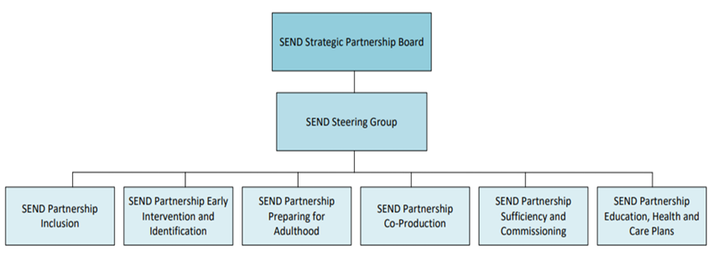



Cheshire West & Chester SEND Governance Structure 2025/26
Julie Duff
Lucy Kennerley
Julie Duff
Lucy Kennerley
Caroline Wynne
Rachel Badzire
Lesley Gledhill
Julie Duff
Julie Duff
Lucy Kennerley
Vanessa Usai
Lucy Kennerley

Slide 35









How we capture parents’ Carers voice

Slide 36



School & College Reps!
Oaklands High School
Rosebank
Archers Brook
Dewren College
Petty Pool College
St Chads Primary
Neston Primary
Lostock Primary
Hartford High School
Whitly Village School
Dorin Park
Ellesmere Port College C of E High School
Tarvin Primary School
Sandiway Primary
Weaverham High School
Grange School
Hinderton
Barton Primary Resource Provision
Helsby High School

Slide 37

Parent Carer Forum
Survey 2024
Key Themes
Communication and culture
EHCP Process
Amazing Charity Network who supported families
Lack of Access to Services - Wrap around care/Short Breaks
Eligibility Criteria – Equity across the borough
Emotional Toll on parents
Read Full Report Here!

Slide 38

Parent Carer Forum
Survey 2025/26
What We’ll Be Able to See
How communication, trust and partnership have changed since 2024
Whether transparency and co-production have improved
If training and accessibility are reaching more families
What We’ll Be Looking For
Any continuing gaps in communication
Waiting times for therapies and health services
How well transitions are supported (early years → school → post-16)
Whether reviews and monitoring are happening consistently
Next Steps
➡️ Once the survey is complete, we can compare with 2024 findings, celebrate improvements, and identify new priorities.

Slide 39


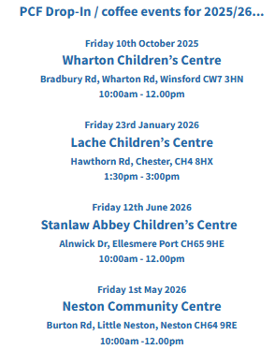


View Coffee Events Page Here

Slide 40


💬 Share your views
🤝 Meet other parent carers
💡 Access support via coffee events, forums, training & resources
🤝 Collaborate with professionals to improve SEND outcomes
Sign up to our newsletter Sign up here!

Slide 41
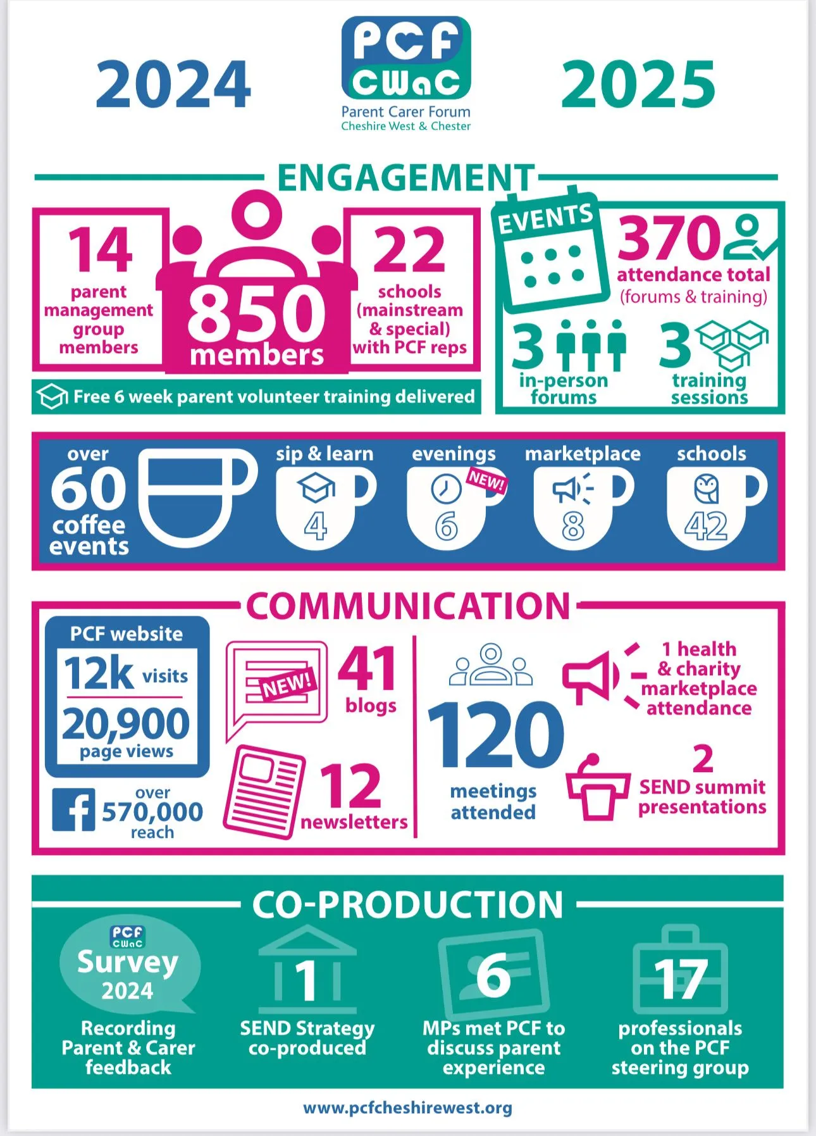
A snapshot of our work in 2024-2025

Slide 42
How to find us & stay updated?
Monthly Newsletters
Sign up here!
Email: info@pcfcheshirewest.org
Website: www.pcfcheshirewest.org
Phone number: 07900840867
PCF YouTube Channel
https://facebook.com/pcfcwac

Slide 43
Thank you.

