Slide 1

Neurodiversity Forum
Thursday 13th November2025
9:30am – 1:30pm
Hartford Golf Club, Burrows Hill, Hartford, Northwich, CW8 3AP

Slide 2



Housekeeping and Introduction

Slide 3


Registration/coffee/marketplace (9:30am-9:45am)
Introduction/ housekeeping (9:45am- 10am)
Meet the Marketplace (10am-10:15am)
What is Neurodiversity and how Cheshire West & Chester Supports and identifies need? (10:15am-11:15am)
Supporting Neurodiversity in Schools (11:15am- 11:45am)
COFFEE, CAKE and MARKETPLACE (11:45am-12:15pm)
PCF Update (12:15pm-12:30pm)
Parent Carer Participation (12:30pm – 12:40pm)
Partnership Inclusion Neurodiversity in Schools (12:40pm- 1pm)
Marketplace (1pm -1:30pm)

Slide 4


Meet the Marketplace

Slide 5


What is neurodiversity?
Gill Tyler
Designated Clinical Officer SEND; NHS Cheshire and Merseyside

Slide 6
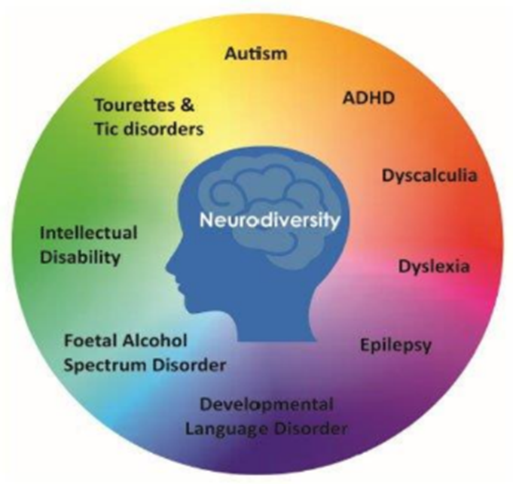
What is Neurodiversity
The neurodiversity paradigm is a framework for understanding human brain function that considers the diversity within sensory processing, motor abilities, social comfort, cognition, and focus as neurobiological differences.
This diversity falls on a spectrum of neurocognitive differences.

Slide 7

What is Neurodiversity
The term neurodiversity describes differences in the way people's brains work. The idea is that there's no “correct” way for the brain to work. Instead, there is a wide range of ways that people perceive and respond to the world, with varying strengths and weaknesses.
Being neurodivergent means having a brain that works differently from the average or “neurotypical” person.

Slide 8
Examples of Neurodiversity
Autism
ADHD ( Attention Deficit Hyperactivity Disorder)
ADD ( Attention Deficit Disorder)
Tics and Tourette’s syndrome
Dyslexia
Dyscalculia
Dyspraxia ( Developmental Coordination Disorder DCD)
Foetal Alcohol Syndrome
Developmental Language Disorder (DLD)

Slide 9
What does this mean for my child?
Some aspects of life may be more challenging for your family if you have a Children and Young Person who is neurodivergent. Some children may thrive at school and others may shine in non academic ways.
In an ideal world, access to services and support should be based on your child’s needs rather than needing a formal diagnosis (Profiling Tool )

Slide 10
Your child may:
Think, learn feel and process information differently
Need extra help and support
Have inconsistent performance at school
Thrive in the right environment if their strengths are used

Slide 11
Neurodiversity Pathways Update:
How do we support in Cheshire West and Chester?

Slide 12
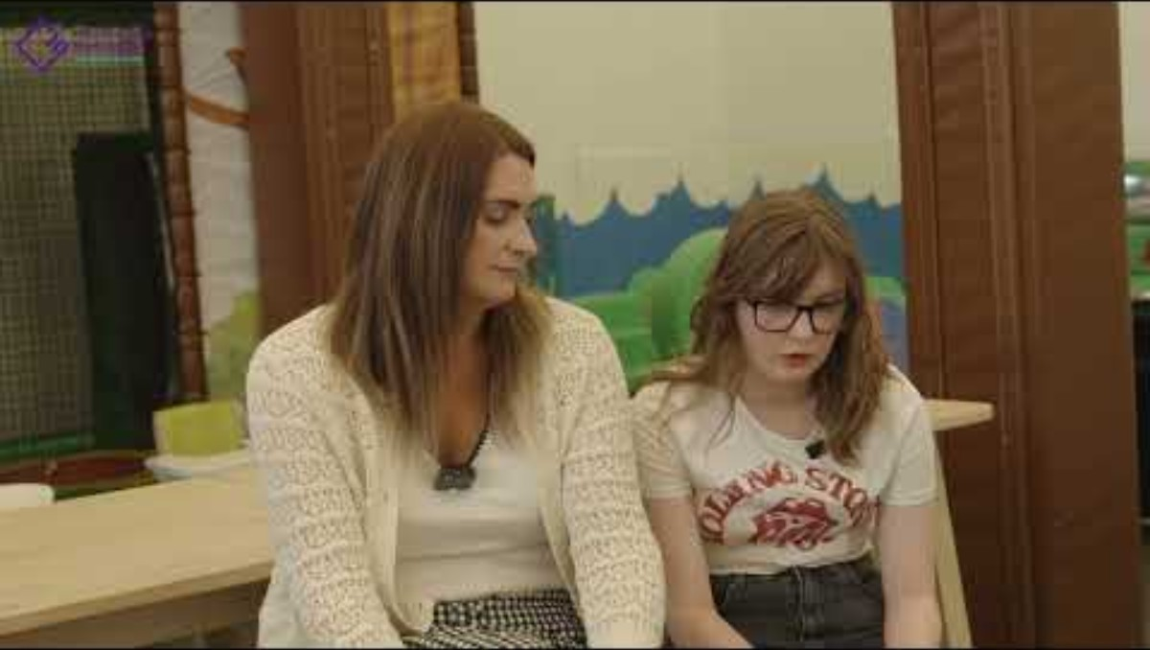
Cheshire and Merseyside neurodevelopmental pathway: Introduction
cheshire-and-merseyside-neurodevelopment-pathway
Frequently asked Questions
Where to go for help - NHS Cheshire and Merseyside

Slide 13
Underlying principles
Needs led - community based.

Slide 14
Why needs led support ?
We increasingly recognise that people may have cognitive differences as part of normal human variation.
The neurodiversity movement – emphasises recognising the strengths not deficits and has led to a new paradigm and approach.
But these differences may also cause barriers to people – and require reasonable adjustments or more.
A Neuro-affirmative needs-based approach in education and services will benefit all CYP and does not legally require diagnosis (CAF 2014)
It is known that CYP may have more than one neurodiversity – and not meet diagnostic criteria but still require support (sub clinical features/DAMP/ESSENCE)
Notes:
N Diversity acknowledges the natural variation of human cognitive processes and experiences (Singer, 1999)
Providing support for a wider population with special educational needs (SEN) or neurodivergence has been advocated to ensure earlier intervention for autistic CYP or those with ID.
One of the arguments inherent in the neurodiversity paradigm,
is that it arose from criticisms of the medical model and argues that neurodivergence should be defined by strengths not deficits, but at the same time access to services and support may be dependent on medical diagnosis which depends on the recognition of impairment.

Slide 15
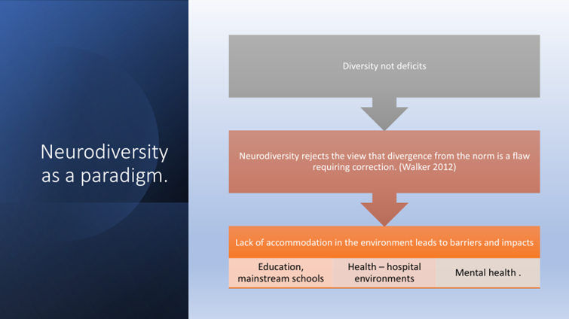
Notes:
Paradigm arose as a criticism of the medical model of symptoms and deficit.
Both a paradigm led to new areas of academic study and a human rights movement.

Slide 16
Development and work in Cheshire and Merseyside

Slide 17



C&M Children and Young People Neurodevelopment Pathway
CHANGE 1: C&M profiling tool
Supported by:
Empowerment & Early Support
CHANGE 2: C&M Standardised early support across 9 ‘dimensions’
CHANGE 3: Place based
Neurodevelopment team
CHANGE 4: Standardised risk stratification/prioritisation tool
Assessment and Diagnosis
CHANGE 5: Multi-disciplinary approach and Streamlined/combined ADHD & autism assessment
Training for education/family professionals on tool
Clear signposting and resources for families
Training for families on tool/neurodiversity
CHANGE 6: Shared care for ADHD medications
Ongoing Support
CHANGE 7: C&M Standardised ongoing support across 10 areas of the new C&M profiling tool
CHANGE 8: Integrated mental health/neurodevelopment offer
Specific support / strategies linked to assessed needs – inc via formal assessment where undertaken
Notes:
Laura

Slide 18
Work done so far in C and M
Approved standard C and M approach to stratification and prioritisation of referrals at triage
Agreed a consistent clinical assessment model for ND services
Piloting the Portsmouth Cornwall Tool in Wirral and St Helens schools
In parallel – CANDDID study team are supporting the evaluation of the pilots and the coproduction of a C and M ND profiling tool based on participation across the 9 places, and pilot site feedback.
Notes:
Clear consistent principles and standards for assessment
MDT assessment – correct skills
Child centred approach
Not having to repeat information
One stop shop approach to ASD and ADHD

Slide 19
Further work on the ND pathway in C and M
Understanding how local offers and Early Help can support children on the ND pathway.
Exploring the role of primary care in ADHD medication prescribing and looking implementing the C and M assessment model and standards.
Stakeholder workshop Feb 26 looking at access and support from mental health pathways.
On going feedback and evaluation from implementations will feed into reviews of the stratification and profiling tools.

Slide 20
Understanding The diagnostic Pathway

Slide 21
What is the difference between being neuro-divergent and having a neurodevelopmental diagnosis?
Diagnostic understanding
Neurodevelopmental Diagnosis (ICD 11-WHO)
Meets research based ICD 11 criteria (WHO)
Evidence base on prognosis / risk /impact
used internationally
diagnostic , consistent across culture,
Developmental trajectory or information processing is not typical ( different from the neurotypical population)
May not reach diagnostic threshold for a “disorder”
NB – people with a neurodevelopmental diagnosis are a subset of neurodivergent people.
Comes from the social model and neurodiversity paradigm
Neurodivergent
Still have needs and experience impact
Come under legal frameworks (CAF 2014, Equality Act 2010)
Notes:
Neurotypical
Neurodiverse
Neuro-divergent

Slide 22
Assessment and Diagnosis Change: Multidisciplinary approach and combined assessment, expanded capacity
If a diagnostic assessment is recommended the Neurodevelopmental Multi-disciplinary Assessment Team will explore autism and/or ADHD, and as part of those assessments will also explore the following where appropriate:
learning, sensory and coordination difficulties
foetal alcohol spectrum disorder
other neurodevelopmental conditions

Slide 23
What Are The Waiting Times?

Slide 24




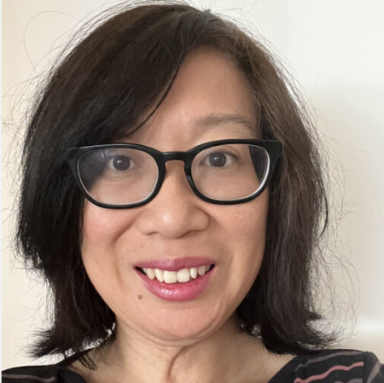
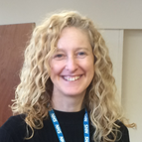


Cheshire and Merseyside Neurodiversity Profiling Tool Pilot Evaluation
PCF Cheshire West Neurodiversity Forum
13th November 2025
Professor
Chris Wee
Isobel Tollerfield
Cheshire and Wirral Partnership NHS Foundation Trust, and
Centre for Autism Neurodevelopmental Disorders and Intellectual Disability (CANDDID)
www.canddid.nhs.uk
@cwp_research
@CANDDID1

Slide 25
CANDDID study team:
Study team admin support Henrietta de Gale
Expert-by-experience Josef de la Moitie
Research assistant (3 days pw) Ruksana Begum-Meades
Senior clinical studies officer (1 day pw) Lisa Douglas
Clinician researcher (1 day pw) Isobel Tollerfield
Mentoring (4 hours pw) Lisa Thompson / Chris Wee

Slide 26
CANDDID study team Feb 2025 – Feb 2026
The CANDDID study team are carrying out the evaluation of the initial pilots using the Portsmouth Cornwall profile in Wirral and St Helens.
They have held one (June 25) implementation workshop and six (July-Sept) coproduction workshops for Cheshire and Merseyside
Another implementation workshop will take place on Tuesday 18th November
Focus on people, processes, and resources needed
200+ stakeholders have taken part in coproduction so far across nine C&M Places (Parents, carers, and practitioners from education, health, and care.
In response to stakeholder feedback on the Portsmouth Tool – a new profiling tool has been coproduced by Cheshire and Merseyside stakeholders.

Slide 27
CANDDID study team Feb 2025 – Feb 2026
The CANDDID study team are carrying out the evaluation of the initial pilots using the Portsmouth Cornwall profile in Wirral and St Helens.
They have held one (June 25) implementation workshop and six (July-Sept) coproduction workshops for Cheshire and Merseyside
Another implementation workshop will take place on Tuesday 18th November
Focus on people, processes, and resources needed
200+ stakeholders have taken part in coproduction so far across nine C&M Places (Parents, carers, and practitioners from education, health, and care.
In response to stakeholder feedback on the Portsmouth Tool – a new profiling tool has been coproduced by Cheshire and Merseyside stakeholders.

Slide 28


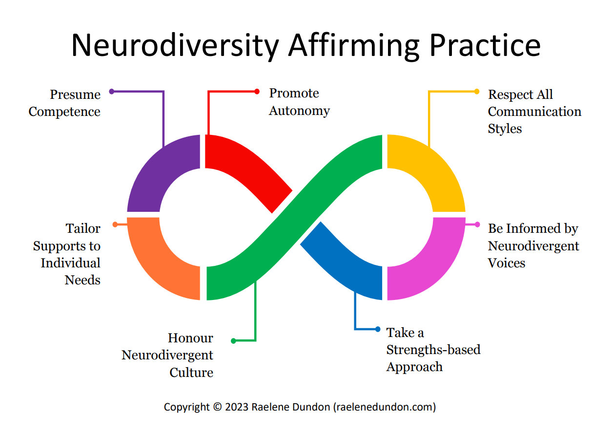
The new C&M profiling tool – a neuro-affirmative approach
Cheshire and Merseyside Stakeholder co-production
Portsmouth-Cornwall profiling tool
Cheshire and Merseyside profiling tool

Slide 29
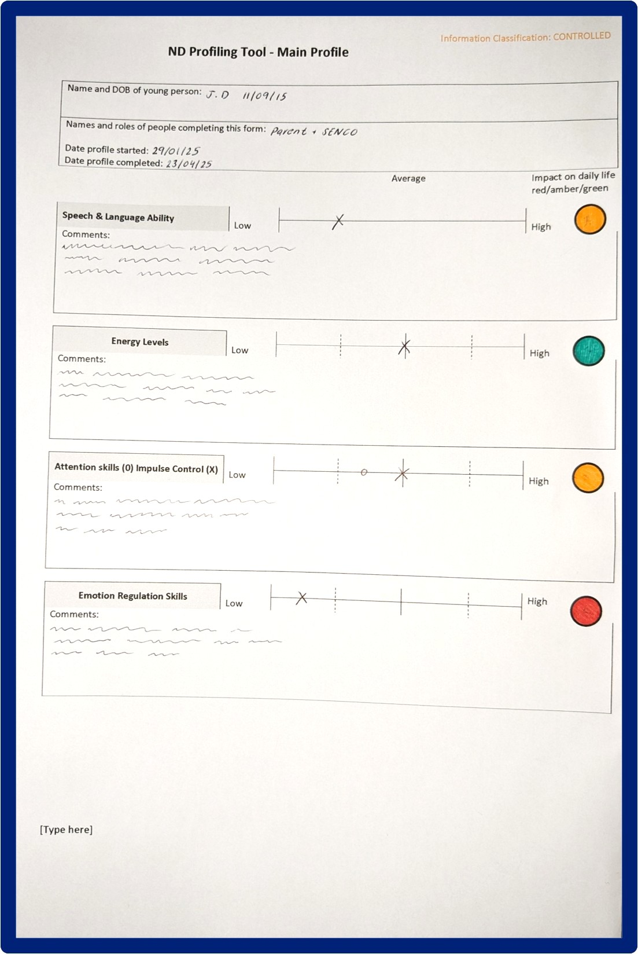
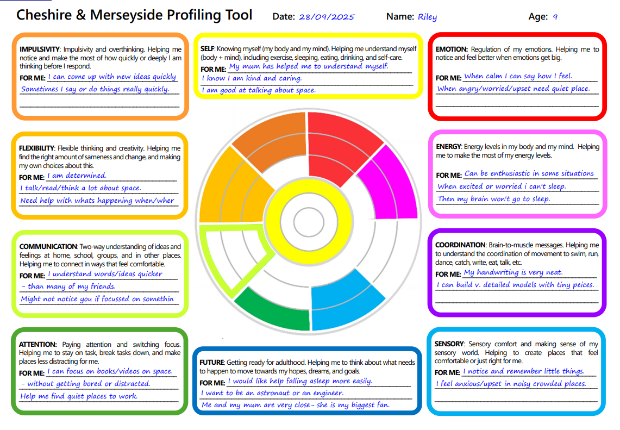
The new co-produced C&M profiling tool
Portsmouth-Cornwall profiling tool
Cheshire and Merseyside profiling tool
Paper format only
A medical model focuses on making judgements based on abilities and ‘behaviours’
Uses ‘red’, ‘amber’, ‘green’ indicators and different scales based on ‘high’ and ‘low’ abilities and support needs
Includes terms that are outdated and difficult to understand
Promoted as a tool that can reduce demand for formal assessment
Digitised (interim version available)
A neuro-affirmative approach focuses on understanding strengths and what works for each young person based on their experiences
Uses a consistent neuro-affirmative system of solid colour and borders to show the level of support and adjustments needed
Uses easy read words with visuals
Promoted as a tool that can help young people, families, and practitioners get earlier access to support

Slide 30
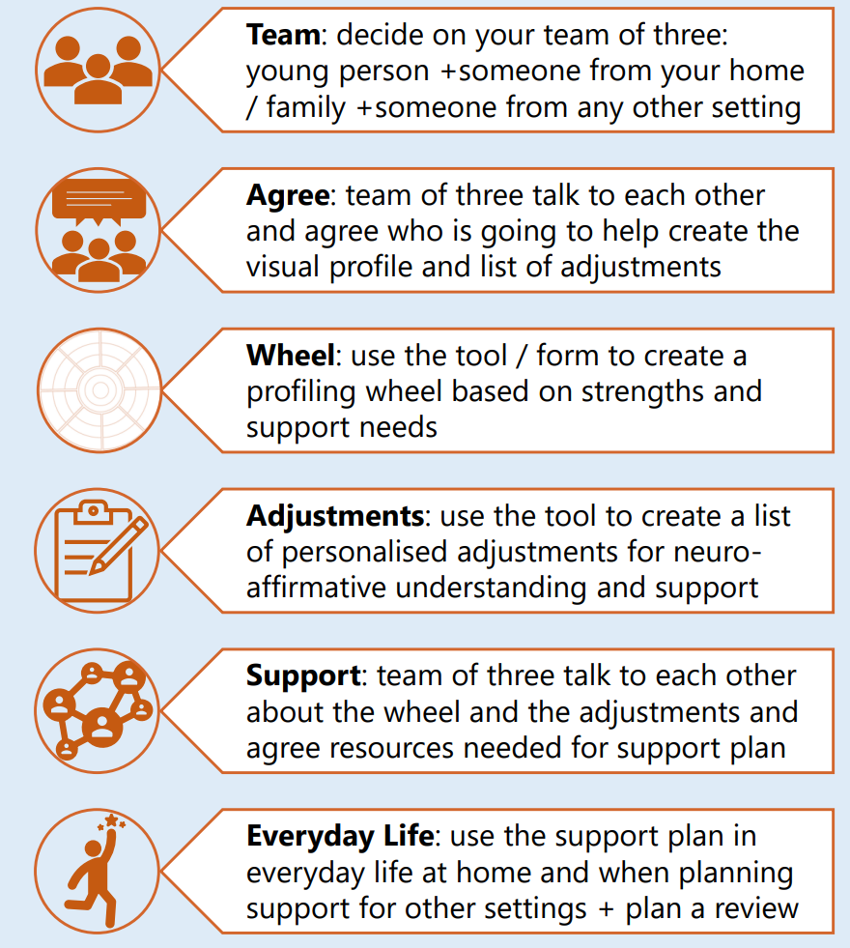

The new co-produced C&M profiling tool

Slide 31
Further work on the neurodiversity pathway in C and M
Understanding how local offers and Early Help can support children on the ND pathway.
Exploring the role of primary care in ADHD medication prescribing and looking implementing the C and M assessment model and standards.
Stakeholder workshop Feb 26 looking at access and support from mental health pathways.
On going feedback and evaluation from implementations will feed into reviews of the stratification and profiling tools.
Study team email: CWP.NDProfileStudy@nhs.net

Slide 32



Introduction and Koala North West's Role​
Koala NW supports both professionals and parents/carers.
Our role is to deliver and facilitate training that ensures professionals and practitioners understand and use the profiling tool effectively.
We will also be offering training to parents to support their understanding of the tool.
Our training promotes inclusive, neuro-affirming approaches across education, health, and care settings.
Today’s session is about creating a shared understanding of the tool to enable the best support for children and young people.
Notes:
Speaker Notes:
Welcome everyone, and thank you for joining us today. My name is ****** and I’m here on behalf of Koala NW.
I’m going to give you an overview of the new Cheshire and Merseyside Profiling Tool, which is currently being rolled out across the area.
Koala NW’s role is to support both professionals and parents/carers by delivering training that helps everyone understand and use the profiling tool with confidence.
Today’s session will:
Explain what the profiling tool is and why it matters.
Show how the process works and how parents are involved.
Highlight that this tool is used alongside diagnosis, not instead of it.
Share how the information is used to create practical support plans for home and school.
Our aim is to create a shared understanding so that parents, schools, and professionals can work together to give children the best chance to thrive.

Slide 33

Understanding the Profiling Tool​
Created with neurodivergent young people, their families and professionals to meet real needs.
Focuses on strengths, not just challenges.
Covers 10 key areas like emotions, energy, attention, and communication.
Can be used with or without a diagnosis – it’s a guided conversation, not an assessment.
Supports home, school, and community settings with practical strategies.
Complements formal assessments, helping early support.
Over 300 professionals trained to ensure consistency and collaboration.
Notes:
Speaker Notes:
This tool is not a test or a diagnosis. It’s a way to understand your child’s experiences, strengths, and what helps them thrive. The tool promotes understanding and supports children who experience the world differently by celebrating neurodiversity.
It looks at 10 key areas such as emotions, energy, attention, communication, and sensory needs.
The aim is to build a full picture of your child, not just focus on challenges. The process is collaborative and your voice as a parent is essential. It’s a guided conversation, not an assessment, and it works whether or not your child has a diagnosis.
The tool uses neuro-affirming language and focuses on strengths, helping us plan support across home, school, and community settings. It also complements formal assessments without replacing them, so support can start early. To date, over 300 professionals have already been trained in using this tool, which means there’s a consistent and joined-up approach across services.

Slide 34

How the Profiling Process Works
Child, family, and professionals work together to create the profile through meaningful dialogue and discussion.
This discussion will focus on the 10 key areas of development.
Can be done on paper or digitally.
Results in a colourful wheel showing strengths and support needs.
Child’s voice is central – through talking, drawing, or their preferred style.
Reviewed regularly (every 12 weeks or sooner) to keep support relevant.
Notes:
Speaker Notes:
Profiling is done with you, not to you. It’s a collaborative process where the child, family, and professionals work together to build a clear picture of strengths and support needs.
The process is child-centred, meaning your child’s voice is at the heart of it. They can share their views in ways that feel comfortable, like talking, drawing, or through their preferred way of communicating.
The outcome is a colourful visual wheel or table that shows what’s going well and where extra support might help. This makes it easy for everyone—home, school, and other settings—to understand and work together.
Profiles are reviewed regularly, usually every 12 weeks or sooner if things change. This means support can adapt as your child grows and their needs change.
The goal is to make sure support is relevant, practical, and consistent across all areas of your child’s life.

Slide 35











The 10 Key Areas
Self – Understanding body, mind, and basic needs
Attention – Focusing and switching between tasks.
Communication – Sharing and understanding
ideas and feelings.
Emotion – Managing and expressing feelings.
Energy – Balancing energy levels throughout the day.
Flexibility – Coping with change and transitions.
Coordination – Movement and motor skills.
Impulsivity – Acting quickly or overthinking.
Sensory – Comfort with sounds, sights, textures, body signals.
Future – Planning and preparing for adulthood.
Notes:
Speaker Notes:
The profiling tool looks at 10 key areas of a child’s life. These areas cover things like emotions, energy, attention, communication, and planning for the future and gives us a structured way of exploring and identifying your child's strengths, interests and where further support may be needed.
The aim is to build a complete picture of your child—what they’re good at, what helps them, and where they need extra help..
This isn’t about labels or scores; it’s about understanding your child’s unique strengths and needs so we can work together to provide the right support at home, in school, and in the community.

Slide 36
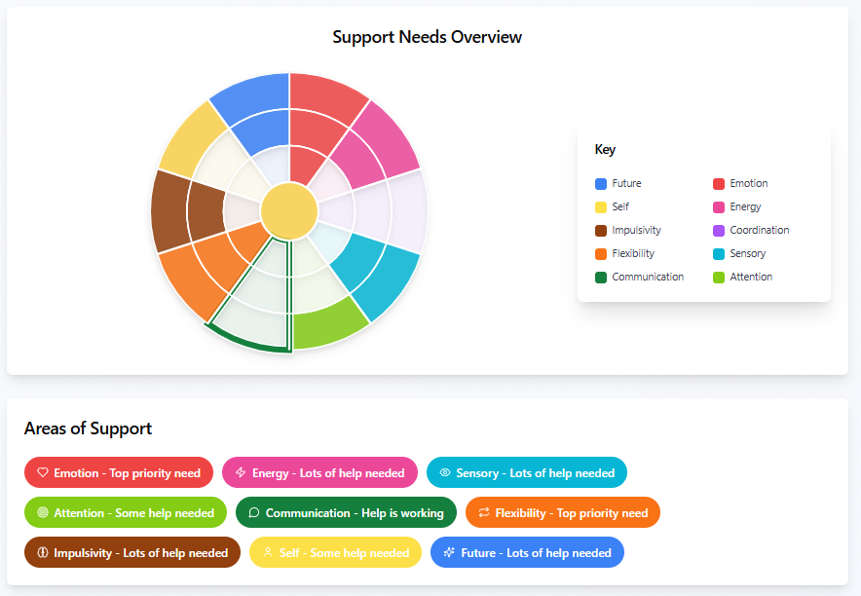
Outcomes and Benefits​
A clear visual profile (wheel or table) showing strengths and support needs.
A personalised support plan for your child.
Practical strategies and adjustments for home and school.
Helps access services and support sooner.
Encourages teamwork between families and professionals, reducing duplication.
Notes:
Speaker Notes:
At the end of the profiling process, you’ll have a clear picture of your child’s strengths and areas where support is needed.
You will also receive a personalised support plan with practical strategies that can be used at home and in school. This means everyone is working from the same plan, creating consistency and reducing anxiety and worry.
The visual profile, often a colourful wheel or table, makes it easy to understand and share with others.
One of the biggest benefits is that this process can help your child get the right support sooner, even while waiting for assessments. It’s about making things better now, not waiting for a diagnosis.
Through this approach, the tool encourages teamwork between families and professionals, so you feel included and supported every step of the way.​

Slide 37

Key Messages ​
Profiling does not delay or replace diagnosis - it works alongside it.
It’s about understanding, not labelling.
Your input matters – parents know their children best.
Celebrates differences and supports inclusion.
Helps home and school work together for consistent support.
Notes:
Speaker Notes:
One of the most important things to know is that profiling does not delay or replace diagnosis. It works alongside the diagnostic process and can actually help by providing useful information for referrals.
The tool is about understanding, not labelling. It focuses on your child’s strengths and what helps them thrive, rather than trying to fit them into a box.
Your input is really important, you know your child best. Your insights help create a profile that truly reflects their needs and strengths. The tool also celebrates differences and promotes inclusion, making sure every child feels seen, heard, and supported, which enables home and school to work together, so strategies are consistent and effective across all settings.

Slide 38

Moving Forward​
Profiling is a starting point, not the end.
After the profile is complete, it is reviewed regularly (every 12 weeks or sooner). Regular reviews keep support relevant.
This helps track progress and adjust support as your child grows and their needs change over time.
You will be involved in conversations about what’s working and what needs to change.
Ask questions and share your views during the profiling process – your voice matters.
Notes:
Speaker Notes:
Profiling is the start of a journey, not the end. It helps us understand your child better and plan support that grows with them.
Children’s needs change over time, and that’s completely normal. That’s why the profile is reviewed regularly, usually every 12 weeks or sooner, to keep support relevant and effective.
These reviews help us track progress and make changes when needed. You’ll always be involved in these conversations about what’s working and what might need to change.
Please remember, your voice matters, ask questions, share your views, to ensure we know what’s important to you and your child. This is a team effort, and we want you to feel confident and supported every step of the way.

Slide 39


This tool is about celebrating neurodiversity, not ‘fixing children’.
It helps professionals understand your child better and work with you to support them.

Slide 40
Special Educational Needs Co-Ordinator – Emily Arnaud
Supporting neurodiversity in schools

Slide 41


The role of the SENCo

Slide 42

The SEND Code of Practice (2015)
The SEND code of practice is a statutory guidance for organizations that work with children and young people (aged 0-25) with special educational needs and disabilities (SEND) in England. It sets out the legal duties for local authorities, schools, and health and social care services, outlining the processes and procedures they must follow to identify, assess, and support these children and young people. A key principle is involving parents and the young person in all decision-making processes.

Slide 43
SEND Code of Practice (2015) states that…
All schools must have a qualified teacher designated as
SENCO and newly appointed SENCOs in
maintained schools must achieve the National Award for
SEN Coordination within three years of appointment

Slide 44
The SENCO is responsible for:
Overseeing the day-to-day operation of the school’s SEND policy – this should be available on the school’s website.
Coordinating provision for pupils with SEND.
Advising teachers on how to identify, assess, and meet the needs of pupils with SEND.
Liaising with parents and carers of pupils with SEND.

Slide 45
Working with external agencies such as Educational Psychologists, Speech & Language Therapists, health and social care professionals.
Ensuring accurate record-keeping of children with SEND and their progress.
Contributing to the professional development of staff to improve understanding and quality of SEND provision.
Liaising with potential next providers of education to ensure smooth transitions

Slide 46
Graduated Approach
The SENCo will oversee that they are continually following the graduated approach.
This involves repeatedly evaluating a child's needs, creating and implementing a plan to meet those needs, and then reviewing the effectiveness of the plan to make adjustments. This should be a collaborative process.
Assess
Plan
Do
Review

Slide 47
How does the SENCo support teachers?
Attending some meetings with teachers and parents as required.
Monitoring learning environments to create whole-school approaches to support ALL learners.
Monitoring continuous professional development (CPD) and training needs for staff across school to be able to support children with SEND.
Looking at the effectiveness of Quality First Teaching in classrooms.

Slide 48
What is Quality First Teaching??
It is NOT about extra interventions.
High quality, effective teaching strategies that support every learner.
High expectations for all learners.
Careful adaptation of tasks and resources to make learning accessible but challenging from the child’s starting point.
Clear learning objectives and well-structured lessons.

Slide 49
Engaging, evidence-based teaching strategies (e.g. modelling, scaffolding, retrieval practice).
Regular assessment and feedback to identify and respond to learning needs.
Inclusive classroom environments that support participation, independence, and confidence.
Effective use of teaching assistants to complement, not replace, teacher instruction and to develop independent learning

Slide 50
SENCo considerations for learning environments…
Classroom learning environments needs to accommodate many different needs within a mainstream classroom – these include learners with physical disabilities, Autism, ADHD, Specific Learning Difficulties e.g. dyslexia (there are many more conditions in every classroom)
These needs may be identified (diagnosed) or unidentified (diagnosis hasn’t been explored or completed)

Slide 51
How can the SENCo help with referrals to external professionals?
Every Local Authority (LA) will have different processes – but all will have a graduated approach to referring children to external professionals.
Not all LAs at the moment have the capacity to assess for all conditions e.g. Educational Psychologist shortages; Specific Learning Difficulties specialists are not commissioned in every LA.
SENCos will need to produce evidence to refer into local Child Development Centres to access paediatric services for neurodiverse conditions

Slide 52
Who can you talk to at school?
Always start with your child’s class teacher – they are working with them everyday and will possibly know your child better than the SENCo in the first instance.
If you’re raising a concern for the first time, ask if they have a graduated approach that you can make sure you’re following for their processes (this helps you keep track where you’re up to)
Always ask what support is in place in the classroom from the class teacher.
If you’ve discussed concerns with the class teacher and still feel concerned, arrange a phone call or meeting with the SENCo.

Slide 53
References
Department for Education & Department of Health (2015). Special Educational Needs and Disability Code of Practice: 0 to 25 years. Available online from GOV.UK.
Department for Education (2022). SEND Review: Right Support, Right Place, Right Time (Green Paper). Available online from GOV.UK

Slide 54
The Autism Service
Supporting neurodiversity

Slide 55



Specialist Teaching Services
AUTISM SERVICE
‘Improving outcomes for children and young people
experiencing social communication differences’

Slide 56

Who Are The Autism Service?
A multi-professional specialist service:
Specialist Teachers:
Have overall responsibility for individual cases. Follow a request for
consultation from school, a lead teacher will liaise with school and co-ordinate the involvement of other team members as appropriate.
Specialist Support Assistants:
The Specialist Support Assistants promote the development of schools’ capacity to meet pupil needs by modelling strategies and supporting intervention plans.
Family Liaison Worker:
Involved on request of the specialist teachers to transfer and develop targeted skills and learning from school to the home, promoting generalisation of skills across settings.
Speech and Language Therapist:
Specialist in Autism, works with the team on a part-time basis. They assess pupils’ understanding and use of language and communication provide advice to support this.

Slide 57


What we do
Support mainstream schools to meet the needs of children with social communication differences and autism. No diagnosis needed.
Provide a range of training, share information and advice to develop staff understanding and capacity to meet need.
May attend multi-agency meetings or liaise with professionals, conduct assessments and provide time bound intervention input.
Consult with staff, observe in school and gain parent and pupil views. Child centred approach.
Make recommendations on adjustments and strategies to support interaction, communication, relationships, regulation, engagement and access to learning.
Support plan-do-review cycle with schools and suggest next steps or signpost

Slide 58

How to access the service
Schools
Schools can request a consultation for a situation to gain general advice.
Pupil referrals come in directly from SENCos or school senior managers and are carefully assessed before a package of support is decided upon.
Any intervention provided by the Autism Service will be on a time-limited basis.
Families
If your child’s school requests
involvement from the Autism Service,
you will be asked to provide
signed permission.
Whenever we write a report, a copy will be sent to school who will share this with parents/carers.
The school SENCo will continue to be the first point of contact for families.

Slide 59


Cheshire West Autism Service
Family Support Padlet
Developed in liaison with parents
Useful websites
Helpful information

Slide 60

Cheshire West Live Well Site
https://www.livewell.cheshirewestandchester.gov.uk/Services/1276

Slide 61

Coffee Cake & Marketplace

Slide 62



PCF Survey’s run Bi- Annually with the last survey was concluded February 2024
PCF Survey’s questions have been co-produced with Education, Health and Social Care
PCF Survey has been designed by external Market Researchers
PCF Survey data can used as a tool to inform decisions and measure accountability. The results are now written into the SEND Strategy as Key Performance Indicators

Slide 63


Themes from 2024
Communication – Navigating the system
EHCP Process – Compliance rate
Wait times – Leading to children in crisis
Lack of Access to Services - Wrap around care/Short Breaks
Eligibility Criteria – Equity across the borough
Emotional Toll on parents
Notes:
Basic levels of communication – answer emails, phone parents back
System changes – Family Hubs for SEND parents across the borough to get answers
EHCP Process –
6% compliance rate
Special School FULL – add in numbers – the life boats are sinking
Sufficiency
Where can we help – Parents voices baked in to help build the confidence that the provision that is being created meets need , communication around this …
Children and families in mental health crisis – no access to services which keeps children out of education
Where can we help – Co-produce reasonable adjustment attendance policy with parent lived experience baked in
Lack of access to services –
Talk about the solutions – special school offer/transport restriction/Direct payment restriction lifted

Slide 64
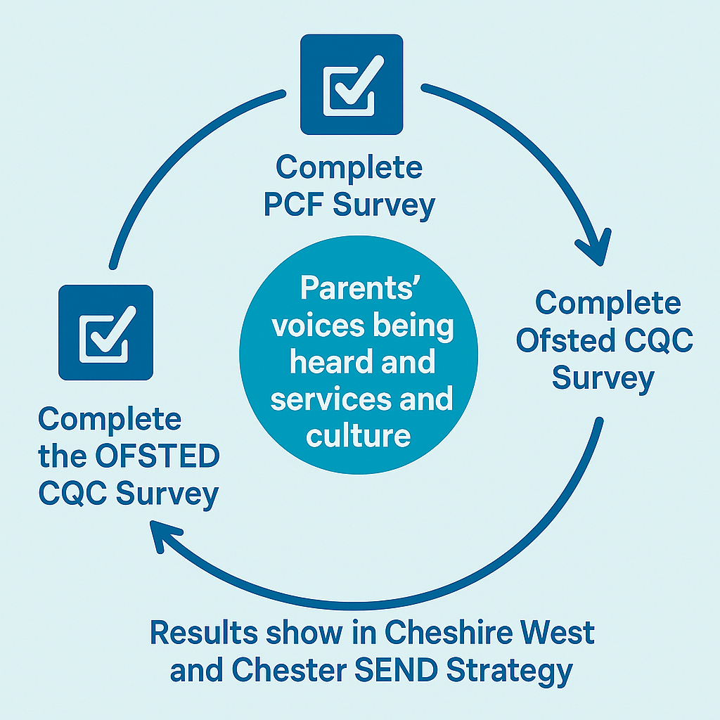





Slide 65
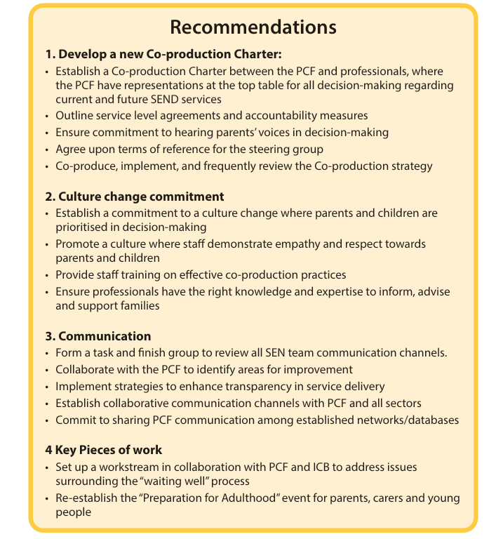
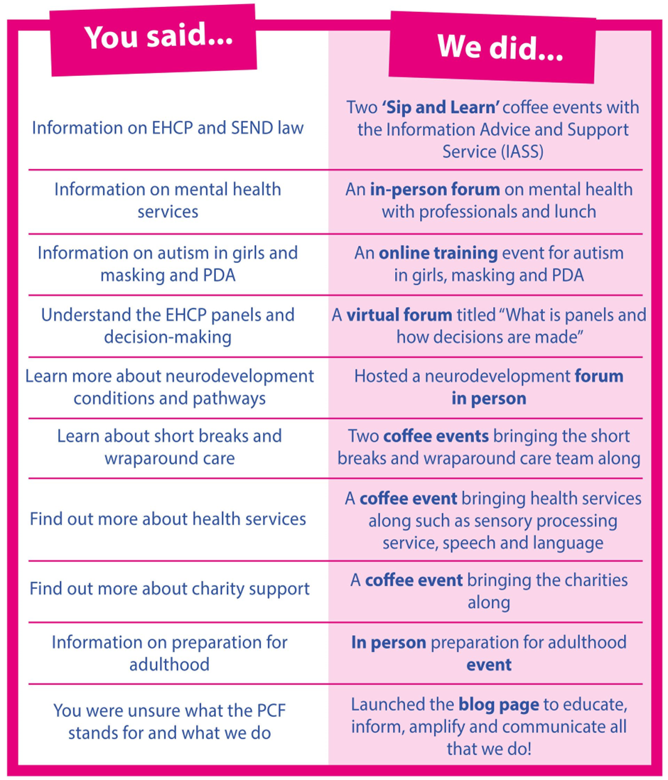
Recommendations 2024
Notes:
Basic levels of communication – answer emails, phone parents back
System changes – Family Hubs for SEND parents across the borough to get answers
EHCP Process –
6% compliance rate
Special School FULL – add in numbers – the life boats are sinking
Sufficiency
Where can we help – Parents voices baked in to help build the confidence that the provision that is being created meets need , communication around this …
Children and families in mental health crisis – no access to services which keeps children out of education
Where can we help – Co-produce reasonable adjustment attendance policy with parent lived experience baked in
Lack of access to services –
Talk about the solutions – special school offer/transport restriction/Direct payment restriction lifted

Slide 66
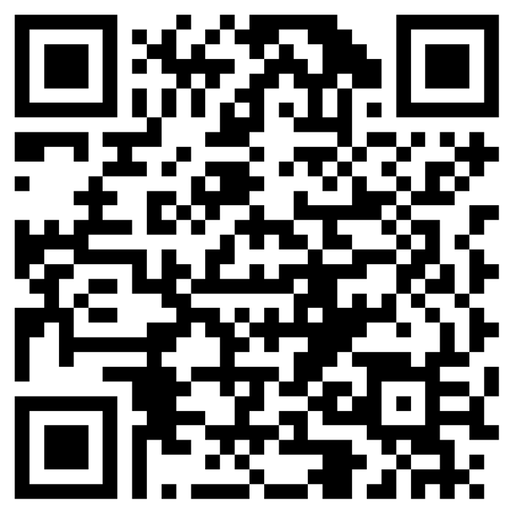


Understanding Inclusion
Understanding Inclusion Presenter View

Slide 67

Culture Change in Action:
The Journey So Far…..
Katy Ellison
Themes for The Pledge
1. Clear and Honest Communication
Everyone involved should share information in a way that is easy to understand, truthful, and shared at the right time.
2. Listening and Caring
We need to really listen to each other and show we care. This helps build trust and good relationships.
3. Trust and Responsibility
Trust grows when we treat each other with respect and take responsibility for what we do.
4. Fair and Open Services
Services should welcome everyone and be easy to use, no matter who you are or what your needs are.
5. Working Together
Families and young people should help shape the services they use. Their experiences and ideas matter.
6. Putting Children First
All decisions and support should focus on what’s best for the child or young person.
7. Easy-to-Use Systems
Families and professionals need systems that are simple to understand and easy to use.

Slide 68

Parent Participation

Slide 69



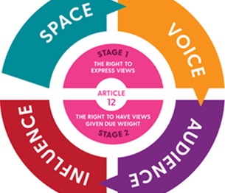
Children, Young People & Families Care Group
Working with children, young people and families to improve our services

Slide 70
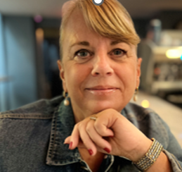

Who we are
Participation & Engagement Lead
Children, Young People & Families Care Group
Cheshire & Wirral Partnership
Participation & Engagement Worker
Children, Young People & Families Care Group
Cheshire community services

Slide 71
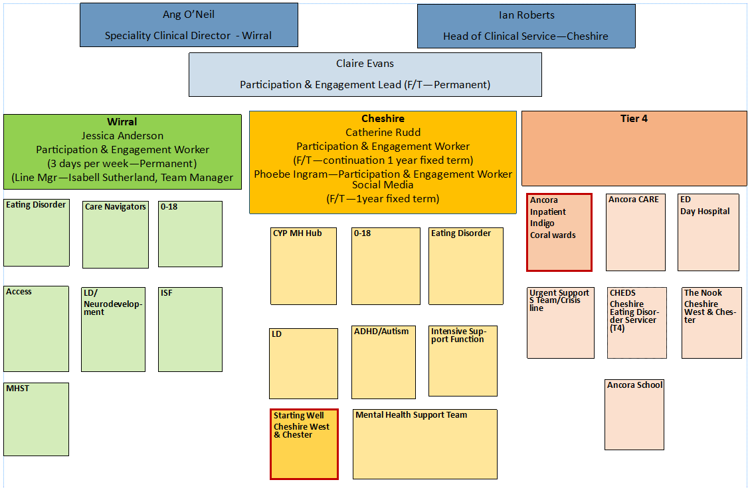
P&E Network

Slide 72





Slide 73
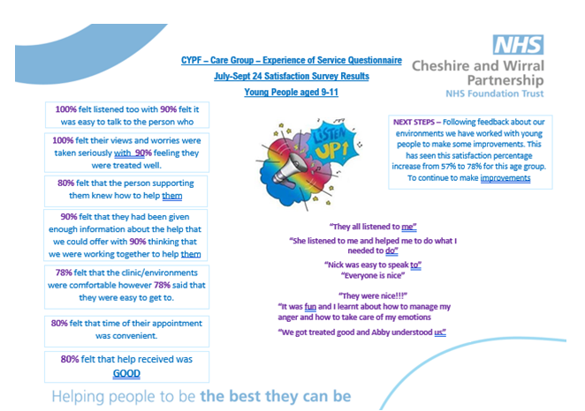

Slide 74
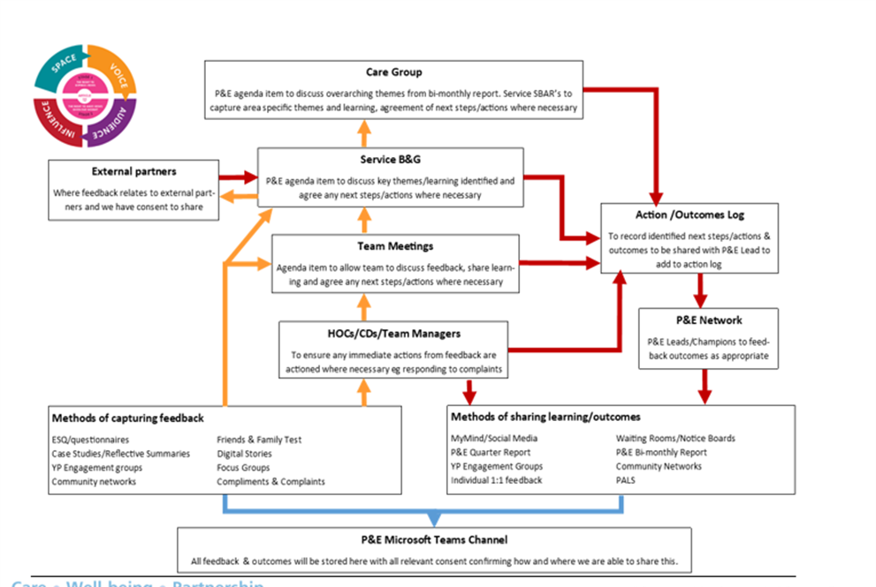
Lived experience learning

Slide 75

Hearing the voice of young people within CWP, across the North West and nationally
2 young people being supported to apply for roles as Governors within the Trust
Young people involved in a 3-year national research project with Kings College London to understand Community Education & Treatment Reviews (CETRs)
Young people supporting their local foodbank
Young people/parents & carers supporting our interview process
Young people to support Countess of Chester junior doctors training
Young people taking over our Strategic Manager’s meeting in November for November Children’s Rights Month
Parent/carers involved in our Cheshire Autism & ADHD rapid improvement work – supporting four working groups

Slide 76

To find out more about our work, visit our Participation & Engagement Page on the MyMind website
Get involved :: Cheshire and Wirral Partnership NHS Foundation Trust

Slide 77

Cheshire West and Chester Autism and Neurodivergence Strategy: A Community-Led Approach
Vision
Cheshire West and Chester aims to create an inclusive, all-age community where Autistic and Neurodivergent people are understood, valued, and empowered through systemic, person-centred support, strong partnerships, and meaningful co-production, ensuring equity and accessibility across all areas of life.
Underpinned by…
Autism Act 2009 and statutory guidance updates
Care Act 2014 and Equality Act 2010 responsibilities.
NICE guidelines on Autism diagnosis and management.

Slide 78
Priorities
Education and training
Promote inclusive education, ensure smooth transitions into adulthood, and enhance autism training to create equitable opportunities for all learners
Governance and accountability
Hold services accountable, expand board representation to include the entire neurodivergent community, and actively leverage staff networks to drive meaningful inclusion
Planning for the Future
Embed co-production across all activities, raise public awareness and acceptance, create sensory-inclusive environments, and drive innovation through research and development
Health
Expand pre- and post-diagnostic support, reduce diagnostic delays, tackle health and care inequalities, and improve mental health services, while embedding reasonable adjustments across all initiatives to ensure equitable and inclusive care
Social support
Create inclusive systems to improve employment opportunities, strengthen community-based care, expand housing options, ensure fair treatment within criminal justice, promote healthy intimate relationships, and empower parents, carers, and families of neurodivergent individuals

Slide 79
All Age Autism and Neurodivergence Partnership Board
A multi-agency group bringing together the Local Authority, Health services, the Voluntary and Community Sector, and – most importantly – people with lived experience.
It provides a safe, supportive, and inclusive space focused on positive action.
The Board operates informally, makes reasonable adjustments where needed, and works through various subgroups aligned with the overarching strategy.
New members are always welcome.

Slide 80
Partnerships for the Inclusion of Neurodiversity in Schools 2025-2026
Cheshire West PCF 13th November 2025
Lesley Firth
Deputy Head of SEND

Slide 81

Overview of PINS
Multi-agency project funded by Department for Education (DfE), supported by the Department for Health and Social Care (DHSC) and NHS England (NHSE), led by NHS Integrated Care Boards (ICBs) and monitored by NHS England and the DFE – it’s a national government initiative across every LA and ICB
A whole school focus working with school staff, not children.
Supports strengthening of parent/carer - school partnerships

Slide 82
Aims – key to evaluation
DFE long terms aims:
Improved attendance
Reduced exclusions
Improved pupil wellbeing
Increased parental confidence
within the wider DfE ambition of inclusive mainstream education
Our additional aims within Cheshire and Merseyside:
Strengthening of parent-carer/school partnerships, rooted in co-production
Increased collaboration between the LA, ICB and schools
Building and sharing expertise in inclusive education - sharing the knowledge and tools

Slide 83


Starts with Self-Assessment
Schools score themselves against 6 themes (over 60 questions):
  Leadership, Culture and Values (including co-production)
  Mental Health
  Readiness to Learn
  Teaching and Learning
  The Environment
  Communication

Slide 84

The PINS Support Offer
Schools are offered equivalent of 37.5 hours of support, comprised of:
On-site visits – audits – review what we see in school with the provider’s ‘fresh’ and expert eye . Follow-up advice and coaching to support development (what school can do next).
Training –online training – led by NHS, LA staff and third sector staff from across C&M. Sessions are recorded to maximise access for all school staff.
Parent Carer Forum is a crucial element of the project - 2 coffee mornings to meet with parents and carers to share survey results and meet with school leaders to support development of co-production in school.

Slide 85
How we will recognise impact
We can see it
What is different about the child?
What is different about the school and staff?
The data – attendance etc
2nd parent survey
Schools revisit their self assessment
We review and discuss together – what worked – what didn’t – Would be even better if..
We continue to learn and develop – what we also need

Slide 86
How we will recognise impact
National Team
Have school self-assessment scores improved
Do parent-carer surveys say things have improved
Focus groups, interviews and case studies

Slide 87
How we will recognise impact
Schools in Year 1 said ‘it is early days, and we need to review in 12 months’, however, they can see
Increased staff confidence
Children calmer and more engaged in learning
Some improvement in attendance
Improved communication and working with parents
Educational progress is improving
What else they can do to build on this work

Slide 88

Partnership for Inclusion of Neurodiversity in Schools ( PINS) Project
Parent Carer Forum Involvement

Slide 89

Who will the PINS project support?
PINS aims to support schools to enable all children to thrive, have a sense of belonging and feel safe.
It is a whole school approach that uses the power of working in partnership with families and professionals to build an inclusive culture where neurodiversity is a valued strength that adds to the school community.

Slide 90
How many schools are taking part?
In the first year of the project, four schools were selected using a set of criteria aimed at identifying schools that could benefit the most from taking part in the project: Neston, Little Sutton, Farndon and St.Winefride’s
This year the schools that have been selected are: Wharton, Witton Church Walk and Charles Darwin
What do schools have to do?
Complete a self evaluation form
Identify the strengths and areas for improvement in the whole school approach to neurodiversity
Identify areas in which the school would most benefit from support from health and education specialists and the Parent Carer Forum and take part in training

Slide 91
How is the Parent Carer Forum supporting the project?
The input, knowledge and insight of parents is a key element and a positive strength of the PINS project and by working together in coproduction with the school, parents and teachers can share information, decrease isolation and develop or strengthen positive relationships
Meetings with parents and carers where they can share their views and experiences and ask questions – at least 3 meetings per school
Meetings with school leaders to discuss the results of the surveys and anonymously share feedback from parents
SENDIASS (Information Advice and Support Service), Koala NW and Autism Practical Support (formerly known as ChAPS – Cheshire Autism Practical Support)
SPOTSS – Sensory Processing Occupational Therapy Support Service
RESOURCES: flyer packs, resource boxes, recordings of online training sessions and resources

Slide 92
THEMES FROM SURVEYS AND MEETINGS
Most parents felt welcome and included and felt that their children were welcome and included at their school
Feelings of isolation and lack of information, advice and support
EHCP application process overwhelming and complicated – little support
Negative impact of long waits for diagnosis or support
Lack of understanding of Neurodiversity in wider school community (some staff, other parents and pupils) – feelings of judgement
Behaviour and attendance policies not always inclusive

Slide 93
Parents’ concerns about their child not always listened to – delays in getting support
Inconsistencies in school - some teachers very knowledgeable and inclusive
Desire for more information and training on Neurodiversity
‘Masking’ not always understood by teachers
More parenting support and advice needed e.g. sleep issues
Anxiety and lack of support with transition to high school
Most parents said they wanted more communication about their child

Slide 94
QUICK WINS – What can ALL schools do?
Regularly share SEND information and signposting with ALL parents
Ensure ALL parents are aware of the SEND Information, Advice and Support Service (IASS) and Local Offer (Livewell website)
Share the PCF newsletter (and other newsletters e.g. ChAPS) with ALL parents
Host SEND coffee mornings/drop-ins where parents can meet others and get information and advice, and staff and parents can learn from each other (co-production!!)
SENCos to encourage a parent to volunteer as a PCF school rep and work together to facilitate future coffee mornings and signpost parents to support
Increase awareness and celebrate Neurodiversity with the whole school community e.g. training, assemblies, lessons, newsletters, awards, environment, culture/ethos

Slide 95
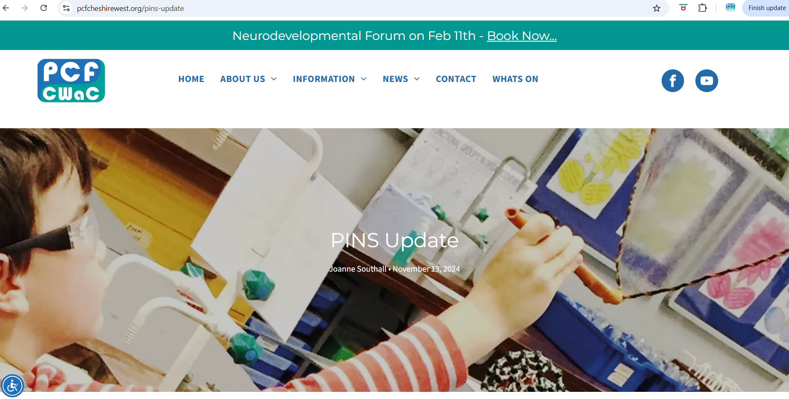

Slide 96




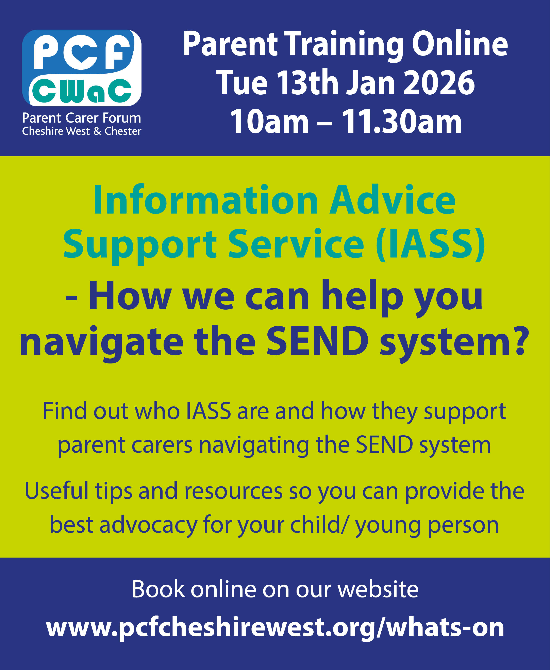

Slide 97
How to find us & stay updated
Monthly Newsletters
Sign up here!
Email: info@pcfcheshirewest.org
Website: www.pcfcheshirewest.org
Phone number: 07900840867
PCF YouTube Channel
https://facebook.com/pcfcwac

Slide 98
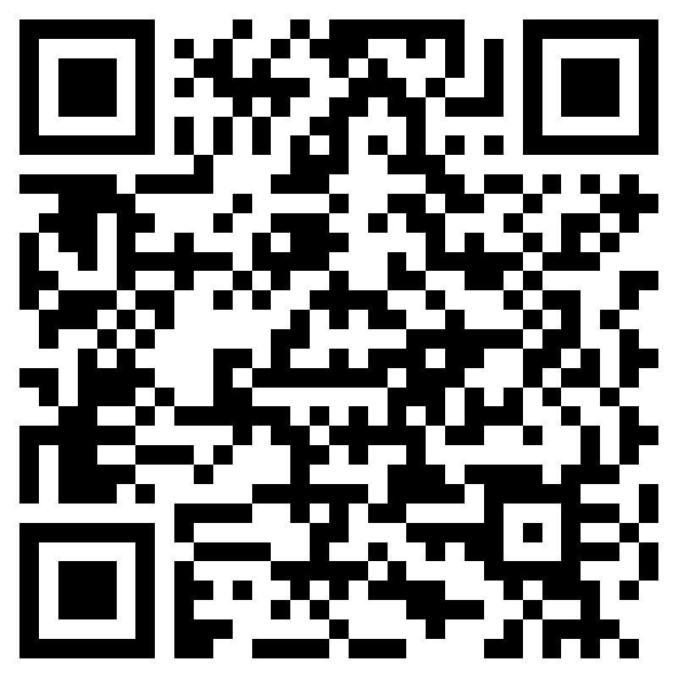
What Went Well?
What Didn’t Go well?
Thank you!
Even Better If?
Presenter View

