Slide 1
School Attendance Difficulties and school related anxiety (EBSA/EBSNA)
Dr Shannon Hatton-Corcoran
Trafford Educational Psychology Service

Slide 2
What is Emotionally Based School Non-Attendance?
Emotionally Based School Non-Attendance (EBSNA) is a term adopted by Trafford Council and number of other authorities to describe children and young people who have significant difficulties in attending school due to a range of emotional factors resulting in extended absence from school.
It is anxiety driven and not a choice
Can’t, not won’t.

Slide 3
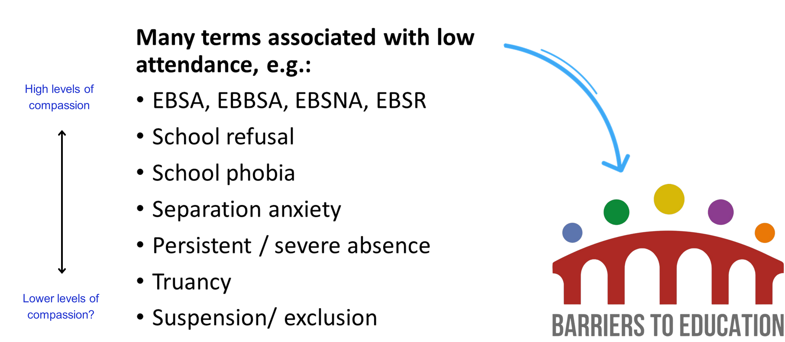

Slide 4

What does school related anxiety look like?
The literature tells us, it can be hidden or more obvious behaviours such as:
Parent/carers share that they have difficulties getting their child to school; CYP struggling to get out of bed, leave the house and get out of the car/on the bus.
Increase in emotional dysregulation, especially on Sunday nights, at the end of the holidays, e.g., very distressed behaviours, crying, withdrawn, shouting and breaking things.
Frequently communicating they feel unwell e.g., headaches, feeling sick (psychosomatic symptoms caused by overwhelming anxiety).
Withdrawn or dysregulated behaviours in schools
CYP does not express looking forward to any aspect of the school, avoids talking about school or talks about it negatively at home
Gradual disengagement in lessons and school activities, increase in late arrivals and, pattern of missing certain days.
Complete non-attendance…

Slide 5
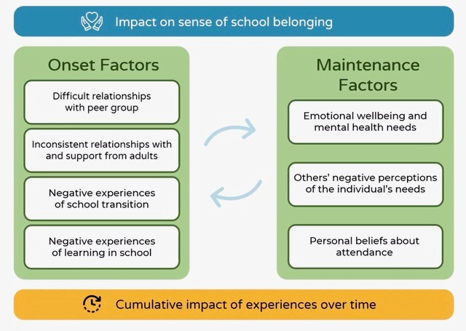
What do young people say? (Corcoran and Kelly, 2022)

Slide 6
What do young people say? (Corcoran and Kelly, 2022)
Children tell us important information and try solve their problems through their behaviour → we need to listen.
Young people describe their non-attendance as a logical and understandable response to the situation.
They want to be at school and have tried hard to be, but without changes to the environment it becomes too hard – not going to school is a last resort.
Difficulties tend to start gradually and help early on, as soon as issues are raised, is important. Their wellbeing is impacted by not going to school.

Slide 7


Slide 8

Why does EBSNA happen?
EBSNA occurs "Where stress exceeds support" (Thambirajah et al, 2008). There is no single cause; EBSNA is underpinned by the interaction of complex and interlinked factors related to the young person, family, school environment (Thambirajah et al, 2008).

Slide 9
EBSNA, Neurodiversity and SEND
“Negative educational outcomes are often underpinned by a poor fit between school environments and autistic ways of being in the world.” Hamilton (2024)
92% of those experiencing ‘school distress’ were identified as neurodivergent.
30% of autistic students fell into ‘persistent absentee’ category and experienced earlier onset and longer durations of ‘school distress’
Little evidence for the efficacy of incentive-based interventions (i.e., attendance rewards/sanctions)
Whole-school approaches to understanding and celebrating neurodiversity and promoting a sense of belonging for all were effective at reducing ‘school distress’
https://ray.yorksj.ac.uk/id/eprint/9253/3/education-14-00156.pdf

Slide 10
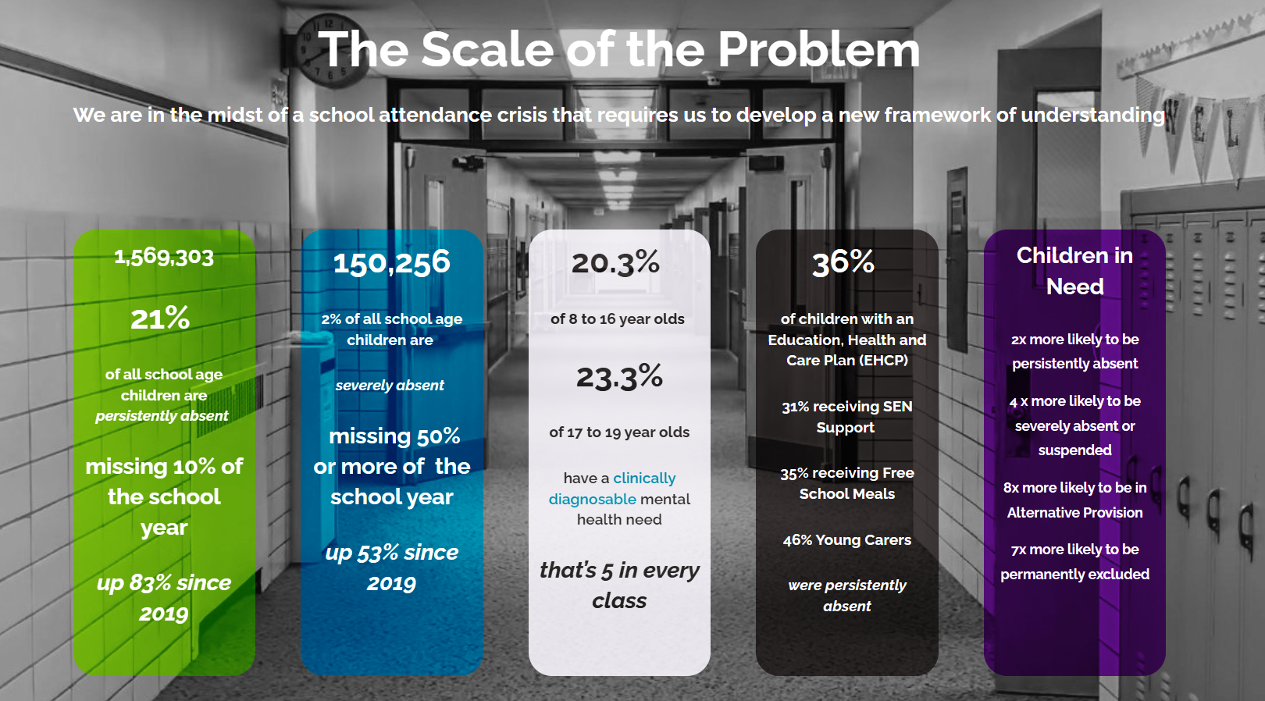


Slide 11
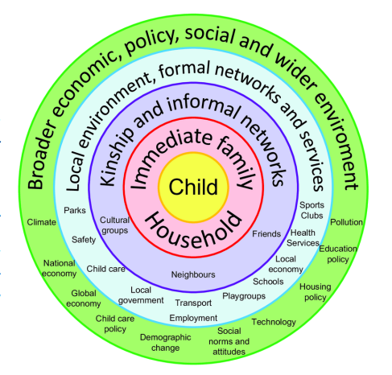
Bronfenbrenner’s ecological systems theory (1979)
Melvin GA, Heyne D, Gray KM, Hastings RP, Totsika V, Tonge BJ and Freeman MM (2019) The Kids and Teens at School (KiTeS) Framework: An Inclusive Bioecological Systems Approach to Understanding School Absenteeism and School Attendance Problems. Front. Educ. 4:61. doi: 10.3389/feduc.2019.00061
EBSA doesn't occur in isolation. As Educational Psychologists, we often turn to Bronfenbrenner's Ecological Systems Theory (to understand the interconnected factors influencing a young person's development). This theory reminds us that a child's experiences aren't shaped by one factor alone but by multiple, interacting systems in their environment.
Using this framework helps us see EBSA not as a single, isolated challenge but as the outcome of a complex interplay between individual and environmental factors, such as predisposing factors, a precipitating event or changes in a child's circumstances related to school, family and the child themselves (see Lester & Michelson, 2024).

Slide 12
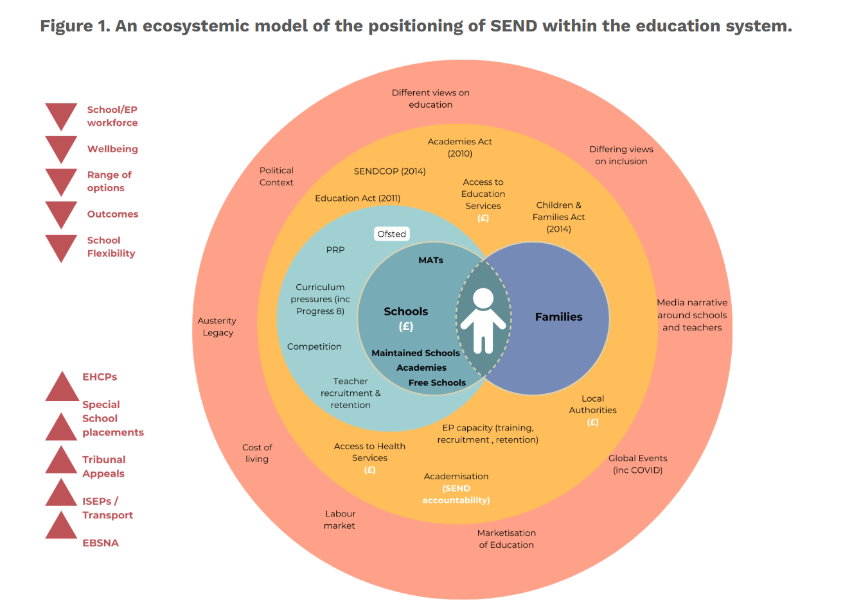

We Don’t Need Just SEND Reform, We Need a SEND Revolution. Who’s In?

Slide 13
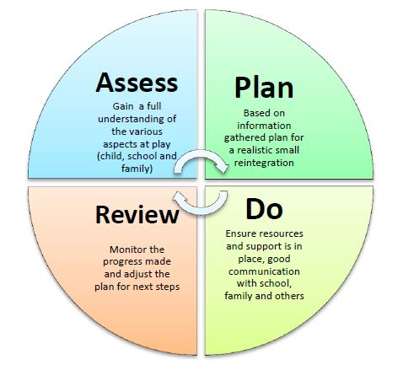
Intervention Key Principles
Evidence shows several factors are associated with positive outcomes, including:
early intervention
working with parents/ carers and ensuring the child’s voice is central to support planning
building a holistic understanding of the barriers to school attendance
taking flexible approaches to consider the highly individual nature of EBSNA
(Corcoran, Bond and Knox, 2022)
Trafford Directory | Trafford SEND Graduated Approach for Practitioners

Slide 14
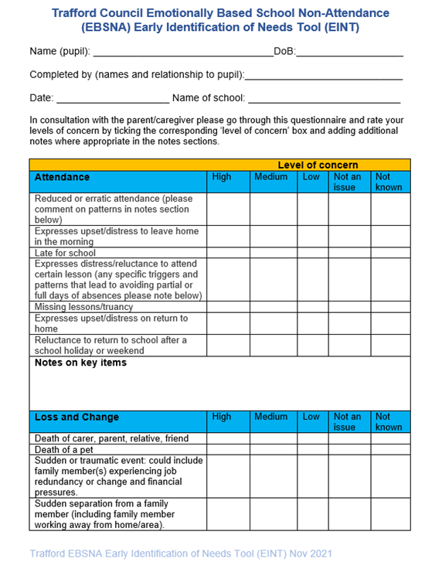
ASSESS: Tools and frameworks for support
Getting in early is key, hence…
The Early Identification of Needs tool: A questionnaire designed to support a conversation with a parent/carer of child who may be at risk of/or is displaying patterns of EBSNA, used to empower you to inform plans of support at a school level
Strategies to gain the voice of CYP and empower them in informing the support they receive
Approaches to understand the information you gather so as to ensure support can be person-centred…

Slide 15


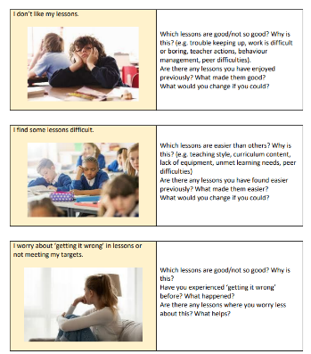
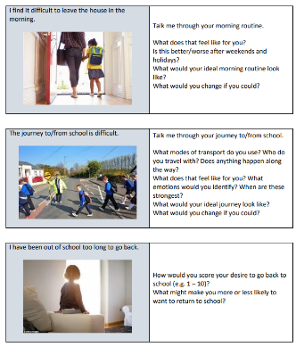
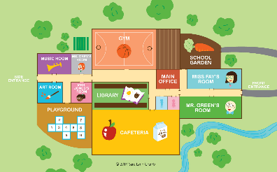
Assess: Gaining the child’s voice

Slide 16
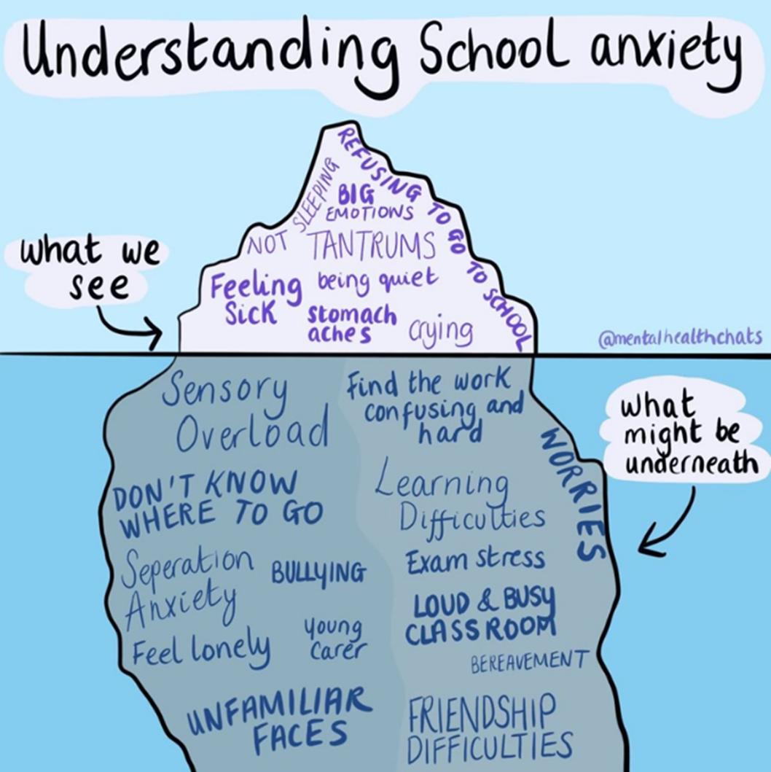

Slide 17

A useful way of thinking about and analysing what the child might need:
As highlighted by Thambirajah et al (2008) we know EBSNA is most likely to occur when the risks are greater than resilience, when stress and anxiety exceeds support:
How can we reduce the things which make it harder to attend school?
How can we promote the things which make it easier to attend school?

Slide 18
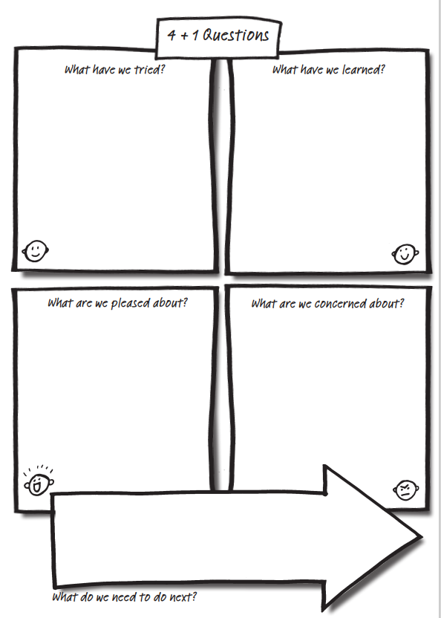
Action plan (&DO)
http://www.helensandersonassociates.co.uk/wp-content/uploads/2015/02/fourplusone.pdf

Slide 19
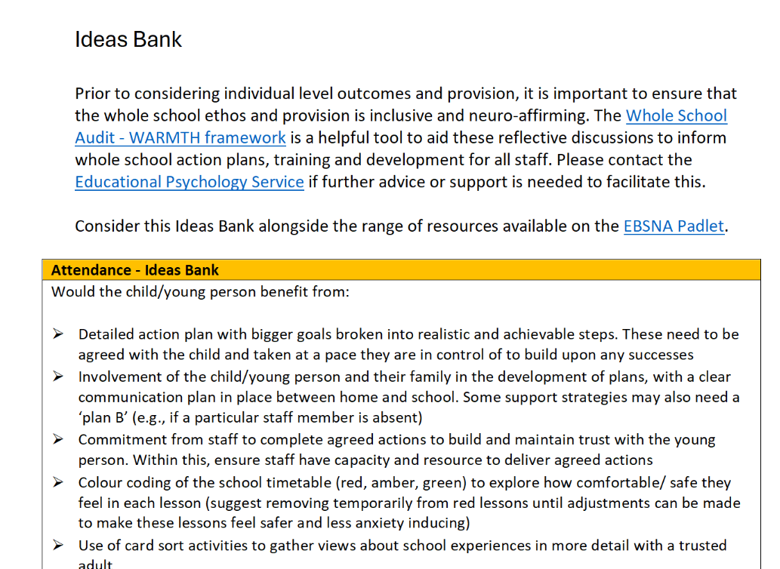
Ideas bank
https://padlet.com/TraffordThrive/barriers-to-education-emotionally-based-school-non-attendanc-n3rqwwolkxfbgr4t

Slide 20
Support strategies – for all staff
Good communication - Key adult and consistent points of contact, one page profile, prep staff around what they say and where/ when
Focus on promoting wellbeing (connection, enjoyable activities, confidence building)
1:1 time with a trusted adult to share views to inform support plans
Hand of support (draw around hand and write key adults and strategies in fingers and palm)
Colour code timetable / map of school – e.g. safe/ ok/ not ok
Plans for self-regulation or ‘reset’ breaks in school day
Agreed a consistent plan – across home and school
Anxiety hierarchy/ ladder – step by step plan of how to extend time in school
Work to support the young person’s understanding of their own anxiety - psychoeducation (EPs and Thrive in Education can also support with this).
Plan to catch up on missed work
Be hopeful and communicate your faith in the young person’s abilities

Slide 21
Energy Accounting models (e.g. spoon theory)
For many children and young people, attending school can feel overwhelming. What might seem like simple daily routines - getting dressed, travelling to school, entering a busy classroom - can require significant emotional and sensory energy. Without understanding these experiences from the child's perspective, we risk missing opportunities to provide effective support.
Exploring emotional barriers to attendance requires creating space for children to share their lived experiences in ways that feel accessible and meaningful to them. Traditional conversations about feelings and difficulties may not always capture the full picture, especially when children struggle to verbalise their experiences or feel their challenges aren't understood.
Visual frameworks and concrete analogies can help bridge this gap, giving children tools to express how different aspects of their school day impact their emotional and sensory wellbeing. Energy Accounting activities offer exactly this kind of structured, visual approach to understanding a child's experience.

Slide 22
Creating a personalised energy map
Working collaboratively with the child, we can create their personal energy map. This might include:
Identifying their peak energy times during the school day
Noting which activities require the most energy
Finding natural breaks where recharging can occur
Planning ahead for particularly demanding periods
Recognising early warning signs of low battery
This understanding allows us to make meaningful adjustments to support attendance. Perhaps a child needs a quiet arrival time before joining the class, or access to calming activities between high-energy lessons. The focus shifts from expecting children to 'push through' to actively managing their energy levels throughout the day.
https://www.edpsyched.co.uk/blog/making-energy-visible-using-energy-accounting-to-support-school-attendance
https://www.edpsyched.co.uk/blog/autism-spoon-theory

Slide 23
Graded Exposure
Go into next two favourite lessons (timings TBC, with support)
Want to do
Attend PE lesson
It is important that this is agreed with the young person and led by them.
For each step think about:
If they are feeling ready and it is the right tool to use (please see: Understanding Your Anxiety | Autism Barriers to Education)
What support will be in place (e.g., key worker available, time out card, access to safe base).
What calming technique will be used (e.g., relaxation, distraction).
Encourage predicting how they will feel at each step and then review this afterwards (e.g., through scaling).
Some situations may need to be broken down into even smaller steps.
Celebrate progress.
Engage in a small group activity in resource base
Enter school and visit the resource base
Enter school and stay in reception area, meet with key adult from resource base
Meet with PE teacher at home to discuss work completed
Complete a worksheet/activity provided by PE Teacher and receive feedback ( 3 times)
Complete a self chosen activity or project around interests (e.g. PE, nutrition).
Go to gym 3 x week with Dad (week 1). Attend gym with Youth Worker (week 2).
Can do

Slide 24
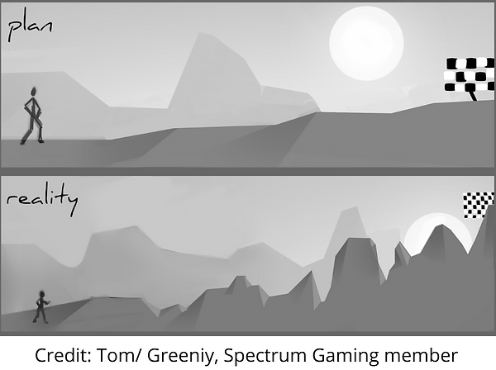
Reviews and Wobble Plans
Wobbles are normal – change is hard and takes time
It may feel sometimes like things have stalled/ regressed but you can keep positive changes going long-term by knowing what has worked previously.
If you identify ‘wobbles’ as quickly as possible and make sure you have a plan, you will be able to get things back on track much quicker. Regular reviews and developing a Wobble Plan can help you with this .

Slide 25
Whole school support
Alongside your individualised support, research shows that whole school approaches to promoting attendance are an effective preventative strategy. You could consider:
Nominate ‘attendance champions’ who can lead on this support and keep it on the agenda
Conduct an audit of current provision (see Padlet for tools to guide this)
Seek pupil, parent and staff views on current provision
Create an action plan to develop your provision in the future
Meet termly to review and update this

Slide 26
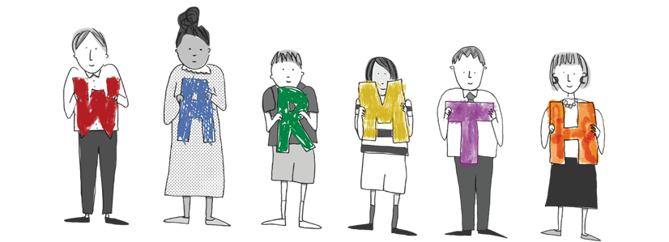
WARMTH – a framework for whole school support
Wellbeing First
Affirming Practice
Relational Approach
Mutual Support and Partnership
Timely Response
Holistic Support
Barriers to Education (padlet.com)
Webinar link: https://padlet.com/spectrumgaming/barriers-to-education-1bnrx2lf6iwfck52/wish/E1P8aXPYDMO5awA9

Slide 27
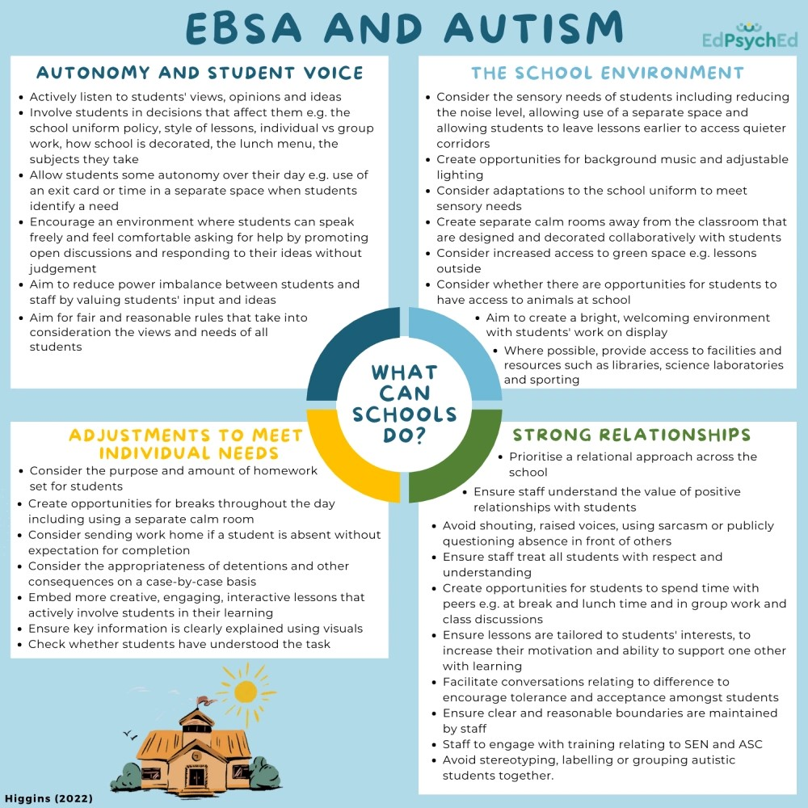
Ebsna and autism
https://www.edpsyched.co.uk/blog/sharing-ep-practice-exploring-the-constructs-of-autistic-young-people-experiencing-emotionally-based-school-avoidance

Slide 28
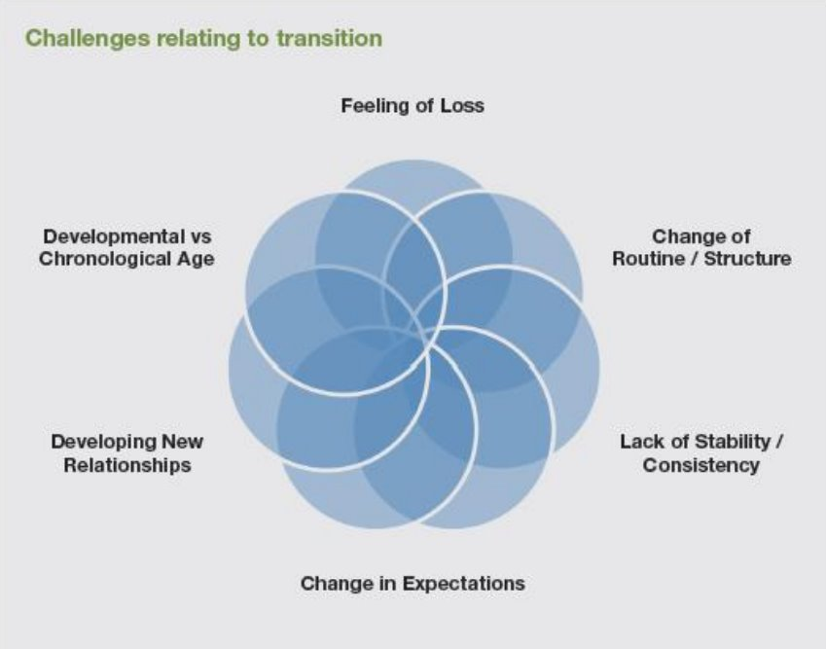
transitions

Slide 29
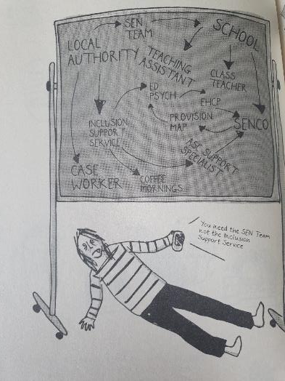
When my child is not ok, I am not ok
Families share they often feel blamed or judged for their child’s difficulties with attendance, when they are usually trying their best.
They care about their child’s education and want to succeed; however, they need understanding and support and to be trusted they know their child best.
Can’t Not Won’t. A story about a child who couldn’t go to school, by Eliza Fricker

Slide 30
Parent views on what helps unblock barriers to school attendance (Square Peg, survey completed by 2000 families)
How are you ensuring these in your approach?
1. Flexibility
2. Reasonable adjustments
3. Prioritising wellbeing and happiness
4. Staff training
5. Kindness
6. Pastoral & mental health support
7. Proactive SENCO
8. Trusting parental opinion / experience
9. Accommodations/ creative thinking
10. Inclusion for SEND/ ill health
https://notfineinschool.co.uk/nfis-surveys

Slide 31
Trafford parent feedback – what helped?
Make appropriate reasonable adjustments according to the child’s needs.
Listen to the child’s voice, trust and listen to parent’s concerns.
Build trusting relationships with families and young people.
Professionals accept fault when things go wrong or do not happen.
Staff understand SEN (with or without diagnoses) and support referrals for assessment or specialist support where needed. Have knowledge of masking and trauma-informed approaches to support families.
Provide clear communication, including clarity around SEN processes and fulfil promises to families. Avoid using jargon and acronyms.
Use the parents’ names (not mum/dad) and ensure they know in advance the purpose of any meetings and who will be there. Encourage parents to bring an advocate if needed.
Signpost families effectively to peer support and other services (e.g., Trafford Parent Forum, STEP, SENAS, SENDIASS, Calm Connections).

Slide 32
Who else could be involved?
Educational Psychology Service
SENDIASS
Parent Carer Forum
Family Information Service
EHC Team
Attendance Officers
Education Welfare Officers (EWOs)
SEN Advisory Service
Social Care / Early Help
Young Carers
Youth Justice
Careers support / Connexions
School nurse
Healthcare professionals
Third sector organisations

Slide 33
Key messages
Can’t, not won’t – children can do well if they can
Put wellbeing first (and address wider wellbeing needs) – this is the priority. This will support the successful return to learning/ school/ education
The young person’s views need to be central and plans needs to be agreed at their pace
Trust parental instincts and work with families
Preventing and responding to EBSNA needs to be a whole school approach

Slide 34
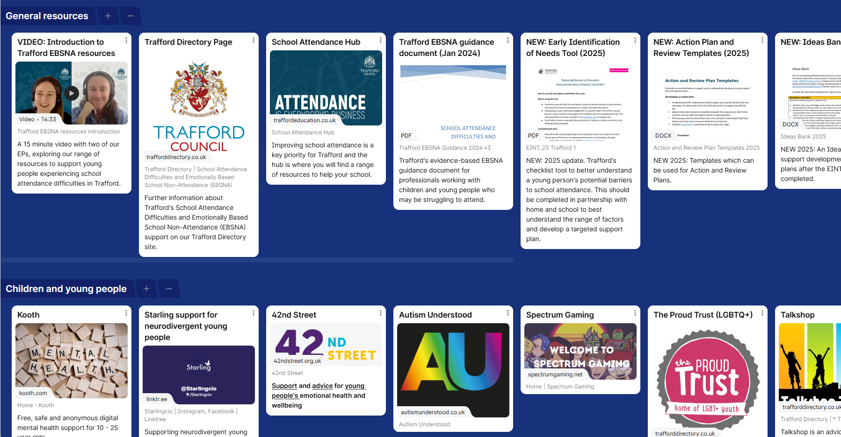
Padlet: Barriers to Education & Emotionally Based School Non-Attendance (EBSNA)

Slide 35



Helpful books

Slide 36
Any questions?

