Slide 1

MENTAL CAPACITY AND THE LAW Kevin McManamon
26th March 2026

Slide 2


Winckworth Sherwood SEND Law Practice
Our dedicated SEND Law Team compromise some of the Country’s leading experts in this field, with accolades and awards from the leading legal directories as well as the Law Society. They have decades of experience representing hundreds of parents and young people through the SEN landscape, securing quantified provision, specialist placements (day and residential) and Education Otherwise than at School. They are also uniquely placed to advise on associated issues including social care and mental capacity.

Slide 3
AGENDA
This session will consider:
1
Guiding principles and key issues of mental capacity law​
5
Lasting Powers of Attorney
2
The Court of Protection
6
Capacity in the context of the SEND Tribunal
3
One-off decisions
4
Deputyship

Slide 4


Sources of Mental Capacity Law
The European Convention on Human Rights and Fundamental Freedoms​
Mental Capacity Act 2005​
Lasting Powers of Attorney, Enduring Powers of Attorney and Public Guardian Regulations 2007​
Court of Protection Rules
Code of Practice

Slide 5

Principles of the Mental Capacity Act 2005
Section 1 Principles​
A person must be assumed to have capacity unless it is established that he lacks capacity​
A person is not to be treated as unable to make a decision unless all practical steps to help him to do so have been taken without success​
A person is not to be treated as unable to make a decision merely because he makes an unwise decision​
Where a person lacks capacity, an act or decision made must be made in the persons best interests​
Before the act is done or the decision is made, regard must be had to whether the purpose for which it is needed can be as effectively achieved in a way that is less restrictive of the persons right and freedom of action.

Slide 6

When a person lacks capacity?
Section 2 MCA 2005​
​
For the purposes of this act, a person lacks capacity in relation to a matter if at the material time he is unable to make a decision for himself in relation to the matter because of an impairment of, or a disturbance in the functioning of, the mind or brain. ​
It does not matter whether the impairment or disturbance is permanent or temporary​
A lack of capacity cannot be established merely by reference to –
a persons age or appearance, or
a condition of his, or an aspect of his behaviour, which might lead others to make unjustified assumptions about his capacity. ​
In proceedings under this act or any other enactment, any question whether a person lacks capacity within the meaning of this act must be decided on the balance of probabilities.

Slide 7
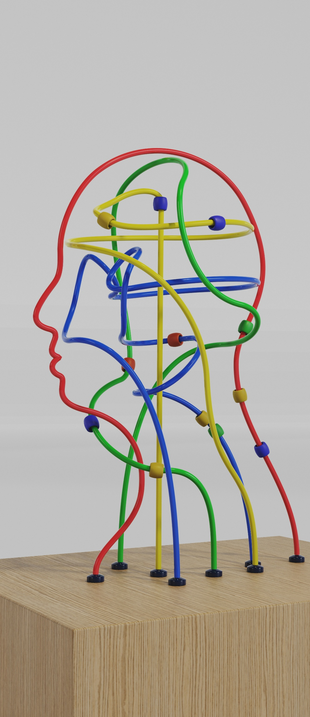
Inability to make decisions
Section 3 MCA 2005​
For the purposes of section 2, a person is unable to make a decision for himself if is he is unable – ​
To understand the information relevant to the decision​
To retain that information​
To use or weigh that information as part of the process of making the decision, or ​
To communicate his decision (whether by talking, using sign language, or any other means)​
A person is not to be regarded as unable to understand the information relevant to a decision if he is able to understand an explanation of it given to him in a way that is appropriate to his circumstances (using simple language, visual aids or any other means)

Slide 8
Inability to make decision cont.
The fact that a person is able to retain the information relevant to a decision for a short period only does not prevent him from being regarded as able to make the decision. ​
​The information relevant to a decision includes information about the reasonable foreseeable consequences of –
deciding one way or another, or
failing to make the decision.

Slide 9

Decision making on behalf of an individual who lacks capacity
Section 4 MCA - Best Interests
When determining what is in a persons best interests​
He must, so far as reasonable practicable, permit and encourage the person to participate, or improve his ability to participate, as fully as possible in any act done for him and any decision affecting him…​
He must consider, so far as is reasonably ascertainable - ​
Person’s past and present wishes and feelings (and in particular any relevant written statement made by him when he had capacity)​
The beliefs and values that would be likely to influence his decision if he had capacity, and ​
The other factors that he would be likely to consider if he would be able to do so.

Slide 10

Chapter 5 Code of Practice- Best Interests
The MCA requires a decision maker to encourage the participation of P. ​
Chapter 5 of the Code of Practice sets out that a decision maker should​
Do whatever is possible to permit and encourage the person to take part, or improve their ability to take part, in making the decision. ​
When considering wishes and feelings, Chapter 5 states that a decision maker should​
Try to find out the views of the person who lacks capacity, including the persons past and present wishes and feelings – these may have been expressed verbally, in writing or through behaviour or habits. ​
Any beliefs and values (e.g. religious, cultural, moral or political) that would be likely to influence the decision in question​
Any other factors that the person themselves would be likely to consider if they were making the decision or acting for themselves.

Slide 11

In practice
Mental capacity is a difficult concept often involving highly emotive situations and conflicts.

Slide 12

The relevance of age
No power that is exercised in relation to a person who lacks mental capacity is exercisable in relation to a person under the age of 16.​
​
Under 16 – parental responsibility​
​
Gillick competence​
​

Slide 13

The Court of Protection
The court of protection is the forum at which to address a wide range of disputes that cannot be resolved otherwise, relating to individuals who lack capacity.​
The Court has no jurisdiction in relation to an individual who has capacity. ​
The Court has jurisdiction to make declarations in relation to an individual’s capacity to make specific decisions, as well as the lawfulness of any act to be done or yet to be done in relation to that person.​
The Court has jurisdiction to make decisions and appoint deputies in relation to a person’s personal welfare and their property and affairs.​
The Court has jurisdiction to consider the lawfulness of any deprivation of liberty safeguards and authorise a deprivation of liberty.

Slide 14

Main Orders of the Court of Protection
The court has the power to make declarations:​
Section 15 MCA 2005​
The court may make declarations as to –​
whether a person has or lacks capacity to make a decision specified in the declaration;​
Whether a person has or lacks capacity to make decision on such matters as are described in the declaration;​
The lawfulness or otherwise of any act done, or yet to be done, in relation to that person.​
“Act” includes an omission and a course of conduct.

Slide 15
Main Orders of the Court of Protection cont.
The court has the power to make decisions and appoint Deputies to make decisions:​
Section 16 MCA 2005​
Powers to make decisions and appoint Deputies: general​
This section applies if a person (‘P’) lacks capacity in relation to a matter or matters concerning – ​
P’s personal welfare​
P’s property and affairs​
The court may – ​
By making an order make the decision or decisions on P’s behalf in relation to the matter or matters, or​
appoint a person (a ‘Deputy’) to make decision on P’s behalf in relation to matter or matters​
The powers of the court under this section are subject to the provisions of this act and, in particular, to sections 1 (the principles) and 4 (best interests)

Slide 16

One-off Decision
The Court of Protection has power to make one-off decisions in relation to any aspect of P’s personal welfare and/or property and affairs.
The Court of Protection steps into the shoes of P
The Court of Protection is only able to consider available options

Slide 17

Deputyship
What is a deputyship order? ​
There are two types of deputyship order. One relates to an individual’s personal welfare, and the other relates to an individual’s property and affairs. ​
A deputyship order provides legal authorisation for a deputy or deputies to make specific decisions for P. This negates the need to repeatedly seek one-off orders from the Court of Protection. ​
A deputyship order will specify exactly which decisions a deputy is authorised to make. It may also preclude certain decisions.​
Permission is required from the Court of Protection to apply for a personal welfare deputyship.​
Typically, a personal welfare deputyship will include decisions regarding where P should live, and what social, educational, and healthcare provision P should receive.

Slide 18
Lasting Power of Attorney
NB – Where an individual has capacity to make decisions, they are entitled to execute a Lasting Power of Attorney. ​
There are two types of LPA. ​
The first relates to personal welfare decisions and takes affect when an individual loses capacity. ​
The second relates to property and affairs, and an individual can decide it takes affect once they lose capacity, or whether they wish to appoint an attorney to assist whilst they still have capacity.

Slide 19

Capacity in the context of the SEND Tribunal
Within the context of the SEND Tribunal it is the parent of a child who has the right to exercise any right of appeal.
However, once a young person turns 16 years of age the right to exercise appeal rights reverts to the young person. In these circumstances the parent can no longer exercise a right of appeal.
This is based on a legal assumption that the young person has “litigation capacity”.
If the presumption in favour of litigation can be rebutted, and it is therefore established that the young person lacks litigation capacity the right of appeal reverts back to what is known as an “Alternative Person”. This will be either a Deputy, Attorney or if neither of these a parent.
N.B - In the vast majority of other litigation a young person will not be able to bring or defend a claim or appeal, in their own right, until they are 18 years of age. They will require a “litigation friend”

Slide 20

Questions

Slide 21
SOLICITORS AND PARLIAMENTARY AGENTS Arbor 255 Blackfrirs Road, London, SE1 9AX DX 156810 London Bridge 6 020 7593 5000 020 7593 5099 www.wslaw.co.uk
Kevin McManamon Partner kmcmanamon@wslaw.co.uk

